Slide 1







how does openVALIDATION work?
1. input
2. preprocess
3. parse
4. generate
5. output
preprocessor
Implementation
C# templates
C#
keyword aliases
Framework
validation.cs
translation
lexer
includes
parser
Java templates
Implementation
Java
Framework
if the applicant's age is less than 18
then you have to be at least 18 years
old to apply
antlr parser tree
validation.java
entry point
JavaScript templates
Implementation
JavaScript
AST-Builder
Framework
validation.js
cli
service
abstract syntax tree
api
schema

Slide 2



how openVALIDATION works?
how to use openVALIDATION
3. Business Analyst uses DSL
to create Validation Rules
4. Developer integrates
Validation Rules in their Projects
if the applicant's age is less than 18
then you have to be at least 18 years
old to apply
rules definition as *.vrd File
Model as
Json Schema
Production
entry point
C#
java
js
Imple-mentation
Imple-mentation
Imple-mentation
cli
api
service
Frame-work
Frame-work
Frame-work
Validation Rule CLI
generates validation
runtime code
preprocessor
Code Generator
MyRules.js
Build & deploy
to Production
templates
MyRules.cs
includes
keyword aliases
MyRules.java
translations
Project
compiles validation rules as
separately artifacts
Business Logic
parser
Parser (antlr.g4)
MyRules.js
Service/Consumer Layer
antlr parser tree
AST-Builder
abstract syntax tree
MyRules.dll
lexer
MyRules.jar
Validation Rules
parser

Slide 3
...
x-ov-rules:
rule: |
the Name SHOULD
NOT be EMPTY
...
custom openVALIDATION-OpenAPI Generator
Service STUB
Validation
Rules
OpenAPI Generator
openVALIDATION
Rule Generation
OpenAPI Java Spring Generator
OpenAPI Csharp
Generator
Client Proxy
OpenAPI xxx
Generator
Validation
Rules
OpenAPI.spec.yaml

Slide 4
...
x-ov-rules:
rule: |
der Name DARF NICHT
LEER sein
...
custom openVALIDATION-OpenAPI Generator
Service STUB
Validierungs-regeln
OpenAPI Generator
openVALIDATION
Regel Generator
OpenAPI Java Spring Generator
OpenAPI Csharp
Generator
Client Proxy
OpenAPI xxx
Generator
Validierungs-regeln
OpenAPI.spec.yaml

Slide 5


Rule Set
humanized
rules
preconditions
domain specific Operators
Domain Expert
Schema/Attribute Access
CLI Setup
Schema/data model
Code Integration
Developer
technical

Slide 6
Regelwerk
menschlich
Regeln
Vorbedingungen
domain spezifische Operatoren
Domain Experte
Schema/Attribut Zugriff
CLI Setup
Schema/Datenmodell
Code Integration
Entwickler
technisch

Slide 7

if ( age < 18 ){
throw new Exception(
„you have to be at
least 18 years old
to apply “);
}
if the applicant's age is less than 18
then you have to be at least 18 years
old to apply

Slide 8
if ( age < 18 ){
throw new Exception(
„Sie müssen mindestens 18 Jahre alt sein, um sich bewerben zu können.“);
}
wenn das Alter des Bewerbers KLEINER 18 ist
dann Sie müssen mindestens 18 Jahre alt sein,
um sich bewerben zu können.

Slide 9
if ( age < 18 ){
throw new Exception(
„applicant's age should not be less than 18 years”
);
}
applicant's age should not be less than 18 years
if ( age < 18 ){
throw new Exception(
„applicant's age should not be less than 25”
);
}

Slide 10
if ( age < 18 ){
throw new Exception(
„Das Alter des Bewerbers sollte nicht unter 25 Jahren liegen”
);
}
if ( age < 18 ){
throw new Exception(
„Das Alter des Bewerbers darf nicht unter 18 Jahren liegen”
);
}
Das Alter des Bewerbers darf nicht unter 18 Jahren liegen

Slide 11
custom openVALIDATION-OpenAPI Generator
Java Spring Boot
Service STUB
Validation
Rules
...
x-ov-rules:
rule: |
the applicant‘s location
MUST the Dortmund
...
Webapplication
html/js
JavaScript
Client Proxy
Validation
Rules
OpenAPI Generator
OpenAPI.spec.yaml

Slide 12
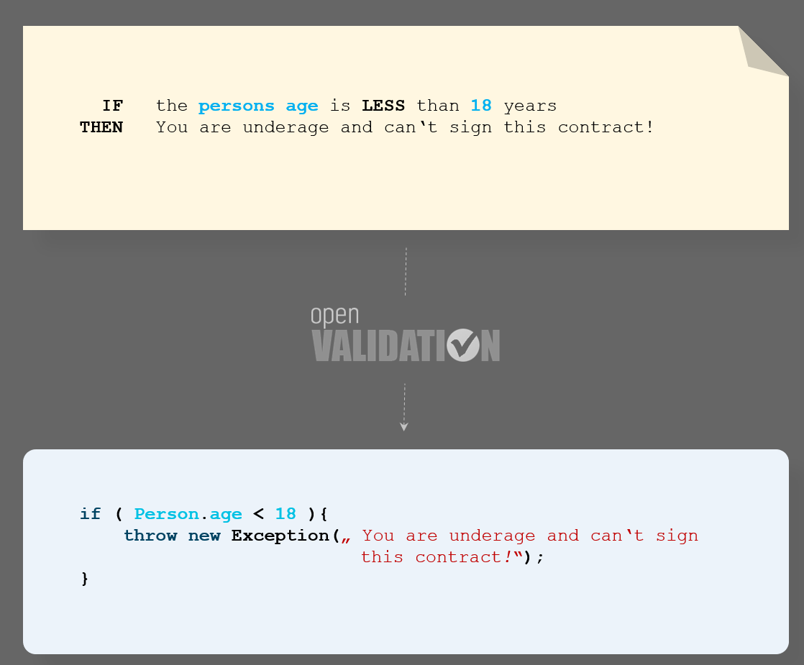
Das Alter des Bewerbers darf nicht unter 18 Jahren liegen
if ( age < 18 ){
throw new Exception(„Das Alter des Bewerbers darf nicht unter 18 Jahren liegen”);
}

Slide 13
applicant's age should not be less than 18 years
if ( age < 18 ){
throw new Exception(„applicant's age should not be less than 18 years”);
}

Slide 14
applicant's age should not be less than 25 years
if ( age < 18 ){
throw new Exception(
„applicant's age should not be less than 25 years”
);
}

Slide 15
custom openVALIDATION-OpenAPI Generator
Java Spring Boot
Service STUB
Validierungsregeln
...
x-ov-rules:
rule: |
der Ort des Bewerbers
MUSS Dortmund sein
...
Webapplication
html/js
JavaScript
Client Proxy
Validierungs-regeln
OpenAPI Generator
OpenAPI.spec.yaml

Slide 16
REST Service STUB
validation rules
title: „sample contract“
...
x-ov-rules:
rule: |
applicant‘s age should
not be less than 18
years
...
version: 1.0.0
OpenAPI Generator
REST Client Proxy
validation rules
OpenAPI.spec.yaml

Slide 17
Comparison Operator
Property of
Schema
Static Value - Operand
Keywords
IF the Power of Engine EXCEEDS 500 kW THEN it is not allowed to use this car in traffic
Error Message

Slide 18
semantic/grammatical
sugar
Vergleichsoperator
Schlüsselwörter
Operand
Schema-Attribut
WENN die Leistung des Motors 500 kW ÜBERSTEIGT DANN es ist nicht erlaubt das Fahrzeug im Straßenverkehr
zu benutzen
Fehlermeldung

Slide 19


Implementation.cs
WENN die Leistung des Motors 500 kW ÜBERSTEIGT DANN es ist nicht erlaubt das Fahrzeug im Straßenverkehr zu benutzen.
Framework.cs
IF the Power of Engine EXCEEDS 500 kW THEN it is not allowed to use this car
in traffic
Implementation.cs
Framework.cs
Implementation.cs
Framework.cs

Slide 20

openlidation.jar
ov-openapi-generator-cli.jar

Slide 21


