Slide 1
OpenVideoCam - Untitled
_
X
X
Welcome to OpenVideoCam!
What would you like to do today?
Create a new video project
Open an existing video project
Open a recently edited video project:
C:\abc\xyz\project 1.vmd
C:\abc\xyz\project 2.vmd
C:\abc\xyz\project 3.vmd

Slide 2





OpenVideoCam – Video Project ABC.vmd
_
X
Game Summary
Details
Date:
Final score
Location:
Team 1:
X
Team 2:
Field size:
Team 1
Team 2
Length:

Slide 3
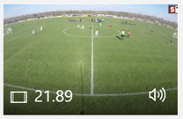
OpenVideoCam – Video Project ABC.vmd
_
X
Input Videos
Add
Remove
Process
…
…
Set field area
Set camera position
VIDEO_XYZ details
Filename: C:\dsdsddsdsdsdsdsdsdsd\sdsd\sd
Size: 3840 x 2460
Length: 21:39
Location:
Team 1:
Team 2:

Slide 4
OpenVideoCam – Video Project ABC.vmd
_
X
X
Input Videos
Add
Remove
Process
…
…
Set field area
Set camera position
Set field area
Auto detect
Set manually
Details
Date:
Final score
Location:
Team 1:
Ok
Cancel
X
Team 2:
Team 1
Team 2
Field size:
Length:

Slide 5
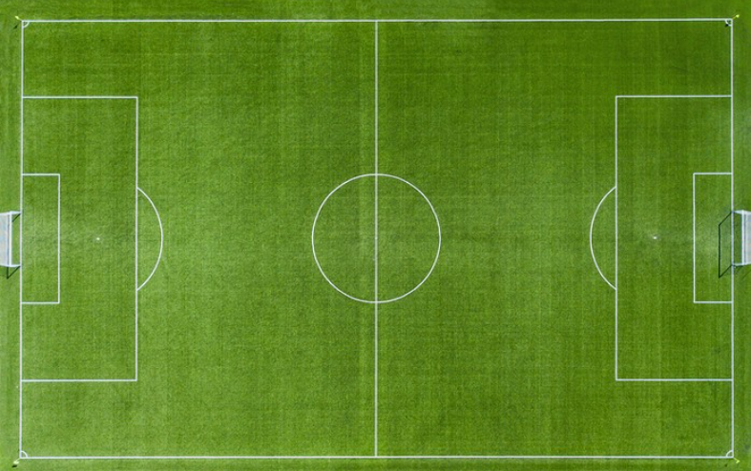
OpenVideoCam – Video Project ABC.vmd
_
X
X
Input Videos
Add
Remove
Process
…
…
Set field area
Set camera position
Set camera position
Details
Date:
Final score
Location:
Team 1:
X
Team 2:
Ok
Cancel
Team 1
Team 2
Field size:
Length:

Slide 6
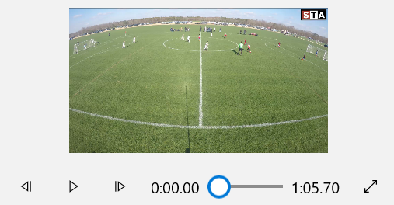
OpenVideoCam – Video Project ABC.vmd
_
X
X
Output video
Create video
Create preview
Details
Filename:
…
Confidence level:
Logo:
Resolution:
Detection margin:
Camera reaction:
Reaction from resting:
Preview
Starting point:
Duration (secs):

Slide 7
OTHERS

Slide 8
OpenVideoCam – Video Project ABC.vmd
_
X
Game Summary
Date:
Final score
Location:
Team 1:
X
Team 2:
Team 1
Team 2
Field size:
Length:
Input Videos
Add
Remove
Process
…

Slide 9
OpenVideoCam – Video Project ABC.vmd
_
X
X
Game Intelligence
Export
This page show all statistics obtained when processing the input videos. You can also visualize all game details here or export to a HTML file.
First half
Heatmap
Statistics
Total game time: 99 minutes 99 seconds
Ball on Team 1 field: 99 minutes 99 seconds
Ball on Team 2 field: 99 minutes 99 seconds
…

