Slide 1


VIET 101 · SECTIONS 001 & 002
Tiếng Việt 101
Elementary Vietnamese I
Monday, August 17, 2026

Slide 2
0:00–0:05 · WELCOME
Today, we’re not going to dive into grammar or walk through the syllabus.
Instead, we’ll get to know what learning Vietnamese can look and feel like in this course, and begin our journey together.

Slide 3
0:05–0:15 Bingo icebreaker
THE 50 MIN AHEAD
Four Activities
0:15–0:23 Dictogloss task
0:23–0:33 Storytelling time
0:33–0:43 Craft activity
0:43–0:50 Wrap-up

Slide 4
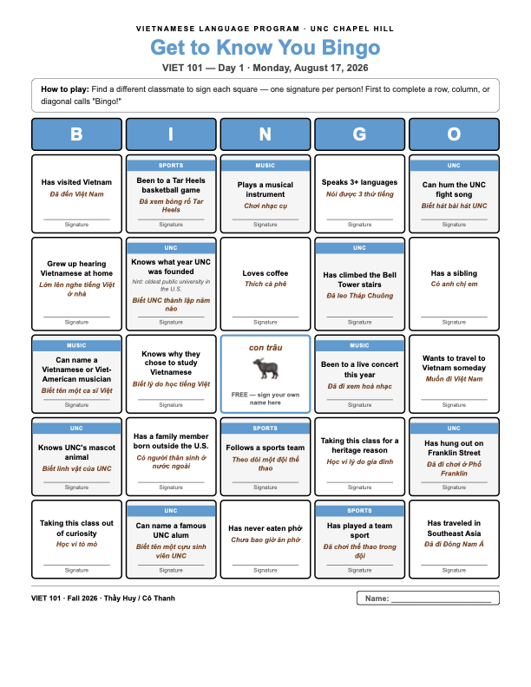
0:05–0:15 · BINGO ICEBREAKER
Tìm người mà…
Find a classmate
MINGLE
~7–8 minutes
Sign one square per person.
BOARD
The Prompts
Get-to-know-you, UNC campus & spirit, and sports & music prompts.
CENTER
Free Space
A free space, waiting quietly to matter later.
First to fill a row calls “Bingo!” — or we just see who fills the most.

Slide 5
0:15–0:23 · DICTOGLOSS
Nghe và viết
Listen, and write
01
Nghe · Listen
You are going to listen to a Vietnamese saying a few times. Don't worry what it means...
02
Viết · Write
...just write what you hear. Use English letters to write your best guess.
03
Chia sẻ · Share
Compare with a neighbor → share aloud.
Notes:
Con trâu ăn cỏ, con thỏ ăn rau.

Slide 6



0:15–0:23 · DICTOGLOSS
Nghe giọng vùng miền
Regional Accent Listening Practice
PHƯƠNG NGỮ BẮC
Northern Accent
PHƯƠNG NGỮ NAM
Southern Accent
Northern / F
Southern / F
Northern / M
Southern / M

Slide 7
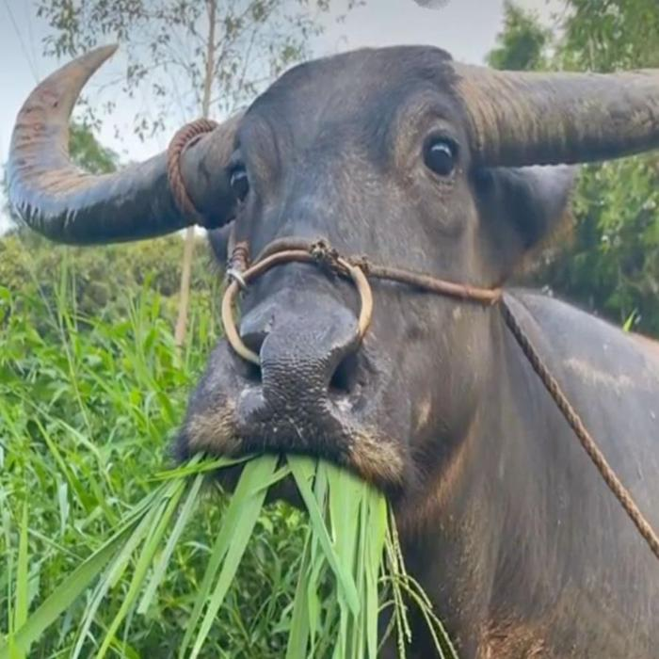
Dictogloss
Wow, you got it!
Don't forget to check this ‘con trâu’ meme

Slide 8
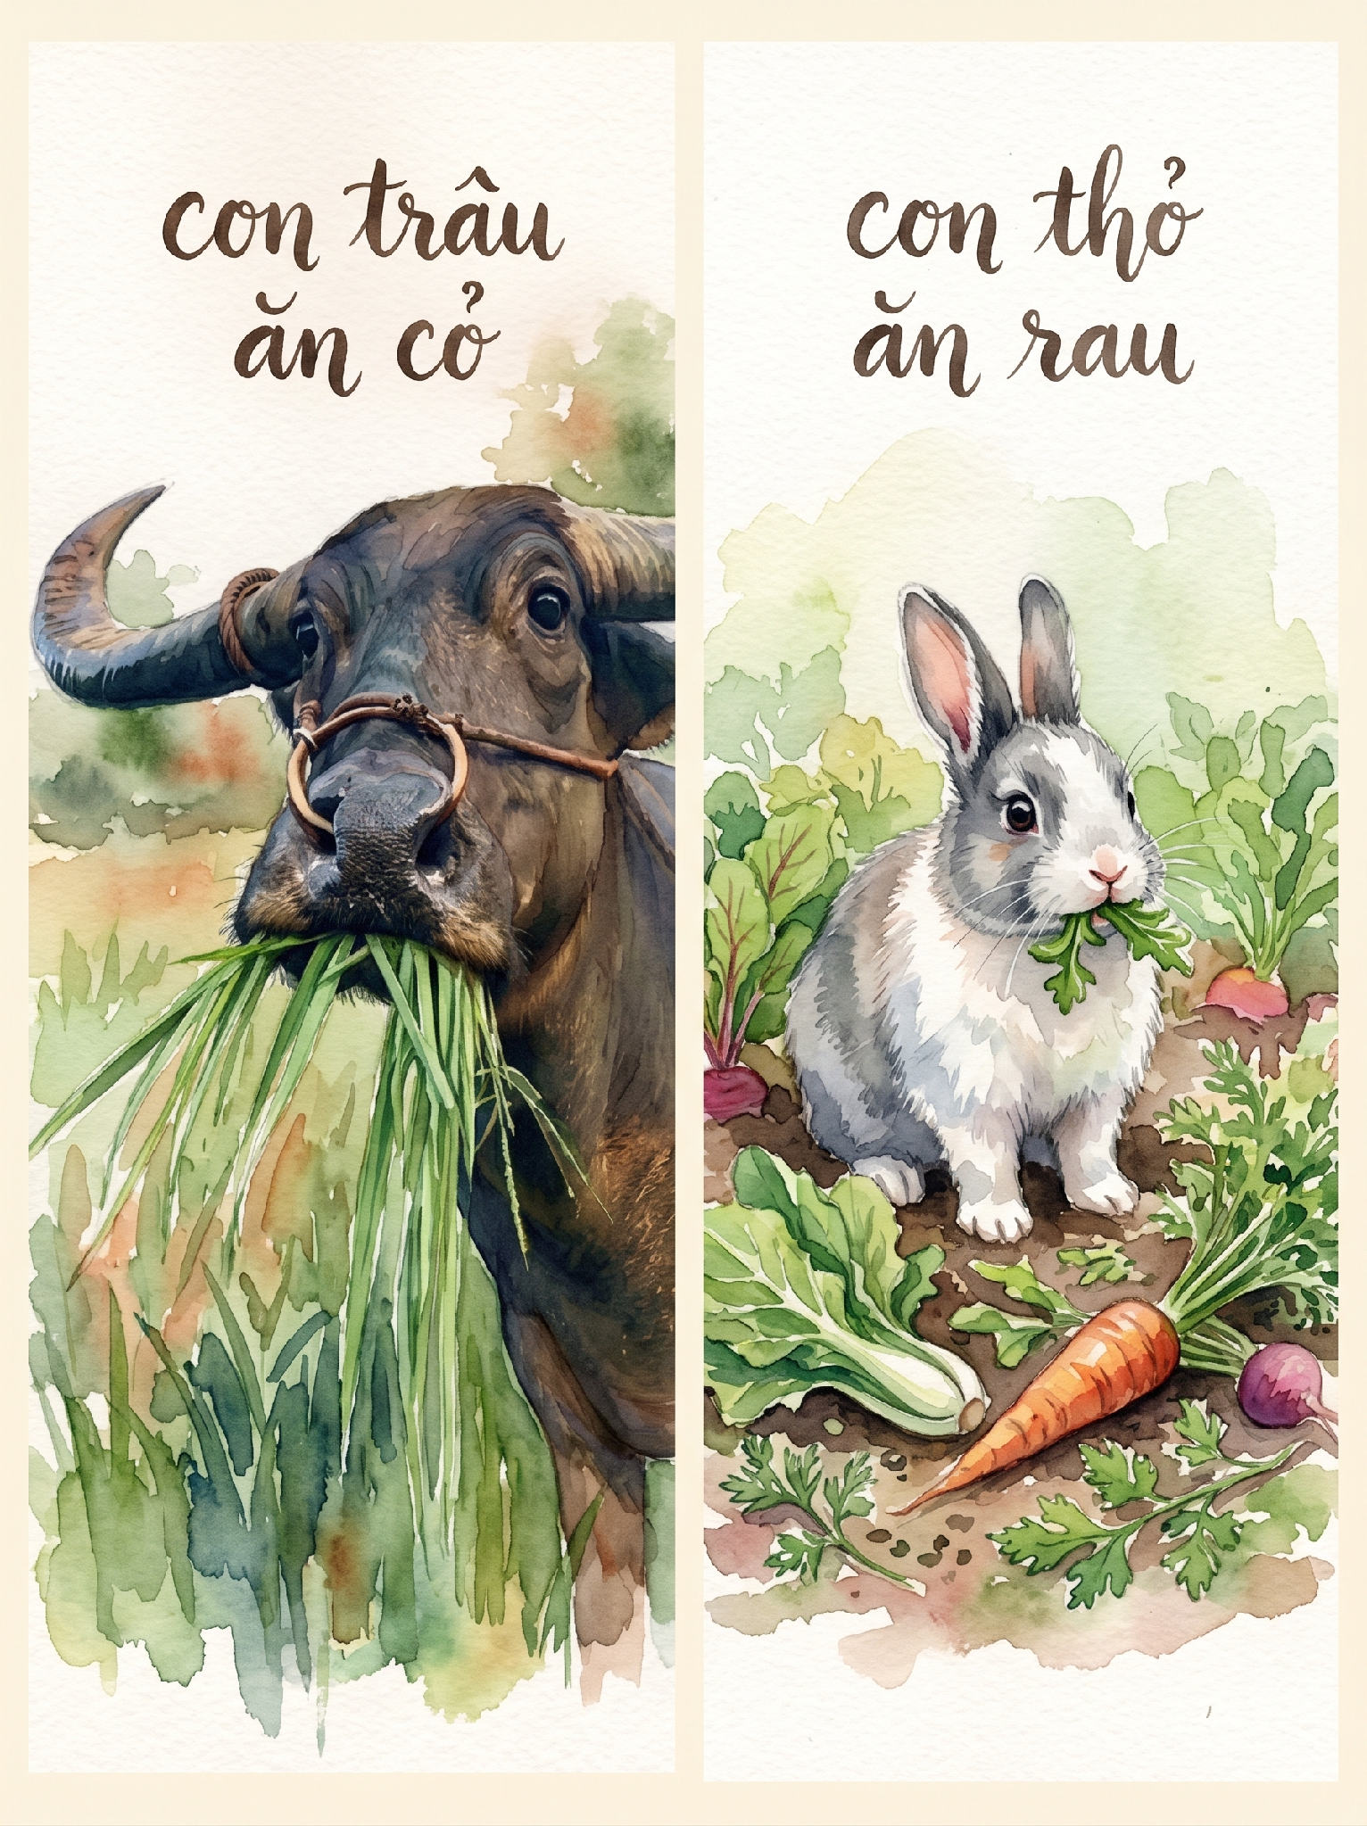
THE REVEAL
Con trâu ăn cỏ, Con thỏ ăn rau
The buffalo eats grass, the rabbit eats vegetables.
This is the program's mascot.
You'll find out why in a few weeks.
Everything and everyone has their own natural place, role, or preference in life.

Slide 9
0:23–0:33 · STORY
400 năm trước
400 years ago
What you all just did, turning a sound you'd never heard into letters you already knew, is almost exactly what a small group of European missionaries did to the entire Vietnamese language.
Read the full story in English.

Slide 10
THE SHORT VERSION
Chữ Quốc Ngữ
how the word got written
1600s
Missionaries romanize Vietnamese sound by sound, inventing tone marks the Latin alphabet never had.
1651
Alexandre de Rhodes' trilingual dictionary standardizes the script.
1945
Hồ Chí Minh's literacy campaign makes it Vietnam's sole national script.
What you did in the dictogloss — that's what they did, for real.

Slide 11
0:33–0:43 · CRAFT
Trâu Lá/Giấy
Leaf/Paper Buffalo
1
Tạo sừng
tear and curl the leaf's edges near the stem to make horns.
2
Tạo thân
roll the long edges inward and secure with a toothpick.
3
Gắn dây
thread grass or string through the stem so pulling it nods the head.
You just heard the word, and just heard its history. Now you make it.

Slide 12

0:43–0:50 · WRAP-UP
Trước thứ Tư
Before Wednesday, on Canvas
READ & ASK
The syllabus. Write down 1-2 questions.
COMPLETE
The Craft. Teach a friend how to make it.
REMEMBER
Bring your leaf/paper ‘con trâu’ to class.
Take your leaf buffalo home with you — finished or not.

Slide 13
KẾT THÚC · WRAP-UP
Hẹn gặp lại các bạn
vào thứ Tư!
See you Wednesday

Slide 14
VIET 101 · SECTIONS 001 & 002
Tiếng Việt 101
Elementary Vietnamese I
Thứ sáu, ngày 21 tháng 8 năm 2026

