Slide 1
OVS DOCA CT Offloads
Gaetan Rivet, Salem Sol, OVS + OVN Conference, Fall 2024

Slide 2
Motivation & Overview
Implementation
Testing connection tracking
Results

Slide 3
Connection Tracking Offloads in userspace OVS
Relevance & Utility
Connection Tracking used to implement access control.
A lot of traffic will go through a CT action in OVN & cloud deployments.
Not offloading CT means bringing all those packets to be processed on CPU.
OVS-kernel supports CT offload, but OVS-DPDK does not.
Most of our customers require it but prefer OVS-DPDK, so we implemented it.

Slide 4
Connection Tracking Offloads
Simplified CT
Key (match):
dl_type
nw_src, nw_dst, nw_proto
tp_src, tp_dst
ct_zone
Action:
ct( state=u8, zone=u16, mark=u32, label=u128, (reduced) src=SNAT, dst=DNAT, )
Restricted to most frequent packets:
UDP & TCP (no ICMP, SCTP).
Not-fragmented.
Only offload ‘validated’ connections:
UDP: Bidirectional traffic. TCP: Established.
Simplification:
Limited TCP window validation. Executed only on opening sequence, then bypassed.
Write only subset of ct-metadata, sufficient for OVN & cloud.

Slide 5
Connection Tracking Offloads
TCP simplified state machine
Opening (no offload)
.A.. / SAFR
SYN + ACK
ESTABLISHED / ESTABLISHED (Offloaded)
FIN || RST
.A.. / SAFR
Closing (no offload)
Execute only a simple state machine in hardware:
ACK: Keep in hardware. FIN or RST: Send to software for state change.
→ Parse TCP flags somehow.

Slide 6
Connection Tracking Offloads
Generic overview
A flow F(M, A) with actions A containing a ct() action is transformed into three parts:
Pre-CT: A first rule with match M and action A’ (which contains parts of original action list A). The packet mark is set to flow F mark.
CT: A second rule that matches on 5-Tuple + CT-zone then applies ‘CT’ actions: set ct_state, ct_label, ct_mark, count then jump to post-CT.
Post-CT: A last rule that only matches flow F mark and applies the remainder of the action list: A’’.
M
F =
A
Pre-CT
CT
Post-CT
M
5T + ct_zone
mark=X
A’,mark=X jump(CT)
ct(st,mk,lbl) jump(Post-CT)
A’’
N=Thousands
N=Millions
N=Thousands

Slide 7
Hardware offloads in userspace OVS
Asynchronous CT offloads
NIC
OVS
Hardware Classifier
hw-offload thread
Wildcard support
Miss
PMD thread
Datapath Classifier
ofproto Classifier
Lookup: TSS
Wildcard support
4 sub-tables
Conntrack
Conntrack
Add

Slide 8
Connection Tracking Offloads
Asynchronous TCP deletion
Functional issue with asynchronous TCP deletion:
Last-ACK race condition: The segment acking a previous FIN can be processed fully in hardware, if the offload is not immediately deleted upon receiving FIN.

Slide 9
Connection Tracking Offloads
Asynchronous CT offloads
Initial implementation using RTE-flow
Very flexible, user-friendly API. Powerful semantic: wildcard support.
Re-use flow offloads infrastructure.
There are however a high volume of updates compared to megaflow (thousands of flows / millions of connections).
Asynchronous deletion for TCP also create issues.
Connections are simple, small and very regular offloads.
Do they need to use the same representation as megaflows?
Offloading is an overhead.
If too costly in cycles and memory, becomes a trade-off to choose depending on elephant/mice distribution.
Very short connections can be slowed by offloading: (e.g. TCP data+FIN segment).

Slide 10
Connection Tracking Offloads
Reset perspective
Interpreting the network configuration into a topology is control path.
Synchronizing the state required to execute flow actions is fast path.

Slide 11
Connection Tracking Offloads
New architecture: DOCA
Nvidia released the DOCA framework to make the best use of its hardware.
Vertical integration: reach fastest possible execution for the compute medium (speed of light).
Template-based API
No TLV with on-demand translations: static topology.
Pre-allocation
Pools of match, actions, offload resources (counters, meters, mirrors, …), etc.
Cooperative threads and data structures
Static participating threads.
Distributed table resize & destroy.
Minimal inter-thread synchronization
Little to no locks or atomics.

Slide 12
Connection Tracking Offloads
Using DOCA-flow
Adaptations were needed to integrate DOCA with the userspace datapath:
Polling threads:
Registering as offload threads.
Participate in distributed structures upkeep.
Made static to simplify thread synchronization.
Conntrack:
Pre-allocate offloads in a mempool.
Static, user-configured CT-offload size. (Usually, many less established connections than closed.)
Batched offloading.
CT-clean must be able to scale to more objects.
Plain-CT actions are very regular: sharing between offload entries for faster insertion and packet processing.
Using a dedicated CT table type in DOCA-flow to use the smallest and simplest form.

Slide 13
Hardware offloads in userland OVS
Synchronous CT offloads
NIC
OVS
Hardware Classifier
hw-offload thread
Wildcard support
Miss
PMD thread
Datapath Classifier
ofproto Classifier
Lookup: TSS
Wildcard support
No Wildcard
4 sub-tables
Conntrack
Conntrack
Add

Slide 14
Connection Tracking Offloads
Synchronous CT offloads
Complexity required for flow offloads is more than what is necessary for CT.
Adds too much overhead and makes it more fragile.
Forces the user to do a careful analysis of traffic patterns to enable or not.
Re-examining the basic principles of CT offloads shows the need for a different approach.
We were able to use it in userspace OVS, however with wide-reaching impact.
The work is in-progress: DOCA offers other ways to improve, requiring further and wider modifications.
Evaluating those offloads is done in three ways:
Overhead is negligible in the worst case (short connections).
Improvement is significant in the favorable case (long connections).
Scaling and stability is improved (concurrent connections).
The next slides will show the testing done and the results on those aspects.

Slide 15
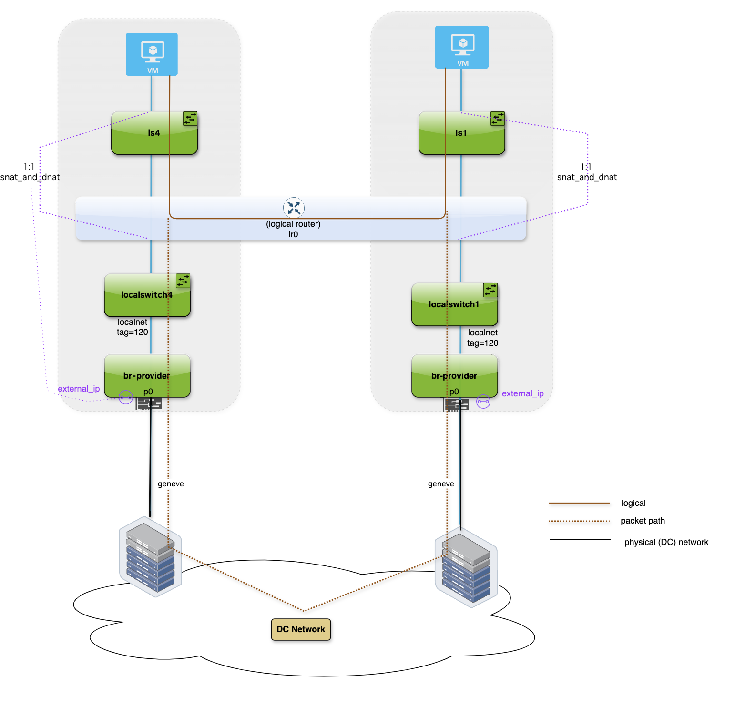
OVS-DPDK vs. OVS-DOCA
Test configuration
Two duplicate nodes running OVN + OVS(DOCA/DPDK)
Tgen
KeySight CyPerf
CyPerf is a cloud-native application and security testing solution that enables users to test and validate the performance, scalability, and security of distributed, hybrid networks. It uses lightweight agents deployed across various environments (physical, cloud, and containerized) to simulate realistic workloads, user behaviors, and security threats at scale.
CPU
AMD EPYC 9654 96-Core
1 physical core used for OVS
RAM
1.5TB
NIC:
NVIDIA ConnectX-7 200GbE PCIe 5.0 x16
9000 MTU
OS:
Rocky Linux release 9.4 (Blue Onyx)
OVN:
v24.09.1

Slide 16
OVS-DOCA vs. OVS-DPDK
Test Definitions
Connections per second:
Purpose:
Identify the maximum number of new connections that can be established without failures and performance degradations.
Simulate real-world users which generates traffic using different protocols.
We used HTTP.
Measure:
Throughput.
Connection establishment rate.
Test execution:
CyPerf generates realistic application traffic (HTTP)
Attempt to initiate new connections at a defined rate (CPS), connections are established with the CyPerf server.
Once a connection is established send GET request of “session size” bytes.
After a successful GET request send POST request of “session size” bytes.
Close the connection.
Maintain the target CPS for 10 minutes.
CyPerf can scale up to the defined rate or scale down in case TCP retries occur.

Slide 17
OVS-DOCA vs. OVS-DPDK
Test Definitions
1.1. Long Connections per second:
Purpose:
Test our “favorable” case.
Have many packets per connection offloaded.
Session Size:
850KB.

Slide 18
Connections per second
Long CPS (30K, 850KB)
DOCA CT offloads allow reaching line-rate at 2.5x throughput.

Slide 19
Connections per second
Long CPS (30K, 850KB)
Using the same number of cores OVS-DOCA allows establishing 2.5x connections per second.

Slide 20
Connections per second
Long CPS (30K, 850KB)
OVS-doca still beats ovs-dpdk 32 cores by 1.5 times

Slide 21
Connections per second
Long CPS (30K, 850KB)

Slide 22
OVS-DOCA vs. OVS-DPDK
Test Definitions
1.2. Short Connections per second:
Purpose:
Emphasize shorter than MTU connections.
Less packets per connections for HTTP traffic -> ~3 offloaded packet per connection.
Session Size:
2KB.

Slide 23
Connections per second
Short CPS (40K, 2KB)
Offload handling does not affect SW performance.

Slide 24
Connections per second
Short CPS (40K, 2KB)
ovs-doca and ovs-dpdk perform the same in short connections handling.

Slide 25
Connections per second
Short CPS (30K, 2KB)

Slide 26
Connections per second
Short CPS (30K, 2KB)

Slide 27
OVS-DOCA vs. OVS-DPDK
Test Definitions
Concurrent Users:
Purpose:
Evaluate the capacity of a network infrastructure to handle many active connections at the same time.
Help identify the limits at which the system begins to degrade in performance.
Measure:
Connections rate.
Concurrent connections.
Test execution:
CyPerf will attempt to open requested number of connections using a single HTTP application.
Attempt to hold the number of request connections for 10 minutes.

Slide 28
Concurrent Users
1M, 500KB
OVS-DOCA outperforms OVS-DPDK in connection rate (open).

Slide 29
Concurrent Users
1M, 500KB
OVS-DPDK can’t process all the packets for 1M connections constantly. Connections are closed and reopened.
OVS-DOCA can hold 1M established connections.

Slide 30
OVS-DOCA vs. OVS-DPDK
Conclusion
OVS-DOCA is required to handle 400Gbps.
Better performance for less resources.
No effect on slowpath.
A credible solution for environments with many short connections.
This is only the beginning ☺.

