Slide 1

Open vSwitch Performance testing
Eelco Chaudron
Senior Software Engineer
December 2018

Slide 2
Why another test suite?
Initially I needed something to test a single NIC independently
I needed something that was easy to setup
Should not mess with my setup
Support for the kernel, DPDK, and TC Flower datapath
Include some basic CPU graphs
Work with the Xena tester I had (don't worry currently it works with TRex also :)

Slide 3
Test topologies
Physical interface to Virtual interface back to Physical interface (PVP)
Physical interface to Virtual interface (PV)
Physical interface to Physical interface (PP)

Slide 4
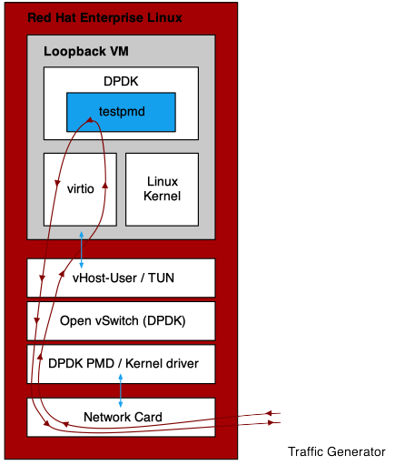

Test topologies
Physical interface to Virtual interface back to Physical interface (PVP)

Slide 5
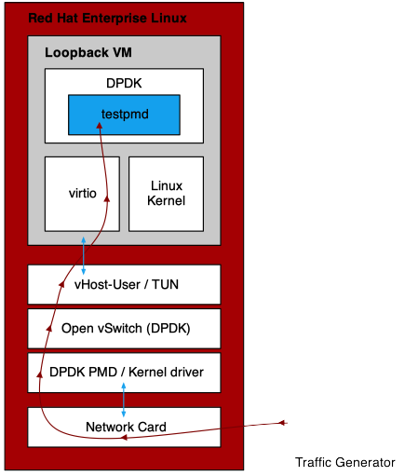
Test topologies
Physical interface to Virtual interface (PV)

Slide 6
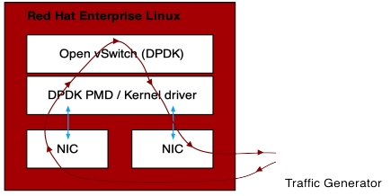
Test topologies
Physical interface to Physical interface (PP)

Slide 7
Traffic generation
All test by default send their traffic at the testers line rate
  This can be adjusted by setting the --traffic-rate option (percentage of line speed)
There is also a zero-loss PVP test, --run-pvp-zero-loss-test
  Uses binary search to figure out at which transmit rate no packets are lost
  Steps can be configured with --zero-loss-step, which is 1% by default
You configure the number of streams, packet sizes, and the duration of each test
  Number of streams: --stream-list; by default 10,1000,10000,100000,1000000
  Packet sizes: --packet-list; by default 64,128,256,512,768,1024,1514
  Runtime: -r, --run-time; by default this is 20 seconds

Slide 8
Traffic generation
Traffic types
All packets send are Ethernet/IPv4/UDP
The following traffic types can be selected, --flow-type:
  L2: the source and destination MAC addresses increase for each packet
  L3: the source and destination IPv4 addresses increase for each packet
  L4-UDP: the source and destination UDP ports increase for each packet
NOTE: L4-UDP is NOT yet supported using the Trex
NOTE: The reason for only having two fields changing was due to a limitation in my XENA testers hardware

Slide 9
Open vSwitch configuration
The script can configure the basic bridge, and add the ports
  To skip this use the --no-bridge-config option, preferred
The script will configure the required OpenFlow rules
  This can be changed using the --flow-rule-type option:
    flows (default)
    NORMAL
    port
    none
NOTE: If you have a switch in the middle with learning enabled, you’ll need to add the --mac-swap option as by default testpmd is started without it.

Slide 10
Open vSwitch configuration
--flow-rule-type options explained
--flow-rule-type options:
  flows(default): Each traffic flow gets its own OpenFlow rule configured based on the ingress port, in_port. Based on the configured --flow-type additional match criteria are programmed. For L2, dl_dst, for L3 the nw_src / nw_dst, for L4-UDP the tp_src / tp_dst. Note that for PVP test this means two rules get programmed. One towards the VM, and one from the VM.
  NORMAL: One OpenFlow rules gets programmed matching all traffic, with the NORMAL action, aka L2/FDB learning.
  port: One (PP, PV) or two (PVP) rules get programmed redirecting all ingress port traffic to the required egress port.
  none: Do not program any rules, and leave the ones installed in place.

Slide 11
How to run it?
You do not need to run the script from the DUT itself
  Its advised to run it on, or close to the tester
The script will ssh to the DUT, and from there jump to the VM if needed
Script will start/stop testpmd on the VM
  Make sure the DUT has access to the VM
  Make sure testpmd can be started on the VM
For Open vSwitch configuration/inspection the ovs-..ctl commands are used, not the Python interface
Debugging can be enabled to see all commands/responses executed by the script (-d, --debug in combination with -l, --logging)

Slide 12
How to run it?
Command line example
# ~/ovs_perf/ovs_performance.py \
-d -l testrun_log.txt \ # Enable script debugging, and save the output to testrun_log.txt
--tester-type trex \ # Set tester type to TRex
--tester-address localhost \ # IP address of the TRex server
--tester-interface 0 \ # Interface number used on the TRex
--ovs-address 10.19.17.133 \ # DUT IP address
--ovs-user root \ # DUT login user name
--ovs-password root \ # DUT login user password
--dut-vm-address 192.168.122.5 \ # Address on which the VM is reachable
--dut-vm-user root \ # VM login user name
--dut-vm-password root \ # VM login user password
--dut-vm-nic-queues=2 \ # Number of rx/tx queues to use on the VM (testpmd --rxq --txq)
--physical-interface dpdk0 \ # OVS Physical interface, i.e. connected to TRex
--physical-speed=10 \ # Speed of the physical interface, for DPDK we can not detect it
--virtual-interface vhost0 \ # OVS Virtual interface, i.e. connected to the VM
--dut-vm-nic-pci=0000:00:02.0 \ # PCI address of the interface in the VM (testpmd -w)
--packet-list=64 \ # Comma separated list of packets to test with
--stream-list=1000 \ # Comma separated list of number of flows/streams to test with
--no-bridge-config \ # Do not configure the OVS bridge, assume it's already done
--skip-pv-test # Skip the Physical to Virtual test
See ./ovs_performance.py --help for additional options.

Slide 13
Results
Results are in a CSV file, including some oddly formatted CPU statistics:
In addition, several graphs are generated:
  Two per stream size, one with and one without showing the theoretical maximum
  Two summarizing all stream sizes, again with and without showing the theoretical maximum
$ grep -v cpu test_results_l3.csv
"Physical port, ""dpdk0"", speed 10 Gbit/s, traffic rate 100%"
"Physical to Virtual to Physical test, L3 flows"
,Packet size
Number of flows,64,100,128,200,256,300,400,500,512,600,700,800,900,1000,1024,1100,1200,1300,1400,1500,1514
10,4682768.6875,4258093.4875,4284439.48125,3711447.0375000006,3770709.4250000003,3086844.75625,...
1000,1525347.8750000002,1502883.7499999998,1499924.7999999998,1471797.05,1461272.05625,1418358,...
10000,1460243.8250000002,1419266.4312500001,1412304.9249999998,1398823.84375,1377321.8187499999,..

Slide 14
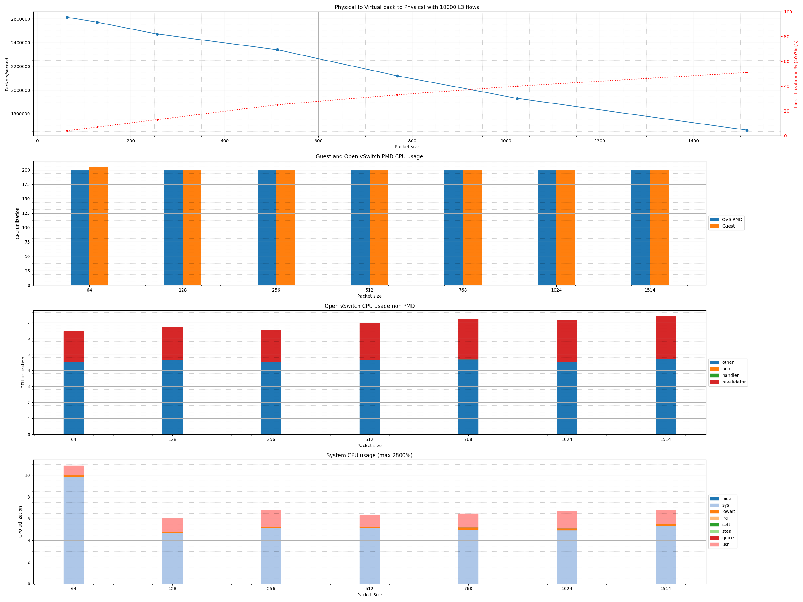
Results
Graphs

Slide 15
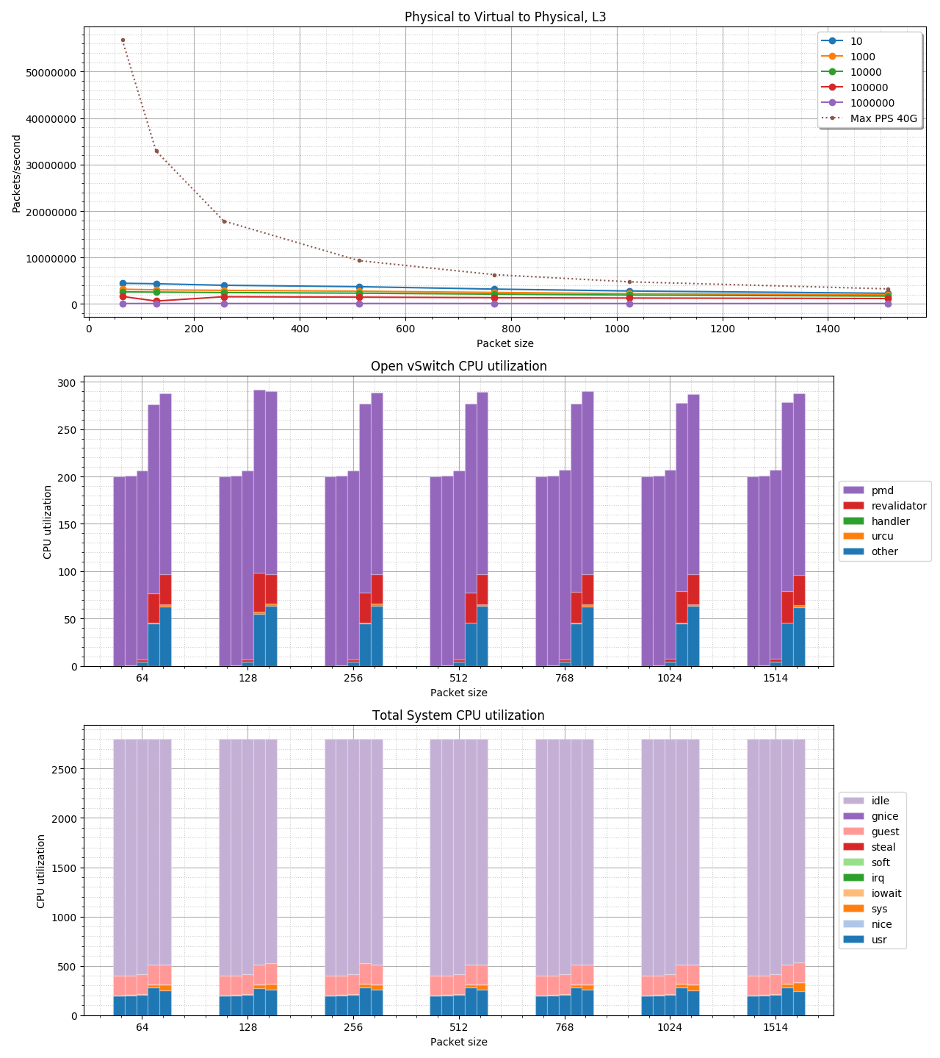
Results
Graphs

Slide 16
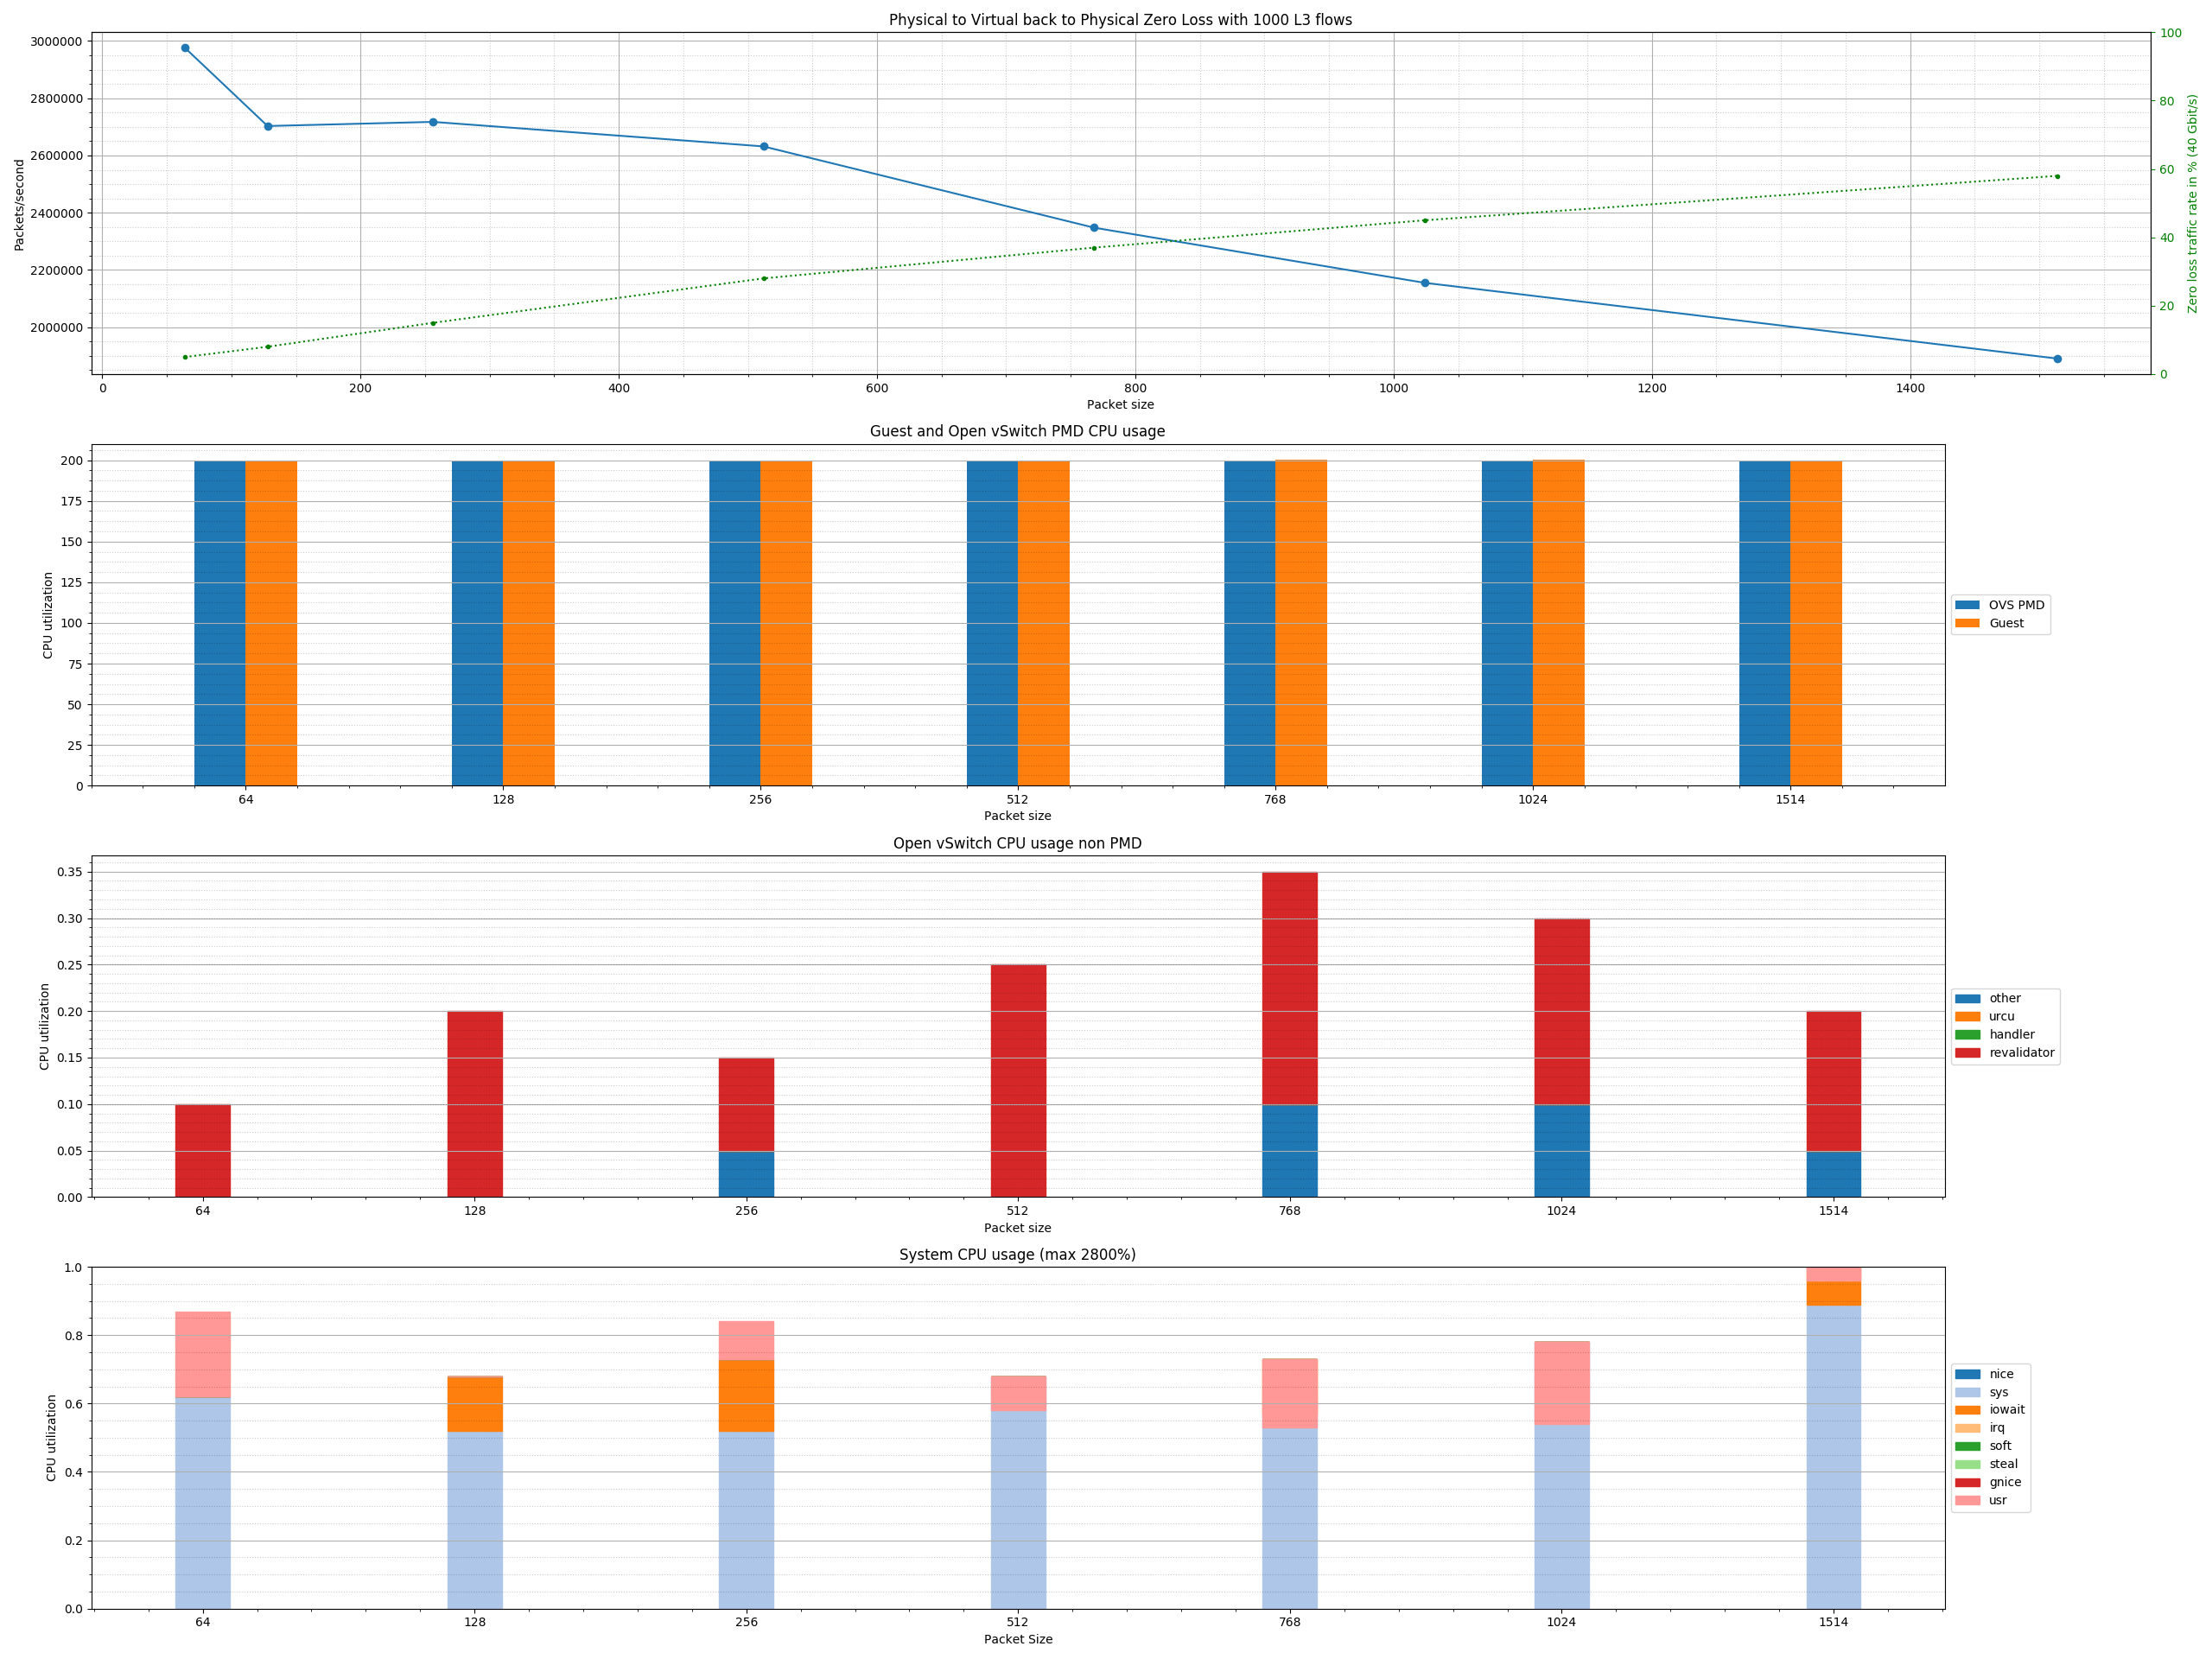
Results
Graphs
zero packet loss

Slide 17







THANK YOU
plus.google.com/+RedHat
facebook.com/redhatinc
linkedin.com/company/red-hat
twitter.com/RedHat
youtube.com/user/RedHatVideos

