Slide 1
Recurrent Layer (64 Cells, Tanh Activation)
Input
Recurrent State
Dense Layer
(32 Cells, ReLU Activation)
R
RNN Model
Dense Layer
(16 Cells, ReLU Activation)
Output
Output Layer
(1 Cell, Linear Activation)

Slide 2
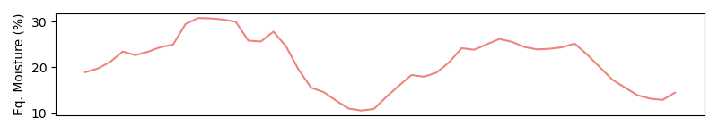
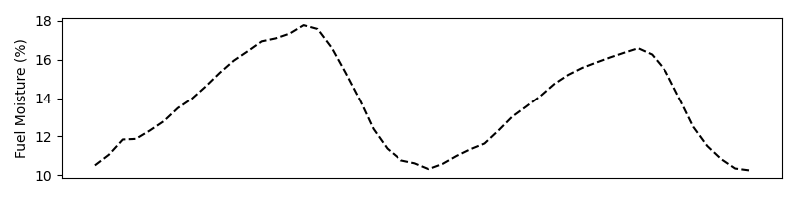







Weather
$$⋮$$
Recurrent State
$$t−1$$
$$t$$
$$t+1$$
$$t+2$$
$$t+3$$
FMC Prediction
Time
$$…$$

Slide 3

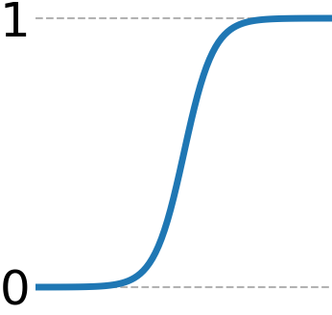
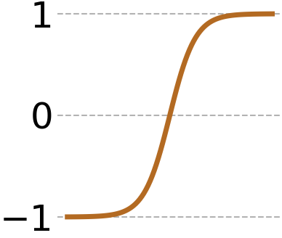
Activation

Slide 4
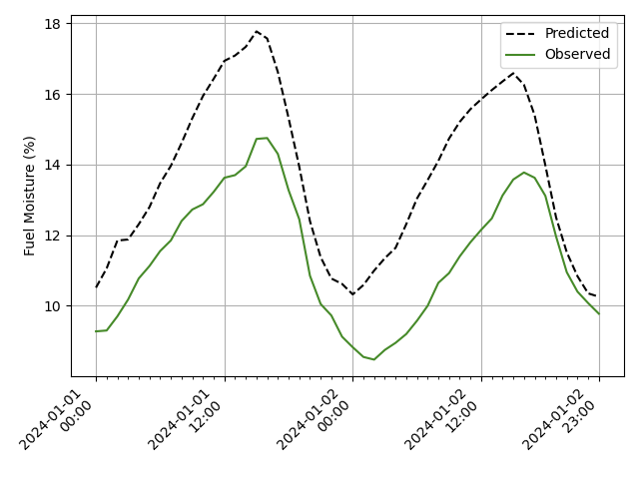
Loss Calculation

Slide 5
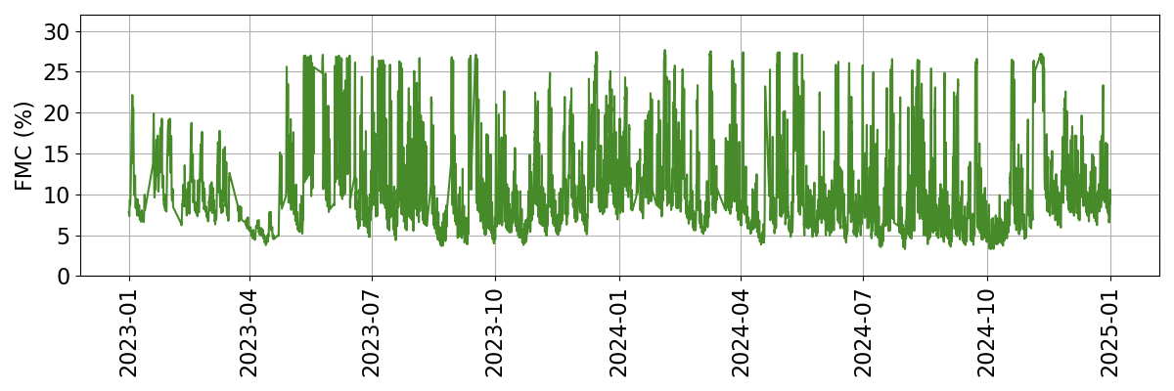
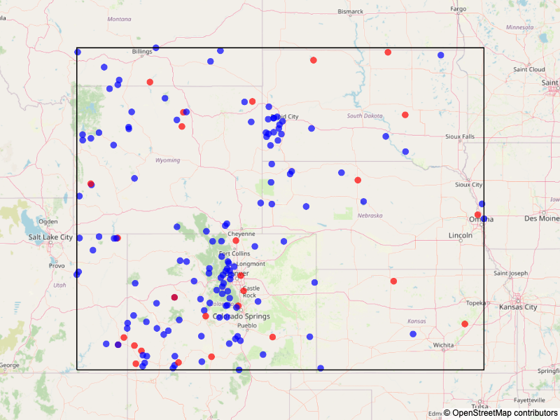
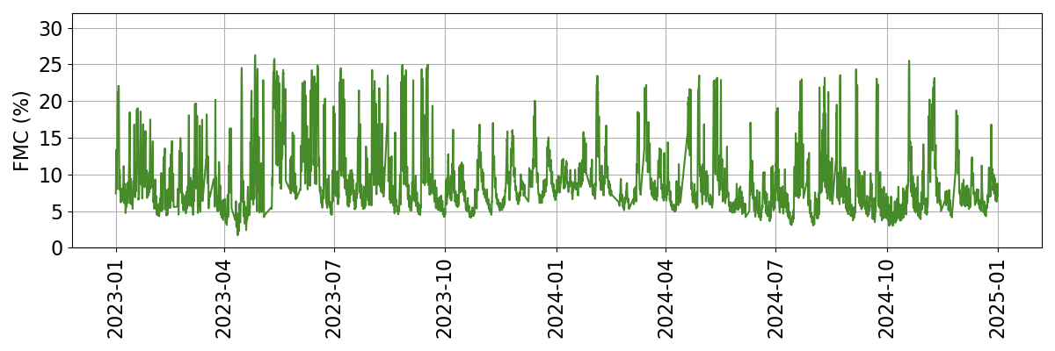
Spatiotemporal CV
: Train
: Test

