Slide 1


Learning
with
building your Serverless
Lesson 2
Building a docker image
for OpenWhisk
Notes:
next

Slide 2
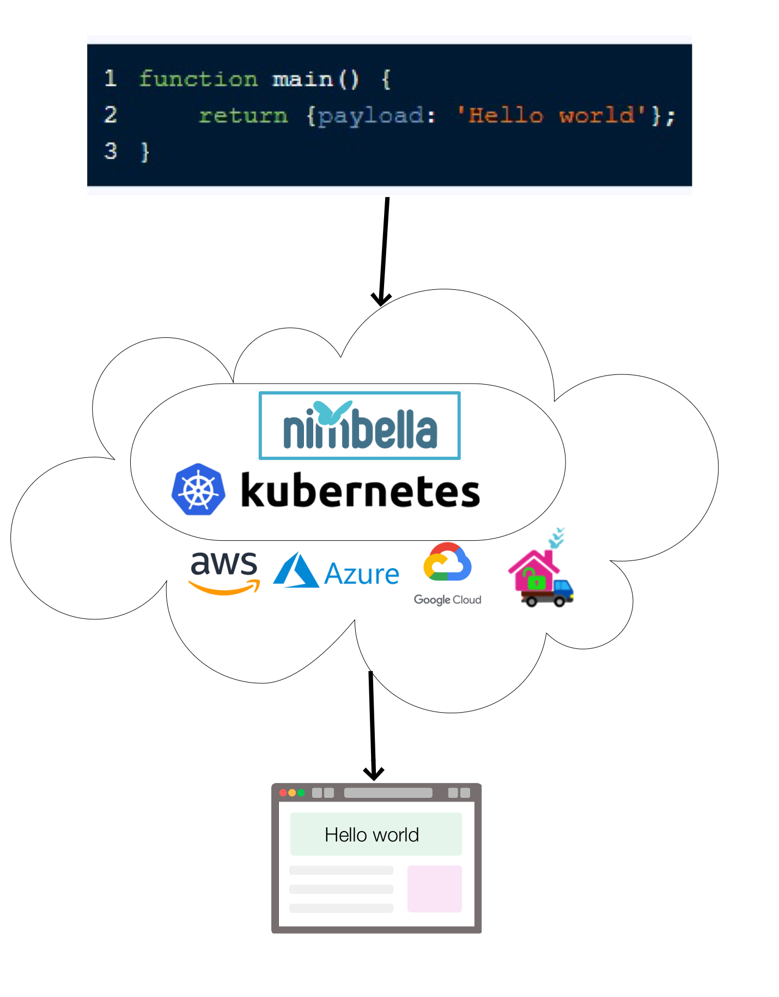
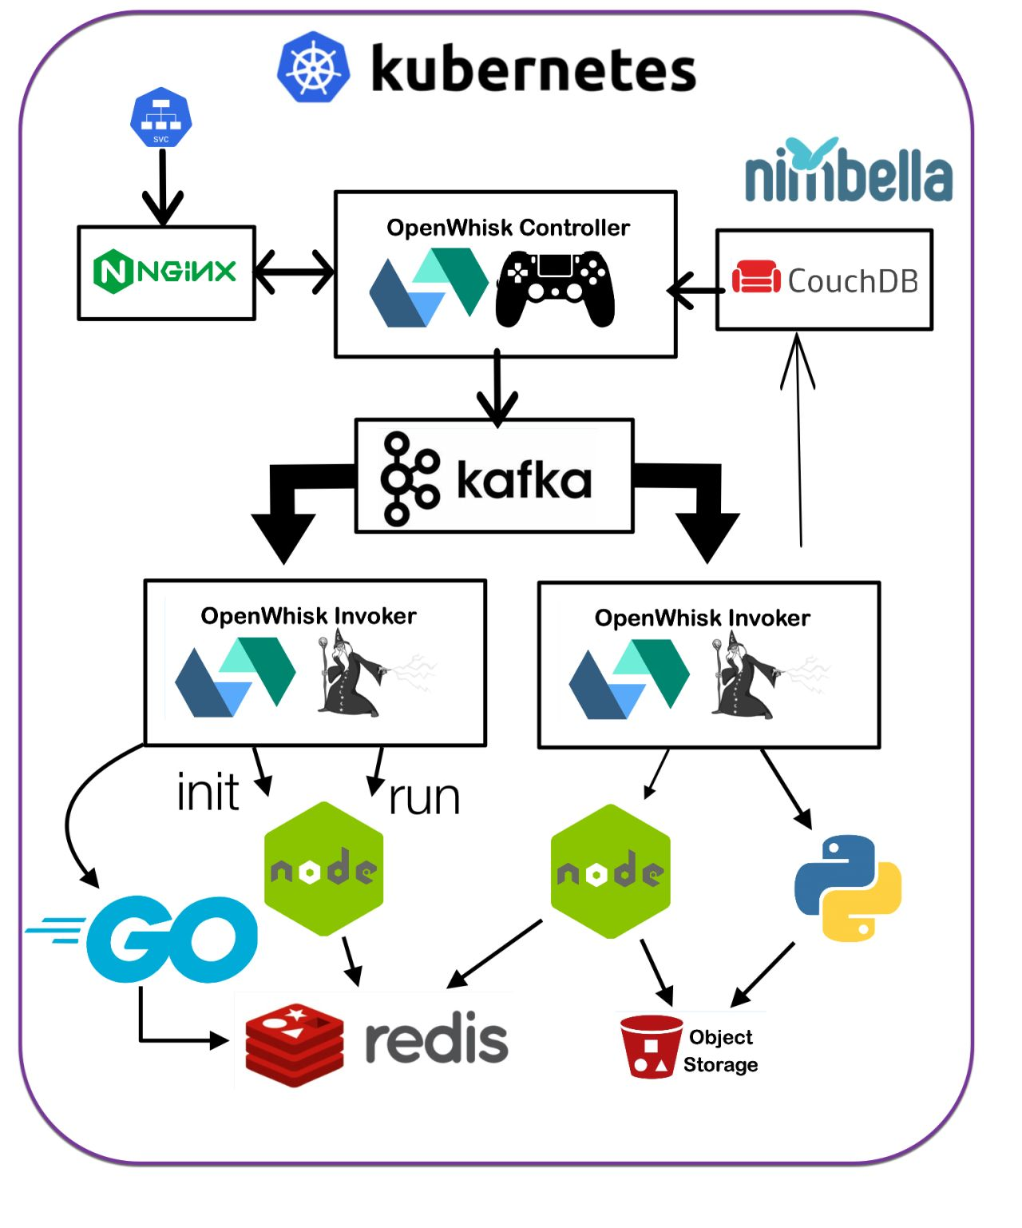
What is OpenWhisk and Serverless
Notes:
Go 1

Slide 3
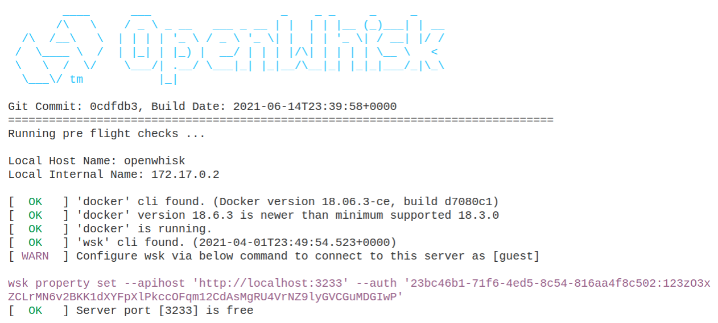
Running «Standalone» OpenWhisk
Notes:
Go 1

Slide 4
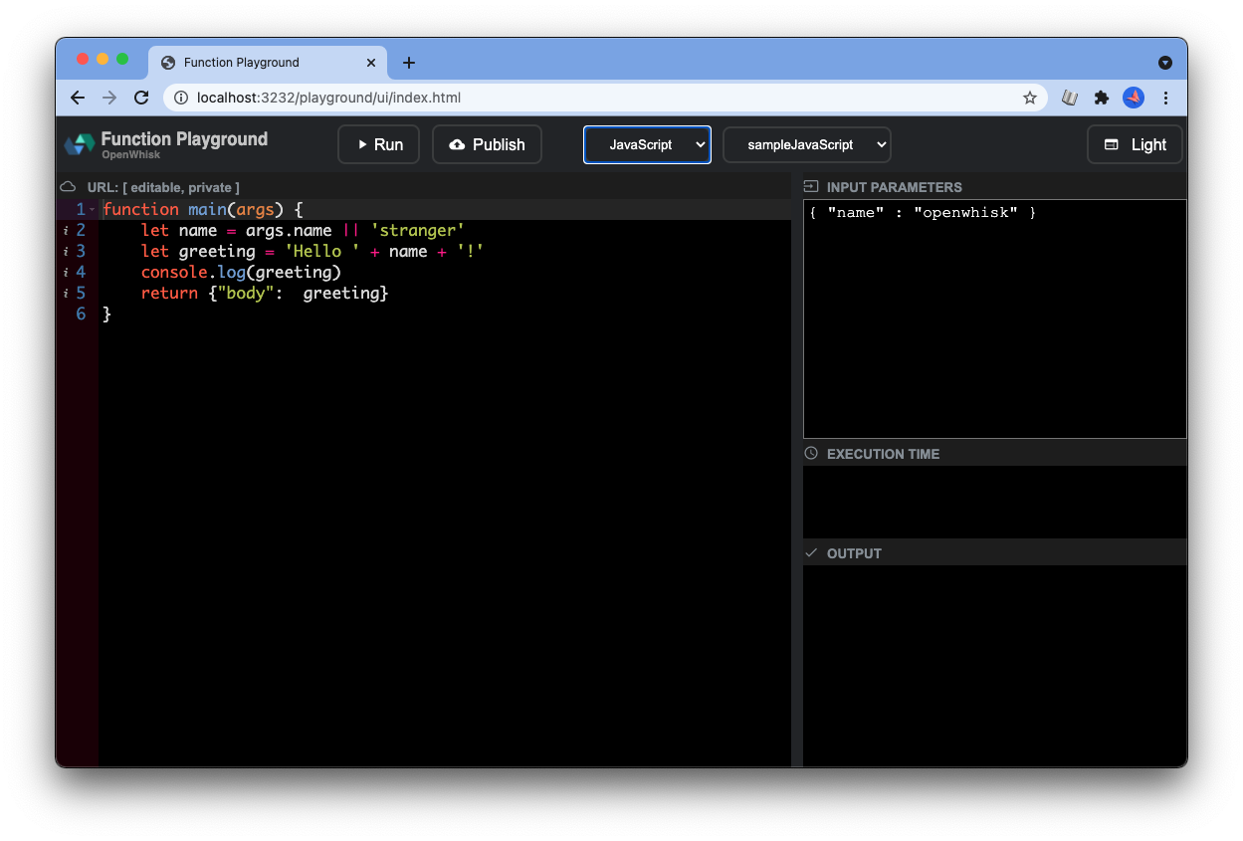
Using the playground
Notes:
Open the playground

Slide 5
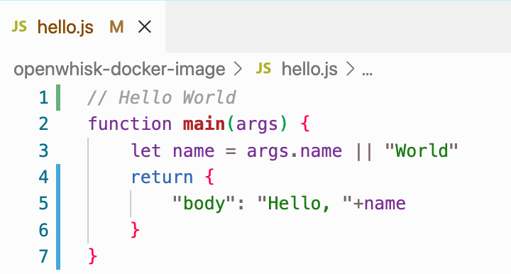
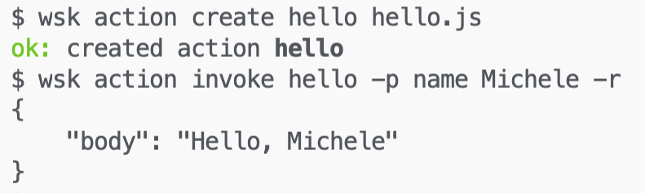
Deploying a Simple function Hello World
Notes:
Go 2

Slide 6



Check prerequisites, compile and launch
./gradlew :core:standalone:build
java –jar bin/openwhisk-standalone.jar
Notes:
Go 4

Slide 7
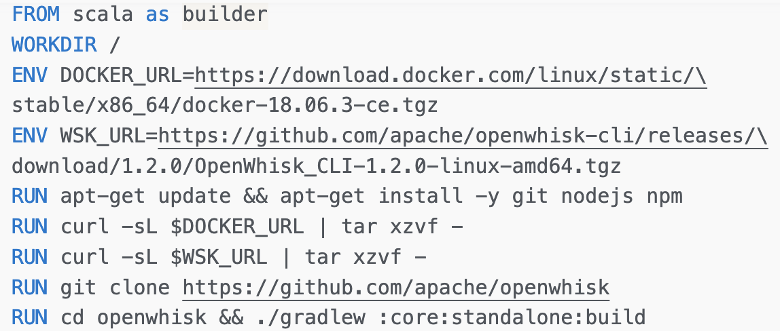
Compiling Standalone OpenWhisk
Base Image
Parameters
Install software
building from sources
Notes:
Go 5

Slide 8
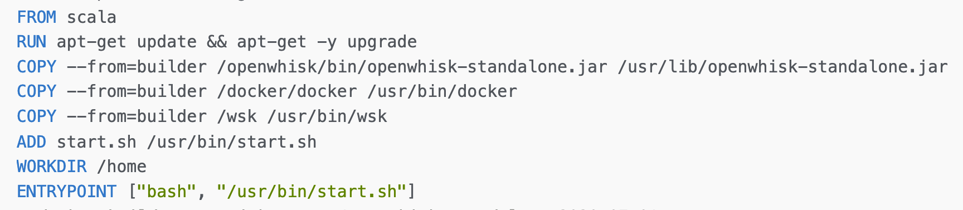
Assembling Standalone OpenWhisk
Base Image,
updated
Copy artifacts from builder
Add and use entry point
Notes:
Go 6

Slide 9
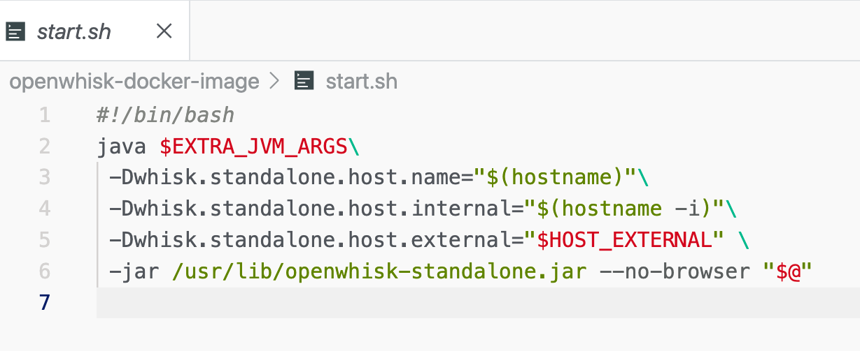


The entry point configure for docker
openwhisk

Slide 10
Launching Standalone OpenWhisk
docker run
-ti --rm \
--name openwhisk \ --hostname openwhisk \
openwhisk
--volume /var/run/docker.sock:\ /var/run/docker.sock \
--network bridge \ -p 3232:3232 -p 3233:3233 \
--env HOST_EXTERNAL=localhost \
sciabarracom/openwhisk-standalone:2020-07-01
Notes:
Go 7

