Slide 1
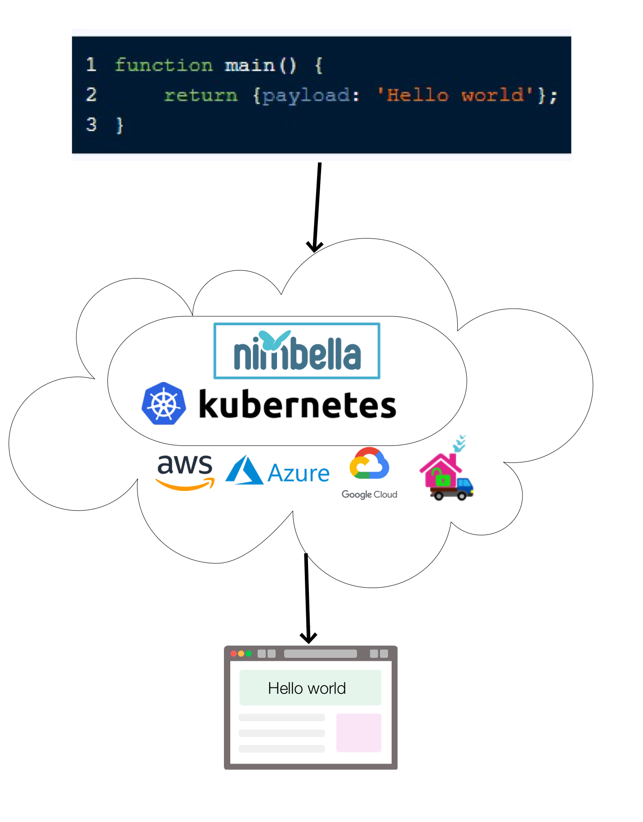
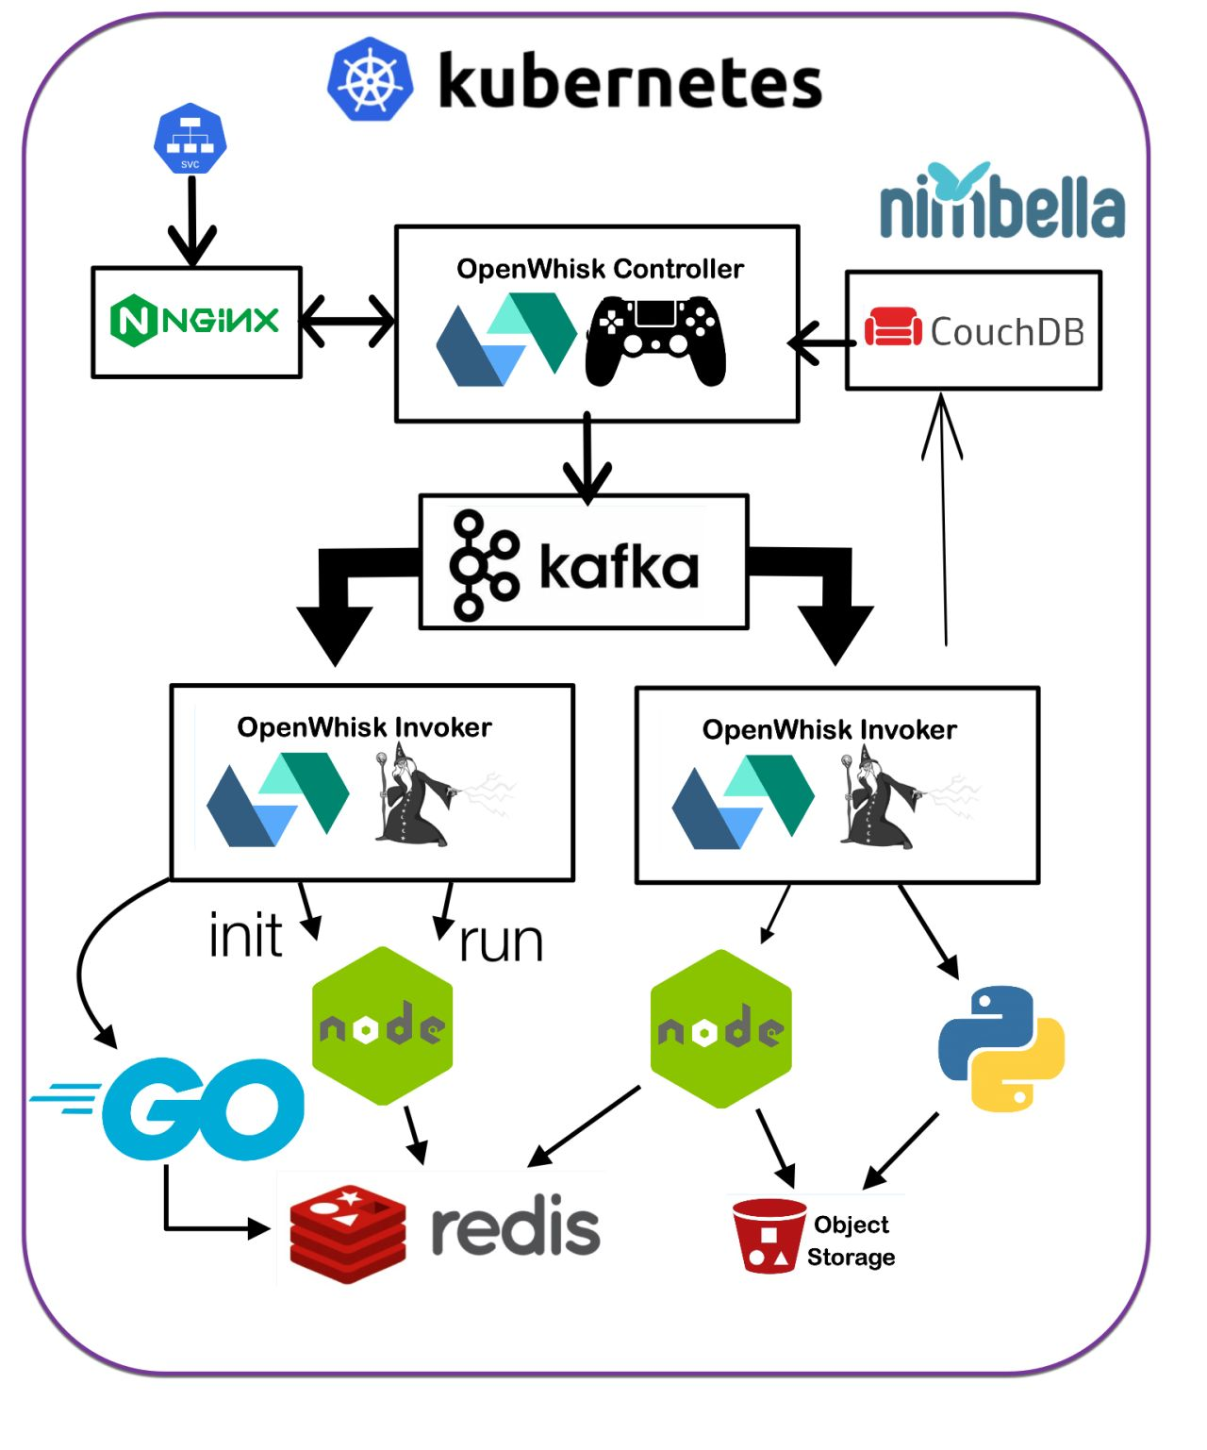
What is OpenWhisk and Serverless

Slide 2
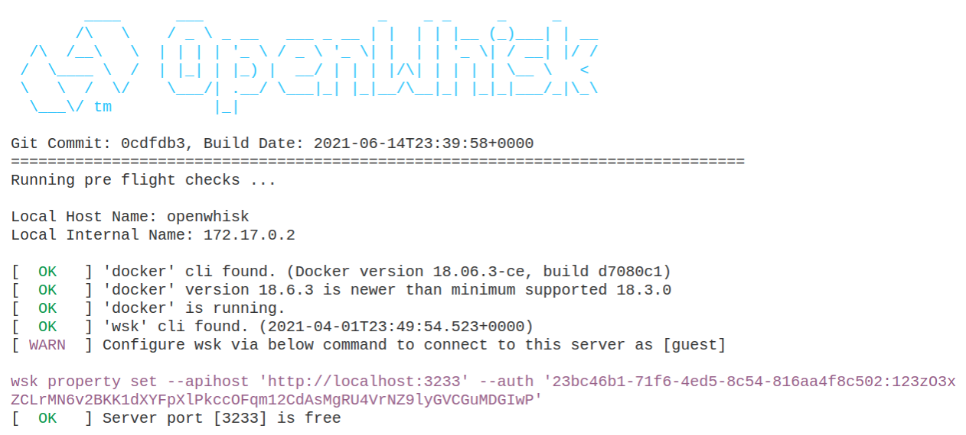
Running «Standalone» OpenWhisk
Notes:
-> launch open whisk

Slide 3
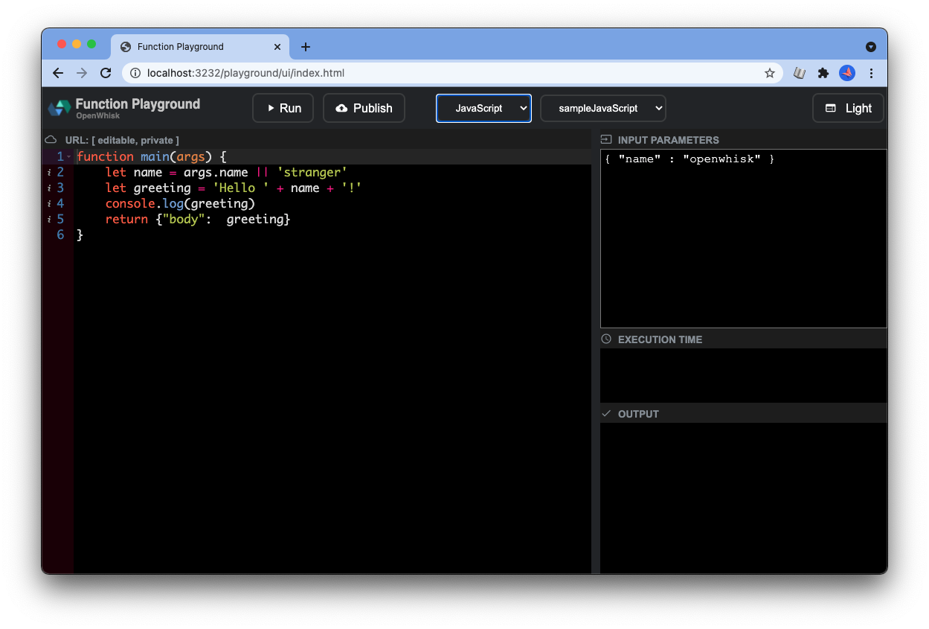
Using the playground

Slide 4
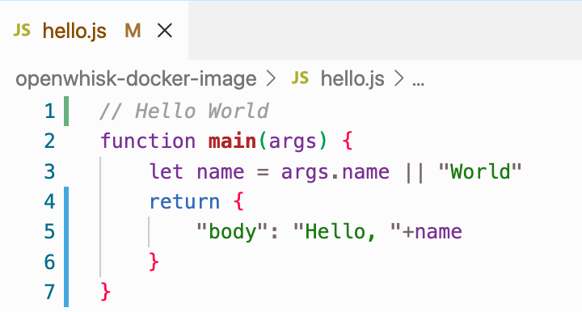
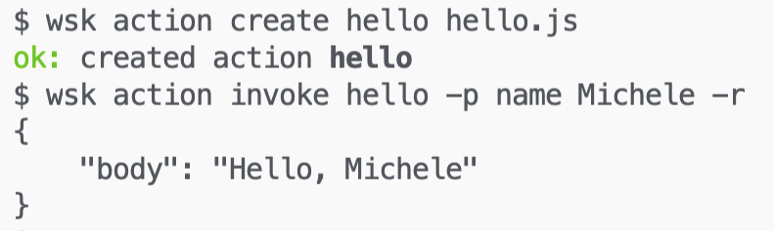
Deploying a Simple function Hello World

Slide 5



Check prerequisites, compile and launch
./gradlew :core:standalone:build
java –jar bin/openwhisk-standalone.jar

Slide 6
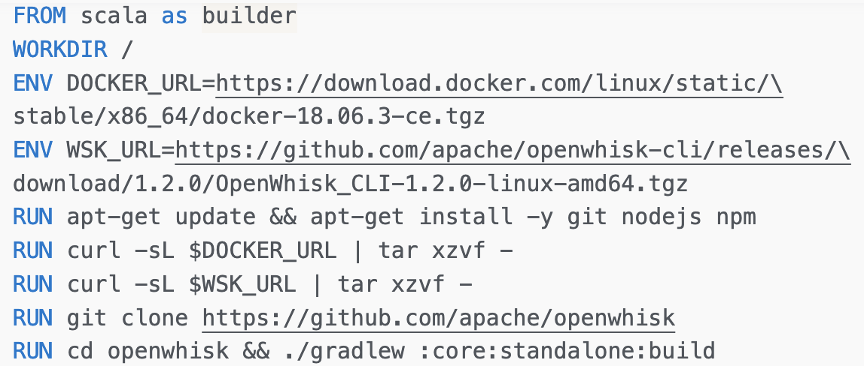
Compiling Standalone OpenWhisk
Base Image
Parameters
Install software
building from sources

Slide 7
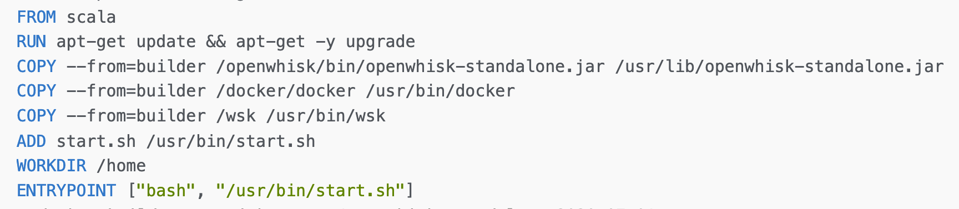
Assembling Standalone OpenWhisk
Base Image,
updated
Copy artifacts from builder
Add and use entry point

Slide 8
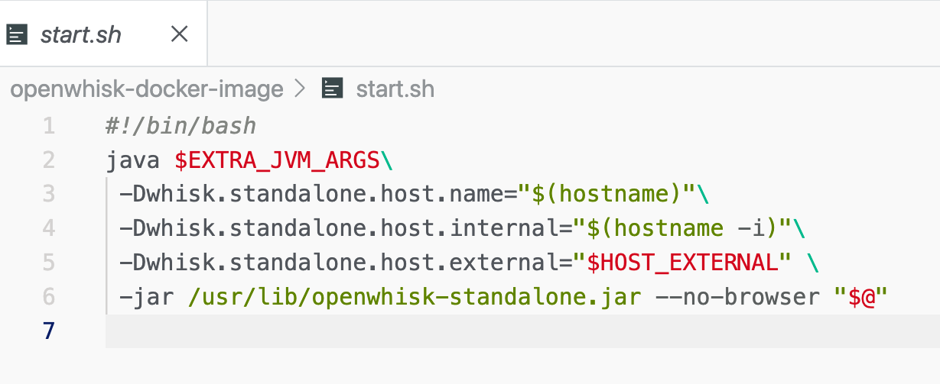


The entry point configure for docker
openwhisk

Slide 9
Launching Standalone OpenWhisk
docker run
-ti --rm \
--name openwhisk \ --hostname openwhisk \
openwhisk
--volume /var/run/docker.sock:\ /var/run/docker.sock \
--network bridge \ -p 3232:3232 -p 3233:3233 \
--env HOST_EXTERNAL=localhost \
sciabarracom/openwhisk-standalone:2020-07-01

