Slide 1
CHAPTER I
The Wave Function
1.1 The SchrÖdinger Equation 1
1.2 The Statistical Interpretation 2
1.3 Probability 5
1.4 Normalization 12
1.5 Momentum 15
1.6 The Uncertain Principle 18
Further Problems

Slide 2
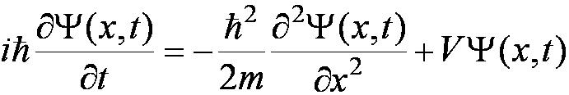
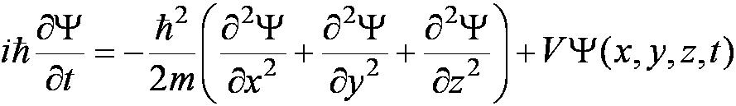


1.1 The SchrÖdinger Equation
The Schrödinger wave equation in its time-dependent form for a particle of energy E moving in a potential V in one dimension is
The extension into three dimensions is
where is an imaginary number.

Slide 3



1.2 The Statistical Interpretation
The wave function determines the likelihood (or probability) of finding a particle at a particular position in space at a given time.
The total probability of finding the electron is 1. Forcing this condition on the wave function is called normalization.

Slide 4
Bohr’s interpretation of the wave function consisted of 3 principles:
    The uncertainty principle of Heisenberg
    The complementarity principle of Bohr
    The statistical interpretation of Born, based on probabilities determined by the wave function
Together these three concepts form a logical interpretation of the physical meaning of quantum theory. According to the Copenhagen interpretation, physics depends on the outcomes of measurement.
This is The Copenhagen Interpretation

Slide 5
The statistical interpretation introduces a indeterminacy into quantum mechanics
It is a fact of nature?
If you say “yes”, then quantum mechanics is worldview.
It is a defect in the theory?
If you say “yes”, then quantum mechanics is methodology.

Slide 6
Three Positions of Particle
Question: I do measure the position of the particle, and find it to be at point A. Then where was the particle just before I made measurement?
The realist position: Einstein, QM theory is incomplete.
The orthodox position: Bohr, Copenhagen interpretation.
The agnostic position: It is silly to answer this question!
ordinary: wave function evolves in a leisurely fashion
measurements: wave function suddenly collapses
How about if I made a second measurement immediately after first one?

Slide 7
John Bell 1964:
Gave an observable difference whether the particle had a precise position prior to measurement
Bell Inequality(your homework, a simple report about Bell Inequality)

Slide 8


1.3 Probability
1.3.1 Discrete Variables
Imagine a room containing 14 people, we let N(j) represent the number of people of age j, and
N(14)=1; N(15)=1; N(16)=3;
N(22)=2; N(24)=2; N(25)=5. then
Total number of peole:
Probability of getting age j:
Most probable age: 25
Median age:23
Average age:

Slide 9




Average of the squares of ages:
Average of some function of j:
Standard deviation:
1.3.2 continuous Vatiables

Slide 10
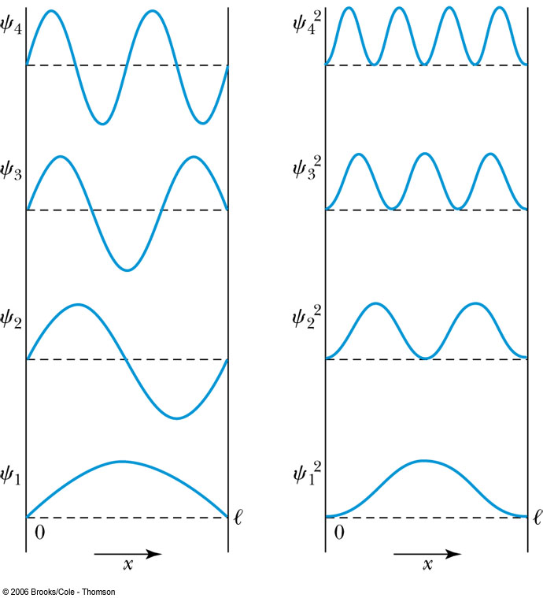

Probability of the Particle
The probability of observing the particle between x and x + dx in each state is
Note that E₀ = 0 is not a possible energy level.
The concept of energy levels, as first discussed in the Bohr model, has surfaced in a natural way by using waves.

Slide 11
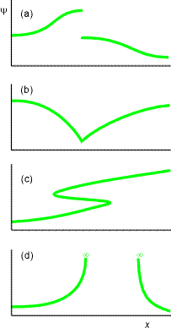
Quantization of Wavefunction
The Born interpretation of ψ places restrictions on the form of the wavefunction:
(a) ψ must be continuous (no breaks);
(b) The gradient of ψ (dψ/dx) must be continuous (no kinks);
(c) ψ must have a single value at any point in space;
(d) ψ must be finite everywhere;
(e) ψ cannot be zero everywhere.
Other restrictions (boundary conditions) depend on the exact system.
These restrictions on ψ mean that only certain wavefunctions and ∴ only
certain energies of the system are allowed.
∴ Quantization of ψ ⇒ Quantization of E

Slide 12
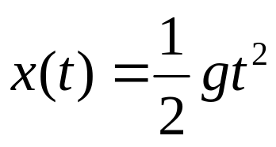
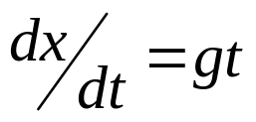
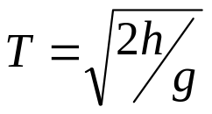
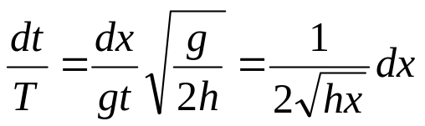
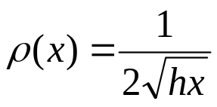
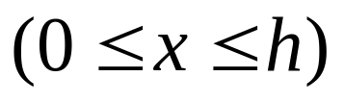
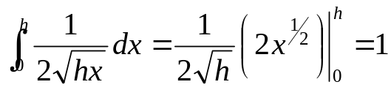
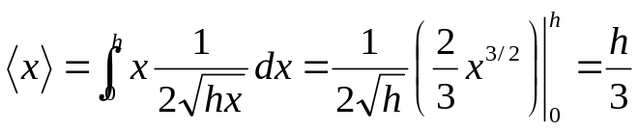
Problem 1.1(P12, checking yourself)
Problem 1.2
(a). Standard deviation of the example1.1
(b). Probability more than 1 standard deviation
away from the average

Slide 13
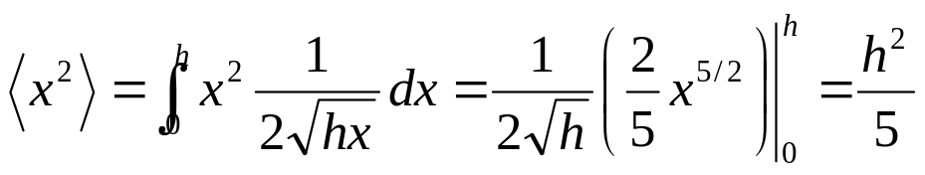
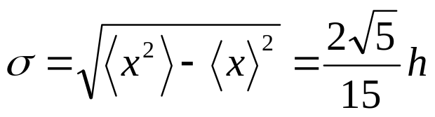
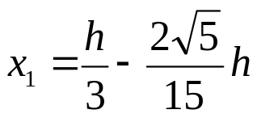
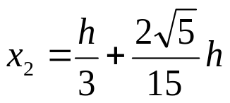
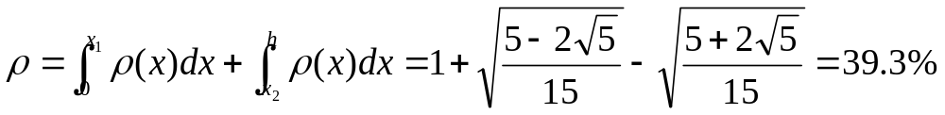

Slide 14
Problem 1.3(P12)
(a)
(b)
(c)
Classroom work

Slide 15
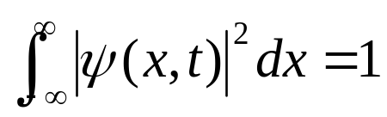
1.4 Normalization
Normalizing non-normalizable
square-integrable Expression difficuty
A problem: when wave function evolves in a leisurely fashion under Schrödinger equation, will it stay normalized?

Slide 16
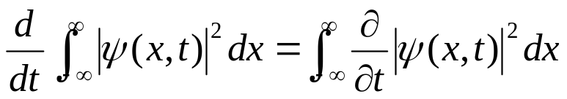
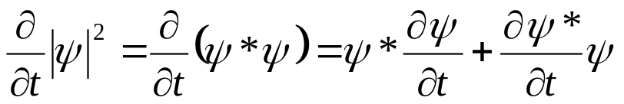
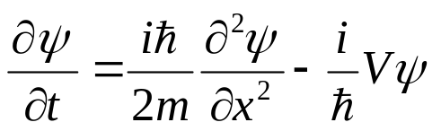
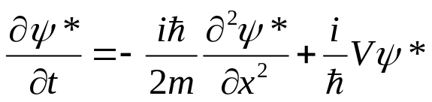
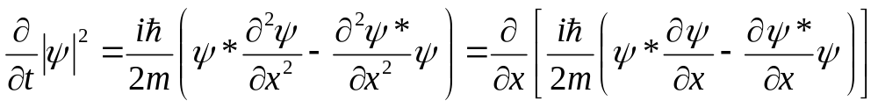
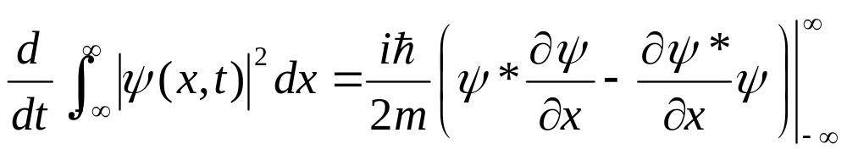
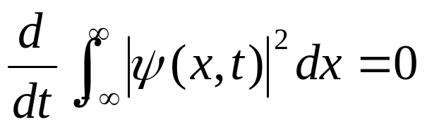
Wavefuntion must go to zero as x goes to infinity if it is normalizable

Slide 17
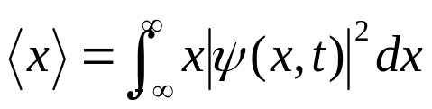
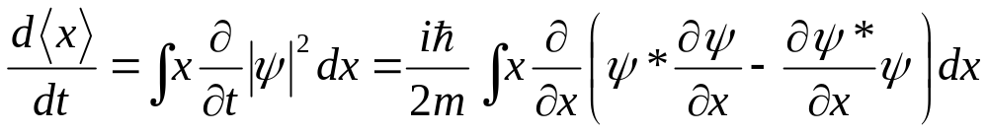
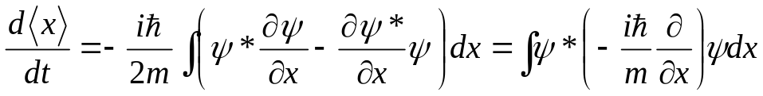
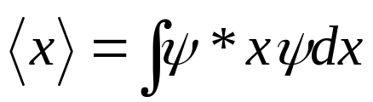
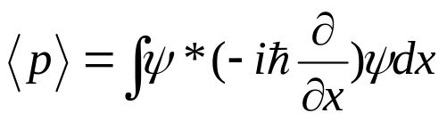
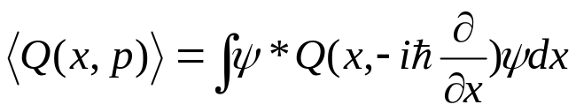
1.5 Momentum
Integration by parts:
And then:
Operator!?

Slide 18
Problem 1.4
Problem 1.5(P14)
Problem 1.6(P18)
Problem 1.7(Ehrenfest’s theorem)
Problem 1.8

Slide 19
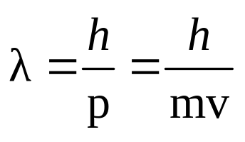
1.6 The uncertainly principle
In 1924 (i.e. one year before Davisson and Germer’s experiment), De Broglie predicted that all matter has wave-like properties.
A particle, of mass m, travelling at velocity v, has linear momentum p = mv.
By analogy with photons, the associated wavelength of the particle (λ) is given by:

Slide 20

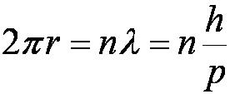
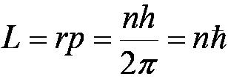
One of Bohr’s assumptions concerning his hydrogen atom model was that the angular momentum of the electron-nucleus system in a stationary state is an integral multiple of h/2π.
The electron is a standing wave in an orbit around the proton. This standing wave will have nodes and be an integral number of wavelengths.
The angular momentum becomes:

Slide 21
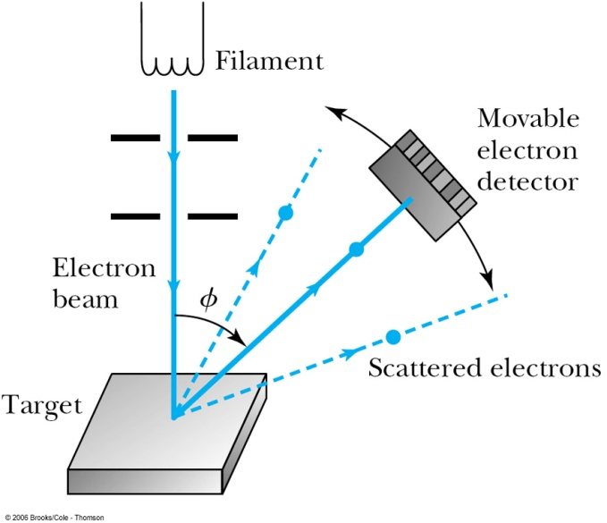
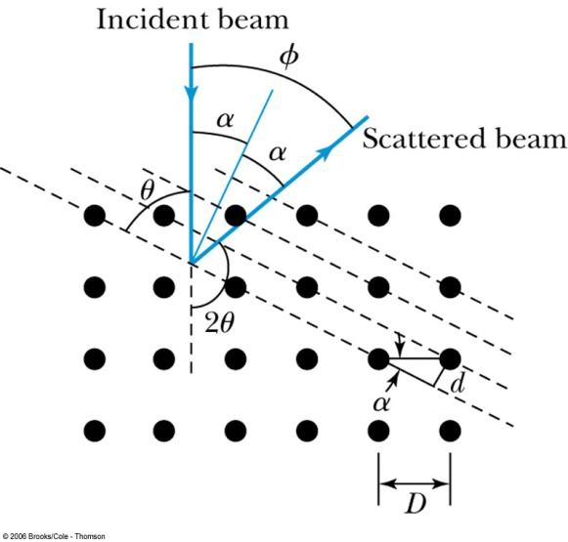
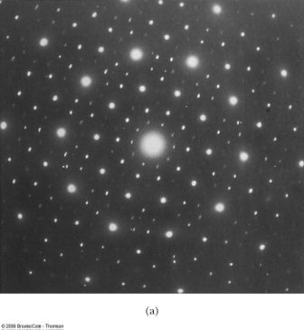
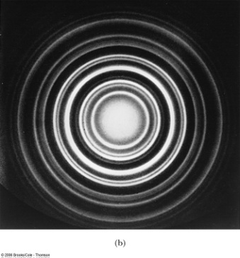
Electron Scattering
Davisson and Germer experimentally observed that electrons were diffracted much like x rays in nickel crystals.
George P. Thomson (1892–1975), son of J. J. Thomson, reported seeing the effects of electron diffraction in transmission experiments. The first target was celluloid, and soon after that gold, aluminum, and platinum were used. The randomly oriented polycrystalline sample of SnO₂ produces rings as shown in the figure at right.

Slide 22
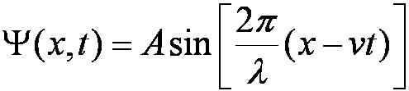
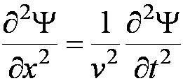
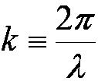
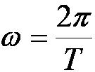
De Broglie matter waves suggest a further description. The displacement of a wave is
This is a solution to the wave equation
Define the wave number k and the angular frequency ω as:
The wave function is now: Ψ(x, t) = A sin (kx − ωt).

Slide 23
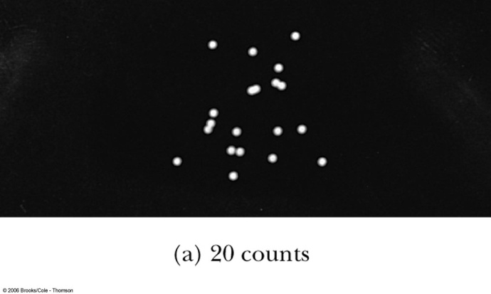
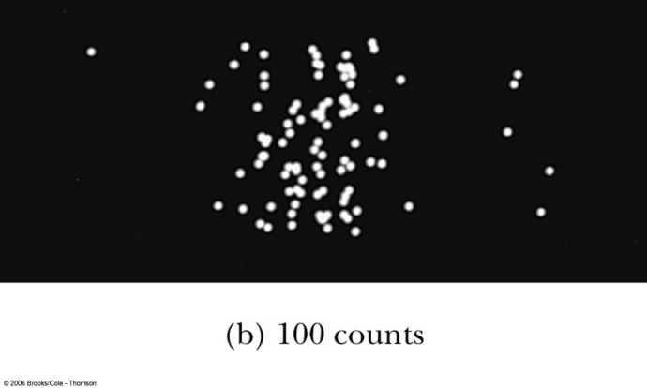
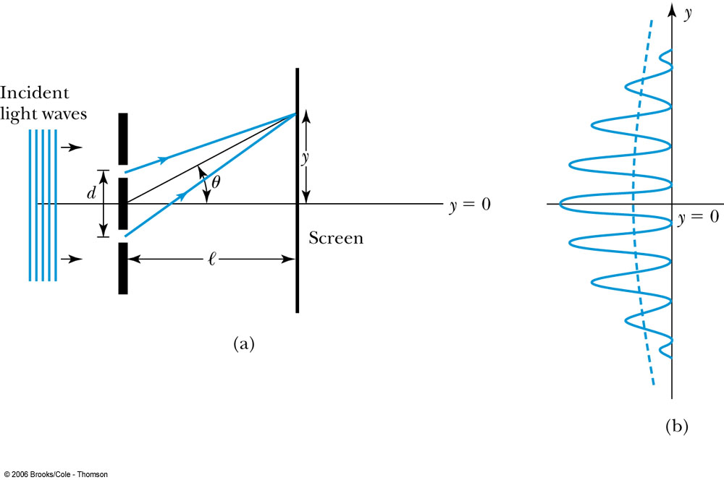
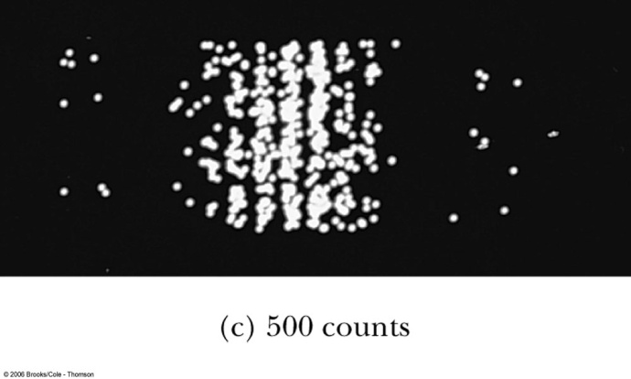
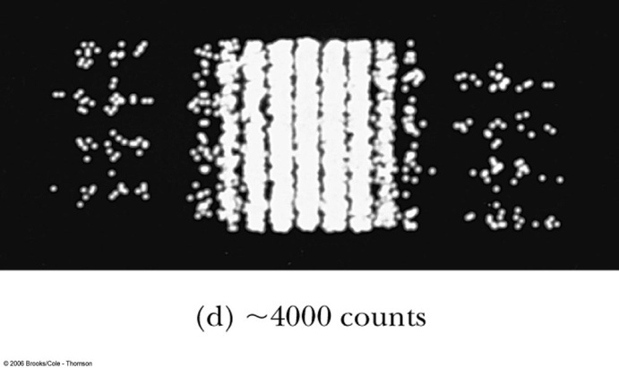
Young’s double-slit diffraction experiment demonstrates the wave property of light.
However, dimming the light results in single flashes on the screen representative of particles.

Slide 24
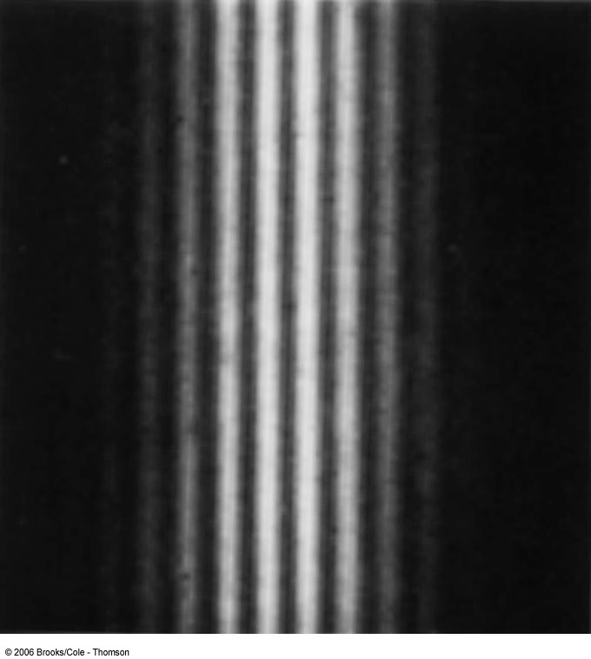
Electron Double-Slit Experiment
C. Jönsson of Tübingen, Germany, succeeded in 1961 in showing double-slit interference effects for electrons by constructing very narrow slits and using relatively large distances between the slits and the observation screen.
This experiment demonstrated that precisely the same behavior occurs for both light (waves) and electrons (particles).

Slide 25
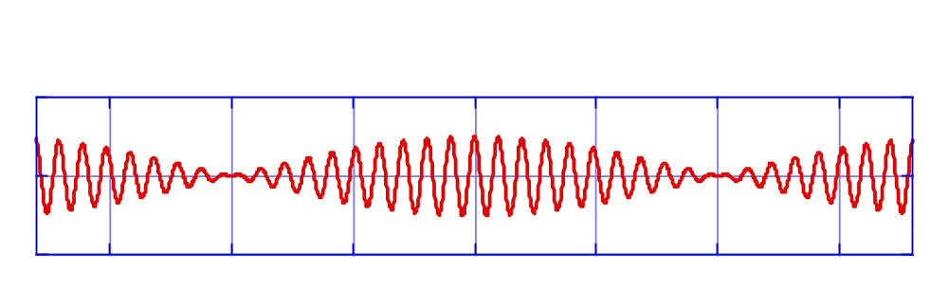
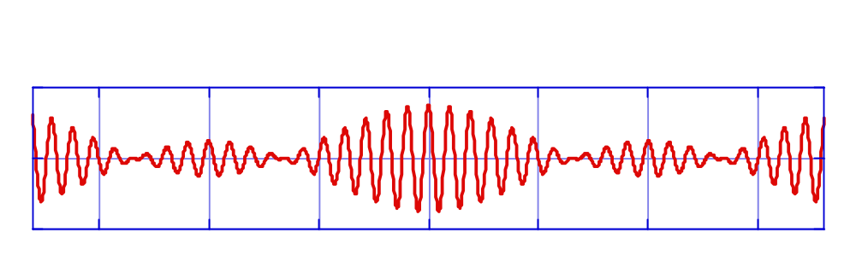

Making a particle out of waves
440 Hz + 439 Hz
440 Hz + 439 Hz + 438 Hz
440 Hz + 439 Hz + 438 Hz + 437 Hz + 436 Hz

Slide 26

Spatial extent of localized sound wave
Δx = spatial spread of ‘wave packet’
Spatial extent decreases as the spread in included wavelengths increases.

Slide 27
Same occurs for a matter wave
Construct a localized particle by adding together waves with slightly different wavelengths.
Since de Broglie says λ = h /p, each of these components has slightly different momentum.
  We say that there is some ‘uncertainty’ in the momentum or the energy
And still don’t know exact location of the particle!
  Wave still is spread over Δx (‘uncertainty’ in position)
  Can reduce Δx, but at the cost of increasing the spread in wavelength (giving a spread in momentum).

Slide 28
For sound, we would just say that the sound pulse is centered at some position, but has a spread.
Can’t do that for a quantum-mechanical particle.
Many measurements indicate that the electron is indeed a point particle.
Interpretation is that the magnitude of electron ‘wave-pulse’ at some point in space determines the probability of finding the electron at that point.

Slide 29

Heisenberg Uncertainty Principle
Using
  Δx = position uncertainty
  Δp = momentum uncertainty
Heisenberg showed that the product
( Δx ) • ( Δp ) is always greater than ( h / 4π )
Often write this as
where is pronounced ‘h-bar’

Slide 30


Thinking about uncertainty
For a classical particle, p=mv, so an uncertainty in momentum corresponds to an uncertainty in velocity.
This says that the uncertainty is small for massive objects, but becomes important for very light objects, such as electrons.
Large, massive objects don’t show effects of quantum mechanics.

Slide 31
Uncertainty principle question
Suppose an electron is inside a box 1 nm in width. There is some uncertainty in the momentum of the electron. We then squeeze the box to make it 0.5 nm. What happens to the momentum?
Momentum becomes more uncertain
Momentum becomes less uncertain
Momentum uncertainty unchanged

Slide 32




Energy Uncertainty
If we are uncertain as to the exact position of a particle, for example an electron somewhere inside an atom, the particle can’t have zero kinetic energy.
The energy uncertainty of a Gaussian wave packet is
combined with the angular frequency relation
Energy-Time Uncertainty Principle: .

Slide 33











Problem 1.9(P20)
(a).
(b).
(c).
(d).

Slide 34







Further Problems
Problem 1.10(P20)
Problem 1.11
Problem 1.12
Problem 1.13
Problem 1.14
Problem 1.15
Problem 1.16

Slide 35
Problem 1.17(home work)
Problem 1.18(P23)

