Slide 1
Chapter 4: Quantum Mechanics in Three Dimension
4.1 SchrÖdinger Equation in Spherical Coodinates
4.2 The Hydrogen Atom
4.3 Angular Momentum
4.4 Spin

Slide 2
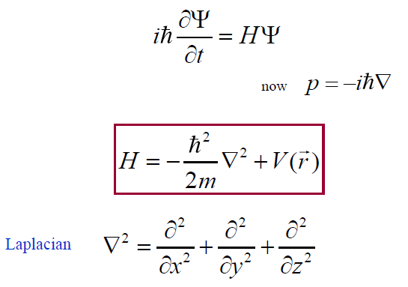
4.1 Schodinger equation in spherical coodinates

Slide 3
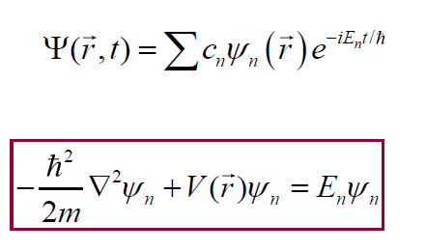
The general solution
stationary states verify:

Slide 4
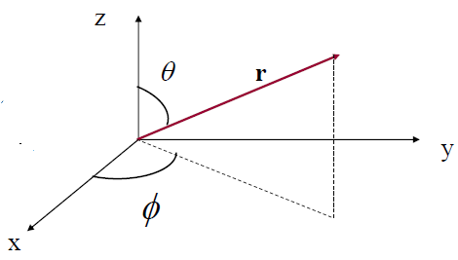

Spherical coordinates
The Laplacian

Slide 5
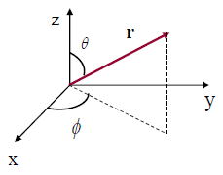

The Schrodinger Equation in Spherical Coordinates:

Slide 6



4.1.1 Separation of Variables
Radial equation
Angular equation

Slide 7




4.1.2 The Angular Equation
Further separation:
And then:
m must be integer,why?

Slide 8

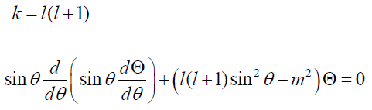
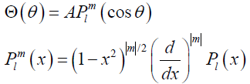

Ө equation

Slide 9

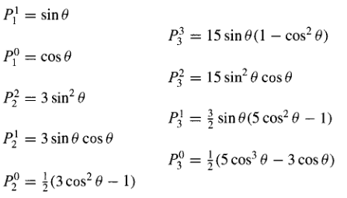
Physical condition

Slide 10
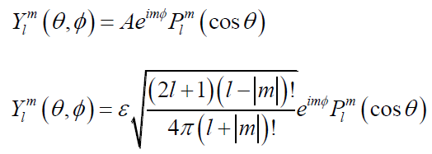
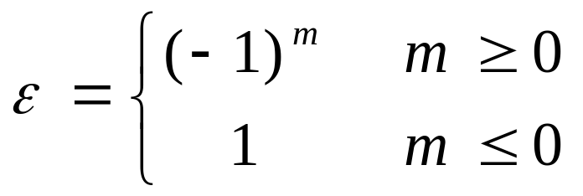
This is spherical harmonics

Slide 11




4.1.3 The Radial Equation
Radial equation:
Variables change:

Slide 12
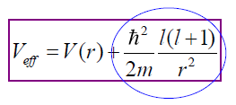
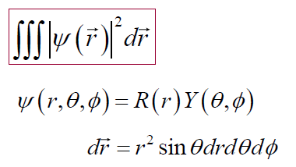
Effective potential:
Then, this is an one-dimensional-Schrodinger equation
Normalization:

Slide 13
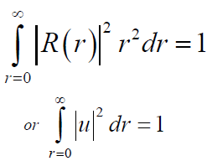
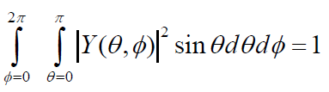
Radial part
Angular part

Slide 14
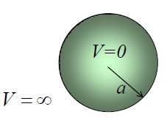

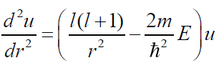

Example 4.1 the infinite spherical well
In the well
Change variables

Slide 15
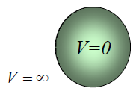




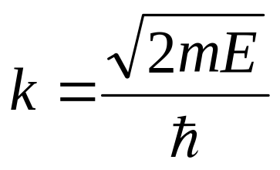

If
General solution:
Consider boundary condition:

Slide 16





if
Solution:
Spherical Bessel function
Spherical Neumann function
Boundary condition: B=0

Slide 17

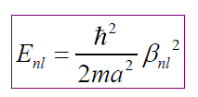



Where is the nth zero of the th Bessel function

Slide 18
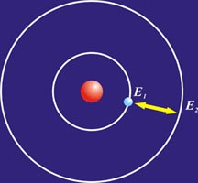
4.2 The Hydrogen Atom
What is the probability of electron density?

Slide 19



The angular equation:
The angular function:

Slide 20




4.2.1 The radial wave function
The radial equation:

Slide 21







The radial equation:
Asymptotic behaviors:

Slide 22







The solution would be as:
We assume the solution can be expressed as a power series:
then:
for very lage j

Slide 23
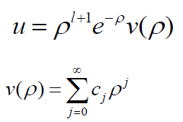
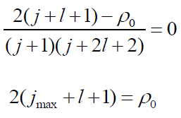

The series must terminate
for boundary condition:
So-called principal quantum
Number:

Slide 24


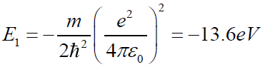




Ground state energy
Binding energy:
Radial wave function:

Slide 25



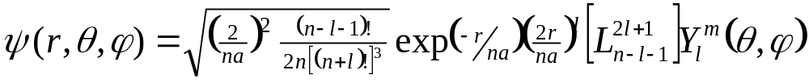

Radial solution is equivalent to associate
Laguerre polynomials:
The normalized hydrogen wave functions are:
Bohr radius:

Slide 26
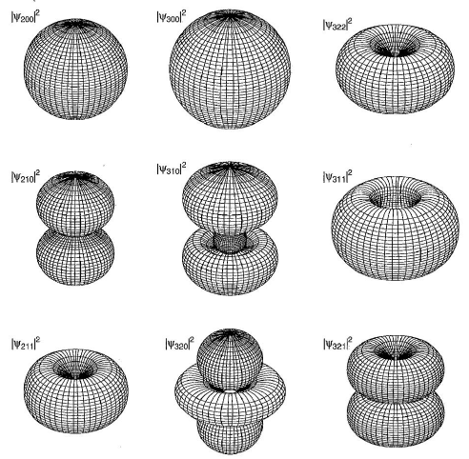
Surfaces of density

Slide 27
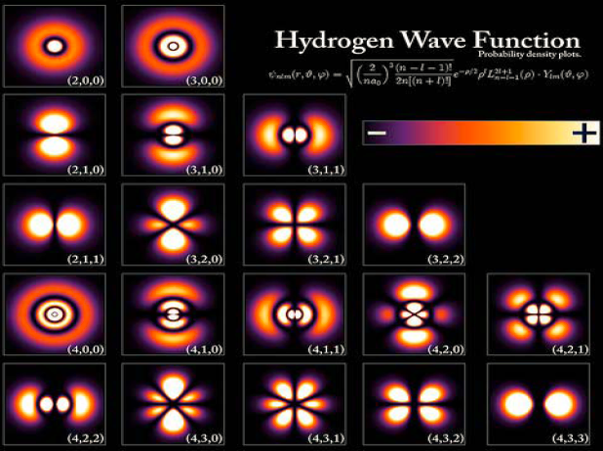

Slide 28
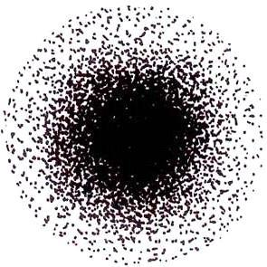
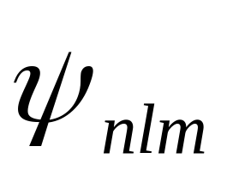
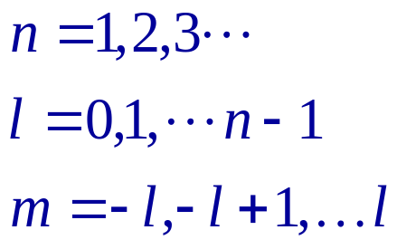
Electronic distribution

Slide 29
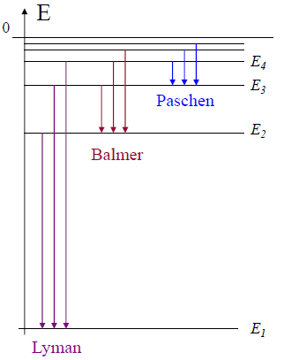
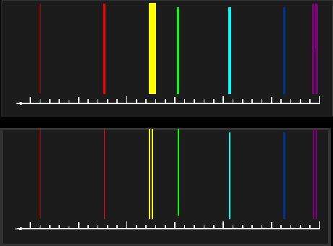
4.2.2 The Spectrum of Hydrogen
Spectroscopy of
hydrogen

Slide 30



Energy level
Energy transition
Rydberg constant

Slide 31
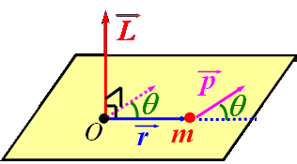
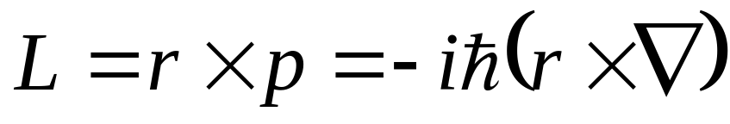
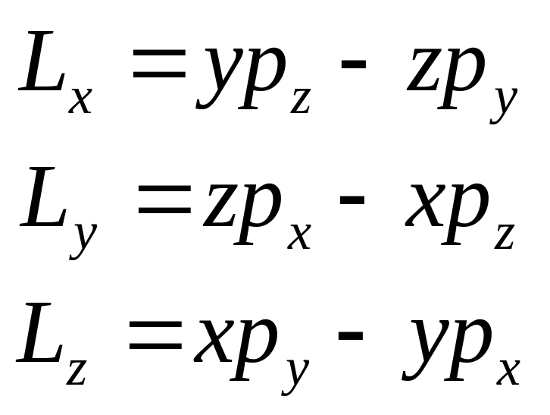
4.3 Angular momentum
The angular-momentum
operator

Slide 32
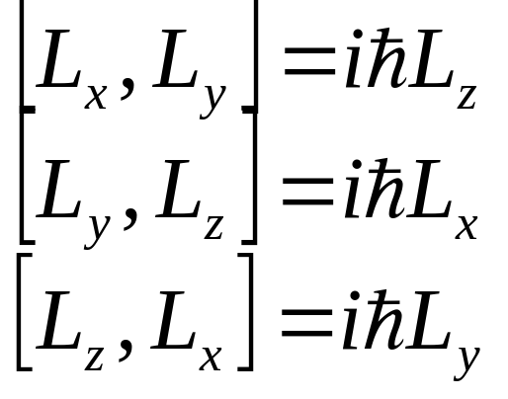
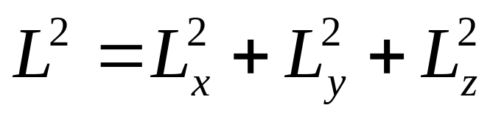
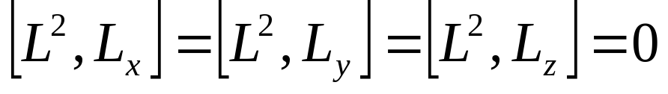
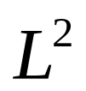

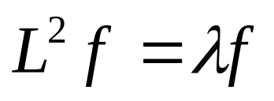
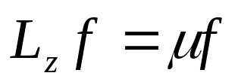
4.3.1 eigenvalues
Fundamental commutation relations
So we can hope to find simultaneous eigenstates of and

Slide 33

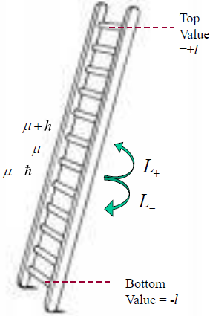
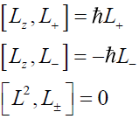
We will use a “ladder operator” technich

Slide 34


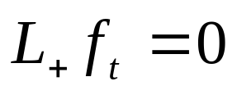
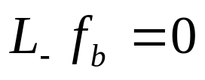
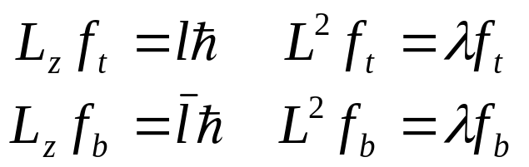
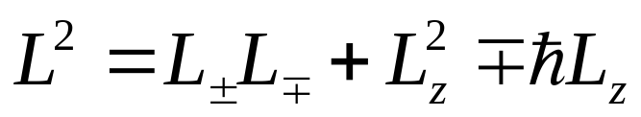
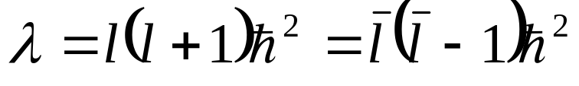
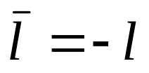
There must exist a “top rung” and
a “bottom rung”
Now there is:
It follows that:
therefore:

Slide 35



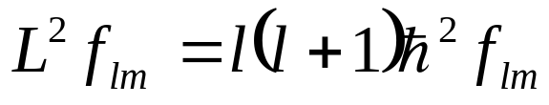
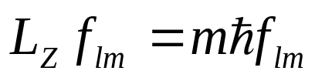
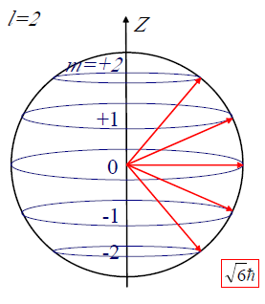


Because the eigenvalue of goes from
to in N integer steps,so:
but why? can you
show that?

Slide 36













then:
at top rung and bottom one:
Therefore, in range of and ,
m only one value and , respectively. So:
is integer

Slide 37







4.3.2 Eigenfunctions

Slide 38





4.4 Spin
orbital
spin

Slide 39
In addition to orbital angular momentum, the electron also
carries another form of angular momentum which has noth-
-ing to do with motion in space, it is spin. But the electron is
a structureless point particle, so elementary particles carry
intrinsic angular momentum in addition to their extrinsic an-
-gular momentum. WHY?
Experimental evidence:
Spectrum and electronic distribution of alkali metal
Fine structure of atomic spectrum
Anomalous Zeeman effect
Stern-Gerlach experiment

Slide 40


4.4.1 The experimental evidence of spin
(1). Spectra and electronic distribution of atomic sodium
Wolfgang E. Pauli: incompatibility principle, 1925,
the fourth quantum number, double value.

Slide 41






(2). The fine structure of atomic spectra
Principle series
1st diffuse series
2nd diffuse series
Atomic lithium

Slide 42



Slide 43



(3). The anomalous Zeeman effect
Zeeman,1896
Hendrik Antoon Lorentz, 1896
T. Preston,1897
Peter Zeeman 1865-1943
Hendrik Antoon Lorentz,1853～1928

Slide 44



Slide 45





Slide 46


(4). Stern-Gerlach experiment(1922)
Angular orientation quantization

Slide 47

Spin angular quantum number is ½!!!

Slide 48


4.4.2 The spin 1/2
(1). History of spin
1912, Paschen and Back, anomanous Zeeman effect
1922, Stern and Gerlach, angular quantization
1924, Pauli, the fourth quantum number
1925, G. Uhlenbeck and S. Goudsmit, spin hypothesis
1928, P. Dirac, relativistic wave equation, spin can be
obtained naturally.
(2). Spin hypothesis
fundamental commutation
relations:

Slide 49
Very interesting, instructive and very complicated story!!
1923, Alfred Lande, atomic corn, Zeeman effect, Pauli
1924. 12, Pauli, the fourth quantum number
1925. 1, Kronig, spin hypothesis, Pauli (because the factor 2)
1925. Summer, Uhlenbeck and Goudsmit: degree of freedom
1925. 11, Ehrenfest, Lorentz, factor 2 and relativity
1925. 12, Einstein and Bohr,
1926. 2, Uhlenbeck and Goudsmit: vector coupling
1926. 2, Uhlenbeck and Goudsmit: X-ray’s double line
1926. 4, L. H. Thomas, the factor 2
1926. 2, Pauli and Heisenberg
1927. Pauli, spin in matrix mechanics
1928. Dirac, relativistic wave equation
1940. Pauli, spin is from quantum field theory

Slide 50







The spin is observable with dimension of angular momentum,
but it can not to be attribute to a rotational motion of electron,
and can not be describe by any function of the position!
Pauli matrices

Slide 51









spin up
spin down
similar results:
any spin state:

Slide 52







4.4.3 Electron in a magnetic field
(1).The magnetic dipole moment of electronic orbital motion
Where is called gyromagnetic ratio
the magnetic dipole:
the hamiltonian:
anomalous gyromagnetic ratio:

Slide 53







The spin precesses about the field at the Larmor frequency
Bohr magneton:

Slide 54




Example 4.3 Larmor precession: Imagine a particle of spin ½
at rest in a uniform magnetic field, which points the z-direction:
SchrÖdinger equation:

Slide 55









The constants a and b are determined by the initial condition:
and then:

Slide 56


Example 4.4 The Stern-Gerlach experiment: In an inhomo-
-geneous magnetic field, there is not only a torque, but also
a force, on a magnetic dipole:
Classical interpretation:
Why?

Slide 57







Quantum interpretation:

Slide 58








(2). The problem of g-factor
Stern-Gerlach experiment
Problem in fine split of atomic spectrum
-e
-e
+Ze
+Ze

Slide 59


L.H. Thomas, 1926, Nature 117

Slide 60






4.4.3 Addition of Angular Momentum
(1). Coupling of two angular momentum
This is operator of
angular momentum
any two ones are all compatible
coupling representation
no coupling representation

Slide 61






For given two angular momentum quantum number, the
dimensions are equal for two representation, then:

Slide 62






Clebsch-Gordan coefficients
(2). Double electronic spin
Why?
(singlet)

