Slide 1
Chapter 7 The Variational Principle
CHAPTER 7
7.1 Theory 293
7.2 The ground state of helium 299
7.3 The hydrogen molecule ion 304
7.4 The Basis expansion method
7.5 Excited states
The variational principle

Slide 2


Suppose you want to calculate the ground-state energy
for a system described by the Hamiltonian , but you are
unable to solve the (time-independent) Schrodinger equation
?
What should you do

Slide 3
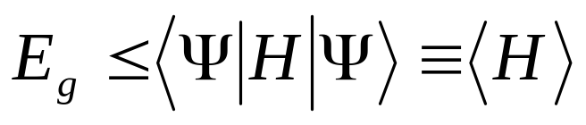

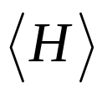
7.1 Theory
Theorem:
is any normalized function
That is, the expectation value of in the (presumably
in correct) state is certain to overestimate the ground-state
energy. Of course, if just happens to be one of the excited
states, then obviously exceeds .

Slide 4


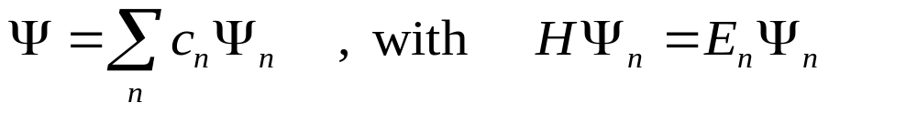
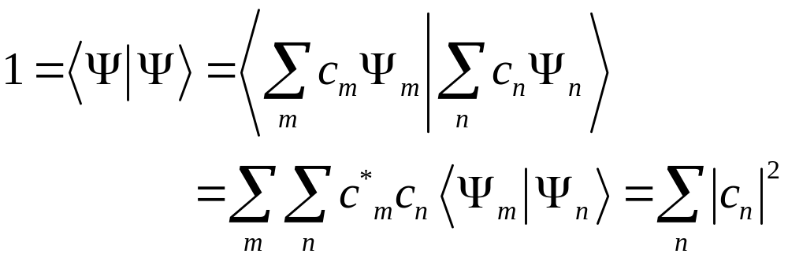
Proof
Since the (unknown) eigenfunctions of form a complete
set ,we can express as a linear combination of them:
And is normalized,

Slide 5
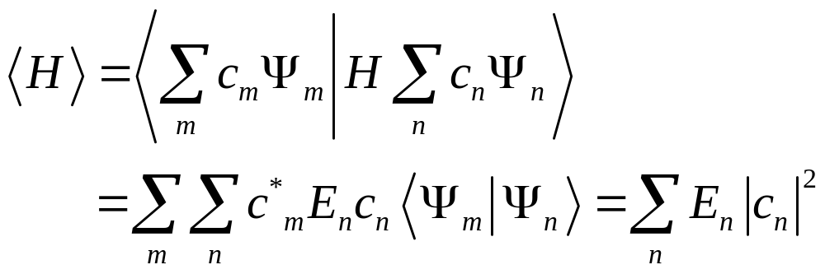
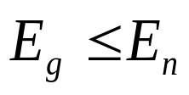
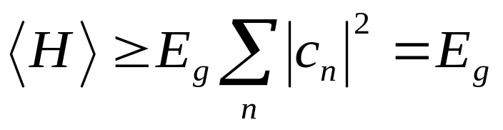
Meanwhile,
Since
,we get
Which is what we were trying to prove.

Slide 6

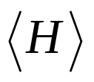

Examples
Aim
To find the ground-state energy
Processes
Step 1. Select a trial wave function
Step 2. Calculate in this state
Step 3. Minimize the
Step 4. Take as the appropriate ground-state energy

Slide 7
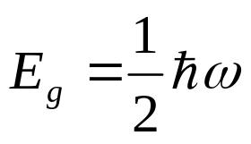
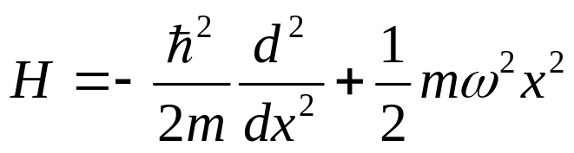
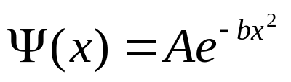


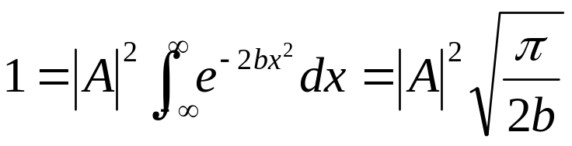
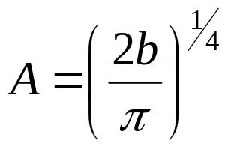
Of course, we already know the exact answer (see chapter 2):
Example 1.
To find the ground-state energy for the one-dimensional
harmonic oscillator:
Pick a Gaussian function as our trial state
where is a constant and is determined by normalization:

Slide 8
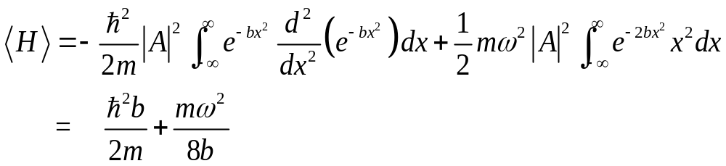

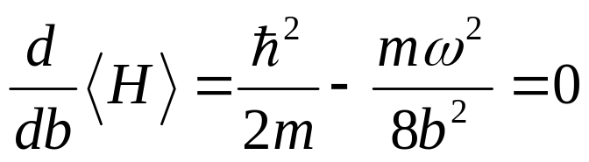
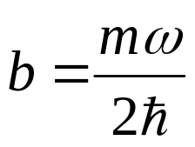
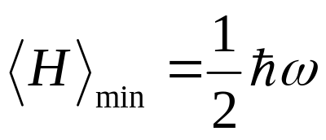
The mean value of is
We can get the tightest bound through minimizing with
respect to :
Putting this back into ,we find

Slide 9
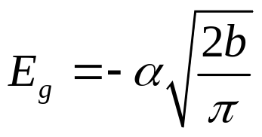
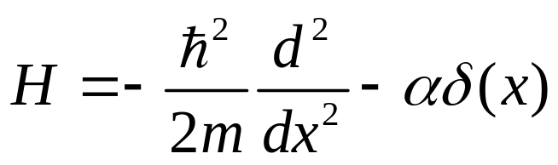
Again ,we already know the exact answer (see chapter 2):
Example 2.
To look for the ground state energy of the delta-function potential:
We also Pick a Gaussian function as our trial state:
The mean value of is

Slide 10
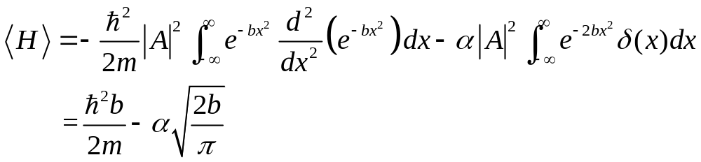
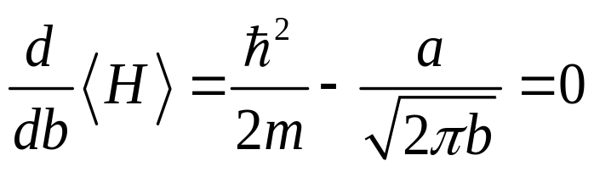
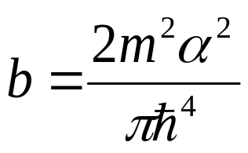
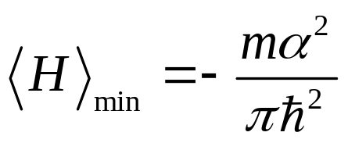


Minimizing it,
So
which is indeed somewhat higher than
,since

Slide 11





Example 3.
To find an upper bound on the ground-state energy of
the one-dimension infinite square well, using the “triangular”
trial wave function (figure 7.1):
Figure 7.1: “triangular” trial wave function
for the infinite square well

Slide 12

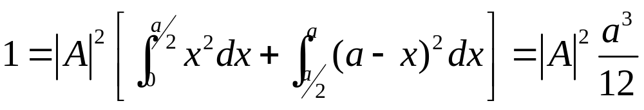
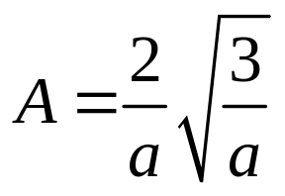

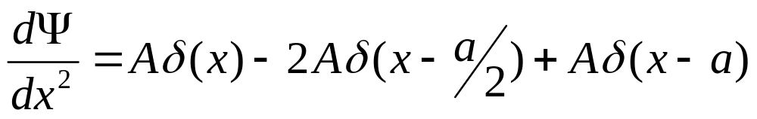
Where is determined by normalization:
In this case
The derivative of this step function is a delta function (see
problem 2.24b)

Slide 13
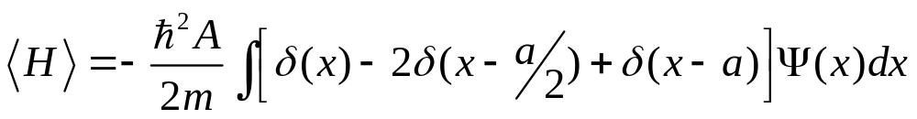
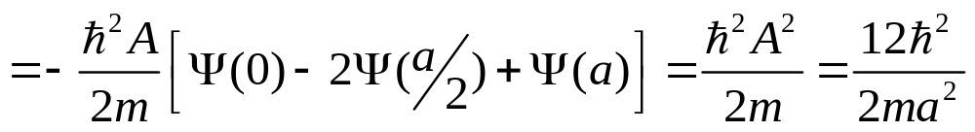
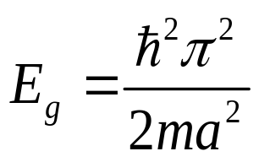

and hence
The exact ground state is ( see chapter 2), so
the theorem works ( )

Slide 14
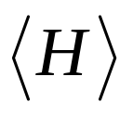


Conclusions
Advantages
The variational principle is very powerful and easy to use
write down a trial wave function
Calculate
tweak the parameters to get the lowest possible value
Even if has no relation to the true wave function, one
often gets miraculously accurate values for

Slide 15
Limitations
It applies only to the ground state
You never know for sure how close you are to the target
and all you can certain of is that you have got an upper
bound.

Slide 16
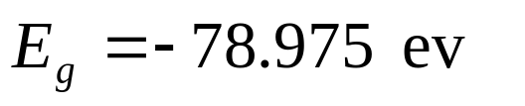
7.2 The ground state of helium
Our task:
To calculate the ground–state energy by using the
Variational Principle
Theoretically reproduce the value :
(experimental)

Slide 17
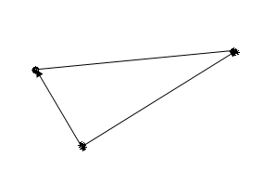
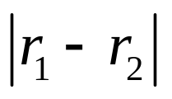



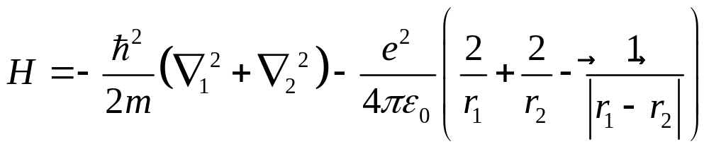
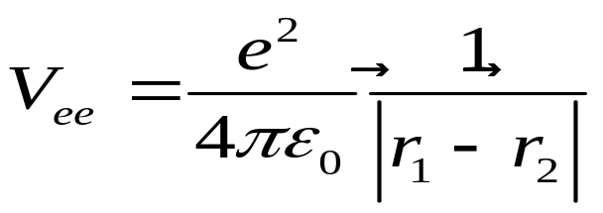
Figure 7.2:the helium atom
The Hamiltonian for the helium atom system (ignoring
fine structure and small correction) is
Let

Slide 18

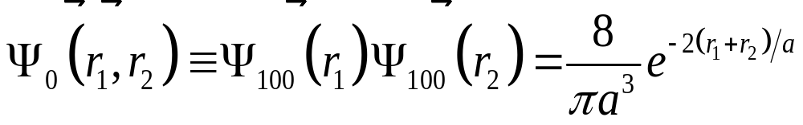




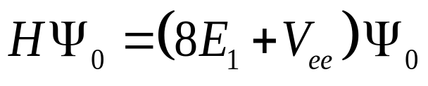
If we ignore the electron-electron repulsion is, the
ground-state wave function is just
where is hydrogen-like wave function with .
Consequently ,the energy that goes with this simplified
picture is (see Chapter 5 ).
In the following we will apply the variational principle ,
using the as the trial wave function. The eigenfunction of
Hamiltonian is:

Slide 19
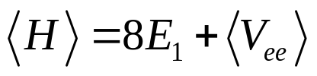
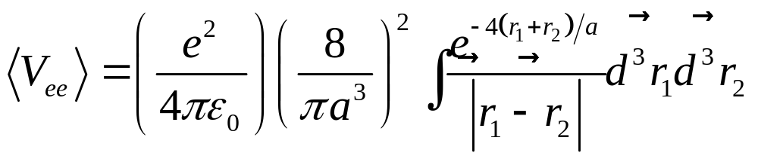


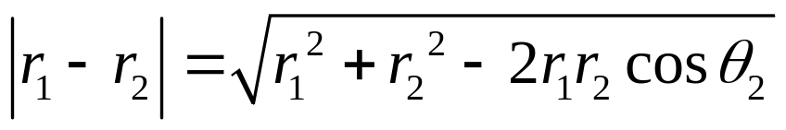
Thus
where
To get the above integral value conveniently, we do the
integral first and orient the coordinate system so that the
polar axis lies along (see Figure 7.3).
By the law of cosines,

Slide 20
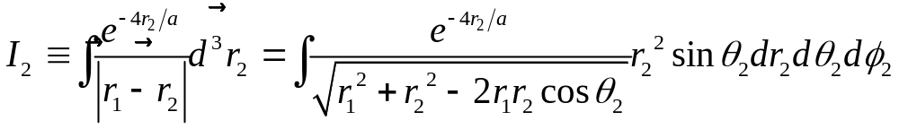
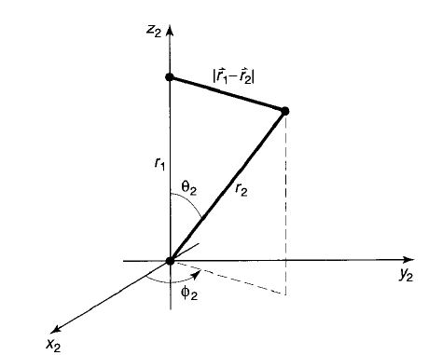



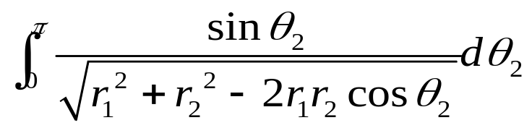
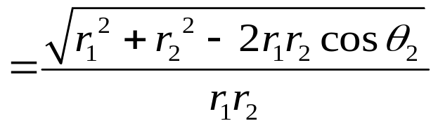
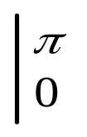

and hence
The integral is trivial
( );the integral is:
Figure 7.3: choice of coordinate for the integral

Slide 21
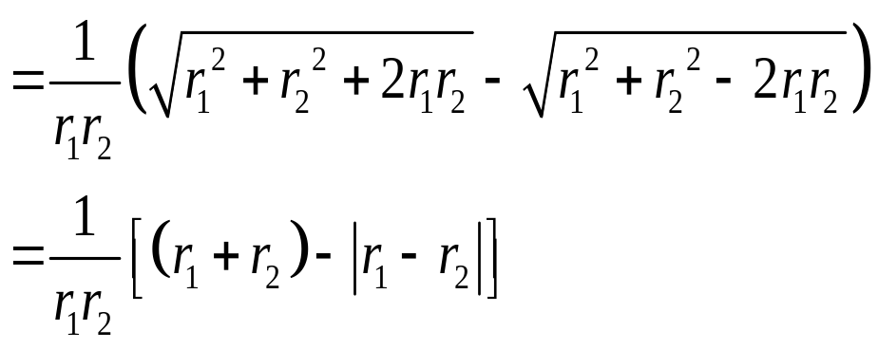
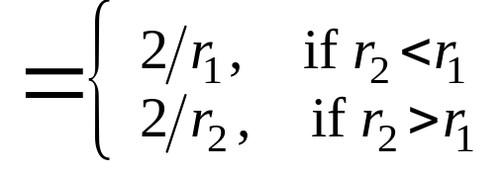
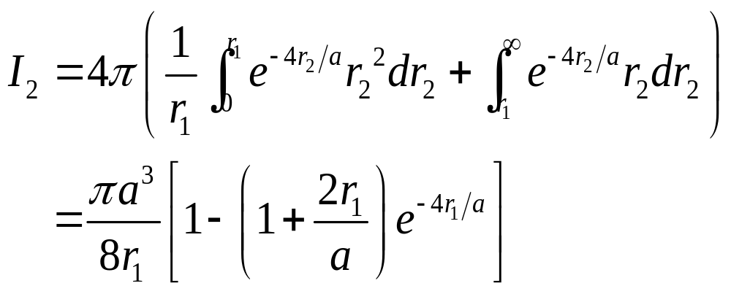
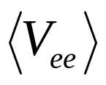
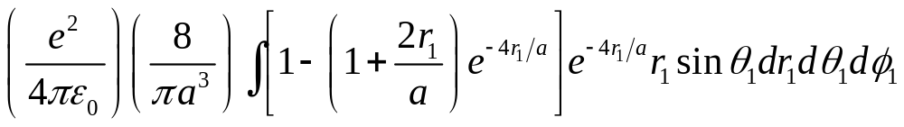
Thus
It follows that is equal to

Slide 22





The angular integals are easy( ),and the integal becomes
Finally , then,
And therefore
Not bad , but we can do better!

Slide 23

Can we think of a more realistic trial function
than
?

Slide 24


We try the product function
and treat Z as a variable rather than setting it equal to 2.
The idea is that as each electron shields the nuclear charge
seen by the other ,the effective Z is less than 2.
In the following, we will treat Z as a variational parameter,
picking the value that minimizes .

Slide 25





Rewrite in the following form:
The expectation value of is evidently
Here is the expectation value of in the (one-particle)
hydrogenic ground state (but with nuclear charge Z).

Slide 26






And according to Chapter 6, we know
The expection value of is the same as before ,except
that instead of ,we now want arbitrary Z—so we
multiply by :
Putting all this together, we find

Slide 27



The lowest upper bound occurs when is minimized:
from which it follows that
Putting in this value for Z, we find
Much nearer to experimental value!

Slide 28
The best theoretical results of helium:
Year | Authors | N | Energy | n
1928 | Hylleraas | 6 | -2.90324 | 4
1957 | Kinoshita | 39 | -2.9037225 | 6
1962 | Schwartz | 189 | -2.903724376 | 9
1986 | Freund et al. | 230 | -2.9037243770340 | 13
1998 | Goldman | 8066 | -2.903724377034119594 | 18
2002 | Drake et al. | 2358 | -2.903724377034119598305 | 20
2002 | Korobov | 5200 | -2.9037243770341195983111587 | 24
2006 | Schwartz | 24099 | -2.903724377034119598311159 245194404446696925309838 | 44
About 78.98ev

Slide 29
The best theoretical results of lithium
Year | Authors | N | Energy | n
1963 | Burke | 13 | -7.477 95 | 3
1968 | Larsson | 60 | -7.478 025 | 5
1986 | King et al. | 352 | -7.478 058 | 5
1991 | McKenzie and Drake | 1134 | -7.478 060 312 | 8
1995 | Yan and Drake | 1589 | -7.478 060 321 | 9
2008 | Yan et al. | 9557 | -7.478 060 323 892 | 10
2009 | Puchalski and Pachucki | 13944 | -7.478 060 323 909 5 | 11
2010 | Puchalski and Pachucki | 30632 | -7.478 060 323 910 097 | 13
2012 | Wang ,Yan, Qiao and Drake | 27720 | -7.4780603239101414 | 15

Slide 30









7.3 The hydrogen molecule ion
Figure 7.4 :the hydrogen molecule ion, .
The Hamiltonian for this system is

Slide 31


To construct the trial wave function , imagine that the ion is
formed by taking a hydrogen atom in its ground state
and then bringing in proton from far away and nailing it down a
distance R away. If R is substantially greatly than the Bohr radius
a, the electron’s wave function probably isn’t changed very much.
But we would like to treat the two protons equally ,so that the electron
has the same probability of being associated with either one. So we
consider a trial function of the form

Slide 32




Normalize this trial function:
Let
Picking coordinates so that the pronton 1 is at the origin and
proton 2 is on the z-axis at the point R (Figure 7.5),we have

Slide 33






and therefore
The integral is trivial ( ).
To do the integral ,let
so that
Figure 7.5: coordinates for the
calculation of I

Slide 34




Then
The integral is now straightforward:
Evaluating the integrals, we find

Slide 35







In the terms of , the normalization factor is
Next we must calculate the expectation value of in the
trial state . Noting that
Where is the ground-state energy of atomic
hydrogen and the same with in place of ,we have

Slide 36





It follows that
Calculate the two remaining quantities ,the so-called direct integral,
and the exchange integral,
The results are

Slide 37






Putting all this together, and recalling that
we conclude that
This is only the electron’s energy----there is also potential energy
associated with the proton-proton repulsion:
Thus the total energy of the system, in units of
and expressed as a function of ,is less than

Slide 38




Figure 7.6: plot of the function ,showing existence of
a bound state.
Evidently bonding does occur, for there exists a region in which the graph
goes below -1,indicating that the energy is less than that of a neutral atom plus
a free proton (to wit, ).The Equilibrium separation of the protons is
about 2.4 Bohr radii, or .

Slide 39








7.4 Basis expansion method
Complete basis set is given as:
Wave function can be expanded by the basis set:
Then:

Slide 40




7.5 Excited states
If we already get low states:
Can define an operator:
The trial wave function can be changed as:
The functional of energy:

