Slide 1
Chapter 5 Identical particle
5.1 Two-particle System 201
5.2 Atoms 210
5.3 Solids 218
5.4 Quantum Statistical Mechanics 230

Slide 2
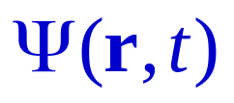
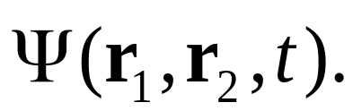
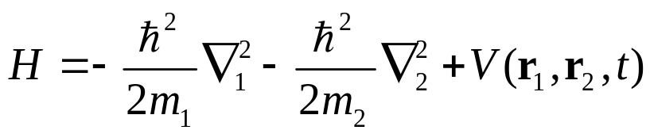
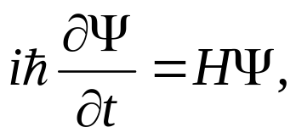
5.1 Two-particle Systems
For a single particle, is a function of the spatial coordinates r and the time t (here now we ignore the spin). The wave function for a two-particle system is a function of the coordinates of particle one (r1), the coordinates of par- -ticle two (r2), and the time:
The Hamiltonian for the whole system is:
Its time evolution is always determined by the SchrÖdinger
equation:

Slide 3
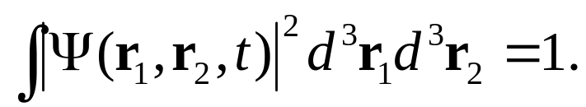
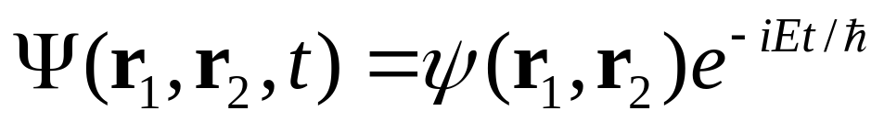
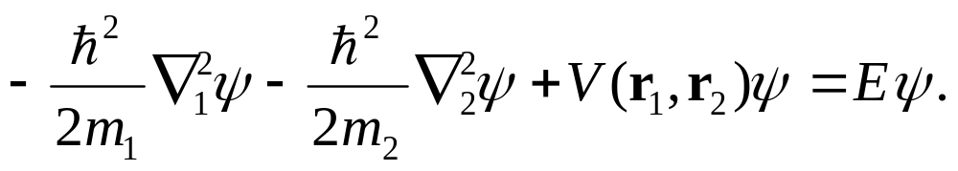
Normalization:
For time-independent potentials, we obtain a complete set of solutions by separation of variables:
The time-independent SchrÖdinger equation:

Slide 4
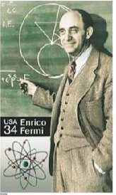
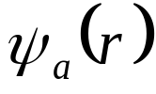
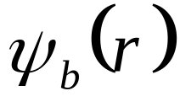
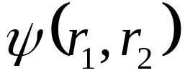
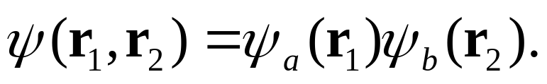
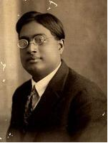
5.1.1 Bosons and Fermions
Suppose particle 1 is in the (single-particle) state
, and particle 2 is in the state . In that
case is a simple conduct:
Quantum mechanics neatly accommodates the
existence of particles that are indistinguishable
in principle: We simply construct a wave function
that is noncommittal as to which particle is in
which state. There are actually two ways to do it:
E. Fermi
+: Bosons; -:Fermions
S. N. Bose

Slide 5
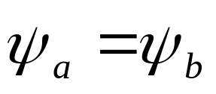
ones with integer spins are bosons (meson, photon)
ones with half-integer spins are fermions (proton, electron)
Further, bosons and fermions have quite different statistical
properties. The connection between spin and “statistics” can
be proved in relativistic quantum mechanics; in non-relativistic
theory it must be taken as an axiom.
if , then:
two identical fermions (for example, two electrons) cannot
occupy the same state, this is the famous Pauli Exclusion
Principle!

Slide 6

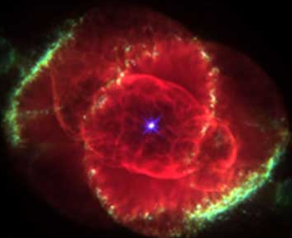


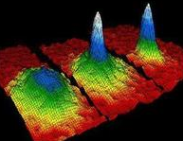
solid
plasma
gas
liquid
Bose-Einstein condensation
the fifth state of matter

Slide 7
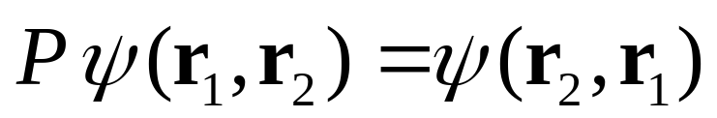
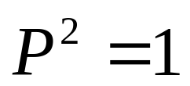
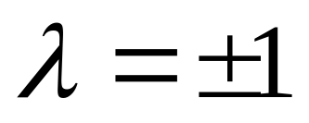
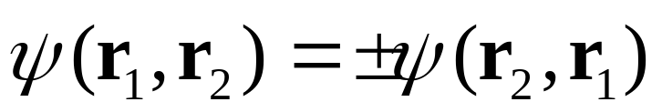
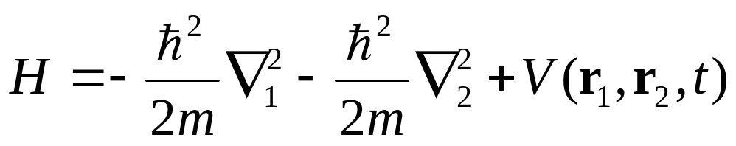
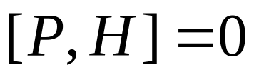
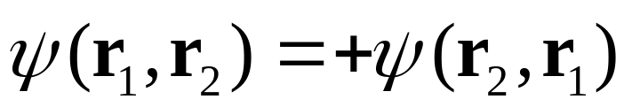
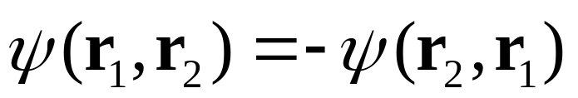
A more general formulation:
define the exchange operator, P:
For stationary states:
bosons
fermions

Slide 8
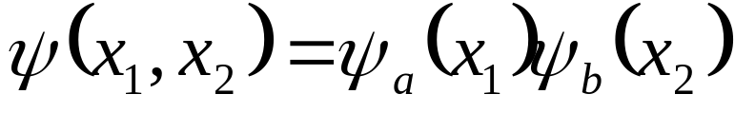
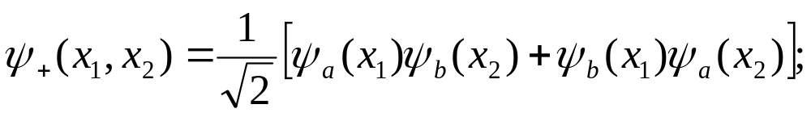
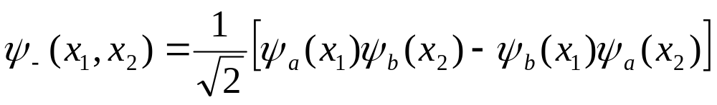
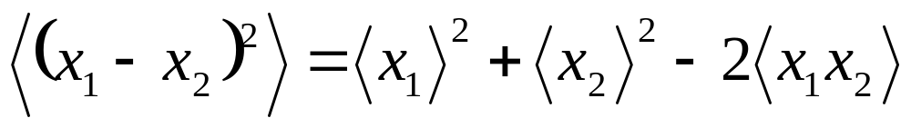
5.1.2 Exchange Forces
two distinguishable particles in one-dimensional motion:
two identical bosons:
two identical fermions:
How about the expectation value of the separation distance
between the two particles?

Slide 9
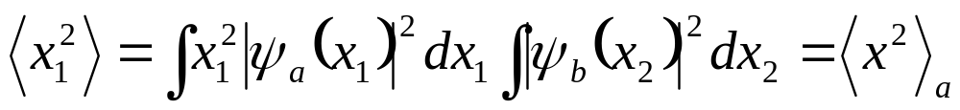
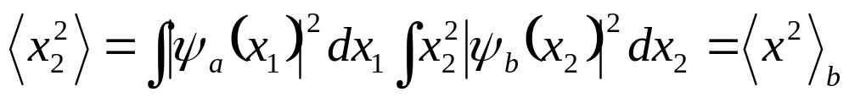
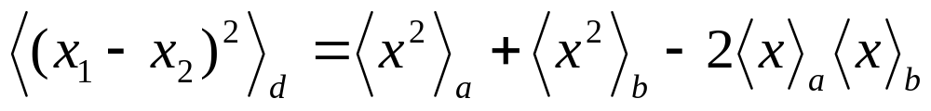
Case 1: distinguishable particles:

Slide 10
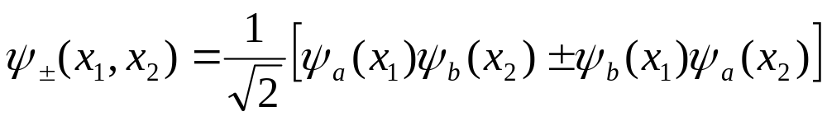
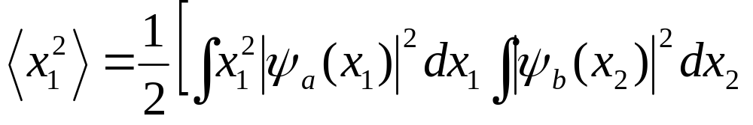
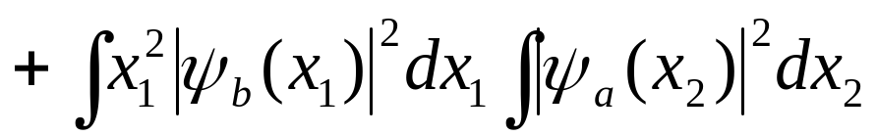
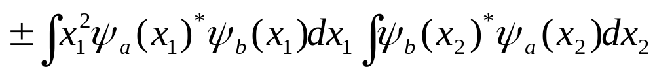
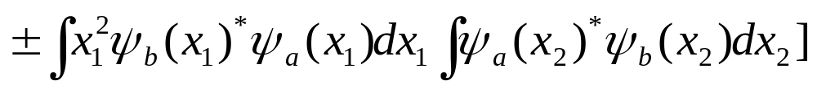
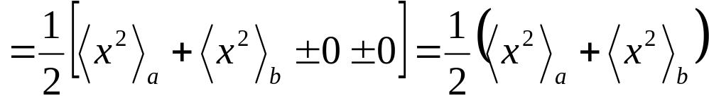
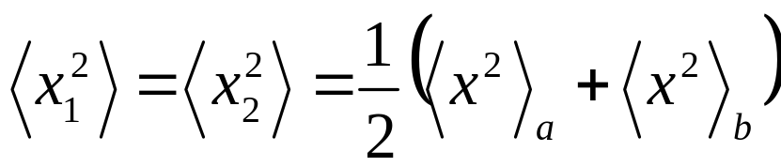
Case 2: Identical particles:
Similarly:

Slide 11
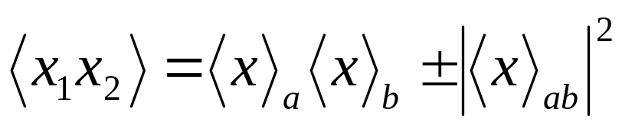
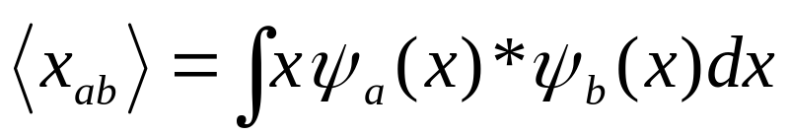
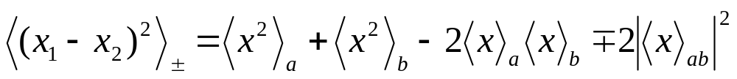
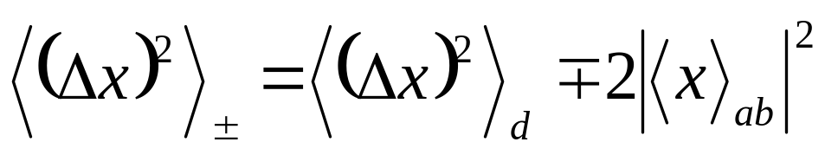
where
so:
Comparing the two cases, we have:
This is called exchange force

Slide 12
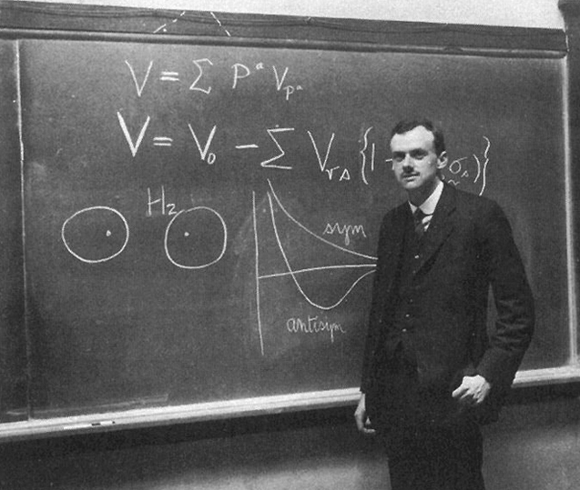
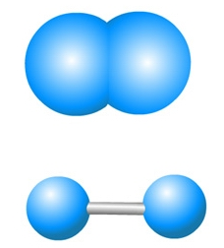
Covalent bonding requires
the singlet state!
P. A. M. Dirac,1928
Hydrogen molecule
The system behaves as though there were a “force of attraction” between identical bosons, pulling them closer together, and a “force of repulsion” between identical fermions, pushing them apart (remember that we are for the moment ignoring spin). We call it an exchange force, although it’s not really a force.

Slide 13
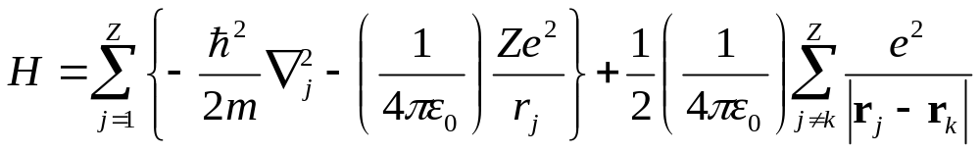
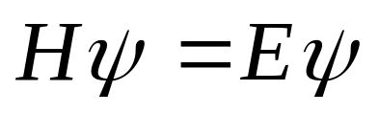
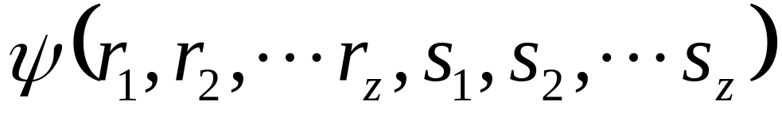
5.2 Atoms
A neutral atom, of atomic number Z, its Hamiltonian is:
kinetic
potential in nucleus
mutual repulsion
of electrons
SchrÖdinger equation:
Solution is antisymmetric with respect to interchange of any
two electrons, no two electrons can occupy the same state:

Slide 14
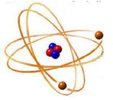
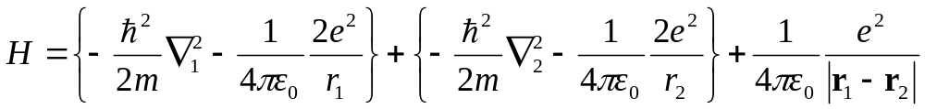
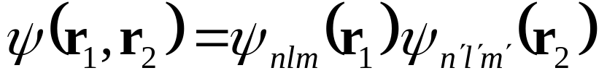



5.2.1 Helium
After hydrogen, the simplest atom is helium, the
Hamiltonian is:
If we simply ignore repulsion of two electrons, the solutions
can be written as products of hydrogen wave functions:
The total energy would be:

Slide 15


Then the ground state energy is:
The experimentally determined energy is 78.975eV
The other excited states are as: , there are not double
excited state for helium.
In this case, we can construct both symmetric and antisymmetric
combinations, in the usual way:
those go with antisymmetric spin configuration are parahelium,
ones go with symmetric spin configuration are orthohelium.

Slide 16

The parahelium energies
Are uniformly higher than
their orthohelium ones.
But why there is not 1S
triplet state?

Slide 17





5.2.2 The periodic table
orbital
ℓ=1 2 3 4 ….n-1
m=-ℓ - ℓ+1 …..ℓ

Slide 18

shell
subshell
magnetic
n=1 shell is called K
l=0 is called s (for “sharp”)
n=2 shell is called L
l=1 is called p (for “principle”)
n=3 shell is called M
l=2 is called d (for “diffuse”)
not listed
n=4 shell is called N
l=3 is called f (for “fundamental”)
l=4 is called g (out of imagination)
l=5 is called h
l=6 is called i
l=7 is called k
Total angular momentum number
Total spin momentum number
The total orbital angular momentum number

Slide 19






electronic configuration:
Pauli exclusion principle:
Hund’s Rules

Slide 20


Hund’s first rule: total spin S
Hund’s second rule: total orbital angular momentum L
Hund’s third rule: total momentum J
√
Х
F. Hund

Slide 21



Slide 22




5.3 Solids
In the solid state, outermost valence electron become detached, and roam throughout the material. Two primitive models:
(1) The electron gas theory:
(2) Bloch’s theory: Periodic potential

Slide 23



5.3.1 The Free Electron Gas Theory
Suppose the object in question is a rectangular solid, with dimensions l_{x}, l_{y}, l_{z}, and imagine that an electron inside experiences no forces at all, except at the impenetrable walls:
Sommerfeld
81 nominations
The Schrodinger equation:

Slide 24



Boundary condition:
Solution of wave function:
The total energy:
where k is the magnitude of the wave vector, k=(k_{x},k_{y},k_{z}).

Slide 25








If you imagine a three-dimensional space, with axes k_{x},k_{y},k_{z}, and planes drawn in at
(k_{x},k_{y},k_{z})
one stationary state
one state for every block
Each block in this grid, and hence each state, occupies a volume in k-space:
l_{z}
l_{x}
l_{y}

Slide 26






Suppose our sample contains N atoms, and each atom contributes q free electrons.
Avogadro's Constant = 6.0221415 × 10²³ mol⁻¹
q is small number: 1 or 2
If electrons were bosons ( or distinguishable particles), they would all settle down to the ground state, . But electrons are in fact identical fermions, subject to the Pauli exclusion principle, so only two of them can occupy any given state. They will fill up one octant of a sphere in k-space, whose radius, k_{F}, is determined by the fact that each pair of electrons requires a volume :
Volume of k-space:
Fermi surface
Volume of all electron require:
therefore:

Slide 27







where:
It is free electron density
The boundary separating occupied and unoccupied states, in k-space, is called the Fermi surface (hence the subscript F). The corresponding energy is called the Fermi energy, E_{F}; for a free electron gas:
Volume element in k-space:
Number of states in v-element:

Slide 28





the energy which each state carries is:
the energy in the volume element:
the total energy is:
defining quantum pressure P:
Degeneracy pressure
Pauli exclusion pressure
Electron-electron repulsion
Thermal motion

Slide 29



5.3.2 Band Structure
The periodic potential here determines the qualitative behavior of solids. Now we develop the simplest possible model: a one-dimensional Dirac comb, consisting of evenly spaced delta function spikes.
F. Bloch
(1). Theorem of periodic potential: Bloch theorem
A periodic potential is one that repeats itself after some fixed distance a:

Slide 30








Let D be the “displacement” operator:
then we are free to choose eigenfunctions of H that are simultaneously eigenfunctions of D:

Slide 31



(2). Band structure
no real solid satisfies the condition of periodic potential.
1
2
N-1
However, for large number of atoms containing in the solid, we can wrap the x-axis around a circle to meet the periodic condition and, finally, we impose the following boundary condition:
2
1
N

Slide 32



then:
Now, suppose the potential consists of a long string of delta-function spikes:

Slide 33




In region 0<x<a the potential is zero, so
where:
the generation solution:
According to Bloch’s theorem, the wave function in the cell immediately to the left of the origin is:
at x=0, there are two boundary condition, one is from Equation 2.125, the other one is continuity:

Slide 34







Slide 35





let:
The constant β is a dimensionless measure of the “strength” of the delta function.
all values of Ka are very close

Slide 36



Graph of f(z):
1st
2nd
band
band
gap
Graph of f(z) for β=10, showing allowed bands (shaded) separated by forbidden gaps (where |f(z)|>1).

Slide 37
(1) Electrons occupation of the band:
In practice there will be Nq of them, where q is again the number of “free” electrons per atom. Because of Pauli exclusion principle, only two electrons can occupy a given spatial state, so if q=1, they will half fill the first band, if q=2 they will completely fill the first band, if q=3 they half fill the second band, and so on——in the ground state.
(2) Conductors, insulators and semiconductors
Band structure is the signature of periodic potential.
If a band is entirely filled, it takes a relatively large energy to excite an electron, since it has to jump across the forbidden zone. Such materials will be electrical insulators. On the other hand, if a band is only partly filled, it takes very little energy to excite an electron, and such materials are typically conductors. If you dope an insulator with a few atoms of larger or smaller q, this puts some “extra” electrons into the next higher band, or creates some holes in the previously filled one, allowing in either case for weak electric currents to flow; such materials are called semiconductors.

Slide 38
5.4 Quantum Statistical Mechanics
(1).The fundamental assumption of statistical mechanics is that in thermal equilibrium every distinct state with the same total energy, E, is equally probable!!
(2).The temperature, T, is a measure of the total energy of a system in thermal equilibrium in classical mechanics. What is the new in quantum mechanics? How to count the distinct states!
Problem: If we have a large number of N particles, in thermal equilibrium at temperature T (total energy is E), what is the probability that a particle would be found to have the specific energy, E_{j}?

Slide 39



5.4.1 An example
Suppose we have just have three noninteracting particles, A, B, and C, (all of mass m) in the one-dimensional infinite square well. The total energy is:
where n_{A}, n_{B}, and n_{C} are positive integers. Now suppose, for the sake of argument, that total energy is , which is to say:
Then, there are 13 combinations of three positive integers.

Slide 40
Thus (n_{A},n_{B},n_{C} ) can be one of the following:
configuration | number | combinations
1st | 1 | (11,11,11)
2nd | 3 | (13,13,5),(13,5,13),(5,13,13)
3rd | 3 | (1,1,19),(19,1,1),(1,19,1)
4th | 6 | (5,7,17),(5,17,7),(7,5,17) (7,17,5),(17,5,7),(17,7,5)
For example, (n_{A},n_{B},n_{C} )=(5,7,17) means n_{A}=5, n_{B}=7, n_{C}=17, If the particles are distinguishable, the three-particle state is:

Slide 41

The most important quantity is the number of particles in each state---the occupation number, so there are 4 configurations:
(11,11,11)
(13,13,5)
(13,5,13)
(5,13,13)
(1,1,19)
(19,1,1)
(1,19,1)
(5,7,17)(5,17,7)
(7,5,17)(7,17,5)
(17,5,7)(17,7,5)
(1)
(3)
(3)
(6)

Slide 42







(1). Distinguishable particle
If the particles are distinguishable, each of these (n_{A},n_{B},n_{C} ) represents a distinct quantum state, and the fundamental assumption of statistical mechanics says that in thermal equilibrium they are all equally likely. Then what is the probability (P_{n})of getting a specific (allowed) energy E_{n} ？

Slide 43


(2). Identical fermions:
For fermions, no two particles are in the same state. This antisymmetrization requirement exclude the configurations where two particles are in the same state. Only the fourth configuration is available now!

Slide 44







(3). Identical bosons:
For bosons, each configuration enables one state, so

Slide 45
Discussion:
(1) This example shows that the nature of the particles determines the counting properties, or the statistical properties! The number of internal distinct states is different and the probability of getting specific energy is different too.
(2) This example gives a system of three particles. If the number of particles in huge, we can conclude: The distribution of individual particle energies, at equilibrium, is simply their distribution in the most probable configuration.

Slide 46



5.4.2 The General Case
Now consider an arbitrary potential, for which one particle energies are:
degeneracies is:
Suppose we put N particles (all with the same mass) into this potential; we are interested in the configuration
for which there are N₁ particles with energy E₁, N₂ particles with energy E₂, and so on.
Now we consider general question: how many distinct states correspond to this particular configuration?

Slide 47


The answer: The number of the distinct states Q(N₁,N₂,N₃,…) depends on whether the particles are distinguishable, identical fermions, or identical bosons.
(1). Distinguishable particles:
Choose N₁ from N for energy bin: the binomial coefficient, and then Arrangement of the N₁ particles within the bin on the degenerate d₁ states. Thus the number of ways to put N₁ particles, selected from a total population of N, into a bin containing d1 distinct option, is:
The same goes for energy bin E₂, of course, except that there are now only N-N₁ particles left to work with:

Slide 48



and so on, it follows:
(2). Identical fermions:
The particles are identical. The antisymmetrization requires that only one particle can occupy any given state, so:

Slide 49


(3). Identical bosons:
The particles are identical. Although the wave function of the N-particle state is symmetry, more than one particles can occupy the draws in certain bin.
Why?
Example: d_{n}=5, N_{n}=7

Slide 50


5.4.3 The Most Probable Configuration
In thermal equilibrium, every state with a given total energy E and a given particle number N is equally likely. So the most probable configuration (N₁, N₂, N₃, ……) is the one that particular configuration for which Q(N₁,N₂,N₃,……..) is a maximum, subject to the constraints:
The problem of maximizing a function F(x₁, x₂, x₃,……) of several variables, subject to the constraints f(x₁, x₂, x₃,……)=0, f(x₁, x₂, x₃,……)=0, etc., is most conveniently handled by the method of Lagrange multipliers. We introduce the new function:

Slide 51






and set all its derivatives equal to zero:
In our case it’s a little easier to work with the logarithm of Q, instead of Q itself. So we let
where α and β are the Lagrange multipliers. Then:

Slide 52





(1). Distinguishable particles:
Assuming the relevant occupation numbers (N_{n}) are large, we can invoke stirling’s approximation:
then:

Slide 53
Z=10 15.11 13.04
Z=100 364.0 360.8
Z=1000 5916 5912
Z=3000 21037 21033
.
.
.
.

Slide 54



It follows that:
The most probable occupation numbers, for distinguishable particles, are:

Slide 55




(2). Identical fermions:
Assume N_{n}>>1 and d_{n}>>N_{n}, so the stirling’s approximation applies:

Slide 56



so:
The most probable occupation numbers for identical fermions are:

Slide 57


(3). Identical bosons:
Similar reduction:
5.4.4 Physical significance of α and β
The parameters α and β came into the story as Lagrange multipliers, associated with the total number of particles and the total energy:

Slide 58


Mathematically, they are determined by substituting the most probable occupation numbers N_{n} back into the constraints.
α and β

Slide 59




Let’s using an example to do this: ideal gas
a large number of noninteracting particles, all with the same mass, in the three dimensional infinite square well, we know that the allowed energies of the particle are:
where
A shell of thickness dk contains a volume
Fermi surface
so the “degeneracy” is:

Slide 60








Slide 61










It is customary to replace α by the so-called chemical potential:

Slide 62






With the chemical potential, we can rewrite the most probable number of particles in an one-particle state with energy ε :
Maxwell-Boltzmann
Fermi-Dirac
Bose-Einstein

Slide 63






5.4.5 The Blackbody Spectrum
Photons are identical bosons with spin 1, but they are very special, because they are massless particles, and hence intrinsically relativistic. There are four properties belong to nonrelativistic quantum mechanics:
(1) Energy:
(2) Wave number:
(3) Spin: two spin states occur, ,but no zero.
(4) The number of the photons are not conserved, so

Slide 64





For free photons in a box of volume V, degeneracy is d_{k}, multiplied by 2 for two spin states, and expressed as:
So the energy density:
Plank’s formula for blackbody spectrum

