Slide 1
Chapter 6 Time-Independent
Perturbation Theory
6.1 Nondegenerate Perturbation Theory 249
6.2 Degenerate Perturbation Theory 257
6.3 The Fine Structure of Hydrogen 266
6.4 The Zeeman Effect 277
6.5 Hyperfine splitting 283

Slide 2
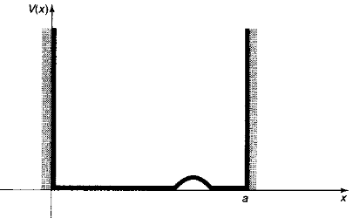
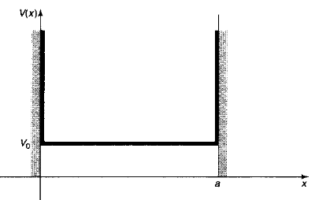
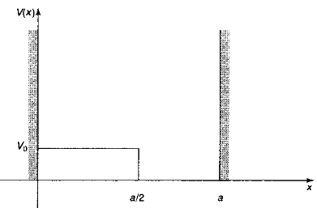
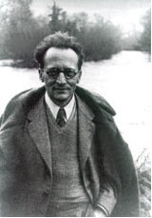
6.1 Nondegenerate Perturbation Theory
Erwin Schrodinger
For example: Infinite square well with small perturbation

Slide 3
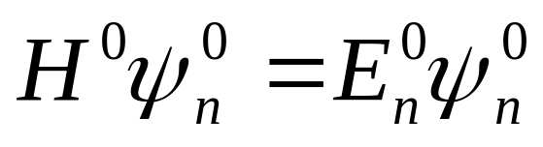
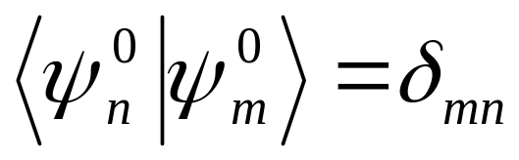

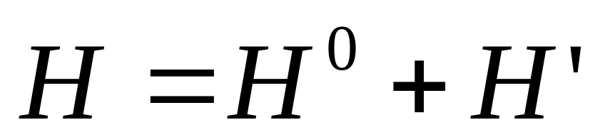
6.1.1 General Formulation
Time-independent schrÖdinger equation is solved:
Considering the perturbed case, we should solve for the new eigenvalues and eigenfunctions:
Additional Hamiltonian of the perturbed system
The Hamiltonian of the unperturbed system

Slide 4
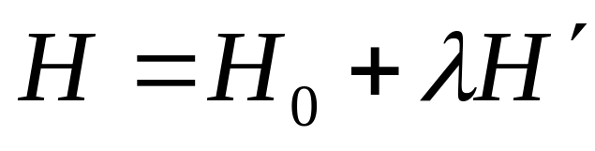
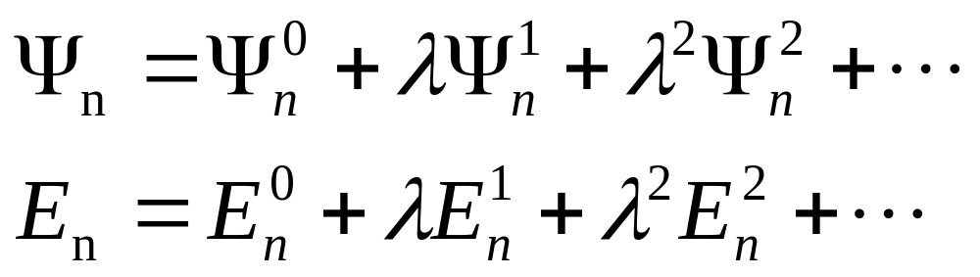
Rewrite the new Hamiltonian as the sum of two terms:
A small number ;later we will crank it up to1,and H will be the true, exact Hamiltonian
Write the nth eigenfunction and eigenvalue as power series in λ as follows:
The first-order correction
The second-order correction

Slide 5
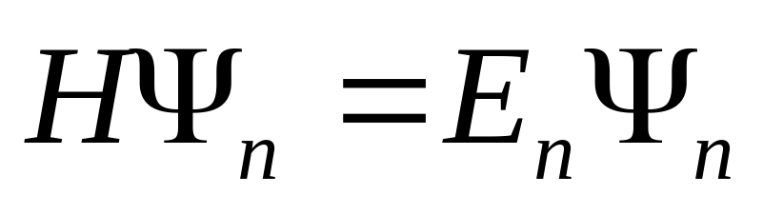
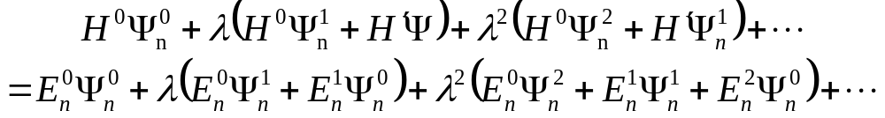
Plugging the above H,ψ_{n} and En into the time-independent equation and Collecting like powers of λ
The λ is a device to keep track of the different orders

Slide 6
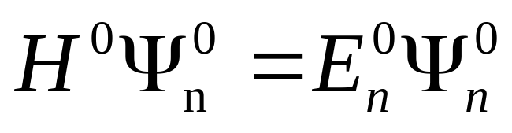
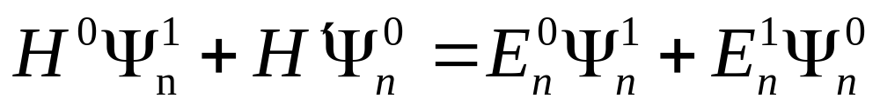
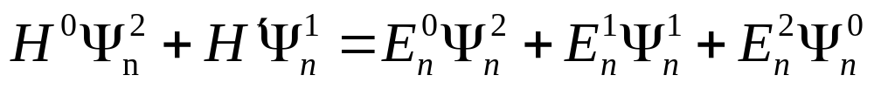
To lowest order:
To first order:
To second order：
And so on

Slide 7
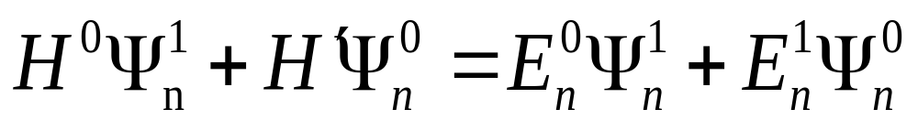
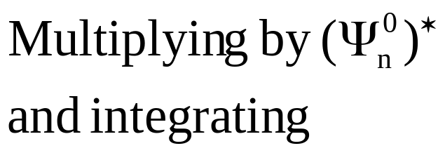
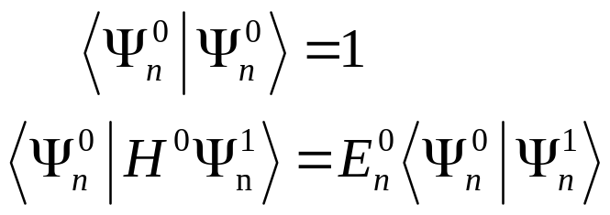
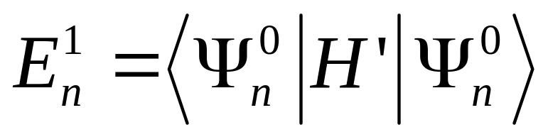
6.1.2 The first-order correction:
Results: The first-order correction to the energy is the expectation value of the perturbation in the unperturbed state.

Slide 8
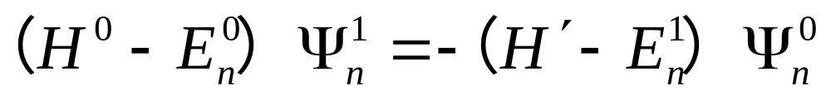
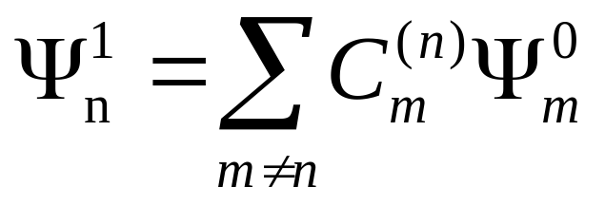
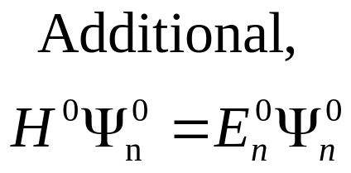
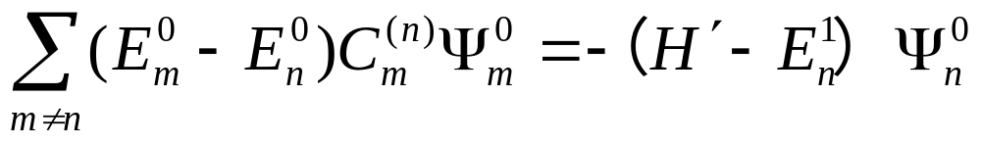
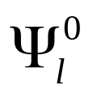
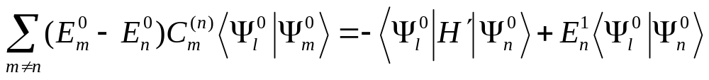
The first-order correction to the wave function:
Rewrite equation
The unperturbed wave functi-
ons constitute a complete set
Take the inner production by

Slide 9
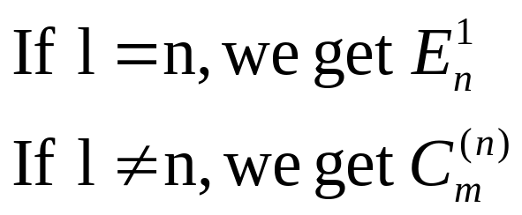
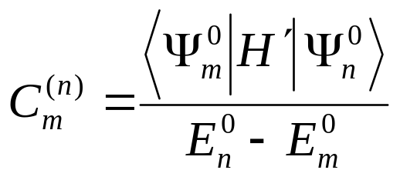
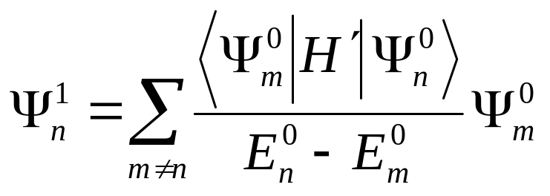
Notice: although perturbation theory often yields surprising by accurate energies, the wave functions are notoriously poor.

Slide 10
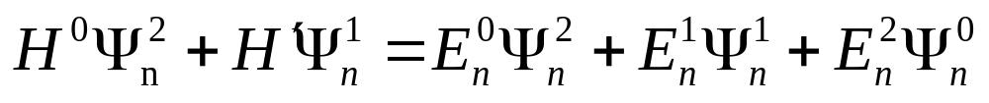

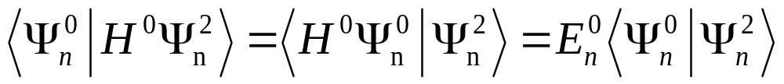
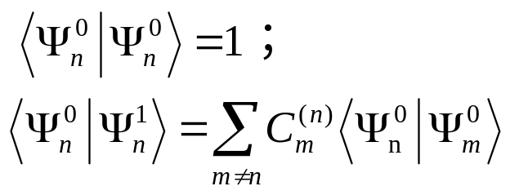
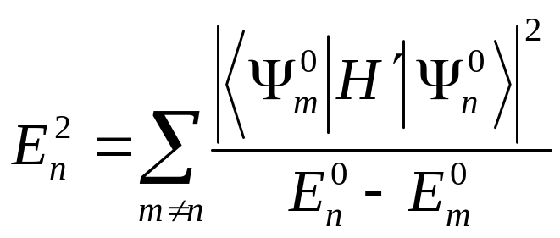
6.1.3 The second-order energies:

Slide 11
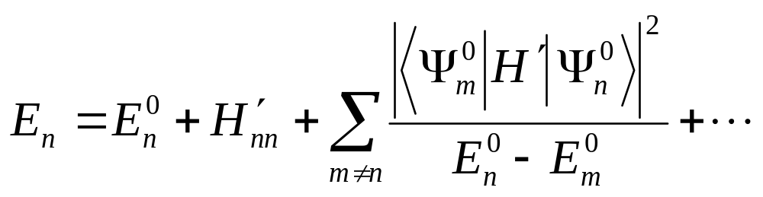
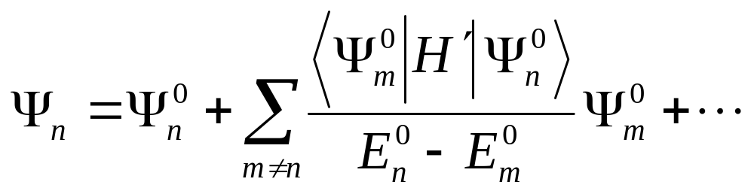
Correction to the eigenvalue:
Correction to the eigenfunction:

Slide 12
6.2 Degenerate Perturbation Theory:
In many cases, where two (or more) distinct states share the same energy, non-degenerate perturbation theory fail !
Sometimes, two energy levels exists so near that non-degenerate perturbation theory cannot give us a satisfied answer.
So, we must look for some other way to handle the problem.

Slide 13
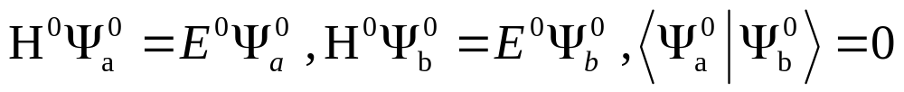
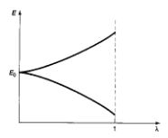
6.2.1 Two-Fold Degeneracy:
In order to see how the method generalizes, we begin with the twofold degeneracy, suppose that:
The perturbation will “break” the degeneracy
Non-degenerate perturbation theory fail!

Slide 14
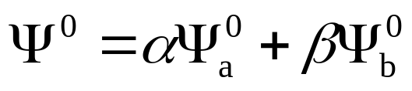
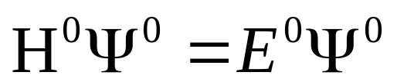
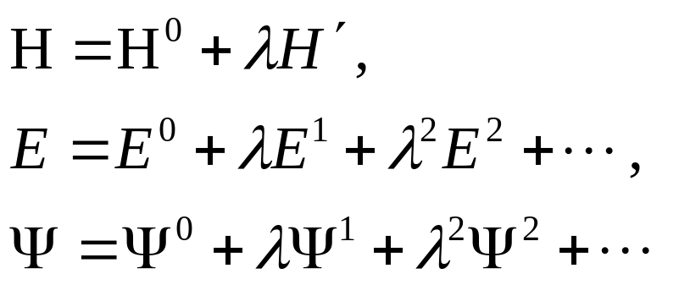
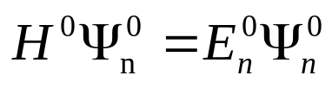
For any linear combination of the above states:
As before, we write H, E, ψ in the following form:
To lowest order:
To first order:

Slide 15

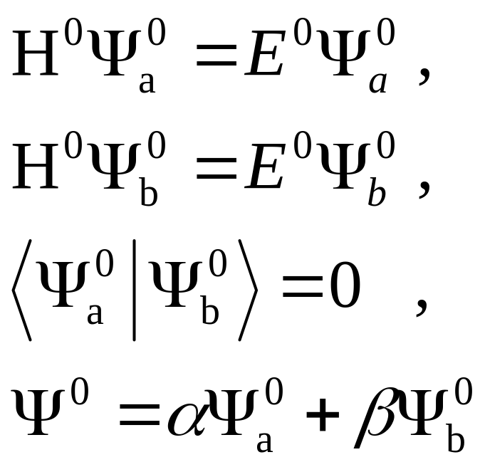
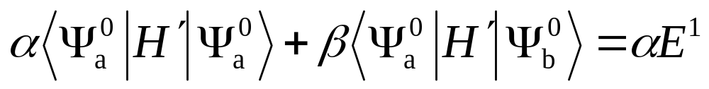
Meanwhile, H⁰ is Hermitian, the first term on the left cancels the first term on the right

Slide 16
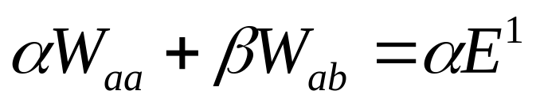
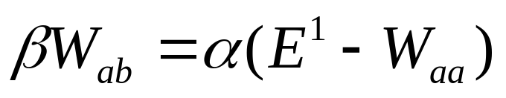
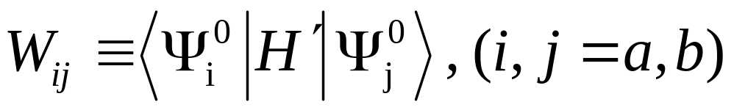
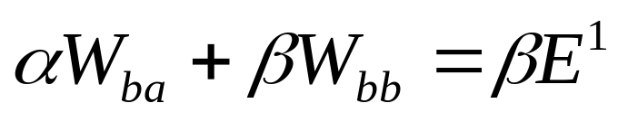
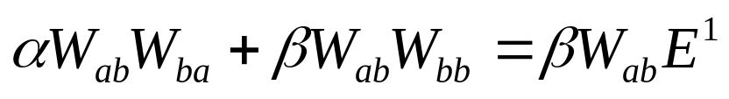
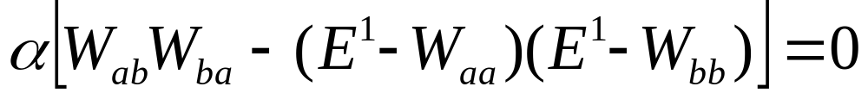
Then:
where:
Similarly:

Slide 17
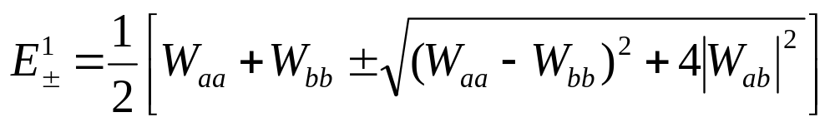
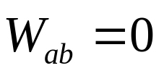
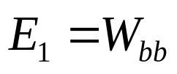
If the α is zero:
answer:

Slide 18
How should we do in practice?
Idea: It would be greatly to our advantage if we could somehow guess the “good” states right from the start.
Look around for some Hermitian operator A that commutes with H' ;
Pick as your unperturbed states ones that are simultaneously eigenfunctions of H⁰ and A ;
Use ordinary first-order perturbation theory.
If you can’t find such an operator, you’ll have to resort to Equation 6.27, but in practice this is seldom necessary

Slide 19


Theorem
Proof

Slide 20



6.2.2 High-Order Degeneracy:
Similarly:
Get a_{k} and E¹
If you can think of an operator A that commutes with H', and use the simultaneous eigenfunctions of A and H⁰, then the W matrix will automatically be diagonal, and you won’t have to fuss with solving the characteristic equation.

Slide 21

6.3 The Fine Structure of Hydrogen
The simplest Hamiltonian of the hydrogen
Correct for the motion of the nucleus
Replace m by the reduced mass
Relativistic correction
Fine structure
Spin-orbit coupling
Quantization of the Coulomb field
Lamb shift
The magnetic interaction between the dipole moments of the electron and the proton
Hyperfine structure

Slide 22


Slide 23


Hierarchy of correction to the Bohr energies of hydrogen:

Slide 24





6.3.1 The Relativistic Correction
Classical kinetic energy
Relativistic Kinetic energy
We need to Express T in terms of the relativistic momentum

Slide 25







In first-order perturbation theory, the correction to E_{n} is given by the expectation value of H' in the unperturbed state

Slide 26





In case of hydrogen:

Slide 27




6.3.2 Spin-Orbit Coupling:
The orbiting positive charge sets up a magnetic field B in the electron frame, which exerts a torque on the spinning electron, tending to align its magnetic moment (μ) along the direction of the field.

Slide 28








Slide 29





Slide 30


Slide 31


6.4 The Zeeman Effect
An atom placed in a uniform external magnetic field B_{ext}
orbital motion
electron spin
Depend on the strength of the external field in comparison with the internal field that gives rise to spin-orbit coupling
Weak-field
Intermediate
Strong-field
B_{ext}<<B_{int}
Comparable
B_{ext}<<B_{int}

Slide 32

6.4.1 Weak-Field Zeeman Effect
B_{ext}<<B_{int}
Fine structure dominates
H_{Z} as a small perturbation
Weak-field Zeeman splitting of the ground state; the upper line (m_{j}=1/2) has slope 1, the lower line (m_{i}=-1/2 ) has slope -1

Slide 33



The spin and orbital angular momenta are not conserved

Slide 34



The zeeman correction to the energy
?
The expectation value of S
In the presence of spin-orbit coupling, L and S are not separately conserved; they precess about the fixed total angular momentum, J.

Slide 35






The landé g-factor, g_{J}
Choose the z-axis to lie along B_{ext}
Bohr magneton

Slide 36

6.4.2 Strong-Field Zeeman Effect
B_{ext}>>B_{int}
The zeeman effect dominates
Fine structure as the perturbation
The splitting of spectrum

Slide 37





Proof!
Choose the z-axis to lie along B_{ext}
H'_{r} : The same as before
How about
=0?

Slide 38


6.4.3 Intermediate-field Zeeman Effect
Neither H'_{Z} nor H'_{fs} dominates
Treat them on an equal footing
As perturbation to Bohr Hamiltonian

Slide 39



My choice
Using the Clebsch-Gordan coefficients

Slide 40

Energy levels for the n=2 states of hydrogen, with fine structure and zeeman splitting

Slide 41

6.5 Hyperfine Splitting
The quark structure of the proton. There are two up quark in it and one down quark. The strong force is mediated by gluons (wavey). The strong force has three types of charges, the so called red, green and the blue.

Slide 42


magnetic field:
The proton itself constitutes a magnetic dipole, smaller than the electron’s
According to classical electrodynamics, a dipole μ sets up a magnetic field.
For a related discussion, see D. J. Griffiths, Am. J. Phys., 50, 698(1982).

Slide 43




The electron near proton
The Hamiltonian of the electron,due to the proton’s magnetic dipole moment
According to perturbation theory, we can get the first-order correction to the energy

Slide 44



For the ground state hydrogen
The wave function is spherically symmetrical
Spin-spin coupling

Slide 45





Spin-spin coupling
The individual spin angular moment are no longerconserved; the “good” states are eigenvectors of the total spin.
The electron and proton both have spin 1/2 .

Slide 46

Effect of spin-spin coupling
Hyperfine splitting in the ground state of hydrogen
Lifting the triplet configuration
Depressing the singlet configuration

Slide 47



The energy gap as a result of spin-spin coupling
The frequency of the photon emitted in a transition from the triplet to the singlet state
Fall in the microwave region
21-centimeter line
This famous “21-centimeter line” is among the most pervasive and ubiquitous forms of radiation in the universe.

