Slide 1
Chapter 12 Afterword
12.1 The EPR Paradox 421
12.2 Bell’s Theorem 423
12.3 The No-Clone Theorem 428
12.4 Schrodinger’s Cat 430
12.5 The Quantum Zeno Paradox 431

Slide 2
1. Did the physical system “actually have” the attribution prior to the measurement? Realist, quantum mechanics is incomplete?
2. Did the act of measurement itself “create” the property? Orthodox, collapse the wave function?
3. Refuse to answer? agnostic

Slide 3
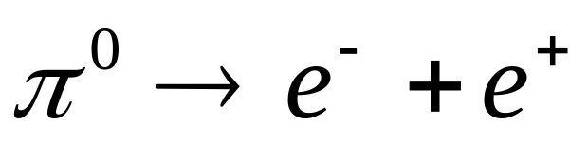
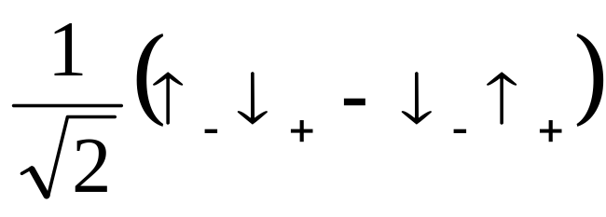
12.1 The EPR Paradox
π⁰
e⁻
e⁺
In 1935, Einstein, Podolsky, Rosen, EPR paradox
Locality: No influence can propagate faster than light.
Instantaneous?

Slide 4
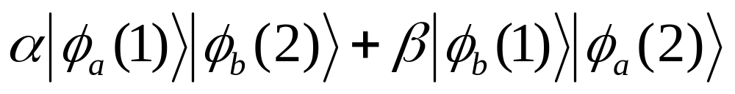
Entangled states: a two-particle can not be expressed as product of two one-particle states.

Slide 5
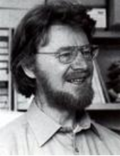
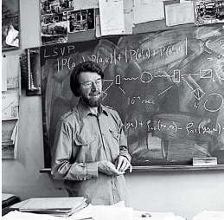
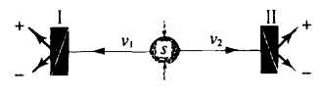

12.2 Bell’s Theorem
John Stewart Bell(1928-1990)
electron | positron | product
+1 | -1 | -1
+1 | +1 | +1
-1 | +1 | -1
+1 | -1 | -1
-1 | -1 | +1
… | … | …
Bell proposed to calculate the average value of the product of two particle’s spins in the direction of unit vector a and b, it is called P(a,b).Then:

Slide 6



For arbitrary orientations, quantum mechanics predicts:
(Problem 4.50)
Suppose that the “complete” state of the electron/positron system is characterized by the hidden variable(s) λ, then there exists some function A(a, λ) and B(b, λ) which give the results of electron and positron’s measurement. These functions can only take on the value of +1 or -1
If ρ(λ) is the probability density for hidden variable, then:

Slide 7

If c is any other unit vector:
since [A(b,λ)]²=1,
Bell inequality

Slide 8




12.3 The No-Clone Theorem
Wootters，Zurek and Dieks 1982
For a unitary operator U
then:

Slide 9
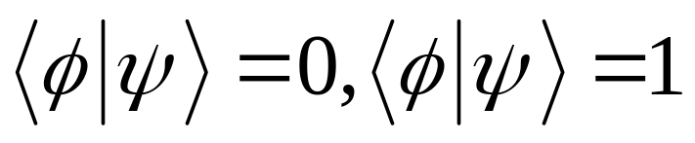
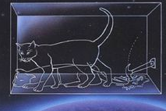
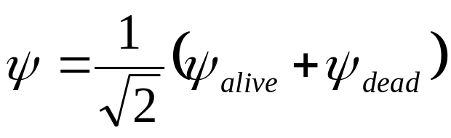
Quantum Xerox can copy vertical states and horizontal ones perfectly, but fail for diagonal.
12.4 Schrödinger Cat
what measurements you can make so that you can tell which mode S is in, without looking at the position of the switch?
Schrödinger, 1935

Slide 10

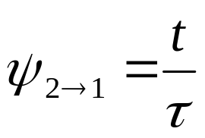
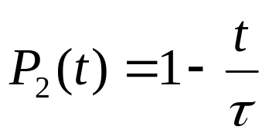
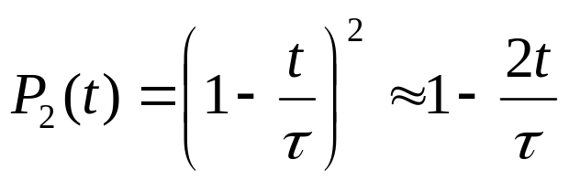
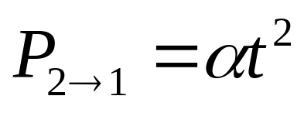
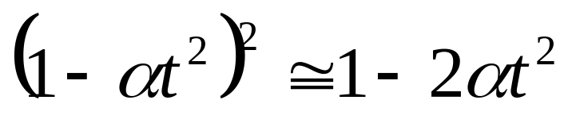
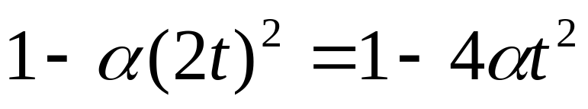
12.5 The Quantum Zeno Paradox
Specifically, suppose a system starts out in the excited state ψ_{2,}, which has a natural lifetime for transition to the ground state ψ₁. Ordinarily, for times substantially less than :
second measurement at 2t:
according to equation 9.39:
only one measurement at 2t:

Slide 11
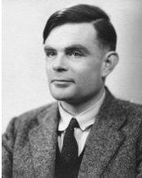
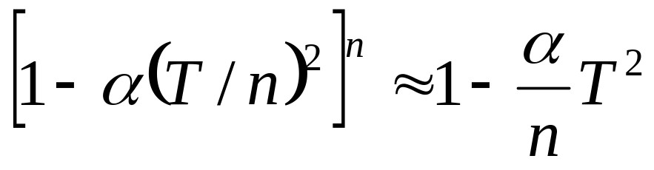
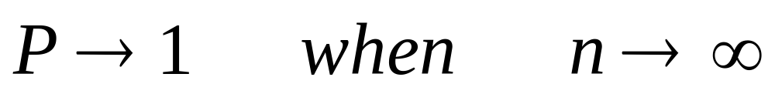
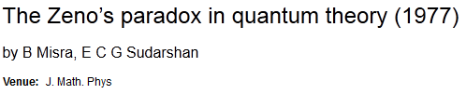
If we examine the system at n regular intervals, from t=0 out to t=T, the probability that the system is still in the upper state at the end is:
Alan Mathison Turing 1912-1954

Slide 12
State
Operator
Schrödinger Equation
Identical Particle
Perturbation theory
Variational theory
Time-dependent Perturbation
Scattering

Slide 13
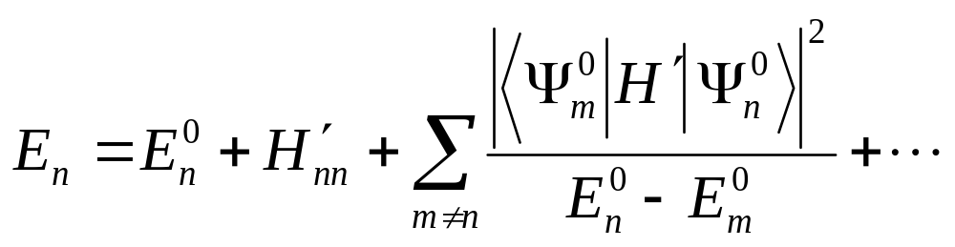
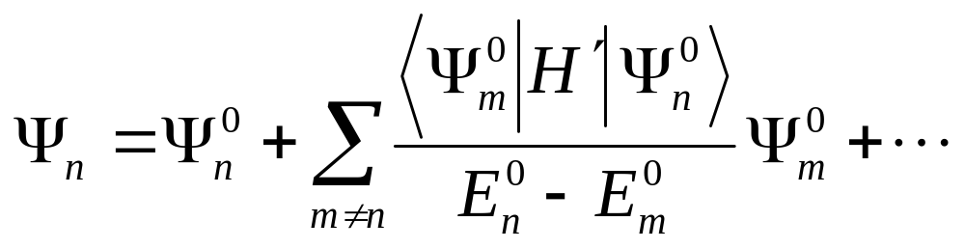
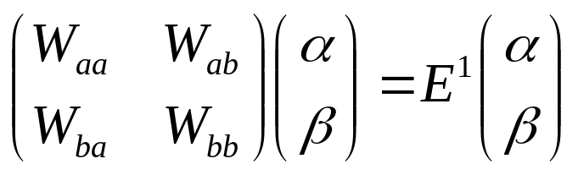

Slide 14
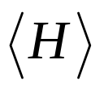

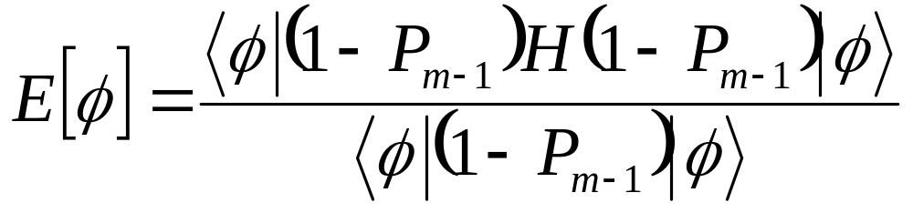
Step 1. Select a trial wave function
Step 2. Calculate in this state
Step 3. Minimize the
Step 4. Take as the appropriate ground-state energy

Slide 15
