Slide 1
Chapter 9 Time-Dependent Perturbation Theory
9.1 Two-level Systems 341
9.2 Emission and Absorption of Radiation 348
9.3 Spontaneous Emission 355

Slide 2
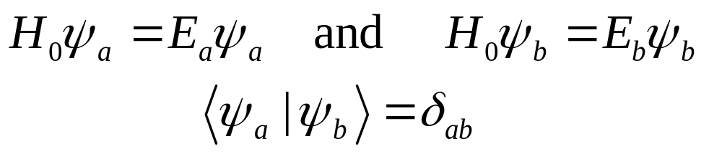
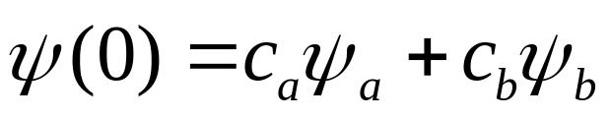
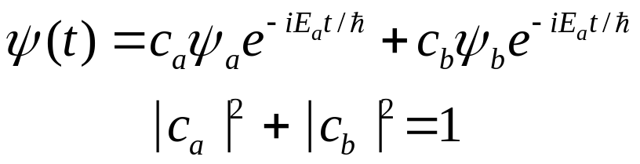
9.1 Two-level systems
Suppose that there are just two states of the system. They are eigenstates of the unperturbed Hamiltonian,and they are eigenstates orthonormal:
Any state can be expressed as a linear combination of them:
In the absence of any perturbation,each component evolves with its characteristic exponential factor at time t:

Slide 3
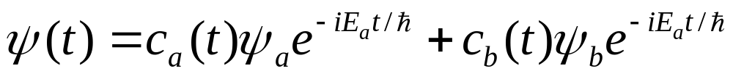
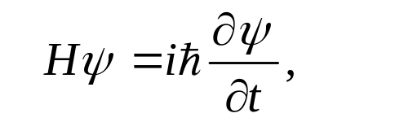
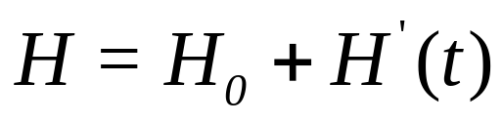
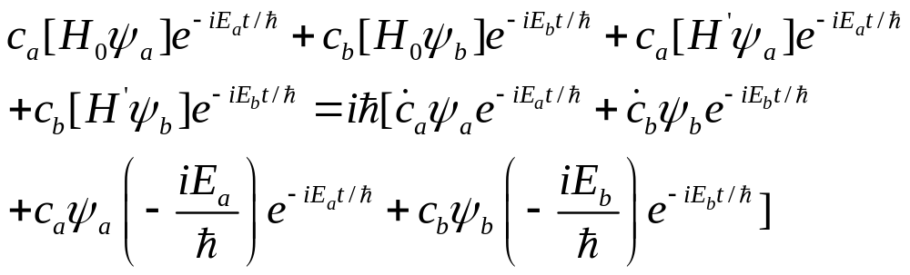
9.1.1 The perturbed system
Now suppose we turn on a time-dependent perturbation,
then the wave function can expressed as follows:
Where:
So, we find that:

Slide 4
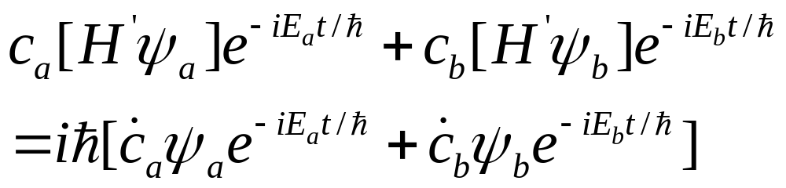
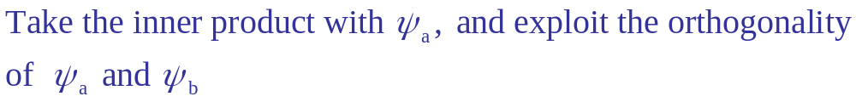
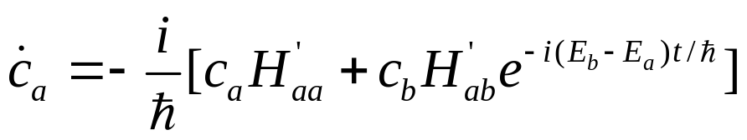
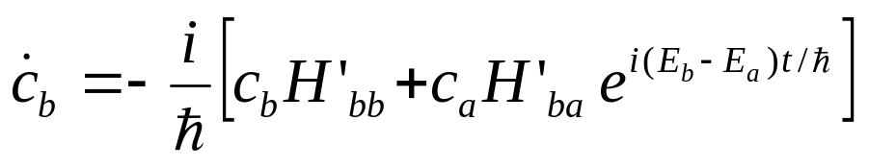
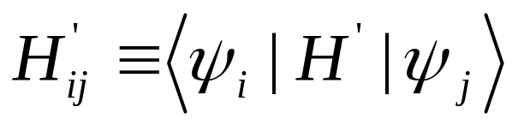
The first two terms on the left cancel the last two terms on the right, and hence
Where:

Slide 5
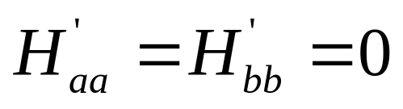
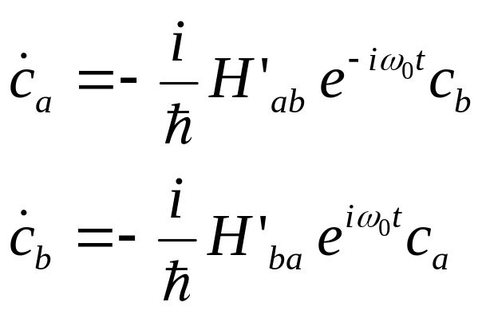
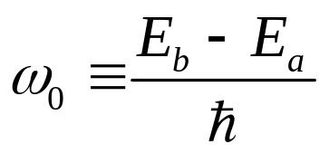

In that case the equations simplify:

Slide 6
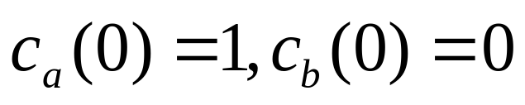
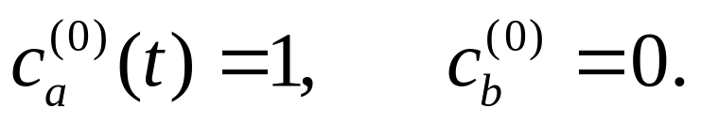
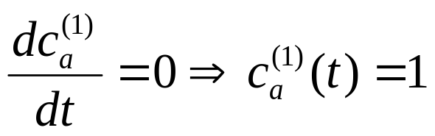
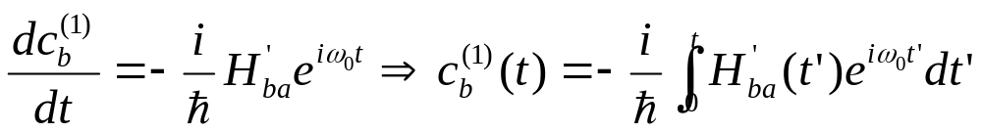
9.1.2 Time-Dependent Perturbation Theory
Suppose the particle starts out in the lower state:
Zeroth order:
First order:

Slide 7
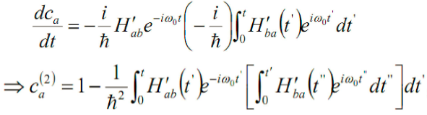
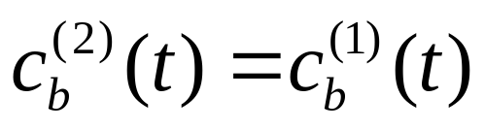
Second order:

Slide 8
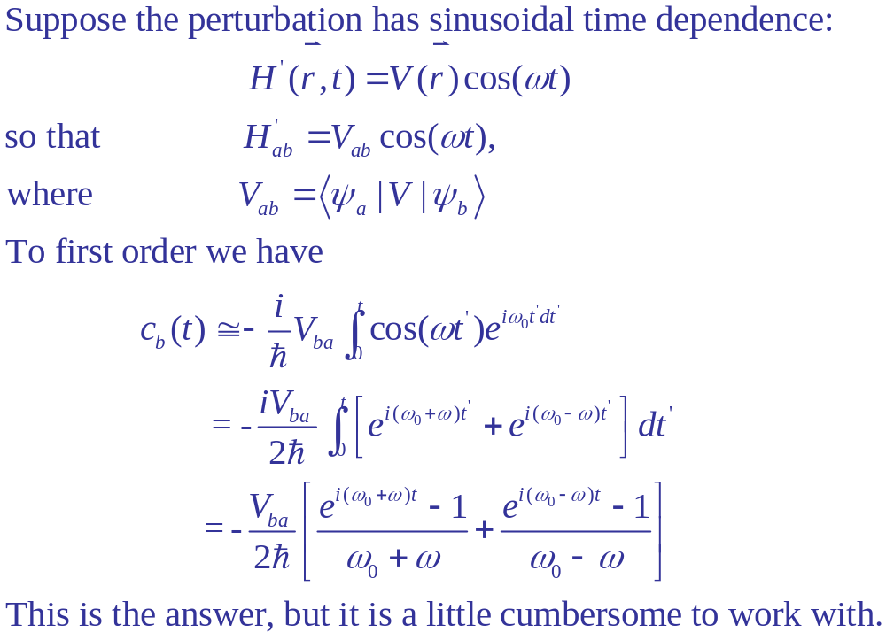
9.1.3 sinusoidal perturbations:

Slide 9
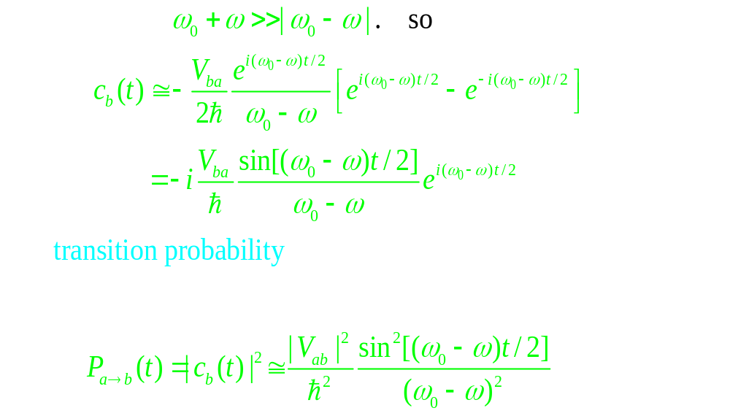

Slide 10
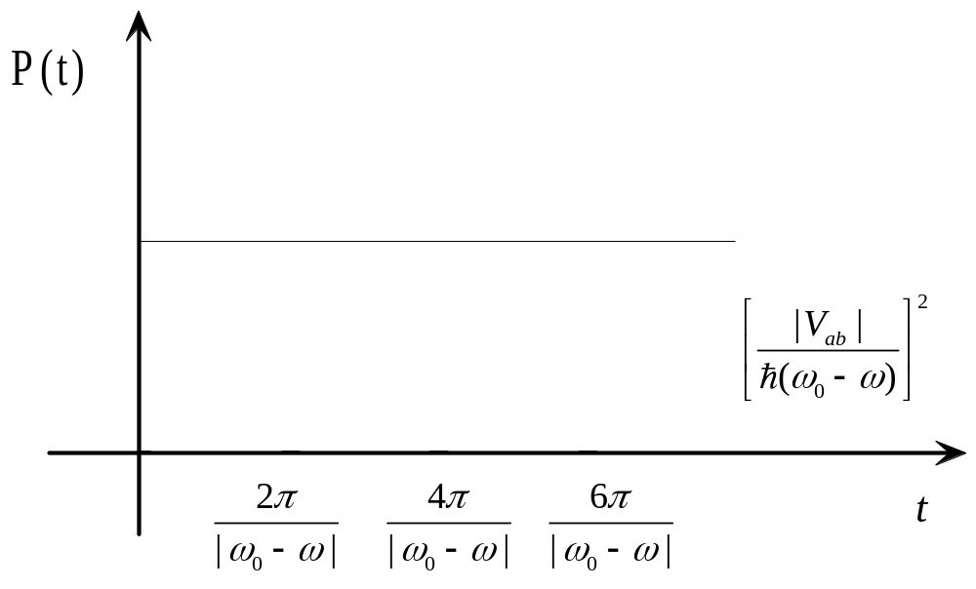
As a function of time, the transition probability oscillates sinusoidally:

Slide 11
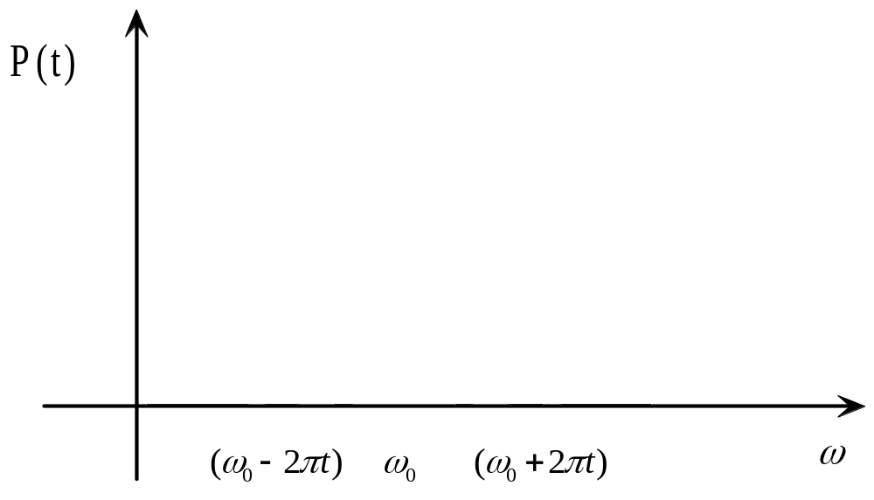
The probability of a transition is greatest when the driving frequency is close to the “natural” frequency:

Slide 12
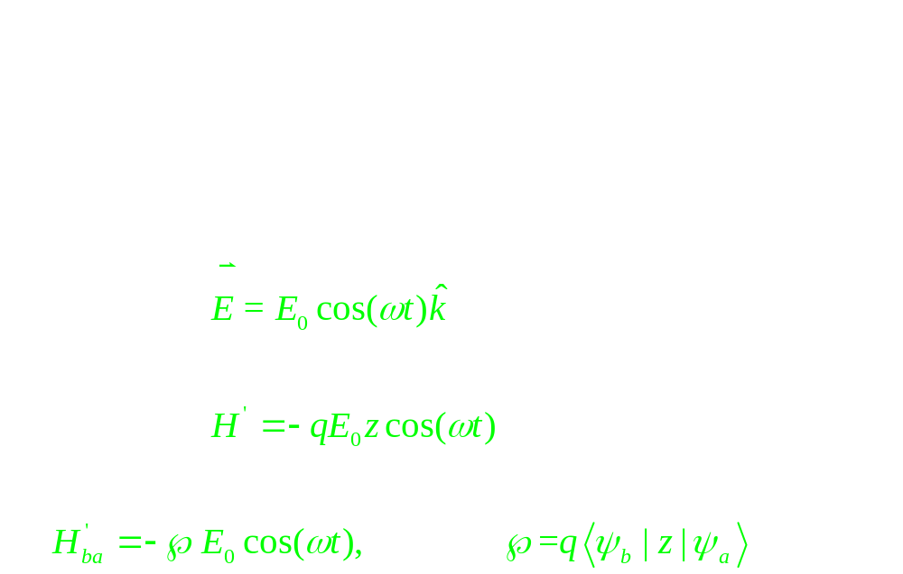
9.2 Emission and absorption of radiation

Slide 13
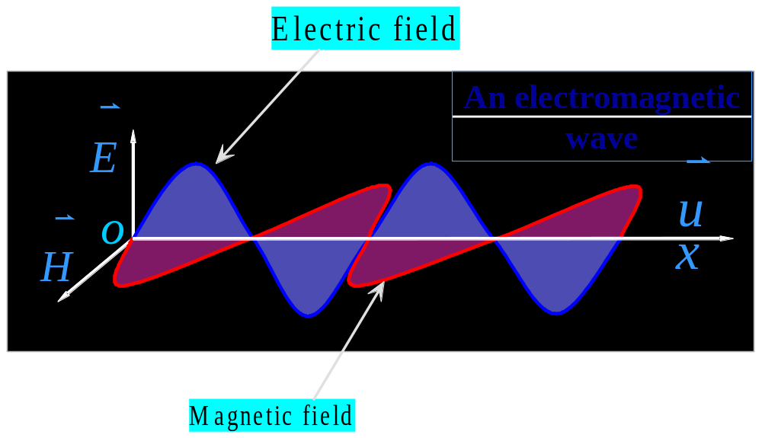
An electromagnetic wave consists of transverse oscillating electric and magnetic fields.

Slide 14
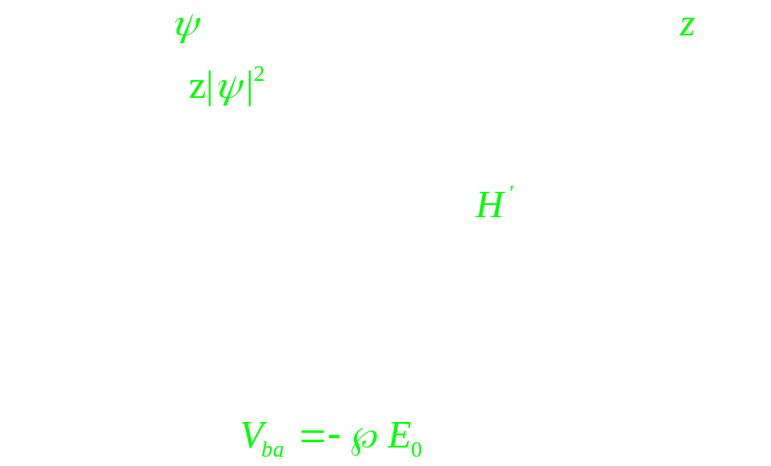

Slide 15
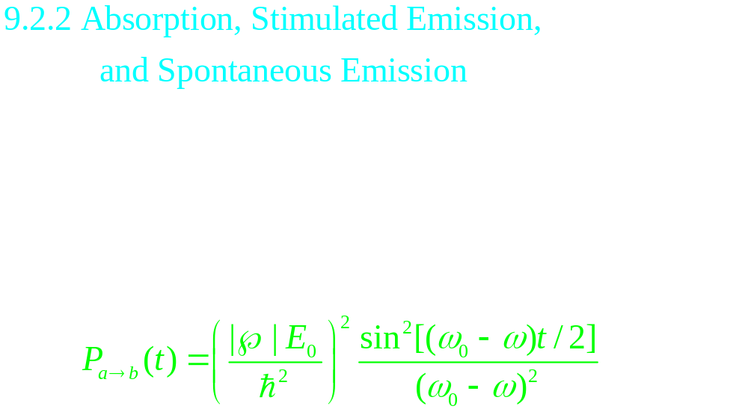
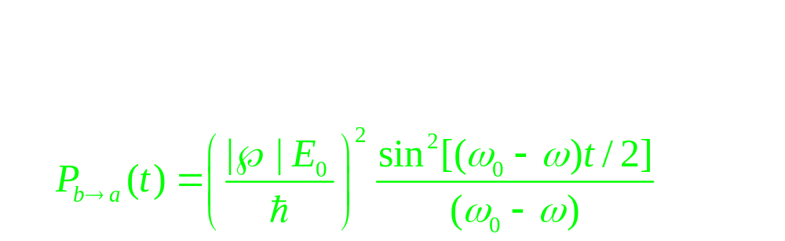

Slide 16
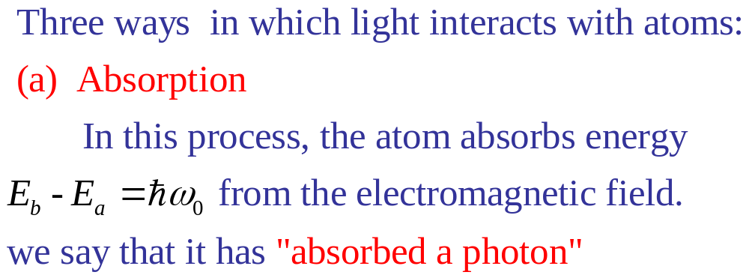
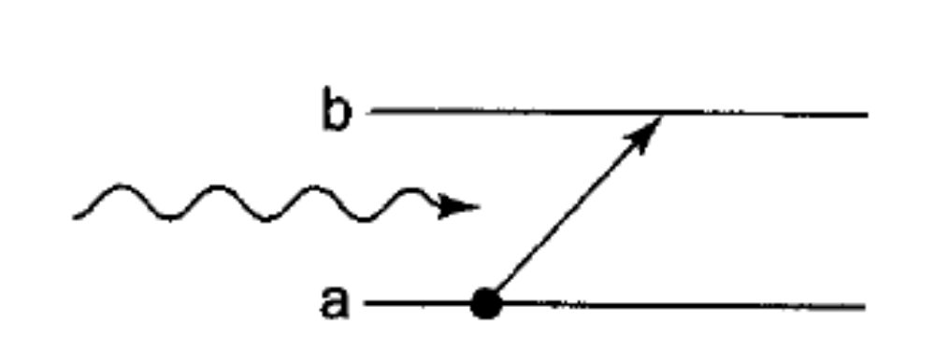

Slide 17
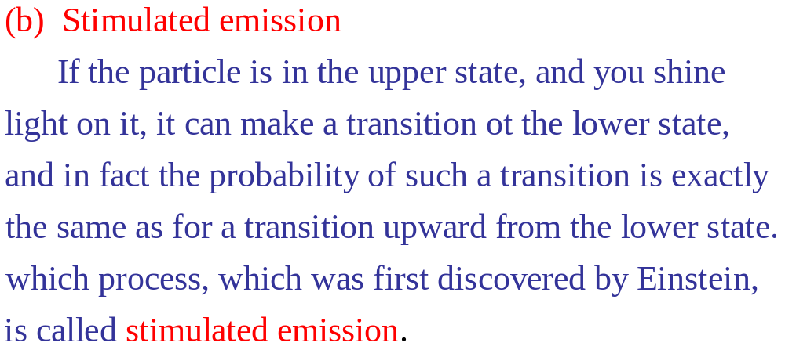
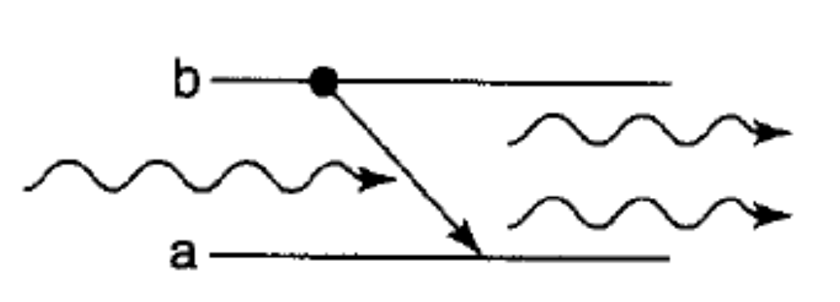

Slide 18
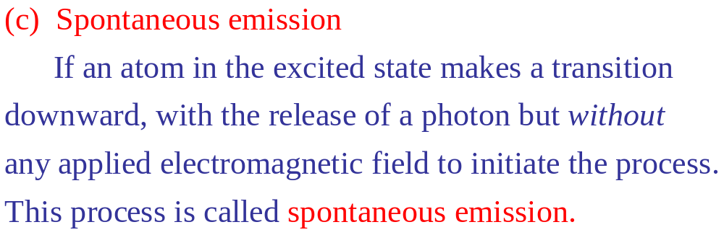
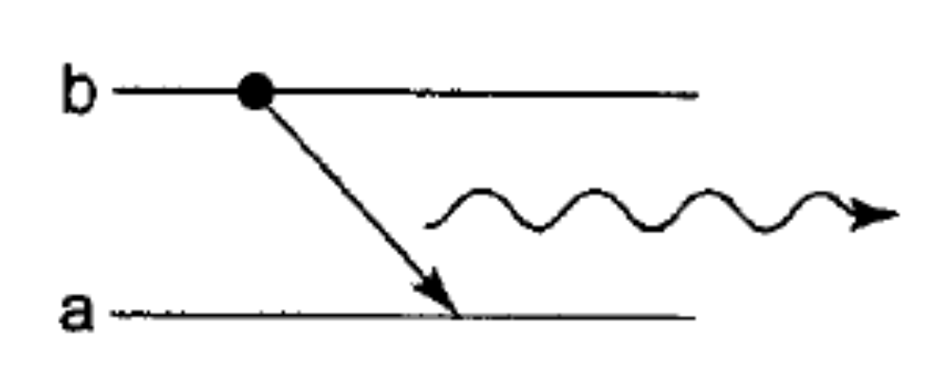

Slide 19
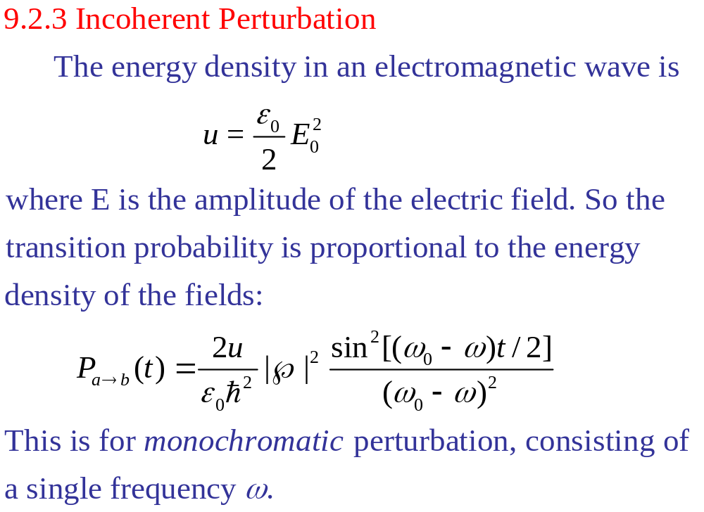

Slide 20
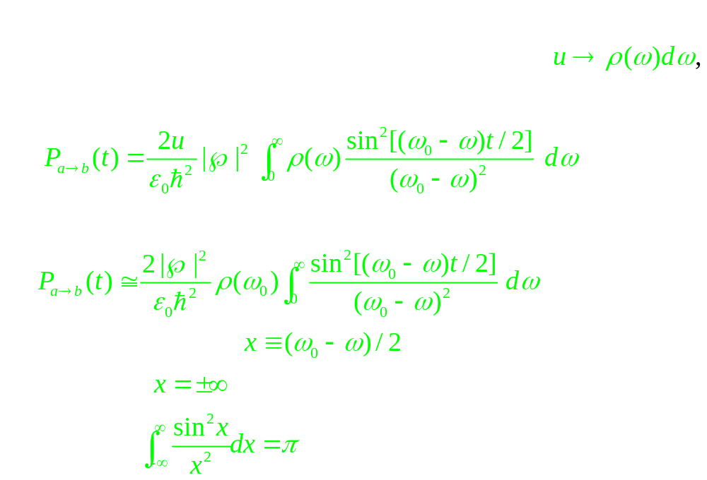

Slide 21
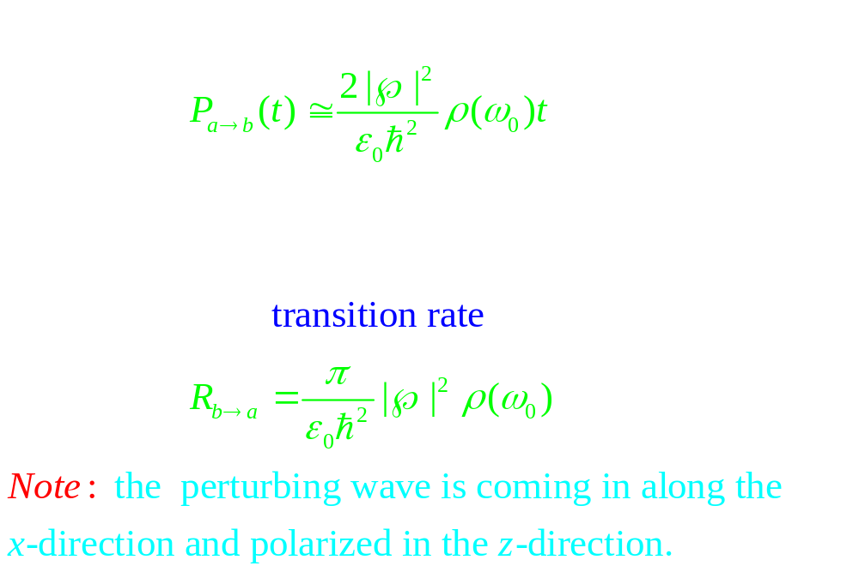

Slide 22
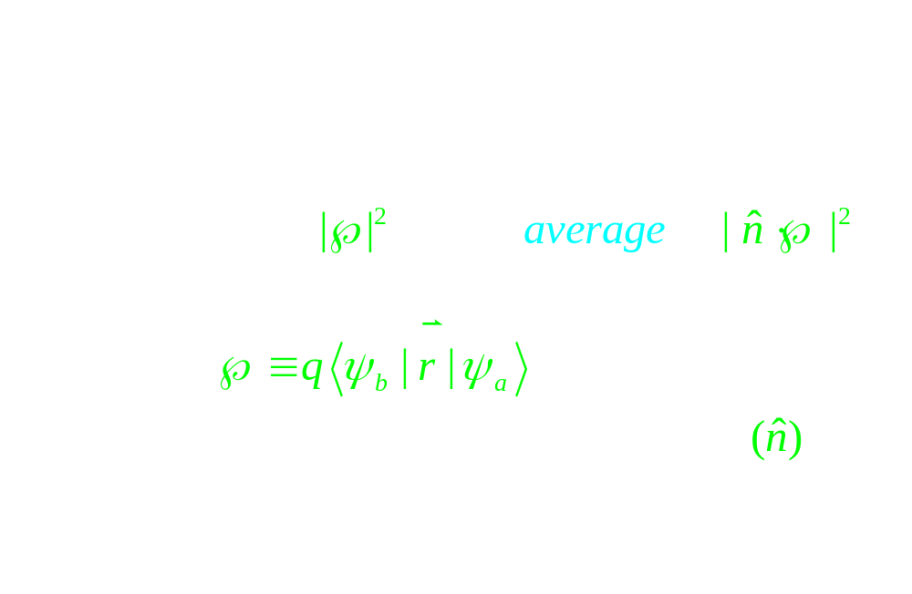

Slide 23
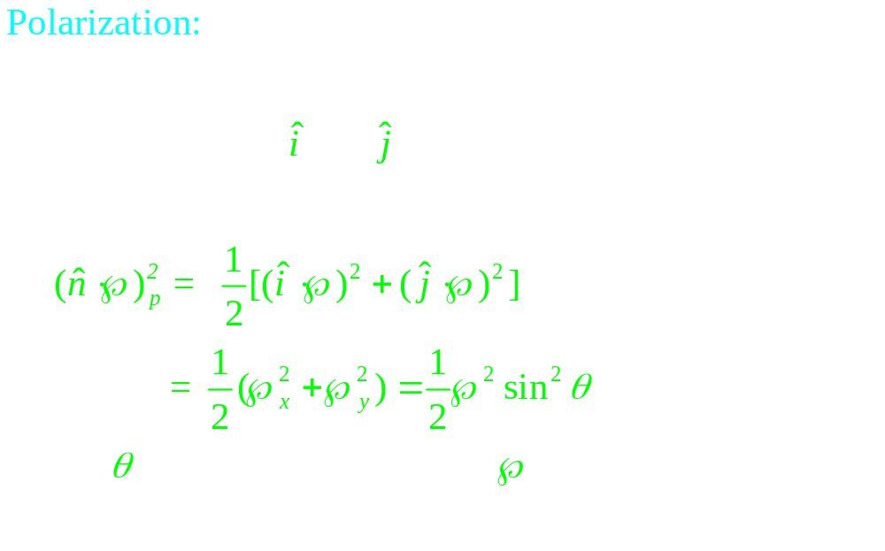

Slide 24
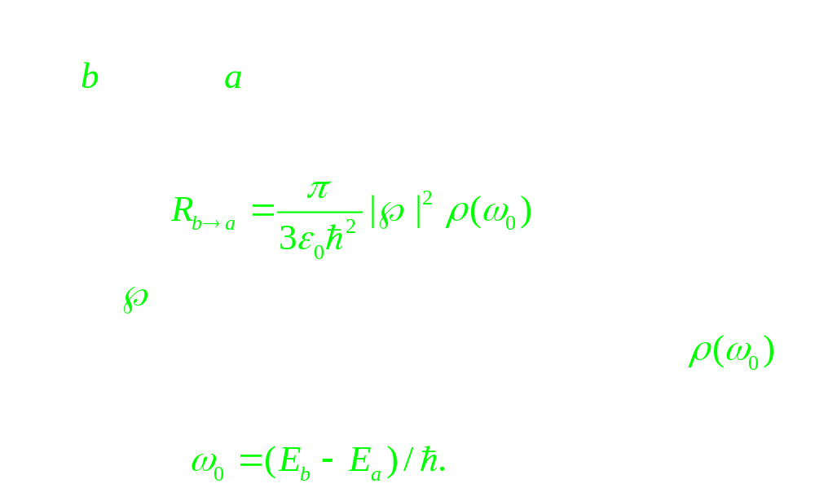

Slide 25
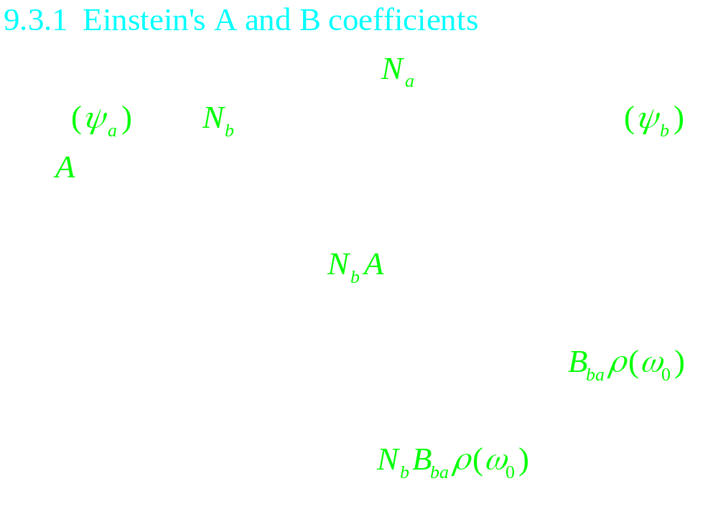
9.3 Spontaneous emission

Slide 26
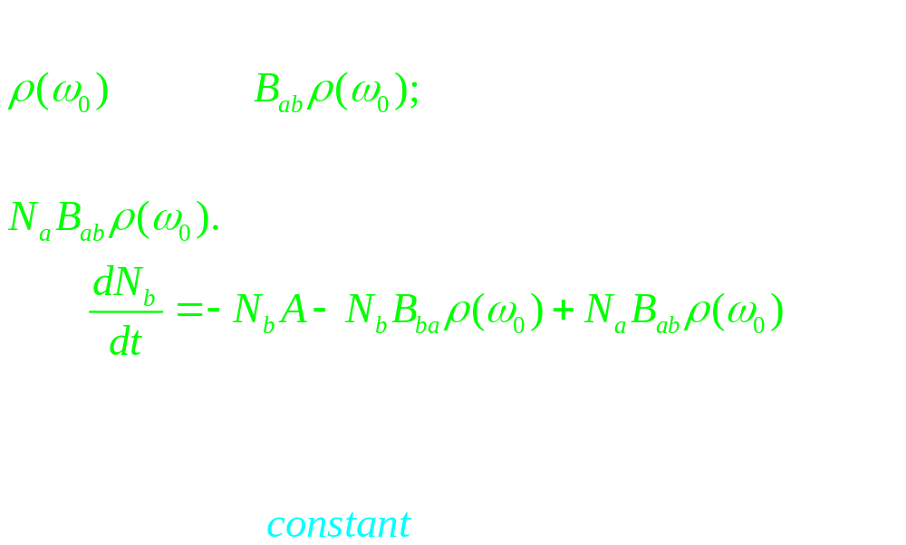

Slide 27
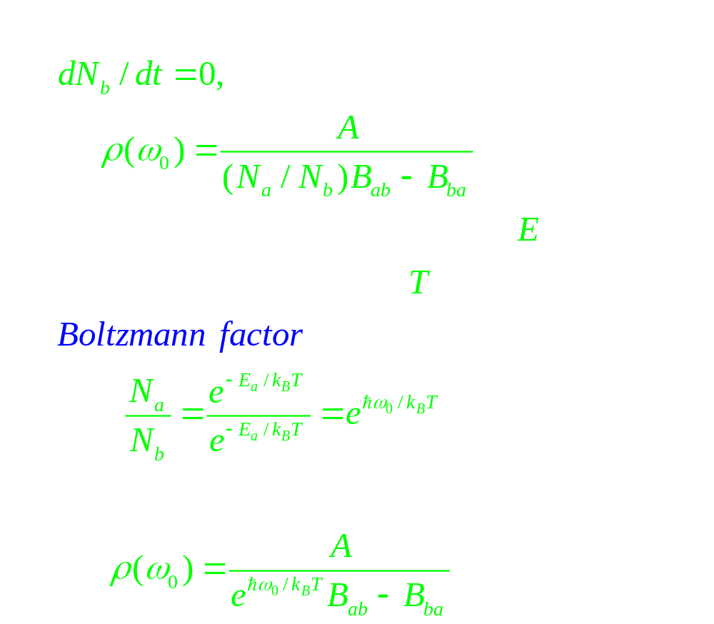

Slide 28
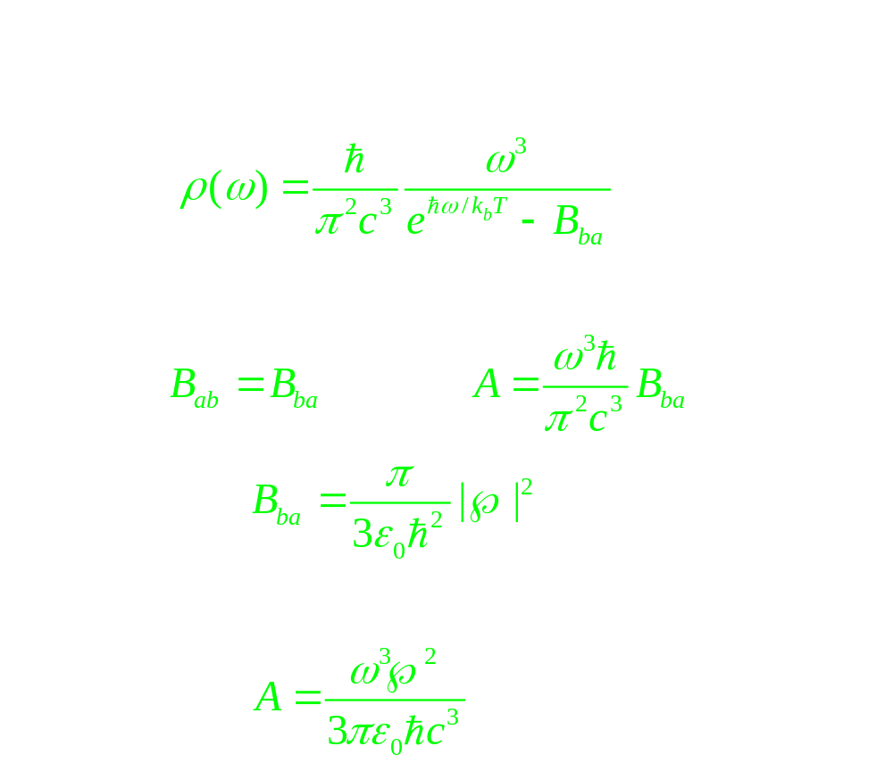

Slide 29
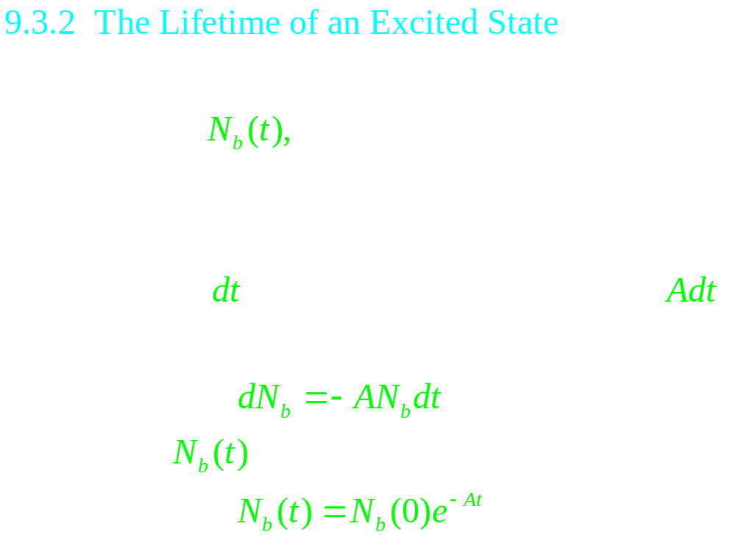

Slide 30
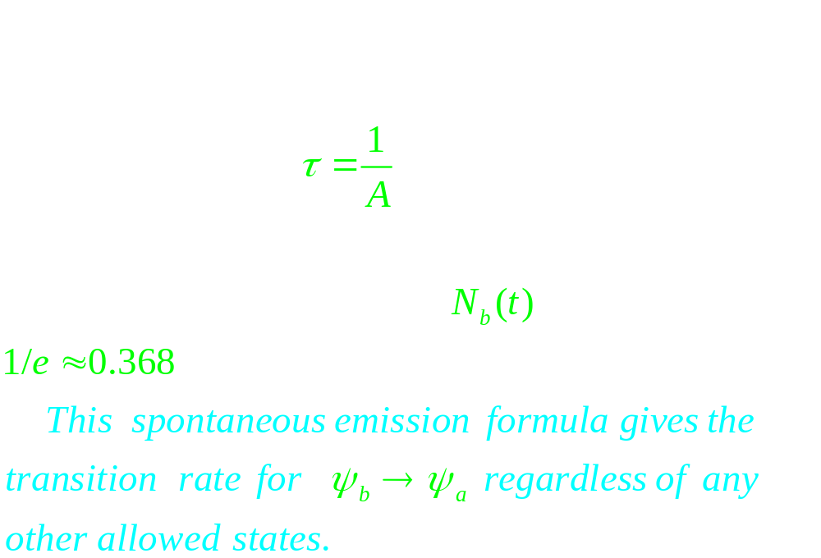

Slide 31
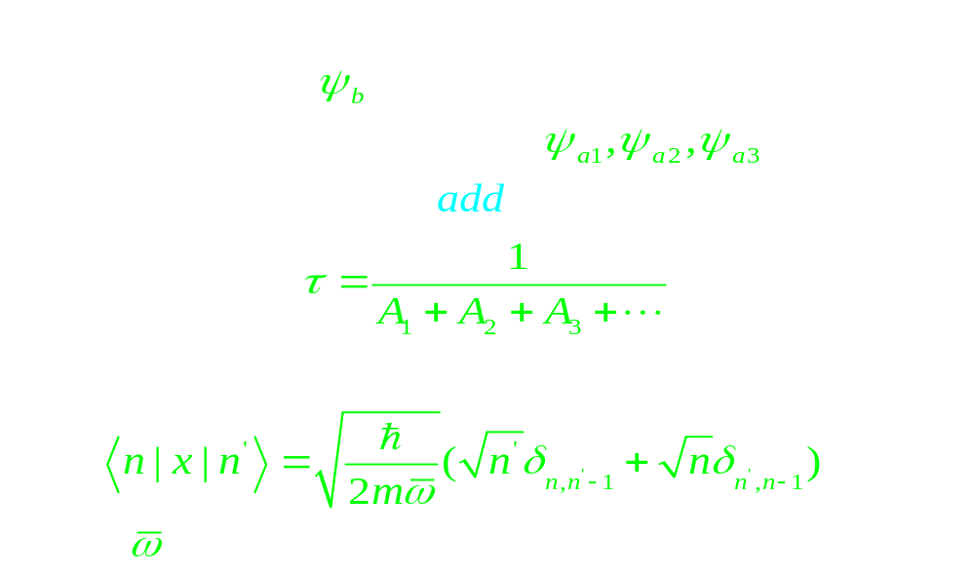
For example (harmonic oscillator)

Slide 32
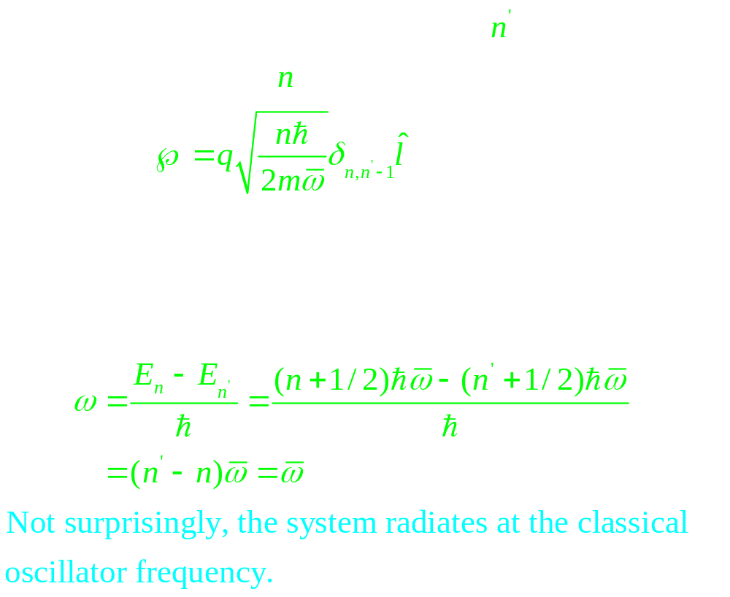

Slide 33


Slide 34



Slide 35



Slide 36


Slide 37


Slide 38


Slide 39


Slide 40


Slide 41


Slide 42


Slide 43


Slide 44

Allowed decays for the first four Bohr levels in hydrogen

