Slide 1
Microprocessor system architectures – IA32 segmentation
Jakub Yaghob

Slide 2
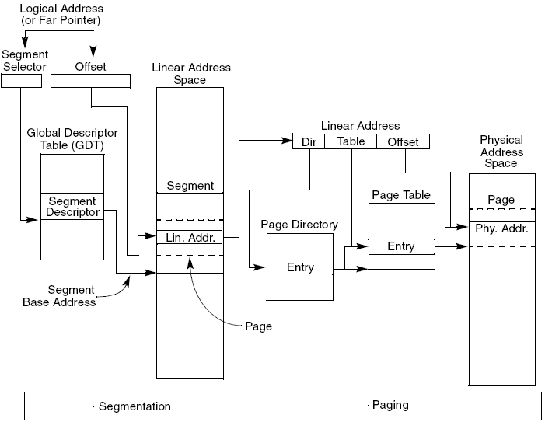
Memory management – overview

Slide 3
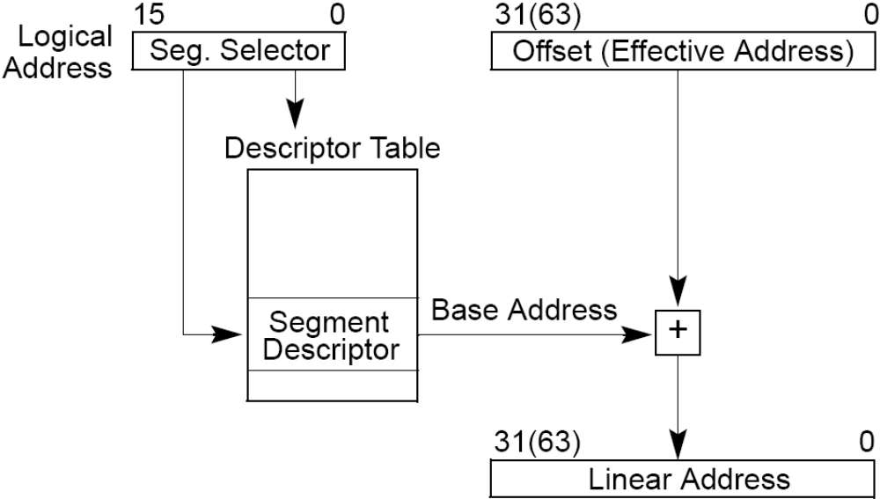
Logical address to linear address translation

Slide 4
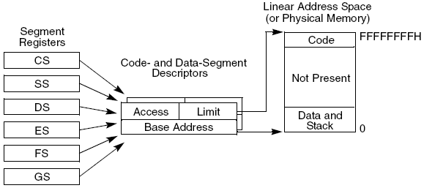
Basic flat model
Only 2 descriptors
  Code
  Data
Both segments have base address 0 and size 4GB

Slide 5
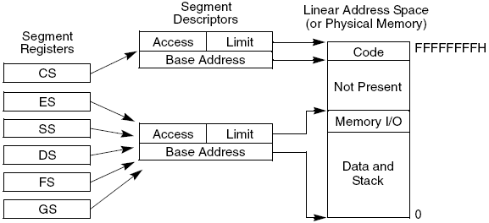
Protected flat model
Only 2 segments
Code segment separated from data segment
Correct segment sizes

Slide 6
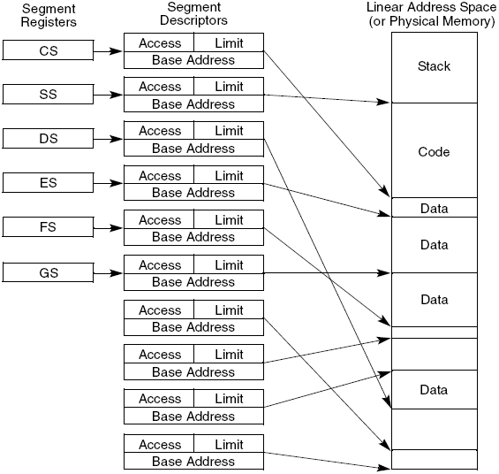
Multi-segment model
Each segment has its own descriptor
Can overlap
Nearly exact representation of a theoretical form of segmentation

Slide 7
Segmentation in long mode
Compatibility mode
  Works as in IA-32 protected mode
64-bit mode
  Segmentation disabled with exceptions
  64-bit flat linear address space
  No limit check
  CS, DS, ES, SS
    Base address 0
  FS, GS
    Have base address
    Support for local storage in OS

Slide 8
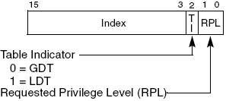
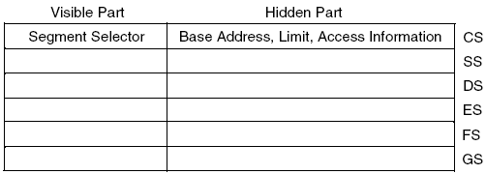
Selector and segment registers
Selector
Segment registers

Slide 9
Segment registers loading
32-bit modes
  Explicit by an instruction
  Implicit during jumps, calls, returns, task switches
64-bit mode
  DS, ES, SS
    Hidden part ignored, some explicit loads disabled
  CS
    Only attributes (CPL, L)
  FS, GS
    Base address mapped to MSR
    Loads load only 32-bit
    WRMSR IA32_FS_BASE/IA32_GS_BASE
    SWAPGS – swaps IA32_GS_BASE and IA32_KERNEL_GSBASE

Slide 10
Basic descriptor classification
Non-system
  Code
  Data
System
  Memory
  Gates

Slide 11
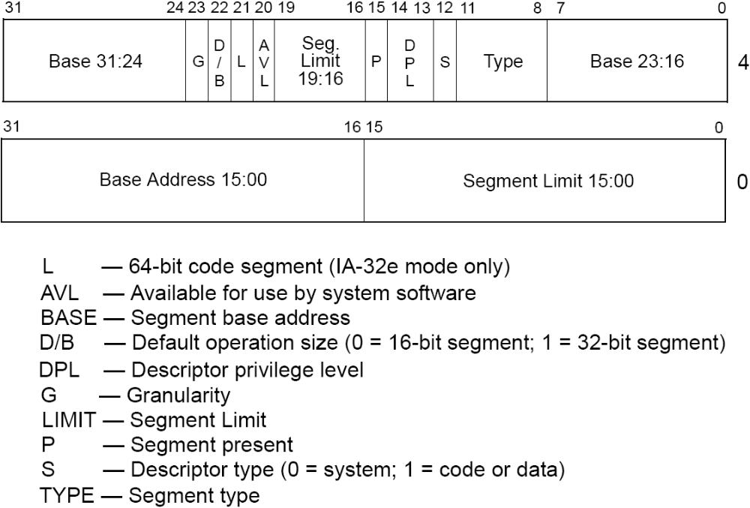
Segment descriptor

Slide 12
Segment descriptor – D/B flag
64-bit mode
  Code segment has L=1, D=0
  64-bit addresses, 32- and 8-bit operands
Code segment
  D=0 – 16-bit code (16-bit addresses, 16- and 8-bit operands)
  D=1 – 32-bit code (32-bit addresses, 32- and 8-bit operands)
  Change address or operand size by instruction prefixes
Stack segment
  B=0 – 16-bit SP
  B=1 – 32-bit SP
Expand-down data segment
  B=0 – upper bound FFFFh
  B=1 – upper bound FFFFFFFFh

Slide 13
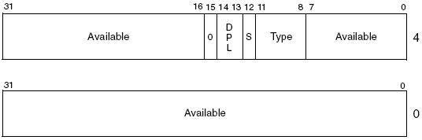
Segment descriptor with Present flag clear

Slide 14
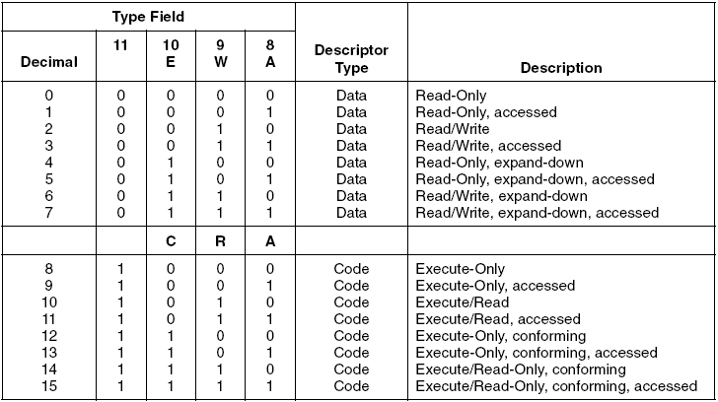
Code and data descriptors

Slide 15
Expand-down segment
Usually used for a stack segment
Normal segment has offsets in <0;LIMIT>
Expand-down segment has offsets in <LIMIT;UPPERBOUND>
  UPPERBOUND depends on D/B flag

Slide 16
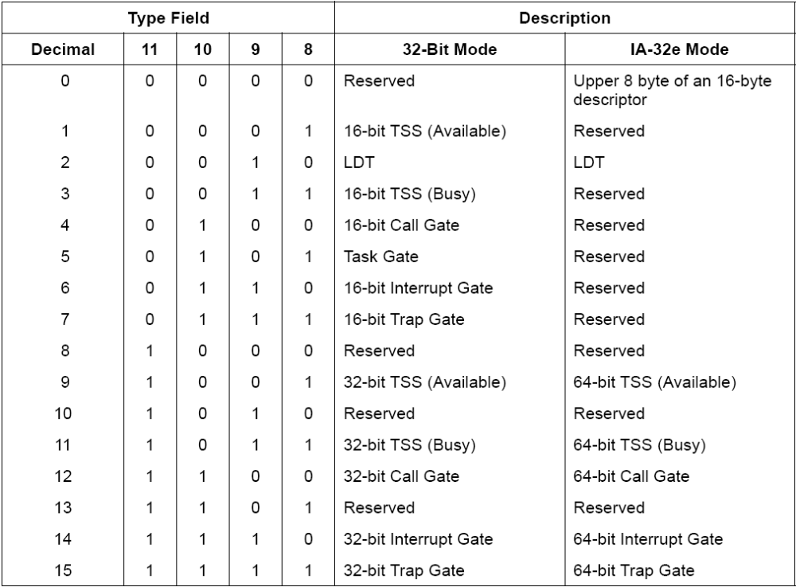
System descriptors

Slide 17
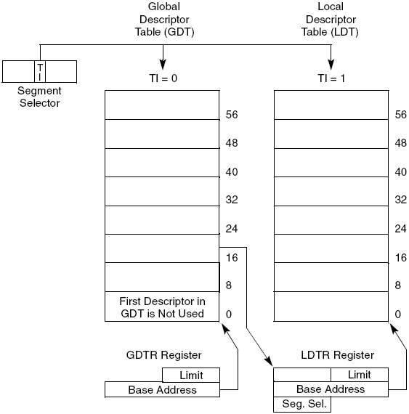
Descriptor tables

Slide 18
Descriptor tables – long mode
32-bit
  8K descriptors in each table
  Each descriptor 8B
Long mode
  All valid system descriptors have 16B
    First 8B-half is regular descriptor with a chosen type
    Second 8B-half is a descriptor with type 0
  Code and data descriptors remain 8B

Slide 19
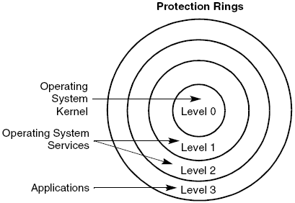
Segment protection

Slide 20
Types of privilege level
CPL
  Current Privilege Level
  Privilege level of currently executing code
  DPL of the descriptor loaded into CS
DPL
  Descriptor Privilege Level
  Privilege level of a segment or gate
  Part of any descriptor
RPL
  Requested Privilege Level
  Override privilege level
  Part of a selector
EPL
  Effective privilege level
  max(CPL, RPL)

Slide 21
Protection checks in the segmentation
Segment registers load (including selector as instruction operand)
  Type checking
  Privilege level checking
  Null segment checking
Memory access (including instruction fetching)
  Limit checking
  Null segment checking
  Type checking

Slide 22
Type checking
Loading
  CS can be loaded only by a code segment
  DS, ES, FS, GS cannot load system segments or not readable code segments
  SS can load only writeable segments
  LDTR can be loaded only by a LDT system segment, the same for TR and TSS
Accessing
  No writes into code segments or R/O data segments
  No read from a not readable code segment

Slide 23
Limit checking
Granularity (flag G in a descriptor)
  G=0 – LIMIT∈<0;FFFFFh>
  G=1 – LIMIT∈<0;FFFFFFFFh>
Expand-down (flag E in a descriptor)
  ∀ addresses during memory access
    E=0 – ∈<0;LIMIT>
    E=1 – ∈<LIMIT;UPPERBOUND> (depends on D/B)
Descriptor table limits
  Checked during segment register loading
64-bit mode
  No limit checking except of descriptor table limits

Slide 24
Null segment checking
32-bit
  Null segment cannot be loaded into CS, SS
  DS, ES, FS, GS can load null segment (selector 0)
  Access using null segment causes an exception
64-bit
  Null segment not checked during access

Slide 25
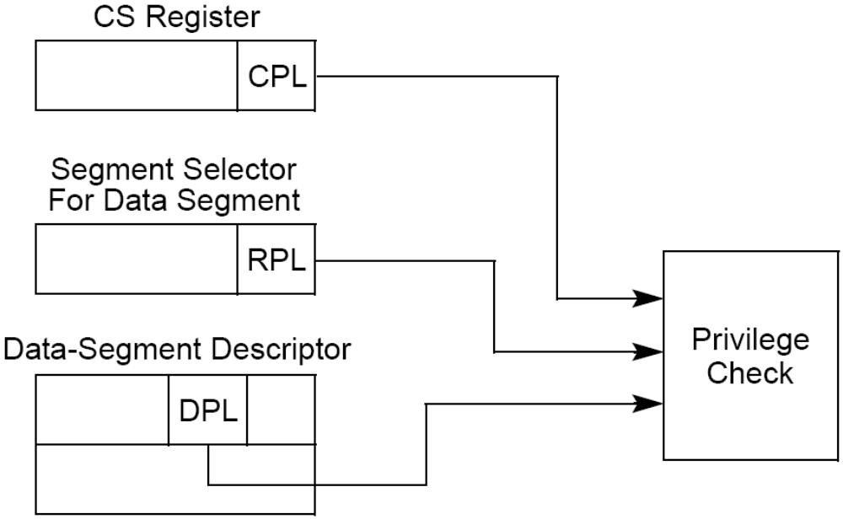
Privilege level checking – data access
Data segments
  EPL ≤ DPL
SS
  EPL = DPL

Slide 26
Privilege level checking – jumps between segments I
Direct jump (CALL, JMP)
  Nonconforming segment
    CPL = DPL
    RPL ≤ CPL
    CPL remains
  Conforming segment
    Code modules as part of OS supporting applications without protected system facilities (math library)
    DPL represents numerically lowest CPL, which can call conforming segment
    CPL ≥ DPL
    RPL ignored
    CPL remains (even if DPL is not equal)

Slide 27
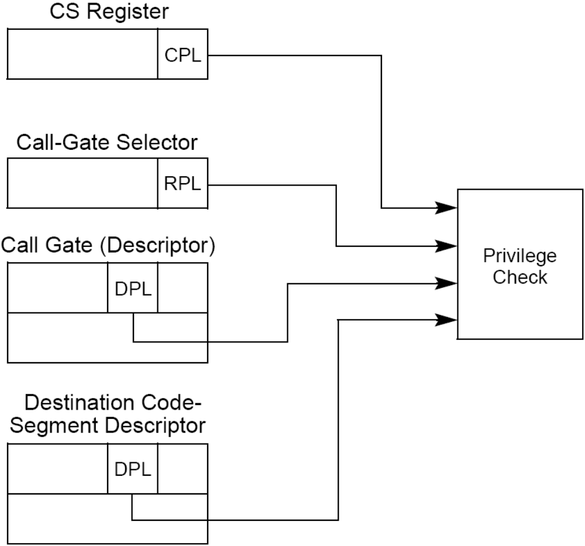
Privilege level checking – jumps between segments II
Using call gate
  Can change CPL
  Always check
    EPL ≤ DPL of the gate
  JMP nonconforming
    CPL = DPL
  JMP conforming
    CPL ≥ DPL
  CALL nonconforming
    CPL ≥ DPL
  CALL conforming
    CPL ≥ DPL

Slide 28
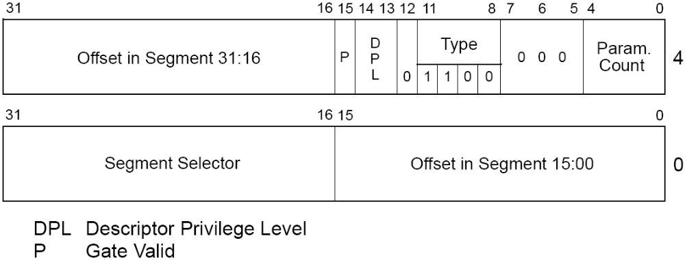
Call gate – 32-bit

Slide 29
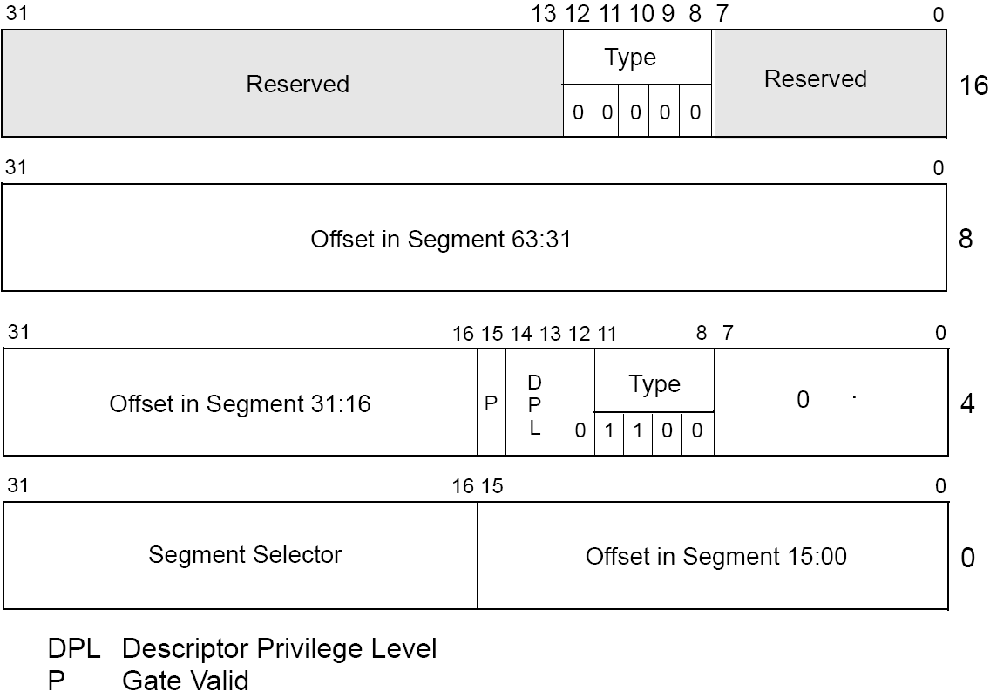
Call gate – 64-bit

Slide 30
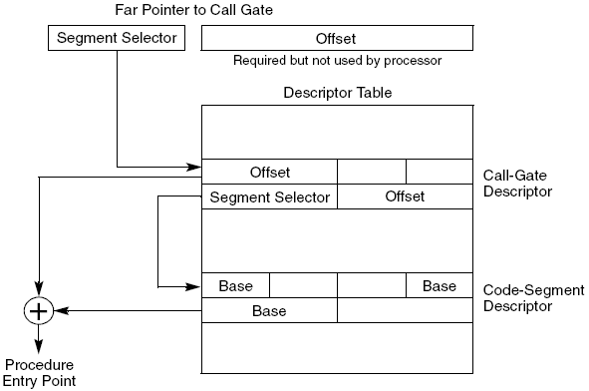
Call gate mechanism

Slide 31
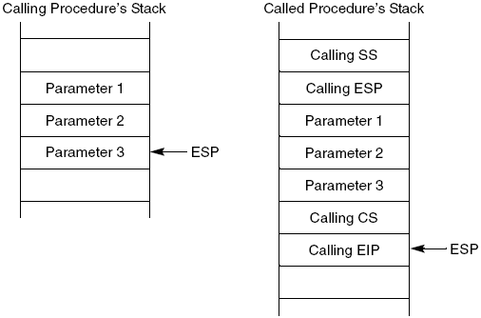
Stack switch using call gate – 32-bit
Only when CPL changes
  Destination conforming segment – CPL retained
  Parameter passing

Slide 32
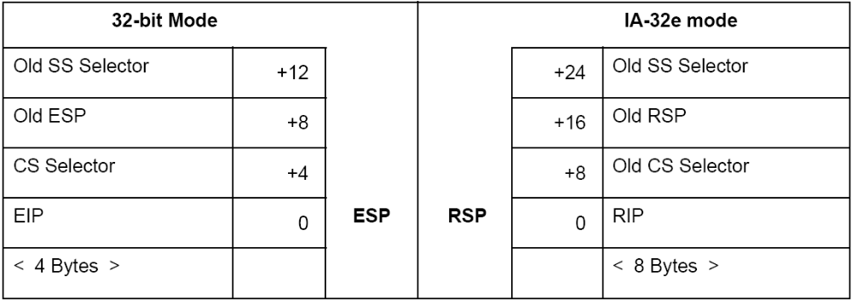
Stack switch using call gate – 64-bit
No new SS loaded from TSS, only RSP
SS is forced to null, and SS selector’s RPL forced to the new CPL
No copy of parameters
RET may load null SS, if the new CPL<3

Slide 33
RET with privilege level change
CPL ≤ DPL of target (returning to less privileged level)
  Using RPL from CS saved on stack
Loads CS:EIP/RIP from the stack
Adds parameter count to ESP/RSP
  Number in bytes obtained from RET
Loads SS:ESP/RSP – see above
Again adds parameter count to ESP/RSP
Check DS, ES, FS, GS
  If DPL< CPL, then load null segment

Slide 34
SYSENTER/SYSEXIT – 32-bit
Pentium II
SYSENTER
  Target address in MSRs IA32_SYSENTER_CS:IA32_SYSENTER_EIP
  Stack address IA32_SYSENTER_CS+8:IA32_SYSENTER_ESP
SYSEXIT
  Only on level 0, returns to level 3
  Target address IA32_SYSENTER_CS+16:EDX
  Stack address IA32_SYSENTER_CS+24:ECX

Slide 35
SYSENTER – long mode
Address MSRs expanded to 64-bit
SYSENTER
  Target address IA32_SYSENTER_CS:IA32_SYSENTER_EIP
    IA32_SYSENTER_CS must be non-NULL
    New CS: base=0, limit=FFFFFFFFh
  Stack address IA32_SYSENTER_CS+8:IA32_SYSENTER_ESP
    New SS: base=0, limit=FFFFFFFFh

Slide 36
SYSEXIT – long mode
SYSEXIT with prefix REX.W
  Returns to 64-bit mode
  Target address IA32_SYSENTER_CS+32:RDX
    New CS: L=1
  Stack address IA32_SYSENTER_CS+40:RCX
SYSEXIT
  Returns to compatibility mode
  Target address IA32_SYSENTER_CS+16:EDX
    New CS: L=0
  Stack address IA32_SYSENTER_CS+24:ECX

Slide 37
SYSCALL/SYSRET – I
Suitable for flat memory model
Check CPUID
From level 3 to 0 and back
SYSCALL
  Save RIP into RCX
  Target address IA32_STAR[47:32]:IA32_LSTAR
  Stack address IA32_STAR[47:32]+8:RSP
  R11=RFLAGS, RFLAGS=RFLAGS & IA32_FMASK

Slide 38
SYSCALL/SYSRET – II
SYSRET with prefix REX.W
  Returns to 64-bit mode
  Target address IA32_STAR[63:48]:RCX
  Stack address IA32_STAR[63:48]+8:RSP
  RFLAGS=R11
SYSRET
  Returns to compatibility mode
  Target address IA32_STAR[63:48]:ECX
  Stack address IA32_STAR[63:48]+8:ESP
  EFLAGS=LOW32(R11)

Slide 39
Checking access rights – LAR
Checks supplied selector as part of loading
  Selector ≠ 0
  Within the limits of GDT or LDT
  Segment valid for LAR
    All code and data segments are valid, from system segments all without interrupt-, trap-gates
  Visibility for CPL for nonconforming segments, DPL≥EPL
If any check fails, ZF=0

Slide 40
Checking read/write rights – VERR/VERW
Checks supplied selector
  Selector ≠ 0
  Within the limits of GDT or LDT
  Code or data segment
  Visibility for CPL for nonconforming segments, DPL≥EPL
  Check for readable (VERR)/writeable (VERW) segment
If any check fails, ZF=0

Slide 41
Checking offset within segment limits – LSL
Checks supplied selector as part of loading
  Selector ≠ 0
  Within the limits of GDT or LDT
  Segment valid for LSL
    All code and data segments, LDT, TSS
  Visibility for CPL for nonconforming segments, DPL≥EPL
If any check fails, ZF=0
Otherwise ZF=1, load unscrambled and scaled limit into the destination register

Slide 42
Checking caller access privileges – ARPL
The instruction adjust RPL of one selector to match that of another selector
Security problem
  Calling procedure should pass all segment parameters with its RPL (e.g. 3)
  Calling procedure can tamper with RPL of passed segment parameters and set it to 0
  Called procedure on lower protection level (possibly 0) uses those parameters
    Without checks, it can breach protection
  Called procedure should use ARPL on all segment parameters comparing them with RPL of calling procedure (stored on the stack as part of CS)

