Slide 1
OPERATING SYSTEMS & PARALLEL COMPUTING
Final Project
GROUP XX
Users: xxxxxx,yyyyyy,zzzzz
Notes:
Group A: Paula, Camila, Rocio
Group B: Sergi, Ryan
Group C: Sarah, Reem, Valeria
Group D: Sidhant, Amaya
Group E: Joaquin, Oriol
Group F: Juan, Qiji
Group G: Karl, Tharun, Alvaro

Slide 2
Implement the “Parallel K-means”
Choose the platform and the algorithm for your personal project:
Using MPI with HPC platform
Using PyCuda with GPU platform
Using SparkML with Big Data Platform
Dataset of 5M rows:
/data/workshop/sesion.csv
Dataset of 141M rows:
/data/workshop/bq*.csv
12702796 bq-results-custdet-aug.csv
20036463 bq-results-custdet-dic.csv
10041040 bq-results-custdet-feb.csv
21108906 bq-results-custdet-jan.csv
15633106 bq-results-custdet-jul.csv
21398358 bq-results-custdet-nov.csv
22389692 bq-results-custdet-oct.csv
18229332 bq-results-custdet-sep.csv
141539693 total

Slide 3
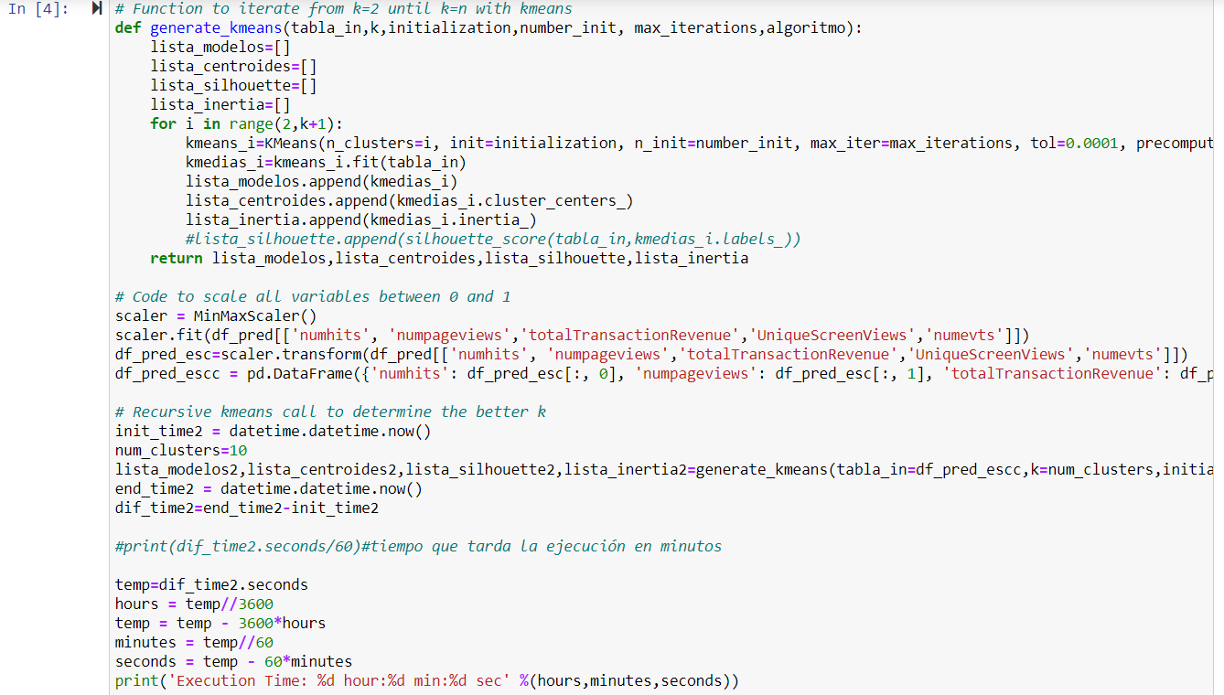
Python Code Comparisons
test_kmeans_scikit
test_kmeans_xxxxx

Slide 4
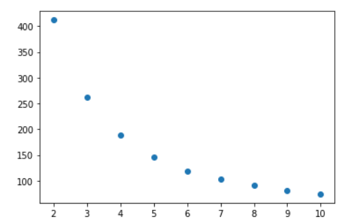
Parallel KMeans Results for 5M rows
 | SCIKIT-LEARN | Parallel KMeans
Time | 2min07s
Optimized K | 8

Slide 5
Parallel KMeans Results for 141M rows
 | SCIKIT-LEARN | Parallel KMeans
Time | -
optimized K | -

Slide 6


