Slide 1

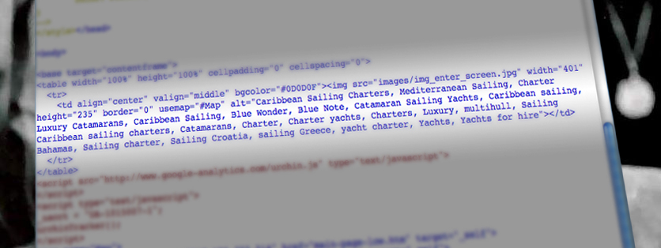

SEO and Accessibility
Bruce Lawson and Vasilis van Gemert
September 4, 2008

Slide 2
Who?
Bruce Lawson, Opera web standards evangelist
Vasilis van Gemert, Mirabeau frontend developer
Seo and accessibility: spot the difference
September 4, 2008

Slide 3
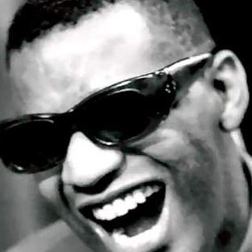
SEO naturally takes care of accessibility because Google is the biggest blind user in the world (The Blind Billionaire)‏
Seo and accessibility: spot the difference
September 4, 2008

Slide 4
Google Design and Content guidelines
Make a site with a clear hierarchy and text links.
Create a useful, information-rich site
Try to use text instead of images for text
Make descriptive TITLE tags and ALT attributes
Check for broken links and correct HTML
Use a text browser such as Lynx to examine your site
Seo and accessibility: spot the difference
September 4, 2008
Notes:
So : text equivalents, headings etc as WCAG 1 (p2) “3.5 Use header elements to convey document structure and use them according to specification.”
Content is king: clear language see “14.1 Use the clearest and simplest language appropriate for a site's content.”
Check for “correct HTML” analogous to WCAG (p2) “ 3.2 Create documents that validate to published formal grammars.”
It's written for a document-based web. A web of information (NOT entertainment, multimedia or applications) e.g. WCAG 1.1 Provide a text equivalent for every non-text element

Slide 5
What's missing
More and more Ajax-driven sites
ARIA for web apps should have no effect on SEO
  Take no account of Flash, PDF
Seo and accessibility: spot the difference
September 4, 2008
Notes:
Doesn't take into account WAI ARIA (for introduction: http://dev.opera.com/articles/view/introduction-to-wai-aria/)‏
Site owners don't care about indexing contents of web apps as it's so unique (as long as you can find them).
Google says about JavaScript (don't use it to access content, don't hide content)‏
Bruce talks about PDF's and how blind people access them: utfg
Vasilis talks about indexing Flash, providing alternative content

Slide 6
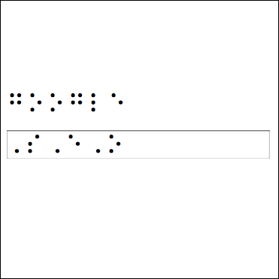
Accessibility takes care of SEO
Seo and accessibility: spot the difference
September 4, 2008

Slide 7
Build for Accessibility, get SEO
Doubled the number of visitors
It has cut maintenance costs by two thirds
Increased the amount of natural search traffic
Product take-up increased 200%
Bonus: usability
Seo and accessibility: spot the difference
September 4, 2008
Notes:
“The new site has almost doubled the number of visitors seeking quotes and buying Legal & General financial products online. It has cut maintenance costs by two thirds and increased the amount of natural search traffic we get by half as much again – Caroline Fawcett, L&G
http://www.isolani.co.uk/presentations/wsg/wsg-webaccessibility.pdf
“Take up of some financial products via the site increased by 200%”
see http://inova.snv.jussieu.fr/evenements/colloques/servonline/Actes/description_ang.php?id=49&num=45
“It is also notable that both blind users and non-impaired users took far longer on low accessibility sites than on high accessibility sites, and that this effect was not much more pronounced for disabled users: 51% longer for blind users, and 46% for non-disabled users.
It follows that all users, not just disabled people, would benefit greatly from the measures required to make sites accessible and usable by blind people.”
http://www.equalityhumanrights.com/Documents/Disability/Accessibility_guidance/web_access_and_inclusion.pdf

Slide 8
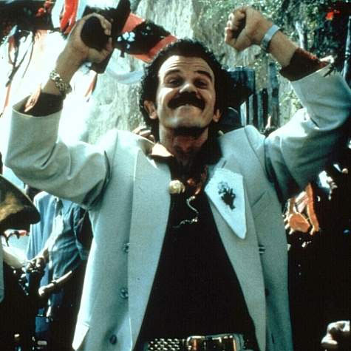
_{Black Hat, White Hat}
Seo and accessibility: spot the difference
September 4, 2008

Slide 9
Know your SEO expert
Keyword stuffing
Cloaking
Seo and accessibility: spot the difference
September 4, 2008
Notes:
Problems with bad SEOs:
http://news.bbc.co.uk/2/hi/technology/4685750.stm

Slide 10
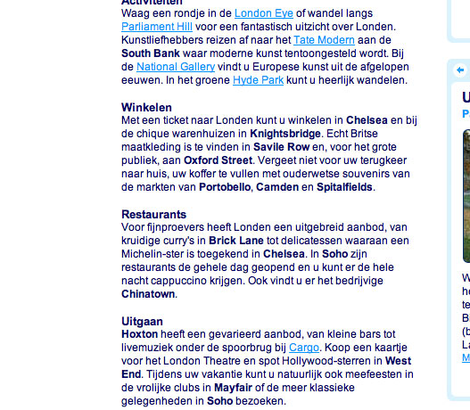
HTML for extra weight
Seo and accessibility: spot the difference
September 4, 2008
Notes:
Don't overdo it

Slide 11
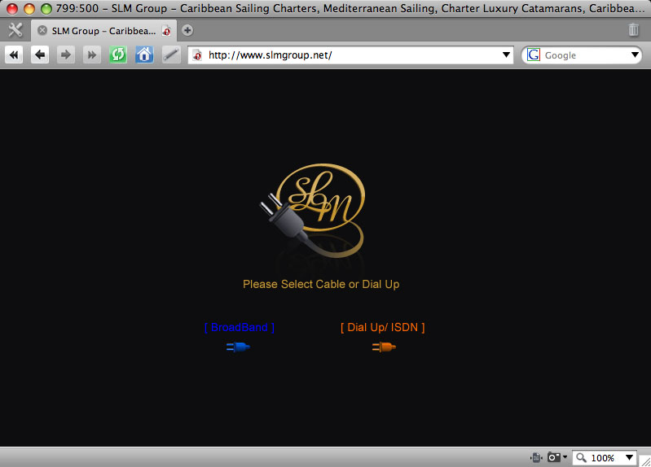
Stuffing keywords
Seo and accessibility: spot the difference
September 4, 2008

Slide 12
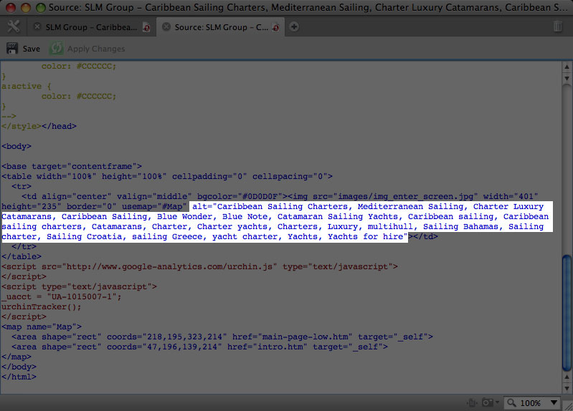
Stuffing keywords
Seo and accessibility: spot the difference
September 4, 2008

Slide 13
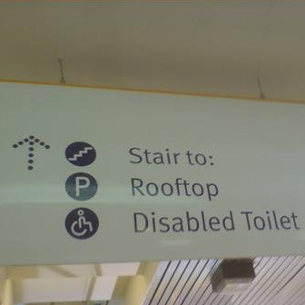
_{SEO vs Accessibility}
Seo and accessibility: spot the difference
September 4, 2008

Slide 14
SEO vs Accessibility
Accessibility
SEO
Navigation first
Start with Skip links
Doesn't care
Interesting!
Content first
Doesn't care
Use breadcrumbs
Write unrelated content with JavaScript
Seo and accessibility: spot the difference
September 4, 2008
Notes:
Vasilis explains why content should be first
Bruce explains why it doesn't necessarily work that way: The majority of screen reader users EXPECT navigation to be presented before the content.
.. please checxk out full research http://www.usability.com.au/resources/ozewai2005/

Slide 15
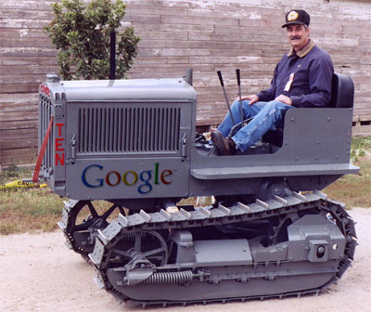
_{Sell Accessibility as SEO}
Seo and accessibility: spot the difference
September 4, 2008

Slide 16
Different lingo
Accessibility
SEO
User
Title and H1 for
  Descriptive linktext
  HTML for meaning
  Skip links
  Logical architecture
  Make accessible websites
Google
Title and H1 for pagerank
Descriptive keywords in linktext
HTML for extra weight
Might help?
Pagerank sculpting/siloing
Make accessible websites
Seo and accessibility: spot the difference
September 4, 2008

Slide 17
Extra reading
http://www.brucelawson.co.uk/2008/standards-based-corporate-web-development/
http://www.thinkvitamin.com/features/design/accessibility-in-suit-and-tie
http://www.usability.com.au/resources/ozewai2005/
Seo and accessibility: spot the difference
September 4, 2008

