Slide 1
DATA SCIENCE:CASE STUDY
Data Investigation and Exploratory Analysis: Maven cloud limited_call_records
By:
Nkahebwa Norris

Slide 2
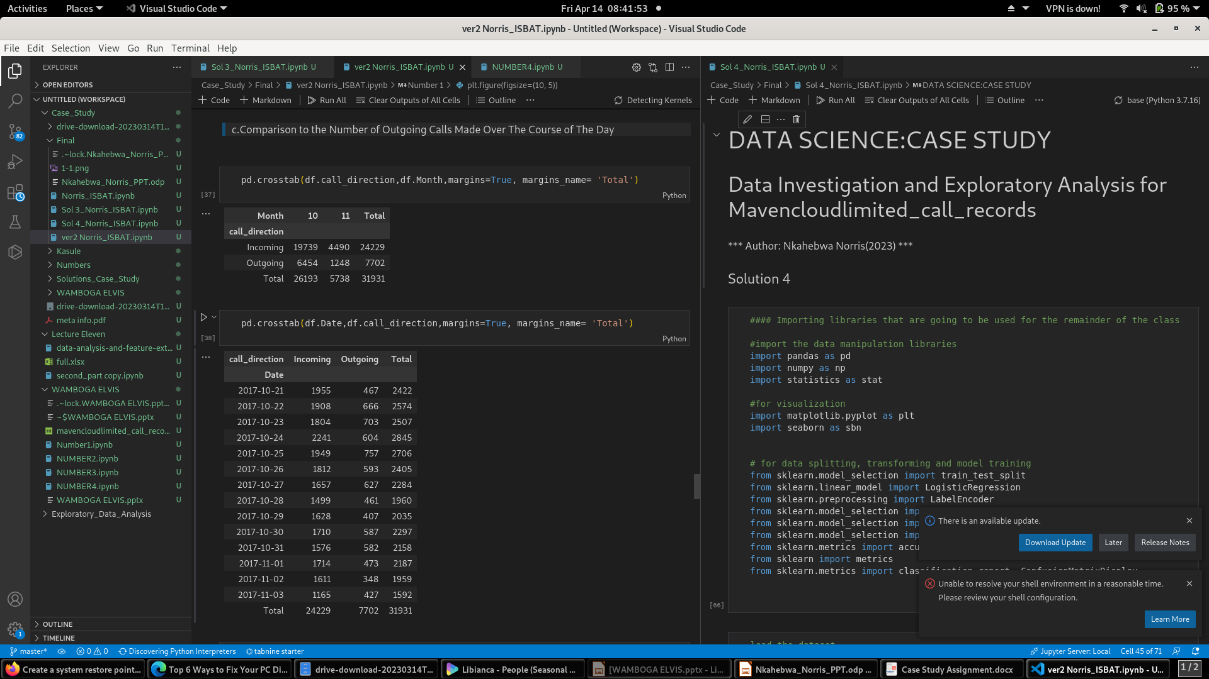
Statistics: Most Incoming Call Traffic
From the summary statistics, it can be deduced that, most Incoming call traffic was witnessed in the month of October and this had a record of 19739.

Slide 3
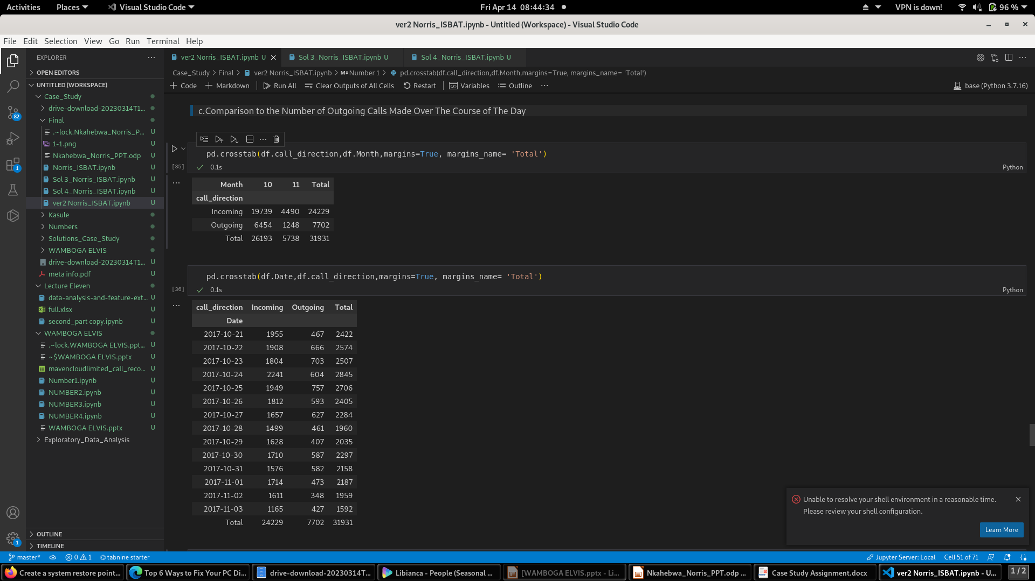
Statistics: Variations Over the Course of the Day
Reference made to summary table, we observe that on 2017-10-24, we had the highest incoming calls being 2241 and the least calls were found to be on 2017-11-03 at 1165.
The case for outgoing calls was exceptional with the highest being recorded on 2017-10-25 at 757 and least on 2017-11-02 at 348.
The keynote to take is that, October had a lot of activities for incoming calls than outgoing.
These could be attributed to customer complaints, purchases or follow-up because hardly does a customer call when satisfied with the service(s).
These are further visualized in the proceeding diagrams

Slide 4
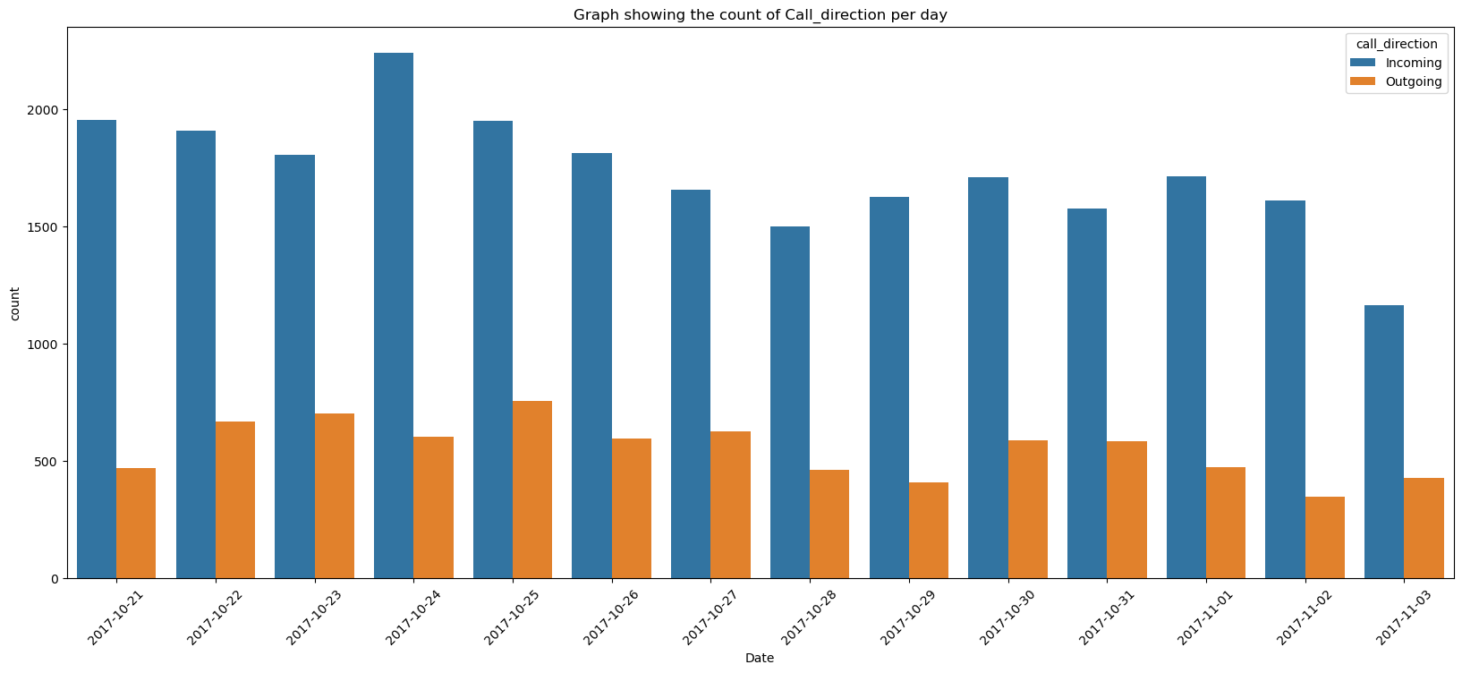
Graph:Call_Direction Variations Over the Course of the Day

Slide 5
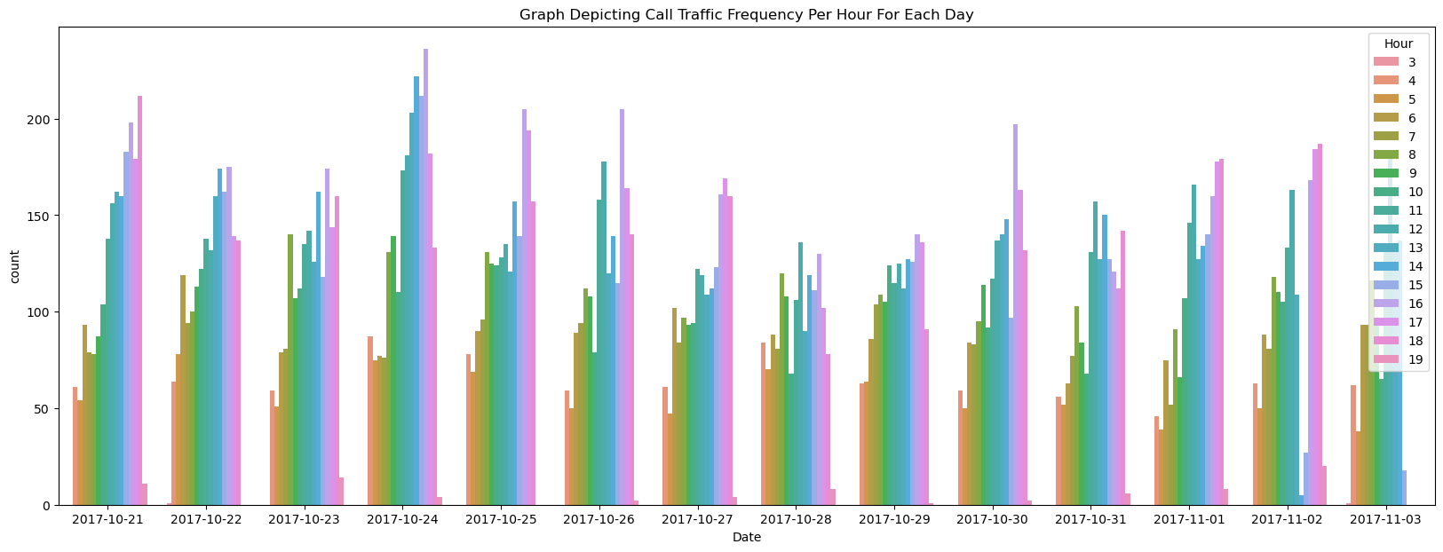
Graph:Call Traffic Frequency Per Hour for Each Day

Slide 6
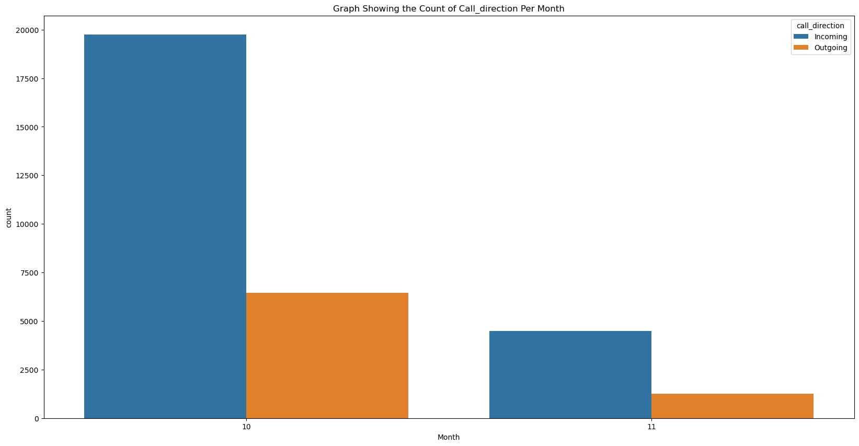
Graph(Bonus):Call_Direction Variations for Oct & Nov

Slide 7
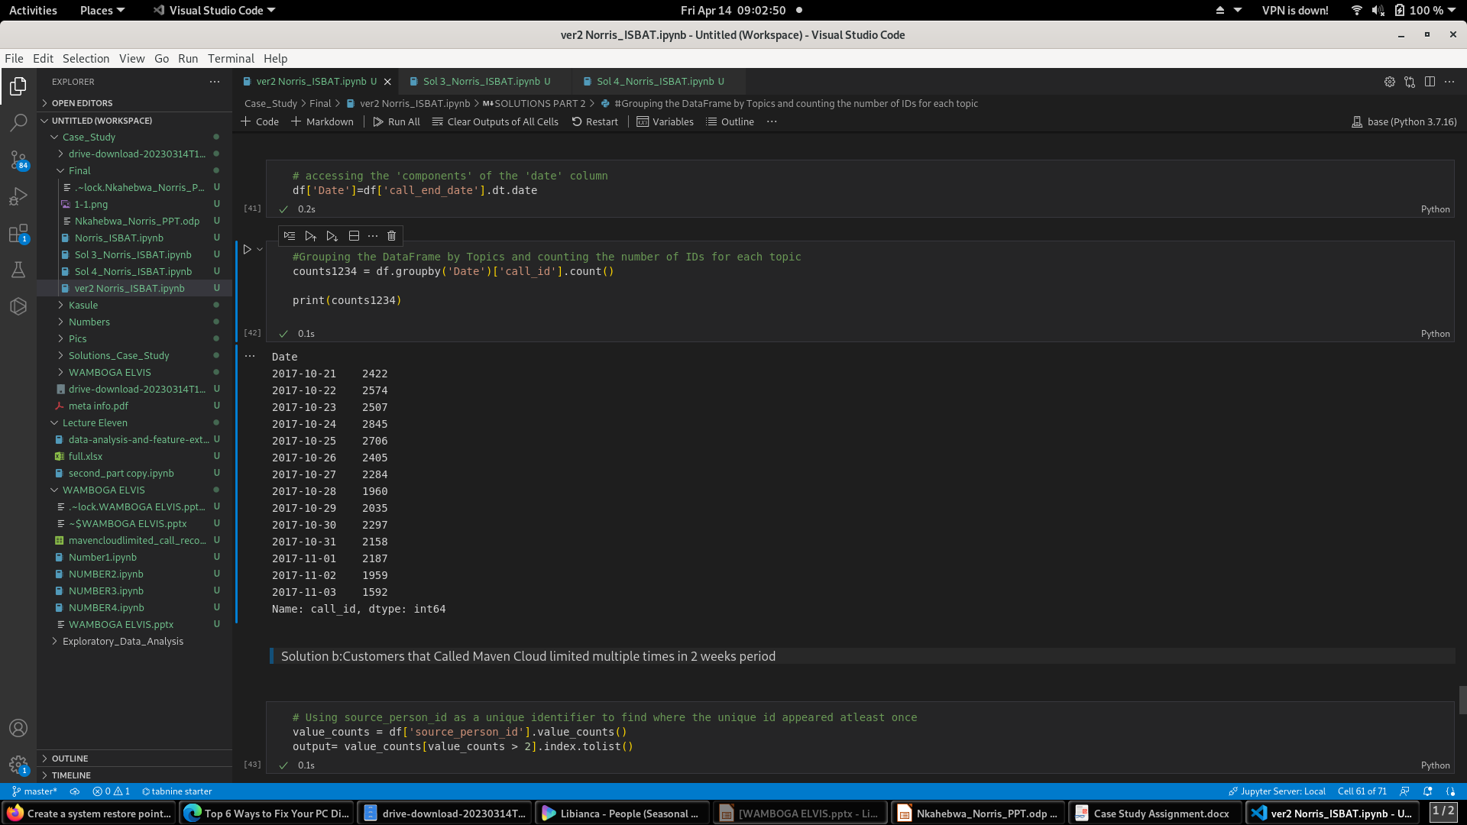
Customers we Talked to on Each Day
Observations:
On 2017-10-24, we talked to the highest number of customers scoring at 2845 and, the least were noted on 2017-11-03 being at 1592.
This still maintains the pattern of much activities in the month of October.

Slide 8
Statistics: Customers who Called Multiple Times in the 2 week period
Using source_person_id: 2,438 customers called Maven Cloud Limited multiple times
Using destination_person_id: 758 customers called Maven Cloud Limited

Slide 9
Subject Matter With Clients
Included the Following:
Codes
Accessory Technical Issue
General
Finance
Sales
Technical/ Battery Performance
Accessory Non-Technical Issue
Accounts
Survey
Portfolio Health
Unsellable Kit (Association Errors)
Other

Slide 10
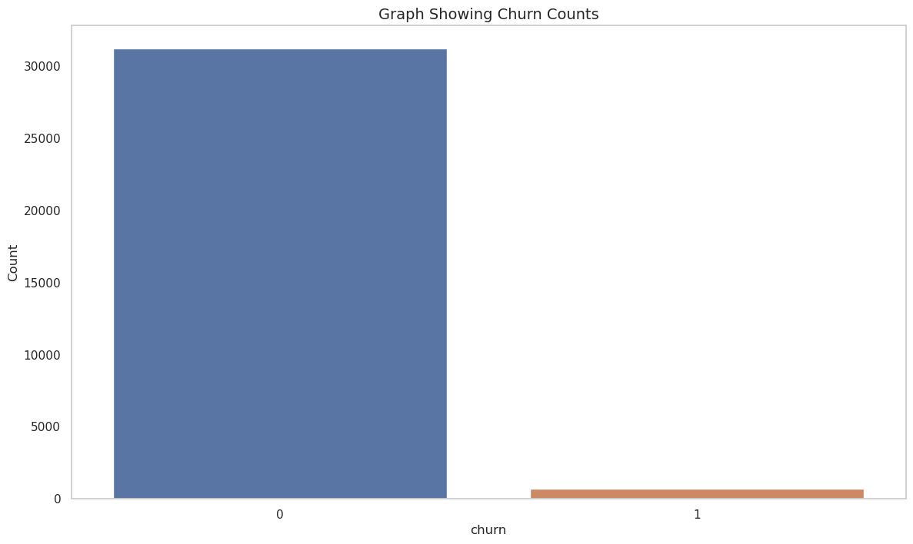
Statistics & Graph:Customers More Likely to Churn
S/No | Churn Status | Total
1 | Yes | 684
2 | No | 31247
Only 684 customers were found to churn which was way too less than their counter parts(Not churning at 31247).
See diagram on the right side to depict the scenario for churn status.

Slide 11
Customers More Likely to Churn Cont’
Observations
From the above output, we can reliably discover that only 2% of data is related to the churned customers and 98% of data is related to the non-churned customer.
This indicated a great difference.
See proceeding investigations on the subject(Churn)

Slide 12
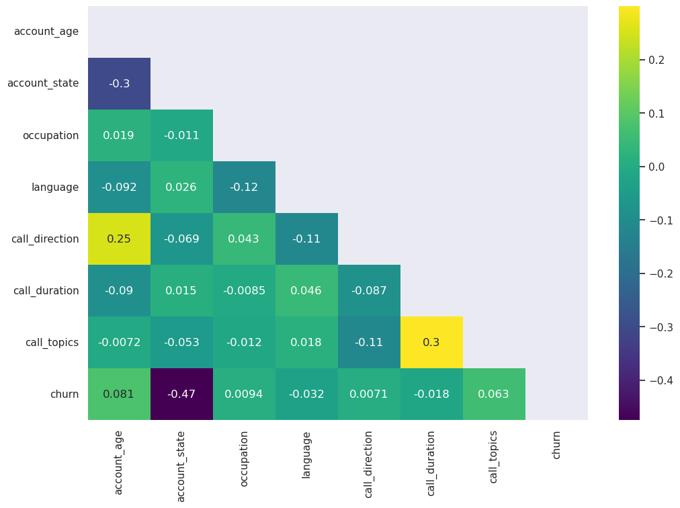
Correlation Matrix
All our Data is important but we need to select the most important one and a correlation Matrix can do that.
From our correlation, we notice that the correlations between call_duration and call_direction are the only remarkable ones though weak.
Thus, we can include either of them.
As a result, i am removing call_direction from the data and considering the other for further analysis.

Slide 13
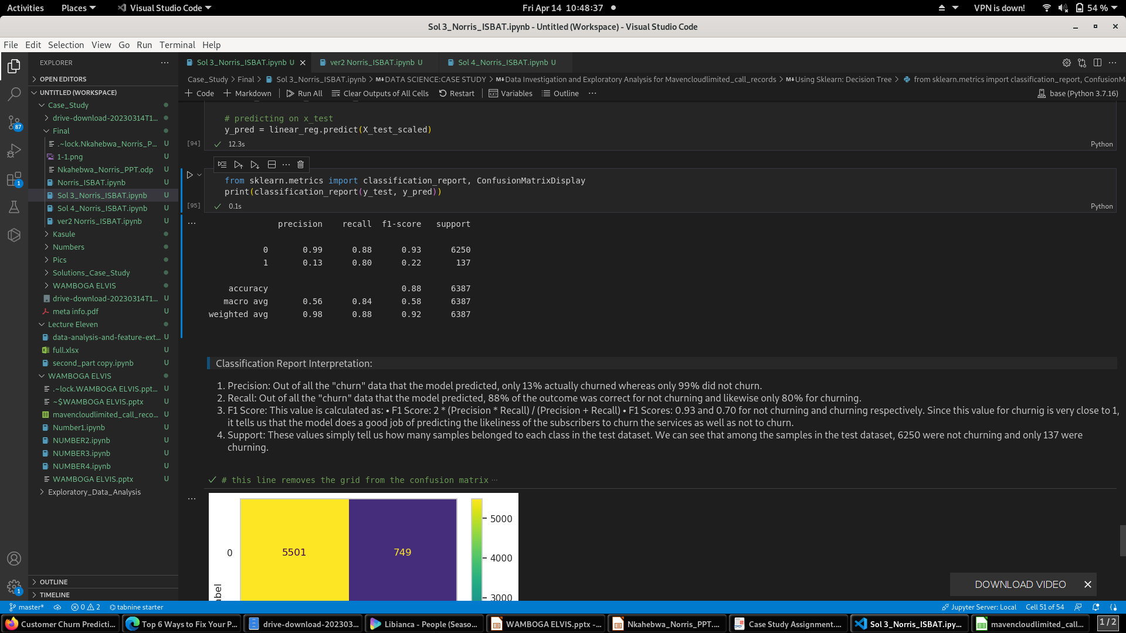
Classification Report for Churn Status
Precision: Out of all the "churn" data that the model predicted, only 13% actually churned whereas only 99% did not churn.
Recall: Out of all the "churn" data that the model predicted, 88% of the outcome was correct for not churning and likewise only 80% for churning.
F1 Scores: 0.93 and 0.70 for not churning and churning respectively.
Since this value for churning is very close to 1, it tells us that the model does a good job of predicting the likeliness of the subscribers to churn the services as well as not to churn.
Support: These values simply tell us how many samples belonged to each class in the test dataset. We can see that among the samples in the test dataset, 6250 were not churning and only 137 were churning.

Slide 14
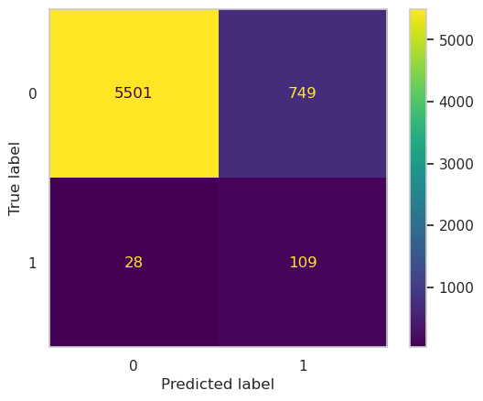
Confusion Matrix
The diagonal elements are the correctly predicted samples.
True positive: 5501 records of churning were predicted correctly by the model.
False-positive: 749 records of not churning were wrongly predicted as churning records
False-negative: 28 records of not churning were wrongly predicted as churning records
True Negative: 109 records of not churning were predicted correctly by the model.
Note: The above output changes as we re run the model

Slide 15
Customers Reasons for Churning
Included some of the Following subjects:
Codes
Accessory Technical Issue
General
Finance
Sales
Technical/ Battery Performance
Accessory Non-Technical Issue
Accounts
Survey
Portfolio Health
Unsellable Kit (Association Errors)
Other

Slide 16
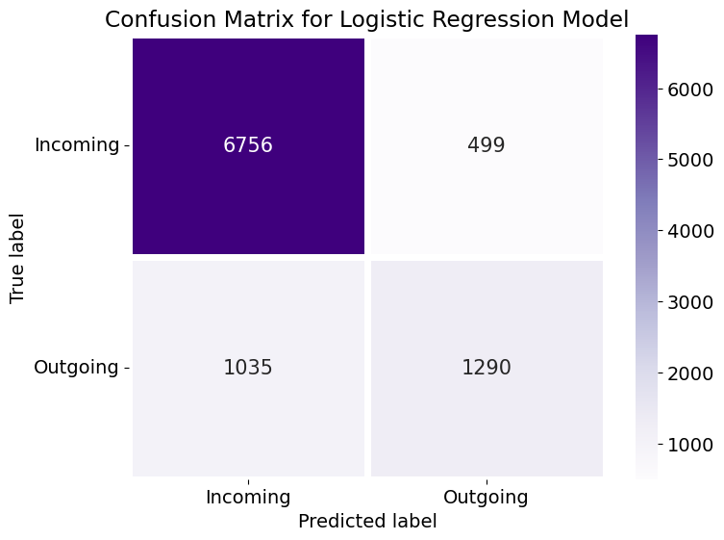
Model 1: Logistic Regression(LR) to Predict the Future Call Direction
The diagonal elements are the correctly predicted samples.
True positive: 6756 records of Incoming were predicted correctly by the model.
False-positive: 499 records of Outgoing were wrongly predicted as Incoming by the model.
False-negative: 1035 records of Outgoing were wrongly predicted as Incoming records
True Negative: 1290 records of Outgoing were predicted correctly by the model.
Model accuracy is at 84%

Slide 17
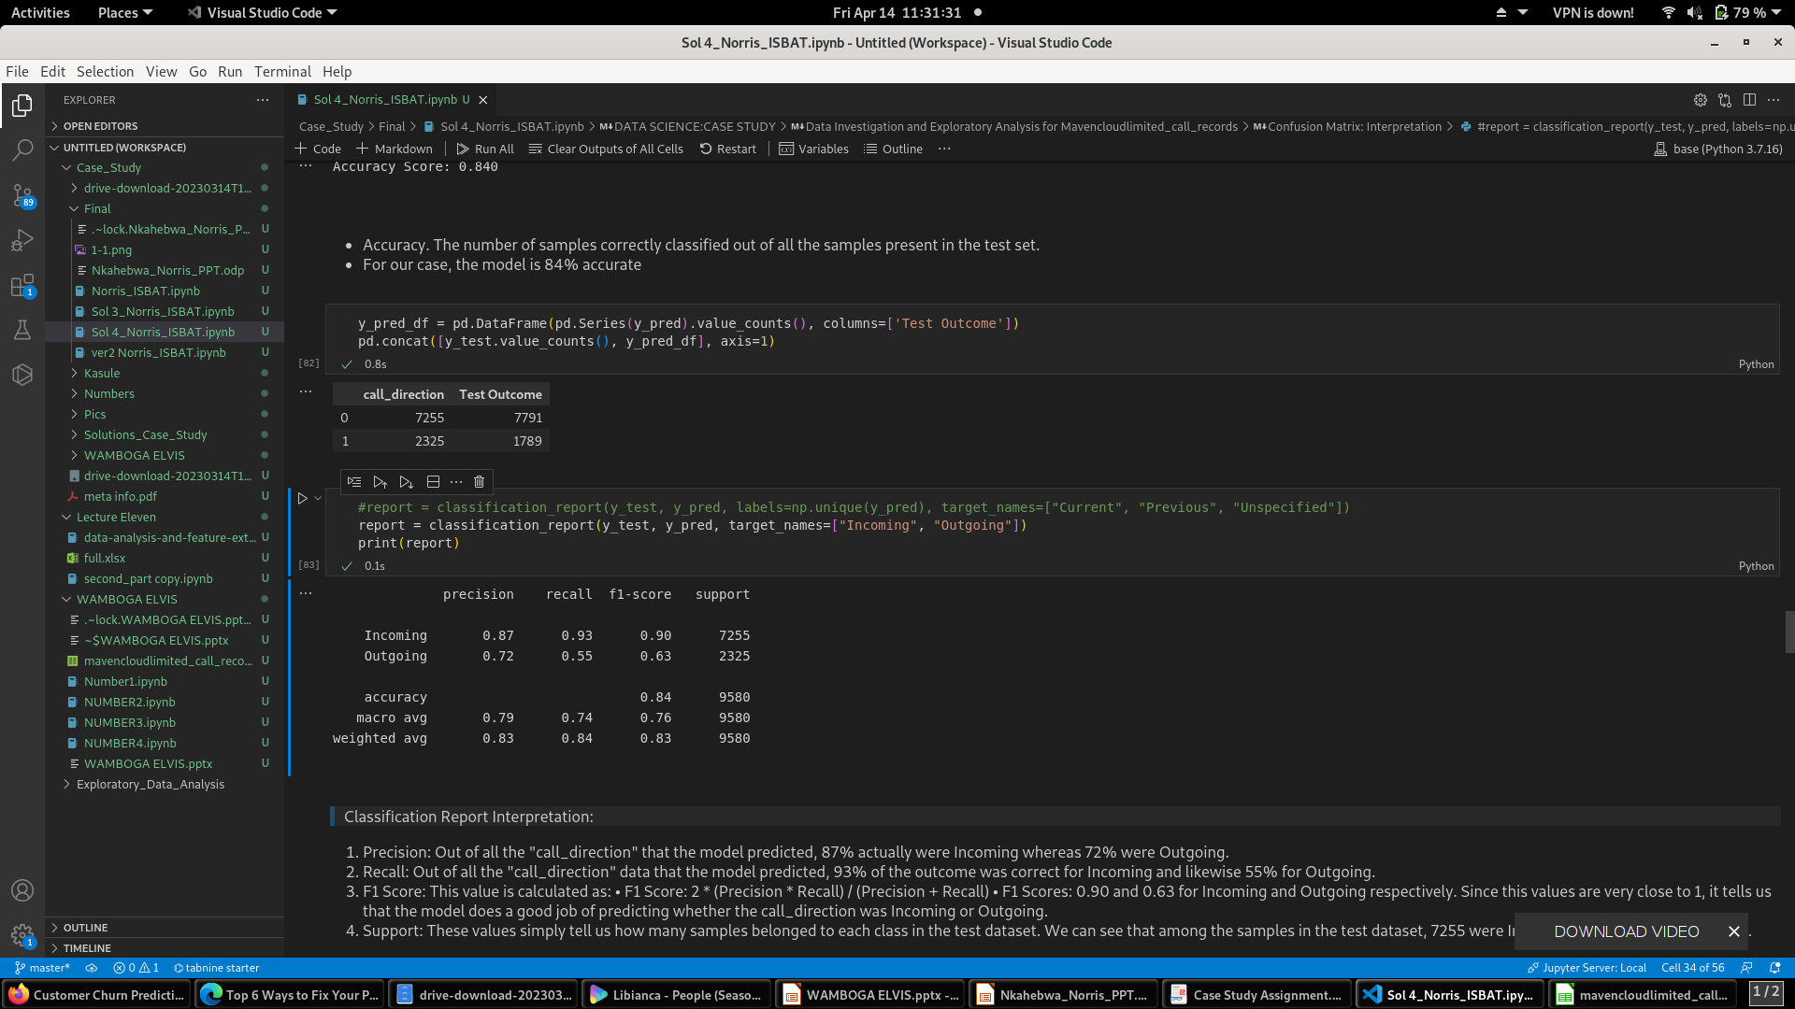
LR Classification Report for Future Call Direction
Precision: Out of all the "call_direction" that the model predicted, 87% actually were Incoming whereas 72% were Outgoing.
Recall: Out of all the "call_direction" data that the model predicted, 93% of the outcome was correct for Incoming and likewise 55% for Outgoing.
F1 Scores: 0.90 and 0.63 for Incoming and Outgoing respectively.
Since these values are very close to 1, it tells us that the model does a good job of predicting whether the call_direction was Incoming or Outgoing.
Support: These values simply tell us how many samples belonged to each class in the test dataset. We can see that among the samples in the test dataset, 7255 were Incoming and 2325 were Outgoing.

Slide 18
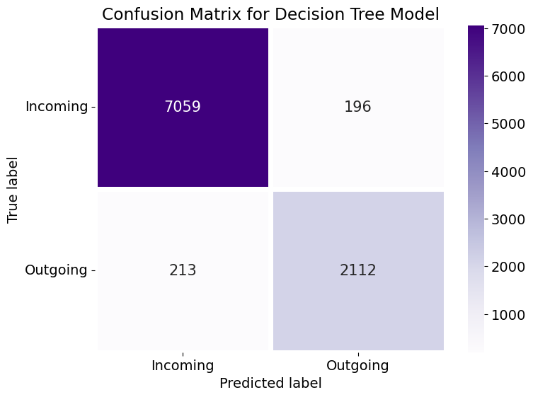
Model 2: Decision Tree(DT) to Predict the Future Call Direction
The diagonal elements are the correctly predicted samples.
True positive: 7059 records of Incoming were predicted correctly by the model.
False-positive: 196 records of Outgoing were wrongly predicted as Incoming by the model.
False-negative: 213 records of Outgoing were wrongly predicted as Incoming records
True Negative: 2112 records of Outgoing were predicted correctly by the model.
Model accuracy is at 95%

Slide 19
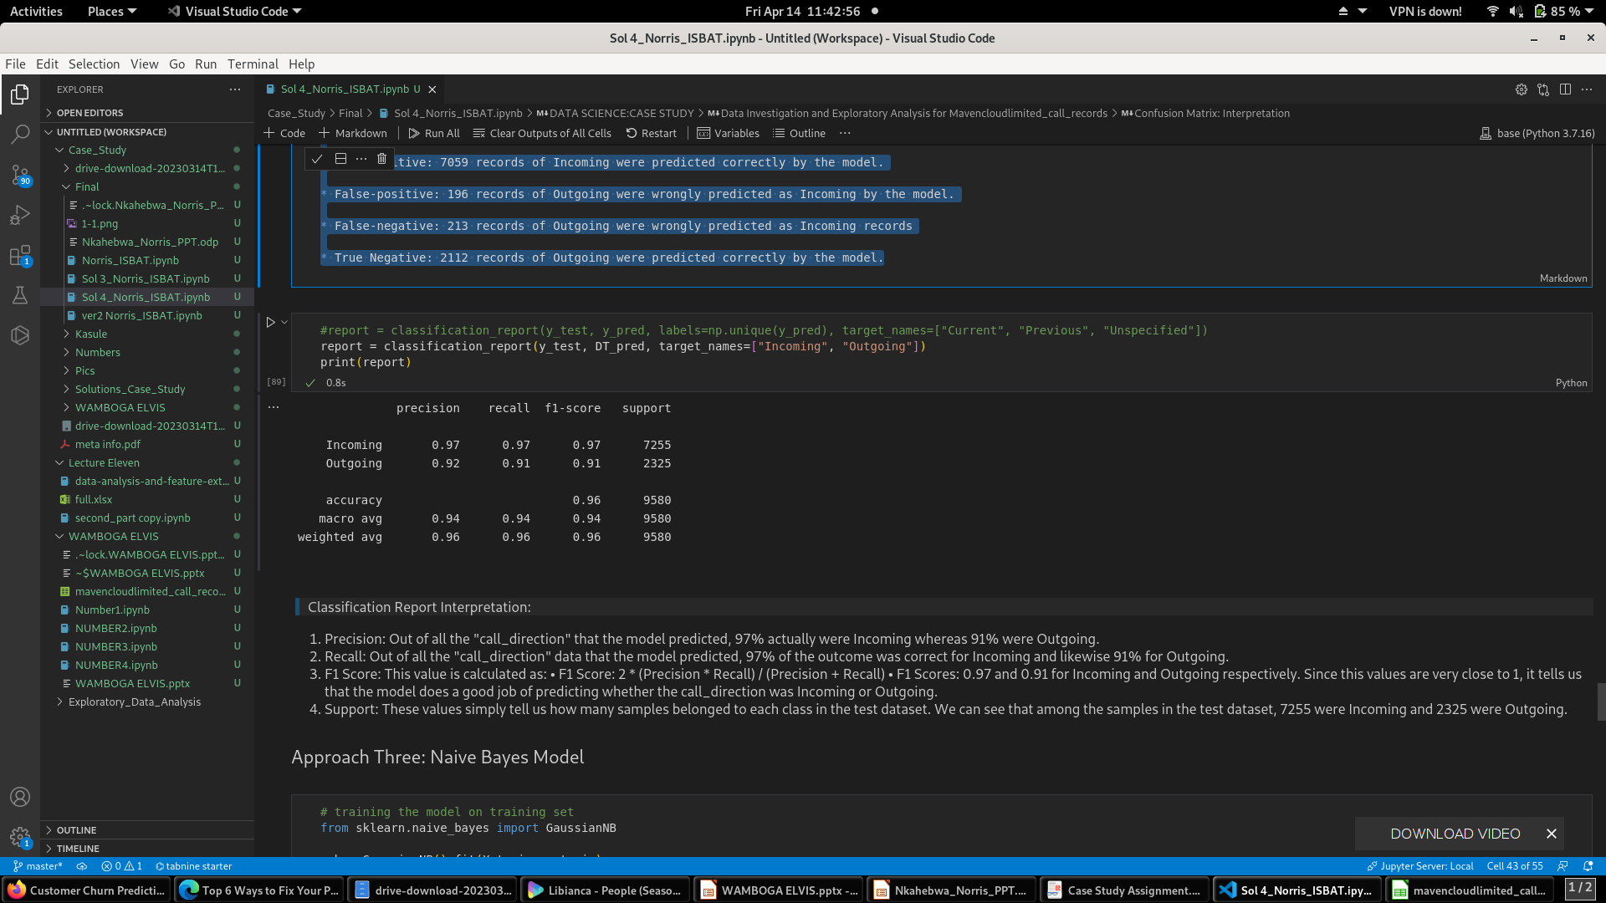
DT Classification Report for Future Call Direction
Precision: Out of all the "call_direction" that the model predicted, 97% actually were Incoming whereas 92% were Outgoing.
Recall: Out of all the "call_direction" data that the model predicted, 97% of the outcome was correct for Incoming and likewise 91% for Outgoing.
F1 Scores: 0.97 and 0.91 for Incoming and Outgoing respectively.
Since this values are very close to 1, it tells us that the model does a good job of predicting whether the call_direction was Incoming or Outgoing.
Support: These values simply tell us how many samples belonged to each class in the test data set We can see that among the samples in the test data set, 7255 were Incoming and 2325 were Outgoing.

Slide 20
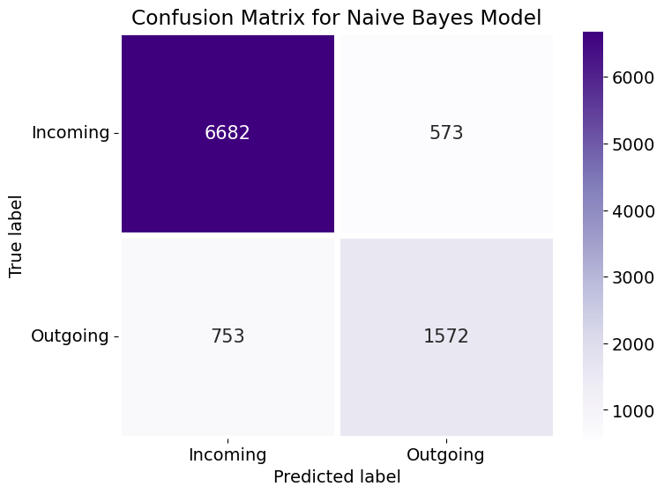
Model 3: Naive Bayes(NB) to Predict the Future Call Direction
The diagonal elements are the correctly predicted samples.
True positive: 6682 records of Incoming were predicted correctly by the model.
False-positive: 573 records of Outgoing were wrongly predicted as Incoming by the model.
False-negative: 753 records of Outgoing were wrongly predicted as Incoming records
True Negative: 1572 records of Outgoing were predicted correctly by the model.
Model accuracy is at 86%

Slide 21
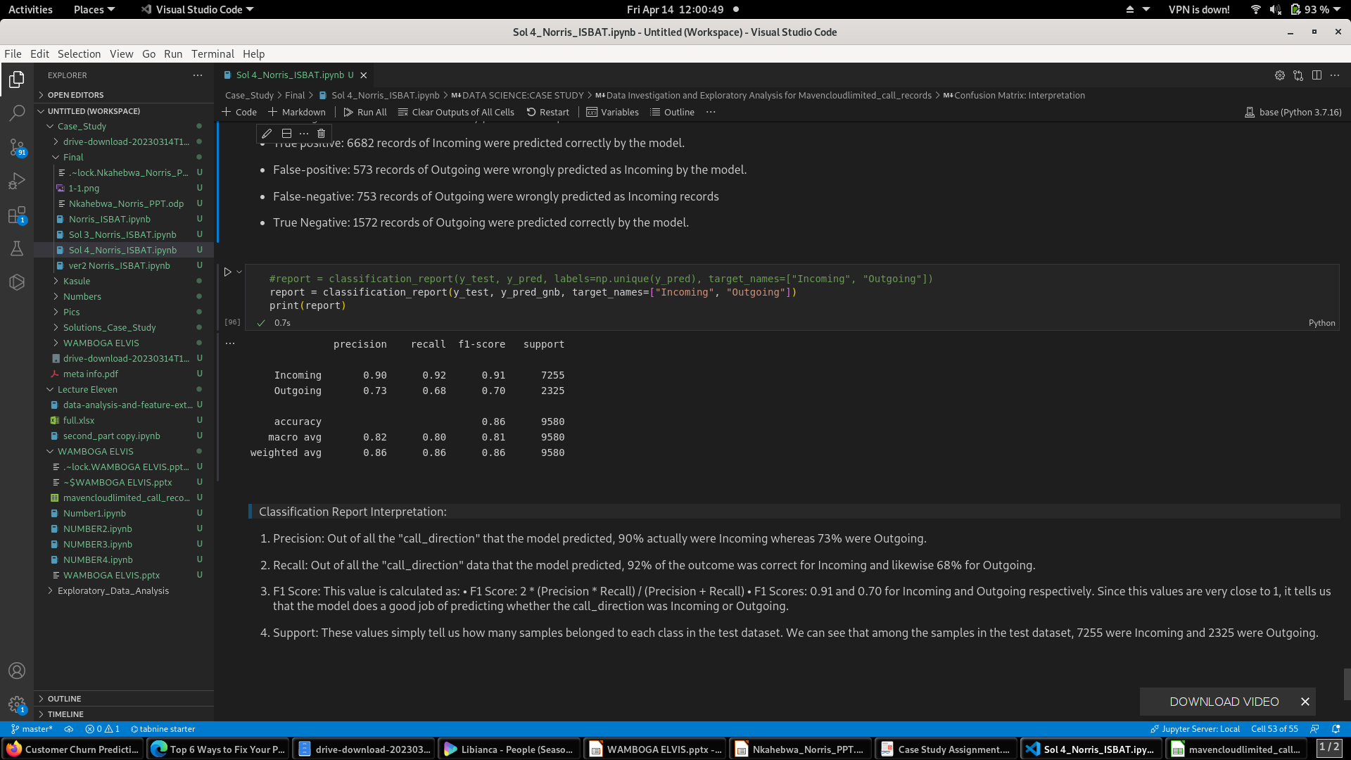
NB Classification Report for Future Call Direction
Precision: Out of all the "call_direction" that the model predicted, 90% actually were Incoming whereas 73% were Outgoing.
Recall: Out of all the "call_direction" data that the model predicted, 92% of the outcome was correct for Incoming and likewise 68% for Outgoing.
F1 Scores: 0.91 and 0.70 for Incoming and Outgoing respectively.
Since this values are very close to 1, it tells us that the model does a good job of predicting whether the call_direction was Incoming or Outgoing.
Support: These values simply tell us how many samples belonged to each class in the test dataset. We can see that among the samples in the test dataset, 7255 were Incoming and 2325 were Outgoing.

Slide 22
Thank you!
Q & A

