Slide 1
OPERATION: TUNA
MTA Configuration, Info Leakage, and yu.
AKA
Happy Fun Email Exploration

Slide 2
It started so innocently.

Slide 3
“dude, mail headers leak a lot of info”

Slide 4
Hmm…

Slide 5
rapid7?

Slide 6
Delivered-To: jcran@0x0e.org
Received: by 10.52.163.6 with SMTP id ye6cs23091vdb;
Sat, 12 Mar 2011 10:56:29 -0800 (PST)
Received: by 10.101.32.10 with SMTP id k10m1224100anj.159.1299956188566;
Sat, 12 Mar 2011 10:56:28 -0800 (PST)
MIME-Version: 1.0
Return-Path: <>
Received: by 10.101.32.10 with SMTP id k10mr1703754anj.159; Sat, 12 Mar 2011
10:56:28 -0800 (PST)
From: Mail Delivery Subsystem <mailer-daemon@googlemail.com>
To: jcran@0x0e.org
X-Failed-Recipients: alsdjflkdasjflkjsadfjlsdafj@rapid7.com
Subject: Delivery Status Notification (Failure)
Message-ID: <0016367d6154d7d2d2049e4da2e4@google.com>
Date: Sat, 12 Mar 2011 18:56:28 +0000
Content-Type: text/plain; charset=ISO-8859-1
Content-Transfer-Encoding: quoted-printable
Delivery to the following recipient failed permanently:
alsdjflkdasjflkjsadfjlsdafj@rapid7.com
Technical details of permanent failure:=20
Google tried to deliver your message, but it was rejected by the recipient =
domain. We recommend contacting the other email provider for further inform=
ation about the cause of this error. The error that the other server return=
ed was: 554 554 5.7.1 <alsdjflkdasjflkjsadfjlsdafj@rapid7.com>: Recipient a=
ddress rejected: Access denied (state 14).

Slide 7
Not much.

Slide 8
qualys?

Slide 9
Not much.

Slide 10
Tenable?

Slide 11
Delivered-To: jcran@0x0e.org
Received: from mail1.dmz.tenablesecurity.com ([172.20.210.11]) by mta1.tenable.com with ESMTP id lu4rFDf2w5F6TEtT for <jcran@0x0e.org>; Wed, 23 Feb 2011 18:39:07 -0500 (EST)
X-Barracuda-Envelope-From:
X-Barracuda-RBL-Trusted-Forwarder: 172.20.210.11
Received: by mail1.dmz.tenablesecurity.com (Postfix)
id D2B593144003; Wed, 23 Feb 2011 18:39:07 -0500 (EST)
Date: Wed, 23 Feb 2011 18:39:07 -0500 (EST)
Message-Id: <20110223233907.D2B593144003@mail1.dmz.tenablesecurity.com>
X-Barracuda-Connect: UNKNOWN[172.20.210.11]
X-Barracuda-Start-Time: 1298504347
X-Virus-Scanned: by bsmtpd at tenable.com
X-Barracuda-Spam-Score: 0.20
X-Barracuda-Spam-Status: No, SCORE=0.20 using global scores of TAG_LEVEL=1000.0 QUARANTINE_LEVEL=1000.0 KILL_LEVEL=9.0 tests=ANY_BOUNCE_MESSAGE, BOUNCE_MESSAGE, BSF_SC0_SA590, EMPTY_ENV_FROM
X-Barracuda-Spam-Report: Code version 3.2, rules version 3.2.2.56209
Rule breakdown below
pts rule name description
---- ---------------------- --------------------------------------------------
0.00 EMPTY_ENV_FROM Empty Envelope From Address
0.20 BSF_SC0_SA590 Custom Rule SA590
0.00 BOUNCE_MESSAGE MTA bounce message
0.00 ANY_BOUNCE_MESSAGE Message is some kind of bounce message
This is a MIME-encapsulated message.
--CADCB3144002.1298504347/mail1.dmz.tenablesecurity.com
Content-Description: Notification
Content-Type: text/plain; charset=us-ascii

Slide 12
Hmm, I wonder…

Slide 13
What if i?..

Slide 14
Send email?

Slide 15
Receive email?

Slide 16
Well, that seems easy enough.

Slide 17
But where to get the email addresses?

Slide 18
top-1m.csv.zip

Slide 19
Thank you Alexa :]

Slide 20
1,google.com
2,facebook.com
3,youtube.com
4,yahoo.com
5,live.com
6,blogspot.com
7,wikipedia.org
8,baidu.com
9,twitter.com
10,qq.com
11,msn.com
12,yahoo.co.jp
13,google.co.in
14,taobao.com
15,amazon.com
16,sina.com.cn
17,linkedin.com
18,bing.com
19,google.de
20,wordpress.com
21,google.com.hk
22,google.co.uk
23,yandex.ru
24,microsoft.com
25,ebay.com
26,google.co.jp
27,google.fr

Slide 21
aesop@bolivia:~operation_tuna$ cat gen_email.rb
#!/usr/bin/ruby def random_alphanumeric(size=16) s = "" size.times { s << (i = Kernel.rand(62); i += ((i < 10) ? 48 : ((i < 36) ? 55 : 61 ))).chr } s end f = File.open("domains.txt") out = File.open("emails.txt", "w") emails = [] f.each_line do |domain| domain.chomp! name = random_alphanumeric(30) out.puts "#{name}, #{name}@#{domain}" ## probably won't work end

Slide 22
AZWOfUWdjXUDxD0PJZzatzu97ham4G, AZWOfUWdjXUDxD0PJZzatzu97ham4G@google.com mLdLJYH0gKE61eXp9a8f5VwvT02FAs, mLdLJYH0gKE61eXp9a8f5VwvT02FAs@facebook.com
7eePLejlvZh1EyMcmyStv1nLCsgPGX, 7eePLejlvZh1EyMcmyStv1nLCsgPGX@youtube.com dIHHVdlQk6PwLlDGPPHILcCTgrP5Hs, dIHHVdlQk6PwLlDGPPHILcCTgrP5Hs@yahoo.com
4fcLsjXyM8u0Mu5e0gGUsHunMR414g, 4fcLsjXyM8u0Mu5e0gGUsHunMR414g@live.com w9lDwET4SCGjcGChLb2Vy0hdFoEPsH, w9lDwET4SCGjcGChLb2Vy0hdFoEPsH@blogspot.com uhRuwht5cAwTstdbJY3gWnXMeI4s8L, uhRuwht5cAwTstdbJY3gWnXMeI4s8L@wikipedia.org
WF0jJ2zAmyYyWEw3pNeIHTHAk93Q3T, WF0jJ2zAmyYyWEw3pNeIHTHAk93Q3T@baidu.com
UPm7eHu1scRoyPQRQCsP1QFetK6ejs, UPm7eHu1scRoyPQRQCsP1QFetK6ejs@twitter.com
2hBUCYzpI18VMsCuLN6fopJ465YOqy, 2hBUCYzpI18VMsCuLN6fopJ465YOqy@qq.com uL3YTsHH7qnbF01186yHNROGhSuMVT, uL3YTsHH7qnbF01186yHNROGhSuMVT@msn.com
XAUXp3gwS6MhOWfDTsojdiwqt0lhkc, XAUXp3gwS6MhOWfDTsojdiwqt0lhkc@yahoo.co.jp
FNv7T9wdkEvxuyuDn6pPVKlc0Cuiki, FNv7T9wdkEvxuyuDn6pPVKlc0Cuiki@google.co.in
Pov60wAdp8cfEiX6WKg1zGstjKu6rv, Pov60wAdp8cfEiX6WKg1zGstjKu6rv@taobao.com ujfF8HjlZIQkfqo5TraGzhBe9SWaud, ujfF8HjlZIQkfqo5TraGzhBe9SWaud@amazon.com
0hM6fmphoGt21KttYQXbj3GkHtvmhi, 0hM6fmphoGt21KttYQXbj3GkHtvmhi@sina.com.cn xS3QVNHXolfn2qgYEIwna7Wcp2towv, xS3QVNHXolfn2qgYEIwna7Wcp2towv@linkedin.com
4LMVDySGgfo0SQW9Tty7AANiLEp3JK, 4LMVDySGgfo0SQW9Tty7AANiLEp3JK@bing.com h3EwfrfTr4F95M5Lu741XBuo9Acwzs, h3EwfrfTr4F95M5Lu741XBuo9Acwzs@google.de
QQ0ha2yQHhfNDLoczRHrbePU6HO9Gs, QQ0ha2yQHhfNDLoczRHrbePU6HO9Gs@wordpress.com zrMcbAf1XnqCKR7rad03ExPfgFpKP2, zrMcbAf1XnqCKR7rad03ExPfgFpKP2@google.com.hk
3BKXd4IbLOhwHJ31RekSFr4gGVP4Zm, 3BKXd4IbLOhwHJ31RekSFr4gGVP4Zm@google.co.uk
LcEjGPqgAIvSs204uVlD7TUcw1UpZb, LcEjGPqgAIvSs204uVlD7TUcw1UpZb@yandex.ru

Slide 23
Use auxiliary/client/smtp/emailer

Slide 24
Hfs, simplify simplify!

Slide 25
Let’r rip!

Slide 26
Your Linode, linode84209, has exceeded the notification threshold (1000) for disk io rate by averaging 10073.11 for the last 2 hours.

Slide 27
20k/emails sent in the first day

Slide 28
1500 ~interesting replies

Slide 29
A quick note on pulling down mail

Slide 30
larch --from imaps://imap.gmail.com --all --from-user aesopisthename@gmail.com --to imap://localhost --to-user aesop

Slide 31
You’ve got mail!

Slide 32
Abuse@linode.com?!?

Slide 33
Aww, crap.

Slide 34
Yo, I’m not a spammer!

Slide 35

I’m tuna fishing!

Slide 36
Clean-mx.de

Slide 37
auto-complaint on a 550?

Slide 38
Quick review of SMTP errors

Slide 39
550 Requested action not taken: mailbox unavailable (E.g., mailbox not found, no access)

Slide 40


Slide 41
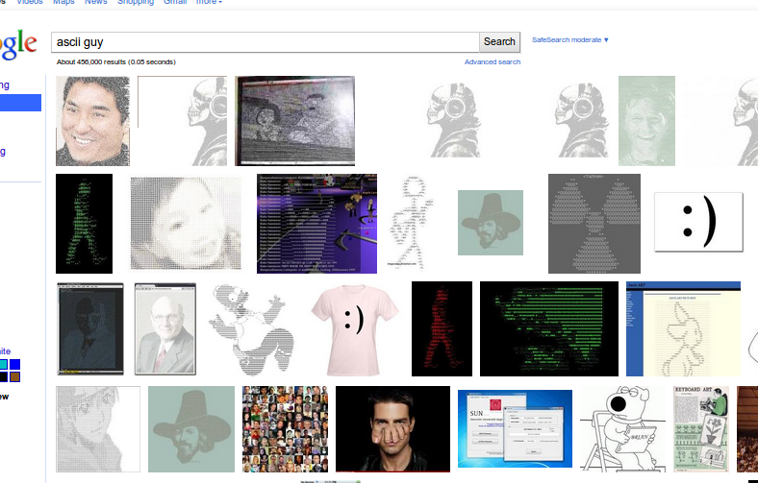

Slide 42
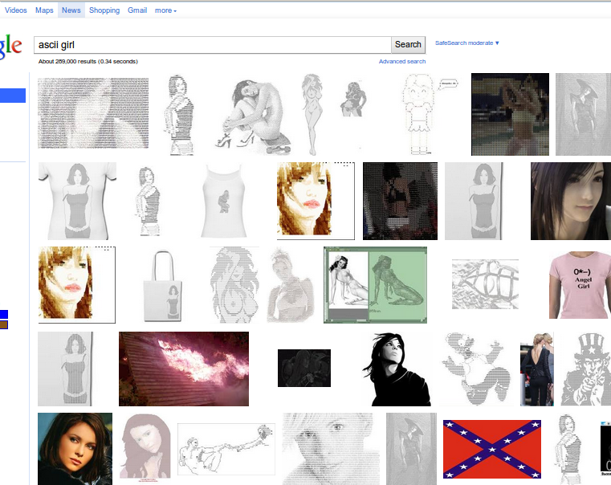

Slide 43
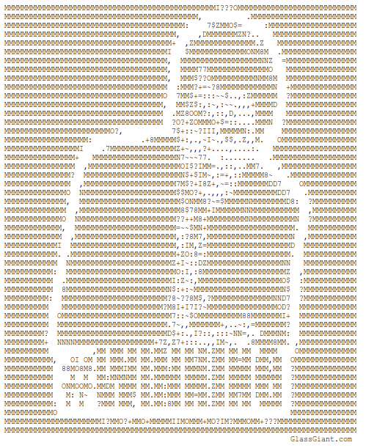

Slide 44
400k emails.
3 complaints.

Slide 45
<Iyu9MpLX25Hv5rr2mulSW9Ma20iBrO@press1.de>
<vmySmBDV0XxDrjLR0g3nKN6WQznifS@clean-mx.de> fVoRYQNejjA2mFF3cQGFjdpDSJKZ1d@ibusiness.de

Slide 46


Slide 47
apologize for the confusion -- you've provided more than enough information, thank you! However in the past, we have had security researches block hosts/ranges of companies who have these types of reporting systems in place to minimize the amount of complaints generated by their Linode(s). At the moment, it appears that these complaints are mainly coming from hosts that operate within netpilot's network (netpilot.net) -- perhaps you could exclude hosts netpilot's network from your tests? This is just a suggestion, however it may help to minimize the frequency of these tickets!
In any case, I have also gone ahead and made a note on your account to let members of our support team know about the security research your are carrying out, which should make future reports a lot easier to deal with.
Once again, I apologize for the confusion. Feel free to resumeyour mailer script :)!
Best Regards,
Danny Ariti

Slide 48
Linode rocks.

Slide 49
Linode rocks.

Slide 50
This is where the AHA left off.

Slide 51
And this is where the fun begins.

Slide 52
379702 emails sent

Slide 53
You are currently using 4995 MB (66%) of your 7560 MB.

Slide 54
Processed ~100k

Slide 55
~20,000 “interesting”responses

Slide 56
The numbers are fail.

Slide 57

A Quick PSA

Slide 58
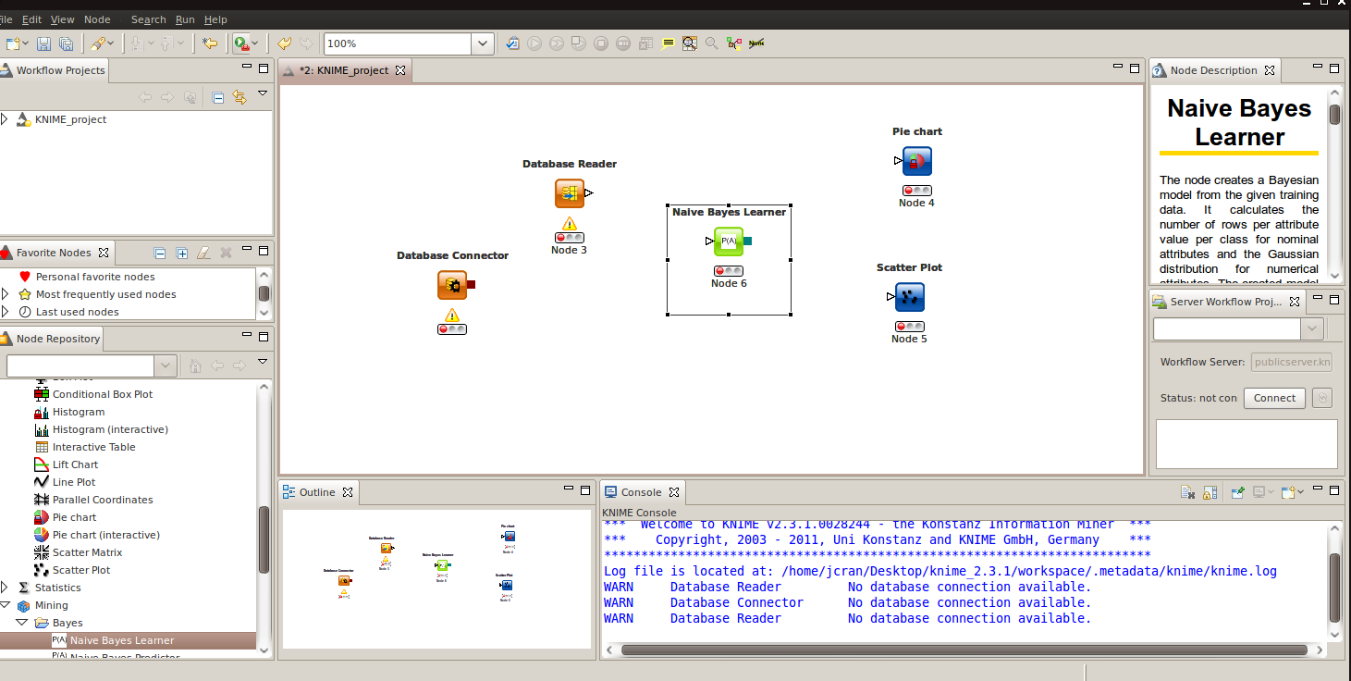

Slide 59
lazy

Slide 60
Rails!

Slide 61
Rails =/= Analysis

Slide 62
pengwynn

Slide 63
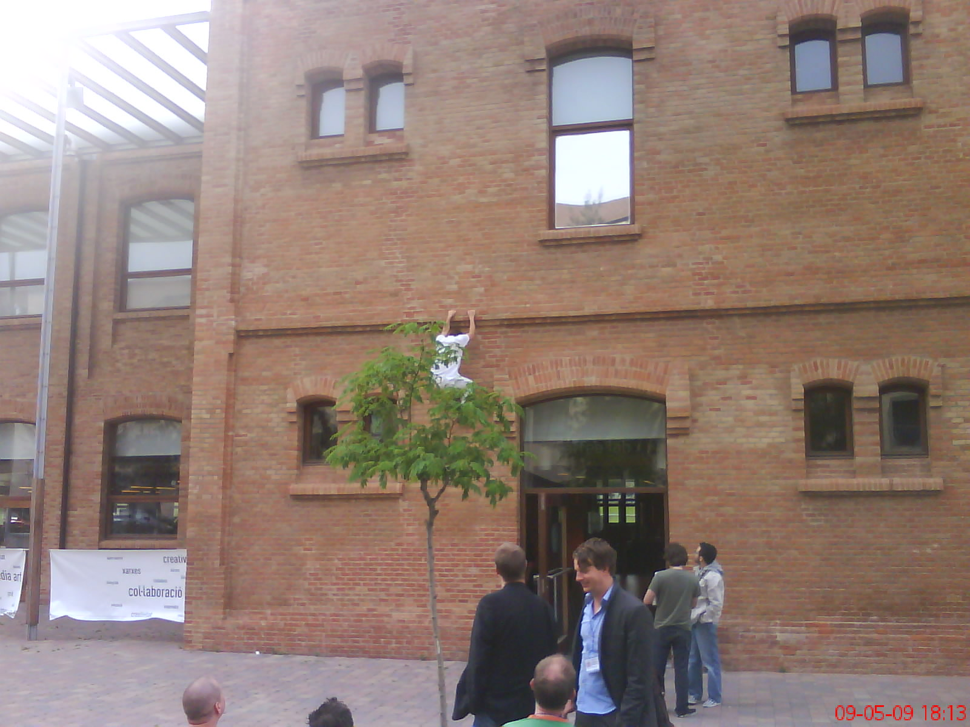

Slide 64
TUNA FACTORY!

Slide 65
Rapid7

Slide 66
When all you have is a hammer

Slide 67


Slide 68
Ghetto Mail Analytics

Slide 69
MTA?

Slide 70
aesop@bolivia:~/operation_tuna/mail$ cat * | grep Exchange | wc
1303 12023 84282 aesop@bolivia:~/operation_tuna/mail$ cat * | grep Postfix | wc
5447 36288 308272 aesop@bolivia:~/operation_tuna/mail$ cat * | grep -i sendmail | wc
15 141 1397 aesop@bolivia:~/operation_tuna/mail$ cat * | grep -i bigfish | wc
3090 18574 226804 aesop@bolivia:~/operation_tuna/mail$ cat * | grep -i sophos | wc
751 1624 40942 aesop@bolivia:~/operation_tuna/mail$ cat * | grep -i barracuda | wc
640 2942 43602

Slide 71
Antispam?

Slide 72
Antivirus?

Slide 73
TODO

Slide 74
todo

Slide 75
todo

Slide 76
Irancell.ir

Slide 77
X-QHPSI: clean
Received: (indimail 5206 invoked by uid 555); 17 Feb 2011 01:53:46 +0330
DKIM-Status: no signatures
DomainKey-Status: no signature
Received: from unknown (HELO drl423.irancell.ir) (::ffff:10.132.62.138)
by 0 with ESMTPS; 17 Feb 2011 01:53:46 +0330
X-QHPSI: clean
Received: (indimail 19157 invoked by uid 555); 17 Feb 2011 01:53:46 +0330
DKIM-Status: no signatures
DomainKey-Status: no signature
Received: from unknown (HELO drl415.irancell.ir) (::ffff:10.132.62.138)
by 0 with ESMTPS; 17 Feb 2011 01:53:46 +0330
X-QHPSI: clean
Received: (indimail 5182 invoked by uid 555); 17 Feb 2011 01:53:46 +0330
DKIM-Status: no signatures
DomainKey-Status: no signature
Received: from unknown (HELO drl423.irancell.ir) (::ffff:10.132.62.138)
by 0 with ESMTPS; 17 Feb 2011 01:53:46 +0330
X-QHPSI: clean
Received: (indimail 19139 invoked by uid 555); 17 Feb 2011 01:53:46 +0330
DKIM-Status: no signatures
DomainKey-Status: no signature
Received: from unknown (HELO drl415.irancell.ir) (::ffff:10.132.62.138)
by 0 with ESMTPS; 17 Feb 2011 01:53:46 +0330
X-QHPSI: clean

Slide 78
Remote host said: 554 too many hops, this message is looping (#5.4.6)

Slide 79
Accenture.com

Slide 80
Received: from AMRXV1001.dir.svc.accenture.com ([10.10.160.61]) by
mtahm1100.accenture.com (Lotus Domino Release 5.0.9a) with ESMTP id
2011021616494061:171546 ; Wed, 16 Feb 2011 16:49:40 -0600
Received: from AMRXH3004.dir.svc.accenture.com ([10.63.34.26]) by
AMRXV1001.dir.svc.accenture.com with Microsoft SMTPSVC(6.0.3790.3959); Wed,
16 Feb 2011 16:49:38 -0600
Received: from AMRXH3006.dir.svc.accenture.com (10.63.34.50) by
AMRXH3004.dir.svc.accenture.com (10.63.34.26) with Microsoft SMTP Server
(TLS) id 8.3.106.1; Wed, 16 Feb 2011 17:49:38 -0500
Received: from EMEXH3001.dir.svc.accenture.com (10.134.3.22) by
AMRXH3006.dir.svc.accenture.com (10.63.34.50) with Microsoft SMTP Server
(TLS) id 8.3.106.1; Wed, 16 Feb 2011 17:49:37 -0500
Received: from EMEXE3001.dir.svc.accenture.com (10.134.4.201) by
EMEXH3001.dir.svc.accenture.com (10.134.3.22) with Microsoft SMTP Server
(TLS) id 8.3.106.1; Wed, 16 Feb 2011 23:49:36 +0100
Received: from mail63-tx2-R.bigfish.com (65.55.88.112) by
emexe3141.accenture.com (10.134.4.141) with Microsoft SMTP Server (TLS) id
8.3.106.1; Wed, 16 Feb 2011 23:49:35 +0100
Received: from mail63-tx2 (localhost.localdomain [127.0.0.1]) by
mail63-tx2-R.bigfish.com (Postfix) with ESMTP id 345A11720493 for
<d5WPgvcCzuDVrcJxuZiDeXpdnXRcxm@accenture.com>; Wed, 16 Feb 2011 22:49:34
+0000 (UTC)
Received: from mail63-tx2 (localhost.localdomain [127.0.0.1]) by mail63-tx2
(MessageSwitch) id 1297896555693214_13963; Wed, 16 Feb 2011 22:49:15 +0000
(UTC)
Received: from TX2EHSMHS031.bigfish.com (unknown [10.9.14.240]) by
mail63-tx2.bigfish.com (Postfix) with ESMTP id 1CF231C600CD for
<d5WPgvcCzuDVrcJxuZiDeXpdnXRcxm@accenture.com>; Wed, 16 Feb 2011 22:48:41
+0000 (UTC)

Slide 81
Received: from AMRXV1001.dir.svc.accenture.com ([10.10.160.61]) by mtahm1100.accenture.com (Lotus Domino Release 5.0.9a) with ESMTP id
2011021616494061:171546 ; Wed, 16 Feb 2011 16:49:40 -0600

Slide 82
http://www.dominosecurity.org/A5581F/DominoSecurityOrg.nsf/c61b67c0b136c61e85256a00006c8d09/9709d3584b0fa22085256cde0069545b!OpenDocument

Slide 83
(01:21:32 AM) mubix: cat bigfish | sed 's/\ /\n/g' | grep bigfish | grep -P '^[0-9a-zA-Z]' | sed 's/[).;]$//' | sed 's/^dns;//' | xargs -I lookup dig lookup +short | sort | uniq -c | sort -n
(01:23:49 AM) mubix: 130 157.55.116.138
(01:23:49 AM) mubix: 144 94.245.120.74
(01:23:49 AM) mubix: 182 216.32.180.10
(01:23:49 AM) mubix: 342 65.55.88.10

Slide 84
What about shells, dude. shells.

Slide 85
Exim 4.72?

Slide 86
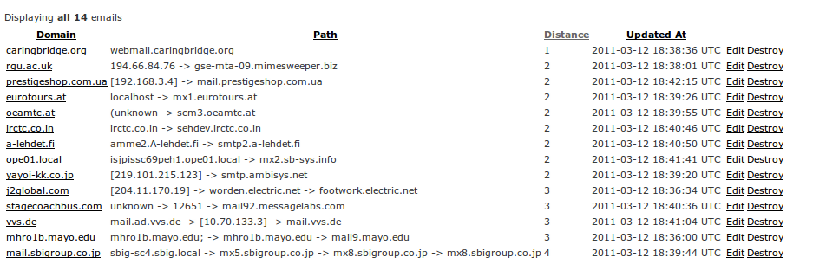

Slide 87


Slide 88
Creds & References:
Metasploit Team
Linode http://www.marktheshark.com/
Michelle Obama

