Slide 1
CSS
CSS is the language used to style web pages
CSS Syntax
/*selector*/ h5 {
color: blue; /*property*/
font-size: 10px; /*value*/
}
CSS Selectors
Element selectors
Class selectors
Id selectors
Grouping selectors
Universal selector

Slide 2
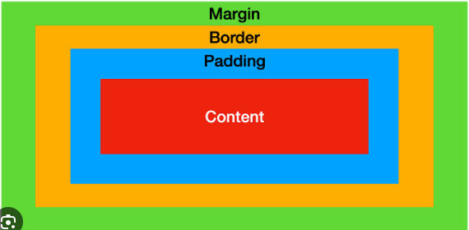
CSS Box Model
The CSS box model is essentially a box that wraps around every HTML element. It consists of: margins, borders, padding, and the actual content. The image below illustrates the box model:

Slide 3
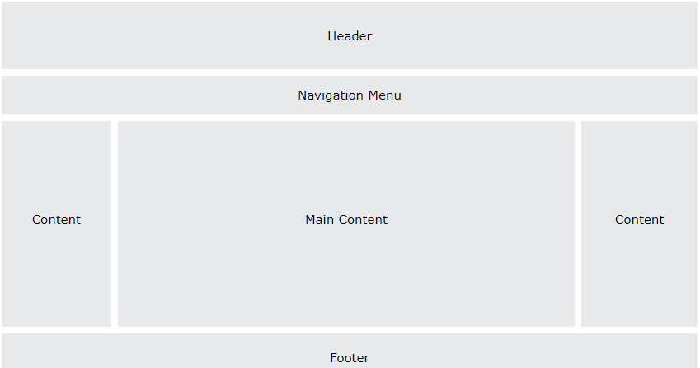
CSS Layouts

Slide 4
Header
A header is usually located at the top of the website
Navigation Menu
These are menu link for resources on web pages
Content
These are divided into column layouts depending on the structure of the web page. It usually contains the main content of a page
Footer
This is usually placed at the bottom of a web page. It is useful for copyright and contact info.

Slide 5
CSS Specificity
CSS specificity is ranking criteria that determines which style declaration is ultimately applied to an element.
These are categories which define the specificity level of a selector:
Inline styles - Example: <h3 style="color: red;">
IDs - Example: #myID
Classes, pseudo-classes, attribute selectors - Example: .myClass, :hover, [href]
Elements and pseudo-elements - Example: h2, ::after
Inline styles also takes specificity over internal style while internal style takes specificity over external style.
Equal Specificity: The latest CSS style will be applied

Slide 6
CSS Important
The CSS !important is used to override all specificity rule applied to HTML elements.
P {
background-color: green !important;
}

