Slide 1

An AQuA Success Story
Analysing A Donated Archive
http://wiki.opf-labs.org/display/AQuA/Externally+Generated+Content
www.openplanetsfoundation.org

Slide 2
The AQuA Challenge
The content:
  The electronic archive of a war studies academic who was a lecturer at Sandhurst.
  Donated to King's College London Archives.
    In the care of Lindsay Ould.
The problem:
  How should Lindsay start the process of archival appraisal? Where to begin?
www.openplanetsfoundation.org

Slide 3
The AQuA Solution
Written by Carl Wilson
Re-uses web crawler techniques:
  Analyses all files with Apache Tika
    Determines content (MIME) type
    Extracts text
  Indexes files using Apache Lucene
    Allow document text to be searched
    Allow word frequency analysis
www.openplanetsfoundation.org

Slide 4
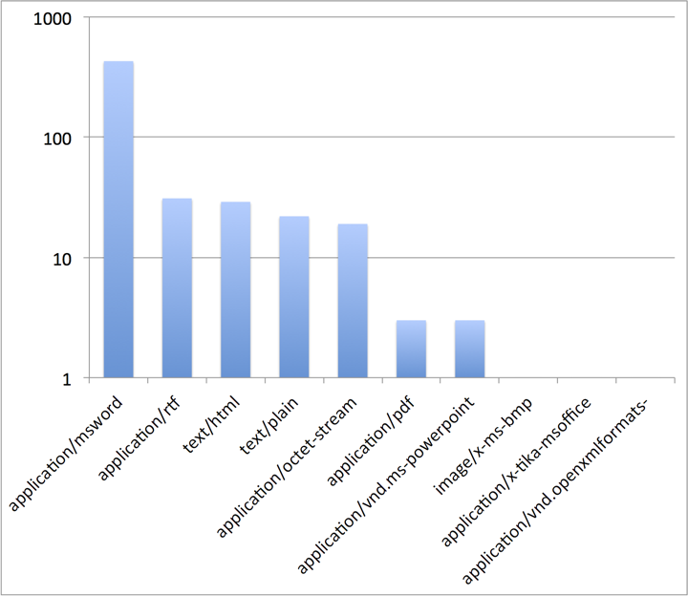
Format Distribution
www.openplanetsfoundation.org
Notes:
Note that this analysis also revealed that this user insisted on renaming *.html to *.doc to allow editing of documents in Microsoft Word. It seems Word allowed this to happen without correcting the mismatch between the content and the extension.

Slide 5
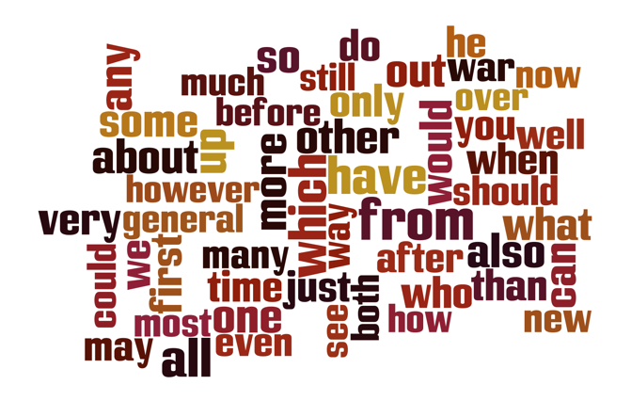
Overall Word Frequencies
www.openplanetsfoundation.org
Notes:
The frequencies of the word in the corpus are not very enlightening - just shows many common words, fairly evenly used.
I realised that it should be possible to measure the word frequencies relative to the general distribution for common English usage. This would mean that the distinctive words, the words that were unusually common in this corpus, would bubble to the top.
I found a small but otherwise suitable reference corpus, generated by some computational linguists, and used that to generate the relative frequency chart.

Slide 6
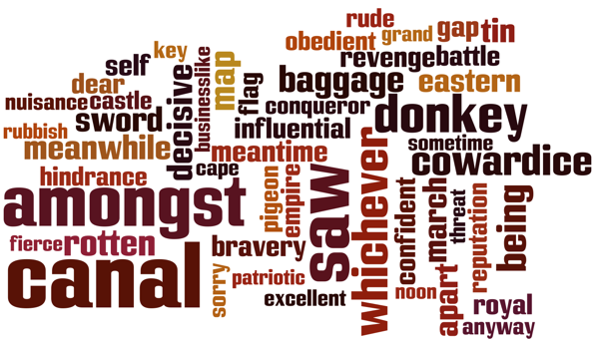
Relative Word Frequencies
www.openplanetsfoundation.org
Notes:
This leads to a much more interesting word cloud. As well as many war-related terms (as would would expect), it seems canals were of particular interest. I also learned from Lindsay that the academic in question did not, shall we say, suffer fools gladly. Some of the more... aggressive terminology did not surprise her.
This is quite interesting, but even more striking is imagining the possible next steps, e.g. linking these words to the search index to look at the use of words in context.
The general approach could also be improved, e.g. Wikipedia to general a larger subject-neutral corpus, e.g. using Wikipedia to train a spam filter to categorise corpora, and offering all of this stuff as a service.

