Slide 1

Optimum routes for LAX-HKG within Russian Airspace in WIN06 Analysis

Slide 2
Objective
Define the major route structure of optimum routes
Determine the potential new entry points in Russian boundary

Slide 3
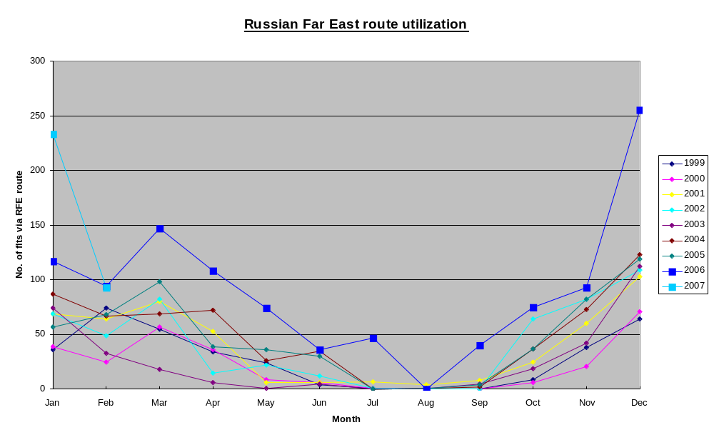

Slide 4
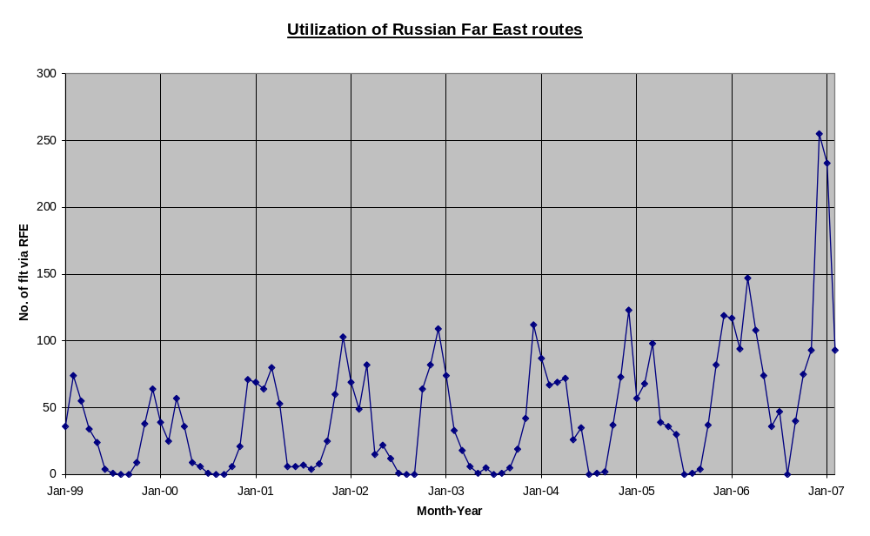

Slide 5
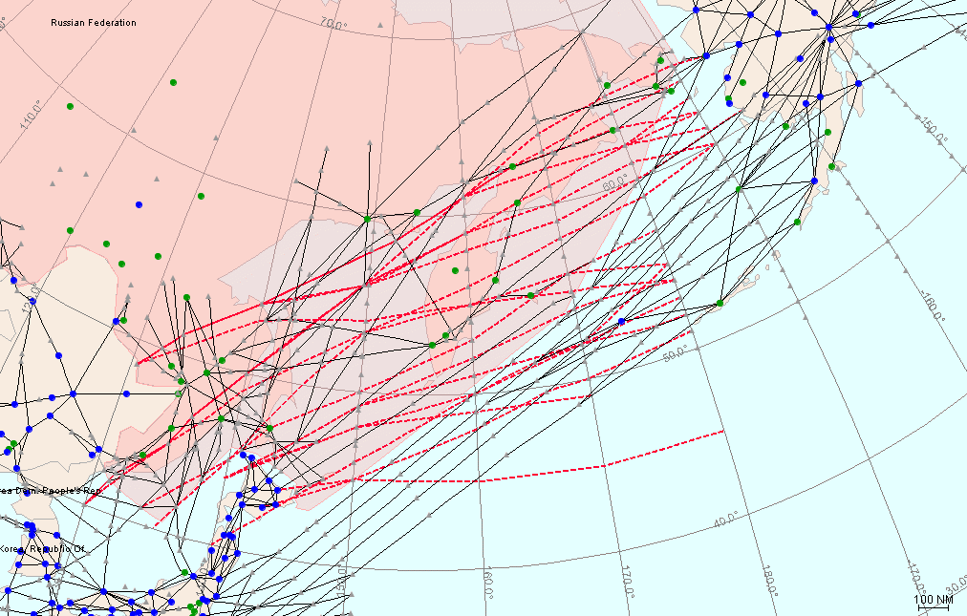
Optimum route for LAX-HKG within Russian airspace in Nov06

Slide 6
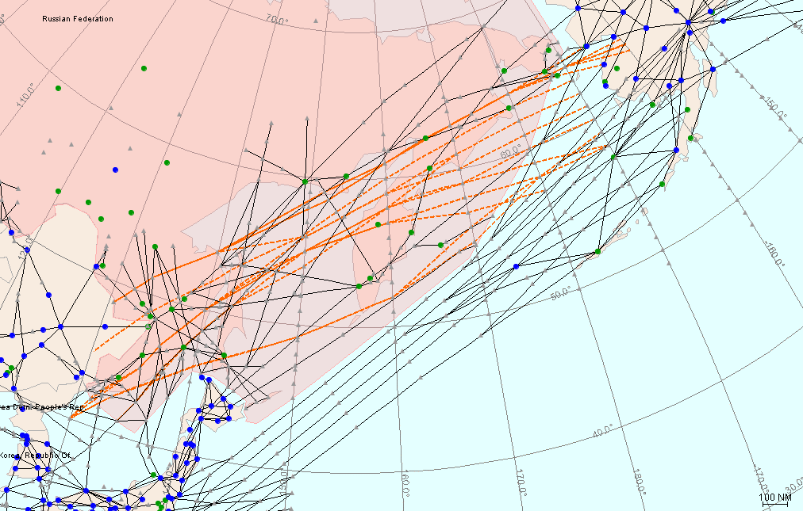
Optimum route for LAX-HKG within Russian airspace in Dec06

Slide 7
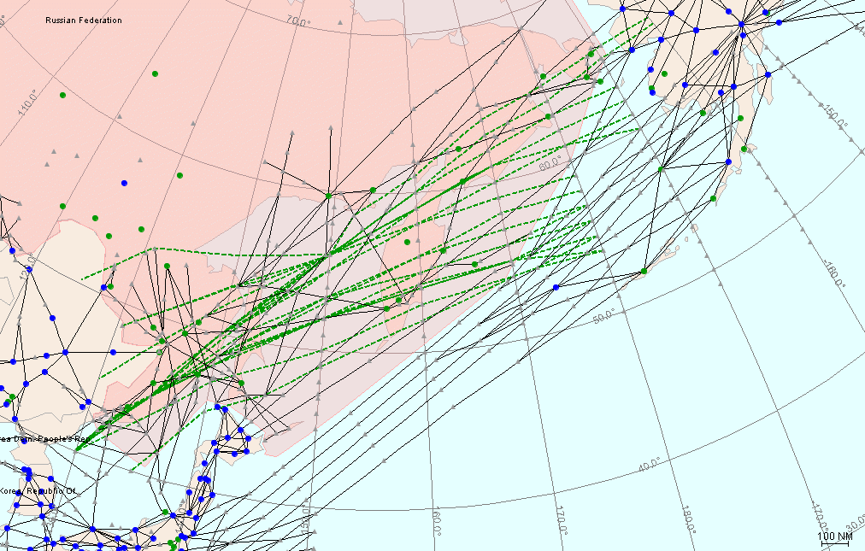
Optimum route for LAX-HKG within Russian airspace in Jan07

Slide 8
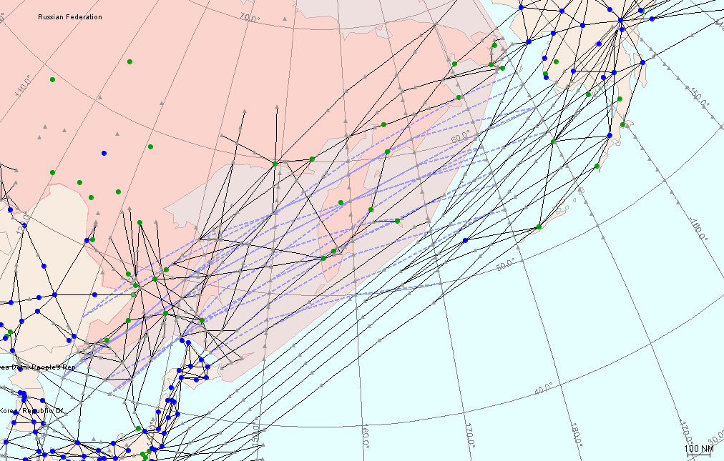
Optimum route for LAX-HKG within Russian airspace in Feb07

Slide 9
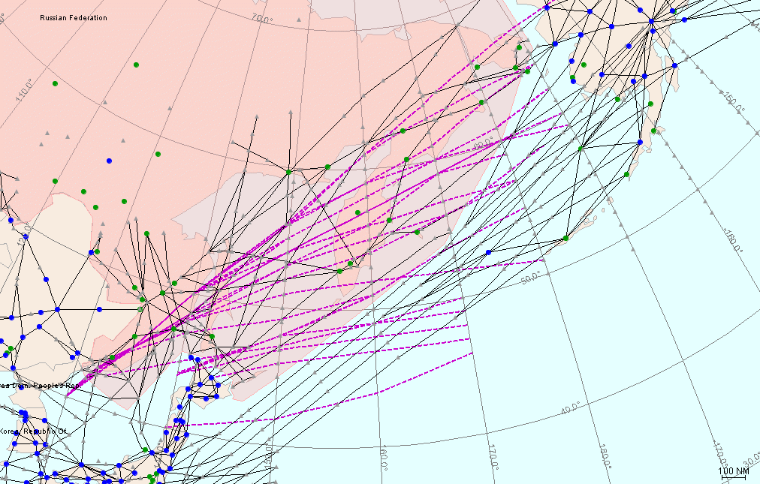
Optimum route for LAX-HKG within Russian airspace in Mar07

Slide 10
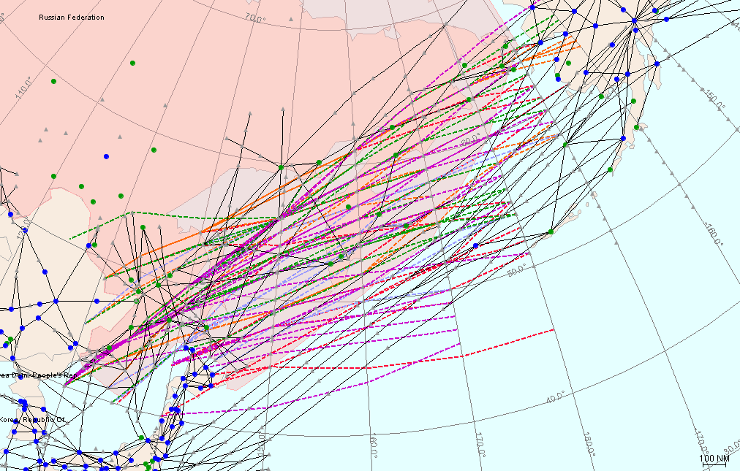

Slide 11
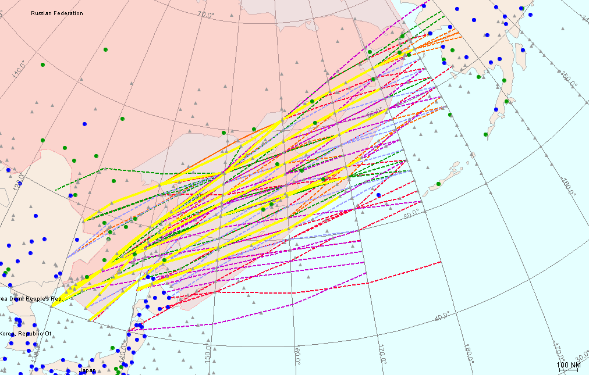
Major flows of optimum routes in monthly basis

Slide 12
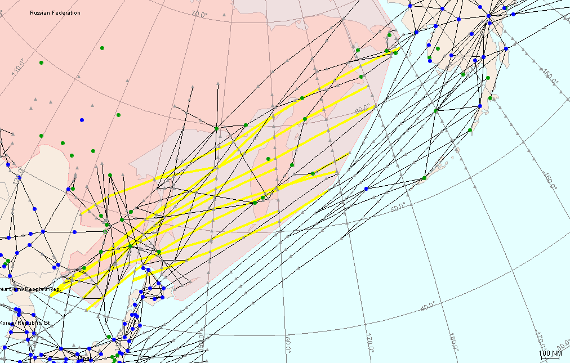
Major flows of optimum routes in monthly basis

Slide 13
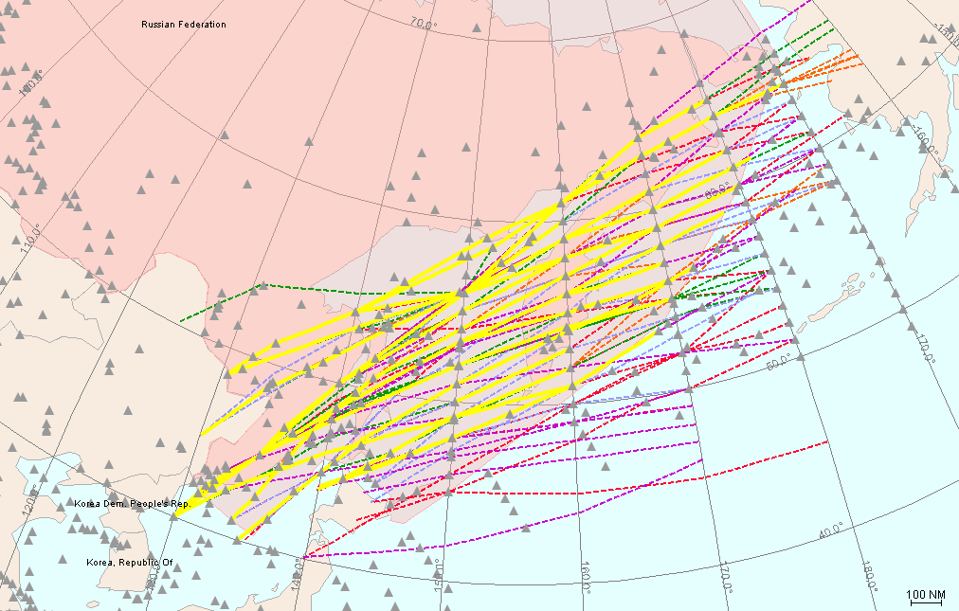
Major flows of optimum routes in WIN06

Slide 14
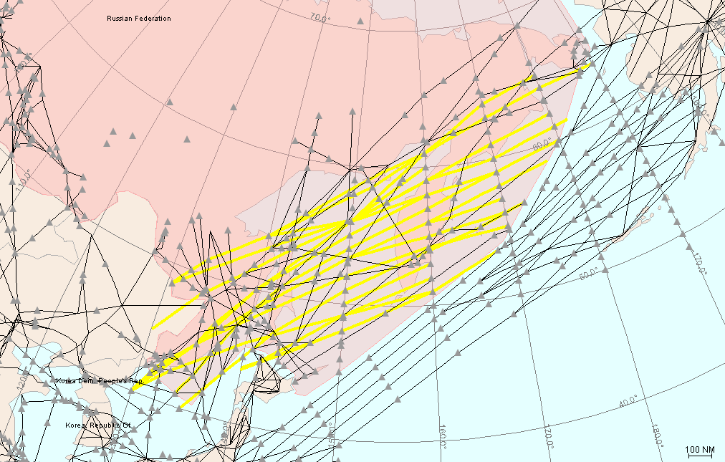
Major flows of optimum routes in WIN06

Slide 15
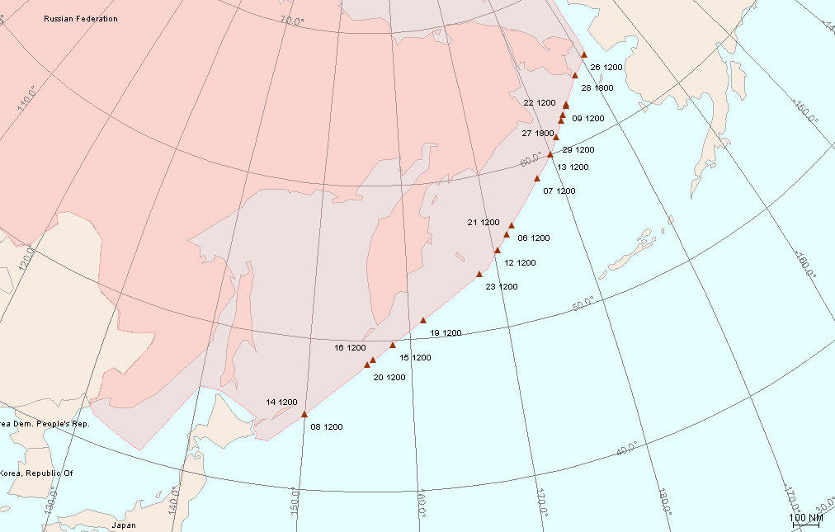
Entry points for optimum routes in Nov06

Slide 16
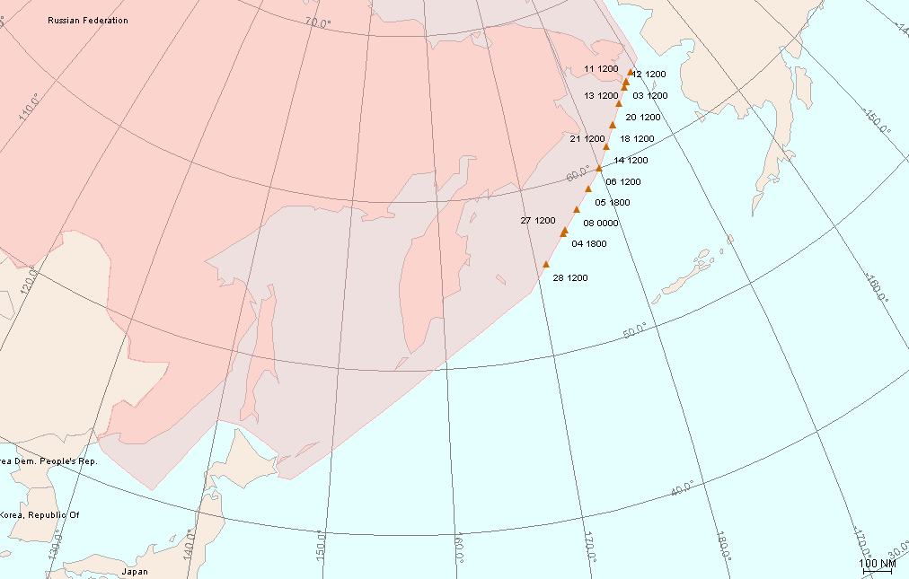
Entry points for optimum routes in Dec06

Slide 17
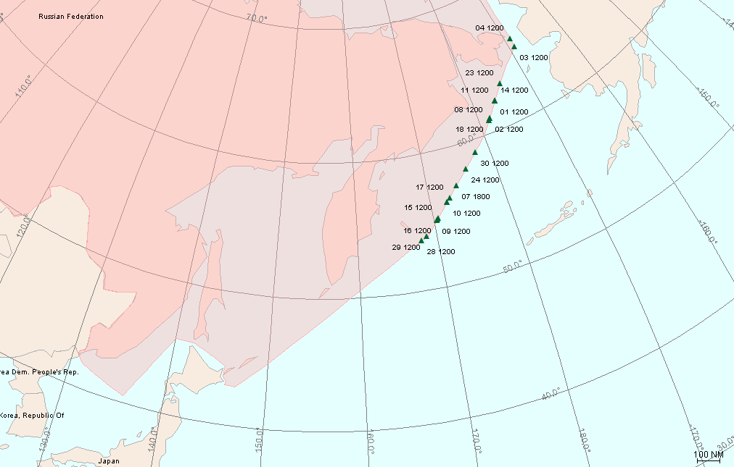
Entry points for optimum routes in Jan07

Slide 18
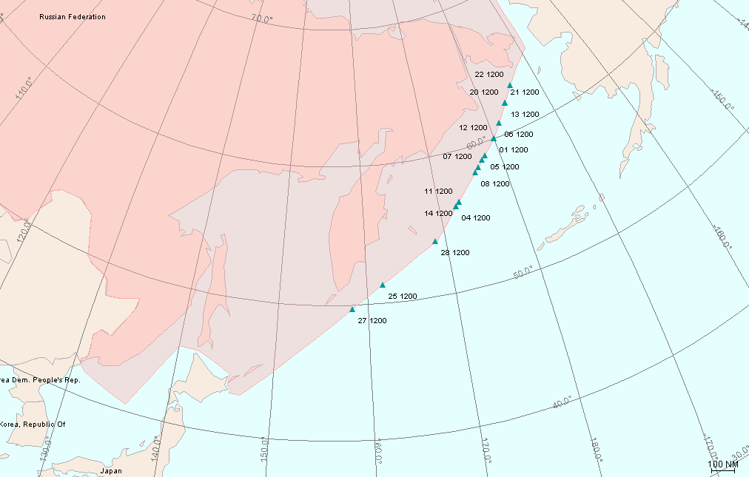
Entry points for optimum routes in Feb07

Slide 19
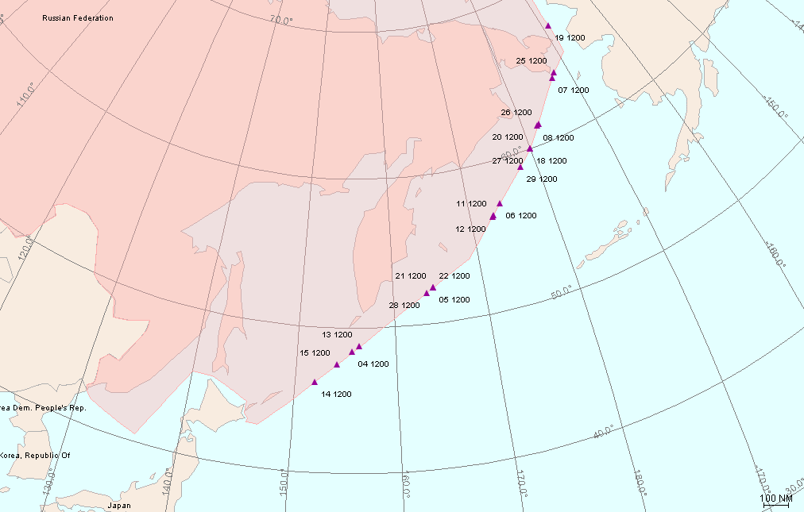
Entry points for optimum routes in Mar07

Slide 20
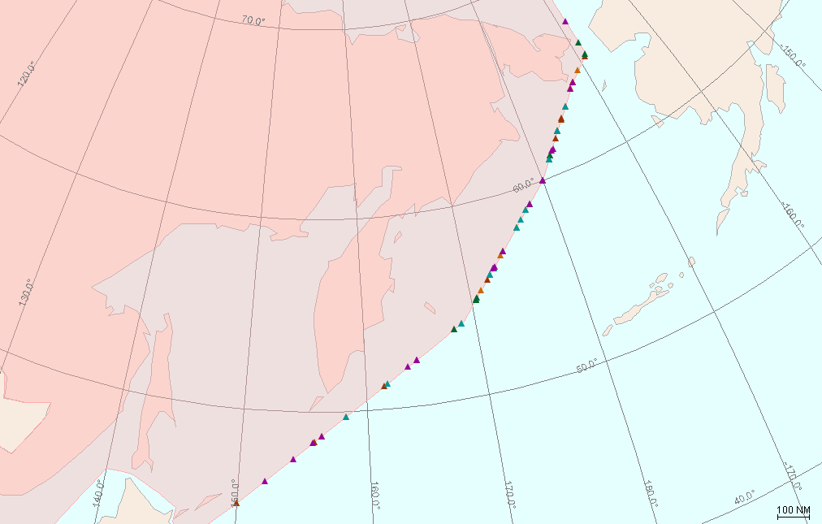
FRENK
BATNI
LARSA
ADLEN
Overall view for the entry points of optimum routes in WIN06
VALDA
ERNIK
OLTON
BESAT
BAMOK
KOKES

Slide 21
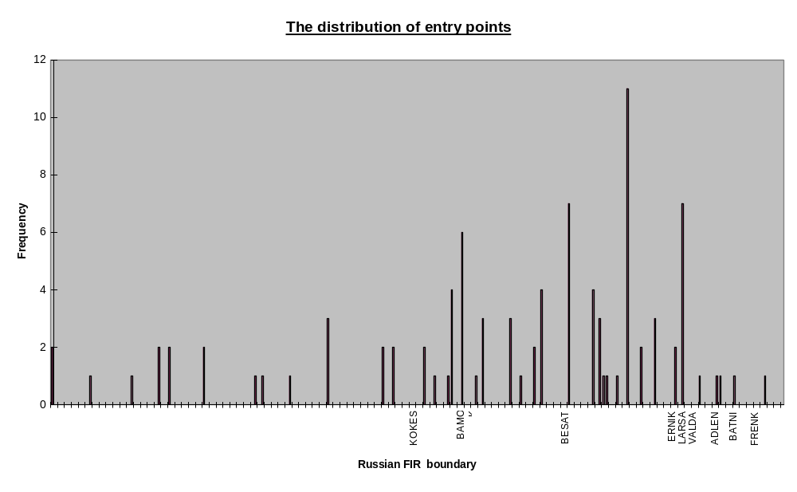
100nm

Slide 22
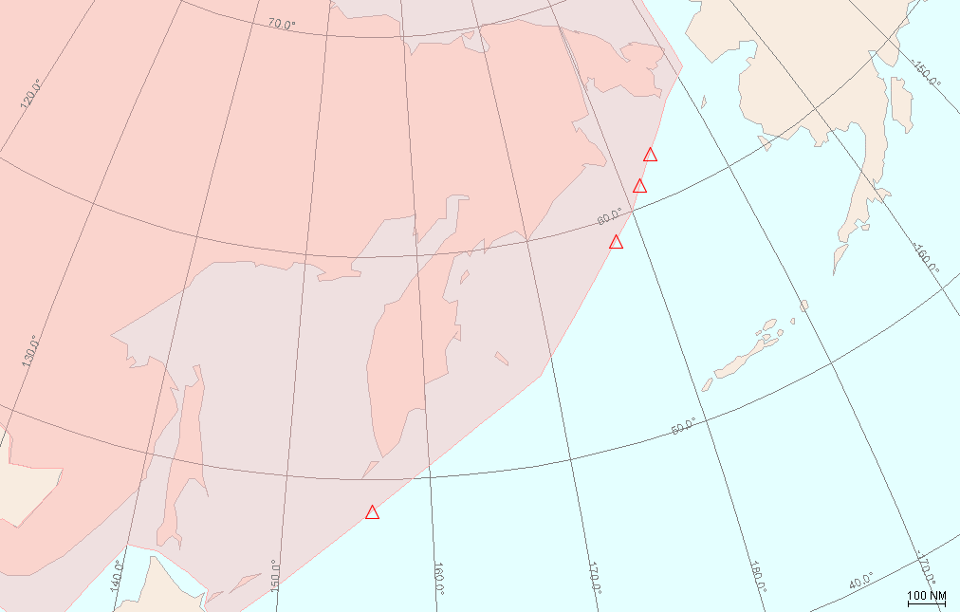




FRENK
BATNI
LARSA
ADLEN
Proposed new entry points
VALDA
ERNIK
OLTON
BESAT
BAMOK
KOKES

Slide 23
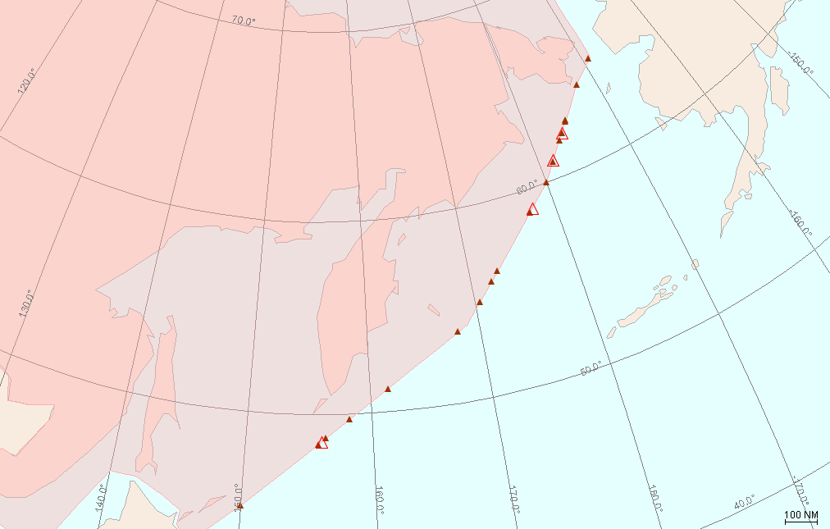
FRENK
BATNI
LARSA
ADLEN
Proposed new entry points with entry points of optimum routes in Nov06
VALDA
ERNIK
OLTON
BESAT
BAMOK
KOKES

Slide 24
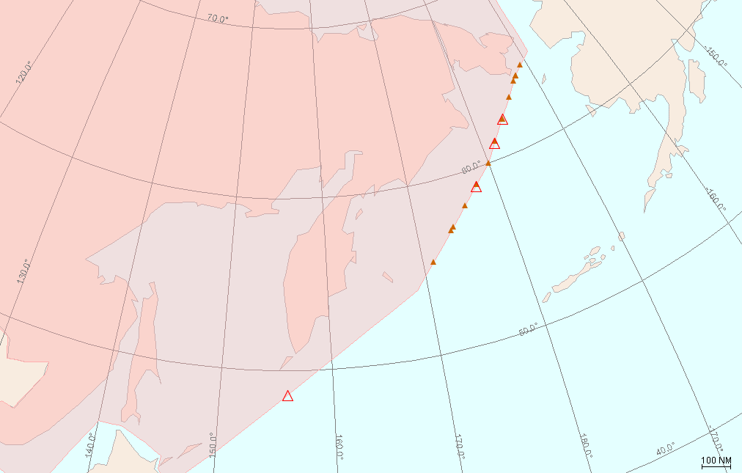
FRENK
BATNI
LARSA
ADLEN
Proposed new entry points with entry points of optimum routes in Dec06
VALDA
ERNIK
OLTON
BESAT
BAMOK
KOKES

Slide 25
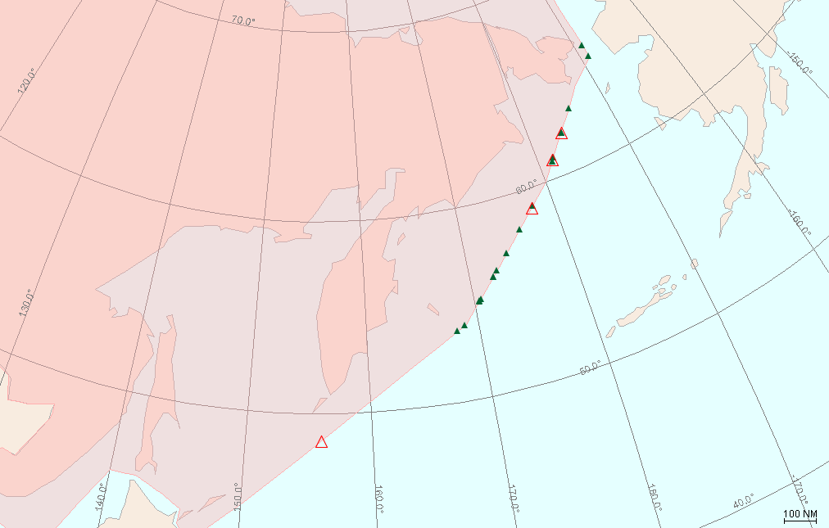
FRENK
BATNI
LARSA
ADLEN
Proposed new entry points with entry points of optimum routes in Jan07
VALDA
ERNIK
OLTON
BESAT
BAMOK
KOKES

Slide 26
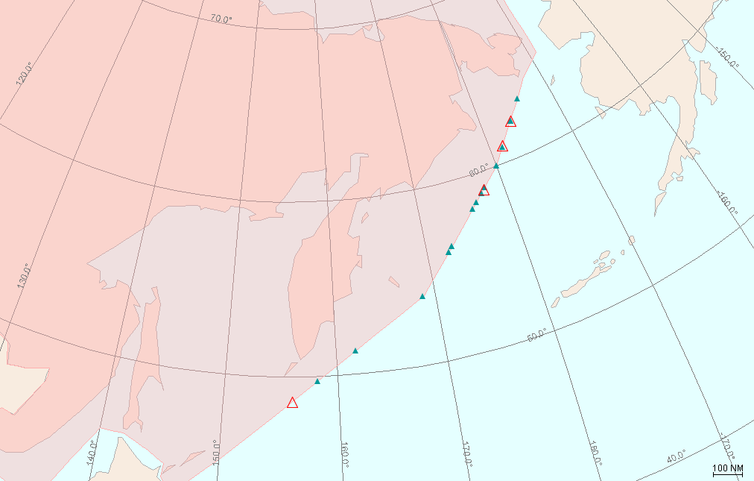
FRENK
BATNI
LARSA
ADLEN
Proposed new entry points with entry points of optimum routes in Feb07
VALDA
ERNIK
OLTON
BESAT
BAMOK
KOKES

Slide 27

FRENK
BATNI
LARSA
ADLEN
Proposed new entry points with entry points of optimum routes in Mar07
VALDA
ERNIK
OLTON
BESAT
BAMOK
KOKES

Slide 28
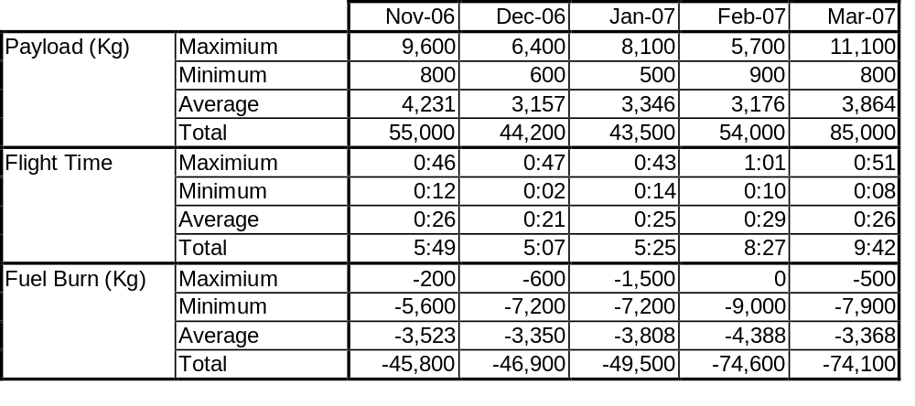
Difference between
optimum and current routes
(PACOTS and RFE)
- daily flight

Slide 29
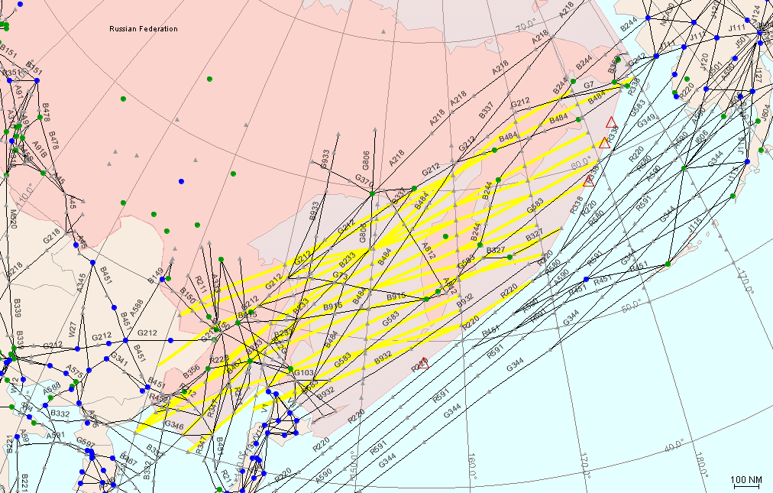
FRENK
BATNI
Proposed new entry points with major flow of optimum routes in WIN06
LARSA
ADLEN
VALDA
ERNIK
OLTON
BESAT
BAMOK
KOKES

