Slide 1


Modern biases in in situ SST measurements
John Kennedy, Nick Rayner, Philip Brohan, David Parker, Chris Folland, et al.

Slide 2
Summary
SST measurement methods.
Introduction to the SST record.
Biases associated with each method.
Impacts of measurement method on climate monitoring.
Notes:
Mention HadSST2 and ICOADS

Slide 3
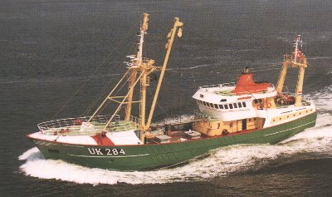
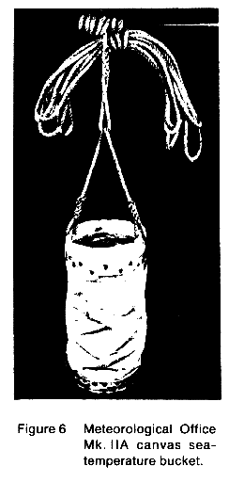
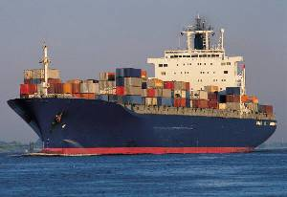
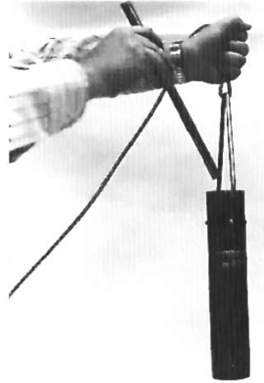
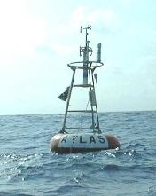
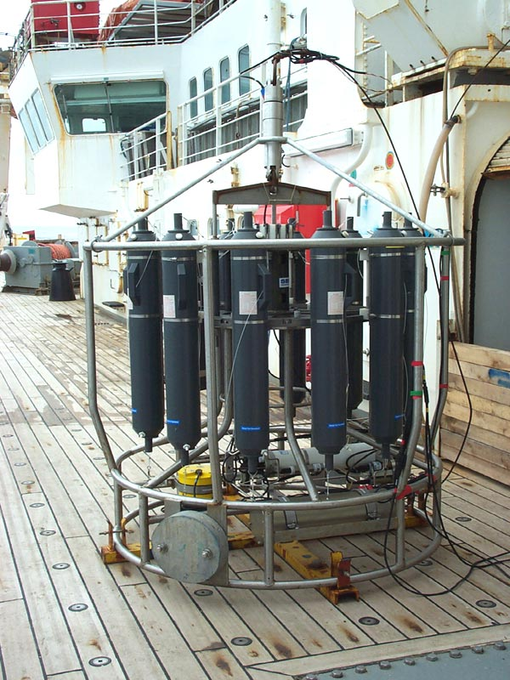
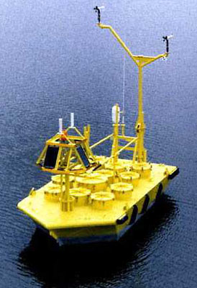
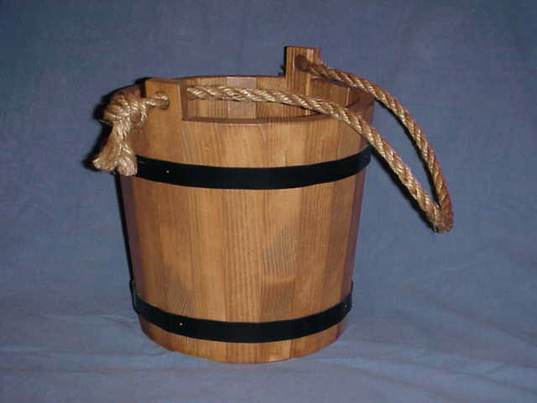
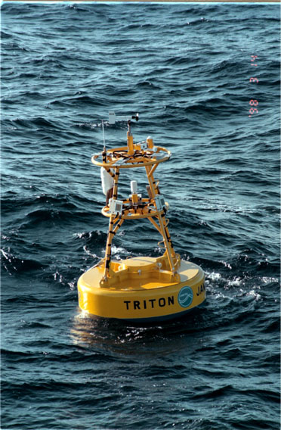
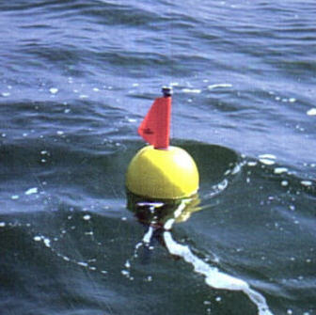
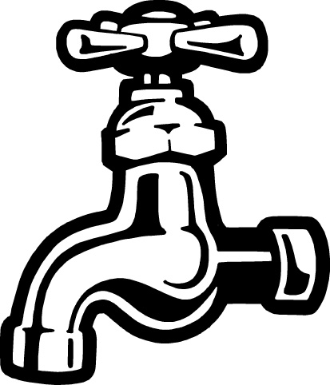
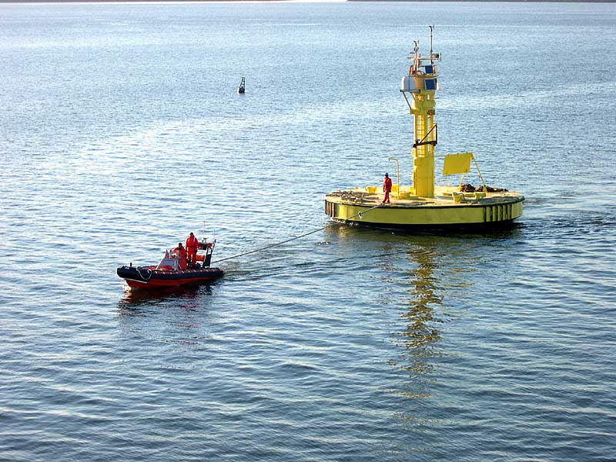
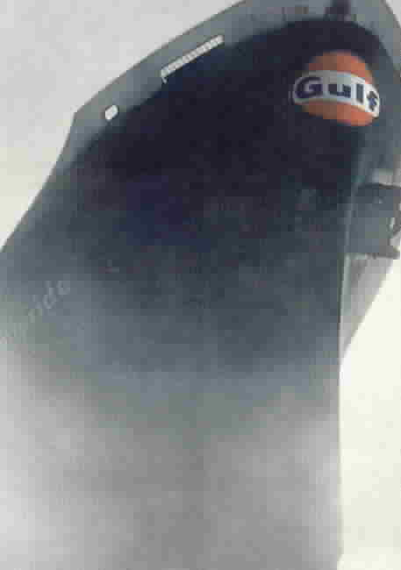
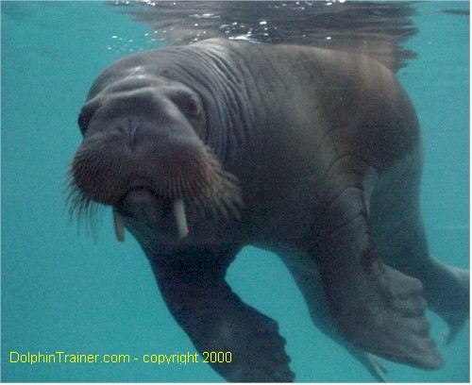
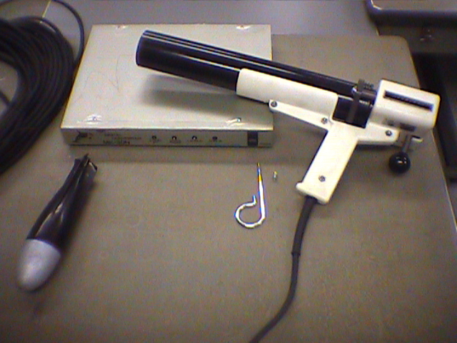
Measurement Methods
Notes:
Buckets insulated, uninsulated, wooden. Buckets cool, sensible and latent heat losses. Sample surface layer ~top 1m
ERI biased warm or cold depending. Warm because ships are bigger and thus water must travel further. Cold because they sample deeper water. Atlantic modern day cooling.
XBT, CTD. Profilers sampling the water column. Observations taken in the top 4m are used.
Moored Buoys. TOGA TAO, US buoys (Discus, Nomad)
Drifting Buoys

Slide 4
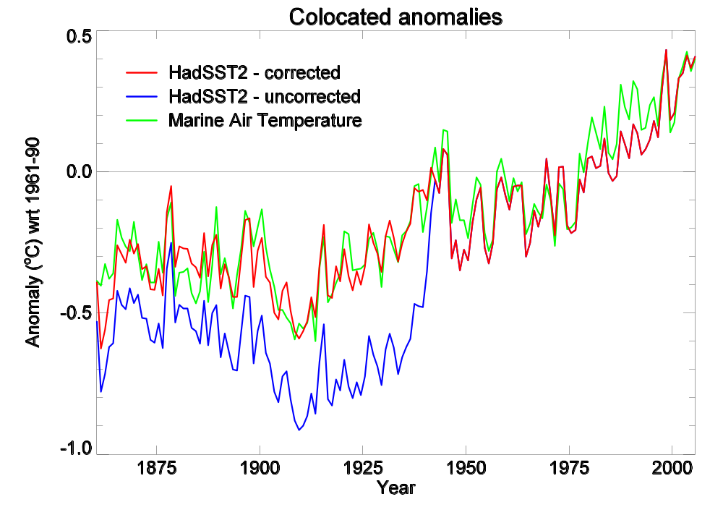
Relating Measurement Method to Bias.
Notes:
Comparison between NMAT and uncorrected and corrected SST. Global annual average.
Assumptions – Wooden bucket –> canvas bucket –> (insulated bucket, ERI, Hull contact sensors) -> all this + buoys

Slide 5
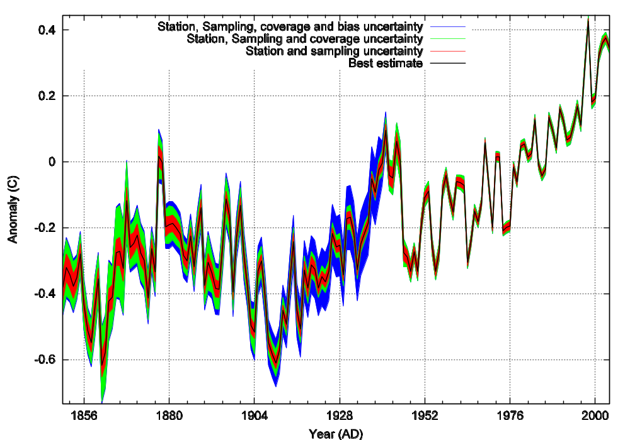
SST (60˚N-60˚S) and uncertainties
Notes:
Things to note: No bias uncertainties after 1941.
TEENY-TINY ERRORS since 1941 – much smaller than the inter-annual variability

Slide 6
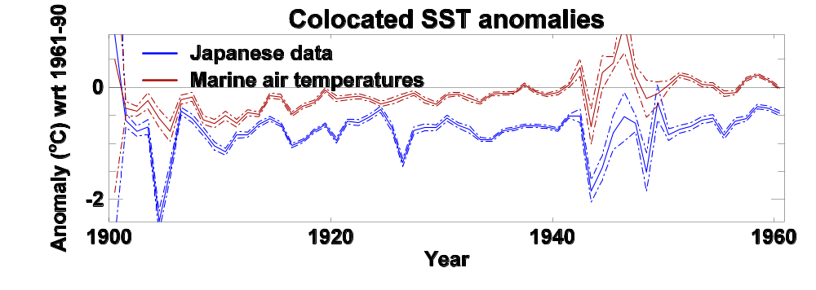
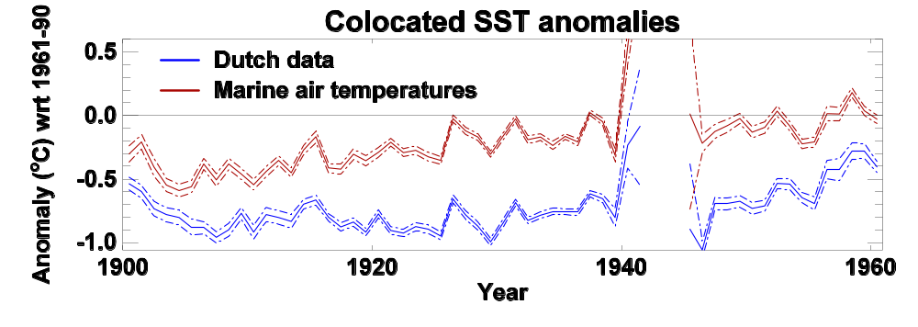
Japanese and Dutch SSTs
Notes:
Global annual average SST anomalies
Dutch and Japanese data using un-insulated buckets it seems.

Slide 7
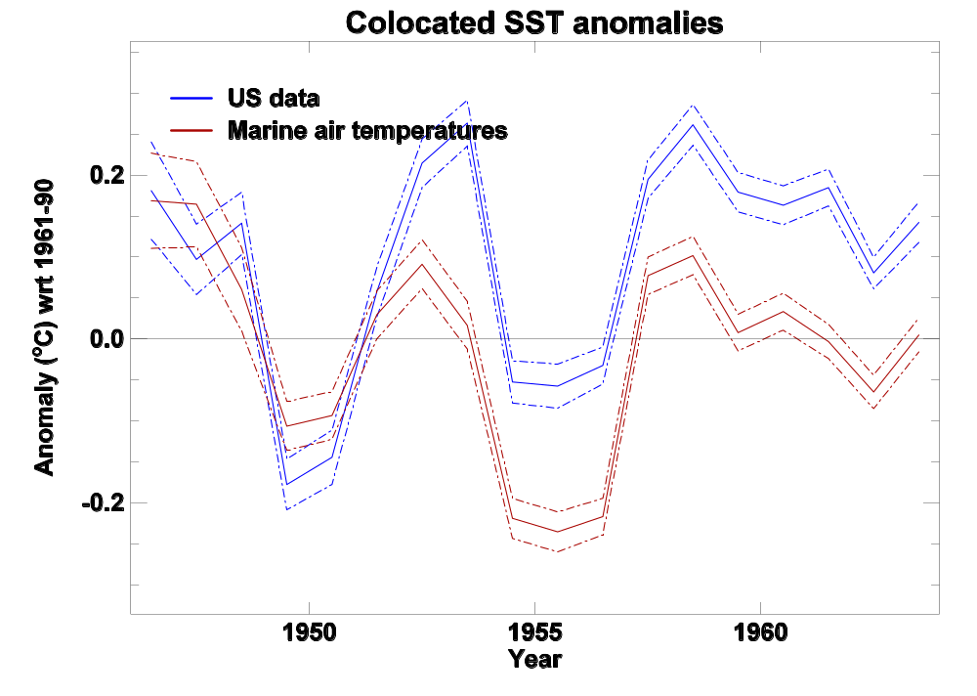
American SSTs
Notes:
Biased warm!
US ships mostly ERI measurements.

Slide 8
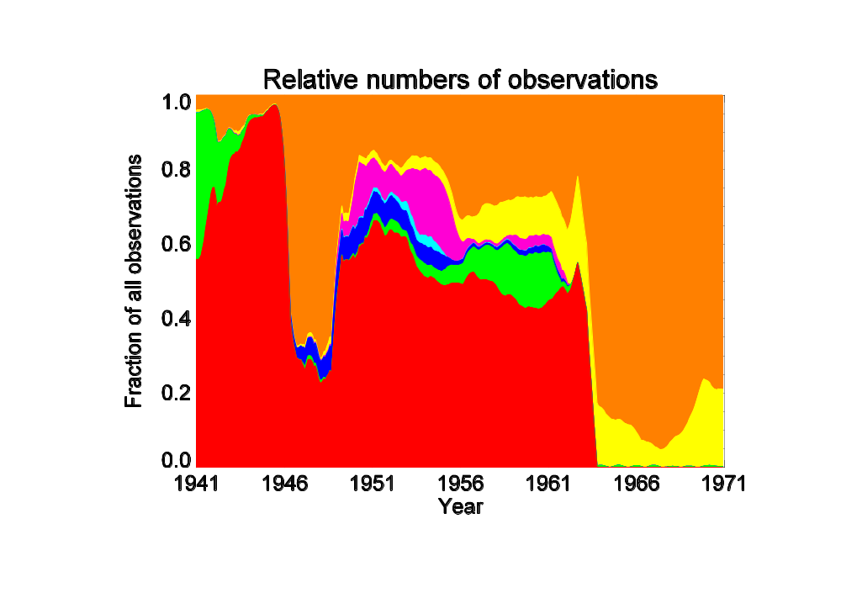
The changing balance
Misc
UK
German
Dutch
Japanese
Russian
US
Notes:
Smoothed data.
Misc: international compilations and contributions from many countries (including UK) for which there are only a few observations
UK, German: Insulated buckets
Dutch: un-insulated buckets
Japanese: buckets – ERI in the later data.
Russian: Buckets
US: ERI
Data sources come and go abruptly -> correlation in time of biases as well as in space
Also implies jumpy biases.
Currently lack the necessary metadata to crack this nut.

Slide 9
Modern period 1970-2005
Metadata on measurement methods from
  WMO publication 47 (1972-2005)
  ICOADS.
  VOSClim
WMO Pub. 47 being digitized back to 1953.
Kent, E. C., S. D. Woodruff and D. I. Berry, 2005: WMO Publication No. 47 Metadata and an Assessment of Observation Heights in ICOADS. Submitted to the Journal of Atmospheric and Oceanic Technology
Kent, E. C., and A. Kaplan, 2005: Towards Estimating Climatic Trends in SST, Part 3: Systematic Biases. Journal of Atmospheric and Oceanic Technology, in press
Notes:
Metadata (at last) from ICOADS and WMO Publication 47.
Details on measurement methods, ship lengths, heights, instrumentation, country of registration, captains shoe-size.
Use this to make datasets which are enriched in buckets or ERI measurements.

Slide 10
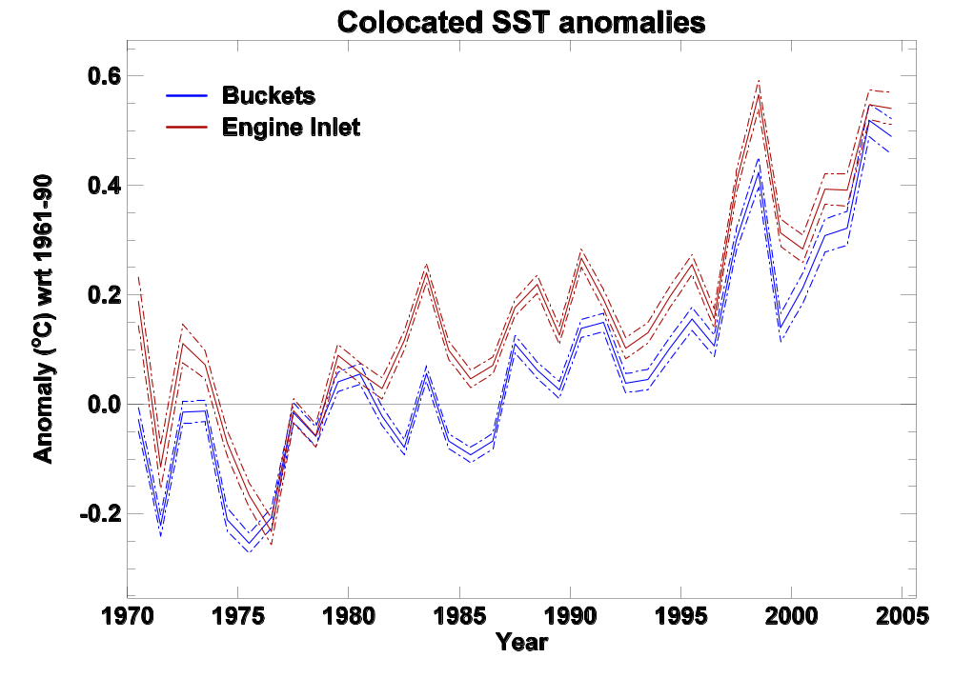
Buckets v ERI
Notes:
ERI warmer than buckets but cooling in the north Atlantic
Too few hull contact observations to say anything meaningful

Slide 11
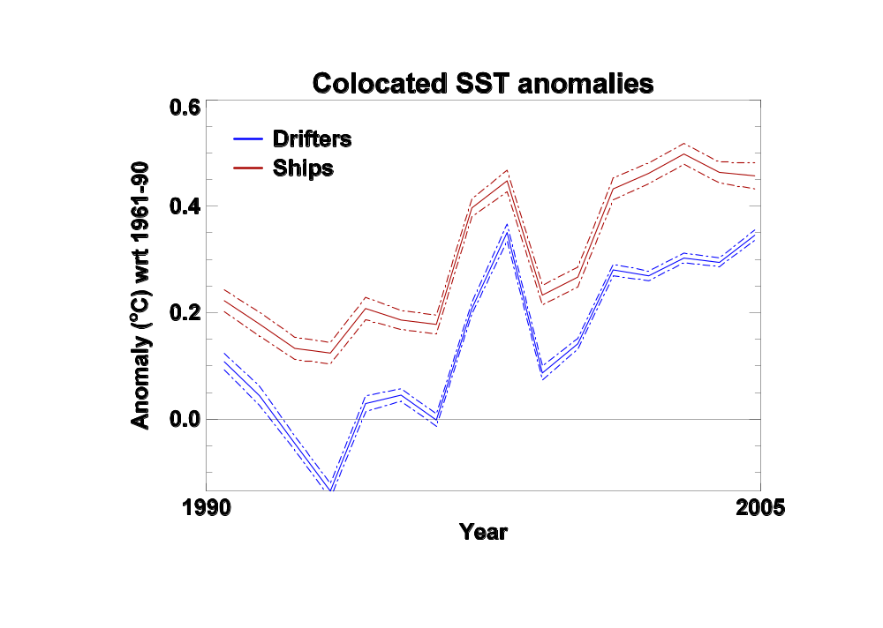
Drifting Buoys vs Ships
Notes:
Free floating truly in situ often considered to be ground truth.
May be true, but in that case not homogeneous.
Nothing like them in the record
What compensates for them?
Nothing
Nice plot of cool buoys.

Slide 12
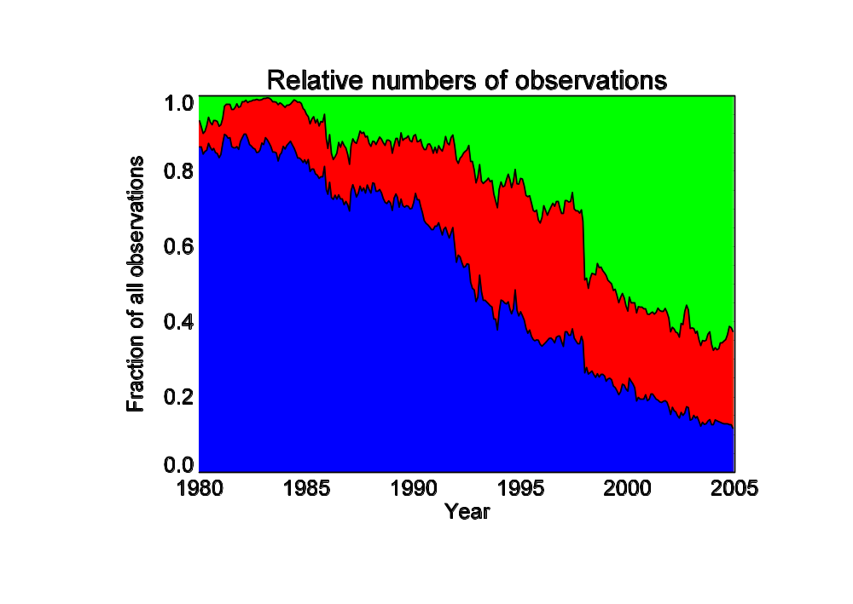
A Plague of Buoys
Drifters
Moorings
Ships
Notes:
1980: ~no buoys
2005: 76% of observations from buoys
Explain about large numbers of observations from moorings and geographically restricted nature of their distribution
Drifters have greater gridbox coverage than ships – not just more observations.

Slide 13
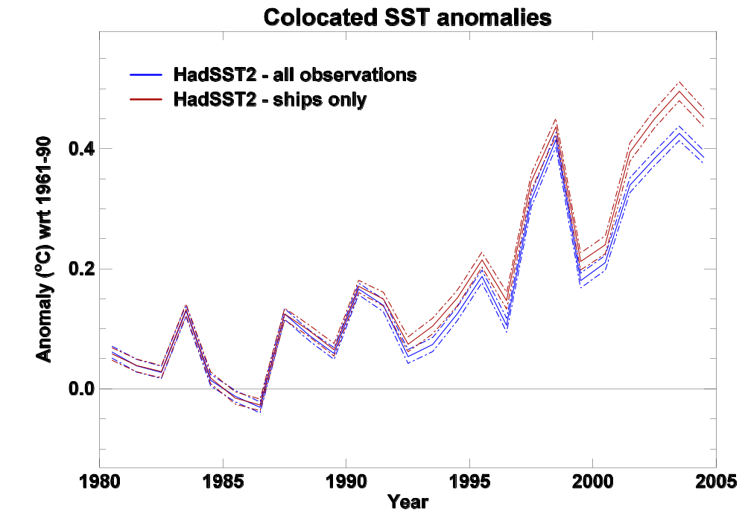
Implications
Notes:
Difference is almost 0.1 degrees on a global annual average.
Difference is larger than random error bounds.
Difference is significant after about 1992.
Underestimate of recent warming. Difference between 1998 being the warmest year for SST and 2003 being it.

Slide 14
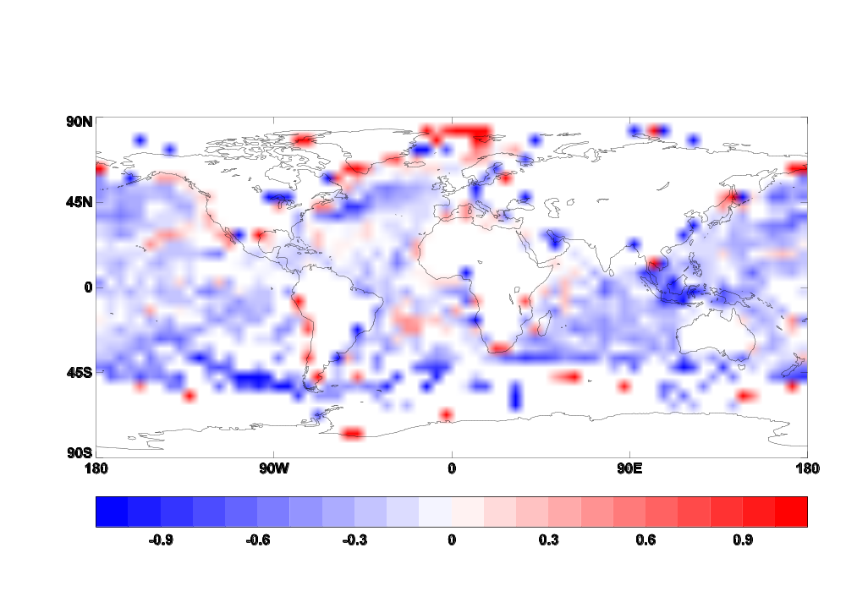
SST_{drifter}-SST_{ship} (average 1990-2005)
Notes:
Hawaiian and Mediterranean features are due to dodgy ships.

Slide 15
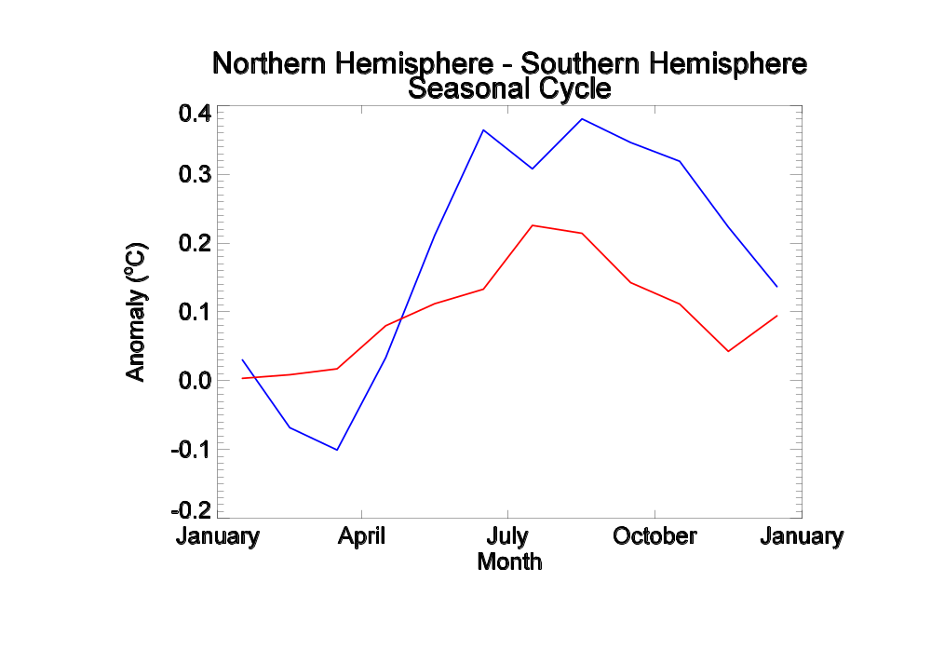
Seasonal Cycle
Drifting Buoys
Difference (˚C)
Ships

Slide 16
Conclusions
There are biases in modern SST measurements
Current monitoring system is potentially good – random errors are small…
… but, errors due to biases are larger than random errors.
Predominance of buoys in recent data may be leading to an underestimate of warming.

Slide 17
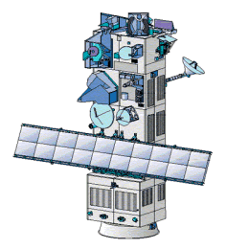
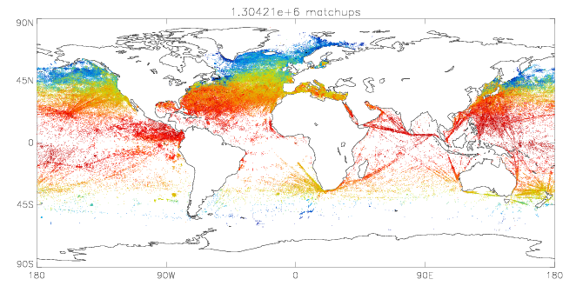
Further Work
Use VOSClim data
(A)ATSR instruments 1991-2005
1.3 Million ship-buoy pairs
Buoy/Ship matchup database
Notes:
AATSR = good because independent of insitu measurements (validated against insitu radiometers, but self calibrating)
Investigate reasons for buoy ship differences
Extend metadata back (WMO publication 47)
Digitization of new obs esp. WWII
Satellite data

Slide 18
Questions and Answers

