Slide 1
Tutorial 0
Statistical Computation and Analysis
Spring 2026

Slide 2
Contact information
Email – noamgone@post.bgu.ac.il
Office hours – Monday 09:00, Schedule in advance
Alarms

Slide 3
Tutorial Outline
Course Logistics
Python
Libraries
Google Colab

Slide 4
Course Information
The course is in English.
The homework assignments need to be handed in in English.
The course is in Python.
The codes for the examples in the lectures and tutorials will be made available on Moodle.

Slide 5
Grading
In class activity – 5%
Questions during lecture (WooClap)
Exercises – 15%
3 exercises, each worth 5%
WooClap on the exercise in the tutorial following submission
Must pass in order to get full credit on the exercise
Failing the WooClap means maximum 3% for the exercise.
Midterm quiz - 10%, Can only improve grade!
In a computer room on campus
Practice for exam
Exam – 70%
On computers on campus
Closed book (we will prepare a formula sheet)
2 hours
Students who do not pass the exam will not pass the course
Notes:
Notes about the assignment WooClaps:
Mandatory, if you cannot attend the tutorial with a valid reason, you may schedule an oral test about the assignment with me (Noam) at a different time.
The grade is binary – pass\ fail.
The goal of the quiz is to make sure the students did the assignment and understood it. The questions should be easy to anyone who did the assignment.

Slide 6
AI Use
Closed-book assessment
Midterm and final exam are closed book
After each homework there will be a short WooClap quiz in tutorial
Your responsibility
We cannot control what tools you use at home
You must understand and be able to explain what you submit
AI as a learning tool
Use AI to clarify concepts and deepen understanding
Do not rely on it to do the work for you
Important
AI tools often have a frequentist bias
Make sure your answers match the framework used in this course

Slide 7
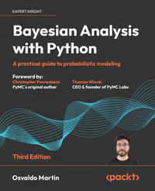
Bayesian Analysis with Python
3rd edition
Publisher’s website
Full text available
the library

Slide 8
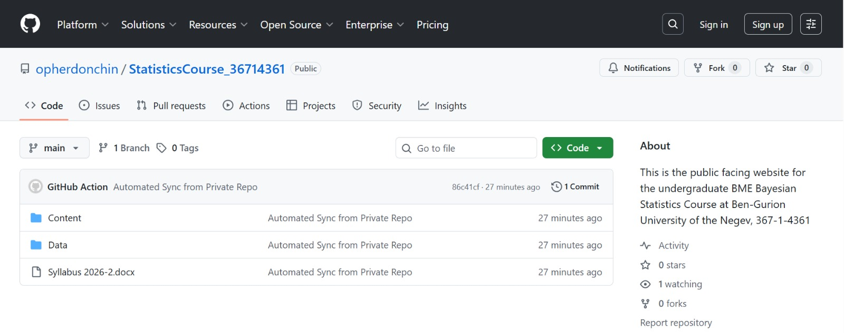
GitHub
Notes:
Content -> The course material, divided by lecture subject.
Data -> data files we use

Slide 9
Additional resources
Practice Google Colab Notebook - Python basics
https://colab.research.google.com/github/cs231n/cs231n.github.io/blob/master/python-colab.ipynb
Code for this tutorial:
Tutorial0.ipynb

Slide 10
Google Colab
Jupyer notebook (.ipynb file)
Text & code blocks
How To Run Code
Run the full block - press arrow or ctrl+enter.
Separate lines - highlight and ctrl+shift+enter
To see variables press on {} at the bottom left corner. Press on variable name to see its content

Slide 11




Data Types
Integers
Floating-point numbers (float)
Boolean
Strings

Slide 12
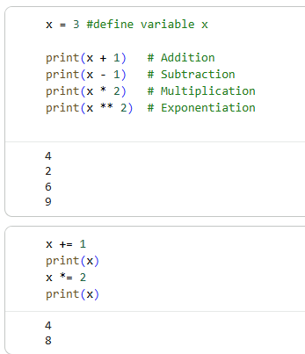
Simple Arithmetics
Integers and floats work as you would expect from other languages

Slide 13
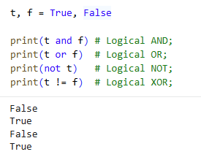
Data Types
Boolean has operators
Compared to MATLAB
MATLAB | PYTHON
true | True
false | False
& | and
| | or
~ | not
~= | !=

Slide 14
Data Types
Strings
Concatenation: ‘hello’ + str(var) + ‘_’ + ‘world’
fstring: f‘hello{var }_world’
Indexing:
MATLAB | PYTHON
Starts from 1 | Starts from 0
array(1:3) | array[0:2]

Slide 15
Containers
Lists: ordered sequences of elements. They can contain any combination of data types and are defined using square brackets, e.g., l = [1, 2, "three"].
Tuples: similar to lists, but they are immutable (cannot be changed). They are defined using parentheses, e.g., t = (1, 2, "three").
Dictionaries: used to store data values in key:value pairs. They are defined using curly brackets, e.g., d = {"brand": "Ford", "model":"Mustang“}.
Notes:
Lists, tuples and dictionaries are new to them.
Tuples use less memory than lists. They are also a bit faster, especially when you're just looking up values. So, if you have data that you don't want to change, it's better to use tuples instead of lists.
If you're defining a constant set of values and all you're ever going to do with it is iterate through it, use a tuple instead of a list. It makes your code safer if you “write-protect” data that does not need to be changed.

Slide 16
Containers
Lists: ordered sequences of elements. They can contain any combination of data types and are defined using square brackets, e.g., l = [1, 2, "three"].
Tuples: similar to lists, but they are immutable (cannot be changed). They are defined using parentheses, e.g., t = (1, 2, "three").
Dictionaries: used to store data values in key:value pairs. They are defined using curly brackets, e.g., d = {"brand": "Ford", "model":"Mustang“}.
Note – In Python, indexing starts from 0.
Notes:
Lists, tuples and dictionaries are new to them.
Tuples use less memory than lists. They are also a bit faster, especially when you're just looking up values. So, if you have data that you don't want to change, it's better to use tuples instead of lists.
If you're defining a constant set of values and all you're ever going to do with it is iterate through it, use a tuple instead of a list. It makes your code safer if you “write-protect” data that does not need to be changed.

Slide 17
For Loops
for i in range(5):
print(i)
Output:
0
1
2
3
4
Notes:
נקודותיים
Indentation in loops

Slide 18
For Loops
animals = ['cat', 'dog', 'monkey’] (list)
for animal in animals:
print(animal)
Output:
cat
dog
monkey

Slide 19
For Loops
for i, animal in enumerate(animals):
print(f"Number {i}, animal {animal}")
Output:
Number 0, animal cat
Number 1, animal dog
Number 2, animal monkey

Slide 20
Functions
def function_name(input arguments):
Defined before function call / separate code and imported.

Slide 21
Python Libraries
NumPy: provides support for arrays, matrices, and mathematical operations on them.
Pandas: provides tools for data manipulation and analysis, including data structures and functions for transforming, cleaning, and analyzing datasets.
SciPy: builds on NumPy and provides additional functionality for scientific computing, including statistical functions.
Matplotlib: data visualization.
Seaborn: more data visualization.
Math: math operations.
Notes:
Packages who contain useful functions and class for your use.
We can import and use, explanations on how to use the code are usually in the API. For example; Numpy API: https://numpy.org/
Numpy – includes a lot of functions like MATLAB

Slide 22
Python Libraries
Import libraries and external functions:
import numpy as np (np.array([1, 2, 3])).
from file_name import function_name
from numpy import * - imports all numpy functions, not recommended.

Slide 23
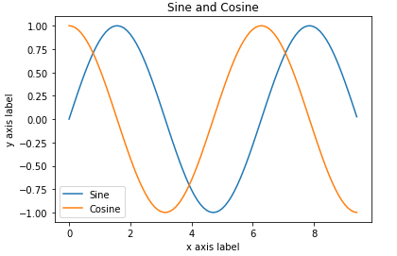
Matplotlib
Plots:
import matplotlib.pyplot as plt
import numpy as np
x = np.arange(0, 3 * np.pi, 0.1)
y_sin = np.sin(x)
y_cos = np.cos(x)
# Plot the points using matplotlib
plt.plot(x, y_sin)
plt.plot(x, y_cos)
plt.xlabel('x axis label')
plt.ylabel('y axis label')
plt.title('Sine and Cosine')
plt.legend(['Sine', 'Cosine'])

Slide 24
Pandas
Provides two types of classes for handling data:
Series – a 1D labelled array holding data of any type.
DataFrame – a 2D data structure that holds data like a two dimension array or a table with rows and columns.

Slide 25
Xarray
We will use Xarray extensively throughout the course.
Many of the tools we will use store model outputs as Xarray objects.
Xarray makes it easier to work with labeled multidimensional data.
It simplifies analysis, indexing, and plotting of model results.
Notes:
We will use Xarray extensively throughout the course.
Many of the tools we will use (e.g., PyMC, ArviZ) store model outputs as Xarray objects.
Xarray makes it easier to work with labeled multidimensional data.
It simplifies analysis, indexing, and plotting of model results.
Understanding Xarray early will make it much easier to work with Bayesian models later in the course.

Slide 26
Xarray
Enables working with multi-dimensional dataframes.
Coordinates: the coordinates at which the measurements were taken.
For example, x value, y value and times.
Lat and lon come from the words latitude and longitude, and are like the rows and the columns in a dataframe.
Here we have an additional dimension of time, for example.
There can be more dimensions.
Data variables: what was measured at the coordinates.
There can be one, or more than one.
Indexes: refer to the coordinate values used for efficient data selection.
In most cases they are created from the coordinates, but there are cases in which they differ.
Attributes: extra metadata about the dataset of the data variables.
Units
Sources

Slide 27
Homework Template
HomeworkTemplate.ipynb on the moodle

