Slide 1
Tutorial 1
Statistical Computation and Analysis
Spring 2026

Slide 2
Tutorial Outline
Data
Measurements
Experiments
Imperfect Data
Summary Statistics
Probability and Uncertainty
Random Variables & Probability Distributions

Slide 3
Data
A set of observations or measurements
Comes from measurements
Finite
We can get more data, but it will still be data
Represents the reality imperfectly

Slide 4
Data Types
3 main types:
Continuous – there can be another data point between any two data values.
Categorical – values can’t be put on a scale.
Ordinal – data can be ordered but are not real numbers.
Notes:
Ordinal, serial - מִסְפָּר סִדּוּרִי, מִסְפָּר סוֹדֵר,
מספר שמתאר את מיקומו של עצם כלשהו בסדרה

Slide 5
Data Types
Morning/afternoon/evening
Weight
Heights
Gender
Time
Color
Baby/child/teenager
Continuous
Ordinal
Categorical
Notes:
If in color we are really looking at wavelength -> continuous.
If we are looking at the order of the rainbow - ordinal

Slide 6
What Are We Measuring?
We need to understand what we are measuring
What is the precision?
Is the data valid?
Is the data reliable?
Notes:
What we are measuring – not always so straight forward.
We want to know if the medicine is helping, what measurements should we take?
If the virus appears only in the blood, looking at any other sample is useless. Or what in the blood do we need to look at.
What units are we measuring in. can our measurements answer the question we’re asking.

Slide 7
What Are We Measuring?
Precision
How precise is the measurement?
Consistency of repeated measurements
`
Significant digits – The number of digits you report should match the precision of the measuring process, not create a false impression of accuracy.
`
Notes:
What we are measuring – not always so straight forward. We want to know if the medicine is helping, what measurements should we take?
If the virus appears only in the blood, looking at any other sample is useless. Or what in the blood do we need to look at. What units are we measuring in. can our measurements answer the question we’re asking.
Significant digits are a way of showing how precise a measurement really is. The number of digits you report should match the precision of the measuring process, not create a false impression of accuracy. This is closely related to the choice of units: a good unit makes the important variation visible without forcing you to write either too many meaningless digits or numbers that are awkwardly large or small. For example, reporting cerebellar volume as 0.13 fraction of TICV may be more appropriate than 0.129847, because the latter suggests a level of precision we probably do not have. In general, choose units that make the data easy to read, and report only as many significant digits as are justified by the actual measurement precision.

Slide 8
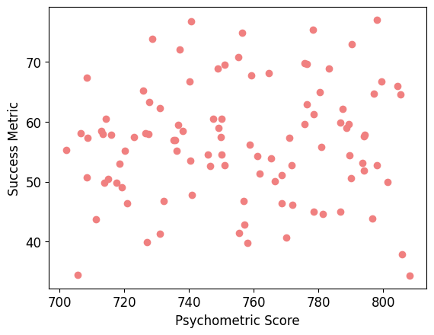
What Are We Measuring?
Validity
Does the measurement measure what we want?
Is a psychometric grade indicative of who would be a good doctor?
Notes:
What we are measuring – not always so straight forward. We want to know if the medicine is helping, what measurements should we take?
If the virus appears only in the blood, looking at any other sample is useless. Or what in the blood do we need to look at. What units are we measuring in. can our measurements answer the question we’re asking.

Slide 9
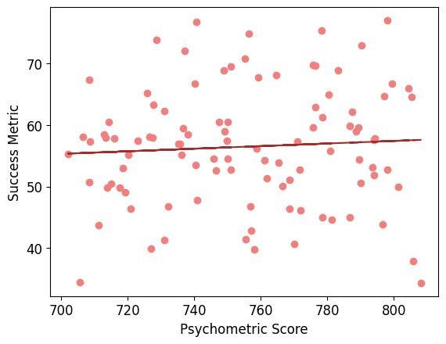
What Are We Measuring?
Validity
Does the measurement measure what we want?
Is a psychometric grade indicative of who would be a good doctor?
Notes:
What we are measuring – not always so straight forward. We want to know if the medicine is helping, what measurements should we take?
If the virus appears only in the blood, looking at any other sample is useless. Or what in the blood do we need to look at. What units are we measuring in. can our measurements answer the question we’re asking.

Slide 10
What Are We Measuring?
Reliability
A measure that is stable – the value will stay the same:
If we measure again
If someone else measures
If we measure at different times (if the measurement is not meant to change over time)
Notes:
What we are measuring – not always so straight forward. We want to know if the medicine is helping, what measurements should we take?
If the virus appears only in the blood, looking at any other sample is useless. Or what in the blood do we need to look at. What units are we measuring in. can our measurements answer the question we’re asking.

Slide 11
What Are We Measuring?
Precision - Consistency of repeated measurements
Valid - the measurement measure what we want
Reliable - A measure that is stable
Notes:
What we are measuring – not always so straight forward.
We want to know if the medicine is helping, what measurements should we take?
If the virus appears only in the blood, looking at any other sample is useless. Or what in the blood do we need to look at.
What units are we measuring in. can our measurements answer the question we’re asking.

Slide 12
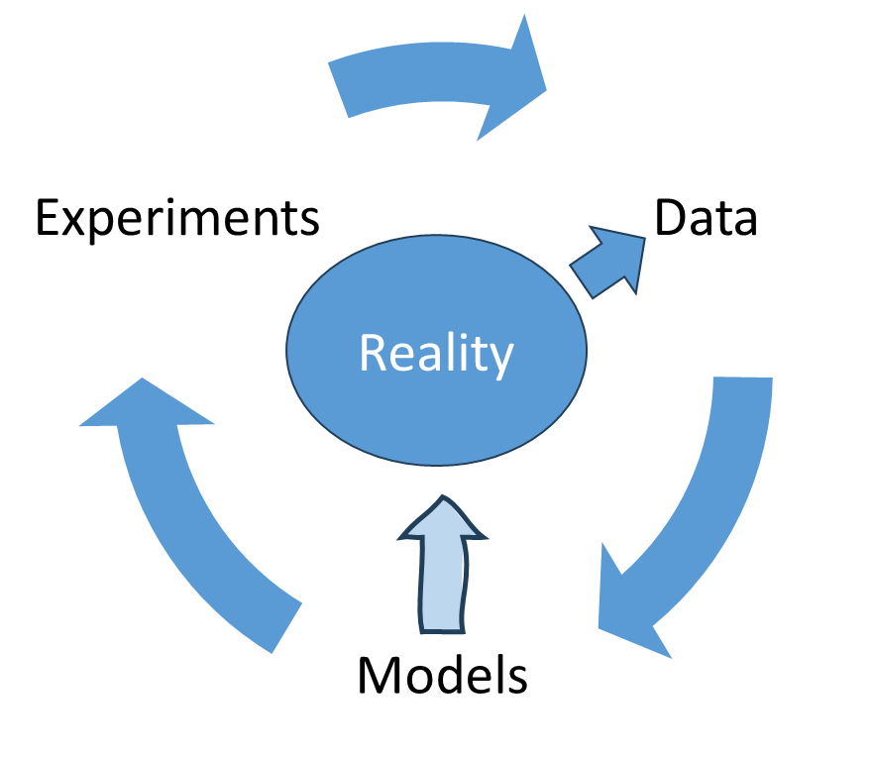
Experiments
Experiments produce data from reality
Data updates models of reality
Models lead to further experiments
Notes:
You understand that what you measure is what you measure, and what is out there is out there.
Data usually reflects multiple measurements and potentially multiple dimensions - each measurement is a poor (noisy, biased, incomplete) measurement of reality.
Repetitions to understand the underlying

Slide 13
Experiments
Experiments produce data from reality
Data updates models of reality
Models lead to further experiments
Data is a concept associated with understanding that measurements are not infinitely precise.
Data usually reflects multiple measurements and potentially multiple dimensions - each measurement is a poor measurement of reality.
Notes:
You understand that what you measure is what you measure, and what is out there is out there.
Data usually reflects multiple measurements and potentially multiple dimensions - each measurement is a poor (noisy, biased, incomplete) measurement of reality.
Repetitions to understand the underlying

Slide 14
Experiment
Our experiment will be asking questions:
How many siblings do you have? (discrete)
What is your height? (continuous)
Form link -
https://forms.gle/cfzsUx12annGpoh36
Notes:
Links:
Form - https://forms.gle/cfzsUx12annGpoh36
Google Sheets (collected data) - https://docs.google.com/spreadsheets/d/1arAtqgmDKWv1Cvz32n0J49LkSq9y7VJcCvGgbvq53wQ/edit?usp=sharing

Slide 15
Experiment Conclusions
We can use (simple or complex) experiments to collect data.
If we run the experiment again on different participants, we will get different measurements.
Each measurement is a poor measurement of reality.
Notes:
If we repeat the experiment:
Results will change
Why?
Because data is a sample from a population

Slide 16
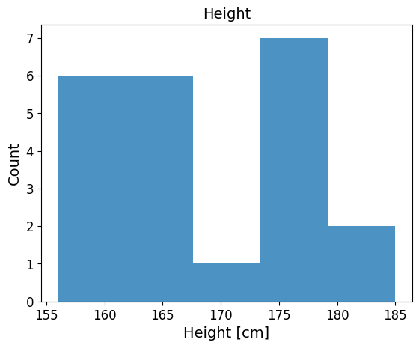
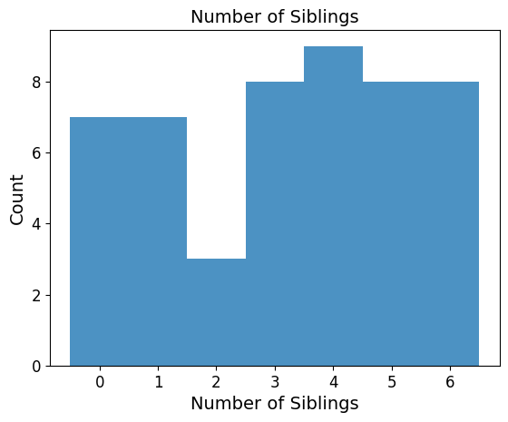
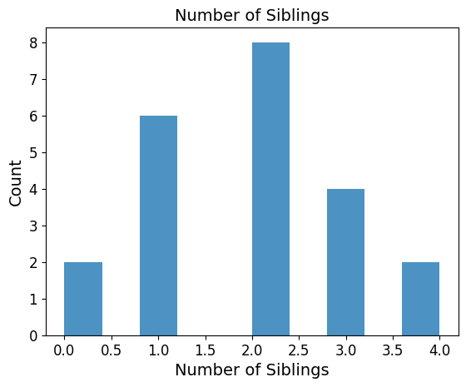
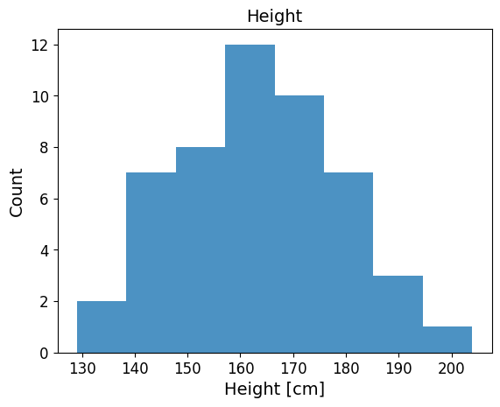
Plotting Results
With random data:
Notes:
Go to Google Colab to see our data plots

Slide 17
Imperfect Data
Real data is never perfect
Common problems:
Sampling bias
Measurement error
Missing data
Proxy measurements

Slide 18
Imperfect Data
Real data is never perfect
Common problems:
Sampling bias – height of a basketball team
Measurement error – A scale that is not calibrated
Missing data - Some observations are not recorded or unavailable.
Proxy measurements – BOLD signal in fMRI as a proxy for neural activity.

Slide 19
Summary Statistics
Simple numbers that describe the distribution
We can use metrics to summarize different aspects of the distribution that generated our collected data.
Central tendency
Spread
Skewness
Kurtosis
Notes:
Why summary statistics? We want simple numbers that describe the distribution

Slide 20
Central Tendency
Measure for middle of the data
Mean – the sum of all values divided by the total number of values.
Median – the middle number in an ordered dataset.
Mode – the most frequent value (discrete) \ the point with the largest probability (continuous).
Notes:
Mean:
Common
Convenient to work with mathematically
Very affected by outliers
Continuous or ordinal (for ordinal need to assign numbers to the categories, e.g., favorite meal, and breakfast, lunch, dinner = 0, 1, 2. The number assignment changes mean. We would have the number of people that preferred each meal)
Median:
The value in the middle -> the same percentage of the population above and below
Continuous or ordinal (no meaning to a median if the data can't be ordered) the median can be that lunch is the preferred meal. Or that size small is.
Mode:
1. The only central tendency measurement for categorical data. Most people prefer dinner. Medicine 1 worked best.

Slide 21
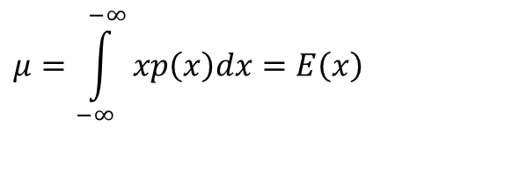

Central Tendency
Measure for middle of the data
Mean:
Median :
Mode – the point with the largest probability.
$$μ=\int_{−∞}^{−∞}{xp\left(x\right)dx}=E\left(x\right)$$
$$\int_{−∞}^{x_{med}}{p\left(x\right)dx}=0.5$$
Notes:
Mean – care more about big errors than small ones.
Median – care about all sizes of errors equally,
Mode – want to make as few errors as possible

Slide 22
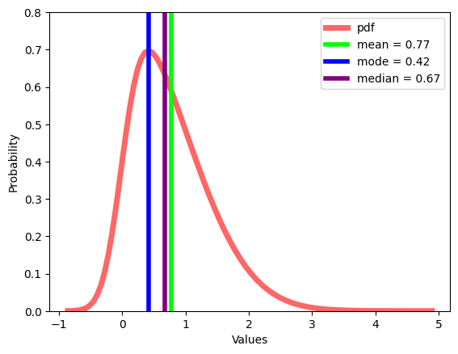
Central Tendency
Where is the middle?
Notes:
Pdf - where values are likely to occur.
Mean – the sum of all values divided by the total number of values.
Median – the middle number in an ordered dataset.
Mode – the point with the largest probability (peak of the pdf).
Population median (sklearn and pds) vs sample median (estimator) –
We estimate the population median but do not know the true distribution, we only have a sample of it.

Slide 23
Central Tendency
Measure for middle of the data
Mean
Convenient to work with mathematically
Very effected by outliers
Can be used for continuous or ordinal data (for ordinal, we need to assign numbers to the categories)
Median
Less effected by outliers
Can be used for continuous or ordinal data
Mode
Less effected by outliers
The only central tendency measurement for categorical data
Notes:
Mean:
Common
Convenient to work with mathematically
Very effected by outliers
Continuous or ordinal (for ordinal need to assign numbers to the categories, e.g., favorite meal, and breakfast, lunch, dinner = 0, 1, 2. The number assignment changes mean. We would have the number of people that preferred each meal)
Median:
The value in the middle -> the same percentage of the population above and below
Continuous or ordinal (no meaning to a median if the data can't be ordered) the median can be that lunch is the preferred meal. Or that size small is.
Mode:
1. The only central tendency measurement for categorical data. Most people prefer dinner. Medicine 1 worked best.

Slide 24
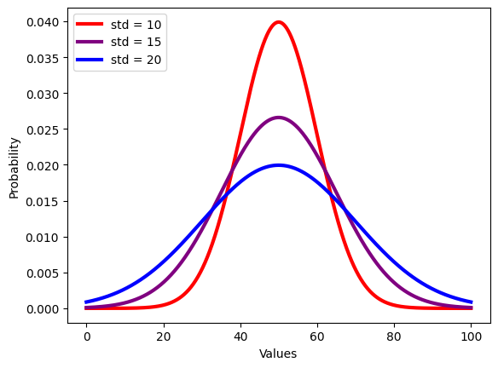

Spread
$$Var\left(x\right)=E\left[{\left(x−μ\right)}^{2}\right]$$
$$std\left(x\right)= \sqrt{Var(x)}$$
How far are we from the middle?
Notes:
If we want to use two numbers to describe the distribution.
Variance: The variance of $X$ is the average of the squared distances between the values of $X$ and the mean.
Standard deviation: The standard deviation of $X$is the square root of the variance, which measures the typical distance of the values from the mean.

Slide 25
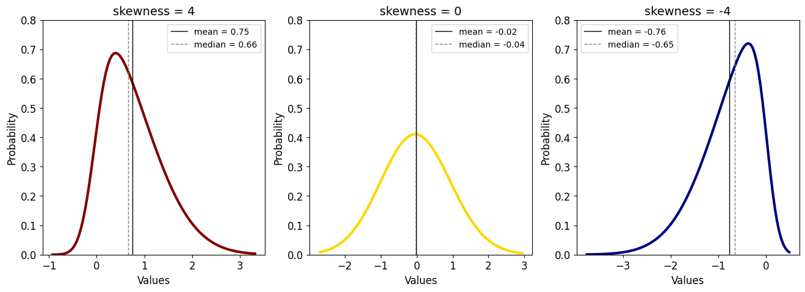
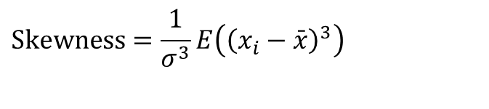

Skewness
$$\text{Skewness}=\frac{1}{σ^{3}}E\left({\left(x_{i}−\bar{x}\right)}^{3}\right)$$
How symmetric is the data?
$$μ$$
Notes:
If we want to use three numbers.
How do we compute on data?
This is what we compute on the population, so it’s a parameter -> change x hat to mu
If I didn’t get to this in the first tutorial -> opher will do it

Slide 26
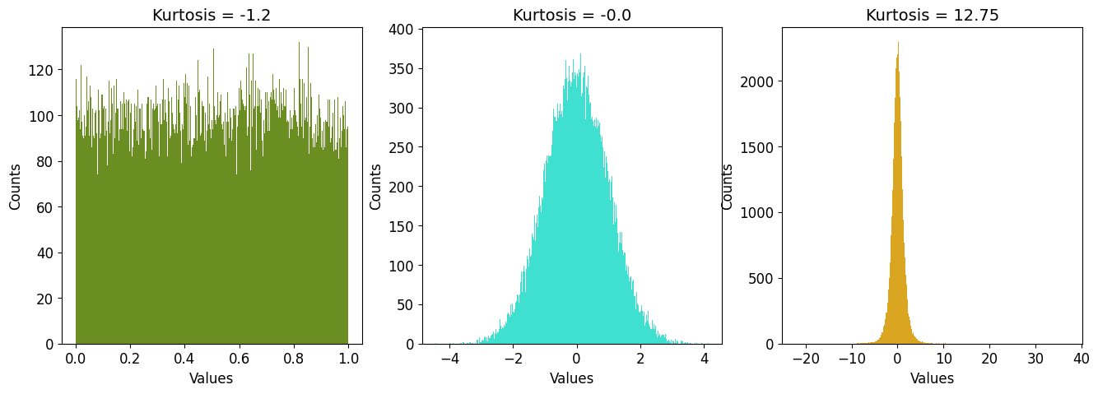
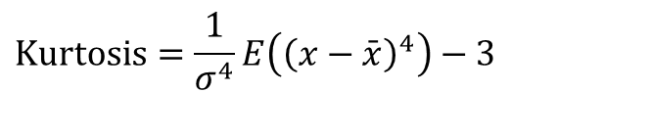

Kurtosis
$$\text{Kurtosis}=\frac{1}{σ^{4}}E\left({\left(x−\bar{x}\right)}^{4}\right)−3$$
Size of tails
Pointiness of peak
$$μ$$
Notes:
If we want to use four numbers.
How do we compute on data?
Can be with or without the three. The minus three sets the kurtosis of a normal distribution to be 0, and then positive is heavier tail than normal distribution, and negative – smaller tails. More of the data is in the middle.
Uniform – more of the data in the middle and not much tail.

Slide 27
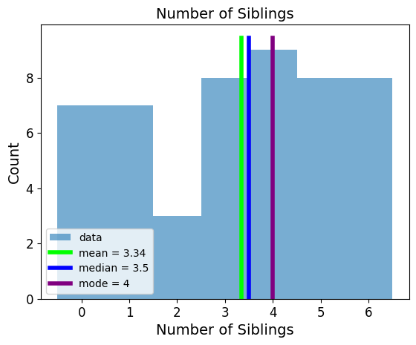
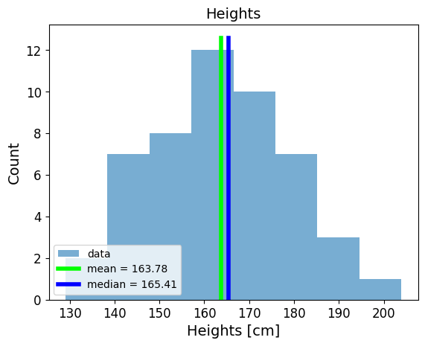
Central Tendency
Why didn’t we calculate the mode for the heights?
With random data:
Notes:
Each exact value appears only once. Continuous data rarely has repeated values.
To actually calculate the mode, we would need to first model the data and then use the mode of the distribution. We did not have this problem with the discrete data because values do repeat themselves.

Slide 28
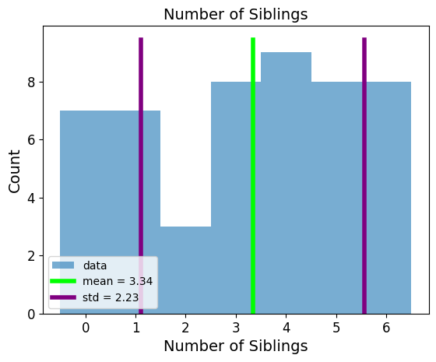
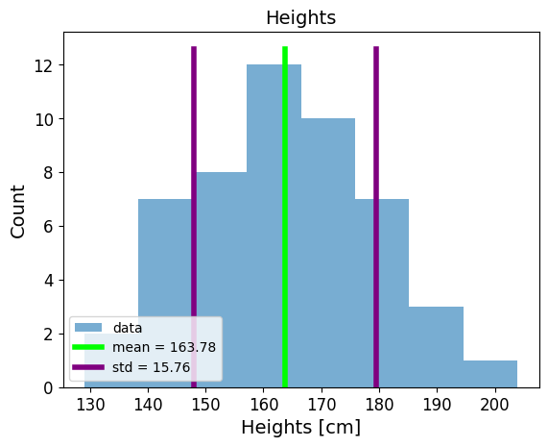
Spread
With random data:
Notes:
If the mean is 10 and the standard deviation is 2, then mean ± 1 std would be 10 ± 2, i.e., [8, 12], which encompasses about 68% of the data for a normal distribution.

Slide 29
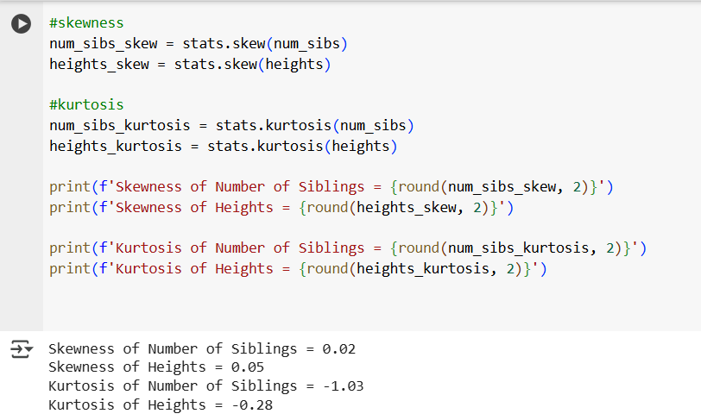
Skewness and Kurtosis

Slide 30
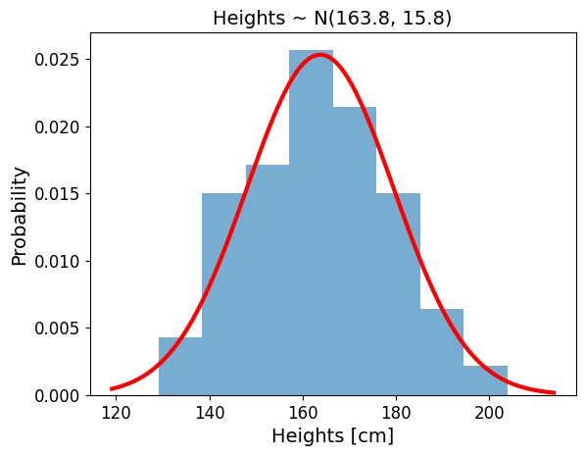
Distribution
We can also model the distribution of the data.
Notes:
We’ll talk about modelling extensively for much of the course. Now we’re just going to do an introduction / review to distributions and probability

Slide 31
From Data to Uncertainty
Data is imperfect.
Therefore:
Our knowledge of the world is uncertain.
Probability helps us describe uncertainty.

Slide 32
Probability
Probability quantifies uncertainty.
Example:
What is the probability of rain tomorrow?
What is the probability of a purple horse?

Slide 33
Interpreting Probability
Two interpretations:
Frequentist
→ probability from repeated experiments
Bayesian
→ probability as uncertainty about the world
Notes:
Side note for our course

Slide 34
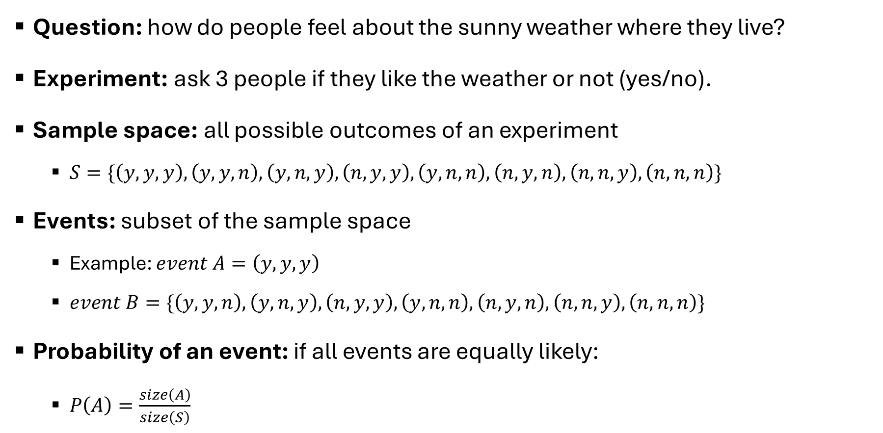
Probability
Question: how do people feel about the sunny weather where they live?
Experiment: ask 3 people if they like the weather or not (yes/no).
Sample space: all possible outcomes of an experiment
$S=\{\left(y,y,y\right), \left(y,y,n\right), \left(y,n,y\right), \left(n,y,y\right), \left(y,n,n\right), \left(n,y,n\right), \left(n,n,y\right), \left(n,n,n\right)\}$
Events: subset of the sample space
Example: $event A=\left(y,y,y\right)$
$event B=\{\left(y,y,n\right), \left(y,n,y\right), \left(n,y,y\right), \left(y,n,n\right), \left(n,y,n\right), \left(n,n,y\right), \left(n,n,n\right)\}$
Probability of an event: if all events are equally likely:
$P\left(A\right)=\frac{size\left(A\right)}{size\left(S\right)}$
Notes:
Event B – at least one person answered no.

Slide 35
Probability
Considering all events equally likely makes calculating probability easier, but it’s not necessarily true.
It is NOT true that all yes-no questions have a 50-50 chance
What is the probability of seeing a purple horse?
Natural color
Cartoon
We’ll assign a distribution.

Slide 36
Random Variable
Function that maps the sample space into real numbers (R)
Discrete / Continuous
A discrete random variable may have different values with probabilities
A continuous random variable has probabilities over ranges
Instead of calculating probabilities of events, we may be more interested in finding out the list of probabilities for all possible events = probability distribution.
Notes:
The mapping between the sample space and ℝ is deterministic. There is no randomness
involved. So why do we call it a random variable? Because we can ask the variable for
values, and every time we ask, we will get a different number.

Slide 37
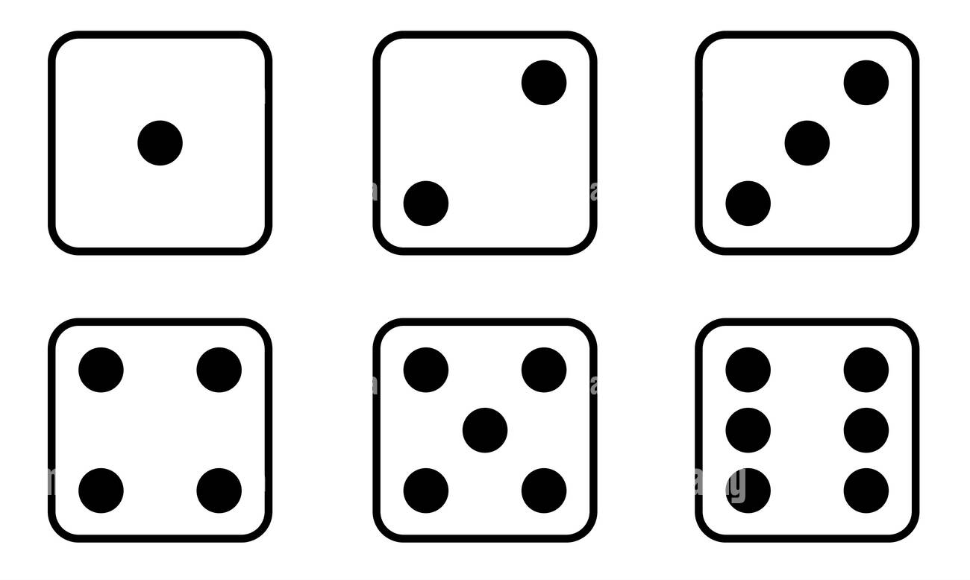

Random Variable
For example, a dice roll:
P(X=3), P(X=x), P(x$≤$4)
1
2
3
4
5
6
Notes:
The mapping between the sample space and ℝ is deterministic. There is no randomness
involved. So why do we call it a random variable? Because we can ask the variable for
values, and every time we ask, we will get a different number.

Slide 38
Discrete Random Variables + Distributions
Instead of calculating probabilities of events, we may be more interested in finding out the list of probabilities for all possible events = probability distribution
Empirical probability distribution:
roll a dice a bunch of times
count how many times we get each number
Normalize by dividing the value for each number by the number of times the dice was rolled
We will do this using advanced computational methods
Notes:
For now, lets review all the distributions we know up until this point.

Slide 39
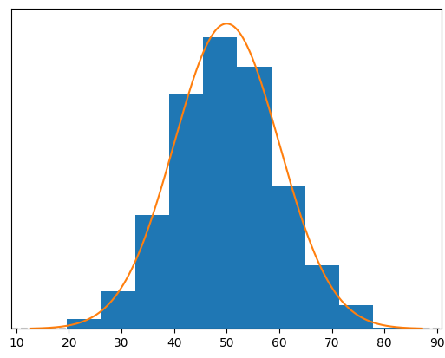
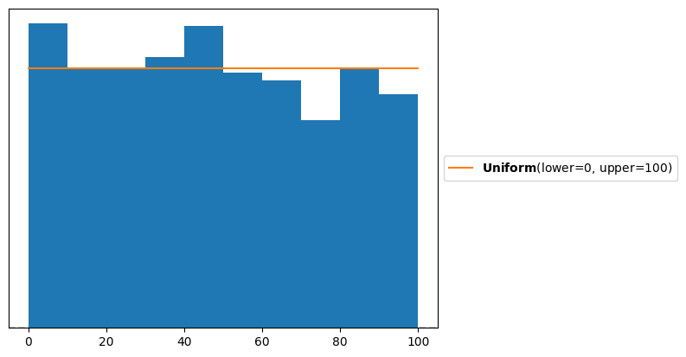
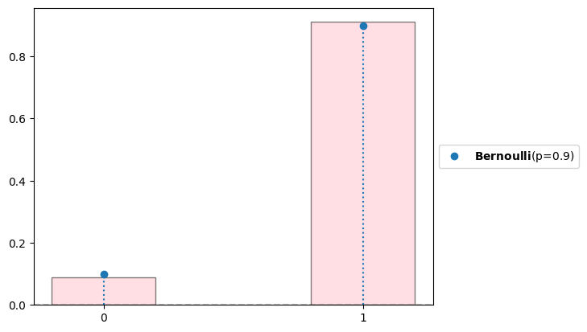
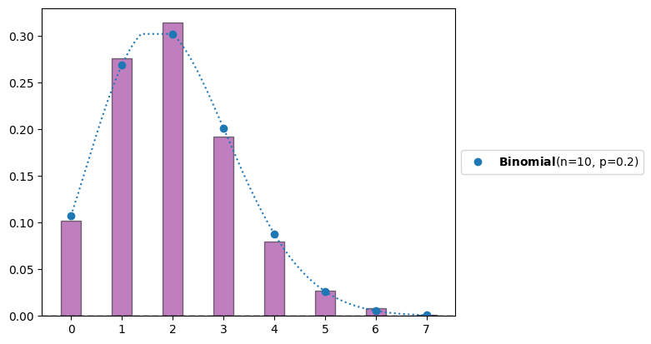
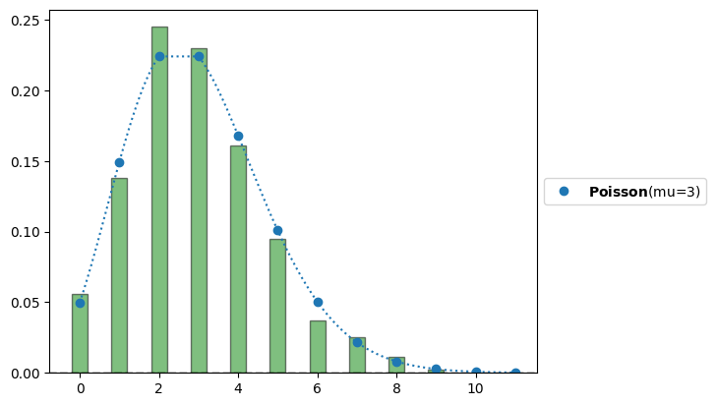
Known Distributions
Normal Continues uniform
Bernoulli Binomial Poisson

Slide 40

Normal Distribution
$$f\left(x\right)=\frac{1}{\sqrt{2π}σ}e^{−\frac{1}{2}{\left(\frac{x−μ}{σ}\right)}^{2}}$$
$μ$ – mean
$σ$ – standard deviation
f(x) – probability density function
Notes:
The key point is that the value of a probability density function at a specific point x represents a density rather than an actual probability. The PDF does not directly give the probability of x, but rather how "dense" the probability is around x.
The probability of a continuous random variable falling exactly at any specific point is always 0. For continuous distributions, probabilities are defined over intervals.
Because the limits of the integral are the same on the top and the bottom.

Slide 41

Continuous Uniform
$$f\left(x\right)=\left\{\begin{aligned}\frac{1}{b−a}, a≤x≤b \\ &0, else\end{aligned}\right.$$
f(x) – probability density function
Notes:
There is also a discrete uniform distribution – for example, throwing a dice: all outcomes are equally likely for a fair dice, where the bounds are between 1-6.

Slide 42
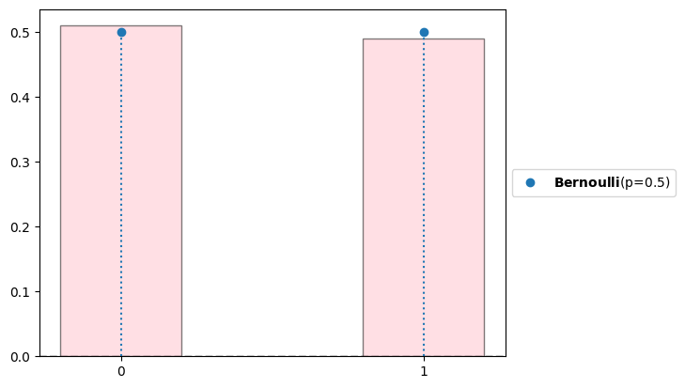

Bernoulli
$$f\left(x\right)=\left\{\begin{aligned}p, x=1 \\ &1−p, x=0\end{aligned}\right.$$
p = the probability of success
1-p = the probability of failure
Coin toss – fair coin p=0.5
success / failure in a single trial
f(x) – probability mass function
Notes:
Discrete – the chance for success.
A PDF gives the relative likelihood of the random variable taking a specific value, but it does not give the probability of the random variable being exactly equal to a value.
A PMF gives the probability that a discrete random variable is equal to a particular value.
The bar plot instead of the hist is because with density = true, plt normalizes also by bin width which is irrelevant in a pmf

Slide 43
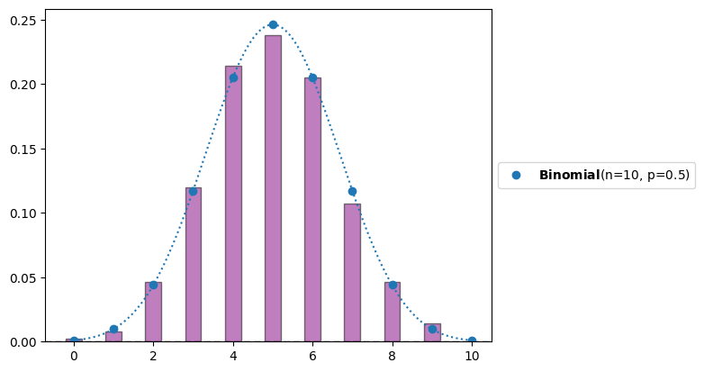

Binomial
$$f\left(k, n, p\right)=\left(\begin{matrix}n \\ k\end{matrix}\right)p^{k}{\left(1−p\right)}^{n−k}$$
p = the probability of success
n = the number of experiments
k = the number of successes
f – probability mass function
Notes:
$$f\left(k, n, p\right)=P\left(X=k\right)=\left(\begin{matrix}n \\ k\end{matrix}\right)p^{k}{\left(1−p\right)}^{n−k}$$

Slide 44
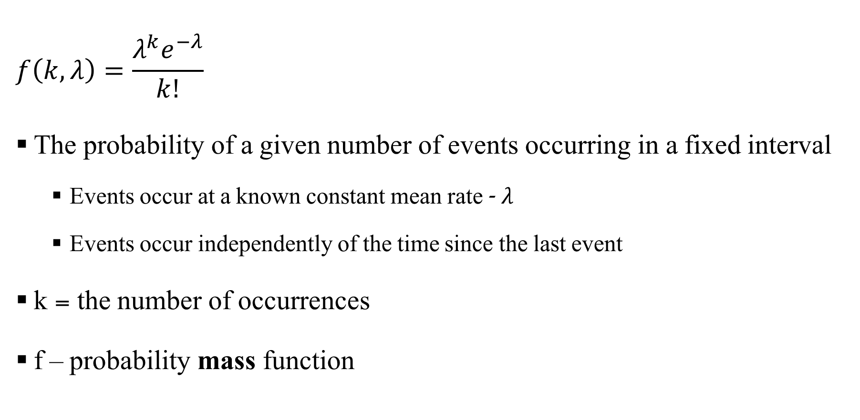
Poisson
$$f\left(k, λ\right)=\frac{λ^{k}e^{−λ}}{k!}$$
The probability of a given number of events occurring in a fixed interval
Events occur at a known constant mean rate - $λ$
Events occur independently of the time since the last event
k = the number of occurrences
f – probability mass function
Notes:
expresses the probability of a given number of events occurring in a fixed interval of time if these events occur with a known constant mean rate and independently of the time since the last event.
For instance, consider a call center which receives an average of λ = 3 calls per minute at all times of day. If the calls are independent, receiving one does not change the probability of when the next one will arrive. Under these assumptions, the number k of calls received during any minute has a Poisson probability distribution.
The fixed time interval is typically specified when describing the rate λ\lambdaλ. For example, if you are modeling the number of cars passing through a toll booth in 1 hour, then λ\lambdaλ would represent the average number of cars passing through the toll booth per hour.

Slide 45
Poisson

Slide 46
Fitting distribution to data
Number of emails received per hour
Randomly choosing a point on a 1 meter stick.
Number of heads in 10 coin flips
Coin flip outcome (1 = heads, 0 = tails)
Height of students in the department
Normal Continues uniform
Bernoulli Binomial Poisson

Slide 47
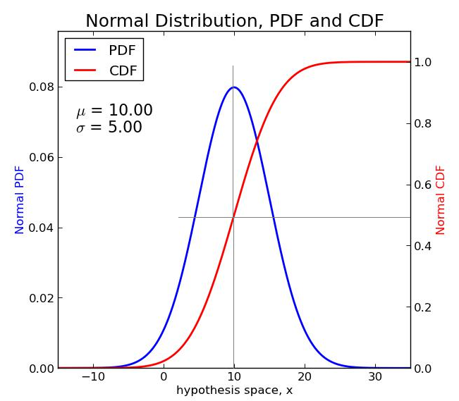
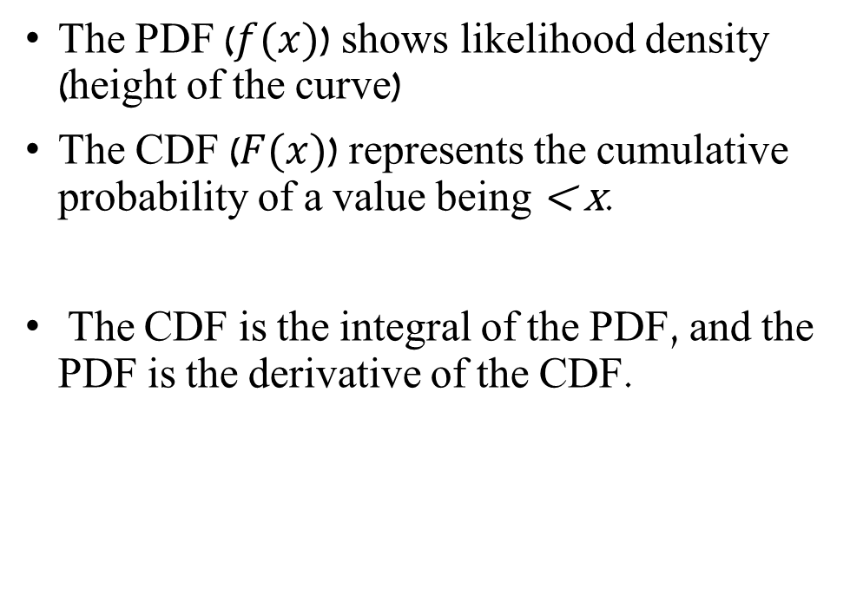
Probability Density Function (PDF) & Cumulative Distribution Function (CDF)
The PDF ($f(x)$) shows likelihood density (height of the curve)
The CDF ($F(x)$) represents the cumulative probability of a value being < x.
The CDF is the integral of the PDF, and the PDF is the derivative of the CDF.
Notes:
CDF - Probability that your height ≤ 170 cm

Slide 48

Cumulative Distribution Function (CDF)
Probability that a variable is ≤ a value
Probability that your height ≤ 170 cm
Notes:
PDF: Shows where values are likely to occur.
CDF: Shows how much probability has accumulated up to a value.

Slide 49
Preliz
We will use this library a lot.
https://github.com/arviz-devs/preliz
Use installation from the tutorial notebook.
Notes:
For now, lets review all the distributions we know up until this point.

