Slide 1
Tutorial 2
Statistical Computation and Analysis
Spring 2026

Slide 2
Before we start
Reserve duty policy
Assignment 1 is up-
submission data 05.05.2026 at 12:00
No tutorial next week (Memorial day)

Slide 3
Tutorial Outline
Modeling data
Conditional probability
Bayes rule
Bayes and modeling
Conjugate priors
Grid method

Slide 4
Models
A model is a specific idea about the shape of the population
A particular distribution
With specific parameters
We can use models to:
Express ideas about the population.
Check ideas about the population.
Provide alternative ideas about the population.

Slide 5
Model
A good model is a simplified description of a system or process
Capture the most relevant aspects of the system
Do not explain every minor detail
A more complex model is not always better

Slide 6
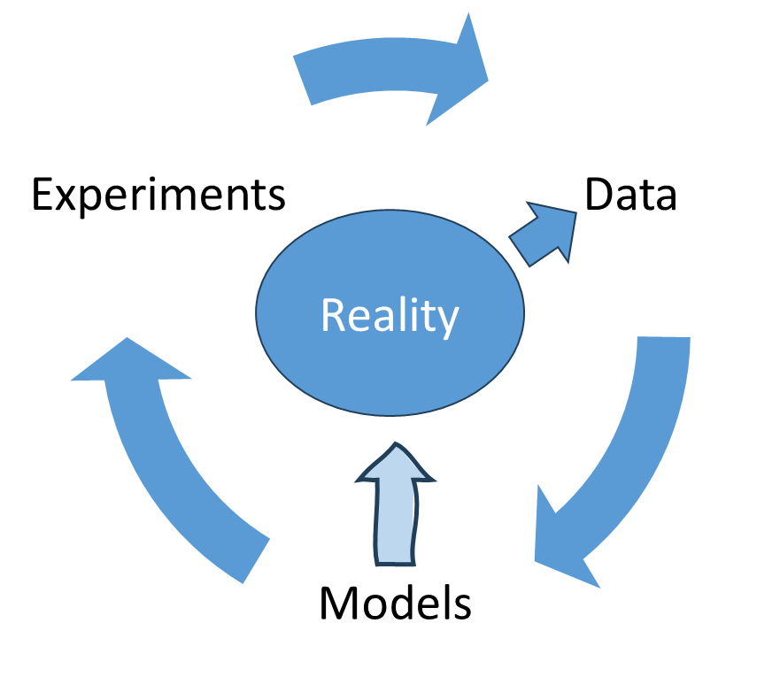
The Basic Approach
Start with data
Make model of data
Combine data with model
To reach conclusions
Evaluate model
Update
Repeat

Slide 7

Conditional Probability - Reminder
What is the chance of event A if we know that event B has occurred?
$$P\left(A | B\right)=\frac{P\left(A, B\right)}{P\left(B\right)}, P\left(B\right)>0$$
Notes:
Why do we divide by $P\left(B\right)$?
we restrict the sample space to B.

Slide 8
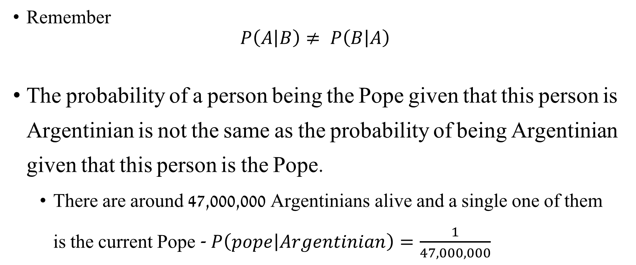
Conditional Probability - Reminder
Remember
$$P\left(A | B\right)≠ P\left(B | A\right)$$
The probability of a person being the Pope given that this person is Argentinian is not the same as the probability of being Argentinian given that this person is the Pope.
There are around 47,000,000 Argentinians alive and a single one of them is the current Pope - $P\left(pope | Argentinian\right)=\frac{1}{47,000,000}$
Notes:
The probability of a person being the Pope given that this person is Argentinian is not the same as the probability of being Argentinian given that this person is the Pope.
There are around 47,000,000 Argentinians alive and a single one of them is the current Pope - $P\left(pope | Argentinian\right)=\frac{1}{47,000,000}$
$$P(Argentinian\left|pope\right)=1$$

Slide 9
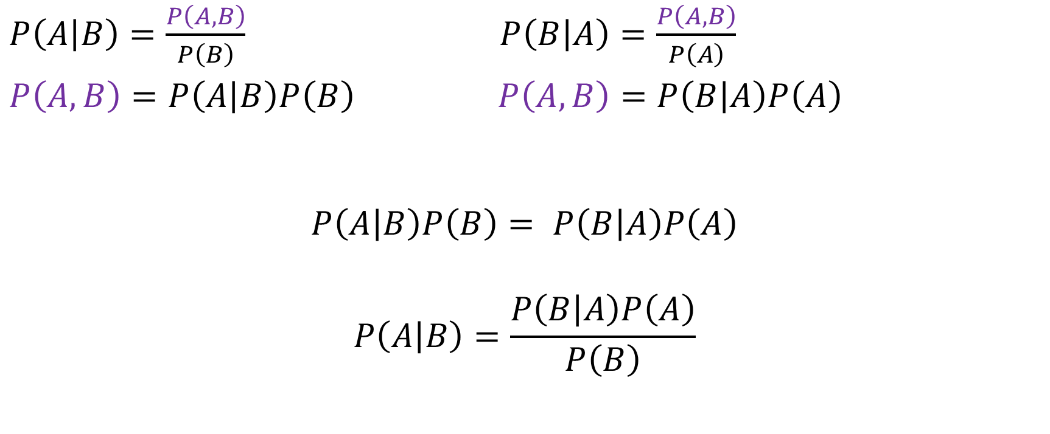
From Conditional Probability to Bayes Rule
$P\left(A | B\right)=\frac{P\left(A, B\right)}{P\left(B\right)}$ $P\left(B | A\right)=\frac{P\left(A, B\right)}{P\left(A\right)}$
$P\left(A, B\right)=P\left(A | B\right)P\left(B\right)$ $P\left(A, B\right)=P\left(B | A\right)P\left(A\right)$
$$P\left(A | B\right)P\left(B\right)= P\left(B | A\right)P\left(A\right)$$
$$P\left(A | B\right)=\frac{P\left(B | A\right)P\left(A\right)}{P\left(B\right)}$$

Slide 10

Bayes Theorem
Components:
$$P\left(A | B\right)=\frac{P\left(B | A\right)P\left(A\right)}{P\left(B\right)}$$
Prior: $P\left(A\right)$
Likelihood: $P\left(B | A\right)$
Evidence: $P\left(B\right)$
Posterior: $P\left(A | B\right)$

Slide 11

Bayes Theorem
$$P\left(A | B\right)=\frac{P\left(B | A\right)P\left(A\right)}{P\left(B\right)}$$
Prior - What do we know about the values of the model before seeing the data.
Likelihood - How we will introduce our data, how likely is the data given our model.
Evidence – The probability of observing the data averaged over all the possible values the parameter can take (Marginal likelihood)
Normalization factor
Posterior - The result of Bayesian analysis. Reflects all we know about our question given our data and model.
Probability distribution for the parameters in our model
Not a single value
Notes:
Under which parameters is the data most likely?
We have to start with some idea – the prior. Then we use our data to update it.
We want to choose a prior which allows for updating it given our data.
$marginal likelihood− \sum_{models}{P\left(\left.data\right|{model}^{∗}\right)P\left({model}^{∗}\right)}$ – probability of the data given all possible models. But we have the data. Also called evidence.
Likelihood – probability distribution of the data – so if we integrate over the data it will give us 1, but not if we integrate over the parameter. We integrate over the parameter in the evidence.

Slide 12
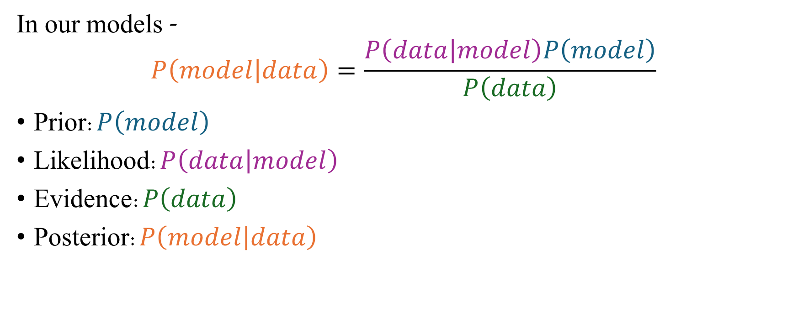
Bayes Theorem
In our models -
$$P\left(model | data\right)=\frac{P\left(data | model\right)P\left(model\right)}{P\left(data\right)}$$
Prior:$P\left(model\right)$
Likelihood:$P\left(data | model\right)$
Evidence:$P\left(data\right)$
Posterior:$P\left(model | data\right)$

Slide 13
Prior
Probability distribution
Describes our prior beliefs on the values of the model
Using Bayes' rule, we combine the likelihood and the prior to obtain the posterior
If we have no prior beliefs, what distribution would we use?
Uniform

Slide 14
Conjugate Priors
For some combinations of priors and likelihoods the posterior has the same distribution family as the prior. Allow for an easy analytic calculation.
These are called conjugate priors.
Useful combinations:
Prior | Likelihood
Gamma | Poisson
Gamma | Exponential
Beta | Binomial
Beta | Bernoulli
Gaussian | Mean: gaussian Variance: Inverse Gamma

Slide 15
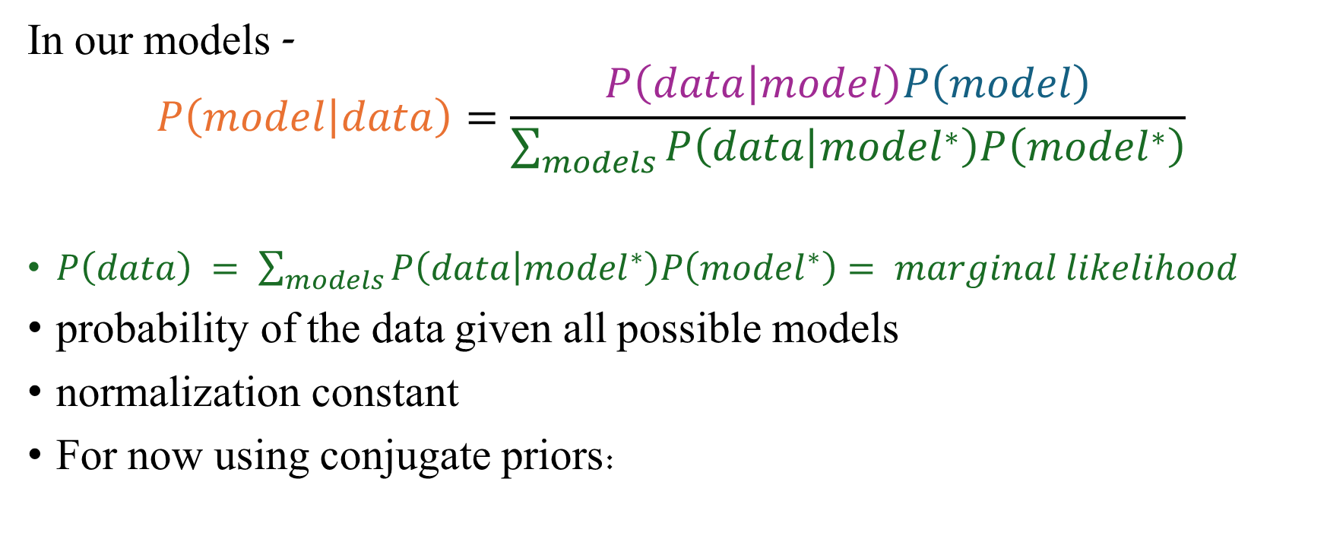
Bayes Theorem
In our models -
$$P\left(model | data\right)=\frac{P\left(data | model\right)P\left(model\right)}{\sum_{models}{P\left(\left.data\right|{model}^{∗}\right)P\left({model}^{∗}\right)}}$$
$P\left(data\right) = \sum_{models}{P\left(\left.data\right|{model}^{∗}\right)P\left({model}^{∗}\right)}= marginal likelihood$
probability of the data given all possible models
normalization constant
For now using conjugate priors:
$$P\left(model∣data\right)∝P\left(data∣model\right)P\left(model\right)$$
Notes:
$$marginal likelihood− \sum_{models}{P\left(\left.data\right|{model}^{∗}\right)P\left({model}^{∗}\right)}$$
Marginal – probability of the data given all possible models. But we have the data. Also called evidence.
$P\left(model∣data\right)∝P\left(data∣model\right)P\left(model\right)$is simply Bayes’ rule written without the normalization constant, emphasizing that
$$\text{posterior}∝\text{likelihood}×\text{prior}.$$

Slide 16
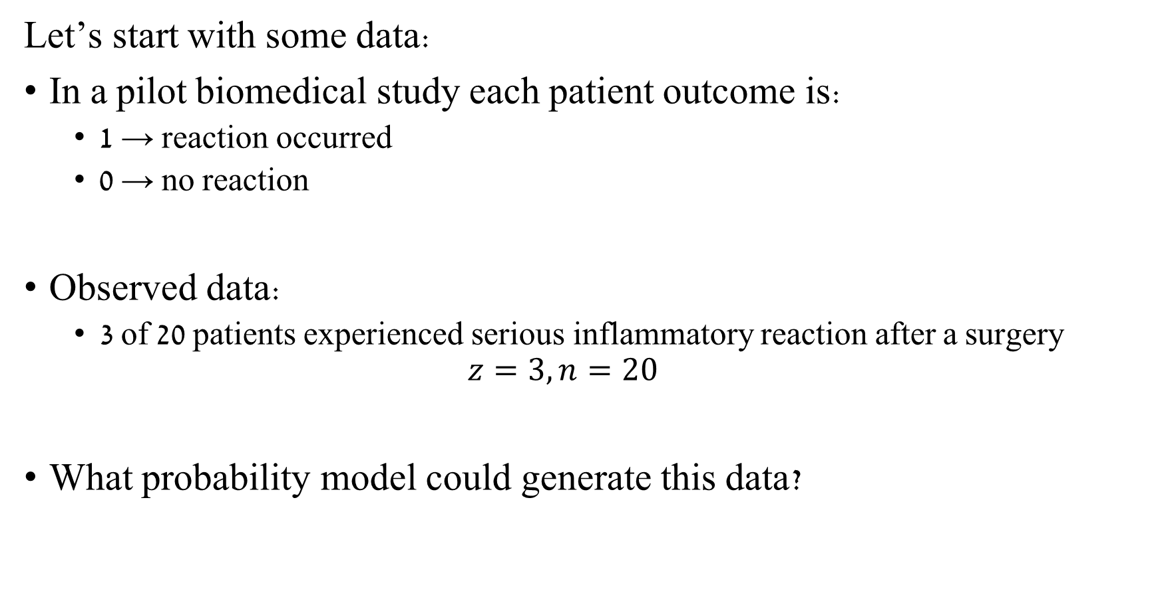
Models – Example 1
Let’s start with some data:
In a pilot biomedical study each patient outcome is:
1 → reaction occurred
0 → no reaction
Observed data:
3 of 20 patients experienced serious inflammatory reaction after a surgery
$$z=3, n=20$$
What probability model could generate this data?
Notes:
100 heights

Slide 17

Models
Each patient outcome is:
1 → reaction occurred
0 → no reaction
This suggests a Bernoulli process.
For $n$ patients:
$$z∼Binomial\left(n , θ\right)$$

Slide 18

Models
Our model contains one unknown parameter:
$θ$ probability that a patient experiences the event
$θ=P\left(\text{event}\right)$
Our goal is to learn about $θ$.

Slide 19
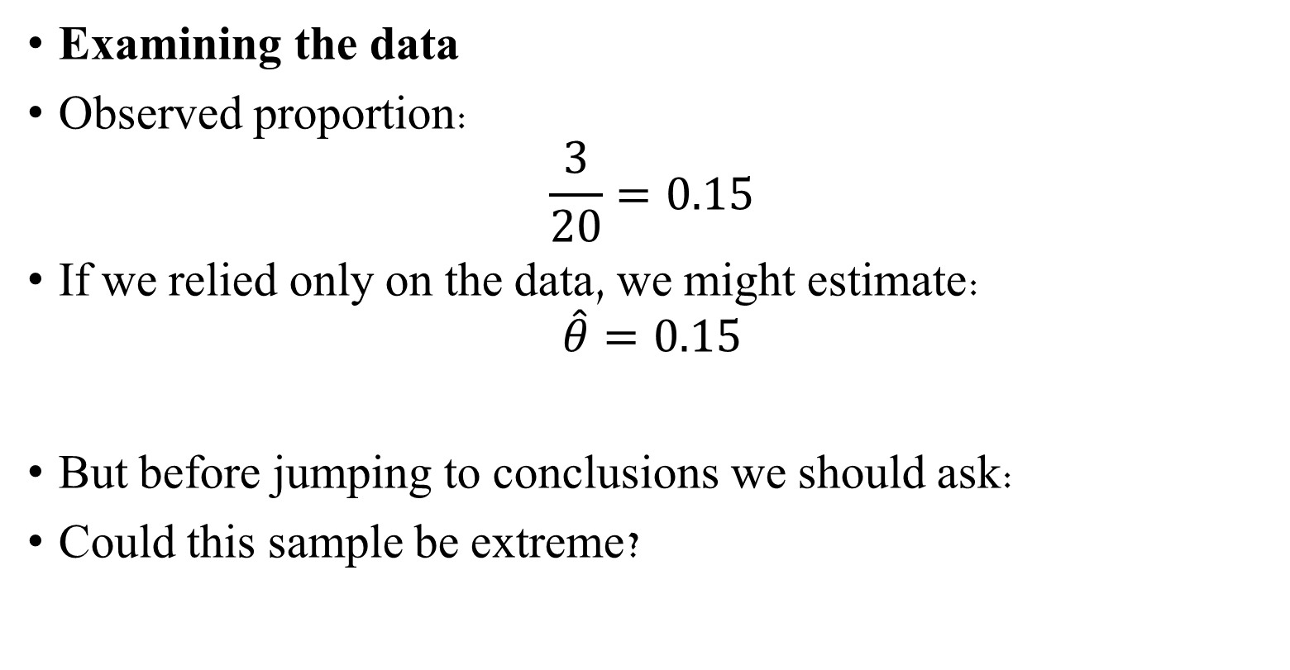
Models
Examining the data
Observed proportion:
$$\frac{3}{20}=0.15$$
If we relied only on the data, we might estimate:
$$\hat{θ}=0.15$$
But before jumping to conclusions we should ask:
Could this sample be extreme?

Slide 20
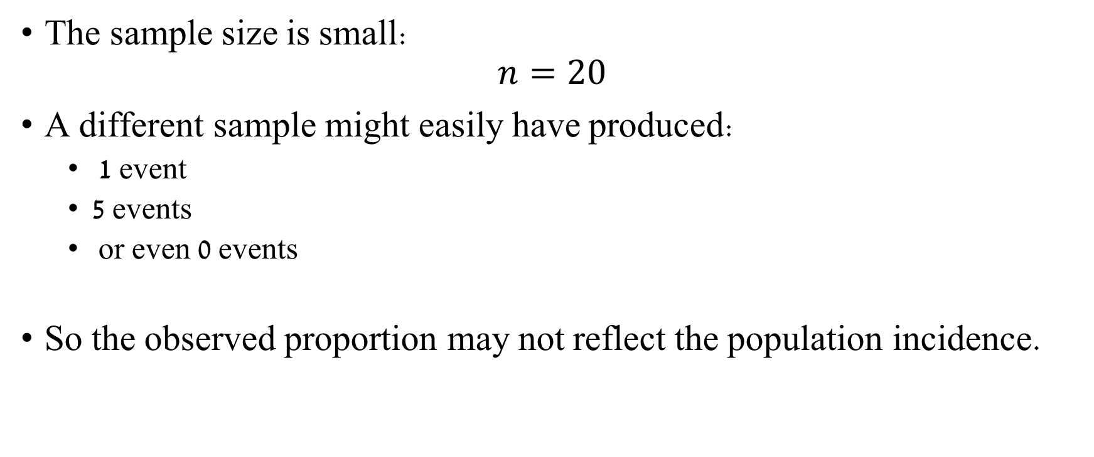
Models
The sample size is small:
$$n=20$$
A different sample might easily have produced:
1 event
5 events
or even 0 events
So the observed proportion may not reflect the population incidence.

Slide 21
Models
To reason about such uncertainty we need probability tools.
In the lecture you saw how conditional probability gives us Bayes rule
Let’s briefly revisit these ideas.

Slide 22

Applying Bayes to our example
Reminder - Observed data:
3 of 20 patients experienced serious inflammatory reaction after a surgery
$$z=3, n=20$$
Likelihood from our model describes:
how probable the observed data are for different values of $θ$.
$$z∼Binomial\left(n , θ\right)$$

Slide 23

Applying Bayes to our example
The likelihood function is:
$$P\left(z=3∣θ\right)$$
Different values of $θ$ make the observed data more or less likely.
Example interpretations:
If $θ=0.15$, the data are quite plausible If $θ=0.01$, the data are very unlikely If $θ=0.40$, the data are also unlikely

Slide 24
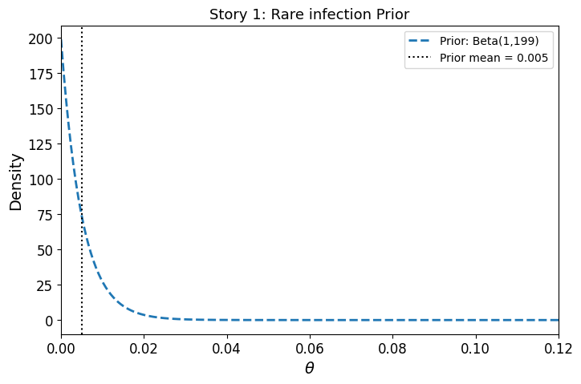

Applying Bayes to our example
Before seeing the data we may have prior knowledge.
For example:
From previous studies we might expect the event rate to be very low.
This belief can be represented with a prior distribution.
Example:
$θ∼Beta\left(1 , 199\right)$
Prior mean:
$0.005$

Slide 25
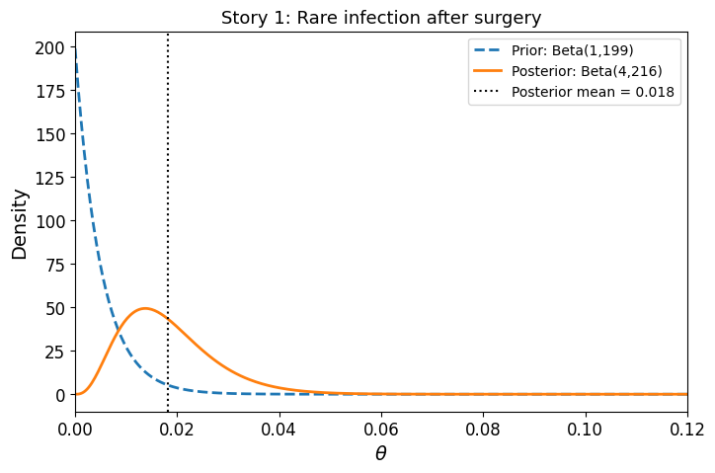
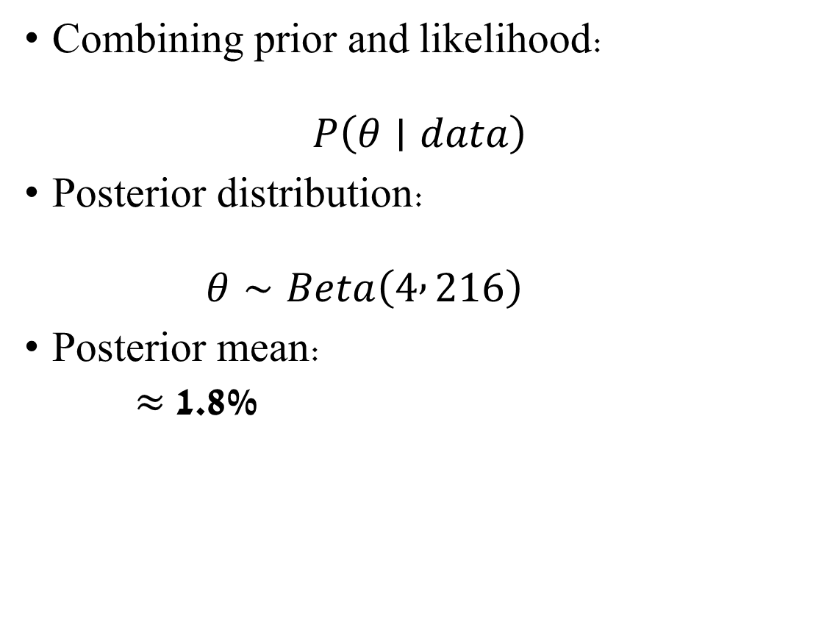
Applying Bayes to our example
Combining prior and likelihood:
$$P\left(θ∣data\right)$$
Posterior distribution:
$$θ∼Beta\left(4 , 216\right)$$
Posterior mean:
≈ 1.8%

Slide 26


Applying Bayes to our example
$$z∼Binomial\left(n , θ\right)$$
$θ$ probability that a patient experiences the event
Interpretation:
Prior expectation:
Extremely rare (<1%)
The inflammatory reaction after a surgery is rare
Observed pilot data:
3 of 20 patients affected.
Posterior conclusion:
The estimated incidence increases, but remains low (~2%).
However:
The data are concerning relative to prior expectations.
$θ∼Beta\left(1 , 199\right)$
$0.005$
$$θ∼Beta\left(4 , 216\right)$$
0.18

Slide 27

Choosing Priors
Now consider a different context -
Suppose the same data arise in a different setting.
Observed data remain identical:
$$3/20$$
But our prior knowledge changes.

Slide 28
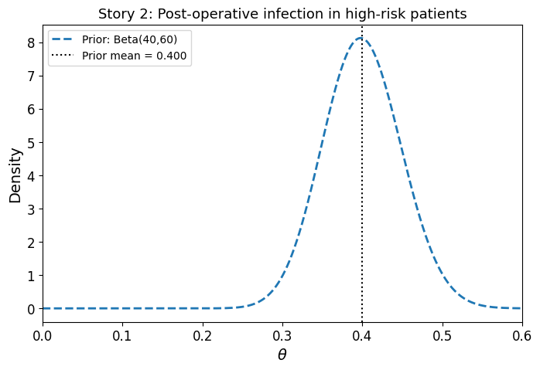

Applying Bayes to our example
Example 2:
Post-operative inflammatory reaction in high-risk abdominal surgery patients.
From previous studies –
Expected incidence:
30%–50%.
Prior:
$θ∼Beta\left(40 , 60\right)$
Prior mean:
40%.

Slide 29
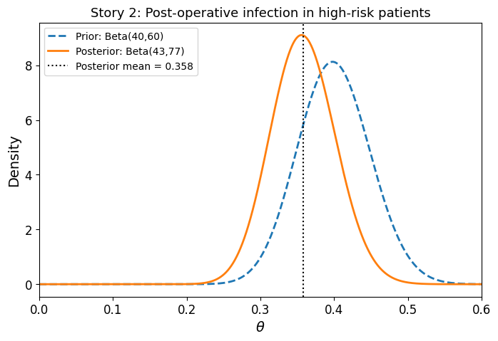

Applying Bayes to our example
Combining the same likelihood with this prior:
Posterior: $θ∼Beta\left(43 , 77\right)$
Posterior mean:
≈ 35.8%

Slide 30
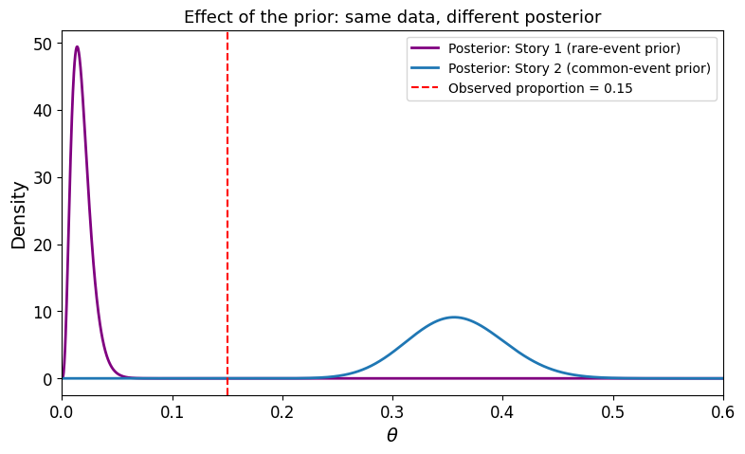
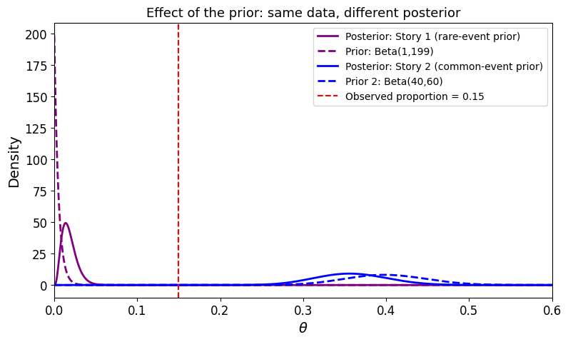
Applying Bayes to our example

Slide 31
Applying Bayes to our example
Bayesian modeling says data never speak alone.
They are interpreted relative to what was plausible before seeing the data.
The same dataset can represent an alarming signal for a rare event or a small deviation from a common event
depending on the prior.

Slide 32
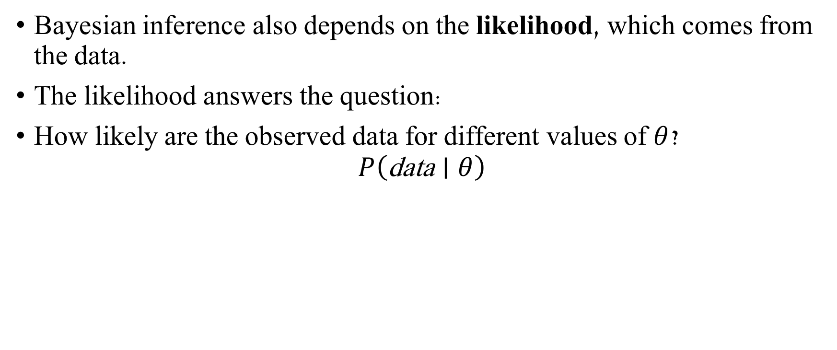
likelihood
Bayesian inference also depends on the likelihood, which comes from the data.
The likelihood answers the question:
How likely are the observed data for different values of $θ$?
$$P\left(\text{data}∣θ\right)$$

Slide 33

Applying Bayes to our example
Observed data:
$$z=3, n=20$$
Observed proportion:
$$\frac{3}{20}=0.15$$
Because the sample is small, this proportion may vary a lot across samples.

Slide 34
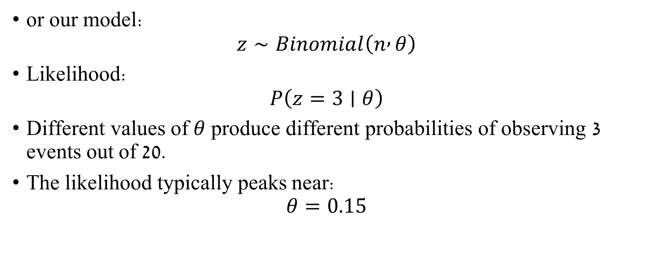
Applying Bayes to our example
or our model:
$$z∼Binomial\left(n , θ\right)$$
Likelihood:
$$P\left(z=3∣θ\right)$$
Different values of $θ$ produce different probabilities of observing 3 events out of 20.
The likelihood typically peaks near:
$$θ=0.15$$

Slide 35
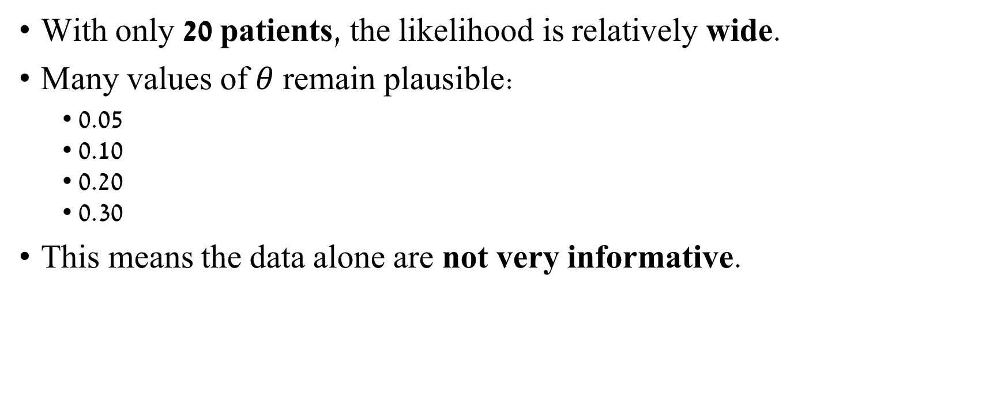
Applying Bayes to our example
With only 20 patients, the likelihood is relatively wide.
Many values of $θ$ remain plausible:
• 0.05 • 0.10 • 0.20 • 0.30
This means the data alone are not very informative.

Slide 36
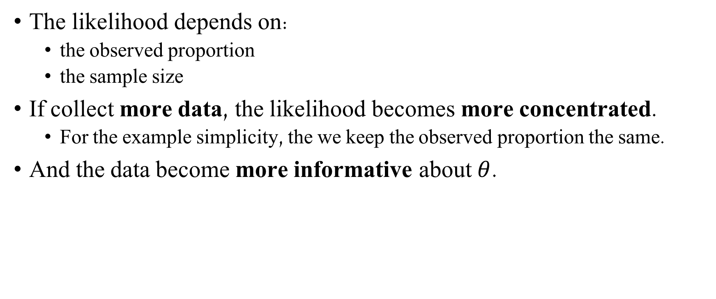
Applying Bayes to our example
The likelihood depends on:
the observed proportion
the sample size
If collect more data, the likelihood becomes more concentrated.
For the example simplicity, the we keep the observed proportion the same.
And the data become more informative about $θ$.

Slide 37

Applying Bayes to our example
Suppose we observe the same event rate in different experiments:
$z = 3, n = 20$
$z =15, n =100$
$z =150, n =1000$

Slide 38
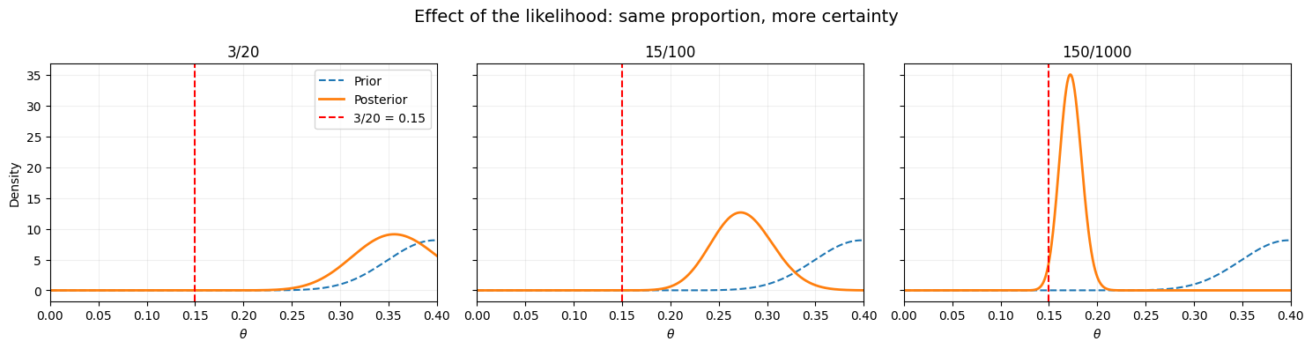

Applying Bayes to our example
As the sample size increases:
the likelihood becomes narrower
values far from the observed proportion become less plausible
the data provide stronger evidence about $θ$
Notes:
Same prior as story 2 (common event)

Slide 39
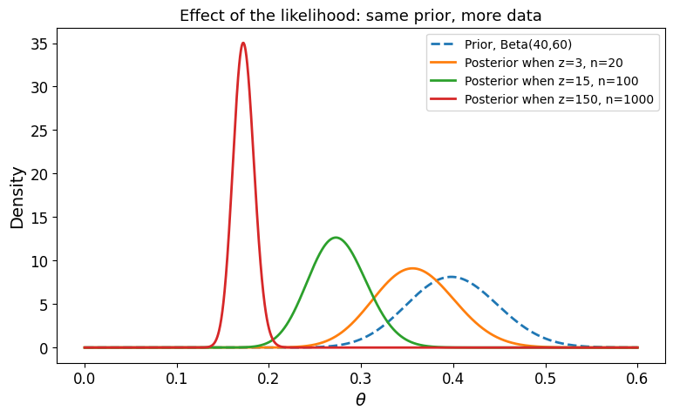
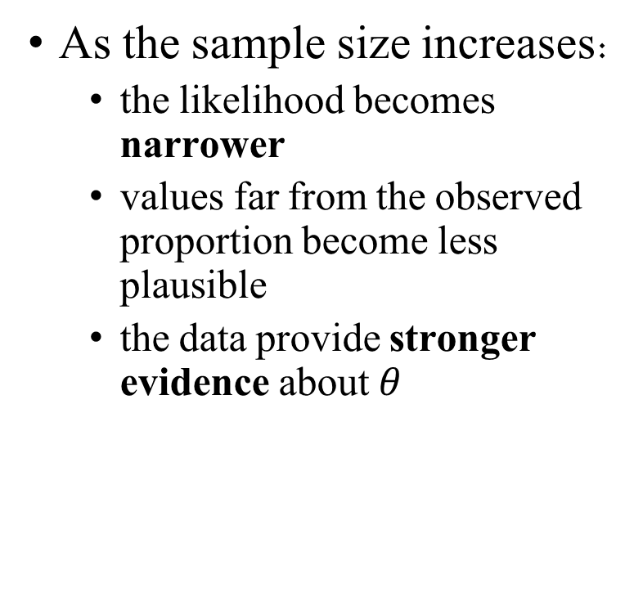
Applying Bayes to our example
As the sample size increases:
the likelihood becomes narrower
values far from the observed proportion become less plausible
the data provide stronger evidence about $θ$
Notes:
Same prior as story 2 (common event)

Slide 40
Bayesian Inference
The result of a Bayesian analysis is a posterior distribution – not a single value but a distribution of plausible values given the data and our model.
The most probable value is the mode of the posterior (today we saw the mean).
The spread of the posterior reflects the uncertainty about the value of the parameter.
The more data we have, the less the prior effects the posterior.
Given a sufficiently large amount of data, two or more Bayesian models with different priors will tend to converge to the same result. In the limit of infinite data, no matter which prior we use, all of them will provide the same posterior.

Slide 41
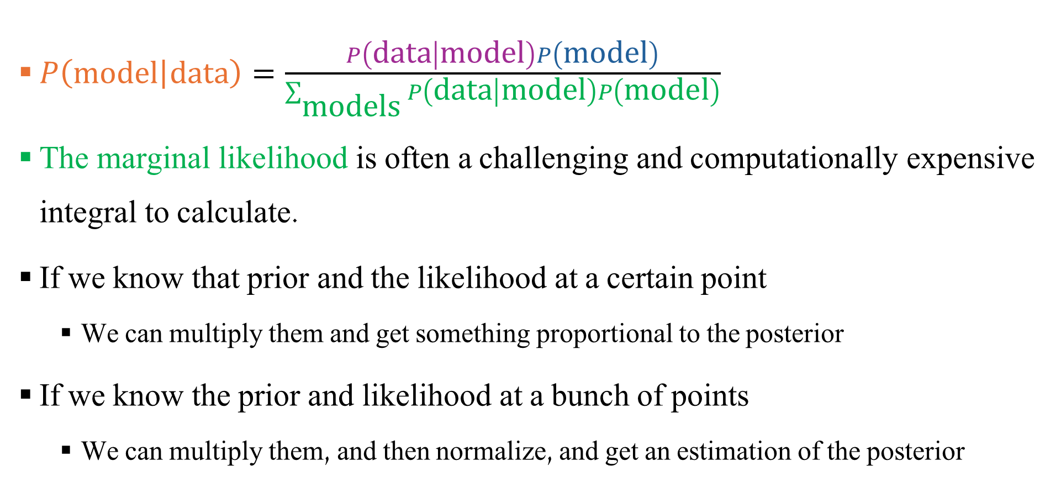
Grid Method
$P\left(\left.\text{model}\right|\text{data}\right)=\frac{P\left(\left.\text{data}\right|\text{model}\right)P\left(\text{model}\right)}{\sum_{\text{models}}{P\left(\left.\text{data}\right|\text{model}\right)P\left(\text{model}\right)}}$
The marginal likelihood is often a challenging and computationally expensive integral to calculate.
If we know that prior and the likelihood at a certain point
We can multiply them and get something proportional to the posterior
If we know the prior and likelihood at a bunch of points
We can multiply them, and then normalize, and get an estimation of the posterior
Notes:
marginal likelihood is computationally expensive
Because:
It requires integrating over all parameter values
In high dimensions → becomes very difficult
This is exactly why:
In the grid method, we compute it implicitly by normalization

Slide 42
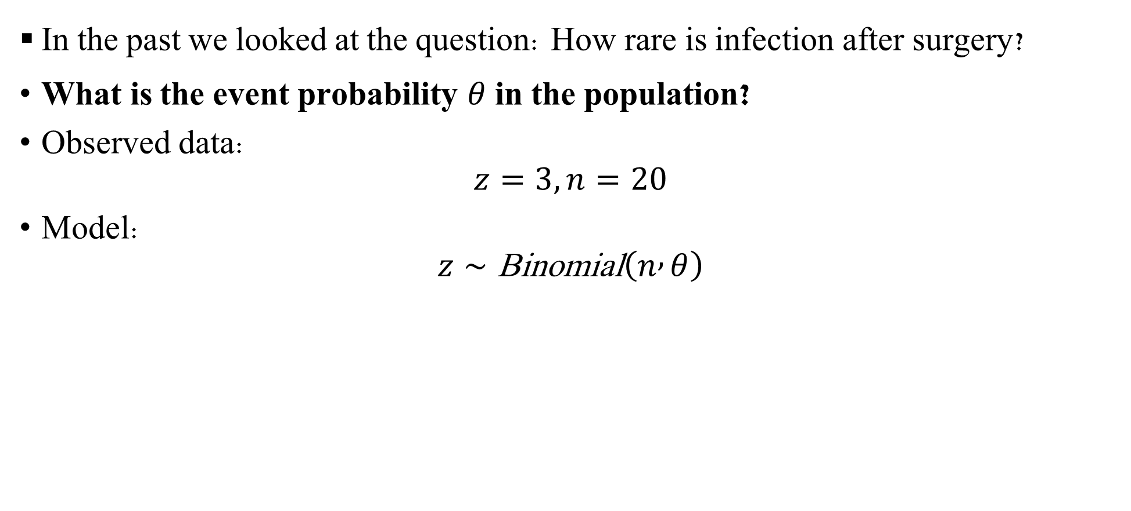
Grid Method
In the past we looked at the question: How rare is infection after surgery?
What is the event probability $θ$ in the population?
Observed data:
$$z=3, n=20$$
Model:
$$z∼\text{Binomial}\left(n , θ\right)$$

Slide 43

Grid Method
Likelihood
For our data:
$$P\left(data∣θ\right)=P\left(z=3 \right|n=20, θ)$$
Using the Binomial model:
$$P(z |n, θ)=\left({n \atop z}\right)θ^{z}{\left(1−θ\right)}^{n−z}$$
So here:
$$P(z=3∣n=20,θ\text{)}=\left({20 \atop 3}\right)θ^{3}{\left(1−θ\right)}^{17}$$

Slide 44

Grid Method
Prior
We also need a prior on $θ$.
For example, in the rare-event story:
$$θ∼Beta\left(1 , 199\right)$$
This prior reflects the belief that the event should be very rare.

Slide 45
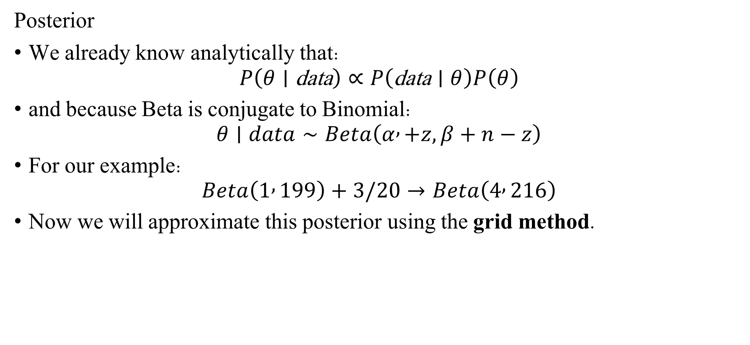
Grid Method
Posterior
We already know analytically that:
$$P\left(θ∣\text{data}\right)∝P\left(\text{data}∣θ\right)P\left(θ\right)$$
and because Beta is conjugate to Binomial:
$$θ∣data∼Beta\left(α , +z, β+n−z\right)$$
For our example:
$$Beta\left(1 , 199\right)+3/20→Beta\left(4 , 216\right)$$
Now we will approximate this posterior using the grid method.

Slide 46
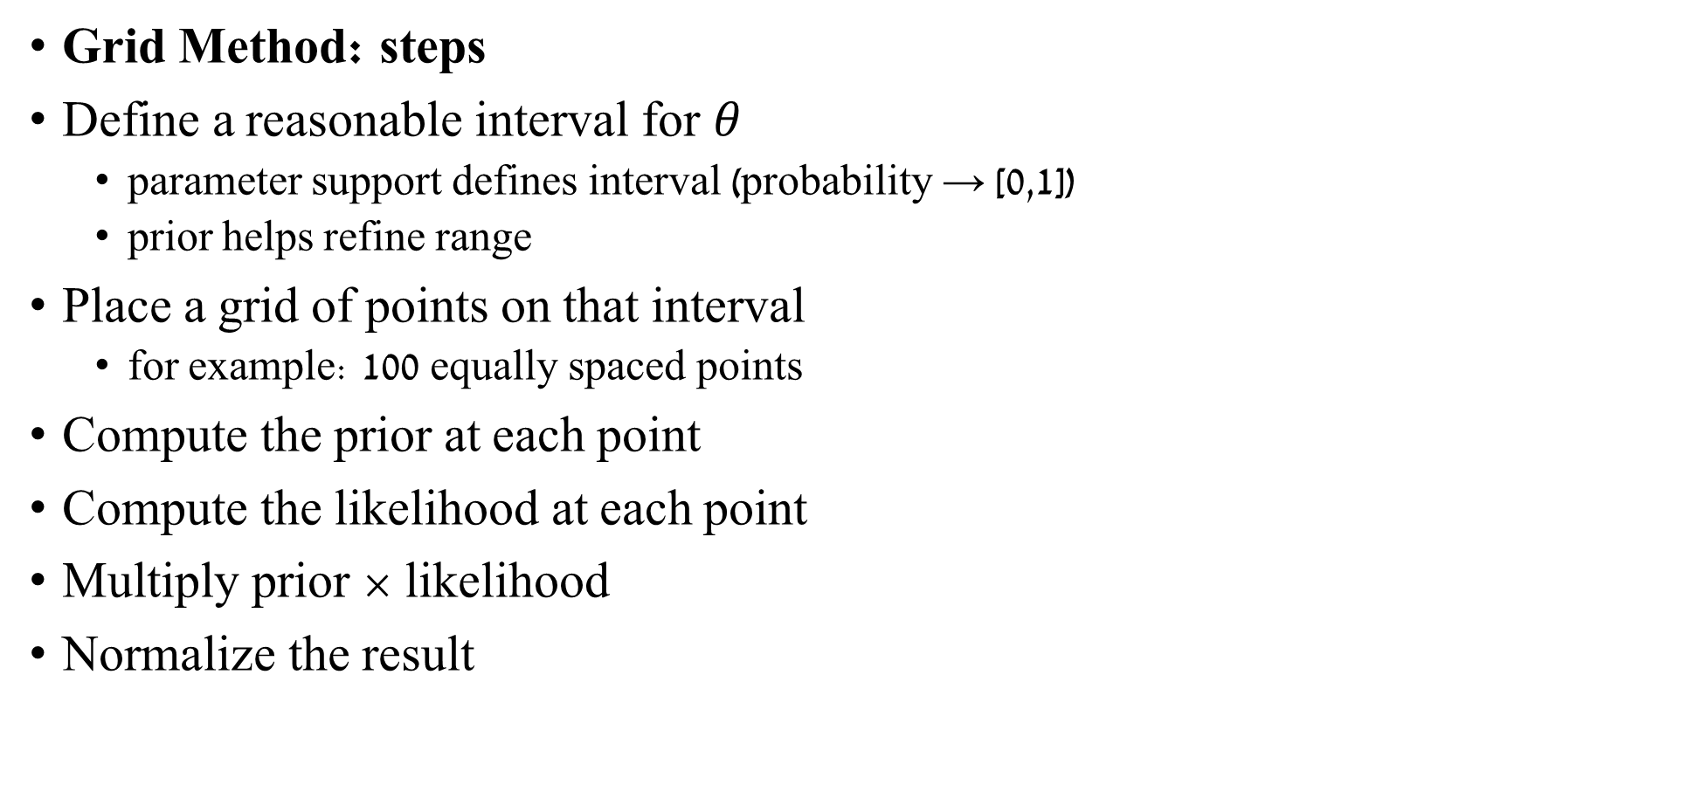
Grid Method
Grid Method: steps
Define a reasonable interval for $θ$
parameter support defines interval (probability → [0,1])
prior helps refine range
Place a grid of points on that interval
for example: 100 equally spaced points
Compute the prior at each point
Compute the likelihood at each point
Multiply prior × likelihood
Normalize the result

Slide 47
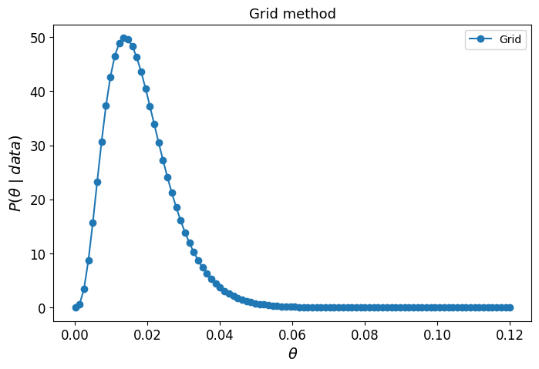

Grid Method
At each grid point $θ_{i}$, we compute:
$$P\left(θ_{i}∣data\right)∝P\left(data∣θ_{i}\right)P\left(θ_{i}\right)$$
After normalization, the values across the grid approximate the posterior distribution.
Notes:
In the future we’ll learn better methods such as MCMC.

Slide 48
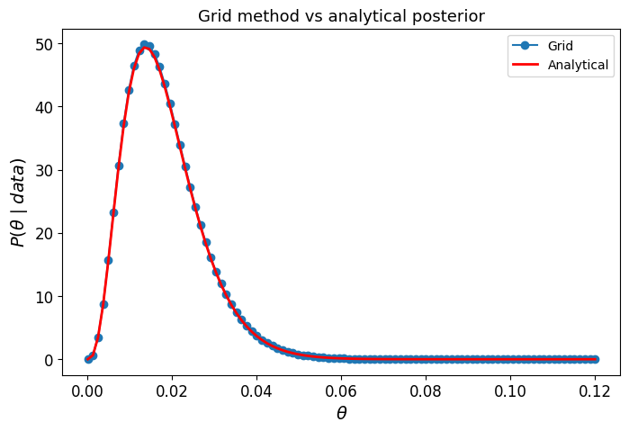
Grid Method
We can see the overlap between the grid method and the analytical results.
We wasted a lot of our grid sampling values above 0.04.
Notes:
In the future we’ll learn better methods such as MCMC.

Slide 49
Grid Method
The grid method introduces the Bayesian workflow:
Define prior
Define likelihood
Compute posterior (analytically or numerically)
Compare results
Later in the course:
grid method → sampling methods (MCMC)
PyMC → automated posterior computation

Slide 50
Additional slides
The following slide offer simple explanations to some not the material, feel free to go over them if you feel the need ☺

Slide 51
Conditional Probability
What is the chance of event A if we know that event B has occurred?
$$P\left(A | B\right)=\frac{P\left(A, B\right)}{P\left(B\right)}, P\left(B\right)>0$$
Notes:
Why do we divide by $P\left(B\right)$?
we restrict the sample space to B.

Slide 52
Conditional Probability
Example:
What is the chance of passing (A) if I studied (B)?
Total | Failed (Not A) | Passed (A)
50 | 5 | 45 | Studied (B)
50 | 15 | 35 | Not Studied (Not B)
100 | 20 | 80 | Total

Slide 53
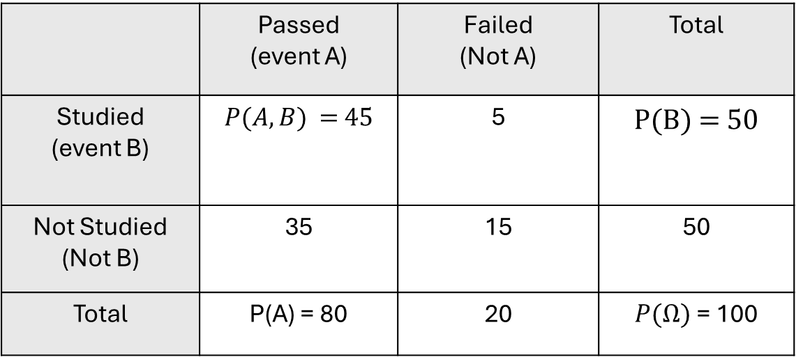
Conditional Probability
Example:
What is the chance of passing (A) if I studied (B)?
Total | Failed (Not A) | Passed (event A)
P(B) = 50 | 5 | $P(A,B)$ = 45 | Studied (event B)
50 | 15 | 35 | Not Studied (Not B)
$P(Ω)$= 100 | 20 | P(A) = 80 | Total

Slide 54

Conditional Probability
What is the chance of passing if I studied?
Total | Failed (Not A) | Passed (A)
50 | 5 | 45 | Studied (B)
50 | 15 | 35 | Not Studied (Not B)
100 | 20 | 80 | Total
Step 1 — Joint probability
$$P\left(A , B\right)=\frac{45}{100}=0.45$$
Step 2 — Probability of $B$
$$P\left(B\right)=\frac{50}{100}=0.5$$
Step 3 — Conditional probability
$$P\left(A∣B\right)=\frac{P\left(A , B\right)}{P\left(B\right)}=\frac{0.45}{0.5}=0.9$$

Slide 55
Conditional Probability
What is the chance of passing if I studied?
Total | Failed (Not A) | Passed (A)
50 | 5 | 45 | Studied (B)
50 | 15 | 35 | Not Studied (Not B)
100 | 20 | 80 | Total
Step 1 — Joint probability
$$P\left(A , B\right)=\frac{45}{100}=0.45$$
Step 2 — Probability of $B$
$$P\left(B\right)=\frac{50}{100}=0.5$$
Step 3 — Conditional probability
$$P\left(A∣B\right)=\frac{P\left(A , B\right)}{P\left(B\right)}=\frac{0.45}{0.5}=0.9$$
If a student studied, the probability they pass is 0.9.

Slide 56
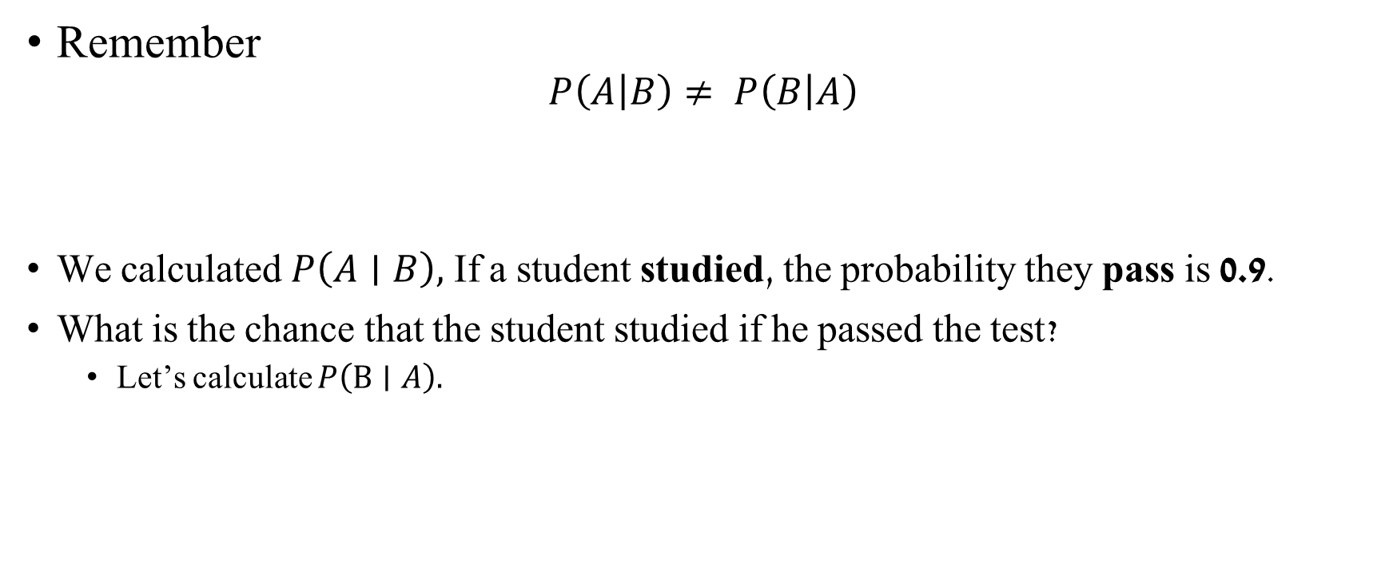
Conditional Probability
Remember
$$P\left(A | B\right)≠ P\left(B | A\right)$$
We calculated $P\left(A∣B\right),$If a student studied, the probability they pass is 0.9.
What is the chance that the student studied if he passed the test?
Let’s calculate $P\left(B∣A\right).$
Notes:
The probability of a person being the Pope given that this person is Argentinian is not the same as the probability of being Argentinian given that this person is the Pope.
There are around 47,000,000 Argentinians alive and a single one of them is the current Pope - $P\left(pope | Argentinian\right)=\frac{1}{47,000,000}$
$$P(Argentinian\left|pope\right)=1$$

Slide 57

Conditional Probability
What is the chance that the student studied if he passed the test?
Total | Failed (Not A) | Passed (A)
50 | 5 | 45 | Studied (B)
50 | 15 | 35 | Not Studied (Not B)
100 | 20 | 80 | Total
Step 1 — Joint probability
$$P\left(A , B\right)=\frac{45}{100}=0.45$$
Step 2 — Probability of $A$
$$P\left(A\right)=\frac{80}{100}=0.8$$
Step 3 — Conditional probability
$$P\left(B∣A\right)=\frac{P\left(A , B\right)}{P\left(A\right)}=\frac{0.45}{0.8}=0.5625$$
If a student passed, the probability they studied is 0.56.

Slide 58

Conditional Probability
Total | Failed (Not A) | Passed (A)
50 | 5 | 45 | Studied (B)
50 | 15 | 35 | Not Studied (Not B)
100 | 20 | 80 | Total
Remember
$P\left(A | B\right)≠ P\left(B | A\right)$
$$P\left(A∣B\right)=\frac{P\left(A , B\right)}{P\left(B\right)}=\frac{0.45}{0.5}=0.9 P\left(B∣A\right)=\frac{P\left(A , B\right)}{P\left(A\right)}=\frac{0.45}{0.8}=0.5625$$
If a student studied, the probability they pass is 0.9
If a student passed, the probability they studied is 0.56.
Notes:
The probability of a person being the Pope given that this person is Argentinian is not the same as the probability of being Argentinian given that this person is the Pope.
There are around 47,000,000 Argentinians alive and a single one of them is the current Pope - $P\left(pope | Argentinian\right)=\frac{1}{47,000,000}$
$$P(Argentinian\left|pope\right)=1$$

Slide 59

Conditional Probability
Another reminder – If A and B are independent :
$$P\left(A, B\right)= P\left(A\right)P\left(B\right)$$
And
$$P\left(A | B\right)=\frac{P\left(A, B\right)}{P\left(B\right)}=\frac{P\left(A\right)P\left(B\right)}{P(B)}=P\left(A\right)$$

Slide 60
Conditional Probability – Independent events
Example:
What is the chance of passing the test (A) if I brought an umbrella to the test (B)?
Total | Failed (Not A) | Passed (A)
50 | 40 | 10 | Umbrella (B)
50 | 40 | 10 | No Umbrella (Not B)
100 | 80 | 20 | Total

Slide 61

Conditional Probability – Independent events
What is the chance of passing the test (A) if I brought an umbrella to the test (B)?
Step 1 — Joint probability
$P\left(A , B\right)=\frac{10}{100}=0.1$
Step 2 — Probability of B
$P\left(B\right)=\frac{50}{100}=0.5$
Step 3 — Conditional probability
$P\left(A∣B\right)=\frac{P\left(A , B\right)}{P\left(B\right)} =\frac{0.1}{0.5}=\frac{P\left(A\right)P\left(B\right)}{P(B)}=\frac{0.2∗0.5}{0.5}=0.2$ = P(A)
Total | Failed (Not A) | Passed (A)
50 | 40 | 10 | Umbrella (B)
50 | 40 | 10 | No Umbrella (Not B)
100 | 80 | 20 | Total

Slide 62

Conditional Probability – Independent events
Example:
What is the chance of passing the test (A) if I brought an umbrella to the test (B)?
Step 1 — Joint probability
$P\left(A , B\right)=\frac{10}{100}=0.1$
Step 2 — Probability of B
$P\left(B\right)=\frac{50}{100}=0.5$
Step 3 — Conditional probability
$P\left(A∣B\right)=\frac{P\left(A , B\right)}{P\left(B\right)} =\frac{0.1}{0.5}=\frac{P\left(A\right)P\left(B\right)}{P(B)}=\frac{0.2∗0.5}{0.5}=0.2$
Total | Failed (Not A) | Passed (A)
50 | 40 | 10 | Umbrella (B)
50 | 40 | 10 | No Umbrella (Not B)
100 | 80 | 20 | Total
Bringing an umbrella does not change the probability of passing.

Slide 63

Models
A model is a specific idea about how data comes from reality
A particular distribution
With specific parameters
$P\left(\left.\text{model}\right|\text{data}\right)=\frac{P\left(\left.\text{data}\right|\text{model}\right)P\left(\text{model}\right)}{\sum_{\text{models}}{P\left(\left.\text{data}\right|\text{model}\right)P\left(\text{model}\right)}}$
$P\left(\left.\text{model}\right|\text{data}\right)∝P\left(\left.\text{data}\right|\text{model}\right)P\left(\text{model}\right)$
We will use data to update our model
Notes:
the denominator does not depend on the specific model. It is a constant with respect to the model when the data are fixed.
Start from Bayes’ theorem:
$$P\left(\text{model}∣\text{data}\right)=\frac{P\left(\text{data}∣\text{model}\right)P\left(\text{model}\right)}{\sum_{\text{models}}{P}\left(\text{data}∣\text{model}\right)P\left(\text{model}\right)}$$
The denominator
$$\sum_{\text{models}}{P}\left(\text{data}∣\text{model}\right)P\left(\text{model}\right)$$
is the evidence $P\left(\text{data}\right)$. It is computed by summing over all possible models and therefore does not change when comparing different models.
So we can rewrite Bayes’ rule as
$$P\left(\text{model}∣\text{data}\right)=\frac{1}{P\left(\text{data}\right)} P\left(\text{data}∣\text{model}\right)P\left(\text{model}\right)$$
Since $P\left(\text{data}\right)$is a constant with respect to the model, the posterior is proportional to the numerator:
$$P\left(\text{model}∣\text{data}\right)∝P\left(\text{data}∣\text{model}\right)P\left(\text{model}\right)$$
The symbol $∝$means “proportional to”. It indicates that the right-hand side gives the shape of the posterior, but it is not yet normalized. The denominator (the evidence) serves only to normalize the distribution so that the probabilities sum to 1.
Reminder:
Likelihood $P\left(\text{data}∣\text{model}\right)$: how well the model explains the data
Prior $P\left(\text{model}\right)$: belief about the model before seeing the data
Posterior $P\left(\text{model}∣\text{data}\right)$: updated belief after observing the data
$P\left(\text{model}∣\text{data}\right)∝P\left(\text{data}∣\text{model}\right)P\left(\text{model}\right)$ is simply Bayes’ rule written without the normalization constant, emphasizing that
$$\text{posterior}∝\text{likelihood}×\text{prior}.$$

Slide 64


From $P\left(\left.\text{model}\right|\text{data}\right)=\frac{P\left(\left.\text{data}\right|\text{model}\right)P\left(\text{model}\right)}{\sum_{\text{models}}{P\left(\left.\text{data}\right|\text{model}\right)P\left(\text{model}\right)}}$ to $P\left(\left.\text{model}\right|\text{data}\right)∝P\left(\left.\text{data}\right|\text{model}\right)P\left(\text{model}\right)$
the denominator does not depend on the specific model. It is a constant with respect to the model when the data are fixed.
The denominator is the evidence $P\left(\text{data}\right)$. It is computed by summing over all possible models and therefore does not change when comparing different models.
So we can rewrite Bayes’ rule as
$$P\left(\text{model}∣\text{data}\right)=\frac{1}{P\left(\text{data}\right)} P\left(\text{data}∣\text{model}\right)P\left(\text{model}\right)$$
Since $P\left(\text{data}\right)$is a constant with respect to the model, the posterior is proportional to the numerator:
$$P\left(\text{model}∣\text{data}\right)∝P\left(\text{data}∣\text{model}\right)P\left(\text{model}\right)$$
The symbol $∝$means “proportional to”. It indicates that the right-hand side gives the shape of the posterior, but it is not yet normalized. The denominator (the evidence) serves only to normalize the distribution so that the probabilities sum to 1.
$P\left(\text{model}∣\text{data}\right)∝P\left(\text{data}∣\text{model}\right)P\left(\text{model}\right)$ is simply Bayes’ rule written without the normalization constant, emphasizing that
$$\text{posterior}∝\text{likelihood}×\text{prior}.$$
Notes:
Likelihood $P\left(\text{data}∣\text{model}\right)$: how well the model explains the data
Prior $P\left(\text{model}\right)$: belief about the model before seeing the data
Posterior $P\left(\text{model}∣\text{data}\right)$: updated belief after observing the data
$P\left(\text{model}∣\text{data}\right)∝P\left(\text{data}∣\text{model}\right)P\left(\text{model}\right)$ is simply Bayes’ rule written without the normalization constant, emphasizing that
$$\text{posterior}∝\text{likelihood}×\text{prior}.$$

