Slide 1
Tutorial 3
Statistical Computation and Analysis
Spring 2026

Slide 2
Tutorial Outline
Graphical models
Probabilistic programming languages – PyMC
Sampling
Posterior distribution
(Bayesian) Estimation
HDI
Frequentist estimation
MLE
CI

Slide 3
Graphical model
Representing our models with diagrams

Slide 4
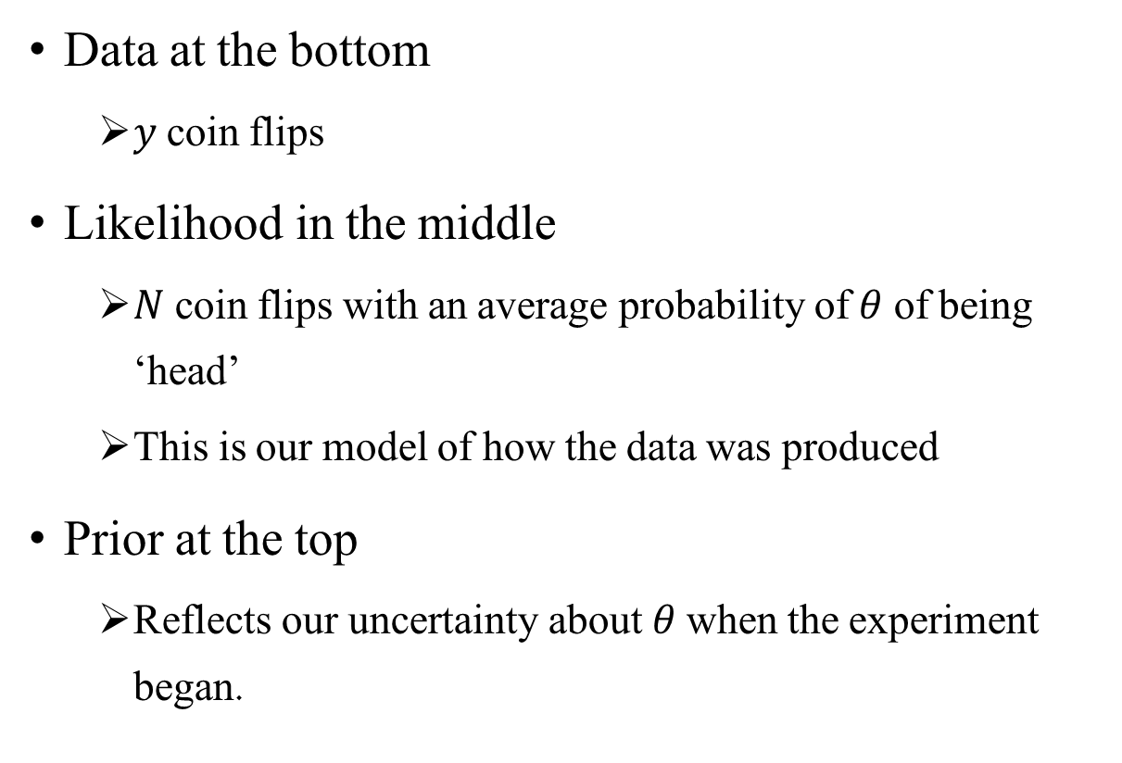
Graphical model
Data at the bottom
$y$coin flips
Likelihood in the middle
$N$ coin flips with an average probability of $θ$ of being ‘head’
This is our model of how the data was produced
Prior at the top
Reflects our uncertainty about $θ$when the experiment began.

Slide 5
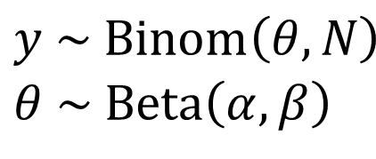
Three Representations of the Same Idea
Equations
Graphical model
PPL
$$y \sim \text{Binom}\left(θ,N\right)$$
$$θ \sim \text{Beta}\left(α,β\right)$$
with pm.Model() as our_first_model:
θ = pm.Beta('θ', alpha=1., beta=1.)
y = pm.Bernoulli('y', p=θ, observed=data)
Notes:
$$\prod_{i=1}^{N}{Bernoulli(y_{i}​∣θ)}≡Binomial(z∣N,θ)$$

Slide 6
Probabilistic Programming Languages (PPL)
Fully probabilistic models often lead to analytically intractable expressions
Probabilistic Programming Languages
Allow clear separation between model creation and inference
Users specify a full probabilistic model by writing a few lines of code
The PPL automatically builds the model and uses algorithms to draw samples from the posterior.
These samples are then used to estimate posterior summaries, uncertainty intervals, and diagnostic
Notes:
Analytically intractable expressions are mathematical formulas that cannot be solved, simplified, or evaluated in a finite number of operations (a closed-form expression) using standard functions (addition, logarithms, trigonometric functions, etc.).

Slide 7
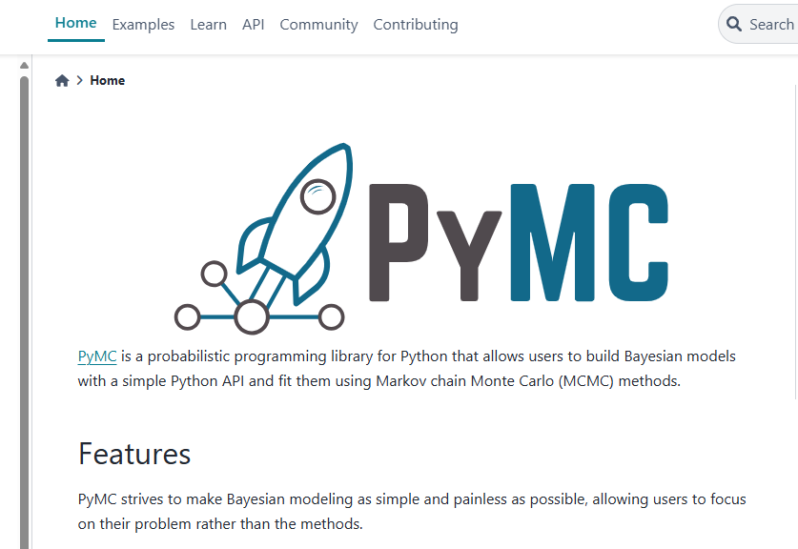
PyMC
A PPL for Python
PyMC defines the model.
ArviZ helps to analyzes posterior samples.
Preliz helps choose priors.
Notes:
https://www.pymc.io/welcome.html

Slide 8
Three Representations of the Same Idea
Equations
Graphical model
PPL (PyMC)
with pm.Model() as our_first_model:
θ = pm.Beta('θ', alpha=1., beta=1.)
y = pm.Binominal('y’, n=N p=θ, observed=y_sum)
Note- y is a sum of multiple Bernoulli observations.
Notes:
$$\prod_{i=1}^{N}{Bernoulli(y_{i}​∣θ)}≡Binomial(y∣N,θ)$$
It’s common to call the sum “z” and not “y” to avoid confusion.

Slide 9
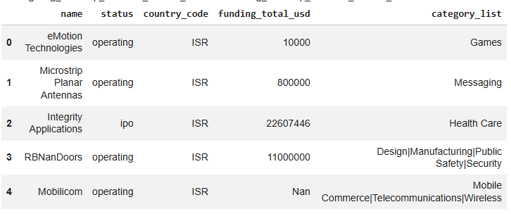
Translating a Graphical Model to a PPL
Biotechnology startups

Slide 10
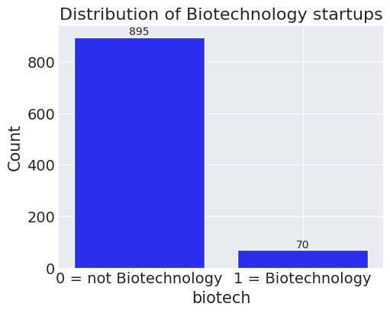
Translating a Graphical Model to a PPL
Biotechnology startups
Variable
biotech = 1 if the startup category is "Biotechnology"
0 otherwise
Notes:
We’ll learn more about line 4 later on.

Slide 11

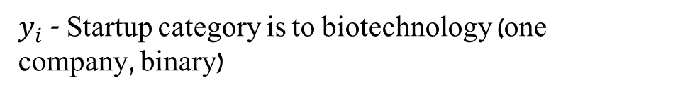
Translating a Graphical Model to a PPL
Biotechnology startups
2 possible models
$$y \sim Binom\left(θ, N\right)$$
$$y_{i} \sim Bernulli(θ)$$
$$θ \sim Beta\left( α, β\right)$$
$y$ - Number of startup in the biotechnology category
$y_{i}$ - Startup category is to biotechnology (one company, binary)
Probability of biotechnology startup

Slide 12
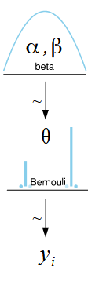

Translating a Graphical Model to a PPL
Biotechnology startups
2 possible models
$$θ \sim Beta\left( α, β\right)$$
$$y \sim Binom\left(θ, N\right)$$
$$y_{i} \sim Bernulli(θ)$$

Slide 13

Translating a Graphical Model to a PPL
Biotechnology startups
2 possible models
$$θ \sim Beta\left( α, β\right)$$
$$y \sim Binom\left(θ, N\right)$$
$$y_{i} \sim Bernulli(θ)$$
Use when data is a sum of Bernoulli outcomes
Use when data is a vector of Bernoulli outcomes

Slide 14
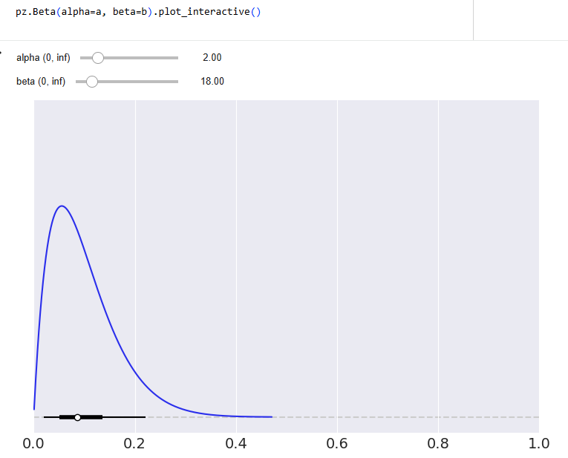

Translating a Graphical Model to a PPL
Biotechnology startups
Choosing a prior
$$θ \sim Beta\left(2, 18\right)$$
$$y_{i} \sim Bernulli(θ)$$

Slide 15
Translating a Graphical Model to a PPL
Biotechnology startups - PPL
Line 1: creates a container for our model. Everything inside the with block will be automatically added to biotech_model.
Line 2: prior
Line 3: likelihood
Line 4: computes the posterior using numerical methods.
# Choosing a prior
a = 2
b = 18
# First PyMC model
with pm.Model() as biotech_model:
theta = pm.Beta("theta", alpha=a, beta=b)
y = pm.Bernoulli("y", p=theta, observed=data)
idata = pm.sample(1000, chains=4)
Notes:
We’ll learn more about line 4 later on.

Slide 16
Translating a Graphical Model to a PPL
Biotechnology startups – Additions to the simple model
Coords & dims – for now, help us name the data in the idata object
# coords - naming our data
coords = {"startup": np.arange(len(data))}
# Choosing a prior
a = 2
b = 18
# First PyMC model
with pm.Model(coords=coords) as biotech_model:
theta = pm.Beta("theta", alpha=a, beta=b)
y = pm.Bernoulli("y", p=theta, observed=data, dims='startup')
idata = pm.sample(1000, chains=4, random_seed=17)
Notes:
Make sure to add these from now on

Slide 17
Sampling
The use of numerical methods solves the challenge of posteriors we cannot compute.
However, what we get are samples from the posterior, rather than the posterior itself.
Every time we run the inference, the samples will change.
If the inference process works as expected, the samples will be representative of the posterior distribution, and we will obtain the same conclusion from any of those samples.

Slide 18
Sampling
Biotechnology startups
Random seed – Help us get the same “random” results everytime we run the model
# coords - naming our data
coords = {"startup": np.arange(len(data))}
# Choosing a prior
a = 2
b = 18
# First PyMC model
with pm.Model(coords=coords) as biotech_model:
theta = pm.Beta("theta", alpha=a, beta=b)
y = pm.Bernoulli("y", p=theta, observed=data, dims='startup')
idata = pm.sample(1000, chains=4, random_seed=17)
Notes:
Optional but recommended

Slide 19
Sampling
with pm.Model(coords=coords) as biotech_model:
theta = pm.Beta("theta", alpha=a, beta=b)
y = pm.Bernoulli("y", p=theta, observed=data, dims='startup')
idata = pm.sample(1000, chains=4, random_seed=17)
Posterior sampling - generating draws that approximate the posterior distribution
Draw - one set of parameter values generated from the posterior distribution.
Chain - a sequence of posterior draws generated by one run of the sampler
InferenceData object - the object PyMC returns to store posterior draws and related outputs

Slide 20
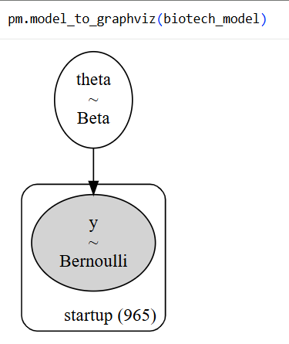
Graphical visualizer
A tool for displaying the dependency structure of a PyMC model

Slide 21
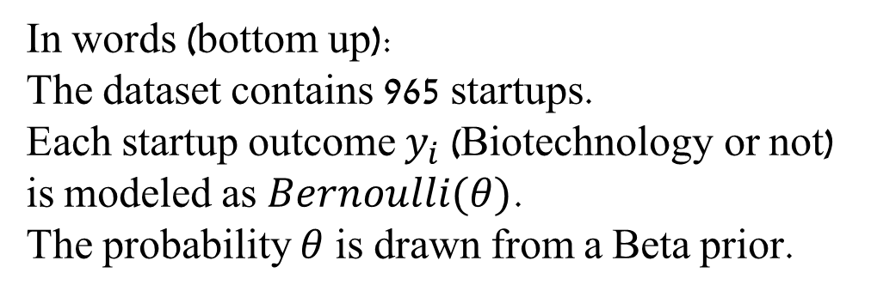
Graphical visualizer
A tool for displaying the dependency structure of a PyMC model
In words (bottom up):
The dataset contains 965 startups.
Each startup outcome $y_{i}$ (Biotechnology or not) is modeled as $Bernoulli(θ)$.
The probability $θ$ is drawn from a Beta prior.

Slide 22
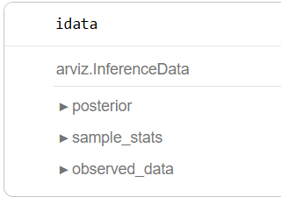
InferenceData Object
idata – what we get back from the inference process
Container for all the data generated by PyMC.
Xarray object
We will use the Arviz library to analyze the posterior
Notes:
Xarray object - labelled multi-dimensional arrays in Python

Slide 23
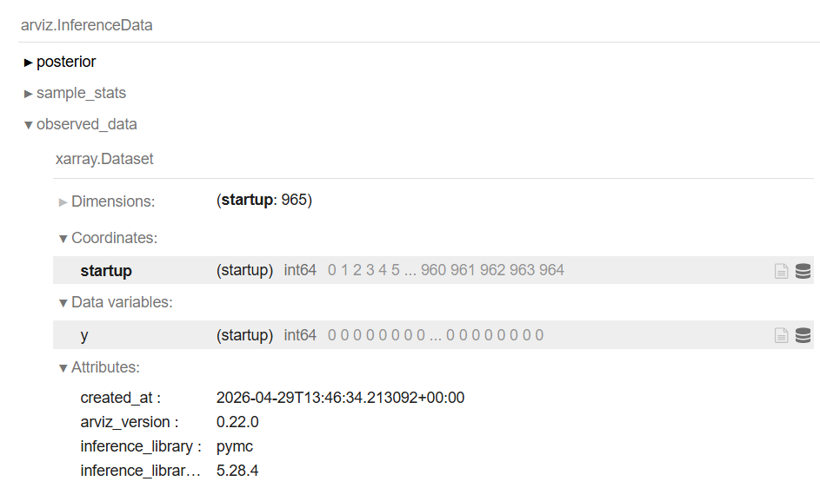
InferenceData Object
Observed data
Number of samples collected (965)
Their coordinates – here just 0-964
The values: 1 for biotechnology startups
0 otherwise

Slide 24
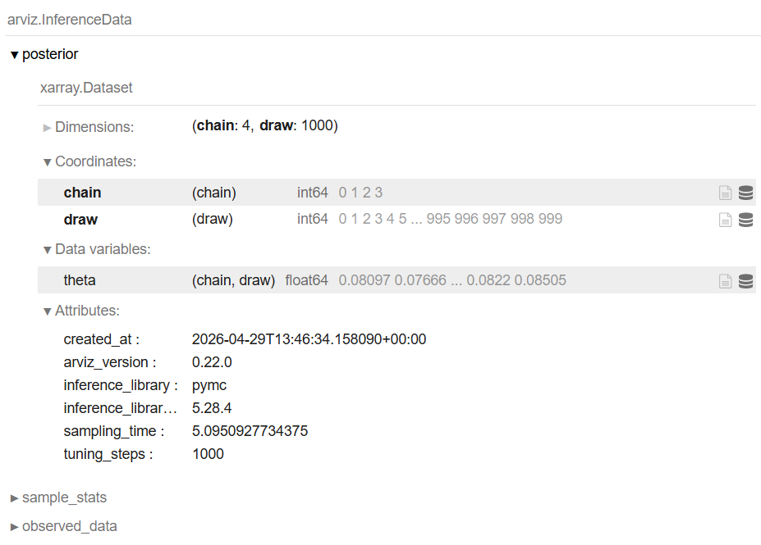
InferenceData Object
Posterior
4 chains of 1000 samples (draws) each
The theta values

Slide 25
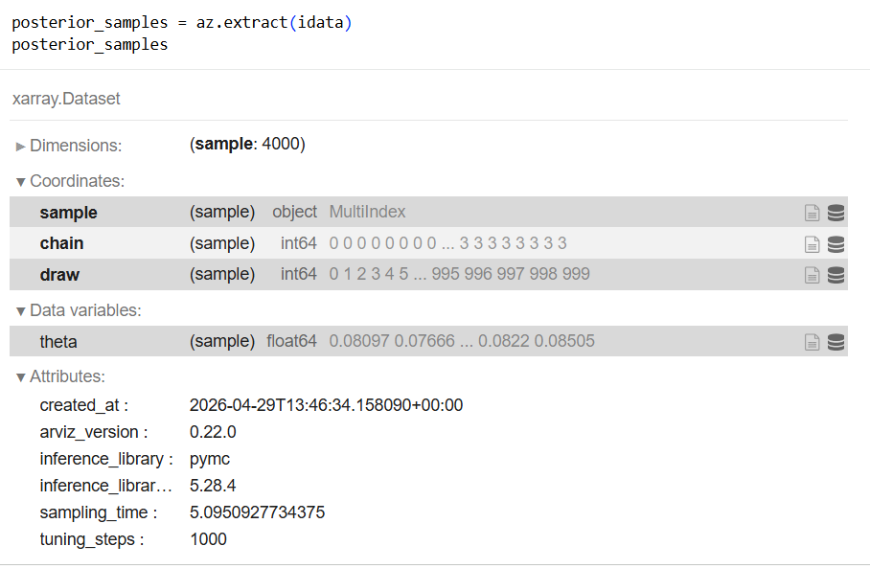
Posterior
We can also get the data as samples instead of as separate chains using az.extract

Slide 26
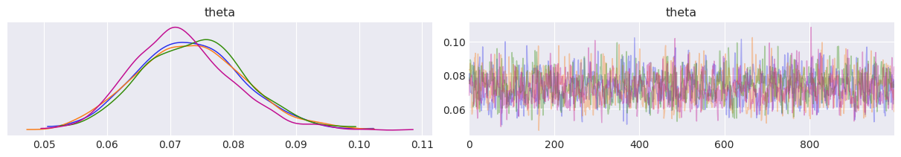
Analyzing the Posterior
Look at the results
Trace plot - a plot of sampled draws across chains and iterations
az.plot_trace(idata)
az.plot_trace(idata, compact=False) if you want the colorful chains
Notes:
Every chain needs to be trained.
Using more than 3-4 chains is a waste.
2 – can’t tell if a chain is messed up or if the sampling is.
Tradeoff between sample efficiency and how well you can evaluate how good your sampling is.
The right graph – the samples we got for each chain in the order we got them

Slide 27
Analyzing the Posterior
Left: the four chains showing the values of the posterior distribution (KDE plot = Kernel Density Estimation)
Right: For now – the overlap between the four chains (colors) shows that the sampler is working.

Slide 28
Analyzing the Posterior
We want all the chains to overlap as much as possible.
How much?
We’ll learn statistics with thresholds we can calculate
For now, It looks pretty good.

Slide 29
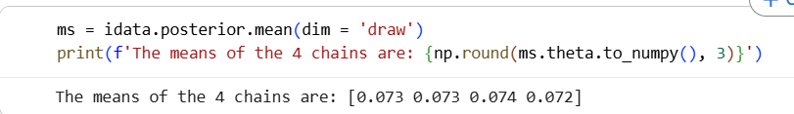
Analyzing the Posterior
How close are the means of the different chains?

Slide 30
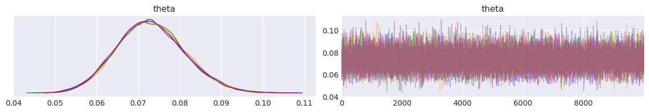
Analyzing the Posterior
How can we get the chains to look more similar?
Sample more (1,000 -> 10,000)

Slide 31
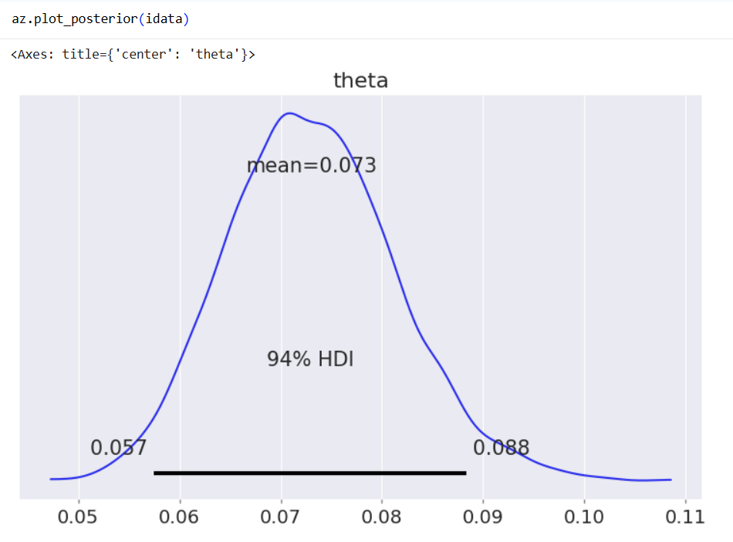
Analyzing the Posterior
Posterior plot -a plot summarizing the posterior distribution of a parameter
Theta mean

Slide 32
Highest Density Interval (HDI)
We computed the mean
We can also compute other statistics, such as the HDI
HDI - the highest density interval, an interval containing the most credible posterior values.

Slide 33
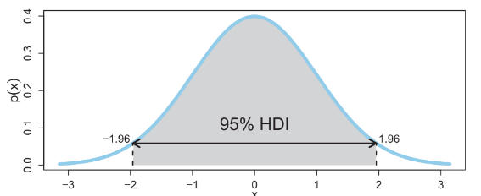
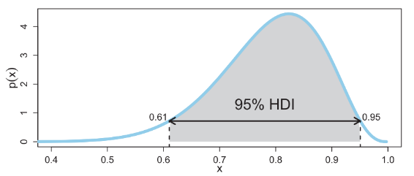
Highest Density Interval (HDI)
There are a lot of intervals like this.
The HDI is the shortest interval containing Z% of the distribution.
Equivalent: the probability of all values inside the HDI are higher than those out of it.

Slide 34
Highest Density Interval (HDI)
The default in Arviz is the 94% HDI, so that’s what we’ll generally use.

Slide 35
Highest Density Interval (HDI)
The default in Arviz is the 94% HDI, so that’s what we’ll generally use.
Lower limit
Upper limit

Slide 36
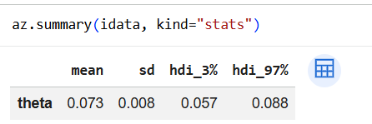
Highest Density Interval (HDI)
The default in Arviz is the 94% HDI, so that’s what we’ll generally use.
Lower limit
Upper limit

Slide 37
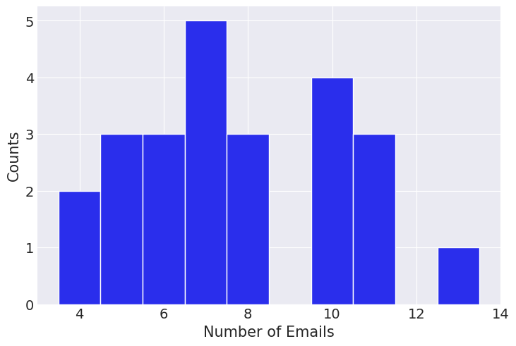
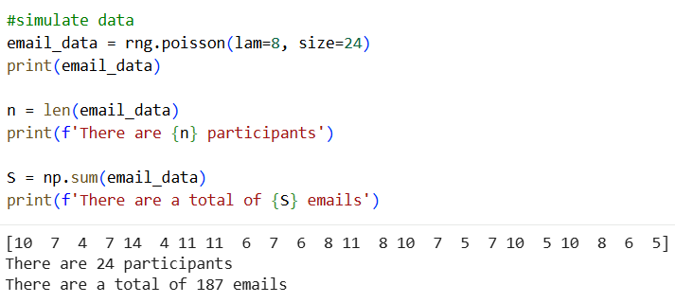

Your turn
Model the number of emails a student gets in a day:
Poisson likelihood
Gamma prior on $λ$ )remember why?)

Slide 38
Exercise:
Go to the tutorial code notebook and:
Choose a prior
Use PyMC to create and sample the model
Visualize the model in a graph
Analyze the posterior using Arviz

Slide 39
Frequentist vs Bayesian philosophies
The Bayesian view - data as updating our uncertainty about parameters
Frequentist view - uncertainty as arising from repeated random datasets generated by a procedure.
In other words:
Bayesian uncertainty - uncertainty about parameters or models given the data and assumptions
Frequentist uncertainty - uncertainty defined through repeated sampling behavior of a procedure

Slide 40
Frequentist estimation
Important Terms (reminder)
Statistic - any quantity calculated from data
Estimator - a statistic used to guess a real parameter value
Sampling distribution - the distribution of an estimator across repeated datasets
Notes:
Also exist in Bayesian statistics

Slide 41

SciPy
Powerful open-source Python library for scientific and technical computing.
Builds on NumPy and provides tools for:
Optimization (e.g., scipy.optimize)
Statistics (e.g., scipy.stats)
Linear algebra (e.g., scipy.linalg)
Signal processing, Fourier transforms
Numerical integration and interpolation
Example Use Cases:
Fitting models with optimize.minimize or optimize.minimize _scalar
Calculating probabilities and distributions with stats.models
Solving equations or differential equations

Slide 42
Maximum Likelihood Estimation (MLE)

Slide 43
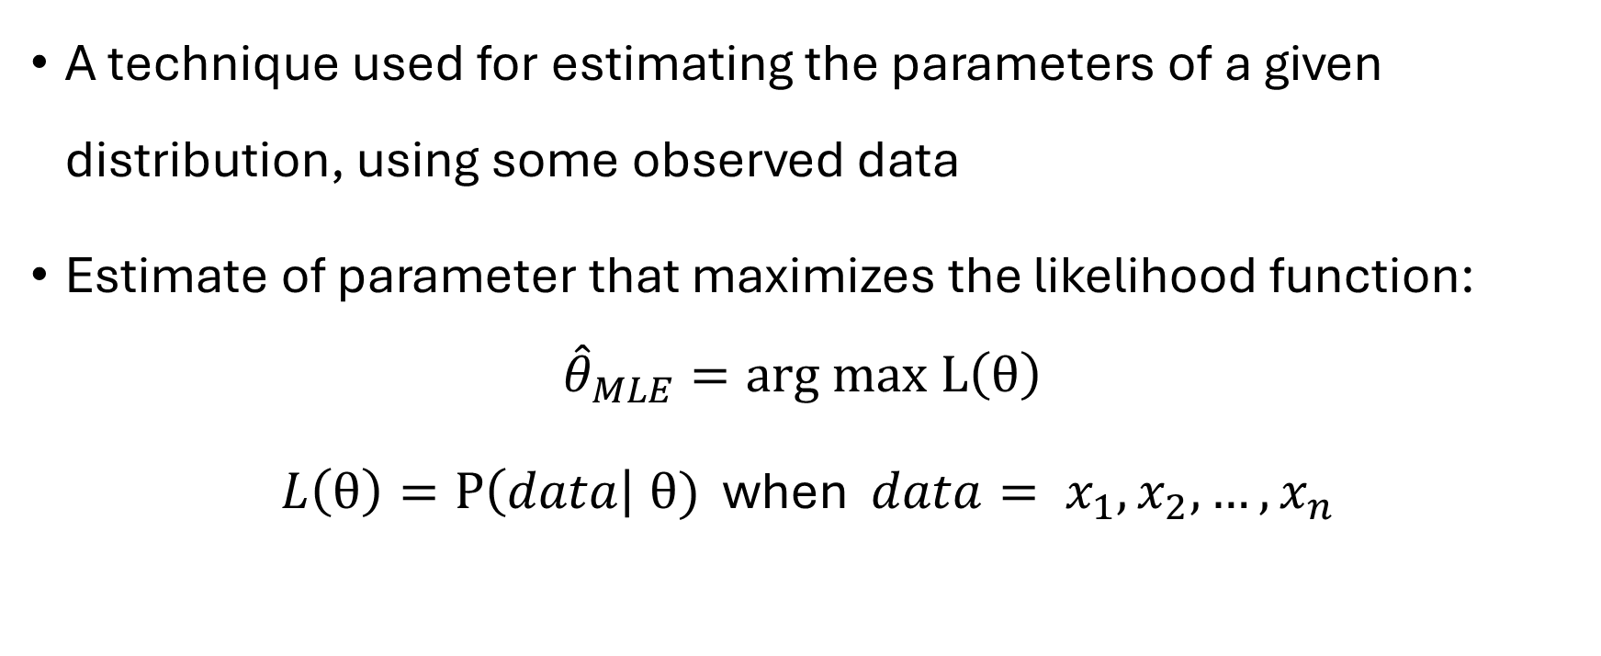
Maximum Likelihood Estimation (MLE)
A technique used for estimating the parameters of a given distribution, using some observed data
Estimate of parameter that maximizes the likelihood function: ${\hat{θ}}_{MLE}=arg max L\left(θ\right)$
$L\left(θ\right)=P\left(data\right| θ)$ when ${data= x}_{1},x_{2},…,x_{n}$
Notes:
This means that MLE is the value of where the likelihood is at its highest — just like the mode of a probability density function is the point of its peak.

Slide 44
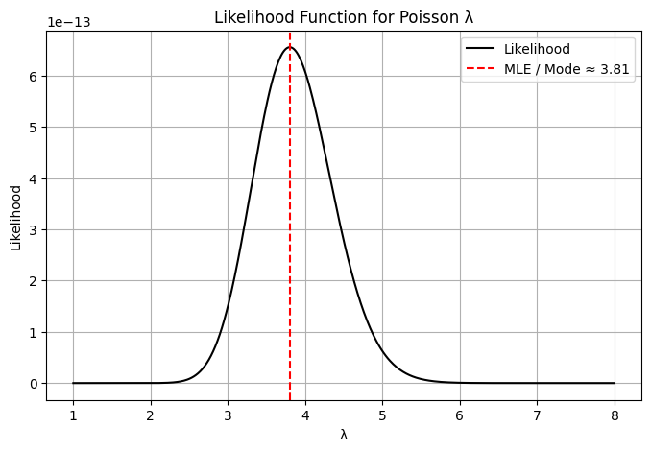
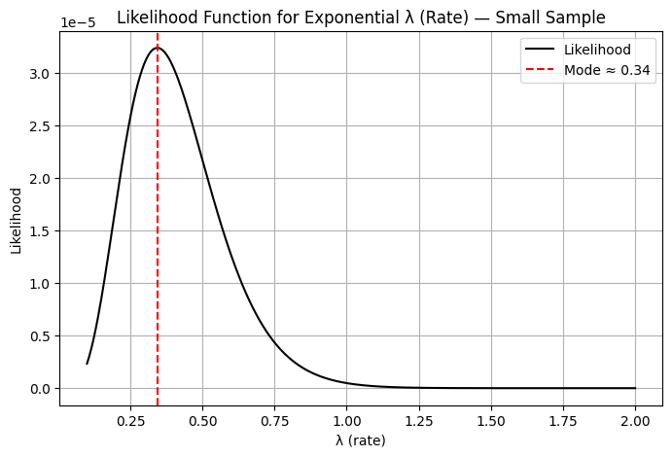
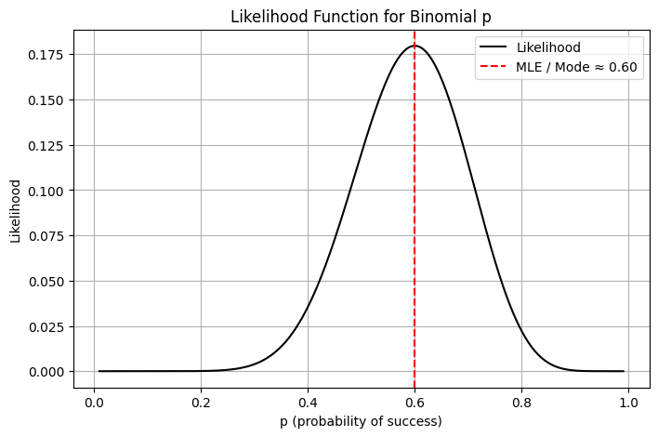
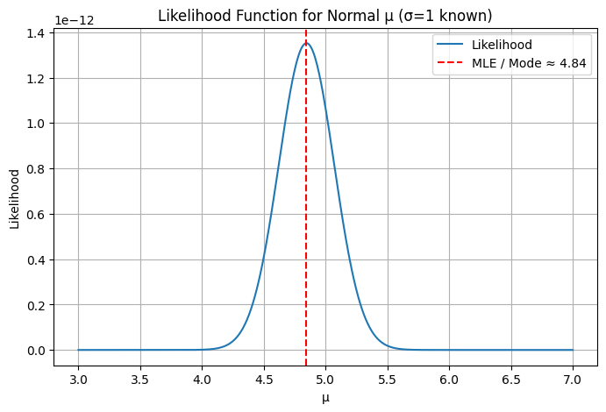
Maximum Likelihood Estimation (MLE)
MLE is the mode of the likelihood
Notes:
This means that MLE is the value of where the likelihood is at its highest — just like the mode of a probability density function is the point of its peak.

Slide 45
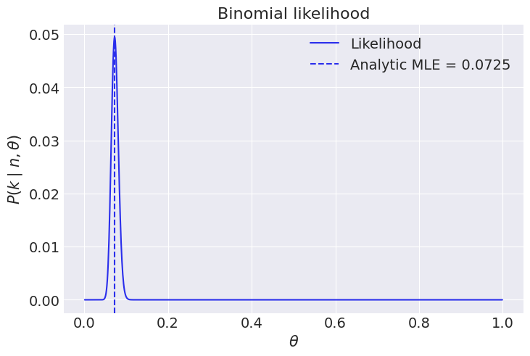

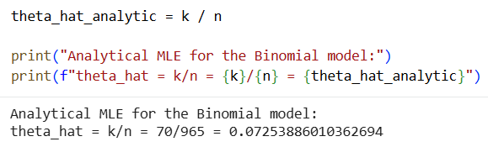
Analytic MLE
Analytic solution means solving the MLE by hand - finding a closed-form expression that maximizes the likelihood.
This is possible for simple models like the Binomial distribution:
Notes:
This means that MLE is the value of where the likelihood is at its highest — just like the mode of a probability density function is the point of its peak.

Slide 46
Log-likelihood
We use the log-likelihood instead of the likelihood because it is numerically stable, mathematically convenient, and gives the same MLE.
This is standard practice in both frequentist and Bayesian inference.
Notes:
We use the log-likelihood instead of the likelihood because it is numerically stable, mathematically convenient, and gives the same MLE.
This is standard practice in both frequentist and Bayesian inference.

Slide 47
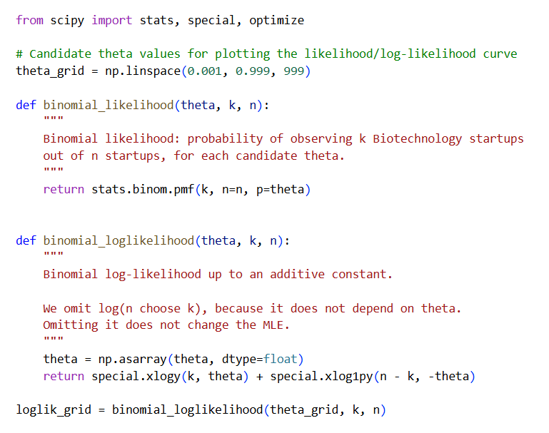
Log-likelihood
Creating a likelihood function
Creating a log-likelihood function
Notes:
We use the log-likelihood instead of the likelihood because it is numerically stable, mathematically convenient, and gives the same MLE.
This is standard practice in both frequentist and Bayesian inference.

Slide 48
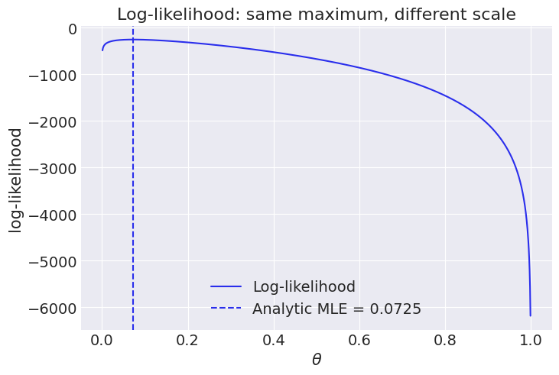
Log-likelihood
Same MLE, different scale

Slide 49
Computational MLE
Computational solution is used when the MLE can’t be written down directly.
We define a likelihood or log-likelihood and use numerical optimization to find the parameter value that maximizes it.
Notes:
This means that MLE is the value of where the likelihood is at its highest - just like the mode of a probability density function is the point of its peak.

Slide 50
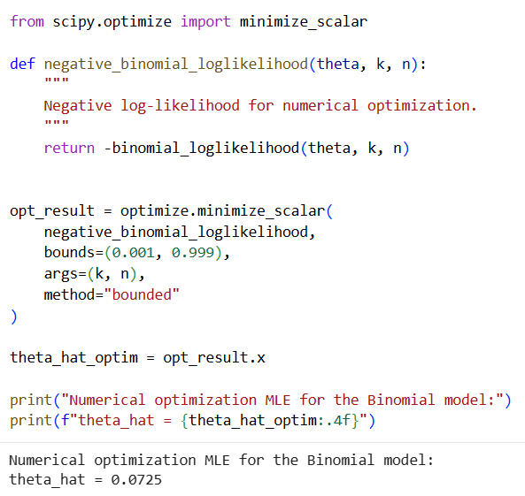
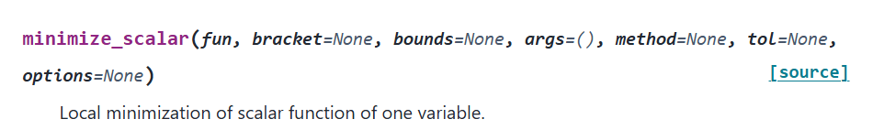
Computational MLE
Creating a negative log-likelihood function
Using the likelihood function to find the MLE of theta
Notes:
We use the log-likelihood instead of the likelihood because it is numerically stable, mathematically convenient, and gives the same MLE.
This is standard practice in both frequentist and Bayesian inference.

Slide 51
Analytic vs. Computational MLE
Use analytic MLE when:
A closed-form solution exists (e.g., Binomial theta, Poisson rate, Normal mu and sigma in the future)
Use computational MLE when:
There is no closed-form solution
You're estimating multiple parameters jointly
You have complex models like logistic regression, mixtures, etc.

Slide 52
Confidence Intervals (CI)

Slide 53
What is a Confidence Interval?
A confidence interval gives us a range of values that we can treat as plausible for the true parameter.
A 95% confidence interval means: If we repeated this experiment many times, about 95% of the calculated intervals would contain the true parameter.
CI expresses uncertainty about the parameter due to random sampling.
Notes:
A CI does not tell us the probability that the true value lies within the interval.
Instead, it means: If we repeat the experiment many times, approximately 95% of the computed intervals would contain the true value.

Slide 54
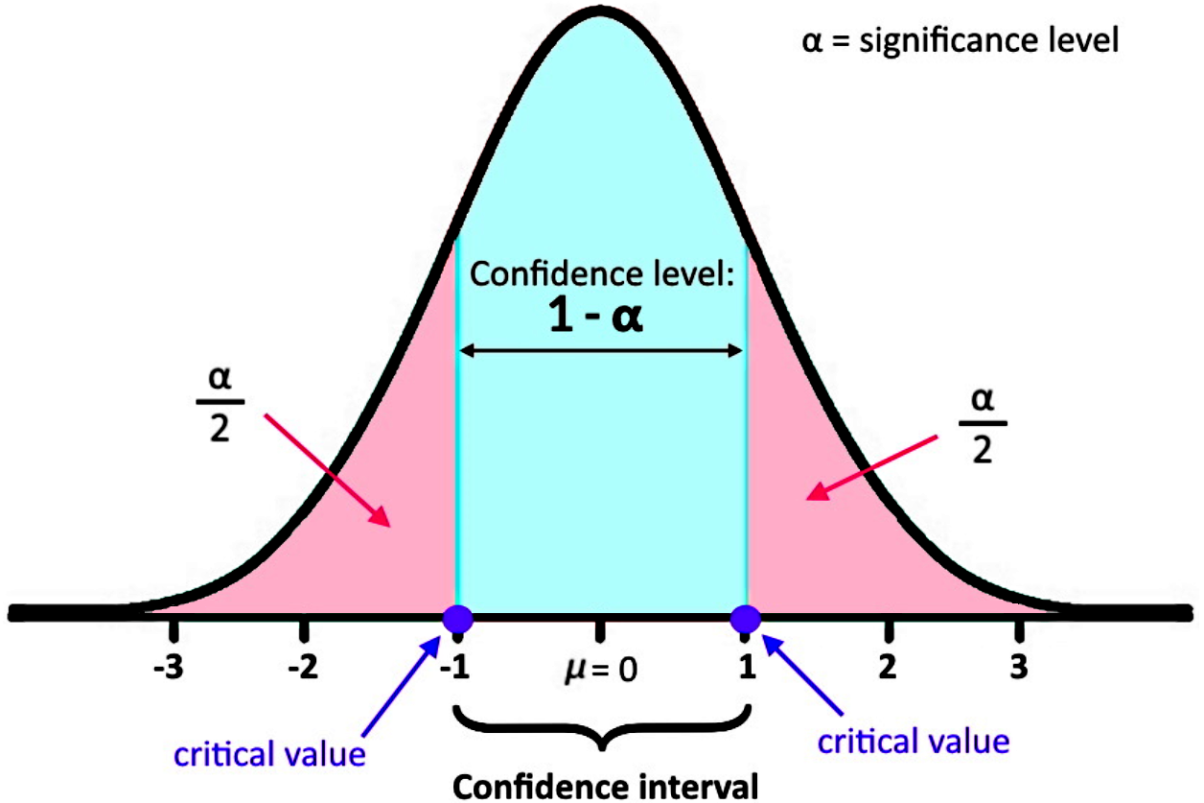
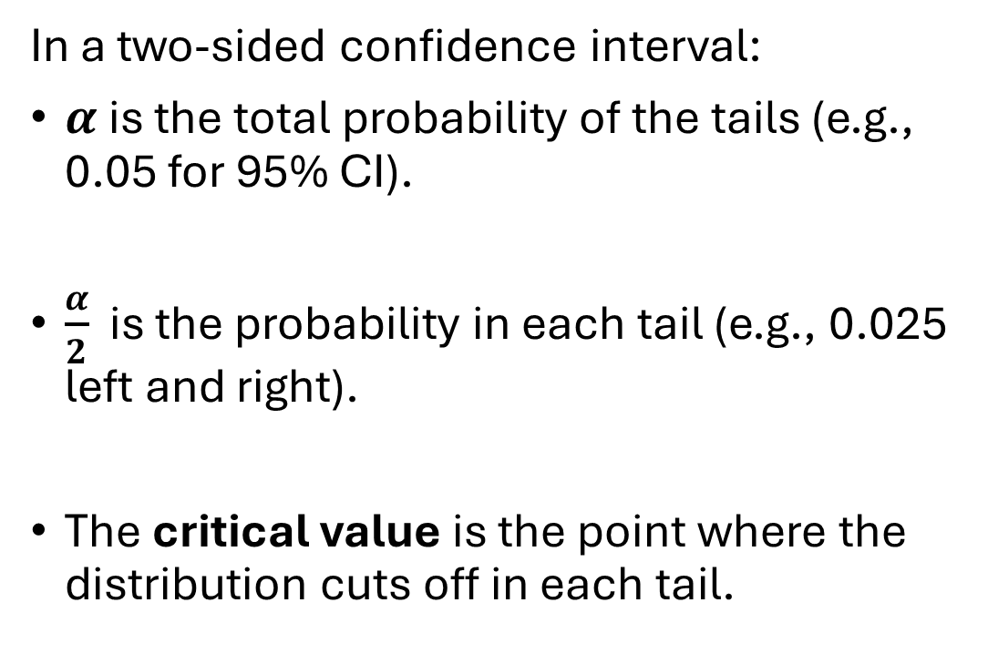
Confidence Interval
In a two-sided confidence interval:
$α$is the total probability of the tails (e.g., 0.05 for 95% CI).
$\frac{α}{2}$ is the probability in each tail (e.g., 0.025 left and right).
The critical value is the point where the distribution cuts off in each tail.
Notes:
We don’t have to use two-sided CI, but it’s the most common

Slide 55

CI for theta of a Binomial model
Let’s say
$$y \sim Binomial \left(n, θ\right)$$
And
$$Y=y_{obs}$$
The lower tail is
$$P\left(Y≤y_{obs} \right| θ)$$
And the upper tail is
$$P\left(Y≥y_{obs} \right| θ)=1 −P\left(Y≤y_{obs} −1 \right| θ)$$
We keep the values of theta that
$$P\left(Y≤y_{obs} \right| θ)> \frac{α}{2} and P\left(Y≥y_{obs} \right| θ)> \frac{α}{2}$$
Notes:
After collecting the data, we observe one value of this random variable, denoted $y_{\text{obs}}$. In other words, we observed a specific number of successes.
The lower tail is the probability of getting a value less than or equal to the observed value, assuming a particular value of $θ$.
The upper tail is the probability of getting a value greater than or equal to the observed value, assuming a particular value of $θ$. Since the Binomial distribution is discrete, this is calculated as one minus the probability of getting a value less than or equal to $y_{\text{obs}}−1$.
Finally, the confidence interval keeps all values of $θ$ for which the observed result is not too extreme. Specifically, we keep values of $θ$ where both the lower tail and the upper tail are larger than $α/2$.

Slide 56
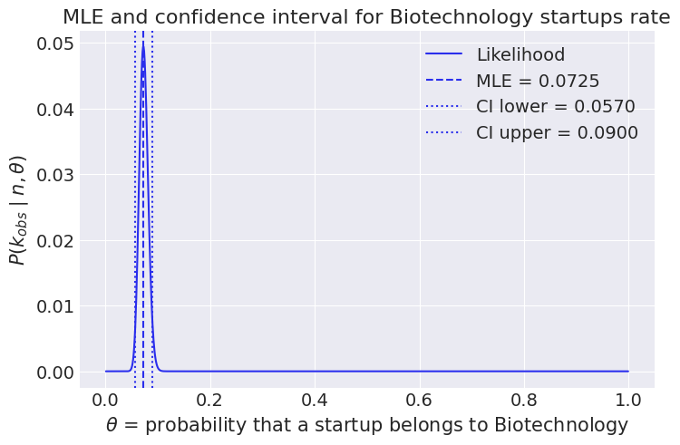
CI for theta of a Binomial model
$$C_{1−α}=\{θ∈\left(0,1\right) :P(Y≤y_{obs}∣θ)>\frac{α}{2}​ and P(Y≥y_{obs}∣θ)>\frac{α}{2}​\}$$
Notes:
we look for the values of $θ$for which our observed data fall in the central part of the Binomial distribution, not in one of the extreme tails.

Slide 57
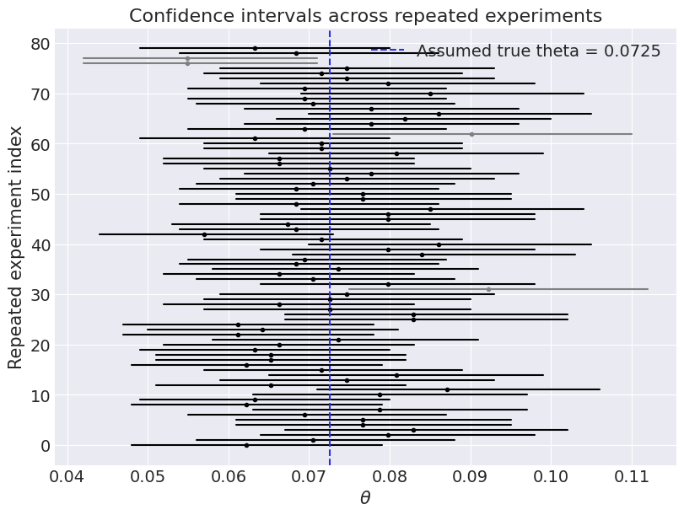
Are We Right 95% of the Time?
How often do 95% CIs for theta actually contain the true rate?
The intervals either contain the true value or not, but across many repetitions, approximately 95% should.
Notes:
This visualizes the frequentist interpretation: intervals either contain the true value or not, but across many repetitions, approximately 95% should.

