Slide 1
Tutorial 10
Hierarchical Regression and Correlation
Statistical Computation and Analysis
Spring 2026
1

Slide 2
Assignment 3 Quiz
Password: HW3
15 minutes
8 questions
Pass\fail, need to answer at least 4 correct to pass
2

Slide 3
Reminder
Reserve duty makeup quizzes:
Assignment quizzes: 21.07 and 11.08 at 16:00 -18:00, location TBD
Midterm quiz: 19.06, time & location TBD
Make sure to makeup all of your missing quizzes & submit all assignments before your final exam.
2

Slide 4

Tutorial Outline
Hierarchical regression
Regression versus correlation
Pearson’s r, population correlation $ρ$, and $ρ²$
Covariance matrix
Simple Bayesian bivariate Normal correlation model
2

Slide 5
Main idea
This tutorial focuses on two ways statistical models represent dependence in data.
Grouped dependence
Symmetric association
Observations from the same group may be more similar.
For example:
houses nested within counties
Modeling response:
hierarchical regression
Two variables may vary together without assigning one as outcome and the other as predictor.
For example:
uranium and log radon
Modeling response:
correlation model
3

Slide 6

Dataset
PART 1: HIERARCHICAL REGRESSION
Variable
Role
Dataset: Household-level radon measurements from Minnesota.
Dependent variable: log_radon.
Predictors: basement status and county-level uranium.
Grouping variable: county.
After cleaning: 878 observations from 85 counties.
log_radon
Outcome
basement
House-level predictor
$$uranium^{z}$$
Standardized uranium predictor
county
Group-level structure
Note: uranium is standardized so the slope is interpreted per one standard deviation increase.
4

Slide 7
Data preparation
Keep rows with log_radon, basement, Uppm, and county.
Keep only basement coded as Y or N.
Convert Uppm and log_radon to numeric.
Standardize uranium and log radon when needed.
radon["𝑢𝑟𝑎𝑛𝑖𝑢𝑚^𝑧 "] = standardize(radon["Uppm"])
radon["log_radon_z"] = standardize(radon["log_radon"])
radon["basement"] = pd.Categorical(
radon["basement"], categories=["N", "Y"]
)
𝑢𝑟𝑎𝑛𝑖𝑢𝑚^𝑧 = (uranium − mean(uranium)) / sd(uranium)
5

Slide 8
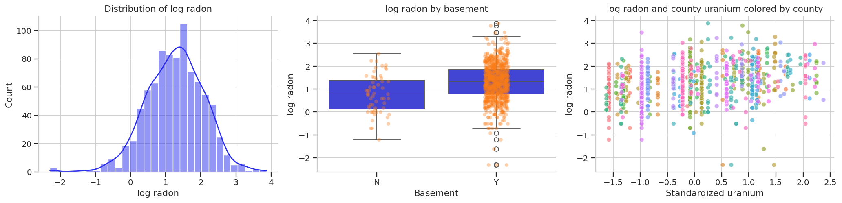
Inspect the data
Output from the notebook: distribution, basement comparison, and uranium association.
Use these plots to check the outcome scale, the basement groups, and the relation between uranium and log radon before fitting models.
6

Slide 9
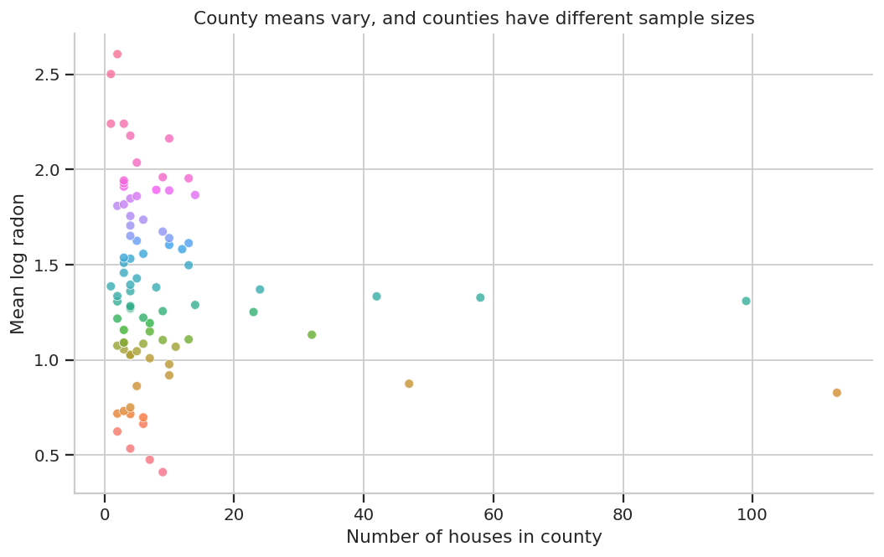
County structure
Houses are nested within counties.
County means vary.
Some counties have very few observations.
This motivates a county-level intercept in the model.
County means vary and counties have different sample sizes.
7

Slide 10

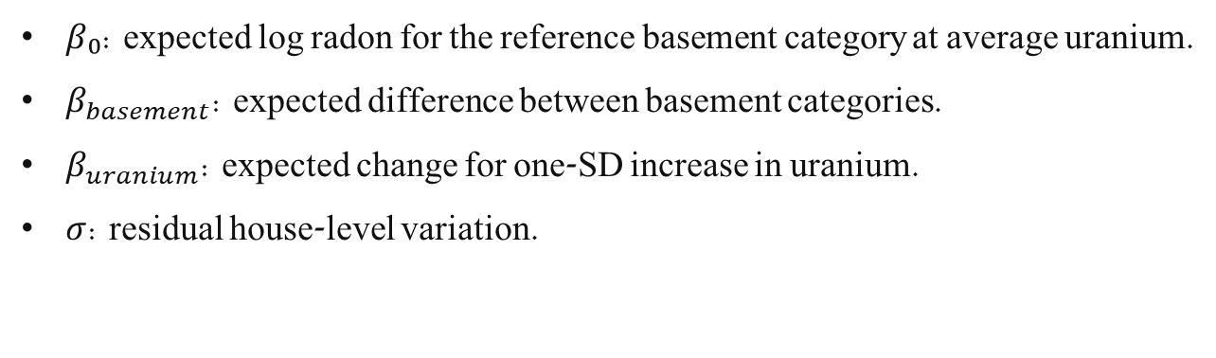
Model 1 - Multiple regression
$$log⁡_radon \sim basement + uranium^{z}$$
$$yᵢ \sim Normal(μᵢ, σ)$$
$$μᵢ = β₀ + β_{basement} x_{basement},ᵢ + β_{uranium^{z}} x_{uranium^{z}},ᵢ$$
$β₀$: expected log radon for the reference basement category at average uranium.
$β_{basement}$: expected difference between basement categories.
$β_{uranium}$: expected change for one-SD increase in uranium.
$σ$: residual house-level variation.
8

Slide 11
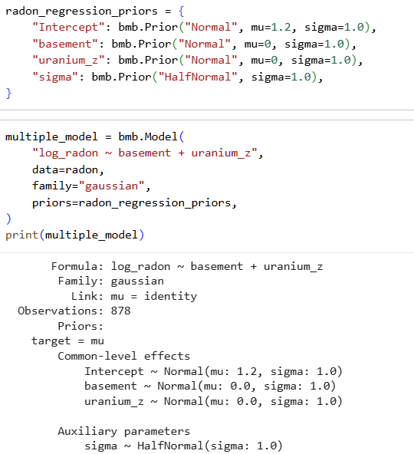
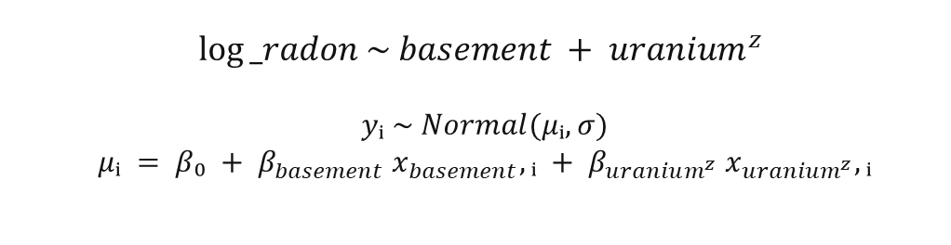


Model 1 - Multiple regression
$$log⁡_radon \sim basement + uranium^{z}$$
$$yᵢ \sim Normal(μᵢ, σ)$$
$$μᵢ = β₀ + β_{basement} x_{basement},ᵢ + β_{uranium^{z}} x_{uranium^{z}},ᵢ$$
$Modeling with Bambi:$
$Choosing our own priors \left(optional\right):$
8

Slide 12
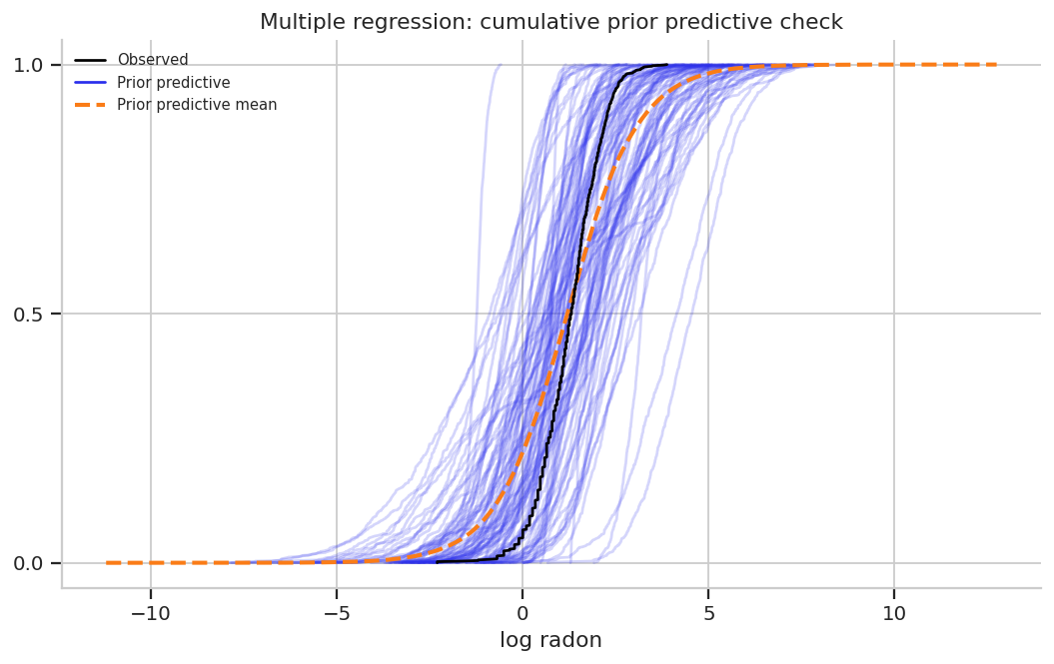
Multiple regression: prior predictive check
Checks whether the priors generate plausible log-radon values before fitting.
Not a model-fit check.
The observed distribution should fall within the range implied by the prior predictive distribution.
Cumulative prior predictive check.
9

Slide 13
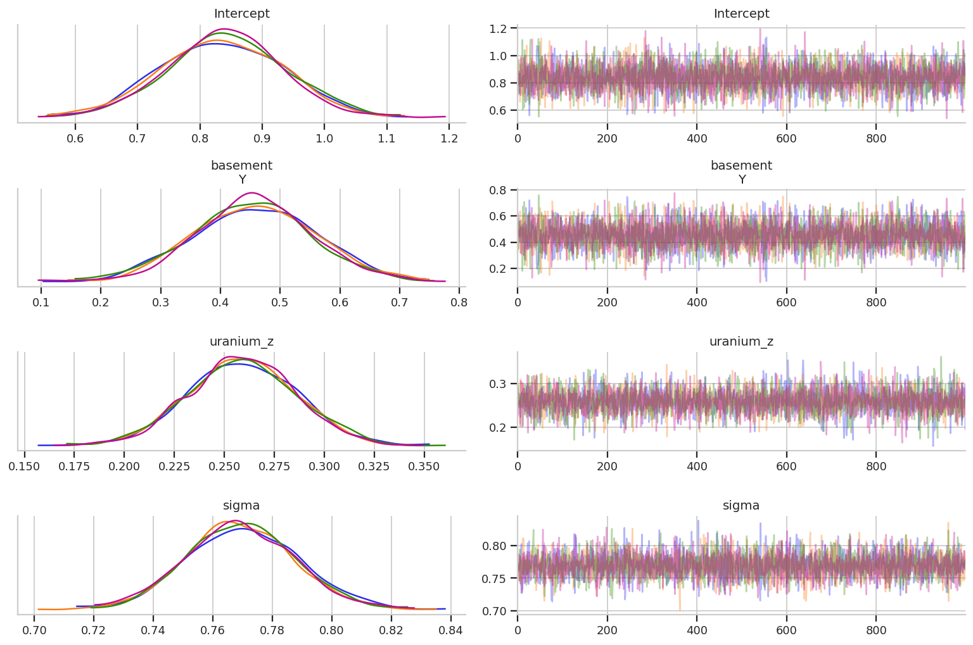

Multiple regression: sampling diagnostics
Parameter
ESS bulk
R-hat
Intercept
4301
1.00
basement[Y]
4319
1.00
$$uranium^{z}$$
4215
1.00
sigma
4348
1.00
Diagnostics check sampling validity.
Here the chains mixed well and R-hat is approximately 1.
Trace plots for fixed effects and residual σ.
10

Slide 14




Multiple regression: posterior summary
Parameter
Mean
94% HDI
Houses with basement = Y have higher expected log radon than the reference group, after accounting for uranium.
Higher county uranium is associated with higher expected log radon.
σ is the remaining residual variation around the regression mean.
$$Intercept$$
0.838
[0.662, 1.025]
$$basement[Y]$$
0.456
[0.259, 0.640]
$$uranium^{z}$$
0.259
[0.207, 0.309]
$$sigma$$
0.770
[0.735, 0.805]
Interpretation should remain observational. The regression model describes association under the model assumptions.
11

Slide 15
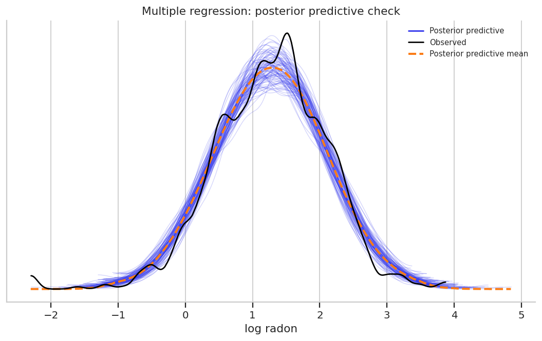
Multiple regression: posterior predictive check
Posterior predictive checks ask whether the fitted model can generate data that resemble the observed data.
The model captures the central part of the distribution reasonably well.
Any mismatch in tails or shape suggests model limitations.
Posterior predictive check for log radon.
12

Slide 16
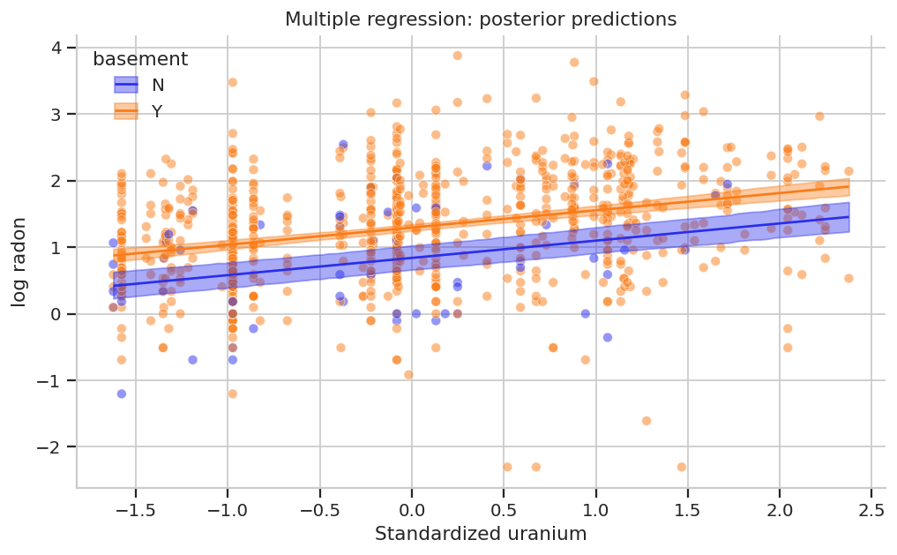
Multiple regression: posterior predictions
The fitted lines summarize expected log radon across uranium values.
Basement status changes the intercept.
The model uses one uranium slope shared across basement groups.
Predicted log radon as a function of standardized uranium and basement status.
13

Slide 17
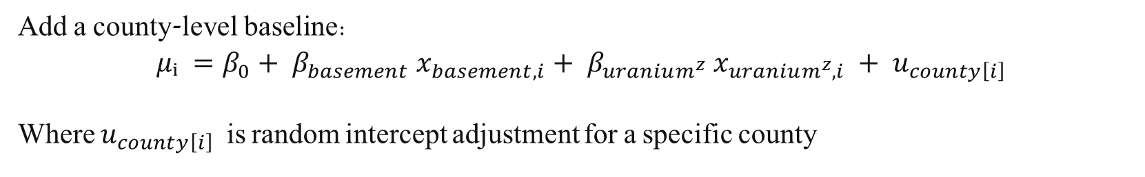
Why add a hierarchical county intercept?
The multiple regression treats all remaining variation as residual house-level noise.
$$μᵢ = β_{0}+ β_{basement}x_{basement},ᵢ + β_{uranium^{z}}x_{uranium^{z}},ᵢ$$
But homes from the same county may share geological or environmental factors not fully captured by uranium.
Add a county-level baseline:
$$μᵢ =β_{0}+ β_{basement} x_{basement, i}+ β_{uranium^{z}} x_{uranium^{z},i} + u_{county\left[i\right]}$$
Where $u_{county\left[i\right]}$is random intercept adjustment for a specific county
14
Notes:
It is called random not because the county effect is “random noise” or meaningless, but because the model treats the county-specific intercepts as draws from a shared population distribution.
county-level deviations are modeled as coming from a probability distribution, rather than as unrelated fixed coefficients.

Slide 18
Why add a hierarchical county intercept?
The multiple regression treats all remaining variation as residual house-level noise.
$$μᵢ = β_{0}+ β_{basement}x_{basement},ᵢ + β_{uranium^{z}}x_{uranium^{z}},ᵢ$$
But homes from the same county may share geological or environmental factors not fully captured by uranium.
Add a county-level baseline:
$$μᵢ =β_{0}+ β_{basement} x_{basement, i}+ β_{uranium^{z}} x_{uranium^{z},i} + u_{county\left[i\right]}$$
Where $u_{county\left[i\right]}$is random intercept adjustment for a specific county
It is called random not because the county effect is “random noise” or meaningless, but because the model treats the county-specific intercepts as draws from a shared population distribution.
14
Notes:
It is called random not because the county effect is “random noise” or meaningless, but because the model treats the county-specific intercepts as draws from a shared population distribution.
county-level deviations are modeled as coming from a probability distribution, rather than as unrelated fixed coefficients.

Slide 19

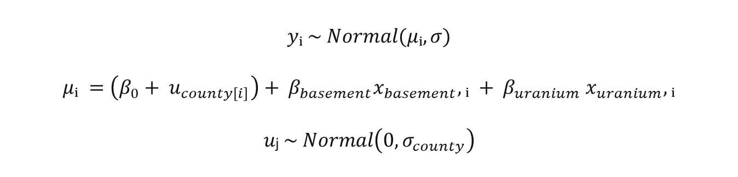
Model 2 - Hierarchical regression
$$log⁡_radon \sim basement + uranium^{z} + (1|county)$$
$(1|county):$each county gets an intercept adjustment.
The county effects are modeled as related, not completely independent.
$σ_{county}$measures between-county baseline variation.
$σ$measures residual house-level variation.
$$yᵢ \sim Normal(μᵢ, σ)$$
$$μᵢ =\left(β_{0}+ u_{county\left[i\right]}\right)+ β_{basement}x_{basement},ᵢ + β_{uranium} x_{uranium},ᵢ$$
$$uⱼ \sim Normal\left(0, σ_{county}\right)$$
15
Notes:
(1|county) means each county gets its own intercept adjustment.
It does not mean the number 1 is a predictor. It means we are adding a random effect for the intercept.

Slide 20
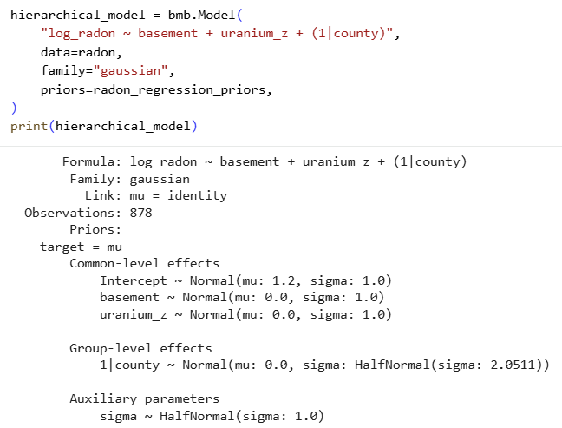
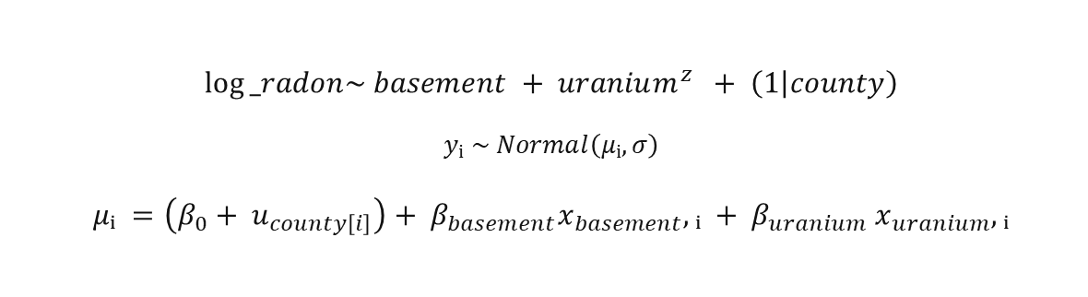
Model 2 - Hierarchical regression
$$log⁡_radon\sim basement + uranium^{z} + \left(1 | county\right)$$
$$yᵢ \sim Normal\left(μᵢ, σ\right)$$
$$μᵢ =\left(β_{0}+ u_{county\left[i\right]}\right)+ β_{basement}x_{basement},ᵢ + β_{uranium} x_{uranium},ᵢ$$
15

Slide 21
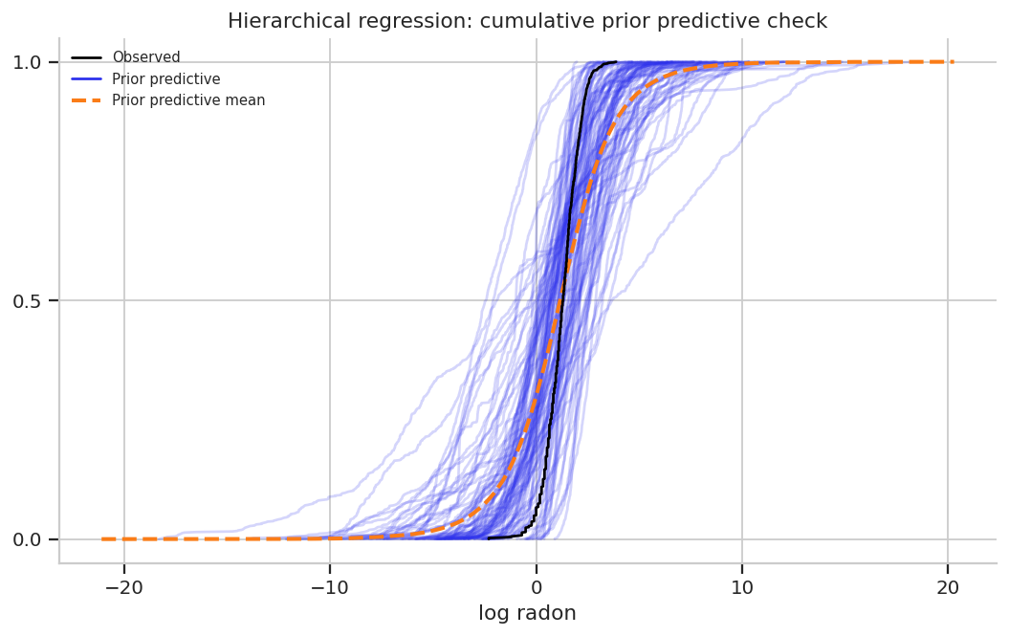
Hierarchical regression: prior predictive check
The hierarchical model has an additional source of variation.
The prior should allow county differences without generating impossible values too often.
The check asks whether the model is coherent before seeing the data.
Cumulative prior predictive check.
16

Slide 22
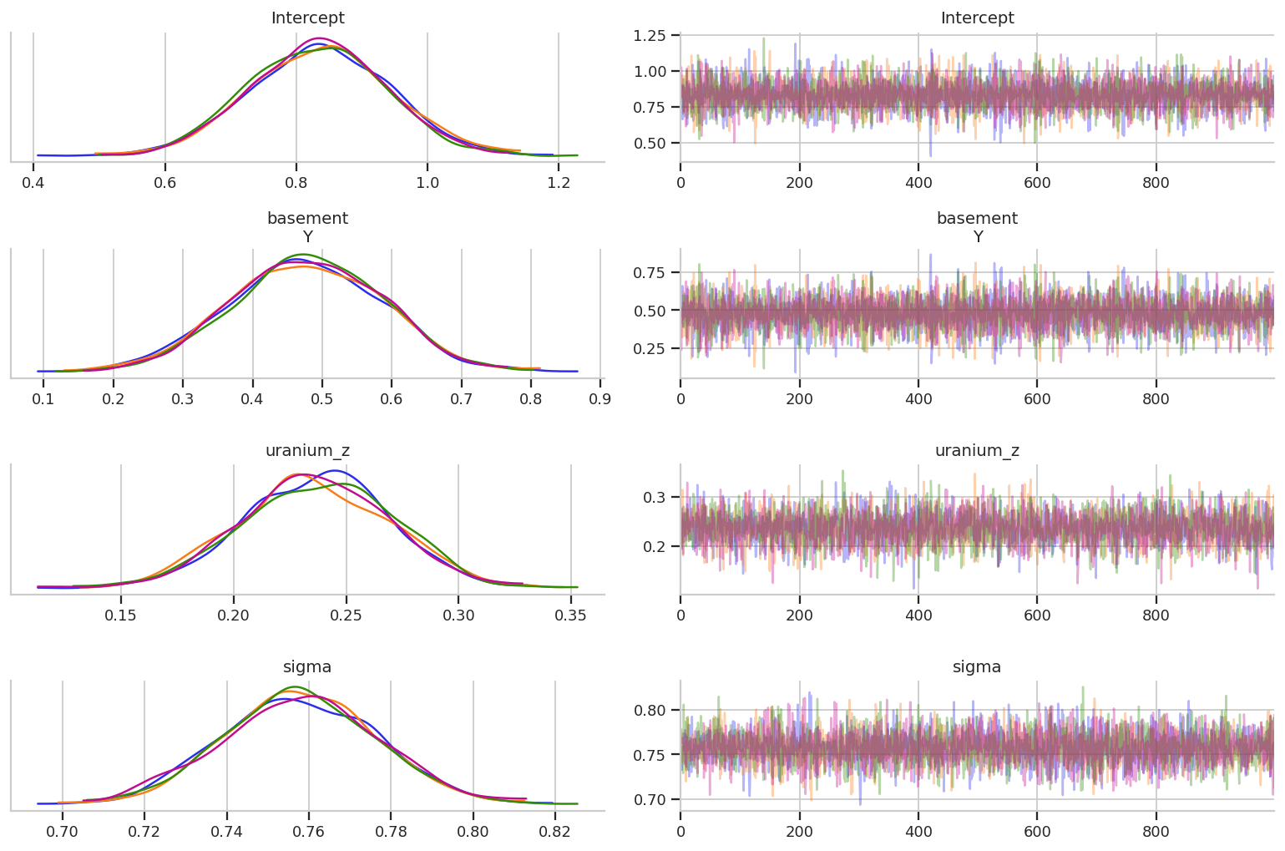


Hierarchical regression: diagnostics
Parameter
ESS bulk
R-hat
Intercept
8327
1.00
$$basement[Y]$$
8141
1.00
$$uranium^{z}$$
4504
1.00
sigma
5643
1.00
The common parameters show good sampling behavior. The county-level scale should also be checked before interpretation.
Trace plots for common parameters.
17

Slide 23
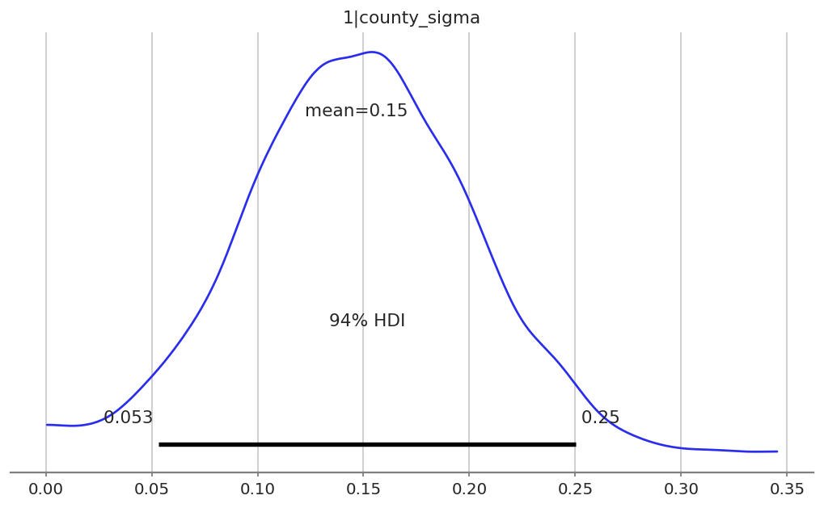
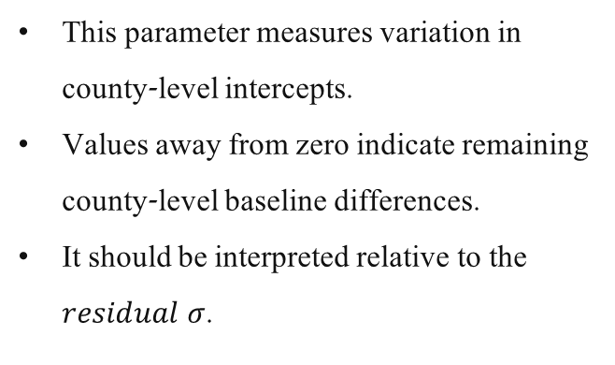

County-level variation
Parameter
Mean
94% HDI
$$1|county_{sigma}$$
0.147
[0.053, 0.250]
This parameter measures variation in county-level intercepts.
Values away from zero indicate remaining county-level baseline differences.
It should be interpreted relative to the $residual σ$.
Posterior for the county-level standard deviation.
18

Slide 24
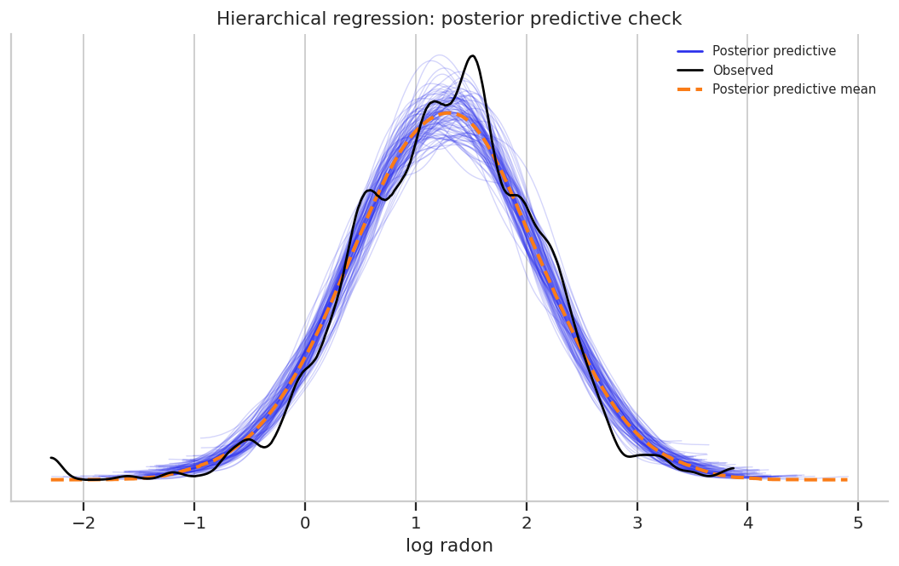
Hierarchical regression: posterior predictive check
Posterior predictive check for hierarchical regression.
19

Slide 25
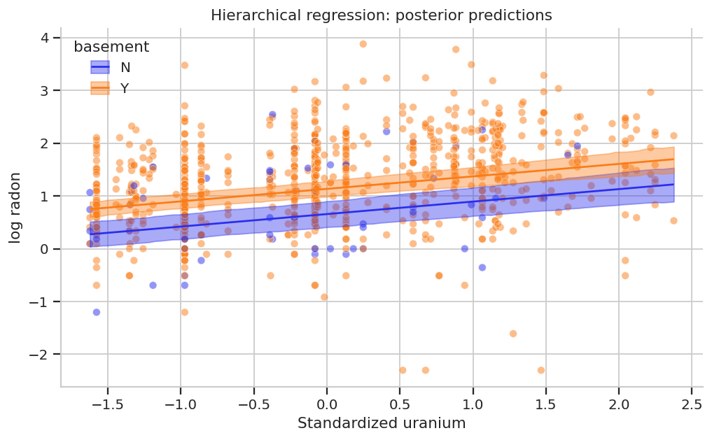
Hierarchical regression: posterior predictions
The plotted lines summarize predictions averaged over the hierarchical structure.
Predicted log radon as a function of uranium and basement status.
20

Slide 26
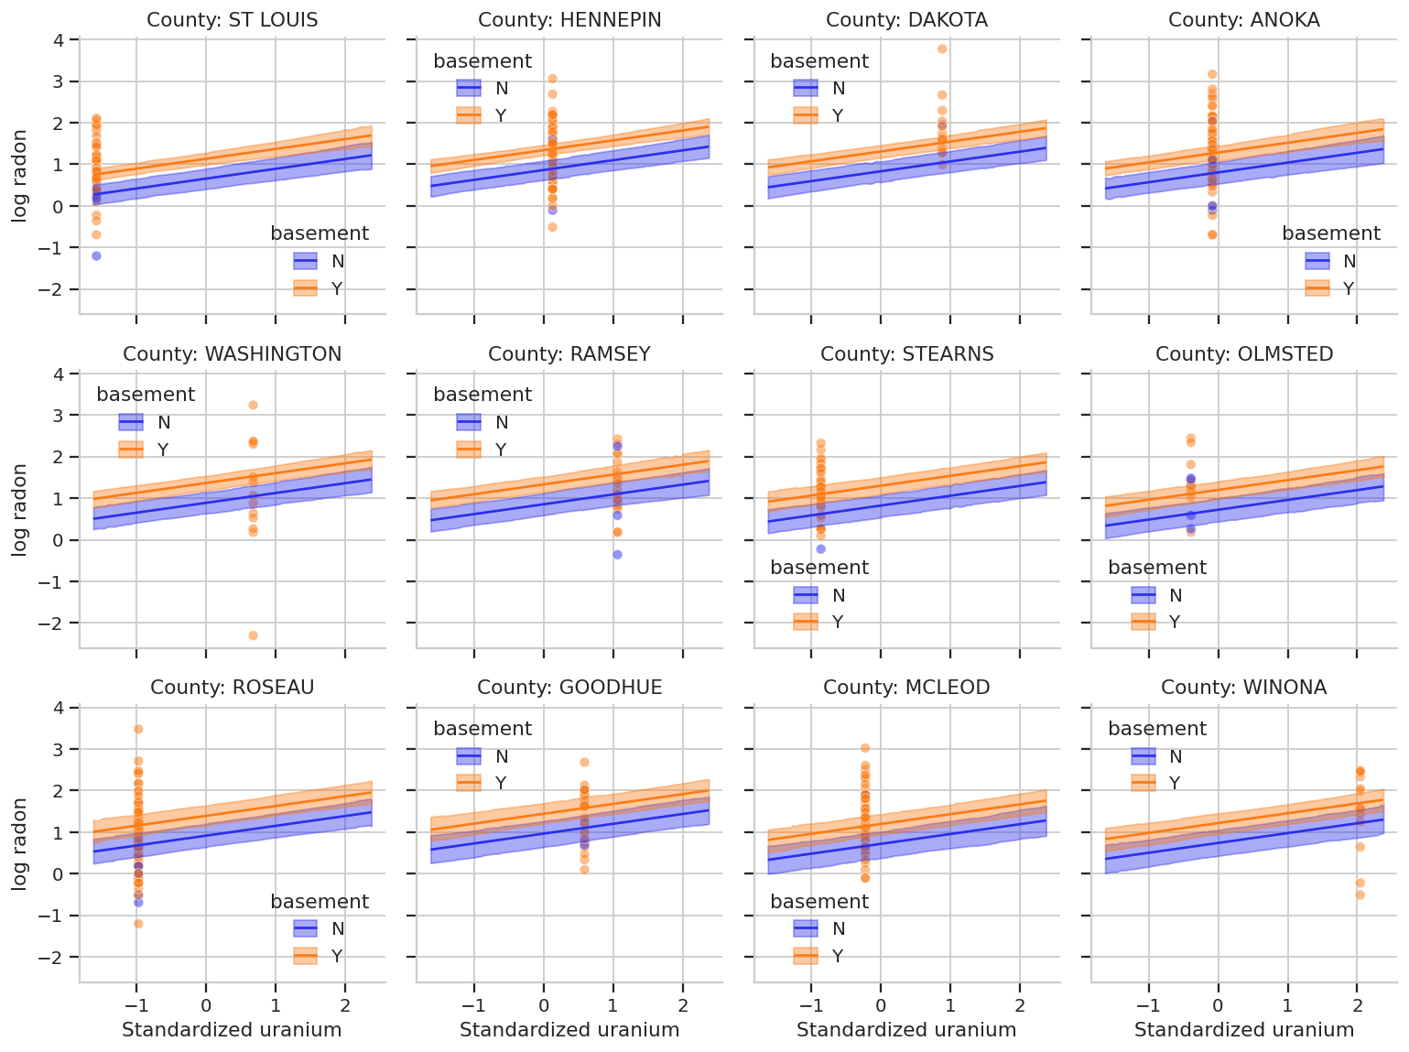
Hierarchical regression: posterior predictions
The plotted lines summarize predictions averaged over the hierarchical structure.
The model also contains county-specific intercept deviations.
The same predictors are interpreted after accounting for county baseline variation.
Predicted log radon as a function of uranium and basement status in each county.
20

Slide 27
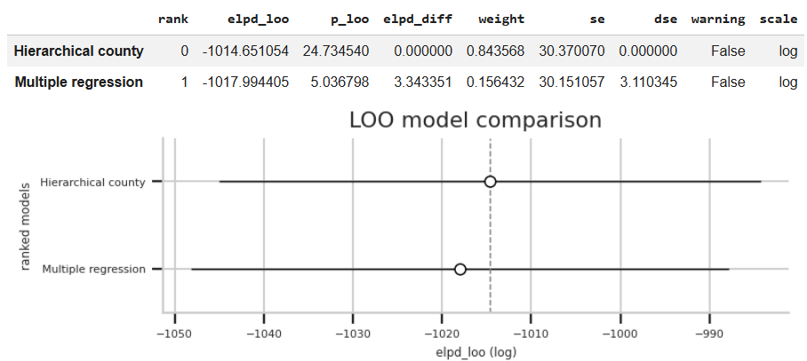
Short model comparison with LOO
LOO comparison plot.
LOO estimates expected out-of-sample predictive accuracy.
The hierarchical model is ranked first, but the difference is modest relative to uncertainty.
The comparison asks about prediction, not whether the model is “true.”
21

Slide 28
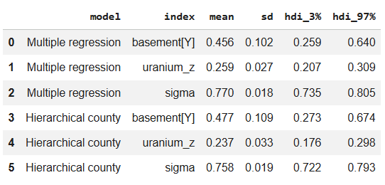
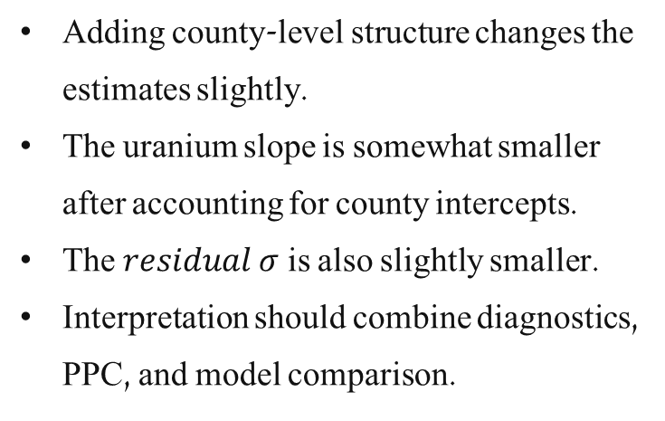




Posterior estimates across models
Model
Parameter
Mean
94% HDI
Adding county-level structure changes the estimates slightly.
The uranium slope is somewhat smaller after accounting for county intercepts.
The $residual σ$is also slightly smaller.
Interpretation should combine diagnostics, PPC, and model comparison.
Multiple
$$basement\left[Y\right]$$
0.456
[0.259, 0.640]
Multiple
$$uranium^{z}$$
0.259
[0.207, 0.309]
Multiple
sigma
0.770
[0.735, 0.805]
Hierarchical
$$basement\left[Y\right]$$
0.477
[0.273, 0.674]
Hierarchical
$$uranium^{z}$$
0.237
[0.176, 0.298]
Hierarchical
sigma
0.758
[0.722, 0.793]
22

Slide 29
Regression section summary
A multiple regression can include more than one predictor.
A hierarchical regression can account for observations nested within groups.
In the radon data, houses are nested within counties.
The county random intercept separates county-level baseline variation from residual house-level variation.
LOO asks whether the added structure improves expected out-of-sample prediction.
23

Slide 30
From regression to correlation
PART 2: CORRELATION AND COVARIANCE
The second part changes the scientific question.
Regression question
Correlation question
How does the expected value of y change as x changes?
One variable is the outcome.
The other variable is a predictor.
Model is directional.
How do two variables vary together?
Neither variable is privileged as the outcome.
Both are modeled jointly.
Model is symmetric.
24

Slide 31
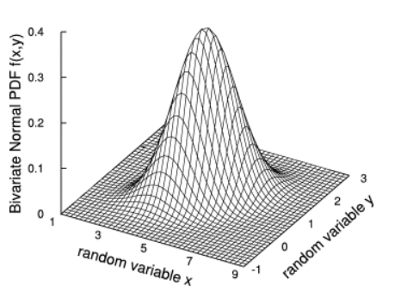
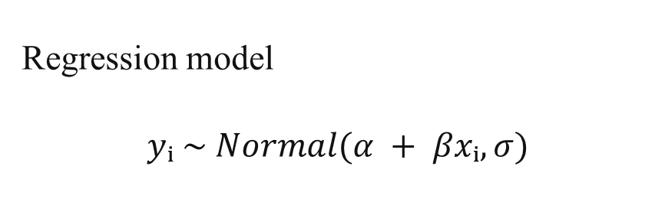
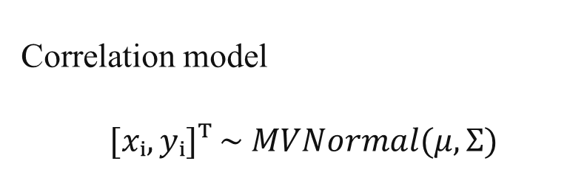
Directional model versus correlational model
Regression model
$$yᵢ \sim Normal(α + βxᵢ, σ)$$
Correlation model
$$[xᵢ, yᵢ]ᵀ \sim MVNormal(μ, Σ)$$
Regression imposes a predictor/outcome structure.
Correlation models joint variation.
Correlation alone is not a causal claim.
William L. Dunn, J. Kenneth Shultis,
Appendix A - Some Common Probability Distributions,
Exploring Monte Carlo Methods (Second Edition),
Elsevier,
2023,
Pages 447-495,
ISBN 9780128197394,
https://doi.org/10.1016/B978-0-12-819739-4.00019-6.
(https://www.sciencedirect.com/science/article/pii/B9780128197394000196)
25
Notes:
The notation MVNormal(μ, Σ) refers to the

Slide 32
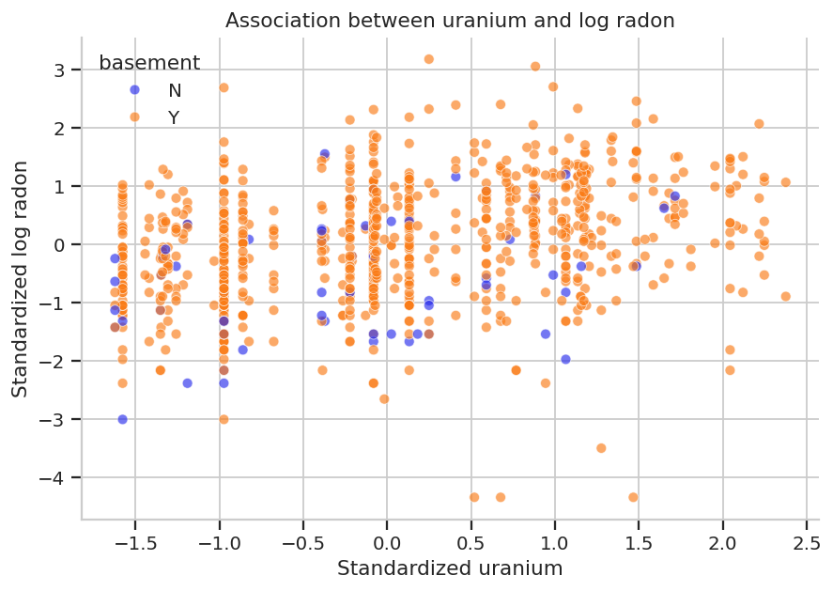
Inspect the association
The scatterplot shows positive association.
The plotted variables are standardized.
Basement is shown only for context; the correlation model below uses two continuous variables.
Association between standardized uranium and standardized log radon.
26

Slide 33
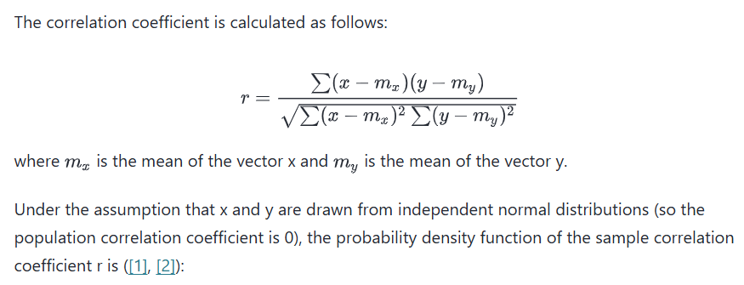

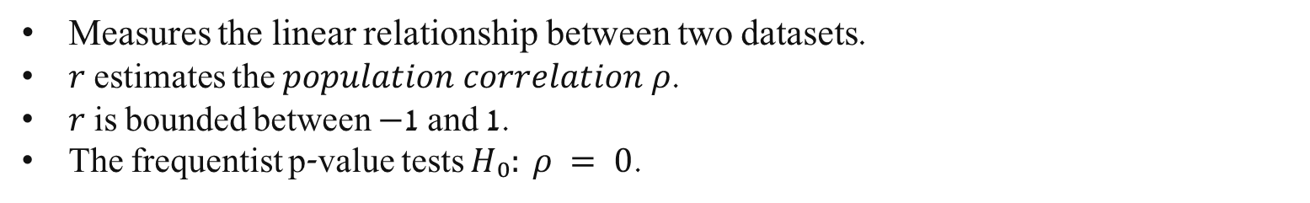
Pearson correlation
$$r = sample Pearson correlation$$
Measures the linear relationship between two datasets.
$r$ estimates the $population correlation ρ$.
$r$ is bounded between −1 and 1.
The frequentist p-value tests $H₀: ρ = 0$.
27
Notes:
https://docs.scipy.org/doc/scipy/reference/generated/scipy.stats.pearsonr.html

Slide 34
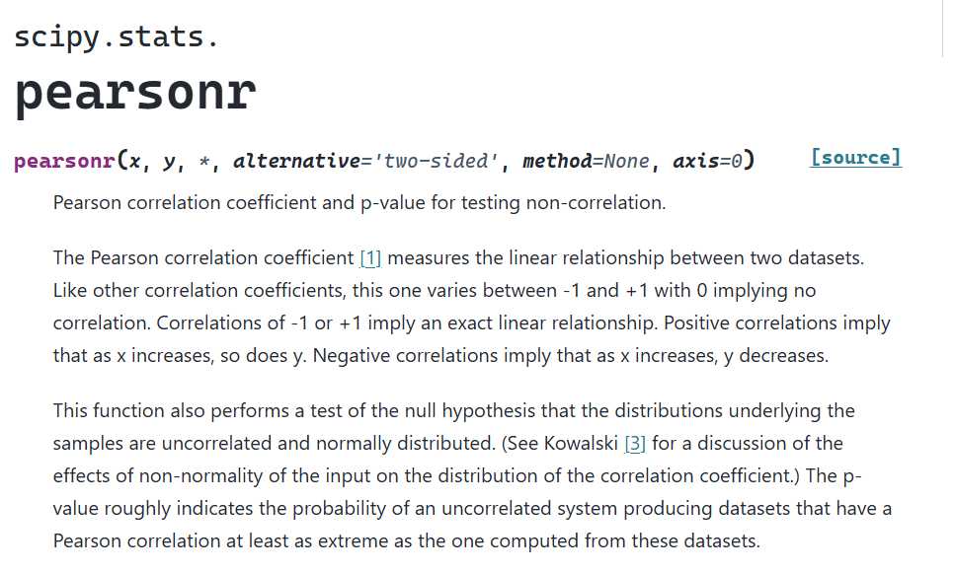
Pearson correlation
27
Notes:
https://docs.scipy.org/doc/scipy/reference/generated/scipy.stats.pearsonr.html

Slide 35

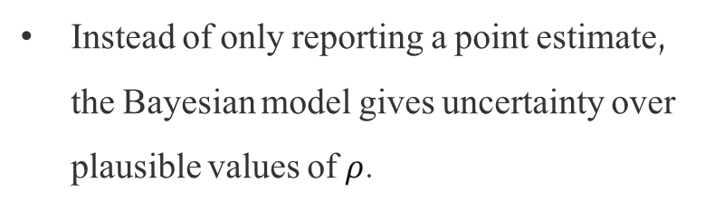
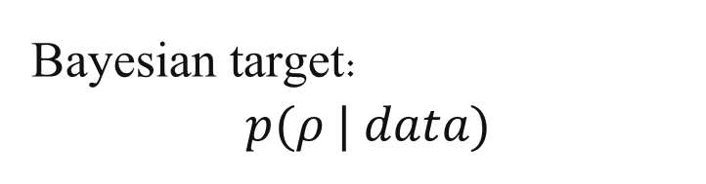
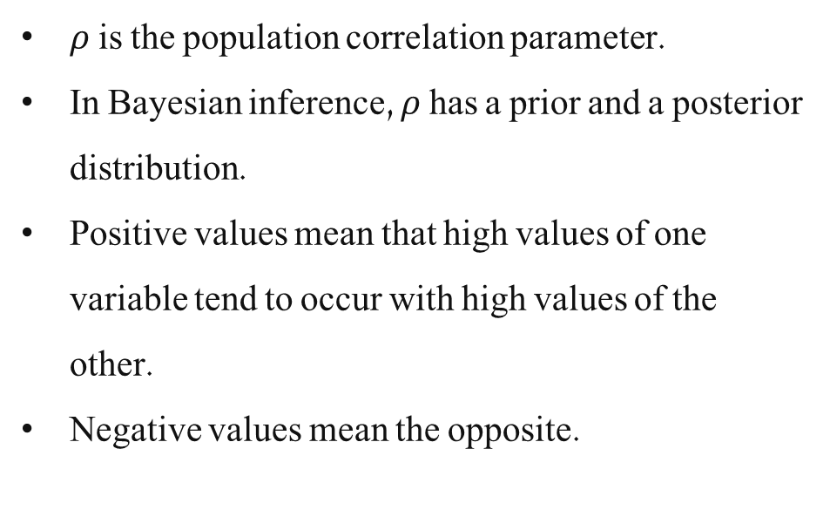
Population correlation ρ
$$−1 ≤ ρ ≤ 1$$
Bayesian target:
$$p(ρ | data)$$
$ρ$ is the population correlation parameter.
In Bayesian inference, $ρ$ has a prior and a posterior distribution.
Positive values mean that high values of one variable tend to occur with high values of the other.
Negative values mean the opposite.
Instead of only reporting a point estimate, the Bayesian model gives uncertainty over plausible values of $ρ$.
28

Slide 36
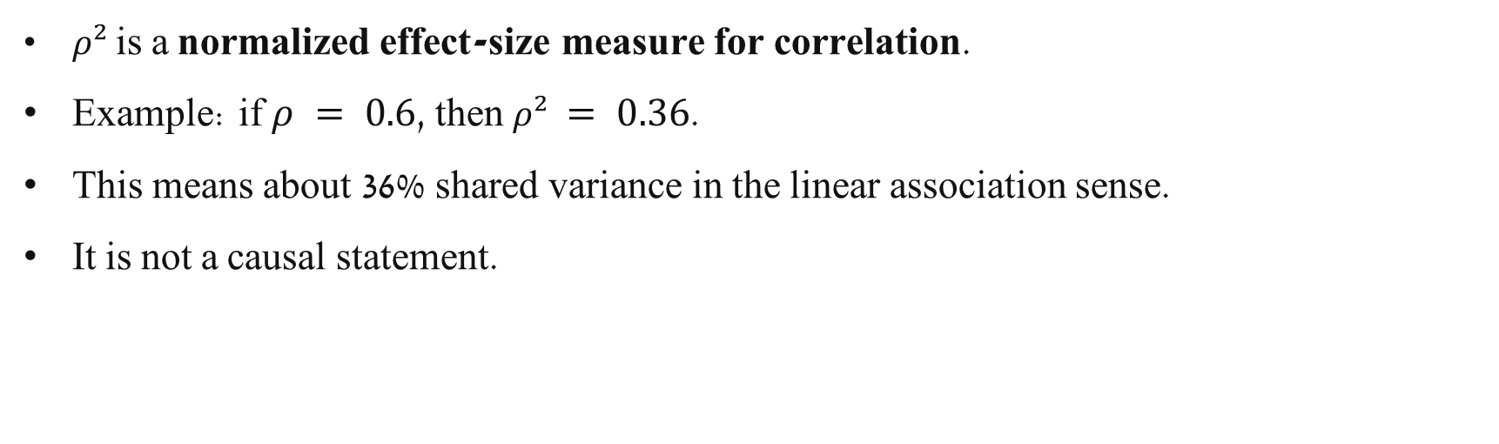
$ρ²$ as shared variance
$$ρ² = fraction of variance shared between two variables$$
$ρ²$ is a normalized effect-size measure for correlation.
Example: if $ρ = 0.6$, then $ρ² = 0.36$.
This means about 36% shared variance in the linear association sense.
It is not a causal statement.
29

Slide 37
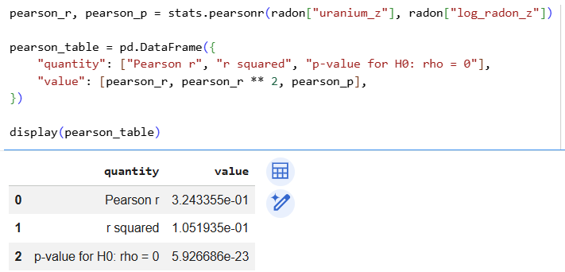
Pearson r and $ρ²$
The p-value is not the effect size.
The effect size is better summarized by r or r².
27
Notes:
https://docs.scipy.org/doc/scipy/reference/generated/scipy.stats.pearsonr.html
$ρ$ is the population correlation coefficient, and it measures the direction and strength of the linear relationship between two variables. Its values range from (-1) to (1): positive values indicate a positive linear relationship, negative values indicate a negative linear relationship, and values close to (0) indicate little or no linear relationship.
$ρ^{2}$, the squared correlation, measures the proportion of shared linear variance between the two variables. Its values range from (0) to (1).
For example, if $ρ= 0.8$, then $ρ^{2}= 0.64$, meaning that 64% of the variance is shared through the linear relationship. Unlike $ρ$, $ρ^{2}$does not preserve the direction of the relationship: both $ρ= 0.8$and $ρ=−0.8$ give $ρ^{2}= 0.64$. Therefore, (\rho) tells us both the direction and strength of the relationship, while $ρ^{2}$tells us only about the amount of shared linear variance.

Slide 38


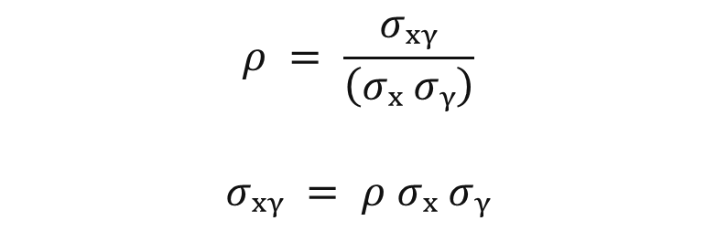
Covariance and covariance matrix
$$Σ = \left[\begin{matrix}σₓ² & σₓᵧ \\ σₓᵧ & σᵧ²\end{matrix}\right]$$
$$Σ = \left[\begin{matrix}σₓ² & ρσₓσᵧ \\ ρσₓσᵧ & σᵧ²\end{matrix}\right]$$
$$σₓᵧ = ρ σₓ σᵧρ = \frac{σₓᵧ}{\left(σₓ σᵧ\right)}$$
Diagonal entries: variances.
Off-diagonal entries: covariance.
The matrix is symmetric.
Covariance depends on units.
30

Slide 39
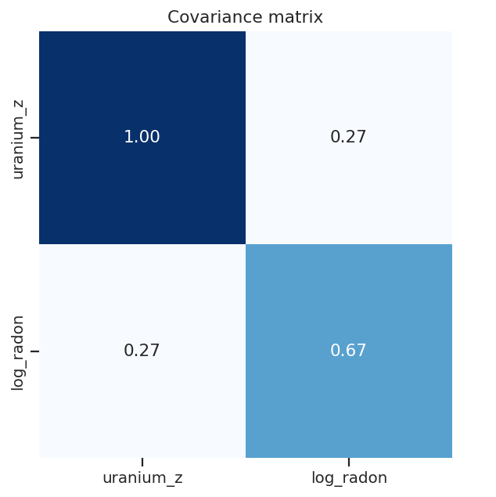

Empirical matrices
$$Σ = \left[\begin{matrix}σₓ² & ρσₓσᵧ \\ ρσₓσᵧ & σᵧ²\end{matrix}\right]$$
Diagonal entries: variances.
Off-diagonal entries: covariance.
The matrix is symmetric.
Covariance depends on units.
31

Slide 40


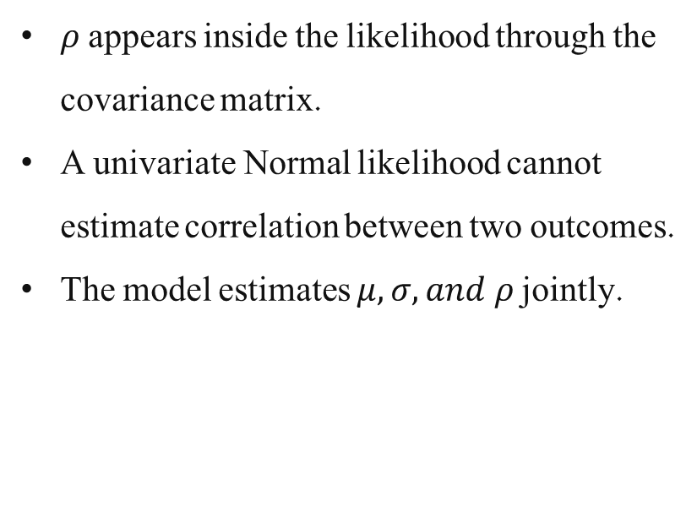

Bayesian correlation model
$$[xᵢ, yᵢ]ᵀ \sim MVNormal(μ, Σ)$$
$ρ$ appears inside the likelihood through the covariance matrix.
A univariate Normal likelihood cannot estimate correlation between two outcomes.
The model estimates $μ, σ, and ρ$jointly.
$$μ = [ μₓ, μᵧ ]ᵀ$$
$$Σ = \left[\begin{matrix}σₓ² & ρσₓσᵧ \\ ρσₓσᵧ & σᵧ²\end{matrix}\right]$$
32

Slide 41
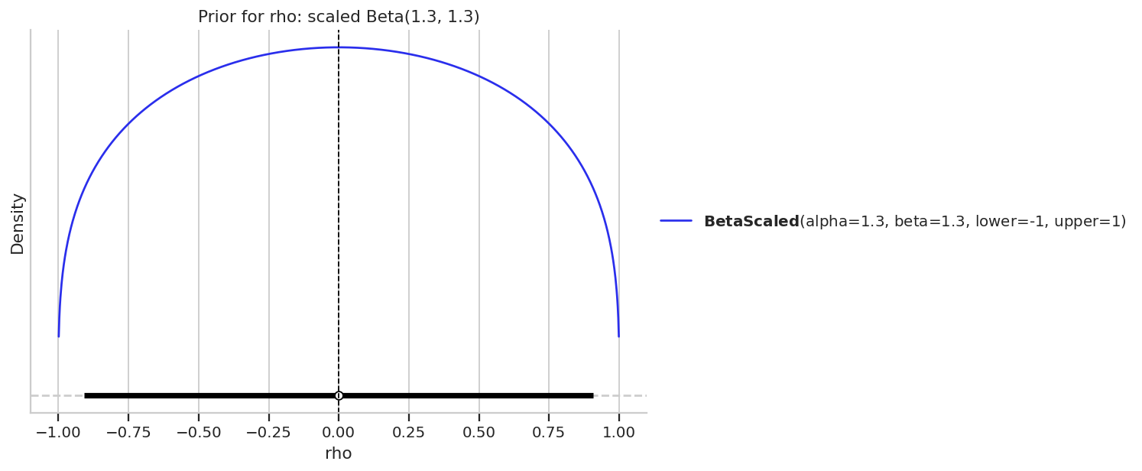


Prior for ρ
$$θ_{ρ} \sim Beta(1.3, 1.3)$$
$$ρ = 2θ_{ρ} − 1$$
A Beta distribution lives on [0, 1].
The transformation maps it to [−1, 1].
This gives a simple bounded prior for correlation.
Prior density for ρ.
33

Slide 42
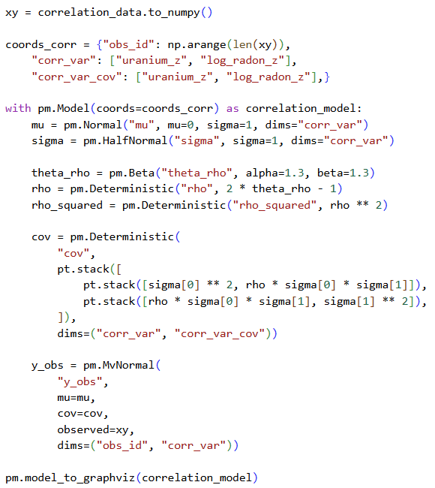
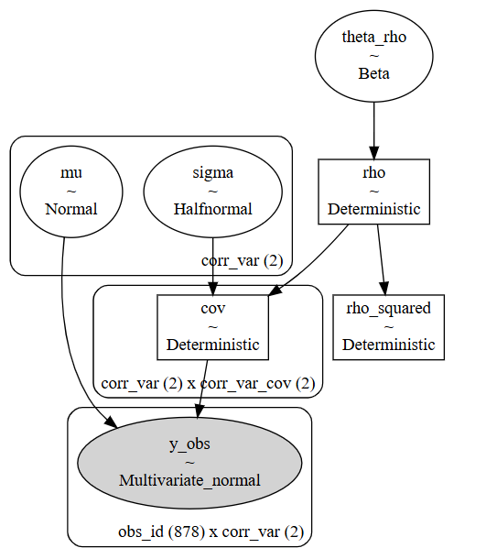

Bayesian correlation model
$$[xᵢ, yᵢ]ᵀ \sim MVNormal(μ, Σ)$$
32

Slide 43
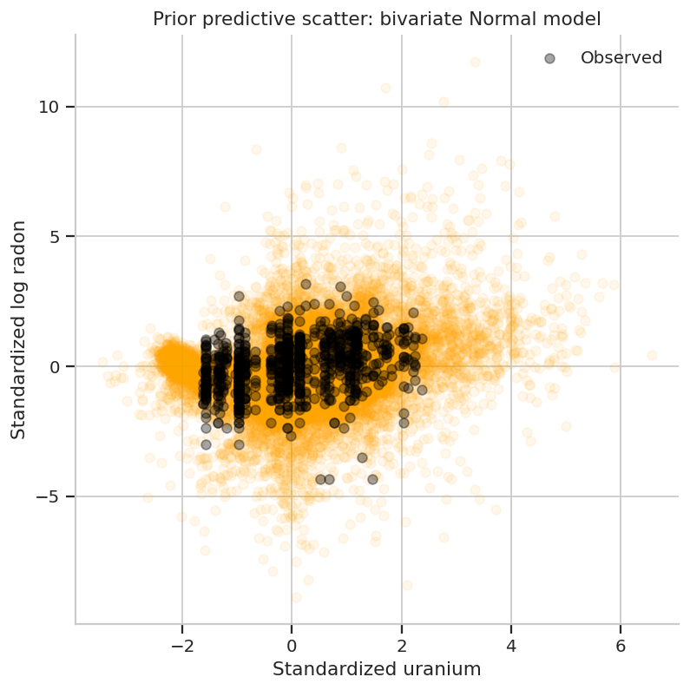
Bayesian correlation: prior predictive
Each orange point cloud is a dataset drawn from the prior predictive distribution.
Observed data are overlaid in black.
The prior predictive check asks whether the joint model is plausible before fitting.
Prior predictive scatter for the bivariate Normal model.
34

Slide 44
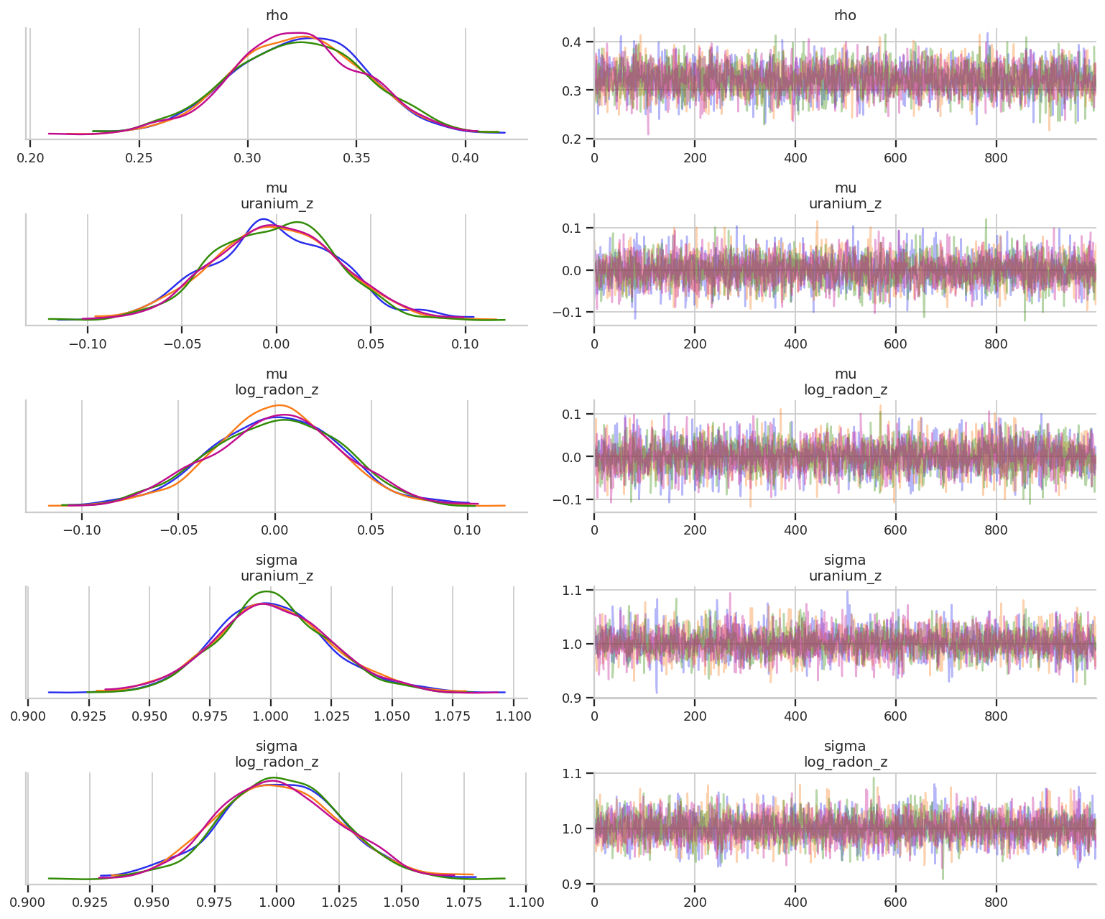
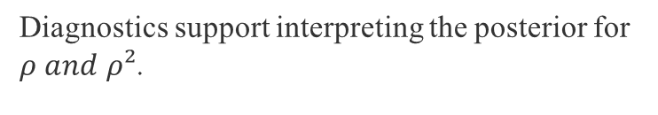




Bayesian correlation: diagnostics
Parameter
ESS bulk
R-hat
$$ρ$$
4045
1.00
$$ρ^{2}$$
4045
1.00
$$μ\left[uranium^{z} \right]$$
4375
1.00
$$μ[log⁡_radon^{z}]$$
4253
1.00
Diagnostics support interpreting the posterior for $ρ and ρ²$.
Trace plots for the bivariate Normal model.
35

Slide 45
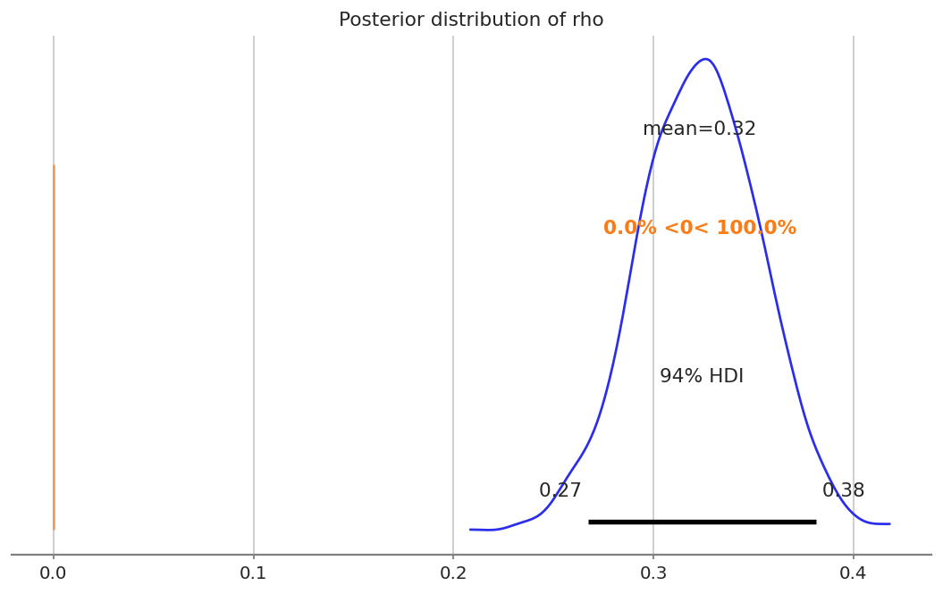

Posterior distribution of ρ
Posterior mean $ρ ≈ 0.323$
94% HDI: [0.267, 0.381].
The posterior is clearly positive in this model.
This describes association, not causation.
Posterior distribution of the population correlation.
36

Slide 46


Posterior distribution of ρ²
Posterior mean $ρ² ≈ 0.105$.
94% HDI: [0.068, 0.141].
Interpretation: roughly 10% shared variance in the linear association sense.
Shared variance describes association not a causal effect.
Posterior distribution of shared variance.
37

Slide 47
Pearson correlation versus Bayesian correlation
Quantity
Value
Pearson r is a sample statistic.
The Bayesian model estimates a posterior distribution for ρ.
The posterior directly expresses uncertainty about plausible population correlations.
The p-value asks a different question: compatibility with H₀: ρ = 0.
Pearson r
0.324
Posterior mean ρ
0.323
ρ 94% HDI
[0.267, 0.381]
Pearson r²
0.105
Posterior mean ρ²
0.105
ρ² 94% HDI
[0.068, 0.141]
38

Slide 48

Final conceptual summary
Grouped dependence:
houses in the same county may be more similar than houses in different counties.
Hierarchical regression represents this using county-level intercepts.
Symmetric association:
two continuous measurements can vary together without a predictor/outcome direction.
$ρ$ is the population correlation coefficient, and it measures the direction and strength of the linear relationship between two variables.
$ρ^{2}$, the squared correlation, measures the proportion of shared linear variance between the two variables.
The bivariate Normal model represents this through the covariance matrix and ρ.
The modeling choice should follow the scientific question and data structure.
39
Notes:
$ρ$ is the population correlation coefficient, and it measures the direction and strength of the linear relationship between two variables. Its values range from (-1) to (1): positive values indicate a positive linear relationship, negative values indicate a negative linear relationship, and values close to (0) indicate little or no linear relationship.
$ρ^{2}$, the squared correlation, measures the proportion of shared linear variance between the two variables. Its values range from (0) to (1).
For example, if $ρ= 0.8$, then $ρ^{2}= 0.64$, meaning that 64% of the variance is shared through the linear relationship. Unlike $ρ$, $ρ^{2}$does not preserve the direction of the relationship: both $ρ= 0.8$and $ρ=−0.8$ give $ρ^{2}= 0.64$. Therefore, (\rho) tells us both the direction and strength of the relationship, while $ρ^{2}$tells us only about the amount of shared linear variance.

