Slide 1

Save The Astronauts
The Game…

Slide 2
Features:
Stunning Graphics
Ege cutting technology
A fun and joy-full ride

Slide 3
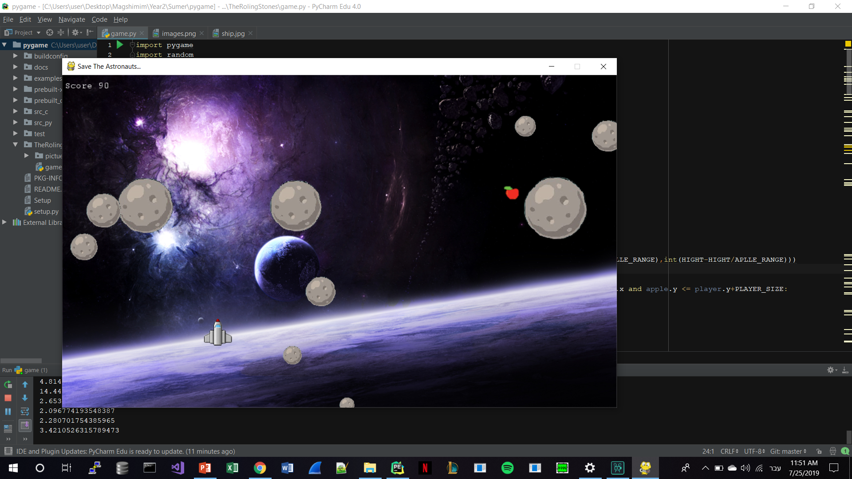
Demenstration
Github:
https://github.com/ophiraz/TheRolingStones

