Slide 1
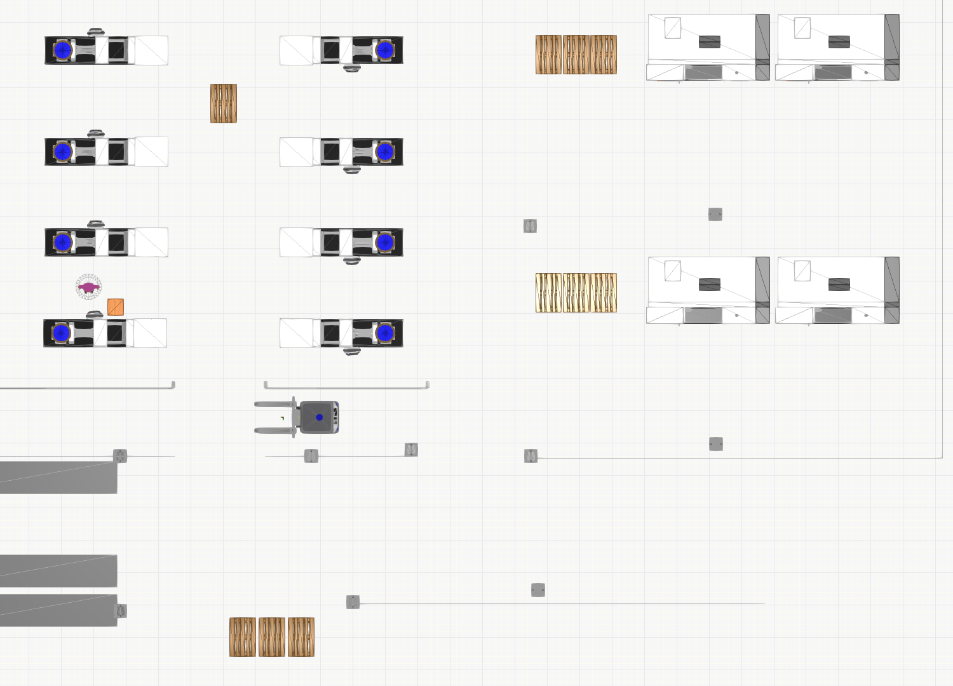
Production area
Machine 2
Packaging area
Machine 1
Warehouse area

Slide 4
$pack_2_1
$pack_2_3
$prod
$pack_1_1
$pack_1_3
$wh_1 $wh_2 $wh_3

