Slide 1
EDGE AI FOR TELE-REHABILITATION
Rehabilitation Exercise Assessment
with SE(3)-Equivariant Edge AI
Engineering problems, design decisions, and measured solutions across the codebase
TEAM
Sayed Ashraful Islam Opin 2232559042
Ahsanul Karim Raiyan 2221450642
Susmit Talukder 2221865042
Natasha Monir Shawon 2121744642
128 Python modules in src/ · 242 banked result files · 3 research threads
KIMORE · NTU RGB+D 60 Cross-View · REHAB24-6 · UI-PRMD
WACV 2026 submission · arXiv extended twin · live webcam demo

Slide 2
THE SETTING
Automated rehabilitation assessment — and why deployment breaks it
The task. Regress a clinician's 0–50 movement-quality score from a skeleton sequence — 25 Kinect joints, one recording per patient per exercise.
The lab assumption. One fixed camera, one fixed frame rate, every joint tracked on every frame.
The clinic. The camera gets moved between sessions, the depth sensor drops frames in bursts, and joints vanish behind the body for seconds at a time.
The baseline family — point-cloud transformer, TCN, ST-GCN — learns geometry from data. Geometry is then only as reliable as the training distribution was representative.
The design bet of this project. Make the invariances structural properties of the architecture — provable and testable to machine precision — instead of hoping augmentation covers the deployment envelope.
src/kimore_cde_data.py · src/models_curvenet.py · docs/reference/PROJECT_BRIEF.md

Slide 3
THE INPUT SIDE
Four corpora, four skeleton conventions, one loader contract
The problem. Every corpus describes a body differently. KIMORE is Kinect v2 with 25 joints and real sensor timestamps in 100-ns ticks; NTU RGB+D uses the same SDK ordering (checked, not assumed); REHAB24-6 is OptiTrack with 26 markers needing an anatomical remap onto those 25; UI-PRMD differs again.
Every preprocessing step has to be equivariance-safe, or the theorem is lost before the model sees anything. Root-relative coordinates give translation invariance; per-sequence scaling uses the median joint radius, a type-0 scalar that commutes with rotation; time is divided by a global constant, because a per-sequence one would erase the clinical duration cue.
The loader never invents an arrival time. Length capping is uniform index subsampling that keeps the real timestamps, so the irregular-sampling claim is not quietly manufactured by the data path it is meant to test.
The demo re-implements the identical preprocessing byte for byte, so what the model sees live differs from training only in domain, not in kind.
Why this gets its own slide. A mis-mapped joint or an invented timestamp does not crash anything. It silently moves a number that nobody can then trace back.
src/kimore_cde_data.py · src/ntu_dataset.py · src/load_rehab246.py · demo/mp_to_kinect.py

Slide 4
PROBLEM 0 — DESIGN
Three paradigms proposed, two killed before a line of code
Proposal | Fatal attack | Verdict
A — Neural biomechanical controller (infer torques, mass matrix, impairment) | Non-identifiable: mass, potential and torque are underdetermined from position-only data. Also needs double differentiation of noisy joints. | Killed
B — Hyperbolic × SE(3) geometry (tree in ℍⁿ, pose in SO(3)) | The hyperbolic half is marginal at skeleton scale — ~25 nodes, depth ~5, which Euclidean space embeds fine in 16–32 dims. | Half kept
C — Optimal-transport bridge (distance to a “health manifold”) | OT needs distributions; a clinic gives one trajectory. Heavy and unstable against a competitor whose brand is CPU real-time. | Killed
The survivor is a synthesis: SE(3)-equivariance from B plus continuous time from A, minus the identifiability-killing force decomposition. Both surviving claims are provable structural properties, not empirical hopes.
Killing a paradigm on validity grounds costs days. Killing it after implementation costs months.
docs/reference/PROJECT_BRIEF.md §2

Slide 5
DESIGN
Where the guarantee is manufactured — and where it is discharged
Root-relative coordinates. Subtracting the spine base makes translation invariance automatic — a constant that is removed, not learned.
Steerable encoder. Bone vectors → spherical harmonics (ℓ≤2) → Clebsch–Gordan-constrained tensor products (e3nn). The radial weights are functions of ‖r‖ only, so they are invariant scalars and cannot leak orientation.
No bias on any non-scalar channel. The only vector fixed by the whole rotation group is zero, so a learnable bias on a type-1 channel silently breaks equivariance. Every steerable layer is built with biases=False.
The invariant cut Π — the one place the theorem is discharged: 32 scalars + 8 vector norms + 28 cosines, pooled to 136, plus 24 bone lengths = 160-d parity-even; plus 56 triple products pooled to 112 and 11 anatomical volumes = 123-d parity-odd. 283-d in total.
Cosines, not raw dot products. Unnormalised quadratic dots once drove predictions into the hundreds — the fix is in the feature definition, not in a clamp.
Recurrence on real inter-arrival times. The GRU consumes the actual Δt between samples rather than a frame index.
src/equivariant_gru.py · src/chirality.py · paper/arxiv_extended/methodology.tex

Slide 6
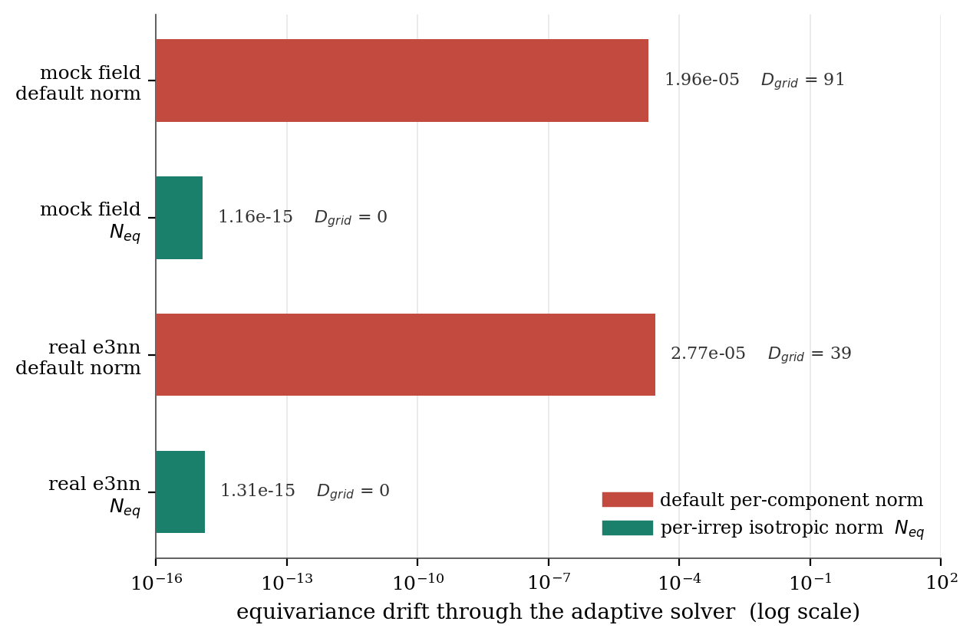
PROBLEM 1 — NUMERICS
The architecture is exactly equivariant. Is the integrator?
Fixed-step explicit RK is safe. Butcher coefficients are scalars, so they commute with every equivariant operation — exact to roundoff, and independent of step size.
Adaptive stepping is not. dopri5 scales each error component by its own magnitude, but a rotation preserves only the L2 norm of each irrep block, not per-component magnitudes.
Formally, invariance needs [ρ(g), W²] = 0 — generically false for the default W even when ρ(g) is orthogonal. The rotated and unrotated runs then take different step grids.
Fix: a per-irrep isotropic error norm N_eq = sqrt( (1/F) Σ_f (1/d_f)·‖e_f‖² ), invariant because each block norm is.
Step-grid divergence goes to exactly zero, and the fix survives replacing the mock field with real e3nn layers — the most likely silent-break point.
src/equivariance_suite.py · docs/reference/outputs_equivariance_certificate.txt

Slide 7
DESIGN DISCIPLINE
Certification is a gate that can fail — not a claim in the abstract
Gate | What it tests | Threshold | Measured
E1 | Encoder equivariance h(g·x) = ρ(g)h(x) | ≤ 1e-12 | 2.41e-16
E2 | Read-out invariance s(g·x) = s(x) — the theorem | ≤ 1e-12 | 8.67e-16
E3 | Violation vs rotation magnitude (log–log slope) | ≈ 0 | 0.039
E4 | fp32 / fp64 ratio — is the residual just roundoff? | ≥ 1e5 | 1.23e+08
E5 | Translation invariance on raw world coordinates | ≤ 1e-12 | 5.21e-16
E8 | Full SO(3) with parity-odd channels active | ≤ 1e-12 | 2.49e-16
Build the control that must fail. A deliberately non-equivariant vector field is run through the same gates and must be rejected: drift 1.18e-02 and a precision ratio of 1.000 against the real model's 1.2e+08. A test that cannot fail proves nothing.
E4 is what separates roundoff from a hidden violation. A genuine symmetry break would not shrink eight orders of magnitude when you move from fp32 to fp64.
src/certify_egru.py · outputs/cde_block2/certify_egru.json · src/equivariance_suite.py

Slide 8
PROBLEM 2 — MEASUREMENT
The ±0.33 MAD “hardware noise floor” was not hardware
The stakes, stated as a number. Repeated runs of the same configuration differed by ±0.33 MAD. The entire effect being claimed is floor 8.31 minus model ≈ 6.6, about 1.65 MAD — so the noise was 20% of the signal and wider than every model-vs-model gap in the paper.
Two nondeterministic kernels, not one. e3nn's index_add_ resolves CUDA write collisions with atomic adds, making fp32 summation order-dependent; cuDNN's fused GRU backward does the same. Fixing either alone leaves a floor.
Fix 1 — change the reduction, not the maths. Replace scatter aggregation with a dense incidence matmul einsum('je,nec->njc', A, m): identical sum, fixed order, numerically equivalent — so existing checkpoints stay valid, which gate G1 asserts to 1e-12 in fp64.
Fix 2 — pin the environment before CUDA exists. CUBLAS_WORKSPACE_CONFIG=:4096:8 is set at module import, ahead of any CUDA context, alongside deterministic algorithms and an unfused GRU.
Outcome. Bitwise-identical forwards and gradients. The seed-to-seed spread (0.48) is now reported separately from the fixed-configuration spread (0.33) instead of the two being conflated into one vague “noise”.
src/determinism.py · src/certify_phase1.py · docs/planning/wacv_evaluation_and_action_plan.md (V3)

Slide 9
PROBLEM 3 — EXPERIMENT INTEGRITY
Making “you sabotaged the baseline” unarguable
Cryptographic input identity. Every robustness experiment routes byte-identical corrupted timelines to both models, and asserts an equal SHA-256 hash of the input at every corruption level and every seed. A promise is replaced by a check.
The baseline gets its best case. The transformer architecturally requires a uniform T×J×3 grid, so it must resample. It is given the better of linear, cubic and forward-fill — not a strawman — and the resampling happens inside the shared engine.
Self-referential metric. Each model is scored against its own clean prediction, so no cross-model scaling can bake in an advantage.
Named failure modes, not uniform noise. Gilbert–Elliott burst drops (real dropouts cluster), Gaussian + AR(1) timestamp jitter under a monotonicity clamp, and Gamma inter-arrivals for 30→10 fps throttling.
Calibrated against reality. 398 KIMORE recordings scanned, 143 with a genuine dropout, 20 clearing the full CV ≥ 0.2 plus burst-gap bar; the synthetic sweep must match the real anchor's statistics within 20% before it is allowed to stand in for it.
src/resilience_sweep.py · src/corruption_pipeline.py · src/irregular_data.py · src/block23_experiments.py

Slide 10
PROBLEM 3B — WHAT A ROBUSTNESS PLOT HIDES
A model that ignores its input has zero degradation
… and would therefore win every robustness plot ever drawn. Degradation is not admissible on its own — it is only interpretable next to absolute accuracy.
The signal gate. Every fold is checked against a per-exercise mean-predictor floor of 8.31 MAD. A run that fails to beat the floor is marked NO-SIGNAL, its degradation columns are declared uninterpretable, and --strict aborts the run outright.
This gate killed our own first architecture. The continuous-time Neural CDE — the original thesis — scored 8.43 against the 8.25 floor measured on that run. Its degradation curve was beautifully flat and completely meaningless. It was demoted to a control instead of being reported as robust.
The same discipline retired a second claim. Selecting the training epoch on the test set inflates results by +1.22 MAD (18.6%) across three seeds, so every number reported is validation-selected — including the ones that then look weaker.
src/block23_experiments.py · src/protocol_null.py · src/train_cde.py

Slide 11
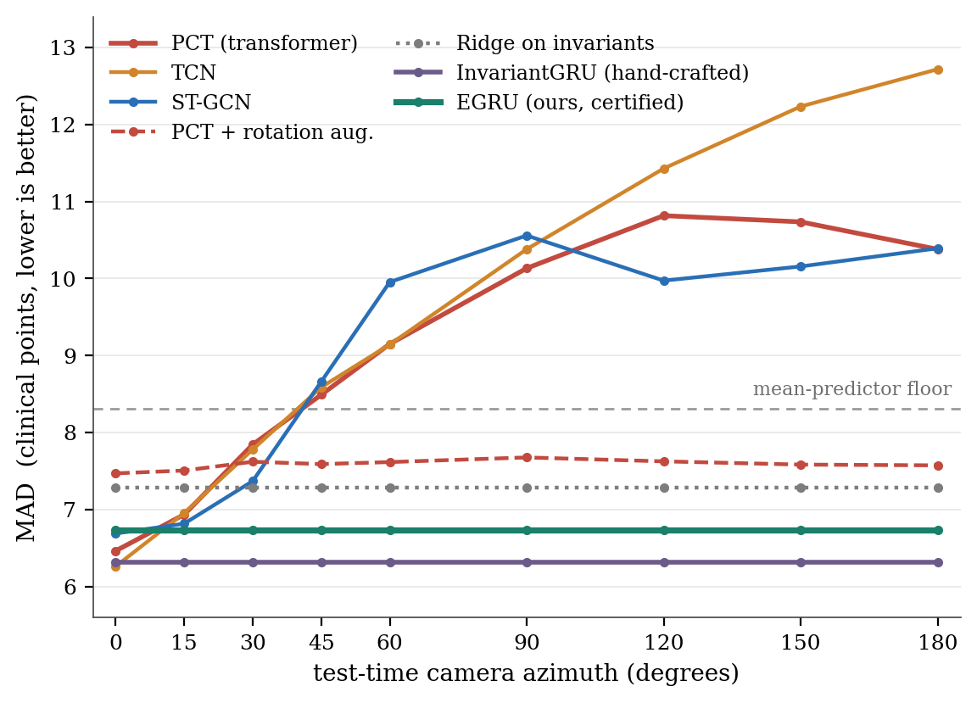
RESULT — THE PAYOFF
Viewpoint: a guarantee versus a fit
Certified models are flat by theorem: EGRU 9.1e-06, InvariantGRU 0, Ridge 0 worst-case degradation.
Three independently designed non-equivariant families all fail: PCT 9.42, ST-GCN 9.18, TCN 13.17 MAD — every one crossing the mean-predictor floor. The fragility is structural, not one competitor's bug.
Augmentation is a partial fix that looks total. PCT + rotation augmentation is flat in aggregate, yet still moves 3.03 MAD per sequence — which is the number an individual patient actually experiences.
Certified on real hardware, not just synthetic rotations. NTU RGB+D Cross-View with a physically different 45° camera: 5.8e-09. Second corpus REHAB24-6 at 90°: AUROC 0.738 unchanged, logit drift 1.5e-04 against the transformer's 23.2.
outputs/cde_block2/final_tables.json · src/block3_baselines.py · outputs/rehab246/

Slide 12
THE HONEST LEDGER
What the guarantee does not buy
Claim | Verdict | Measured
Clean accuracy | A tie, not a win | PCT 6.46 · InvariantGRU 6.31 · EGRU 6.73 (floor 8.31)
Sensor-node failure | The transformer is genuinely best | MAD lost, 0→8 dead joints: PCT +2.27 · EGRU +3.76 · InvariantGRU +12.05
Irregular sampling | Null on this corpus | The grid-free advantage does not materialise — the transformer degrades less
Chirality | Principled, unrewarded here | +0.11 MAD for +16.7% parameters; KIMORE has no chiral pathology to detect
The sampling null is predicted, not merely observed. A spectral census puts 97.7% of positional energy below the resampling corner (2.19 Hz), so the operator we avoid destroys only 2.2% of it. The claim only has teeth where the task depends on the velocity band — 70% of which sits above the corner.
All four rows are in the paper. A negative result you can derive is stronger evidence of understanding than a positive one you stumbled into.
outputs/cde_block2/final_tables.json · src/bandwidth_law.py · outputs/cde_block2/block5_bandwidth_law.json

Slide 13
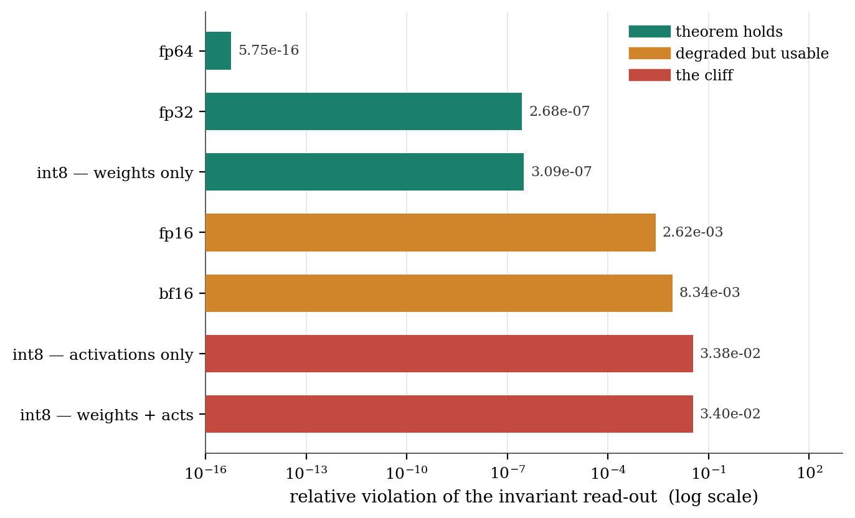
PROBLEM 4 — DEPLOYMENT
Equivariance has a precision budget
Why there is a budget at all. Quantisation is not an orthogonal map, so it does not commute with ρ(g). The theorem is exact in real arithmetic and has a numerical floor in every format a device actually runs.
fp16 beats bf16 by 3.2× at the same width (2.62e-03 vs 8.34e-03) — equivariance is paid for in mantissa bits, not exponent range.
The int8 cliff decomposes. Weight-only quantisation preserves the theorem (3.09e-07) because the encoder is equivariant for any weights. It is activation quantisation that breaks it (3.38e-02): round(ρ(g)v) ≠ ρ(g)round(v).
A trap worth naming. e3nn builds its Clebsch–Gordan tables at the default dtype at construction time. Calling .half() afterwards leaves them in fp32 and yields a fake certificate — 2.8e-08 instead of the honest 8.5e-15. Every format here is built natively.
src/precision_budget.py · src/int8_quant_budget.py · outputs/precision_budget/

Slide 14
PROBLEM 5 — DEPLOYMENT
A bidirectional model cannot stream — yet it shipped as real-time
The contradiction. The trained classifier was bidirectional with a mean-pool over all frames. It cannot emit a score until the clip ends, so its honest time-to-first-score is the entire recording — while the paper described a real-time system.
Controlled conversion, one variable. Freeze the trained encoder and projection; retrain only the unidirectional GRU and head, behind a causal running-mean read-out updated in O(1) per frame. A loader assertion refuses to run if any other parameter moved.
The cost is measured, not assumed: 79.81% causal against 82.98% bidirectional on NTU Cross-View — 3.17 points for causality.
Latency timed on a genuinely incremental single-frame step, not the vectorised path, which would be a lie about live latency: 8.9 ms/frame, 112 fps, p95 9.9 ms, inside the 33.3 ms budget at 30 fps. Median 54 frames to lock on the correct class.
The engineering that made it runnable on ~6 GB free: frozen features streamed to an on-disk fp16 memmap via buffered writes, because a writable memmap pins dirty pages in the working set and OOM-killed the run.
src/train_stream_egru.py · src/ttfs_benchmark.py · outputs/ntu_stream/

Slide 15
FROM THEOREM TO A LAPTOP
The live demo — and the gate that runs before the camera does
Pipeline. Webcam → MediaPipe 33 landmarks → Kinect-25 remap (spine chain synthesised; a single AXIS_SIGN constant owns the Y-flip) → preprocessing byte-matched to the training loader → both models.
No hidden asymmetry. One predict() call feeds byte-identical samples to the EGRU and the transformer; the transformer is resampled onto its required 100-frame grid inside the engine, where it is visible, rather than upstream where it would look like a handicap.
Real-time on a booth CPU. Camera loop runs every frame, inference every 6th (≈6 Hz score updates), over a 64-frame bounded ring buffer — one --infer-every knob for a slow machine.
The gate runs first. smoke_test.py re-measures the thesis on a synthetic body before any camera is touched, and asserts it: EGRU 3.76e-05 against PCT 8.02, tolerance 1e-03. If it passes, every later failure is plumbing rather than science.
Honest about the residual. A real screen-to-webcam sweep over 7 physical viewpoints gives spreads of 3.19 (EGRU), 3.10 (InvariantGRU) and 6.89 (PCT). The runbook states plainly that EGRU's spread is not zero because the residual is pose-estimation noise, not model drift.
demo/engine.py · demo/smoke_test.py · demo/mp_to_kinect.py · src/variant_b1_score.py

Slide 16
KEEPING THE RESULTS TRUSTWORTHY
One repository, three research threads, one source of truth
The problem. This is a monorepo carrying three live threads at once — the equivariant work, an earlier self-supervised cross-sensor study that ended in a negative result, and an isolated EGNN/canonicalization sandbox. Threads that share a directory can quietly contaminate each other's results.
One source of truth for every published number. aggregate_final.py regenerates all of them from banked JSON, and measures parameter counts with sum(p.numel()) rather than quoting them from memory.
Isolation is asserted, not assumed. The sandbox verifies src/ and outputs/ are untouched via a size-and-mtime manifest; train_rehab246.py refuses to start unless its output path ends in outputs/rehab246.
Reviewer questions answered without retraining wherever possible. The per-invariant-family ablation zeroes a family while preserving the projection dimension — no retrain, no architecture change, so the anchor value reproduces the published number exactly.
Deprecation lives in the code, not a changelog. protocol_inflation.py marks itself .. deprecated:: and names its successor, so nobody re-derives a superseded result.
src/aggregate_final.py · src/ablation_invfamily.py · research_egnn/README.md · src/protocol_inflation.py

Slide 17
WHAT GENERALISES
Six practices that did the actual work
Every claim is a gate with a number. 127 asserts across 36 modules, each with a named threshold and a diagnostic that says which invariant to inspect when it trips.
Build the control that must fail. A deliberately broken vector field and a mean-predictor floor are what make a passing result informative.
Enforce fairness mechanically. A SHA-256 input hash beats a promise that both models saw the same data.
Treat determinism as an instrument, not hygiene. A noise floor you have not measured is a result you cannot defend.
Prefer an honest gap to a fake baseline. build_model('ctrgcn') raises NotImplementedError with an implementation pointer rather than shipping a weak stand-in.
Ship the negative results, and reverse on measurement. The EGNN comparison was expected to dilute the thesis and instead supported it; an earlier thread's headline was reversed by a bootstrap over ten subjects.
docs/planning/wacv_evaluation_and_action_plan.md · research_egnn/FINDINGS.md · docs/reviews/RESPONSE_TO_REVIEWER_R1.md

