Slide 1
DAILY SLIDE DECK
North Carolina Drug Checking

Slide 2
Orientation
About This Slide Deck
Every figure and statistic is rebuilt from the live extract on each nightly run.

Slide 3
Methods

Slide 4
Orientation
How Samples Reach the Lab
Sample-level records: results.streetsafe.supply/sample/&lt;sampleid&gt;

Slide 5
The Data
Sample Collection: Core Principles
Collection and shipping protocol details in the Supplemental Material

Slide 6
The Data
How Samples Are Analyzed
Qualitative GCMS — abundance is not concentration · full protocol and library details in the Supplemental Material

Slide 7
The Data
Two Linked Datasets
Direct downloads above · refreshed daily · also in Stata, Excel, SAS at data.streetsafe.supply/datasets/NC/

Slide 8
The Data
Primary vs. Trace: How to Read the Variables
Convention documented in technical_details.md · every following chart is stacked primary + trace-only

Slide 9
Orientation
Accessibility
Static slide — reviewed by lab staff, not regenerated nightly

Slide 10
Coverage Summary

Slide 11
The Data
North Carolina at a Glance
Unique samples = n_distinct(sampleid) · substances from lab_detail.substance · includes samples with date_complete {{STAT:first_date}} – {{STAT:latest_date}}

Slide 12
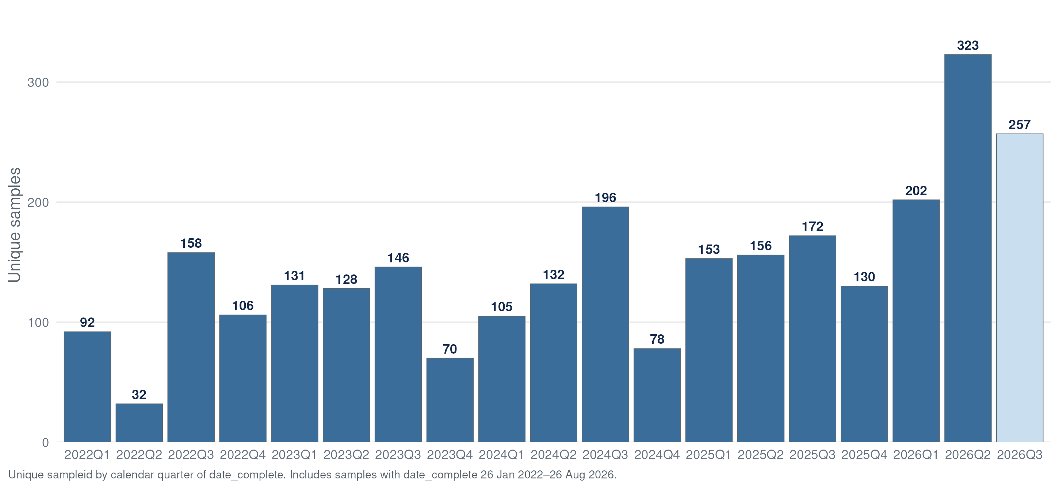
The Data
Samples Completed by Quarter
Unique sampleid by calendar quarter of date_complete · current quarter shown striped + labeled partial · data table: Appendix A1

Slide 13
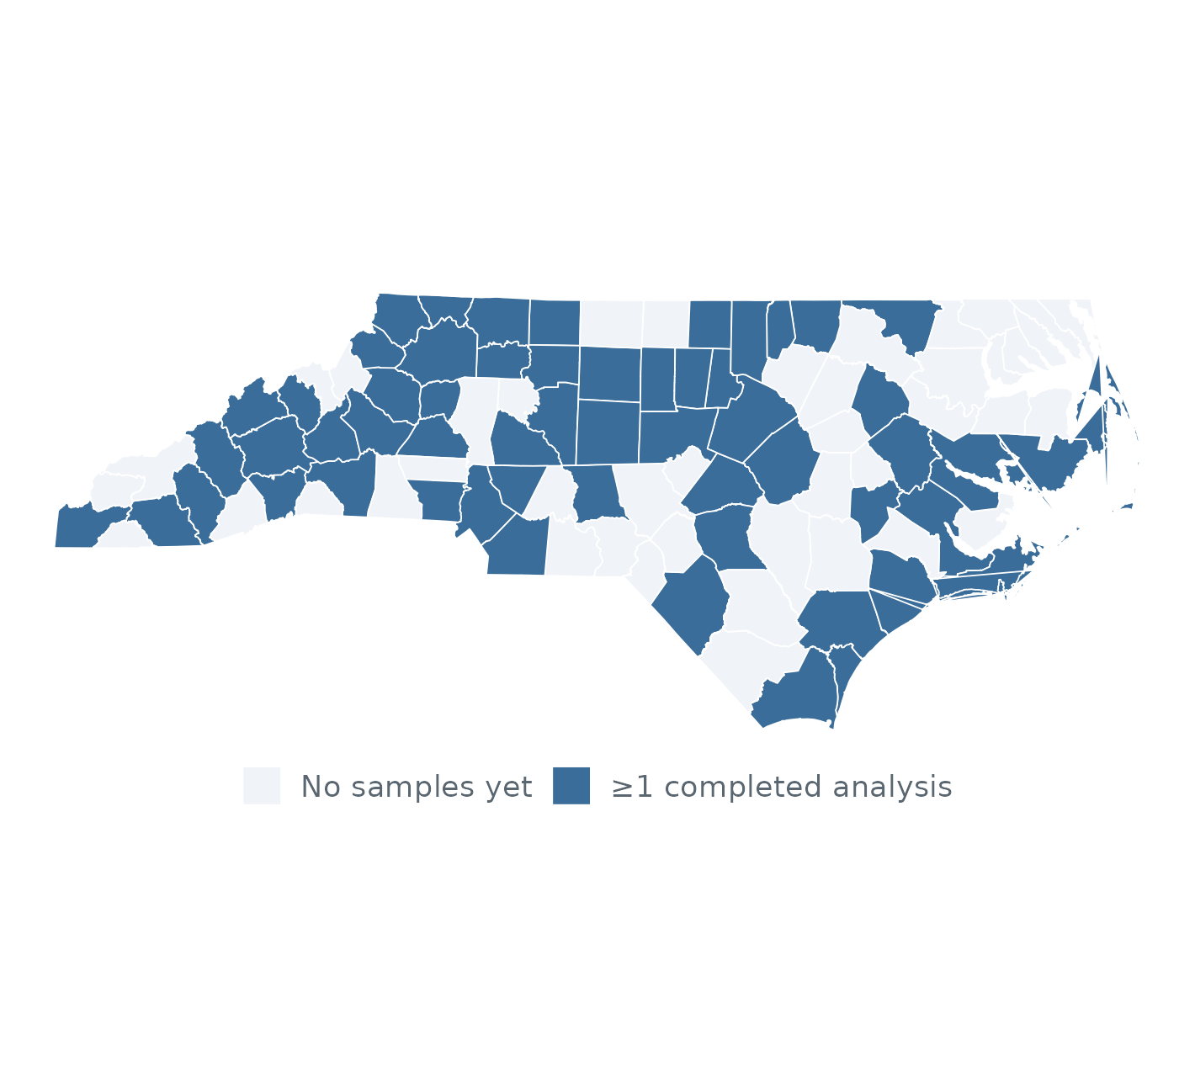
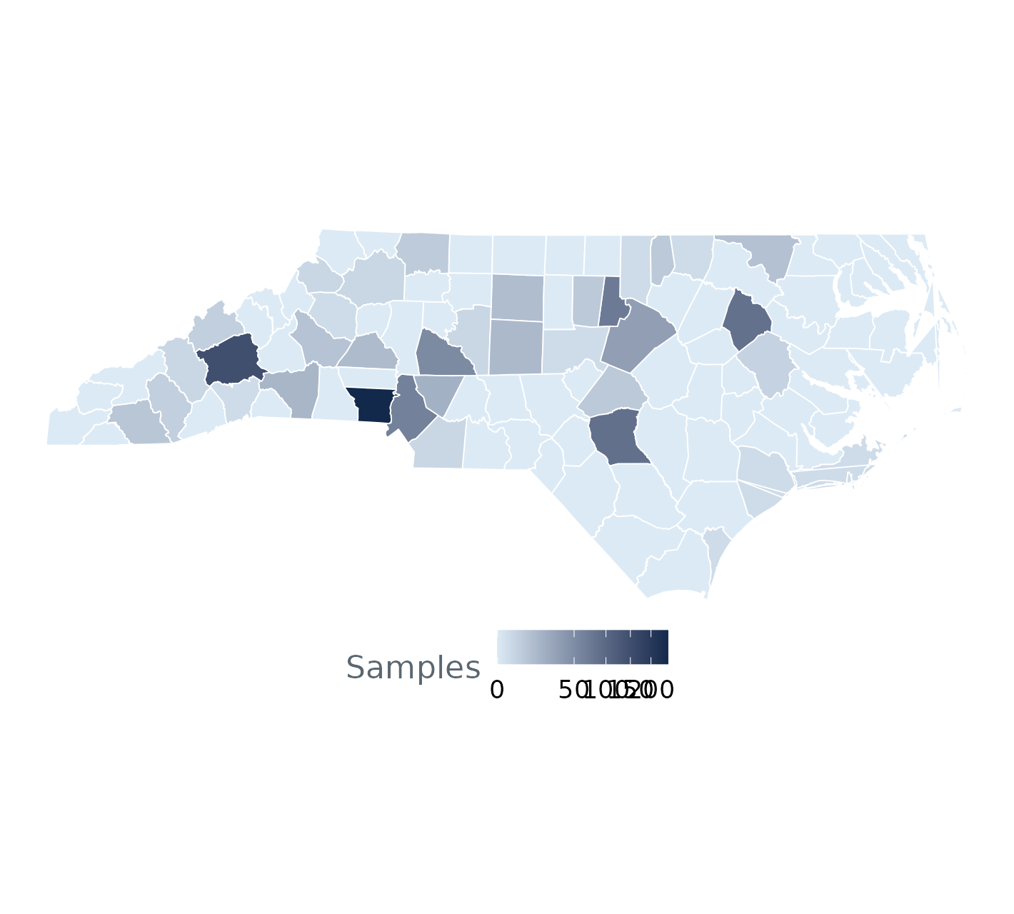
The Data
County Coverage
County = samplecounty · left: ≥1 completed analysis ever · right: unique samples per county (sqrt color scale) · all time: {{STAT:first_date}} – {{STAT:latest_date}} · last 12 months: {{STAT:run_date_prior_year}} – {{STAT:latest_date}}* · coverage reflects participation, not prevalence

Slide 14
What the Card Tells Us

Slide 15
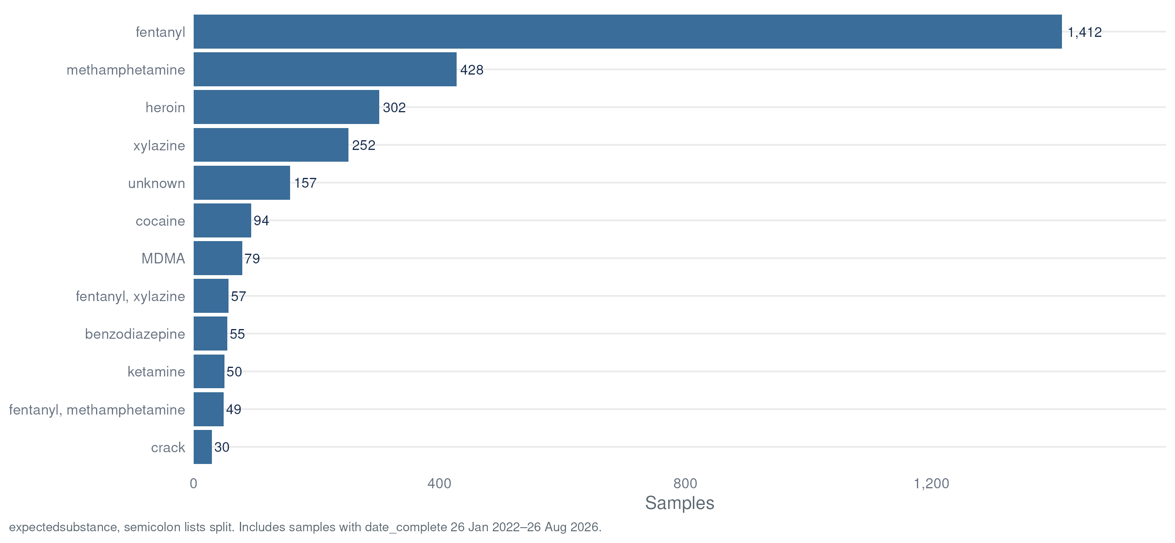
What the Card Tells Us
Expected Substances
expectedsubstance (verbatim card write-in, semicolon lists split) · derived flags: expect_opioid, expect_fentanyl, expect_meth, expect_cocaine, expect_stimulant… · includes samples with date_complete {{STAT:first_date}} – {{STAT:latest_date}} · data table: Appendix A2

Slide 16
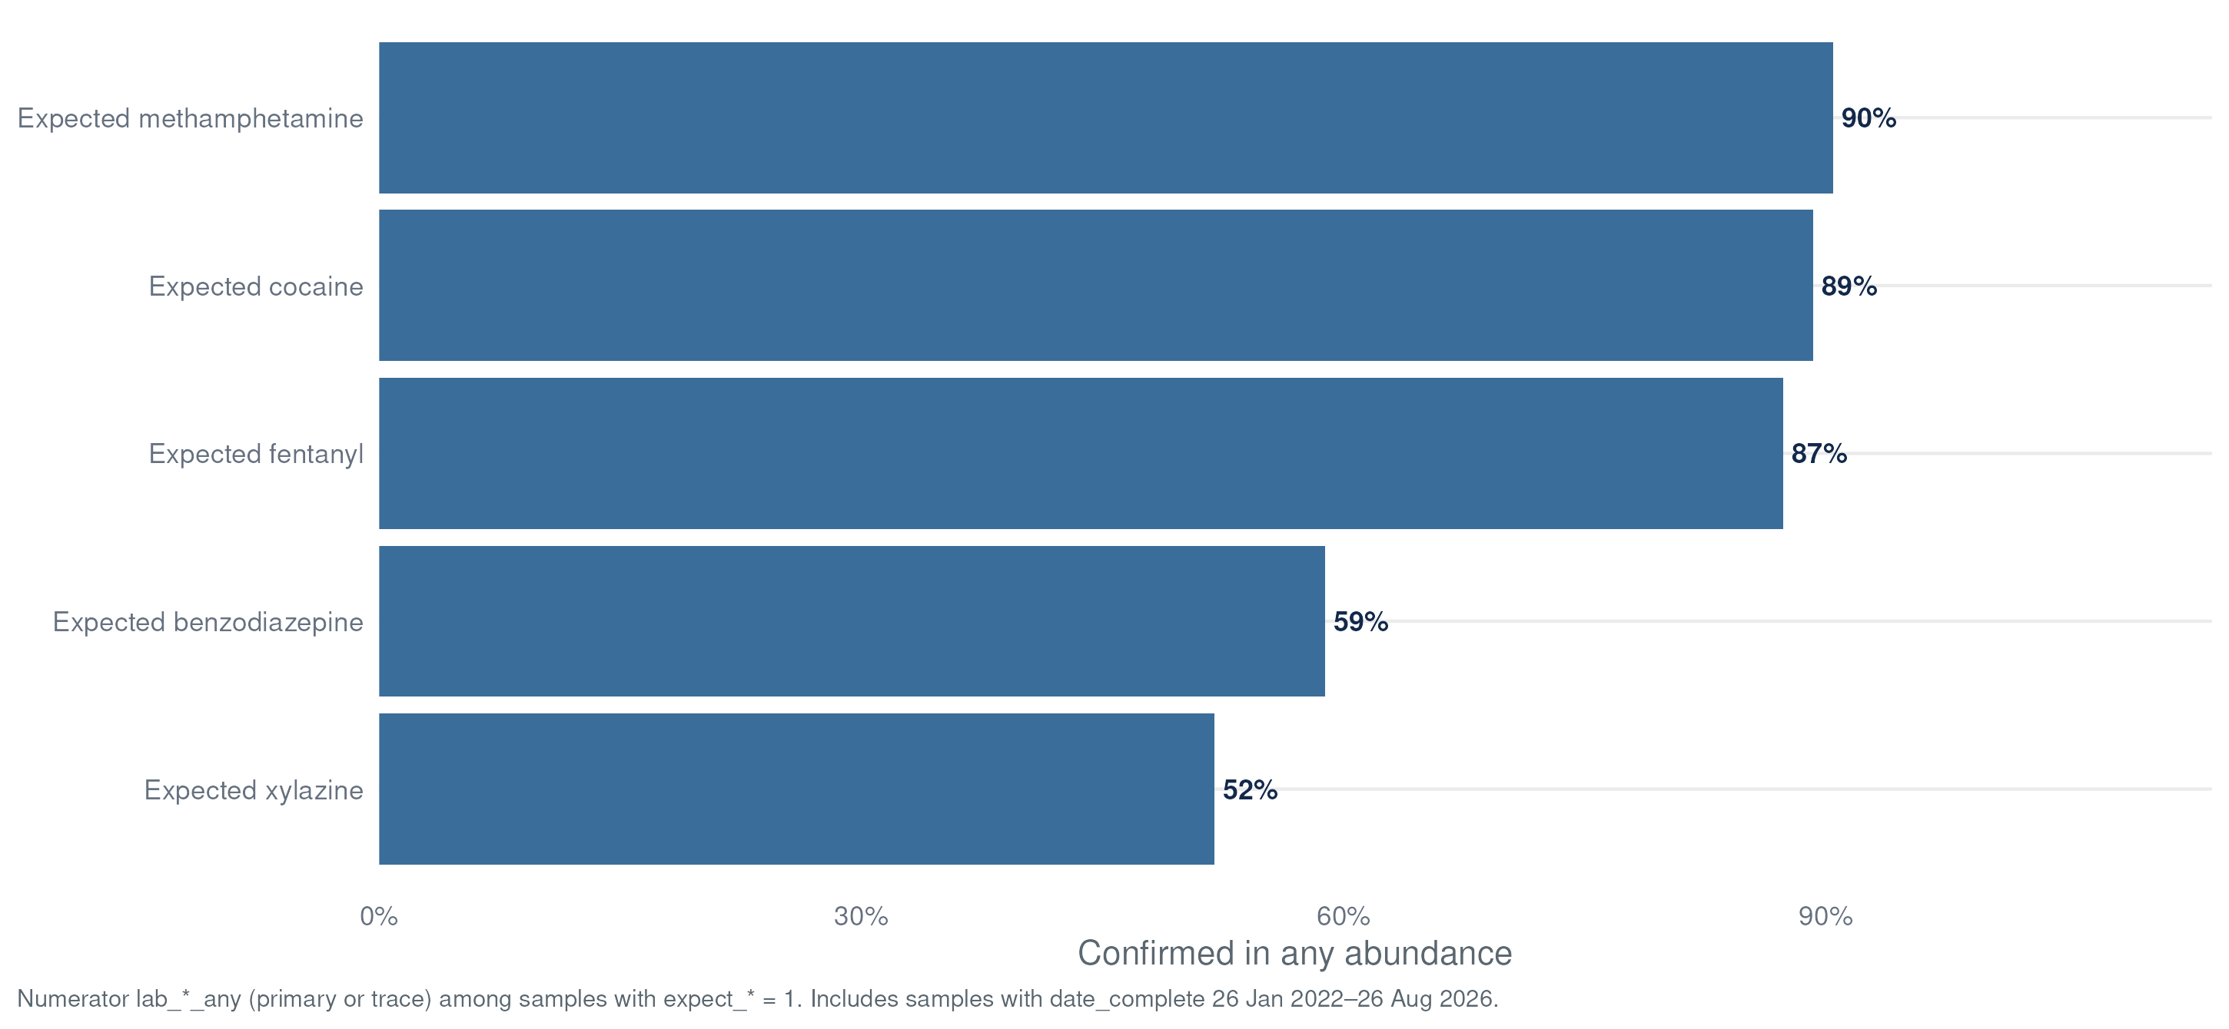
What the Card Tells Us
Expectation vs. Lab Result
Numerator uses lab_*_any (primary or trace) among samples with expect_* = 1 · includes samples with date_complete {{STAT:first_date}} – {{STAT:latest_date}} · data table: Appendix A3

Slide 17
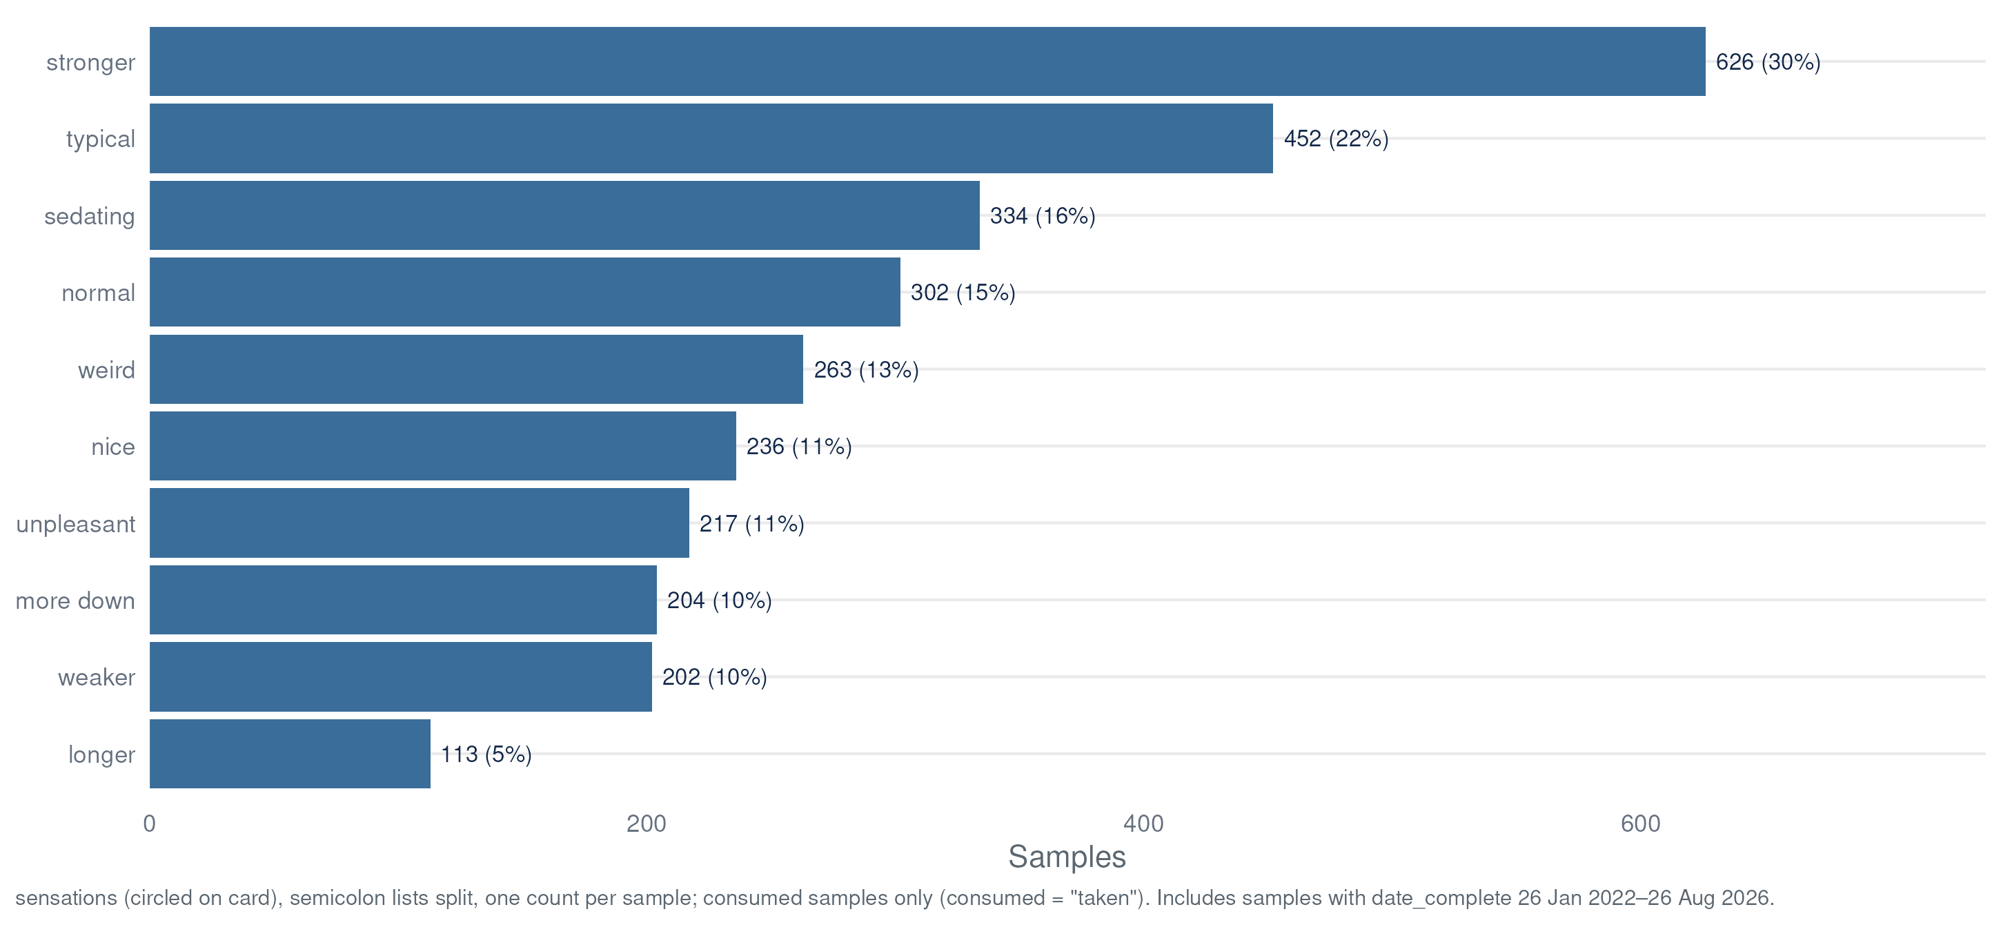
What the Card Tells Us
Reported Sensations
sensations (circled on card, semicolon lists split) · post-consumption samples only (consumed = 1) · includes samples with date_complete {{STAT:first_date}} – {{STAT:latest_date}}

Slide 18
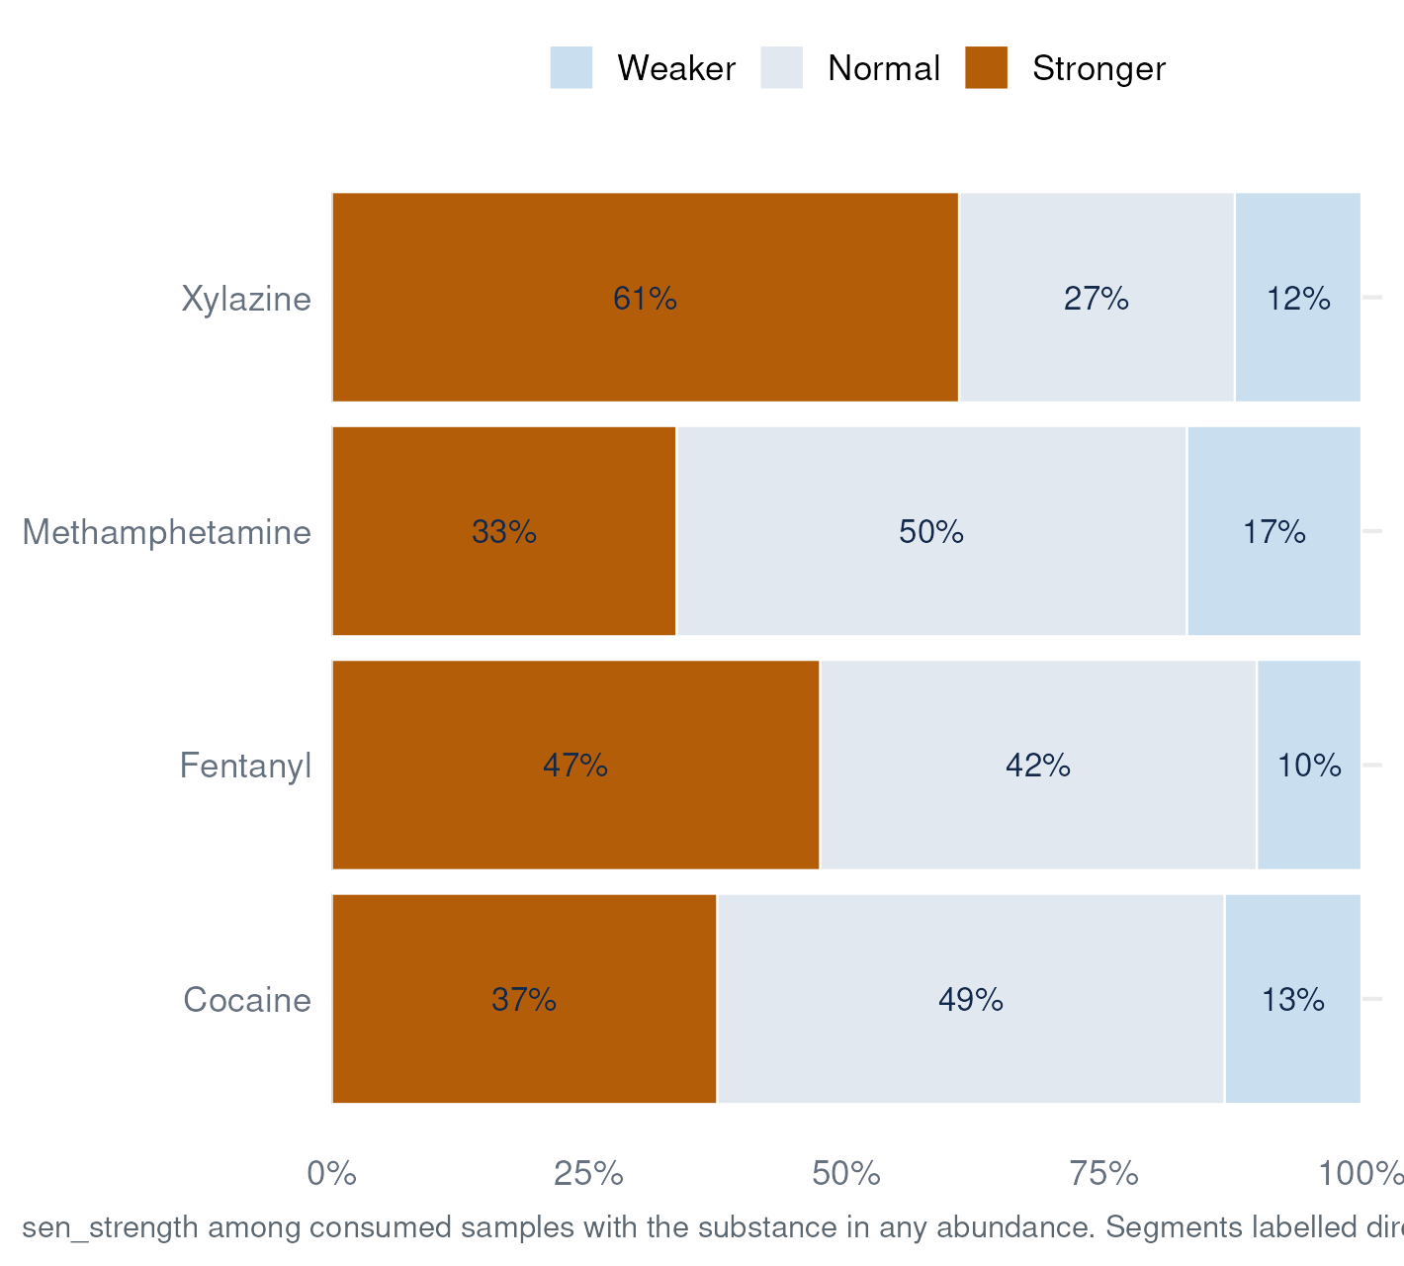
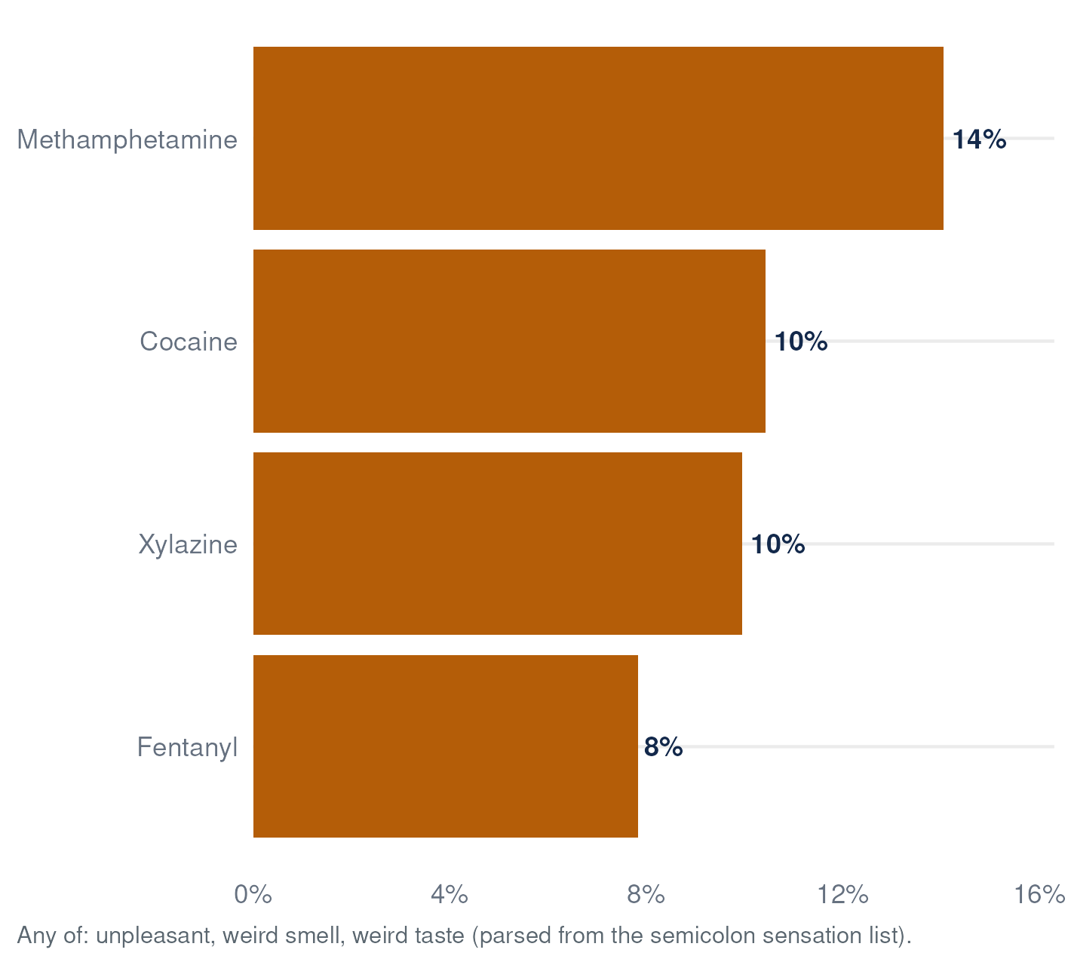
What the Card Tells Us
Sensations by Key Substance
sensations semicolon lists parsed per report · consumed = 1 only · denominator: consumed samples with lab_*_any = 1 · includes samples with date_complete {{STAT:first_date}} – {{STAT:latest_date}}

Slide 19
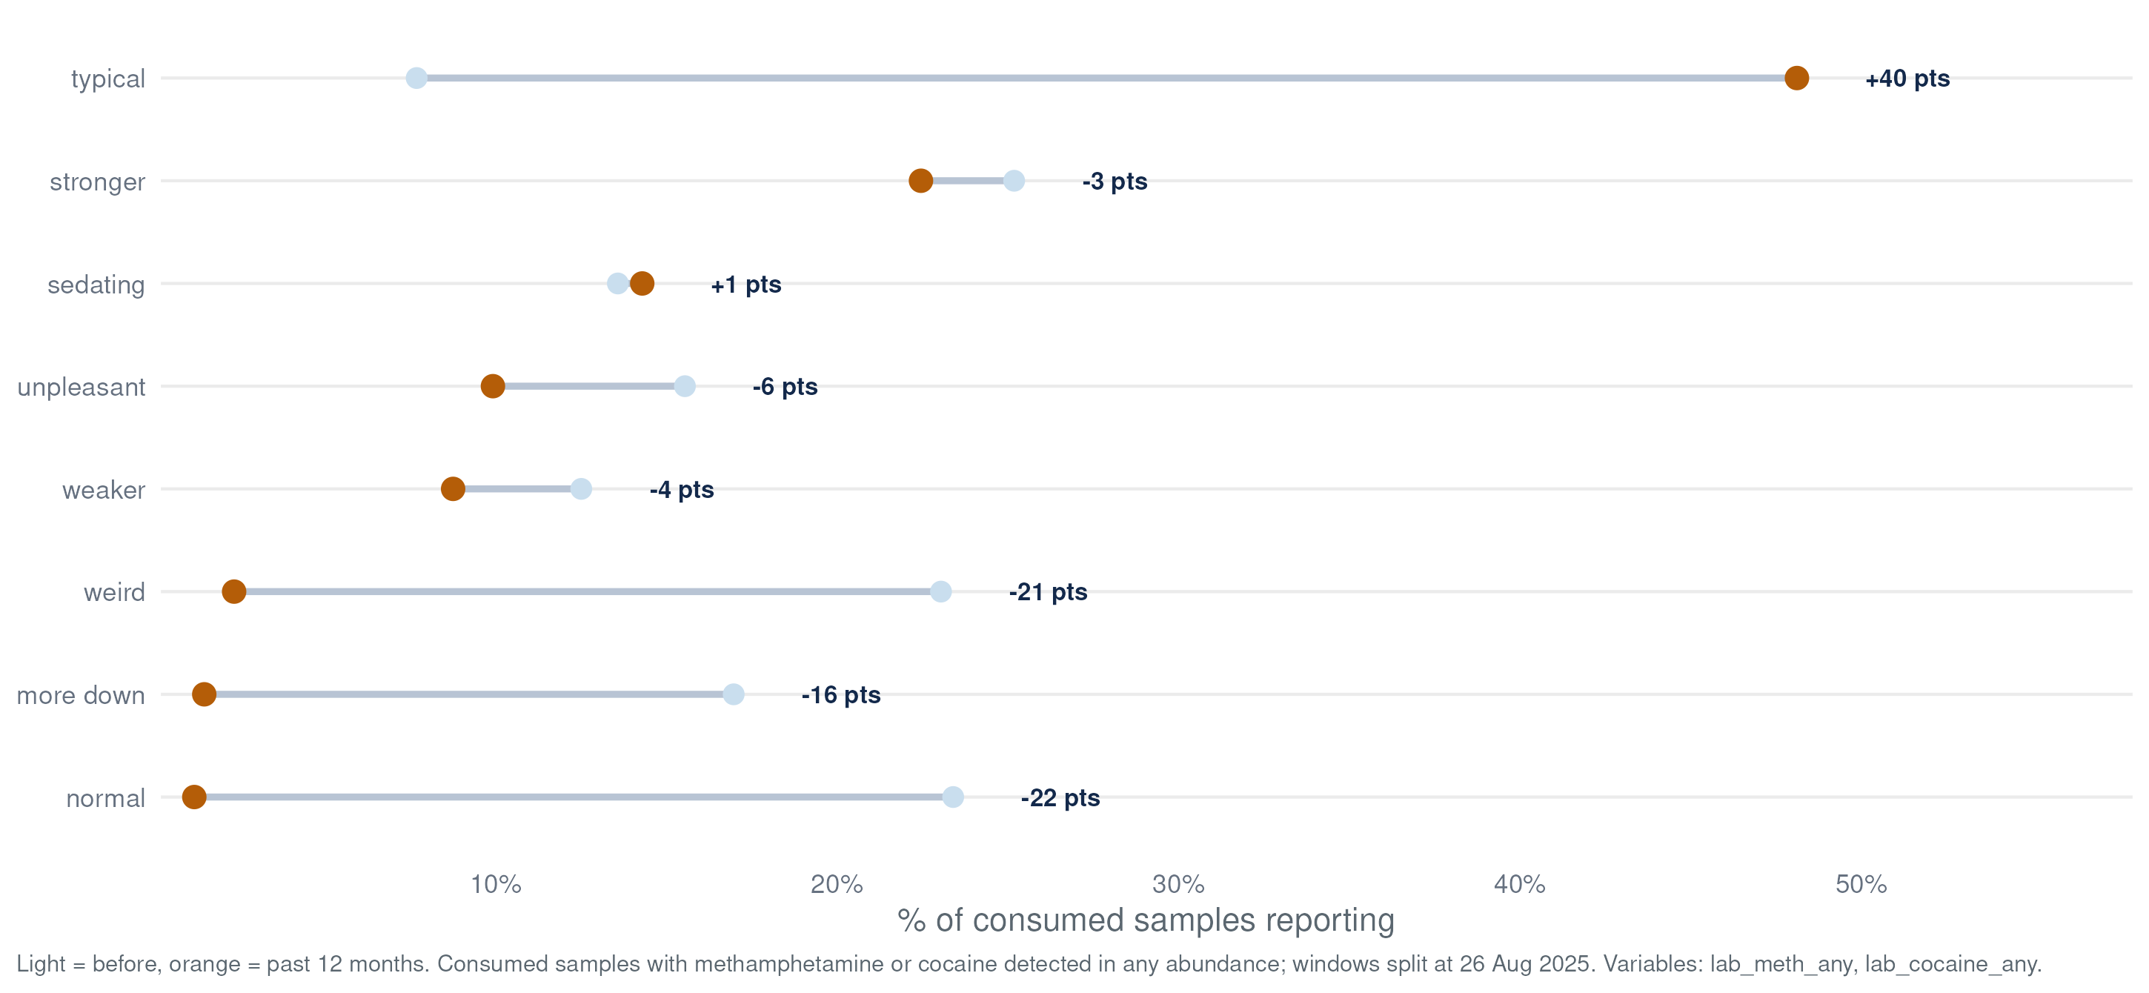
What the Card Tells Us
Sensation Shift — Stimulants
Samples with methamphetamine or cocaine detected (any abundance); samples in both classes appear on both slides · sensations semicolon lists parsed + sen_strength (own denominator) · consumed = 1 only · before: {{STAT:first_date}} – {{STAT:latest_date_prior_year}} · past 12 months: {{STAT:run_date_prior_year}} – {{STAT:latest_date}}* · Δ in percentage points

Slide 20
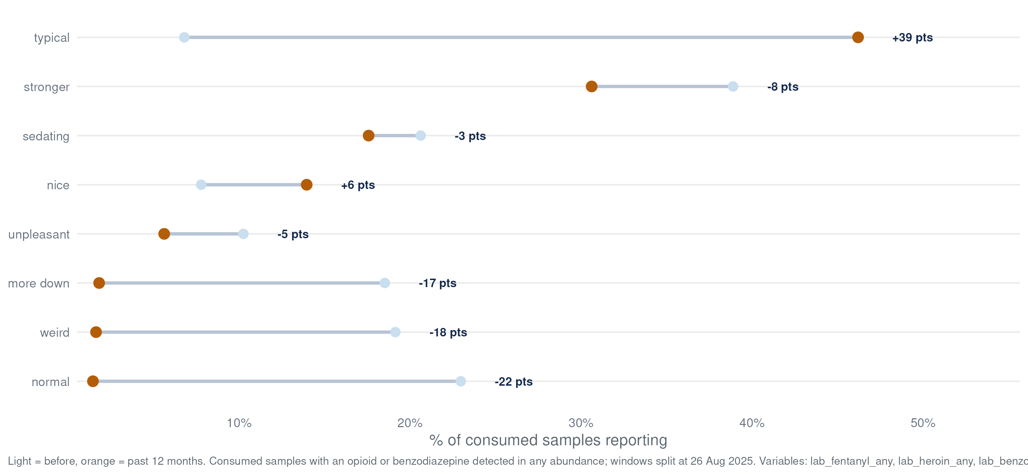
What the Card Tells Us
Sensation Shift — Opioids + Benzos
Samples with an opioid (fentanyl, heroin) or benzodiazepine detected (any abundance); samples in both classes appear on both slides · sensations semicolon lists parsed + sen_strength (own denominator) · consumed = 1 only · before: {{STAT:first_date}} – {{STAT:latest_date_prior_year}} · past 12 months: {{STAT:run_date_prior_year}} – {{STAT:latest_date}}* · Δ in percentage points

Slide 21
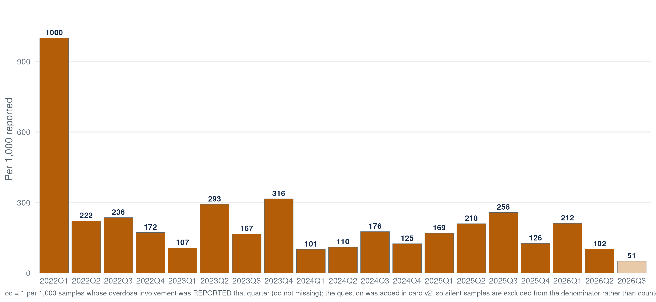
What the Card Tells Us
Overdose Involvement
od = 1 (reported involved) per 1,000 unique samples completed that quarter · verbatim context in overdose_notes

Slide 22
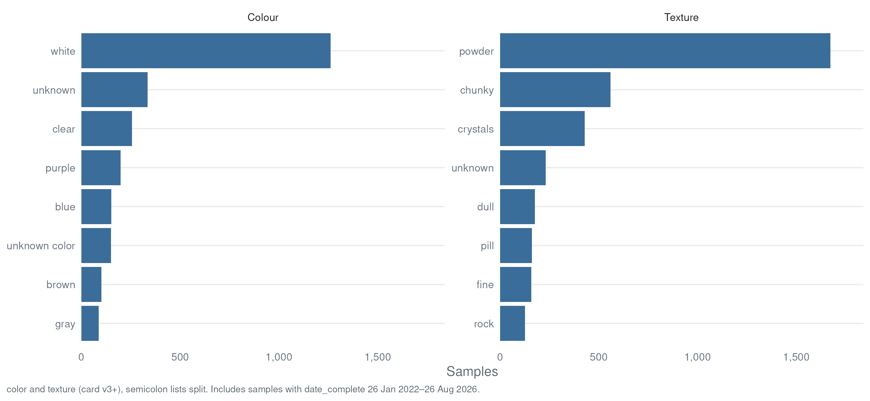
What the Card Tells Us
Color and Texture
color, texture (card v3+, semicolon lists split) · derived: bright_color excludes white/tan/brown family — orange bar above · includes samples with date_complete {{STAT:first_date}} – {{STAT:latest_date}}

Slide 23
What the Lab Detects

Slide 24
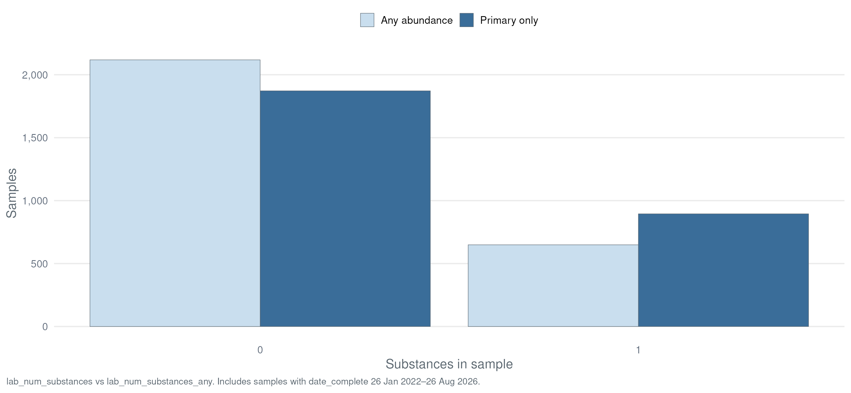
What the Lab Detects
Substances per Sample
Distribution of substances detected per sample, both definitions shown side by side · includes samples with date_complete {{STAT:first_date}} – {{STAT:latest_date}}

Slide 25
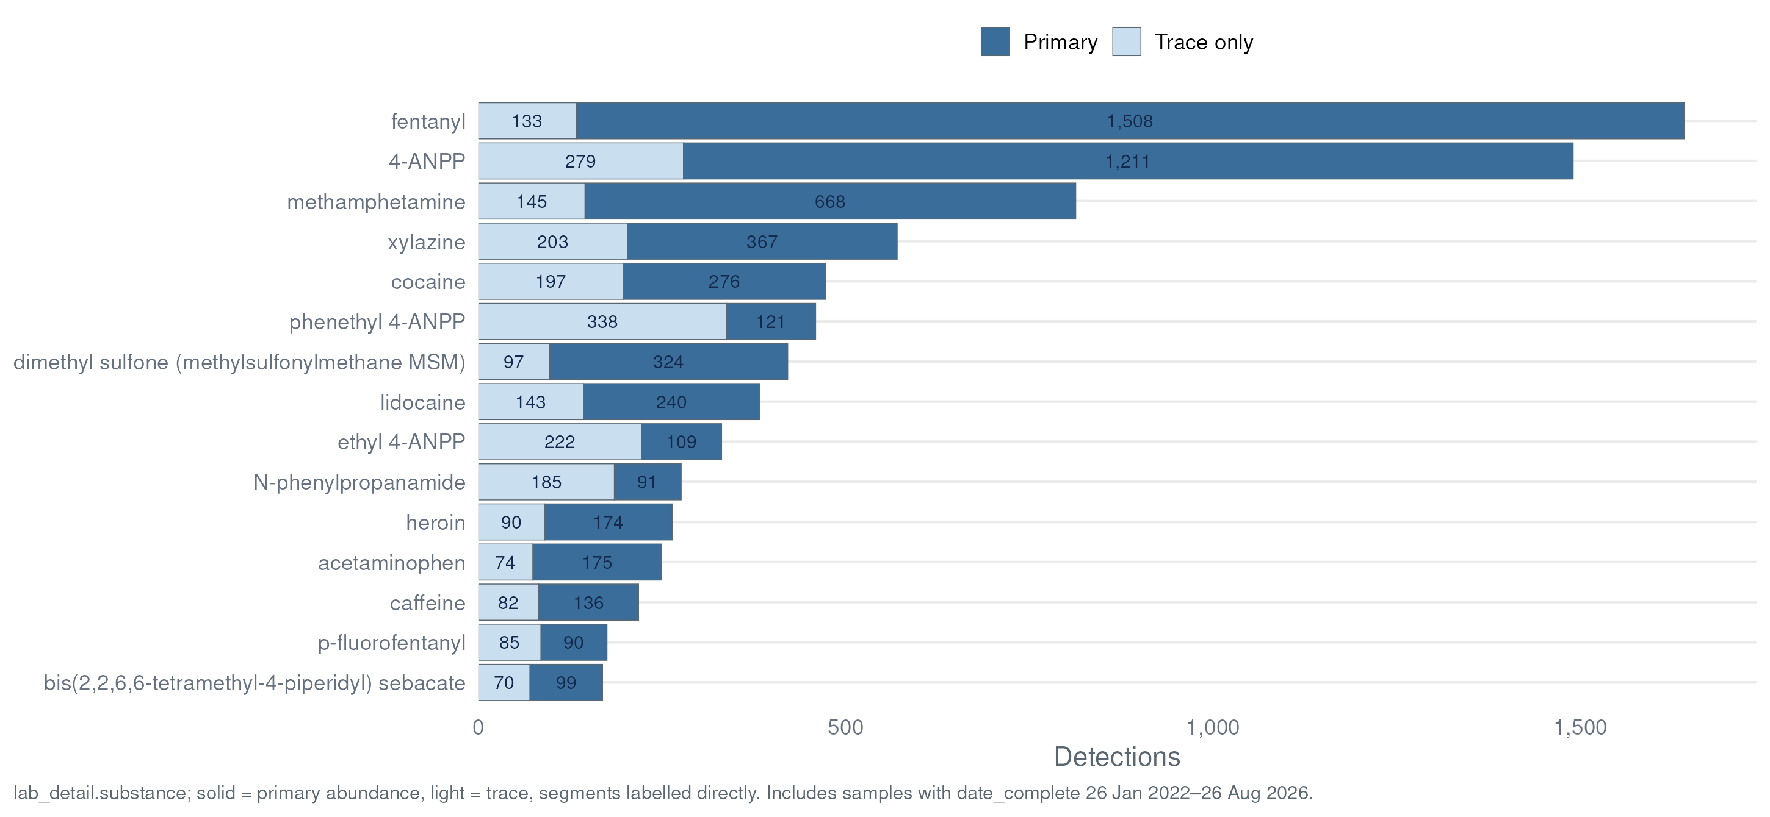
What the Lab Detects
Top Substances Detected
lab_detail.substance counts · solid = primary abundance, light = trace · standardized names (PubChem-linked) · includes samples with date_complete {{STAT:first_date}} – {{STAT:latest_date}}

Slide 26
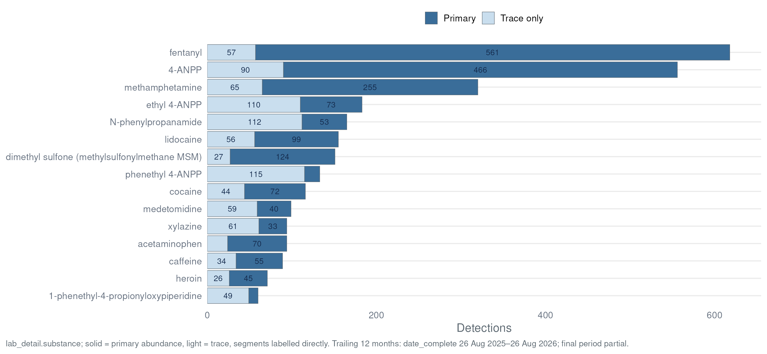
What the Lab Detects
Top Substances — Past 12 Months
lab_detail.substance counts · solid = primary abundance, light = trace · standardized names (PubChem-linked) · window: date_complete {{STAT:run_date_prior_year}} – {{STAT:latest_date}}* (trailing 12 months, current month partial)

Slide 27
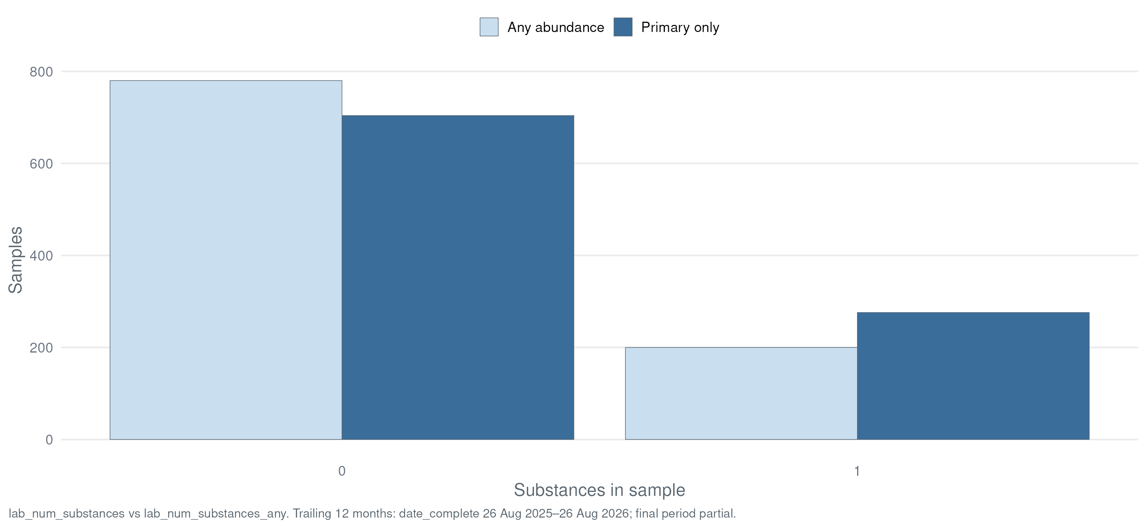
What the Lab Detects
Substances per Sample — Past 12 Months
Distribution of substances detected per sample, both definitions shown side by side · window: date_complete {{STAT:run_date_prior_year}} – {{STAT:latest_date}}* (trailing 12 months, current month partial)

Slide 28
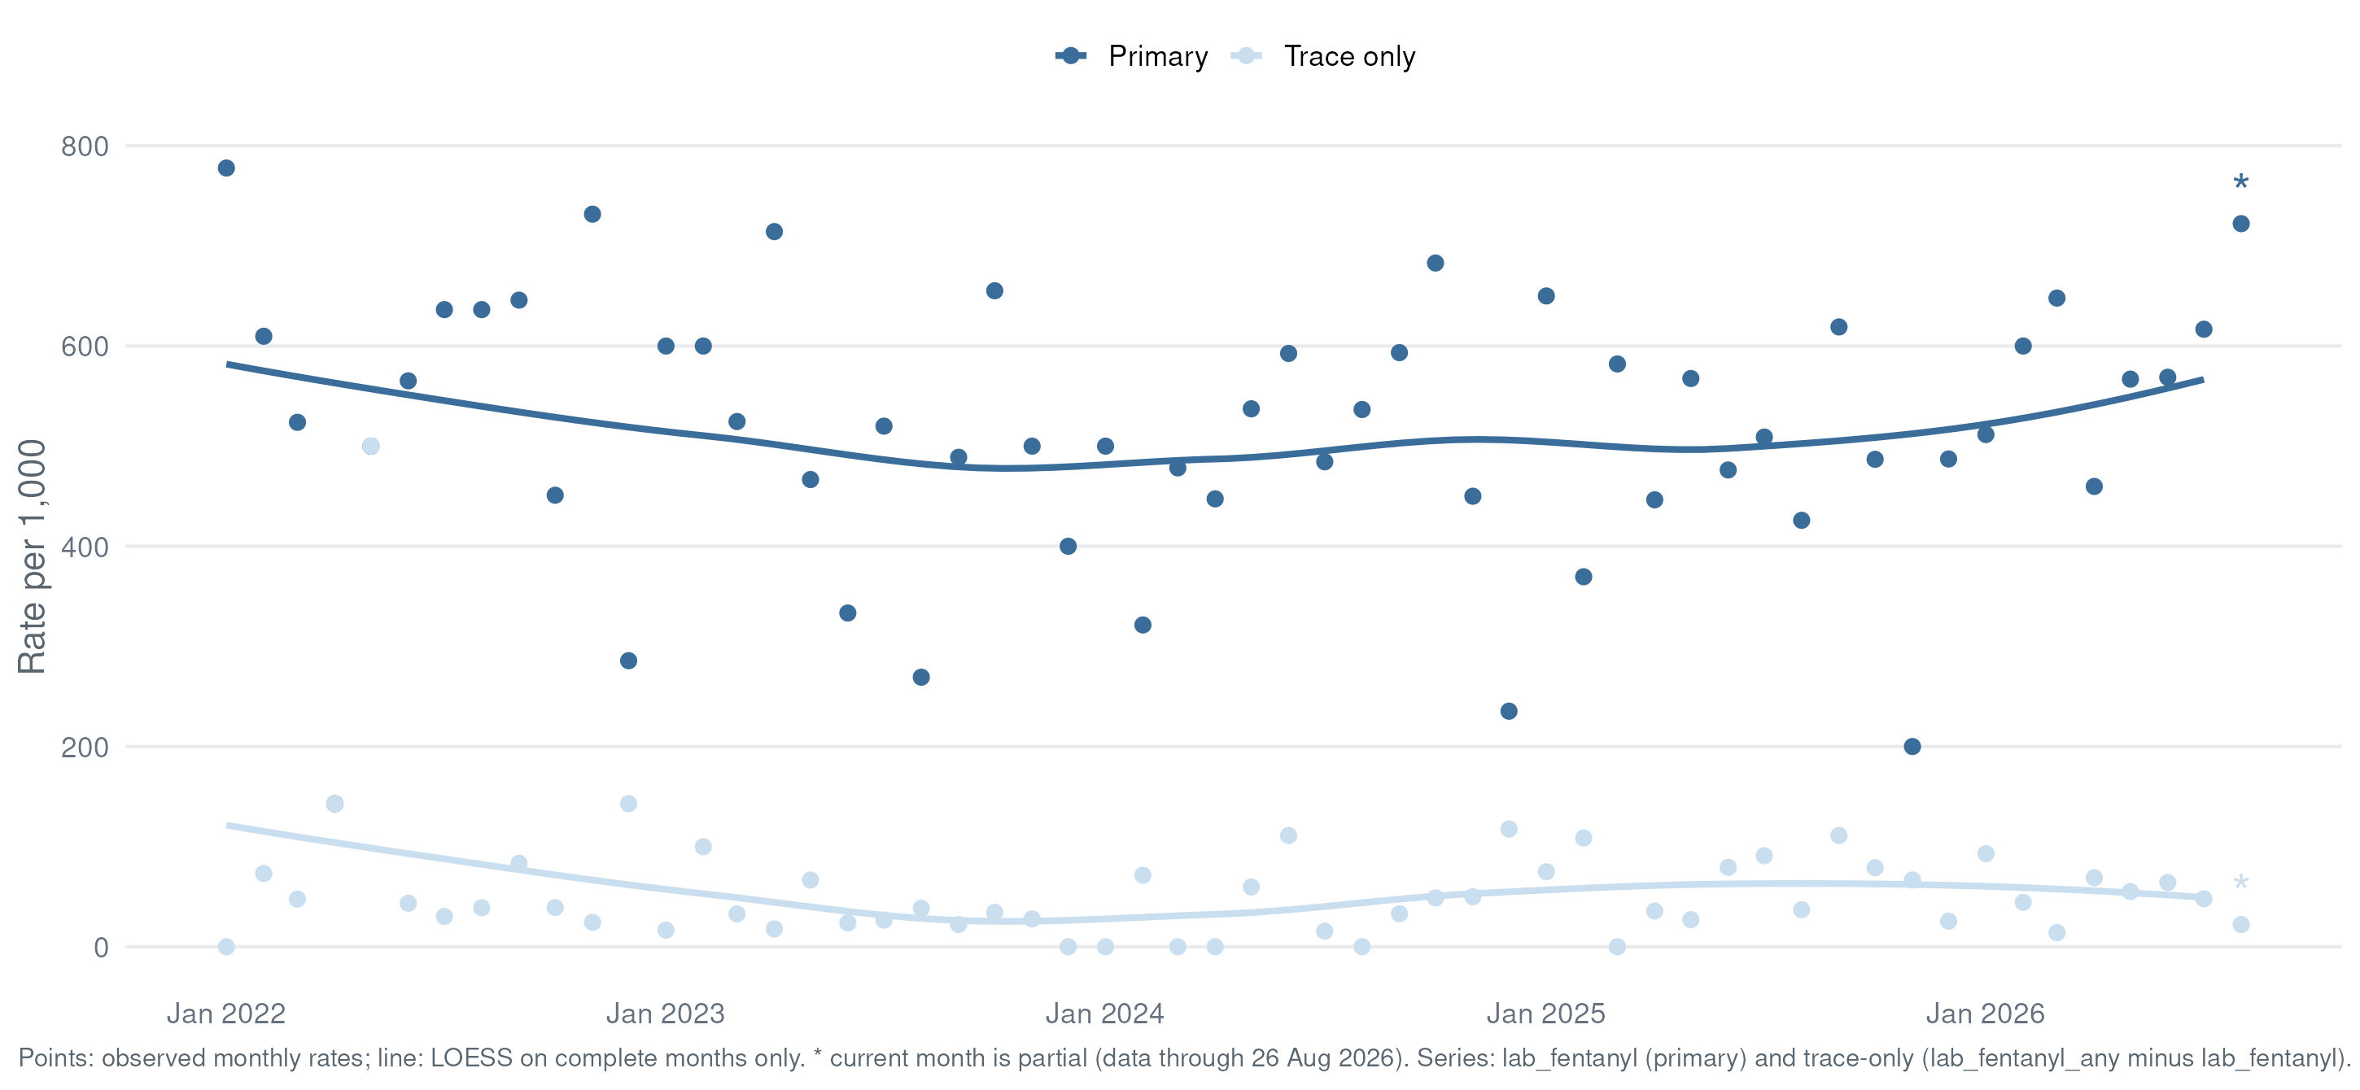
What the Lab Detects
Fentanyl
Series: lab_fentanyl (primary) + trace-only (lab_fentanyl_any − lab_fentanyl) · exact match, analogues excluded · per 1,000/month · LOESS on complete months · * = partial month

Slide 29
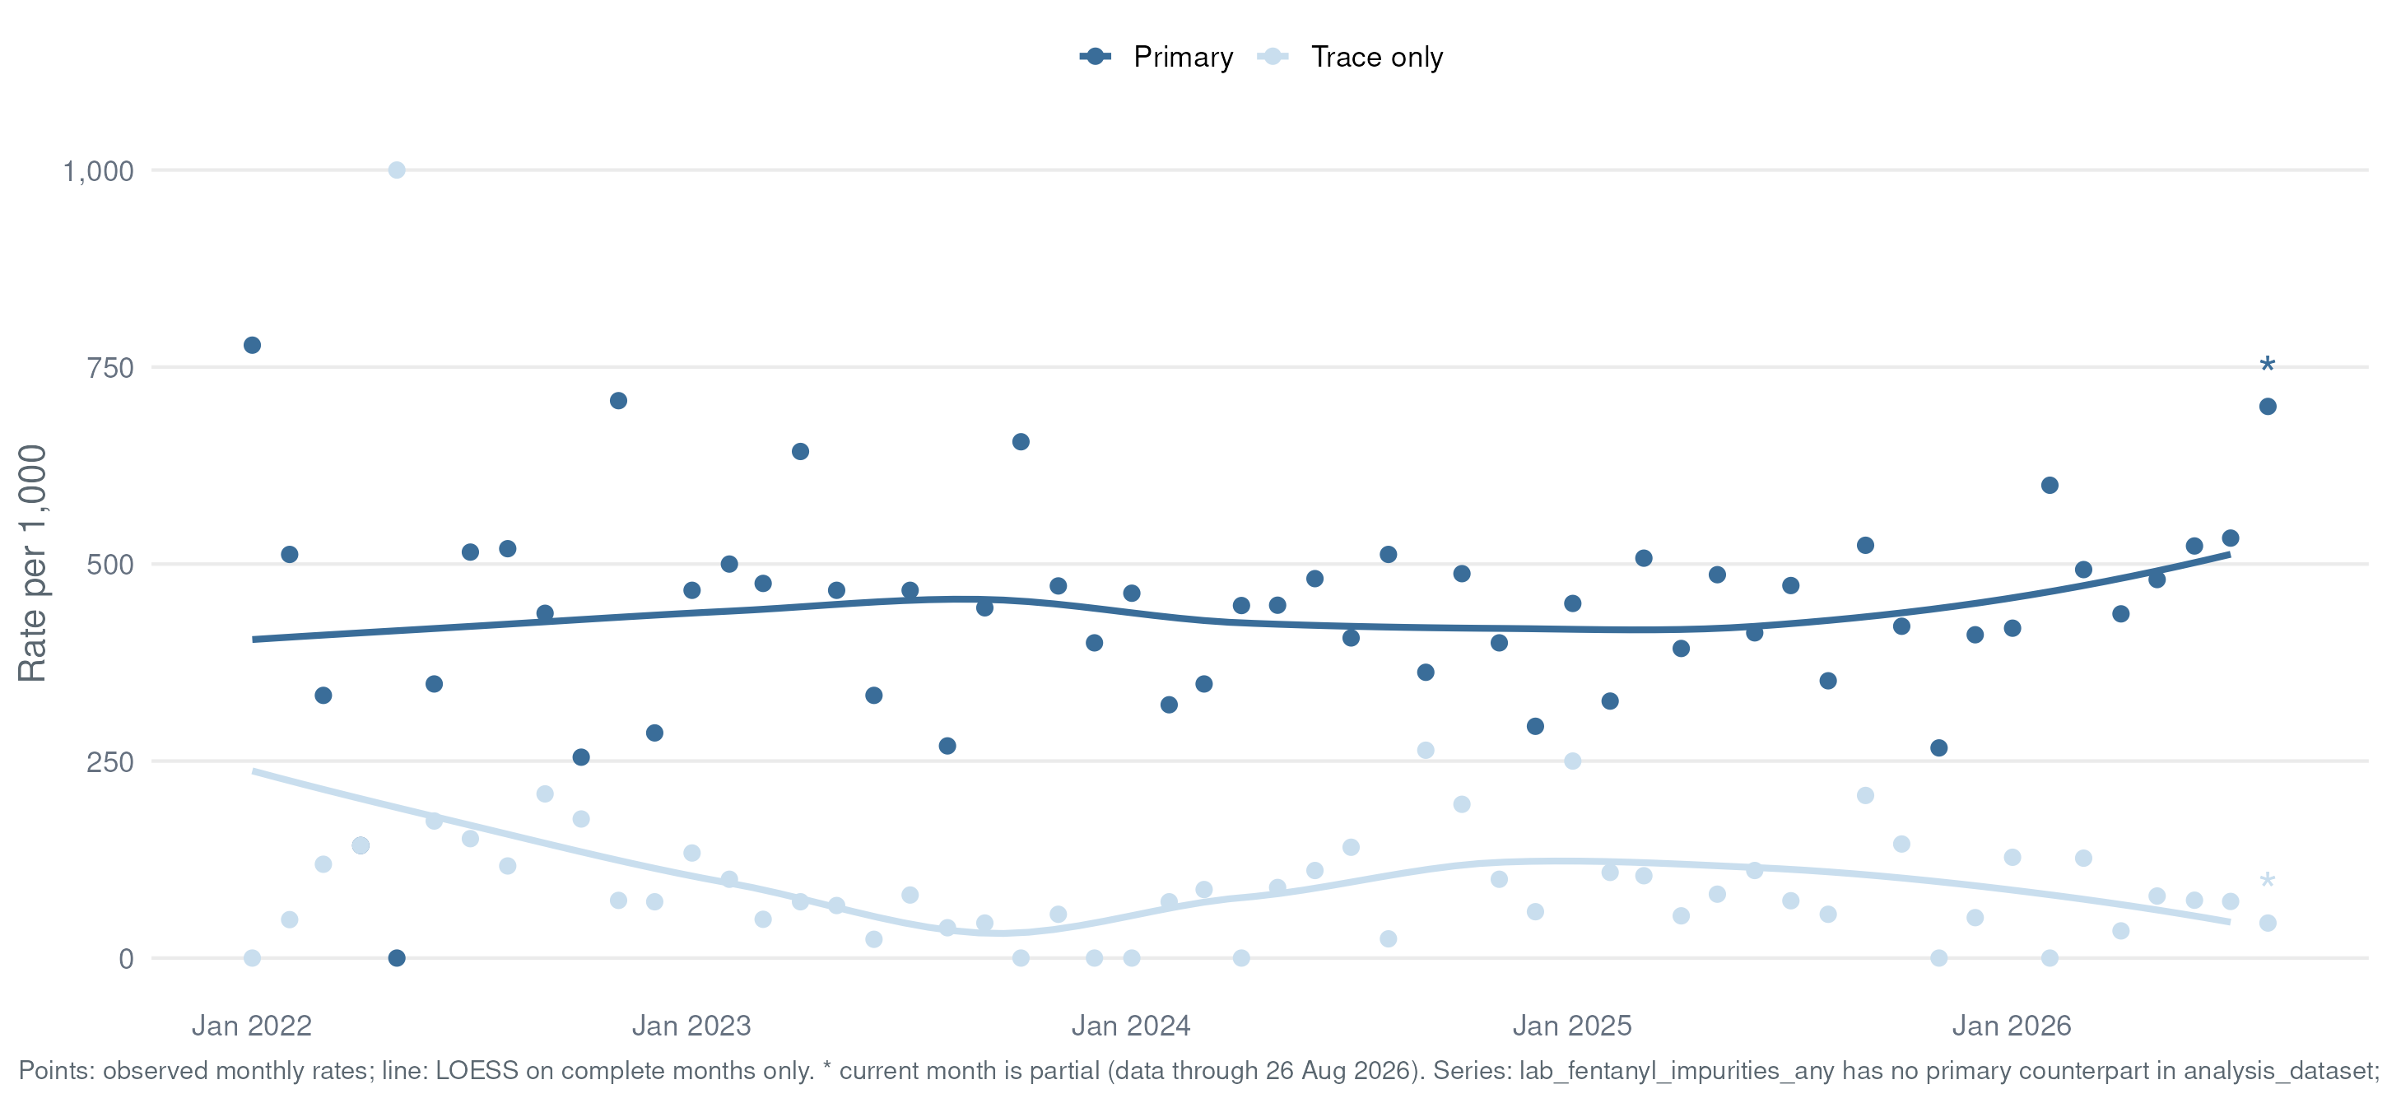
What the Lab Detects
Fentanyl Synthesis Impurities
Flags from lab_detail regex '4-ANPP|phenethyl' (see lab_fentanyl_impurity) · per 1,000/month · LOESS on complete months · * = partial month

Slide 30
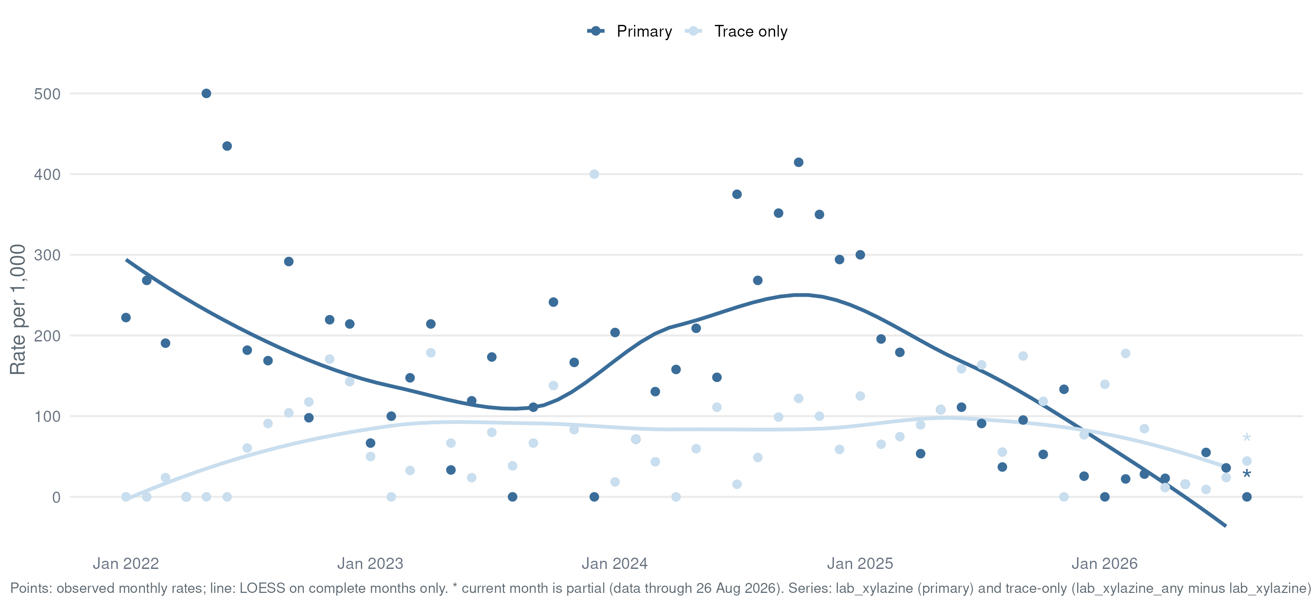
What the Lab Detects
Xylazine
Series: lab_xylazine (primary) + trace-only (lab_xylazine_any − lab_xylazine) · per 1,000/month · LOESS on complete months · * = partial month

Slide 31
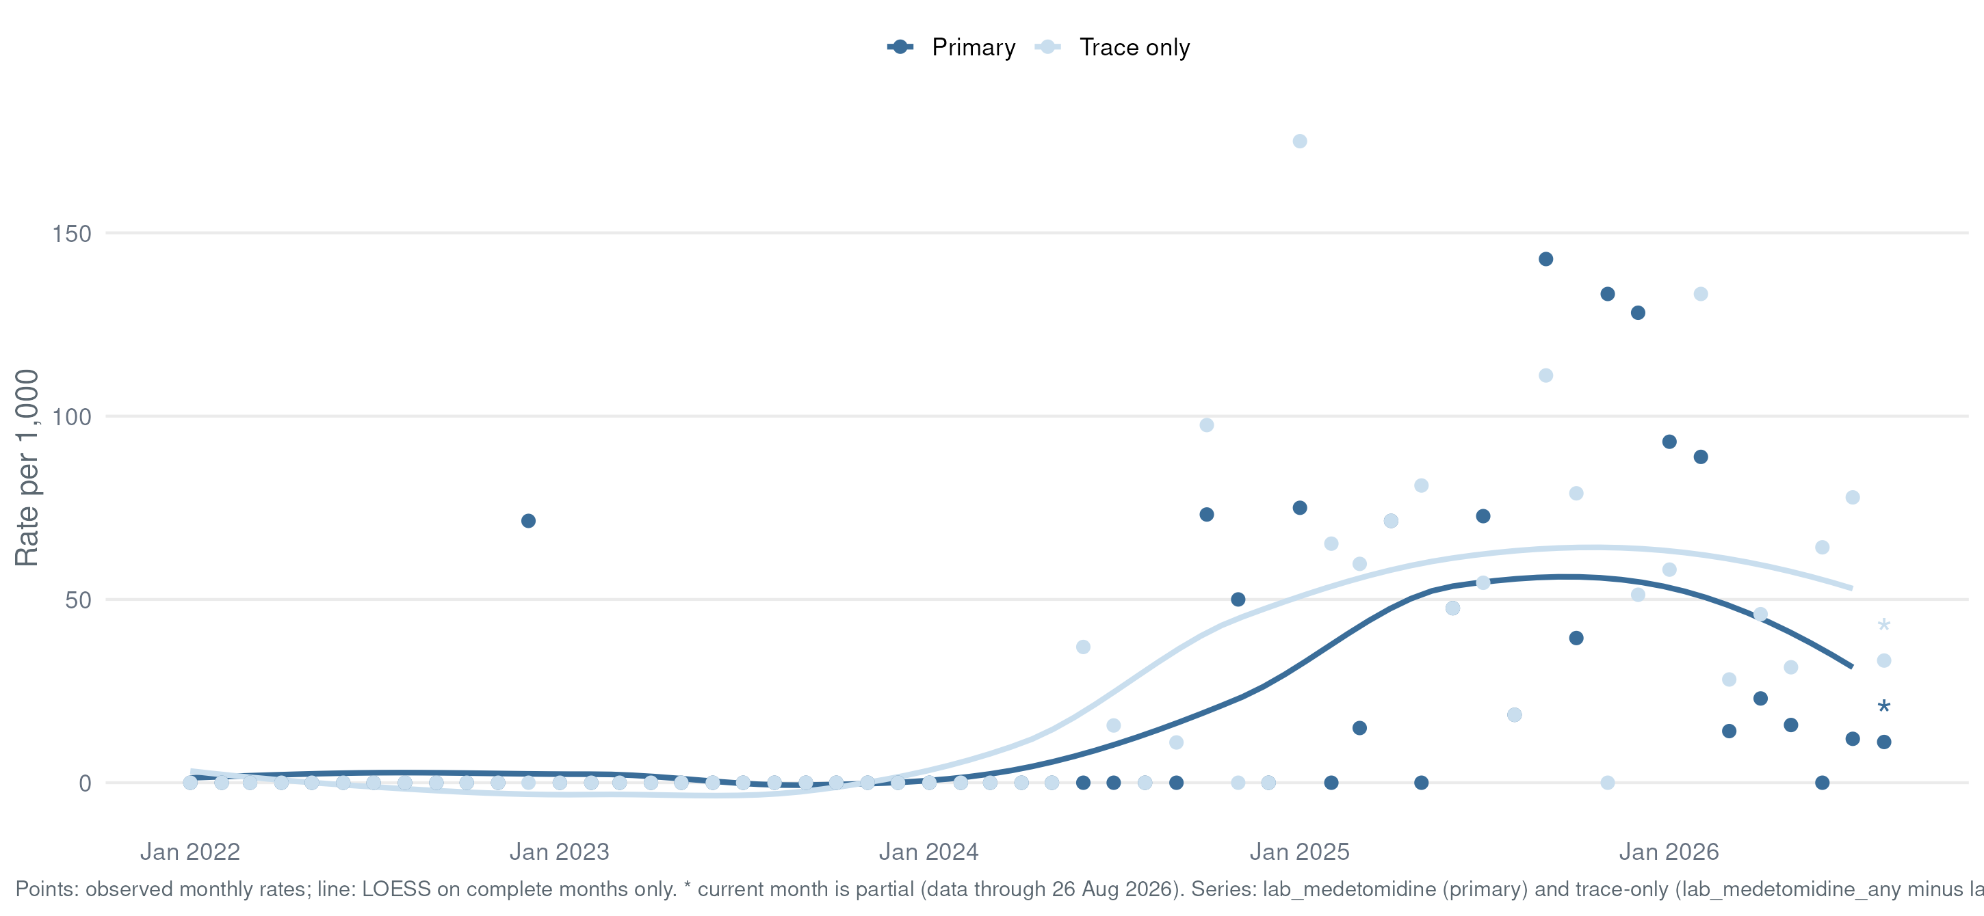
What the Lab Detects
Medetomidine
Flags from lab_detail regex 'medetomidine' with abundance split · per 1,000/month · LOESS on complete months · * = partial month

Slide 32
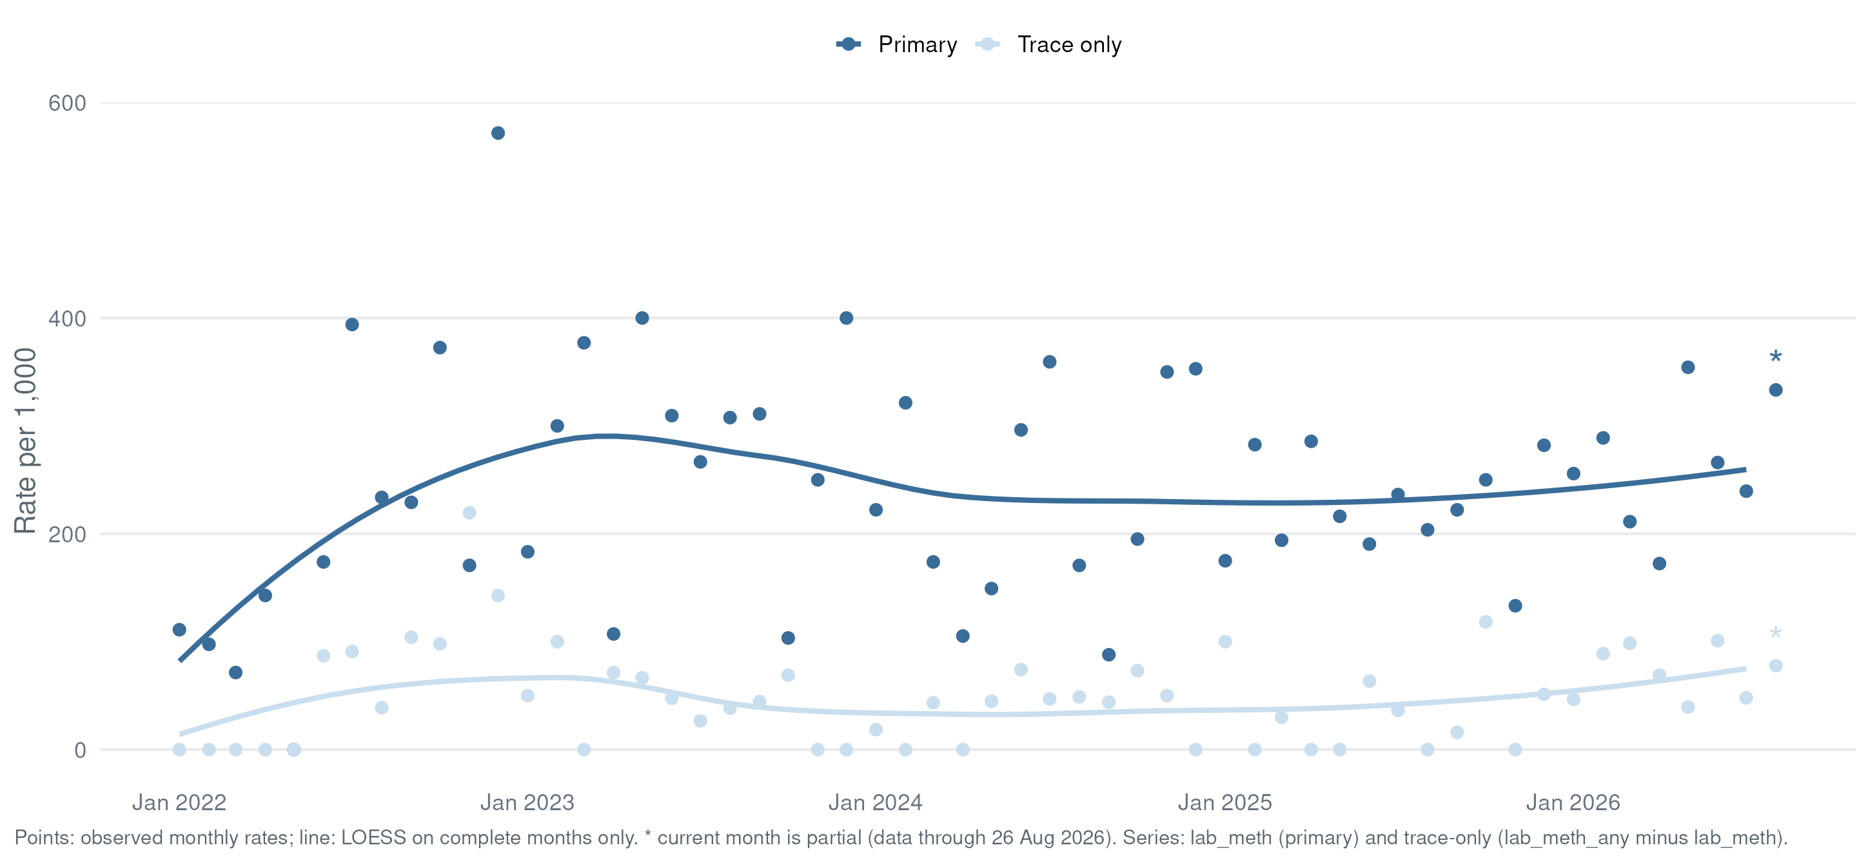
What the Lab Detects
Methamphetamine
Series: lab_meth (primary) + trace-only (lab_meth_any − lab_meth) · per 1,000/month · LOESS on complete months · * = partial month

Slide 33
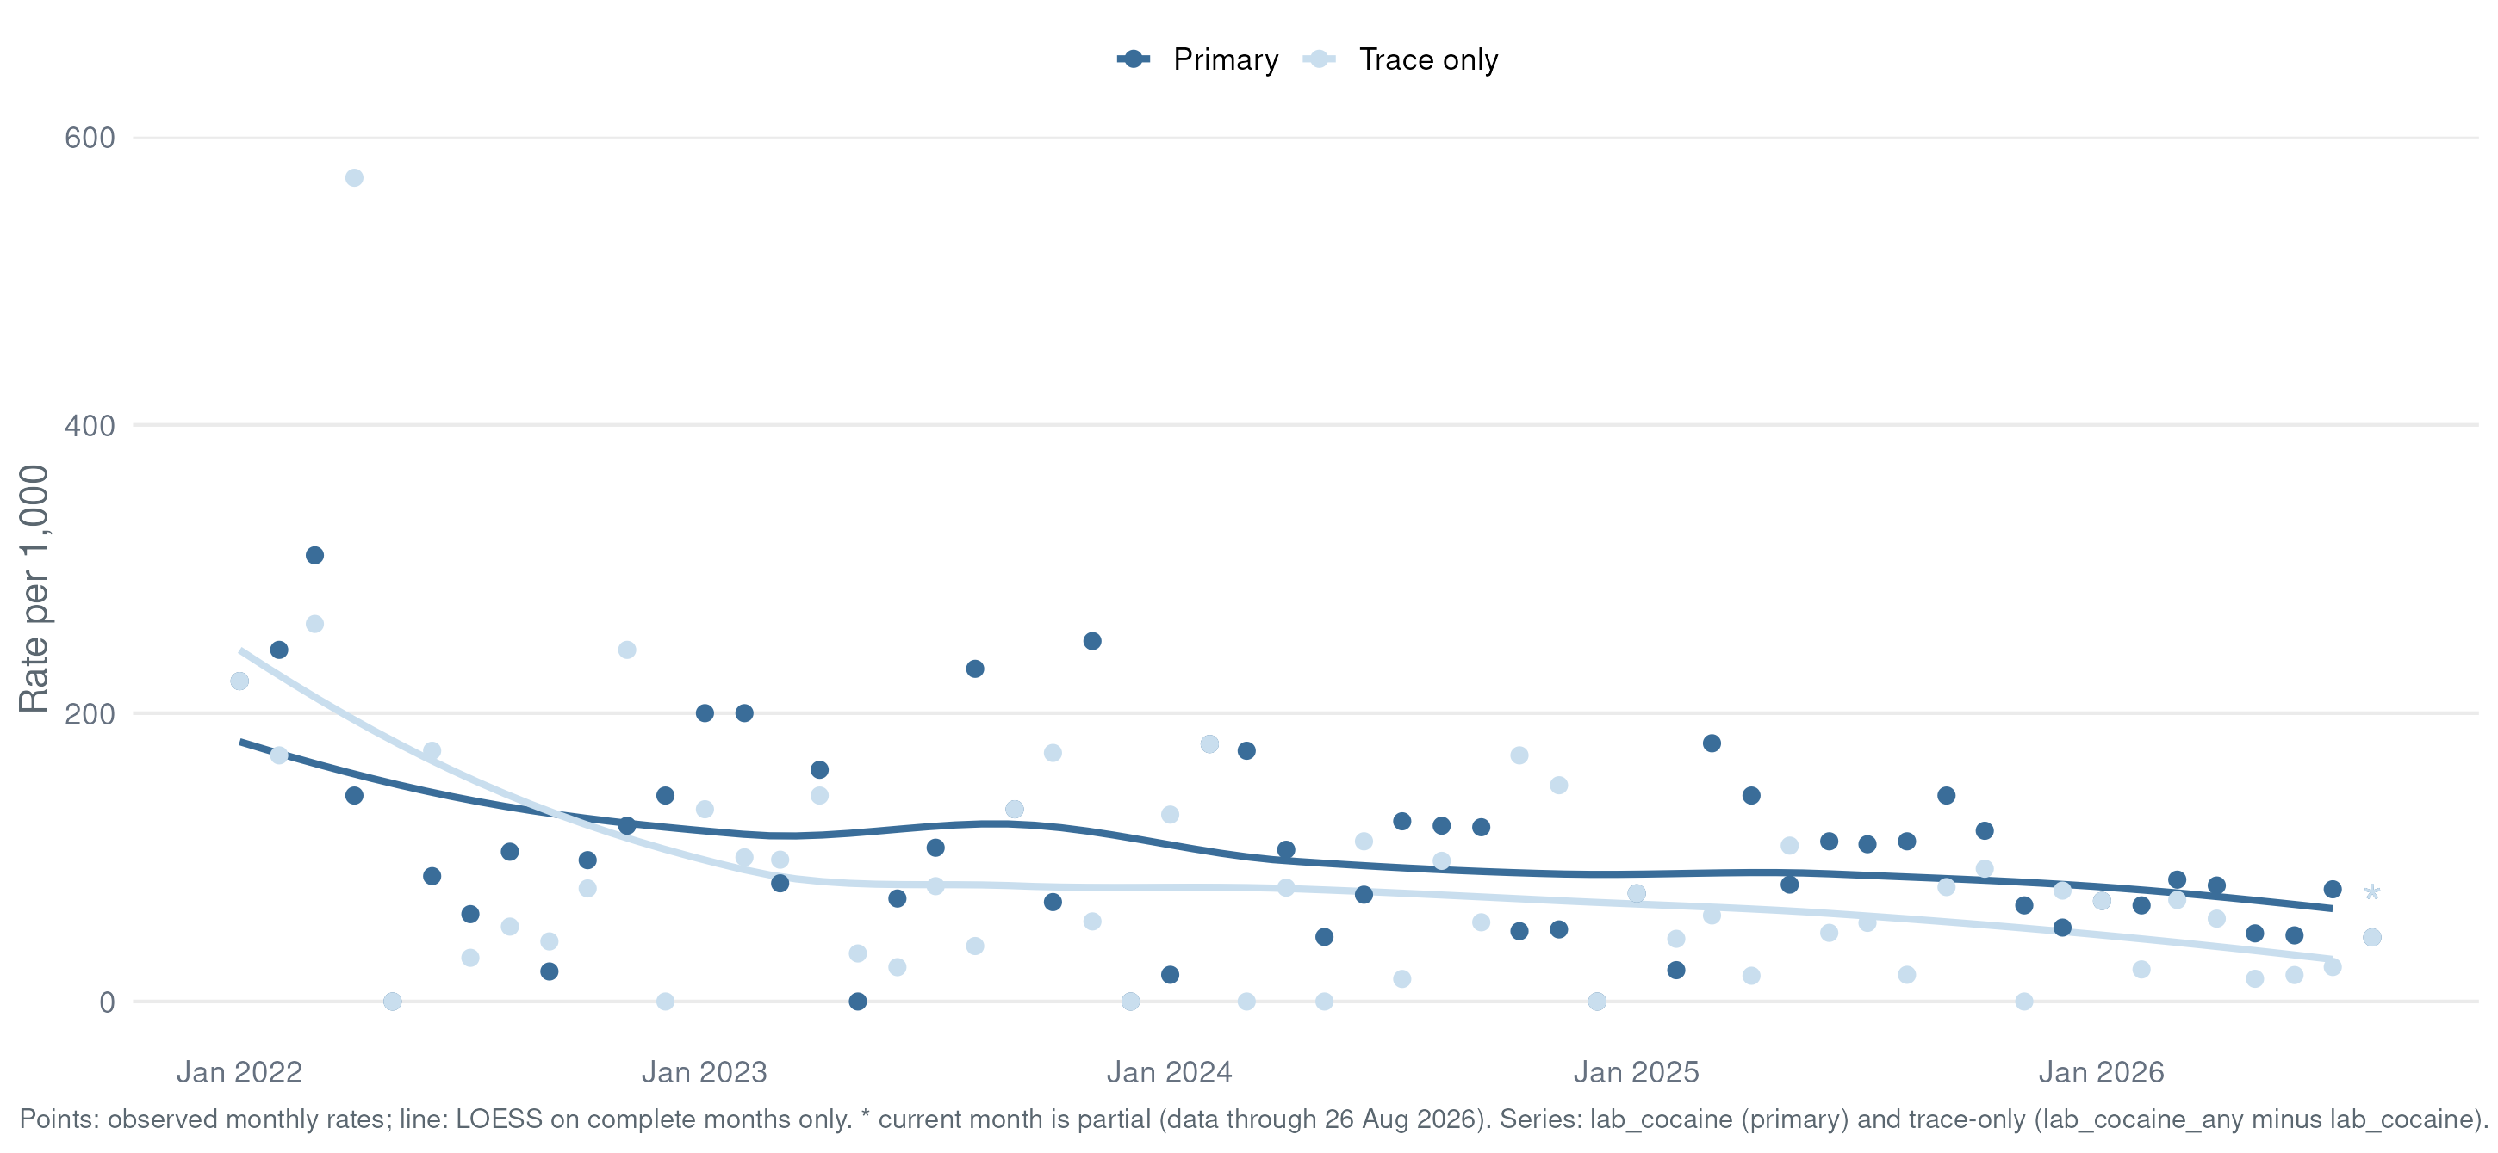
What the Lab Detects
Cocaine
Series: lab_cocaine (primary) + trace-only (lab_cocaine_any − lab_cocaine) · per 1,000/month · LOESS on complete months · * = partial month

Slide 34
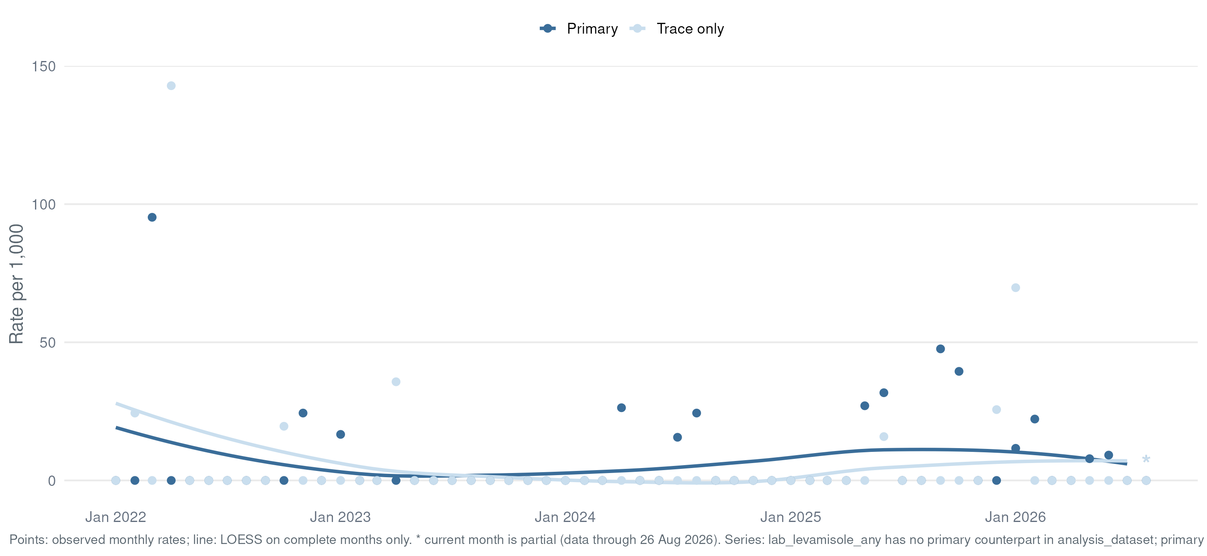
What the Lab Detects
Levamisole
lab_levamisole_any is the only derived flag — primary/trace split rebuilt from lab_detail abundance · per 1,000/month · LOESS on complete months · * = partial month

Slide 35
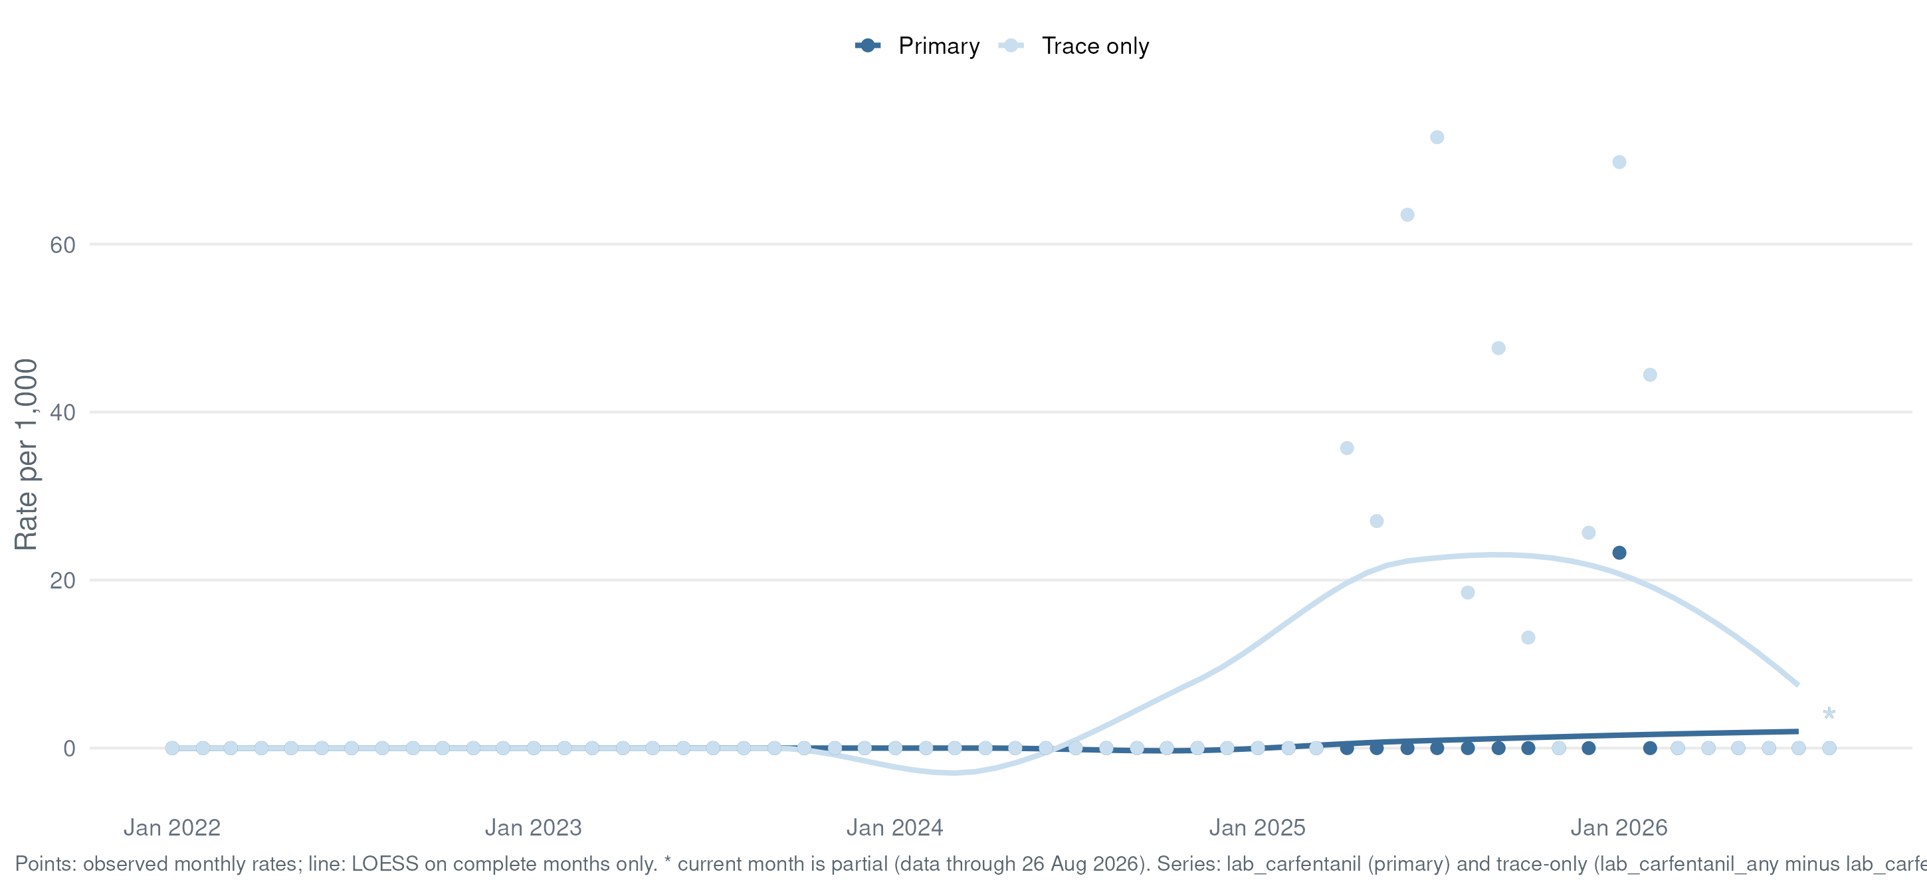
What the Lab Detects
Carfentanil
Series: lab_carfentanil (primary) + trace-only (lab_carfentanil_any − lab_carfentanil) · per 1,000/month · LOESS on complete months · * = partial month

Slide 36
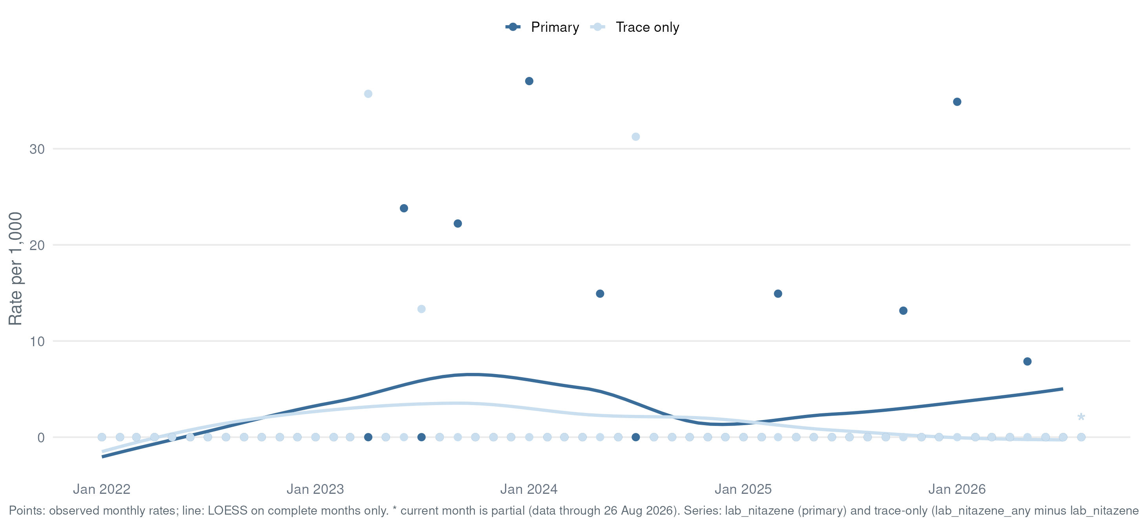
What the Lab Detects
Nitazenes
Flags from lab_detail regex 'nitazene|etonitazene|metonitazene|protonitazene|isotonitazene' · per 1,000/month · LOESS on complete months · * = partial month

Slide 37
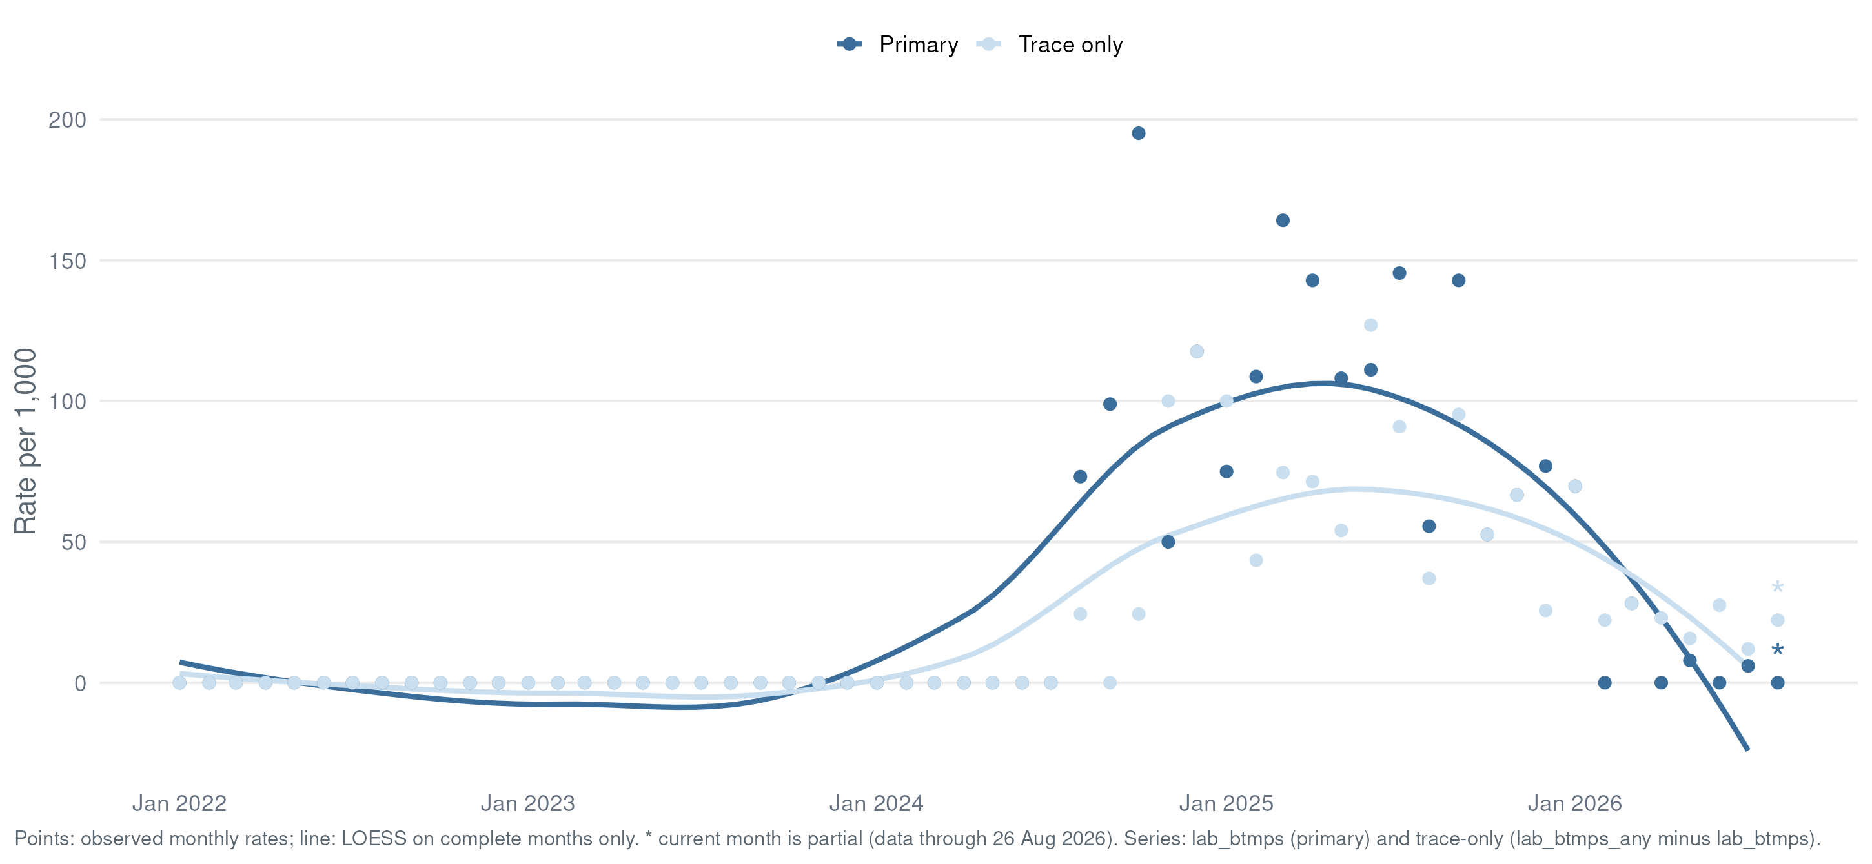
What the Lab Detects
BTMPS
Flags from lab_detail regex 'BTMPS|bis(2,2,6,6…' · per 1,000/month · LOESS on complete months · * = partial month

Slide 38
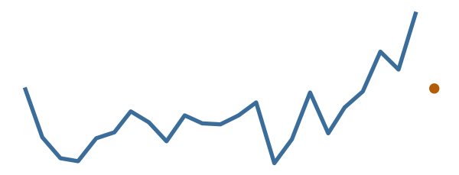
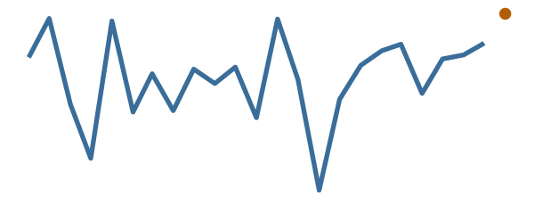
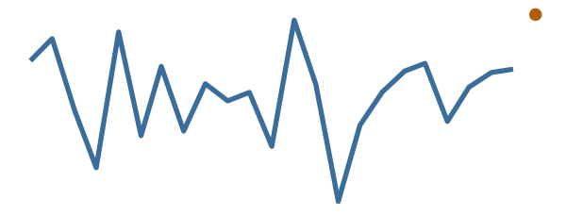
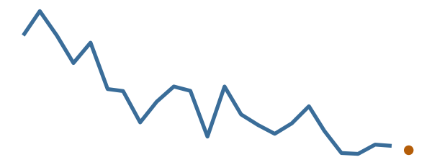
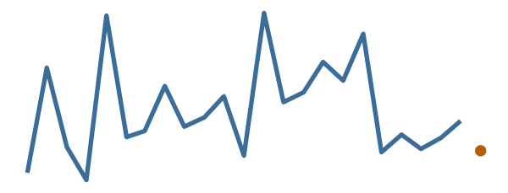
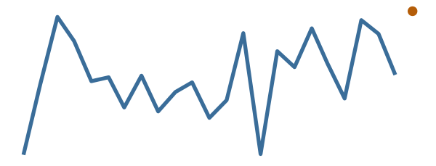
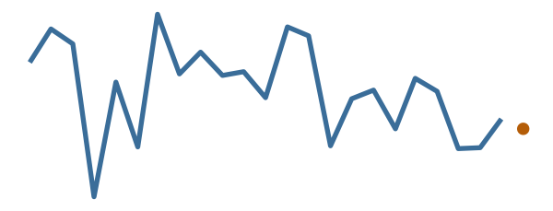
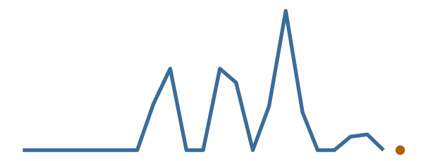
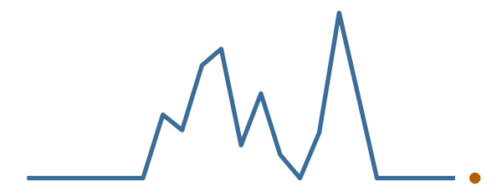
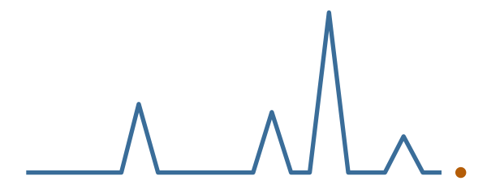
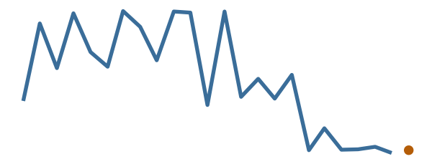
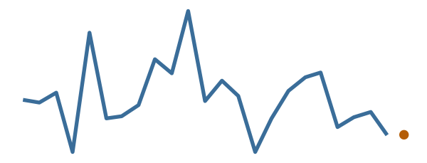
Two-Year Trends
Key Metrics, Last 24 Months
SAMPLES COMPLETED
FENTANYL (ANY)
FENTANYL IMPURITIES (ANY)
XYLAZINE (ANY)
167 / month
665 per 1,000
605 per 1,000
60 per 1,000
MEDETOMIDINE (ANY)
METHAMPHETAMINE (ANY)
COCAINE (ANY)
LEVAMISOLE (ANY)
90 per 1,000
287 per 1,000
102 per 1,000
0 per 1,000
CARFENTANIL (ANY)
NITAZENES (ANY)
BTMPS (ANY)
OVERDOSE-INVOLVED
0 per 1,000
0 per 1,000
18 per 1,000
50 per 1,000
Monthly values, trailing 24 months from run date · line = LOESS on complete months · Δ = last complete month vs prior · green = favorable direction · orange point* = partial month · data table: Appendix A4

Slide 39
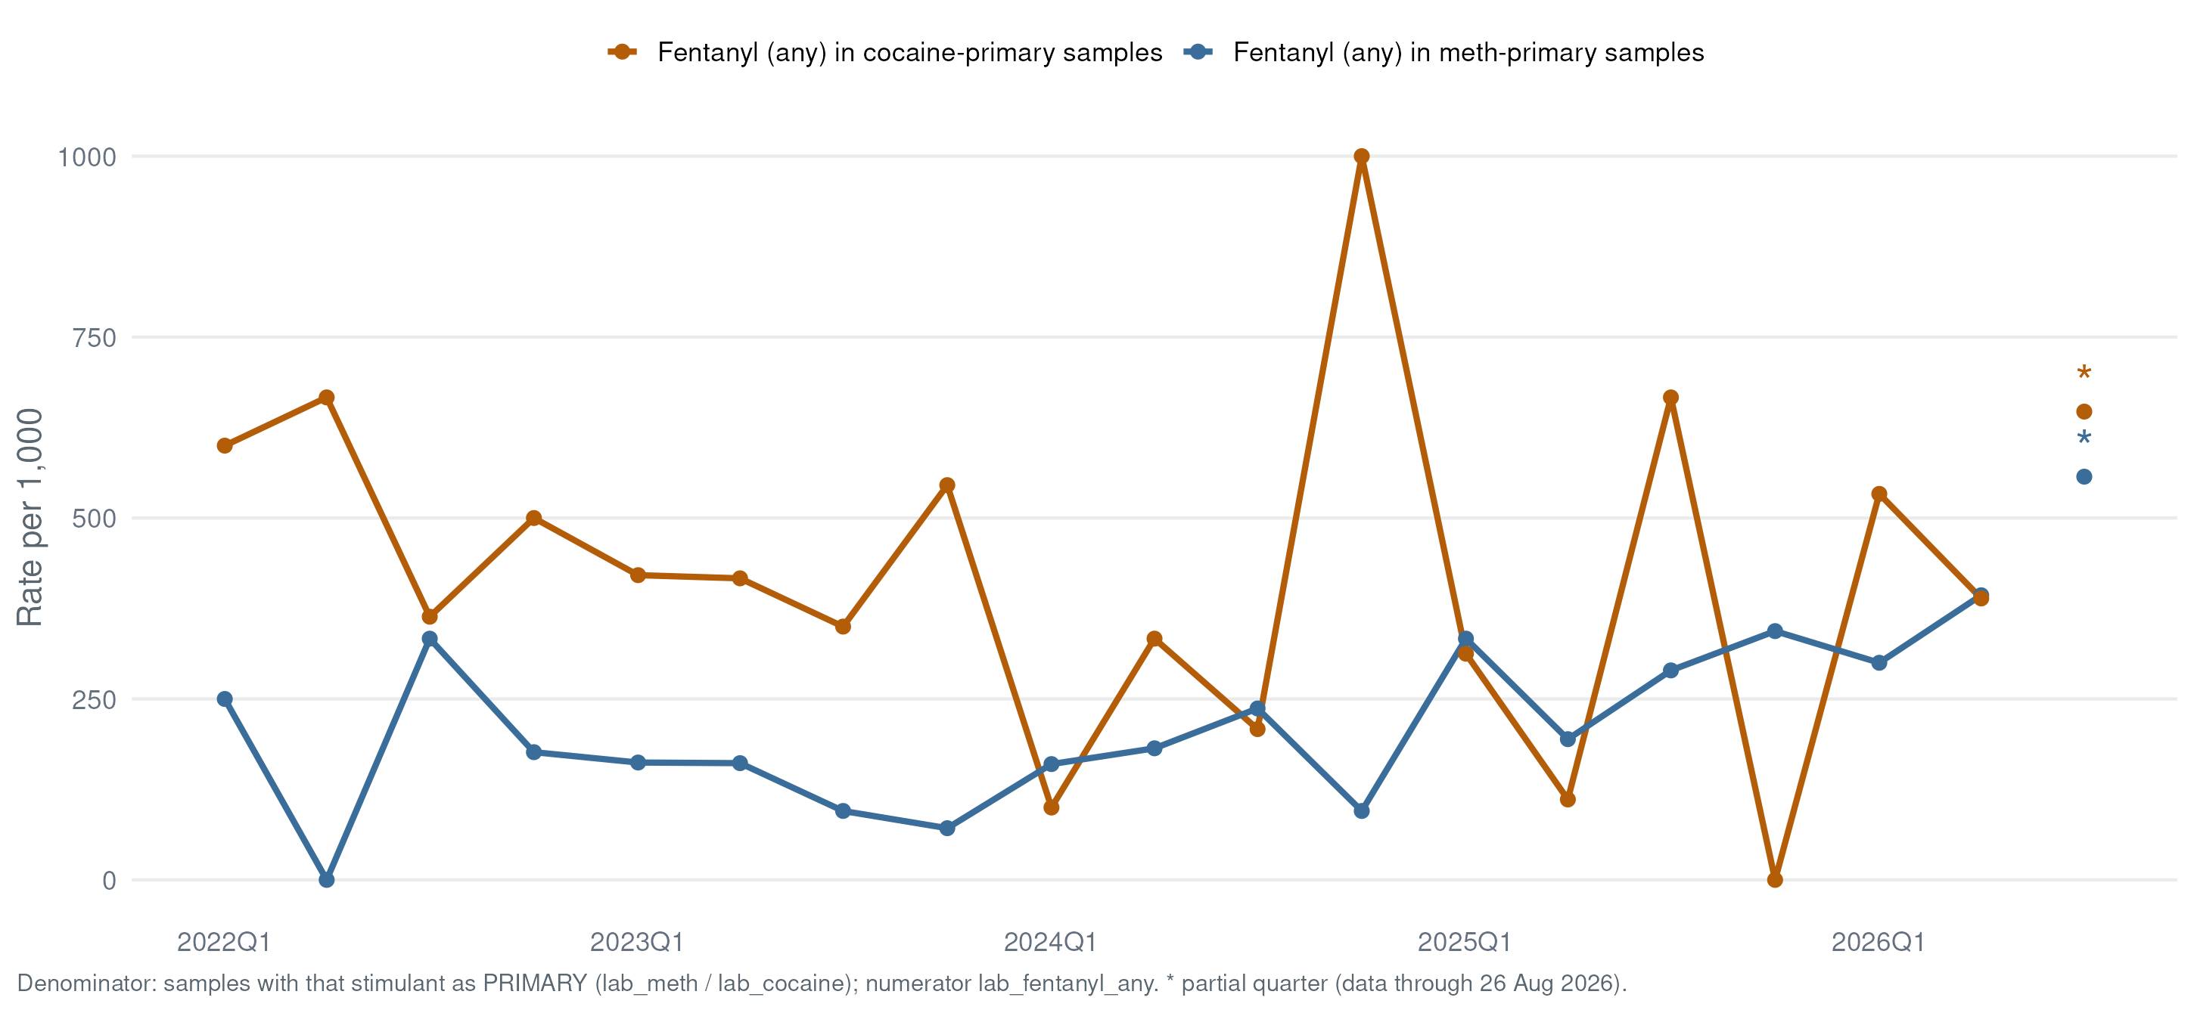
What the Lab Detects
Opioid–Stimulant Overlap
lab_fentanyl_any = 1 per 1,000 samples where lab_meth = 1 (or lab_cocaine = 1) that quarter

Slide 40
The State View

Slide 41
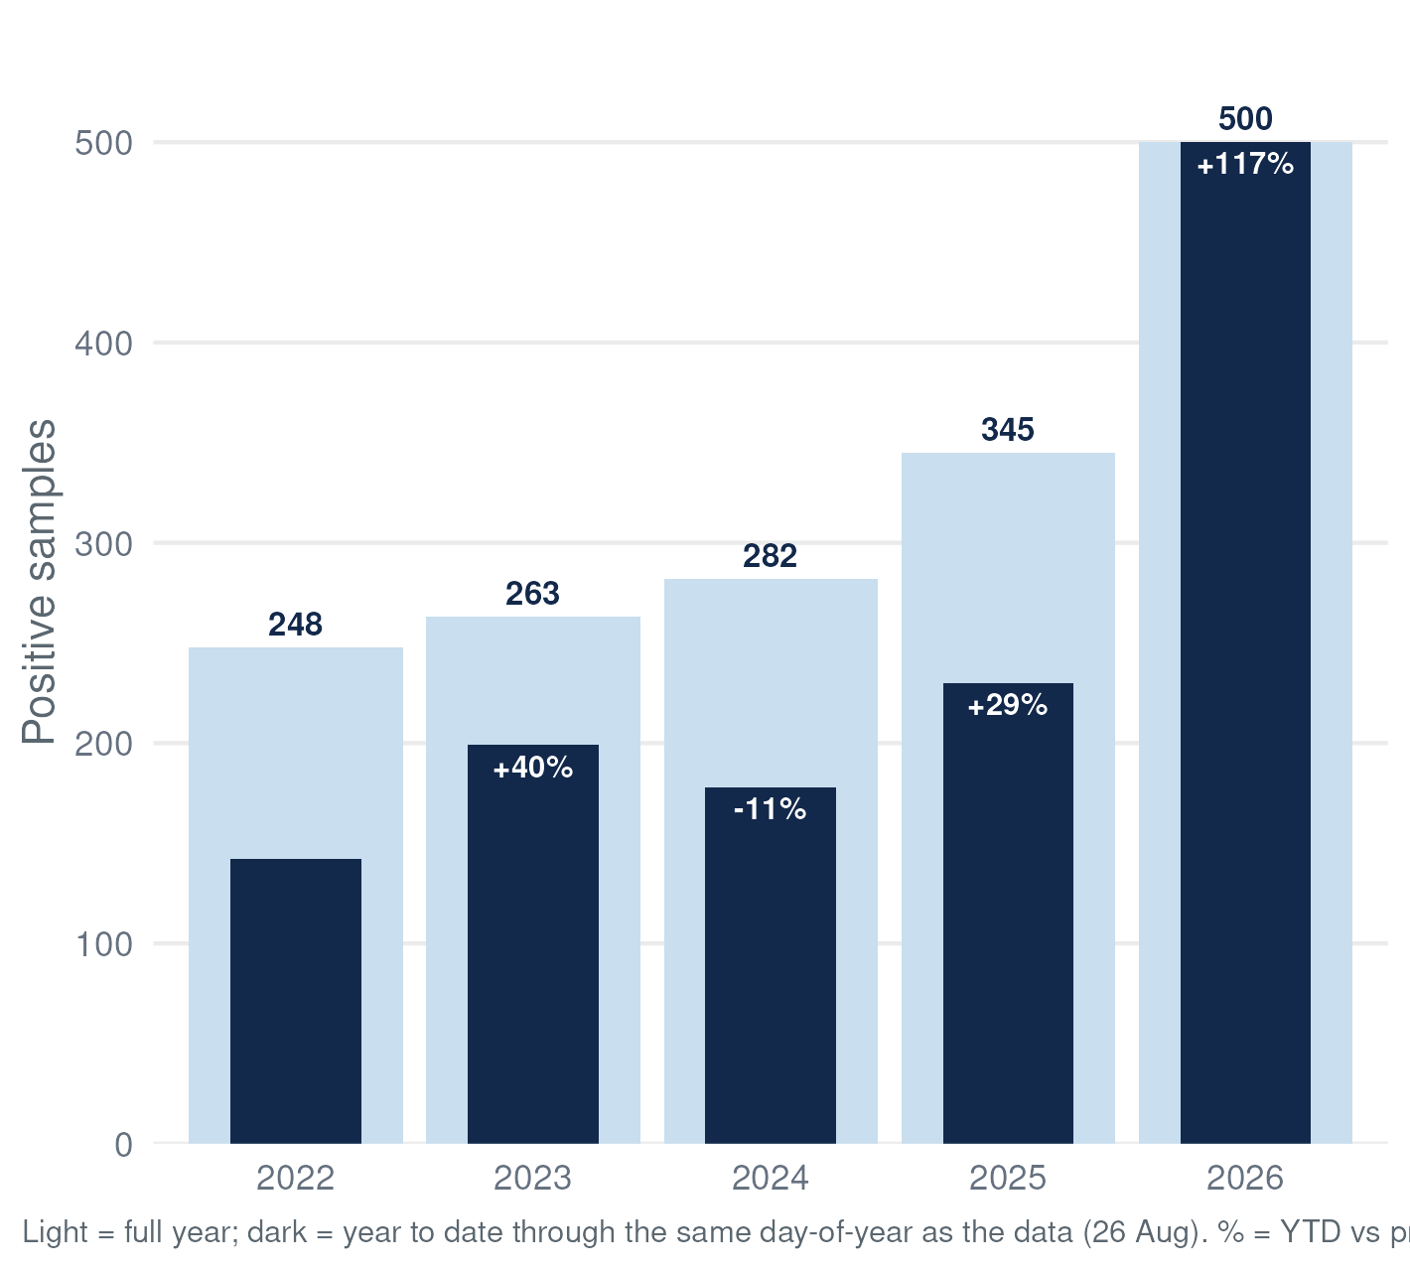
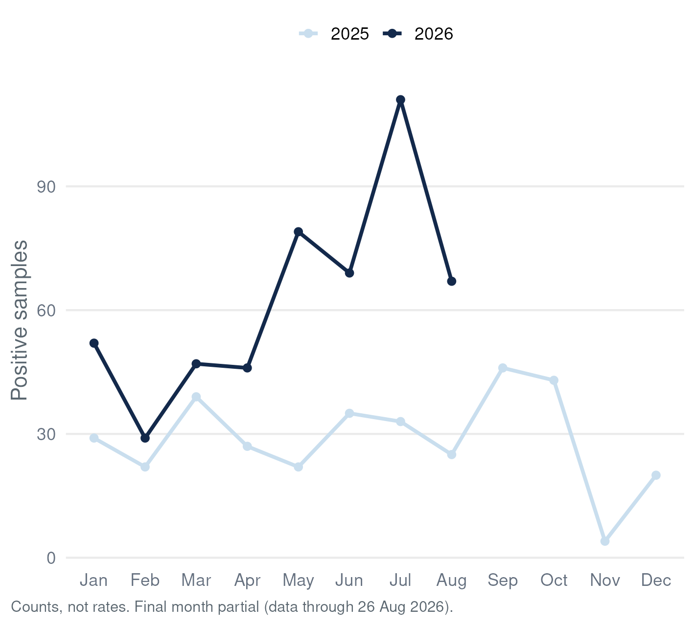
Fentanyl-Positive Samples, UNC Street Drug Analysis Lab (Drug Checking) Data: {{STAT:latest_month}}*

Slide 42
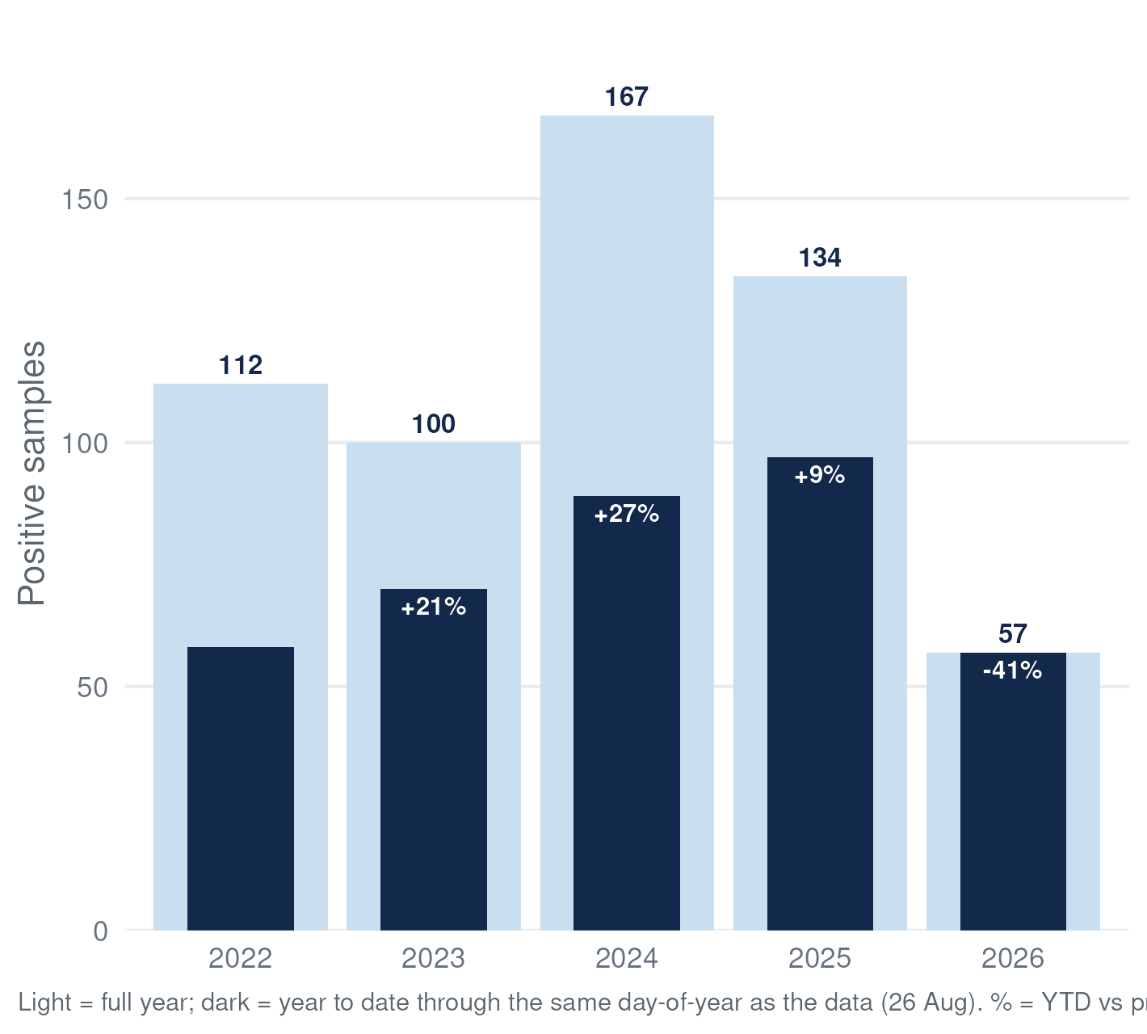
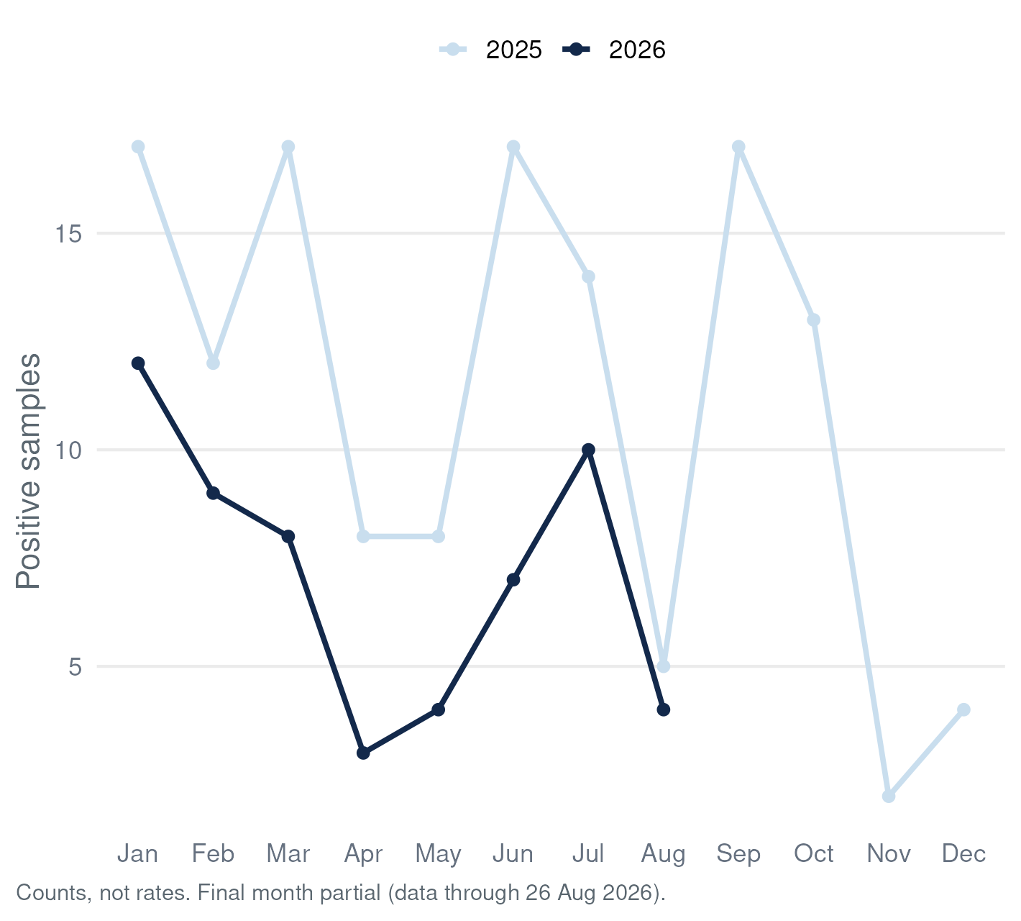
Xylazine-Positive Samples, UNC Street Drug Analysis Lab (Drug Checking) Data: {{STAT:latest_month}}*

Slide 43
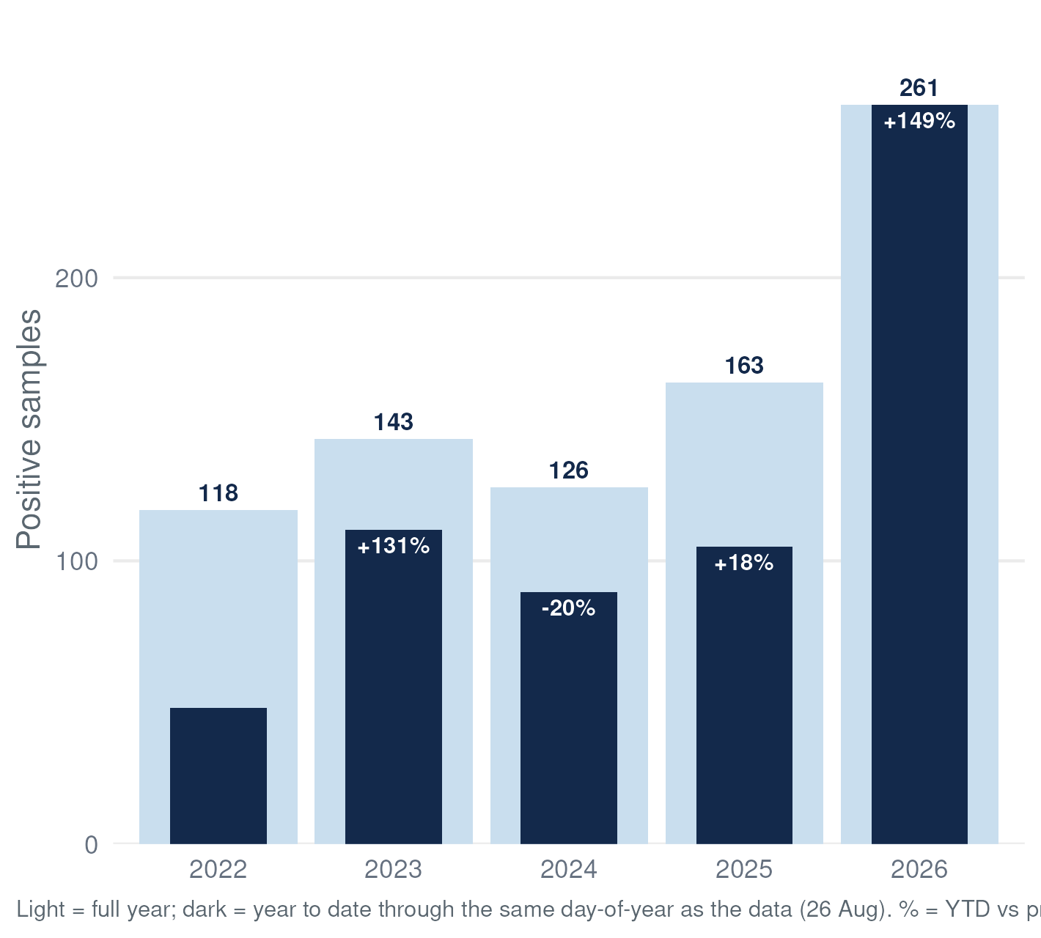
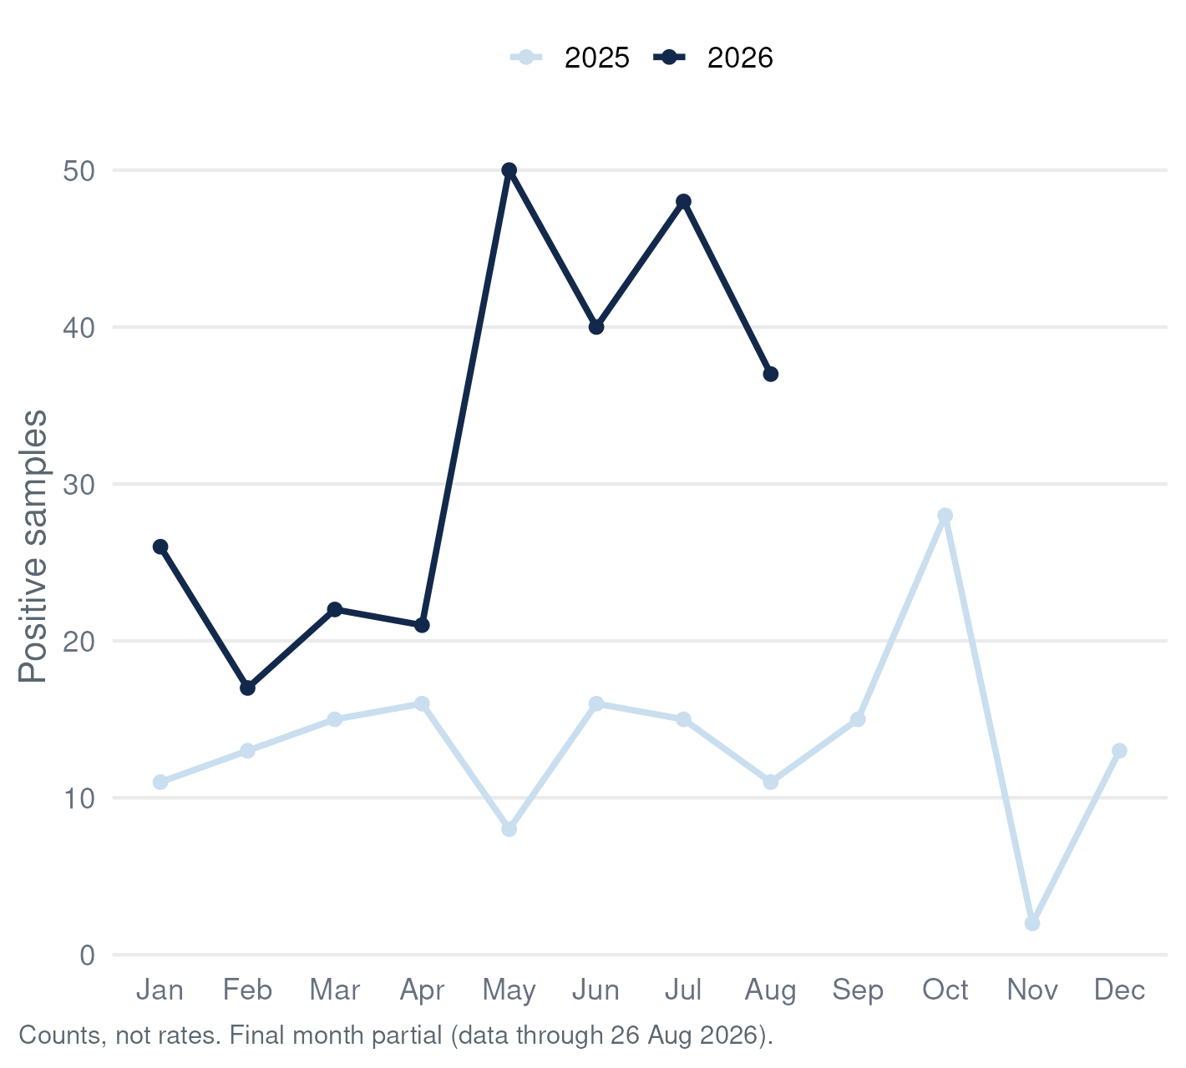
Methamphetamine-Positive Samples, UNC Street Drug Analysis Lab (Drug Checking) Data: {{STAT:latest_month}}*

Slide 44
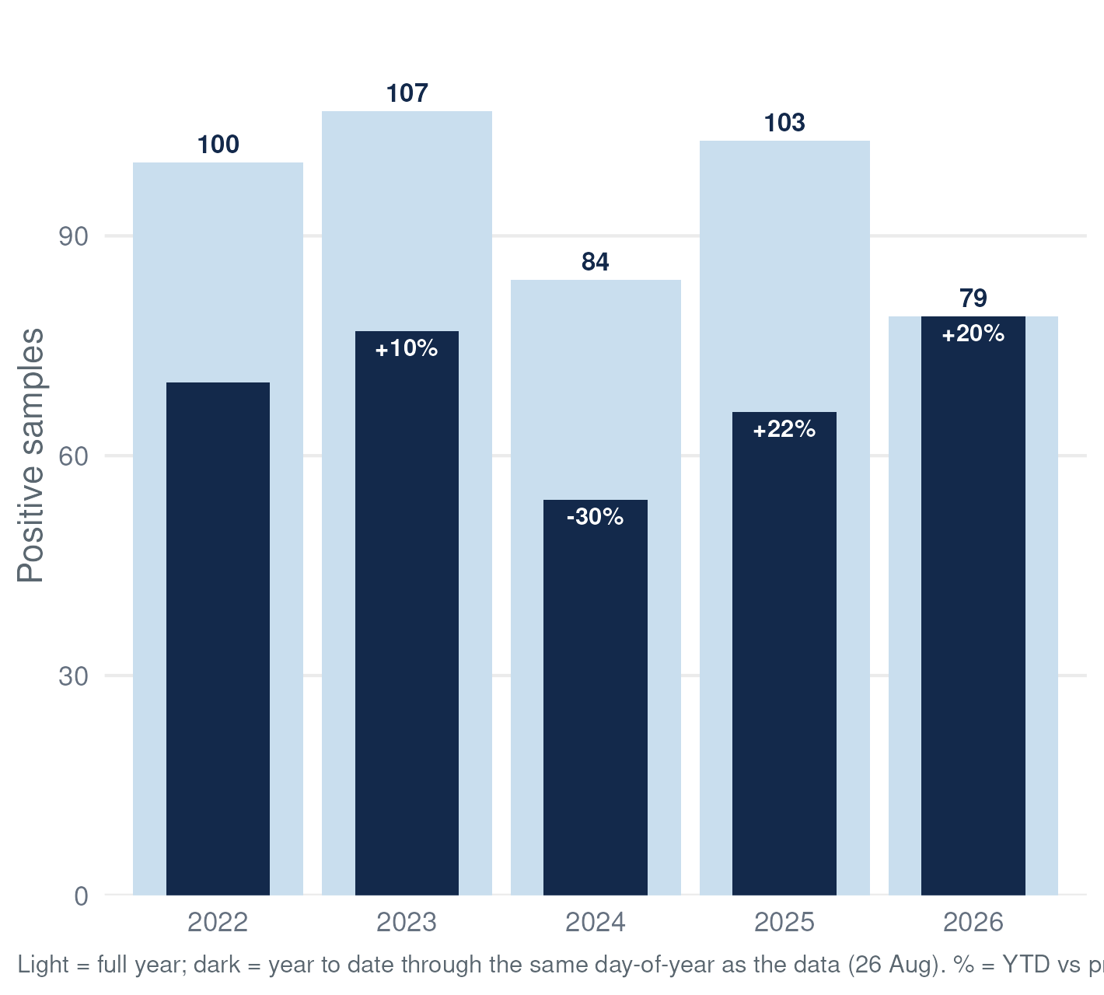
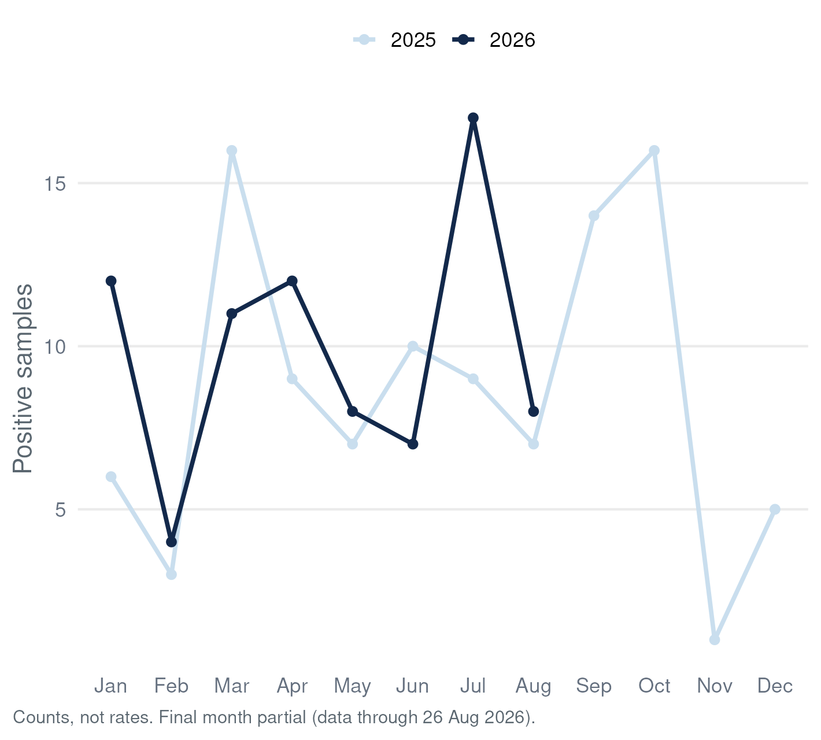
Cocaine-Positive Samples, UNC Street Drug Analysis Lab (Drug Checking) Data: {{STAT:latest_month}}*

Slide 45
Regional Maps

Slide 46
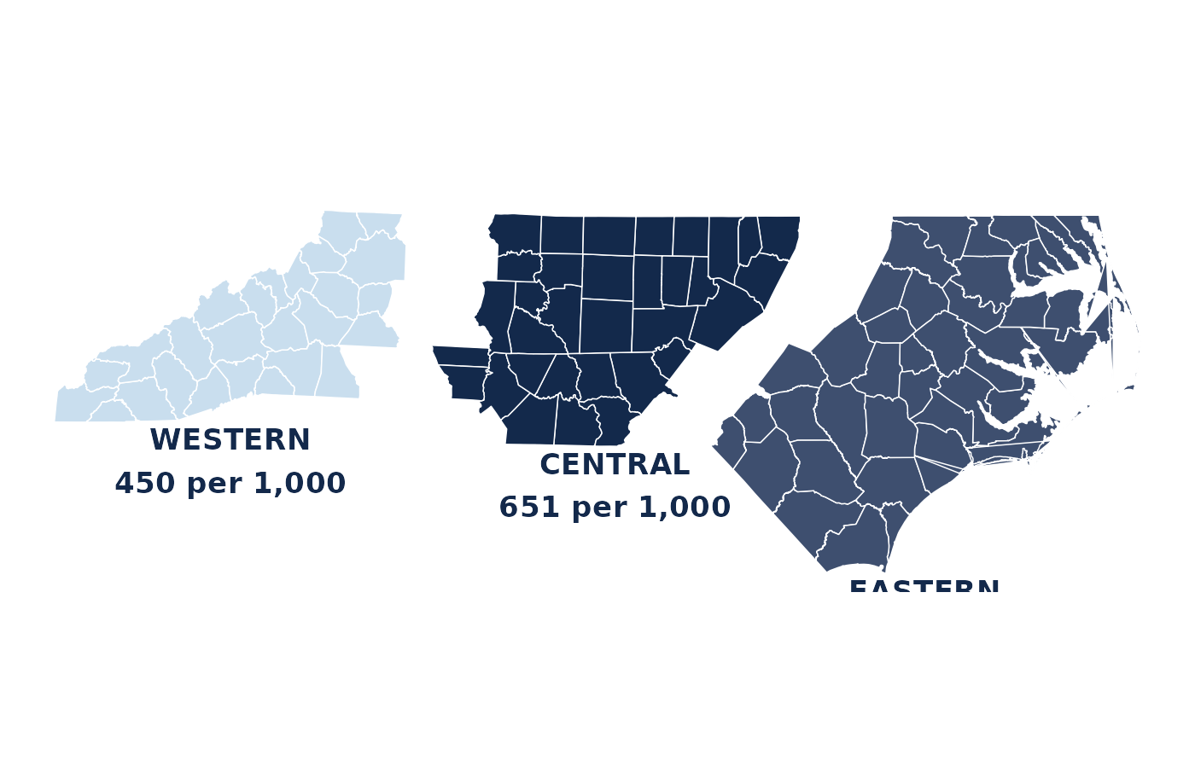
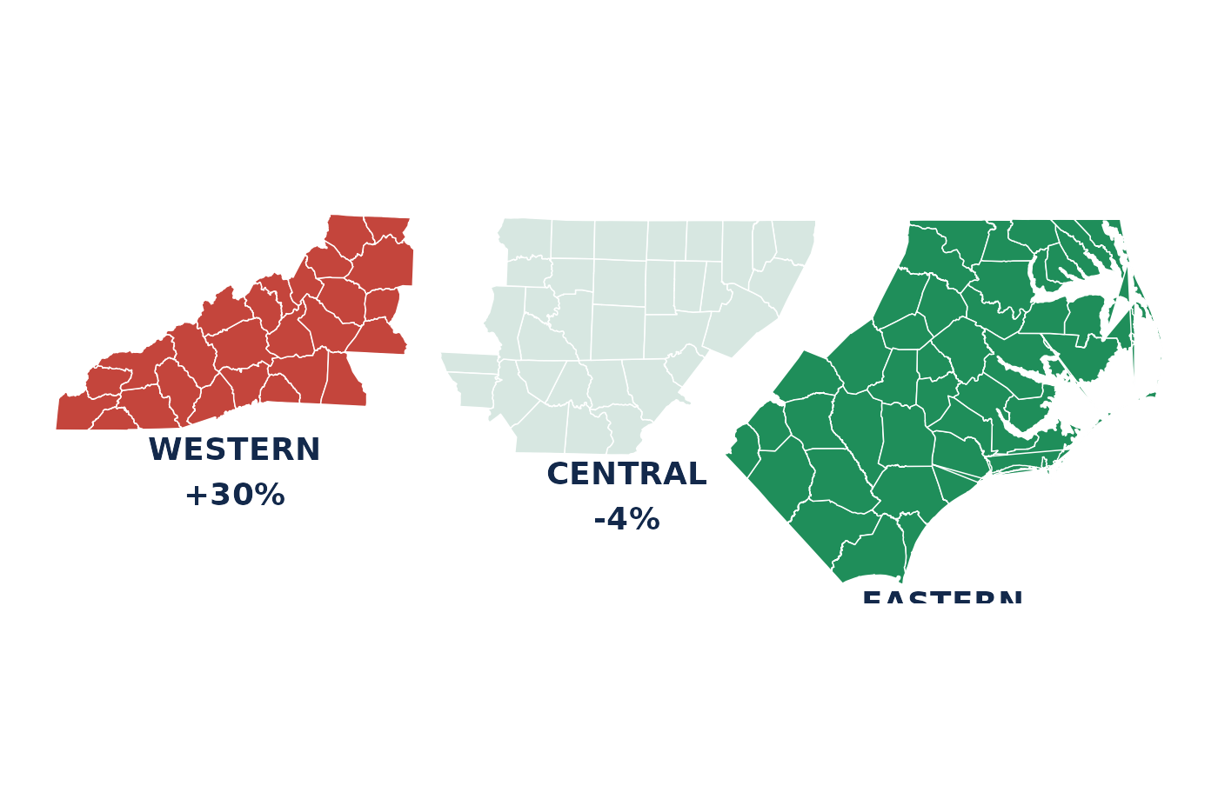
Fentanyl by Region, UNC Street Drug Analysis Lab (Drug Checking) Data: {{STAT:latest_q}}
Fentanyl-positive (any abundance) per 1,000 samples completed in the region, {{STAT:latest_q}}

Slide 47
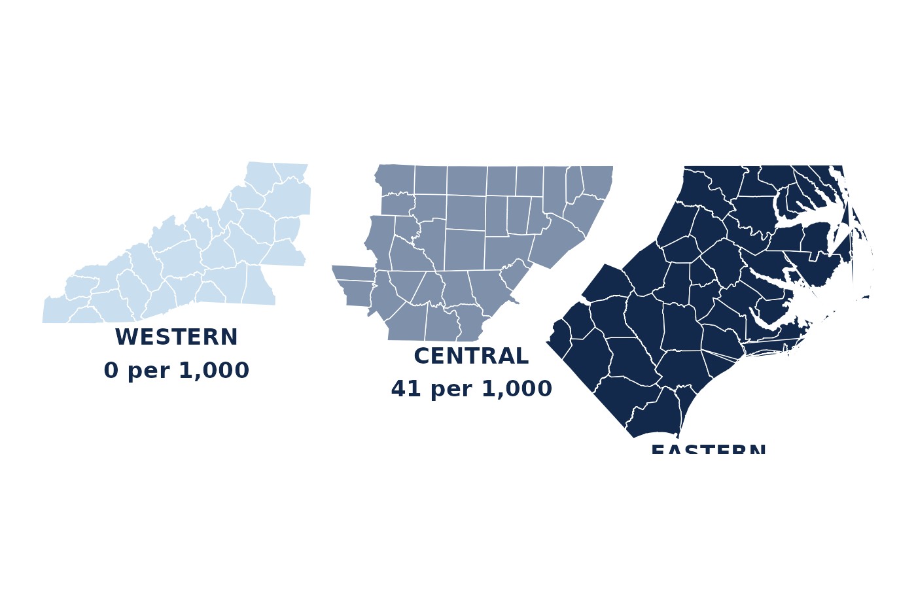

Xylazine by Region, UNC Street Drug Analysis Lab (Drug Checking) Data: {{STAT:latest_q}}
Xylazine-positive (any abundance) per 1,000 samples completed in the region, {{STAT:latest_q}}

Slide 48


Methamphetamine by Region, UNC Street Drug Analysis Lab (Drug Checking) Data: {{STAT:latest_q}}
Methamphetamine-positive (any abundance) per 1,000 samples completed in the region, {{STAT:latest_q}}

Slide 49


Cocaine by Region, UNC Street Drug Analysis Lab (Drug Checking) Data: {{STAT:latest_q}}
Cocaine-positive (any abundance) per 1,000 samples completed in the region, {{STAT:latest_q}}

Slide 50
New Detections

Slide 51
New Detections
New to North Carolina: Last Three Months
Substance | First seen | Abundance | Detections | Sample
delorazepam | 11 Aug 2026 | primary | 1 | 605335
misoprostol | 06 Aug 2026 | primary | 1 | 816799
sucrose octaacetate | 30 Jul 2026 | primary | 1 | 816795
aminopyrine | 28 Jul 2026 | primary | 1 | 605808
antipyrine | 28 Jul 2026 | primary | 1 | 605809
N-(2-phenylethyl)aniline | 17 Jul 2026 | primary | 2 | 900889
fentanyl methylene homolog | 16 Jul 2026 | trace | 1 | 900796
retatrutide | 13 Jul 2026 | primary | 1 | 603217
MDMB-4en-PINACA | 10 Jul 2026 | primary | 1 | 605414
triacetin | 25 Jun 2026 | primary | 18 | 900817
2-fluoro-2-oxo-PCPr | 16 Jun 2026 | primary | 1 | 603838
2-oxo-PCE (O-PCE) | 16 Jun 2026 | primary | 1 | 603838
Definition: min(date_complete) per substance in NC falls within the last 91 days · linked to the public sample record · data table: Appendix A5

Slide 52
New Detections
Emerging Substance Watchlist
Curated by lab staff — the one slide reviewed by a human rather than regenerated nightly

Slide 53
Fine Print

Slide 54
Fine Print
Data Caveats
Full methods and variable notes: technical_details.md + codebook in the opioiddatalab/drugchecking repository

Slide 55
Fine Print
Variable Reference
Full codebook (96 variables): github.com/opioiddatalab/drugchecking → datasets/unc_druchecking_codebook.txt

Slide 56
Fine Print
Data Access
Questions about access or additional chemical classifications: contact the lab via opioiddata.org

Slide 57
Data Tables

Slide 58
Appendix — Data Tables
A1 · Samples Completed by Quarter
Quarter | Unique samples | Status
2022Q1 | 92 | complete
2022Q2 | 32 | complete
2022Q3 | 158 | complete
2022Q4 | 106 | complete
2023Q1 | 131 | complete
2023Q2 | 128 | complete
2023Q3 | 146 | complete
2023Q4 | 70 | complete
2024Q1 | 105 | complete
2024Q2 | 132 | complete
2024Q3 | 196 | complete
2024Q4 | 78 | complete
Chart: slide 11 · unique sampleid by calendar quarter of date_complete

Slide 59
Appendix — Data Tables
A2 · Expected Substances
Expected substance | Samples
fentanyl | 1,412
methamphetamine | 428
heroin | 302
xylazine | 252
unknown | 157
cocaine | 94
MDMA | 79
fentanyl, xylazine | 57
benzodiazepine | 55
ketamine | 50
fentanyl, methamphetamine | 49
crack | 30
Chart: slide 14 · expectedsubstance, semicolon lists split

Slide 60
Appendix — Data Tables
A3 · Expectation vs. Lab Result
Expectation | Samples | Confirmed (any abundance) | Variable
Expected fentanyl | 1,620 | 87% | lab_fentanyl_any
Expected methamphetamine | 491 | 90% | lab_meth_any
Expected cocaine | 139 | 89% | lab_cocaine_any
Expected benzodiazepine | 68 | 59% | lab_benzodiazepine_any
Expected xylazine | 358 | 52% | lab_xylazine_any
Chart: slide 15 · numerator lab_*_any among samples with expect_* = 1

Slide 61
Appendix — Data Tables
A4 · Key Substance Rates, Latest Complete Month
Metric | Per 1,000 samples | Change
Samples completed | 167 / month | +53%
Fentanyl (any) | 665 | +5%
Fentanyl impurities (any) | 605 | +1%
Xylazine (any) | 60 | -7%
Medetomidine (any) | 90 | +40%
Methamphetamine (any) | 287 | -22%
Metric | Per 1,000 samples | Change
Cocaine (any) | 102 | +59%
Levamisole (any) | 0 | -100%
Carfentanil (any) | 0 | n/a
Nitazenes (any) | 0 | n/a
BTMPS (any) | 18 | -35%
Overdose-involved | 50 | -58%
Chart: slide 37 · rate = per 1,000 unique samples completed in the latest complete month (453 samples)

Slide 62
Appendix — Data Tables
A5 · New to North Carolina, Last Three Months
Substance | First seen | Abundance | Detections | Sample
delorazepam | 11 Aug 2026 | primary | 1 | 605335
misoprostol | 06 Aug 2026 | primary | 1 | 816799
sucrose octaacetate | 30 Jul 2026 | primary | 1 | 816795
aminopyrine | 28 Jul 2026 | primary | 1 | 605808
antipyrine | 28 Jul 2026 | primary | 1 | 605809
N-(2-phenylethyl)aniline | 17 Jul 2026 | primary | 2 | 900889
fentanyl methylene homolog | 16 Jul 2026 | trace | 1 | 900796
retatrutide | 13 Jul 2026 | primary | 1 | 603217
MDMB-4en-PINACA | 10 Jul 2026 | primary | 1 | 605414
triacetin | 25 Jun 2026 | primary | 18 | 900817
2-fluoro-2-oxo-PCPr | 16 Jun 2026 | primary | 1 | 603838
2-oxo-PCE (O-PCE) | 16 Jun 2026 | primary | 1 | 603838
Chart: slide 50 · min(date_complete) per substance within the last 91 days

