Slide 1
DAILY SLIDE DECK
North Carolina Drug Checking
Generated Saturday, September 05, 2026 · 7:20 AM ET UNC Street Drug Analysis Lab · OpioidData.org · results.streetsafe.supply Download as PowerPoint

Slide 2
Orientation
About This Slide Deck
Rebuilt every night from the daily North Carolina extracts of the UNC drug checking datasets. Designed for public health officials and researchers — every figure names the exact variables behind it. Rates are per 1,000 unique samples completed per unit time; the month/current quarter is labeled partial. Charts state whether substance detections counts are in primary or trace abundance. All slides in this deck are made placed in public domain and available for public reuse without any additional permission. Nightly pipeline 1 Upstream CSVs refresh daily 2 Rscript r/build_nightly.R at 2:30 AM 3 ggplot2 figures + stats land in figs/ 4 This deck re-renders with fresh numbers Every figure and statistic is rebuilt from the live extract on each nightly run. r/build_nightly.R
Every figure and statistic is rebuilt from the live extract on each nightly run.

Slide 3
Methods
How samples are collected and shipped, how the lab analyzes them, and how results become the two public datasets — the ground rules behind every chart that follows.

Slide 4
Orientation
How Samples Reach the Lab
alt="The UNC Street Drug Analysis Lab logo banner." style="width:1240px;align-self:center;margin:56px 0 40px"> 1 · CollectResidue on a card with what the donor expected, felt, and saw 2 · MailAnonymous samples mailed from harm reduction programs statewide 3 · AnalyzeGCMS identifies each substance and flags primary vs. trace abundance 4 · PublishResults posted publicly and folded into these two datasets daily Sample-level records: results.streetsafe.supply/sample/&lt;sampleid&gt;
Sample-level records: results.streetsafe.supply/sample/&lt;sampleid&gt;

Slide 5
The Data
Sample Collection: Core Principles
1 Voluntary Samples are provided voluntarily to a partnering organization — never collected covertly. 2 Anonymous Individual sample donors are anonymous to the UNC lab; no identifying information travels with a sample. 3 Donor gets results first Results must be returned to the sample donor in a timely manner — before any aggregate reporting. Who submits Health-serving organizations: harm reduction programs, drug user unions, public health agencies, and universities. How samples travel Collected as powders, pill fragments, swabs, or used cottons; dissolved in acetonitrile and shipped with a prepaid return envelope — under established harm reduction exemptions in state controlled-substance law and federal small-quantity hazardous-materials regulations. Collection and shipping protocol details in the Supplemental Material Static slide — reviewed by lab staff, not regenerated nightly
Collection and shipping protocol details in the Supplemental Material

Slide 6
The Data
How Samples Are Analyzed
1 Dissolve & mail. Samples dissolved in acetonitrile and mailed to the lab in compliance with federal regulations. 2 Separate. Gas chromatography on a Thermo TraceGOLD TG-5SilMS column (30 m × 0.25 mm × 0.25 μm). 3 Detect. GCMS with an electron ionization source; qualitative results from a Thermo Scientific Q Exactive GC Orbitrap. 4 Identify. Untargeted search in Xcalibur Qual Browser 4.5, with fragmentation analysis against three libraries of drug standards. 5 Confirm. Every detected substance positively identified and confirmed with pure, commercially available reference standards. 6 Classify. Reported as primary or trace abundance — trace = less than 5% chromatogram peak height relative to the most abundant substance. Qualitative GCMS — abundance is not concentration · full protocol and library details in the Supplemental Material Static slide — reviewed by lab staff, not regenerated nightly
Qualitative GCMS — abundance is not concentration · full protocol and library details in the Supplemental Material

Slide 7
The Data
Two Linked Datasets
analysis_dataset.csv Wide · one row per sample. Everything from the card — location, dates, expected substance, sensations, overdose involvement — plus ~60 derived lab_* 1/0 flags. 96 variables · quarterly denominators come from here data.streetsafe.supply/datasets/NC/analysis_dataset.csv sampleid ⟷ lab_detail.csv Long · one row per substance per sample. Standardized substance name, method (GCMS), abundance (blank = primary, "trace"), chemical-class flags, PubChem CID / CAS / UNII. Source for substance-level counts and new detections data.streetsafe.supply/datasets/NC/lab_detail.csv Direct downloads above · refreshed daily · also in Stata, Excel, SAS at data.streetsafe.supply/datasets/NC/ r/data.R::load_nc()
Direct downloads above · refreshed daily · also in Stata, Excel, SAS at data.streetsafe.supply/datasets/NC/

Slide 8
The Data
Primary vs. Trace: How to Read the Variables
lab_xylazine = 1 Detected as a primary constituent lab_xylazine_any = 1 Detected in any abundance — primary or trace trace-only = any − primary The light-blue increment stacked on every chart Example sample A powder sample contains xylazine in trace abundance: lab_xylazine = 0 lab_xylazine_any = 1 Trace defined as less than 5% peak height of the most abundant molecule on the GCMS chromatogram. Abundance is qualitative — trace ≠ quantified concentration and never implies purity. Convention documented in technical_details.md · every following chart is stacked primary + trace-only r/data.R::quarterly_rate()
Convention documented in technical_details.md · every following chart is stacked primary + trace-only

Slide 9
Orientation
Accessibility
This deck conforms to WCAG 2.2 Level AA, the level required by UNC's Accessibility of Digital Content and Materials Standard and ADA Title II. · Contrast-checked palette — text ≥ 4.5:1, chart marks ≥ 3:1 · Alt text regenerates nightly with each figure, from the same data · Full data tables for key charts in the Appendix (end of deck) · No color-only encoding — segments labeled directly, partial quarters striped · Logical heading structure and reading order on every slide Found a barrier? Report it to the UNC Digital Accessibility Office: digital_accessibility@unc.edu digitalaccessibility.unc.edu/report 919-962-7636 Static slide — reviewed by lab staff, not regenerated nightly
Static slide — reviewed by lab staff, not regenerated nightly

Slide 10
Coverage Summary
How much of the state the program sees: statewide totals at a glance, sample volume by quarter, and county-level reach — the denominators behind every rate in this deck.

Slide 11
The Data
North Carolina at a Glance
PLACEHOLDER · figs/stats.json January 2022 to Wednesday, September 02, 2026 N = 2,786 NC samples analyzed Mailed in from 86 harm reduction programs Collected across 57 counties 244 distinct substances detected to date Unique samples = n_distinct(sampleid) · substances from lab_detail.substance · includes samples with date_complete 26 Jan 2022 – 02 Sep 2026 r/build_nightly.R → figs/stats.json
Unique samples = n_distinct(sampleid) · substances from lab_detail.substance · includes samples with date_complete 26 Jan 2022 – 02 Sep 2026

Slide 12
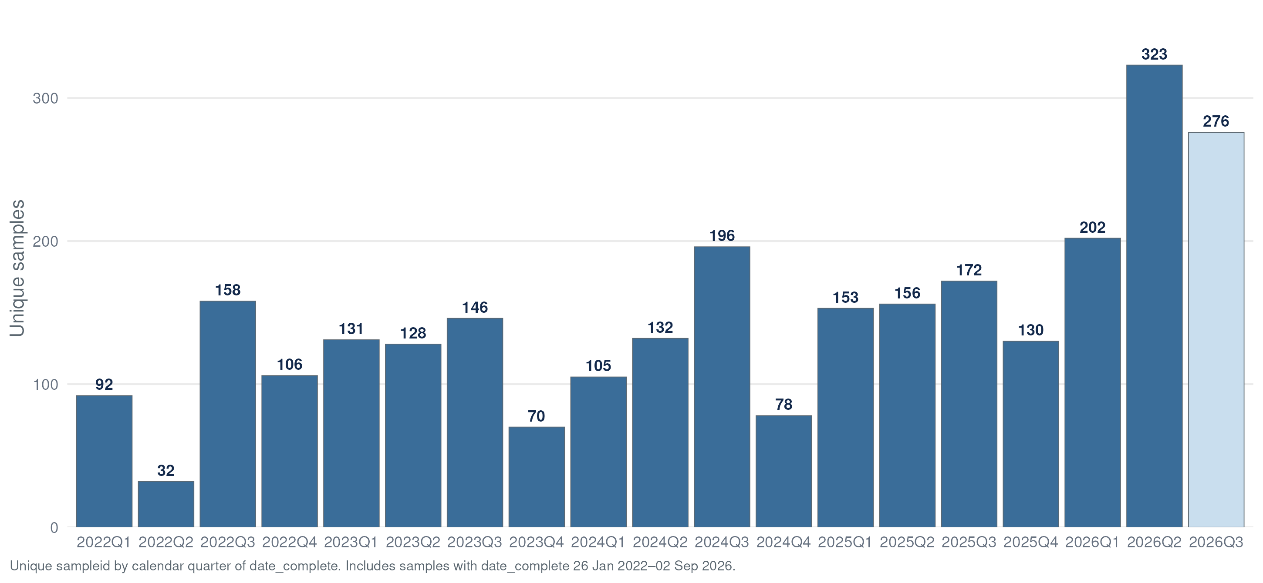
The Data
Samples Completed by Quarter
Unique sampleid by calendar quarter of date_complete · current quarter shown striped + labeled partial · data table: Appendix A1

Slide 13
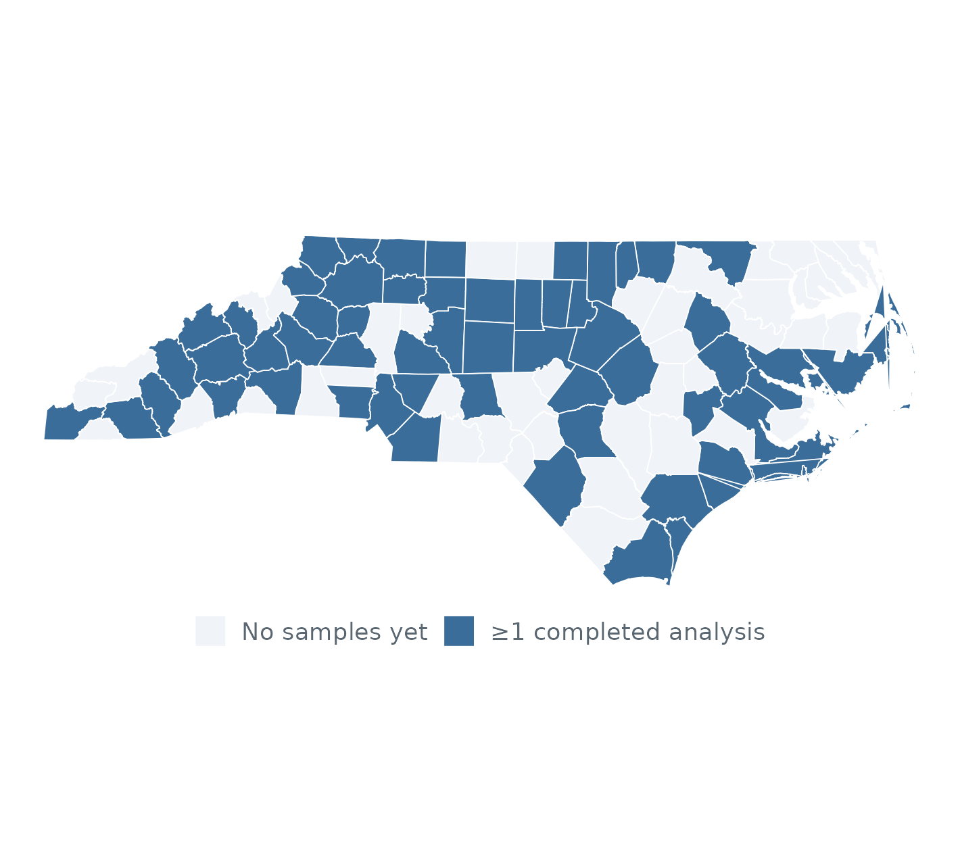
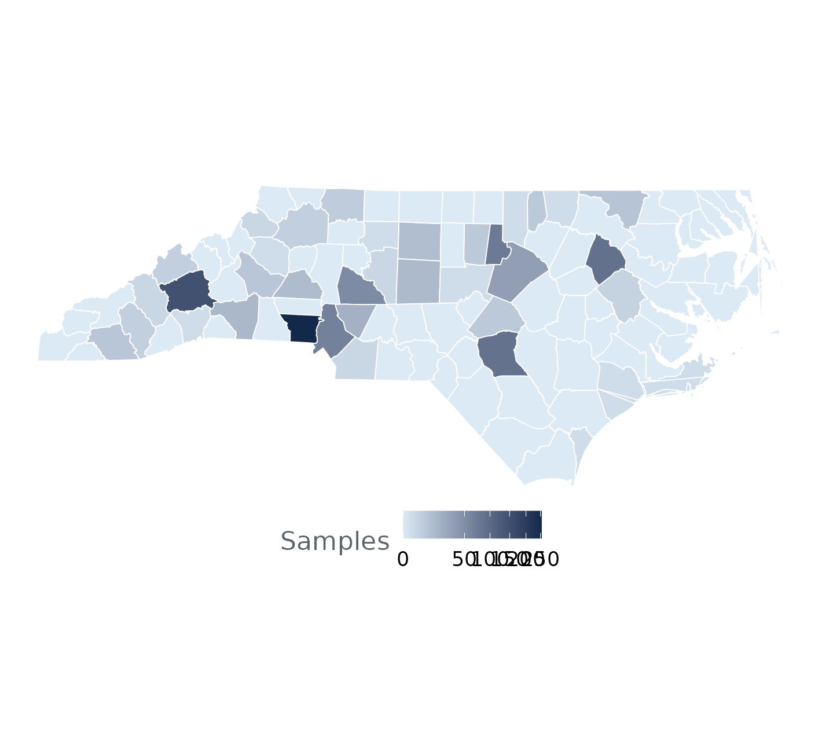
The Data
County Coverage
County = samplecounty · left: ≥1 completed analysis ever · right: unique samples per county (sqrt color scale) · all time: 26 Jan 2022 – 02 Sep 2026 · last 12 months: 05 Sep 2025 – 02 Sep 2026* · coverage reflects participation, not prevalence

Slide 14
What the Card Tells Us
Donor-reported context collected with every sample: what they expected, how it felt, how it looked, and whether an overdose was involved.

Slide 15
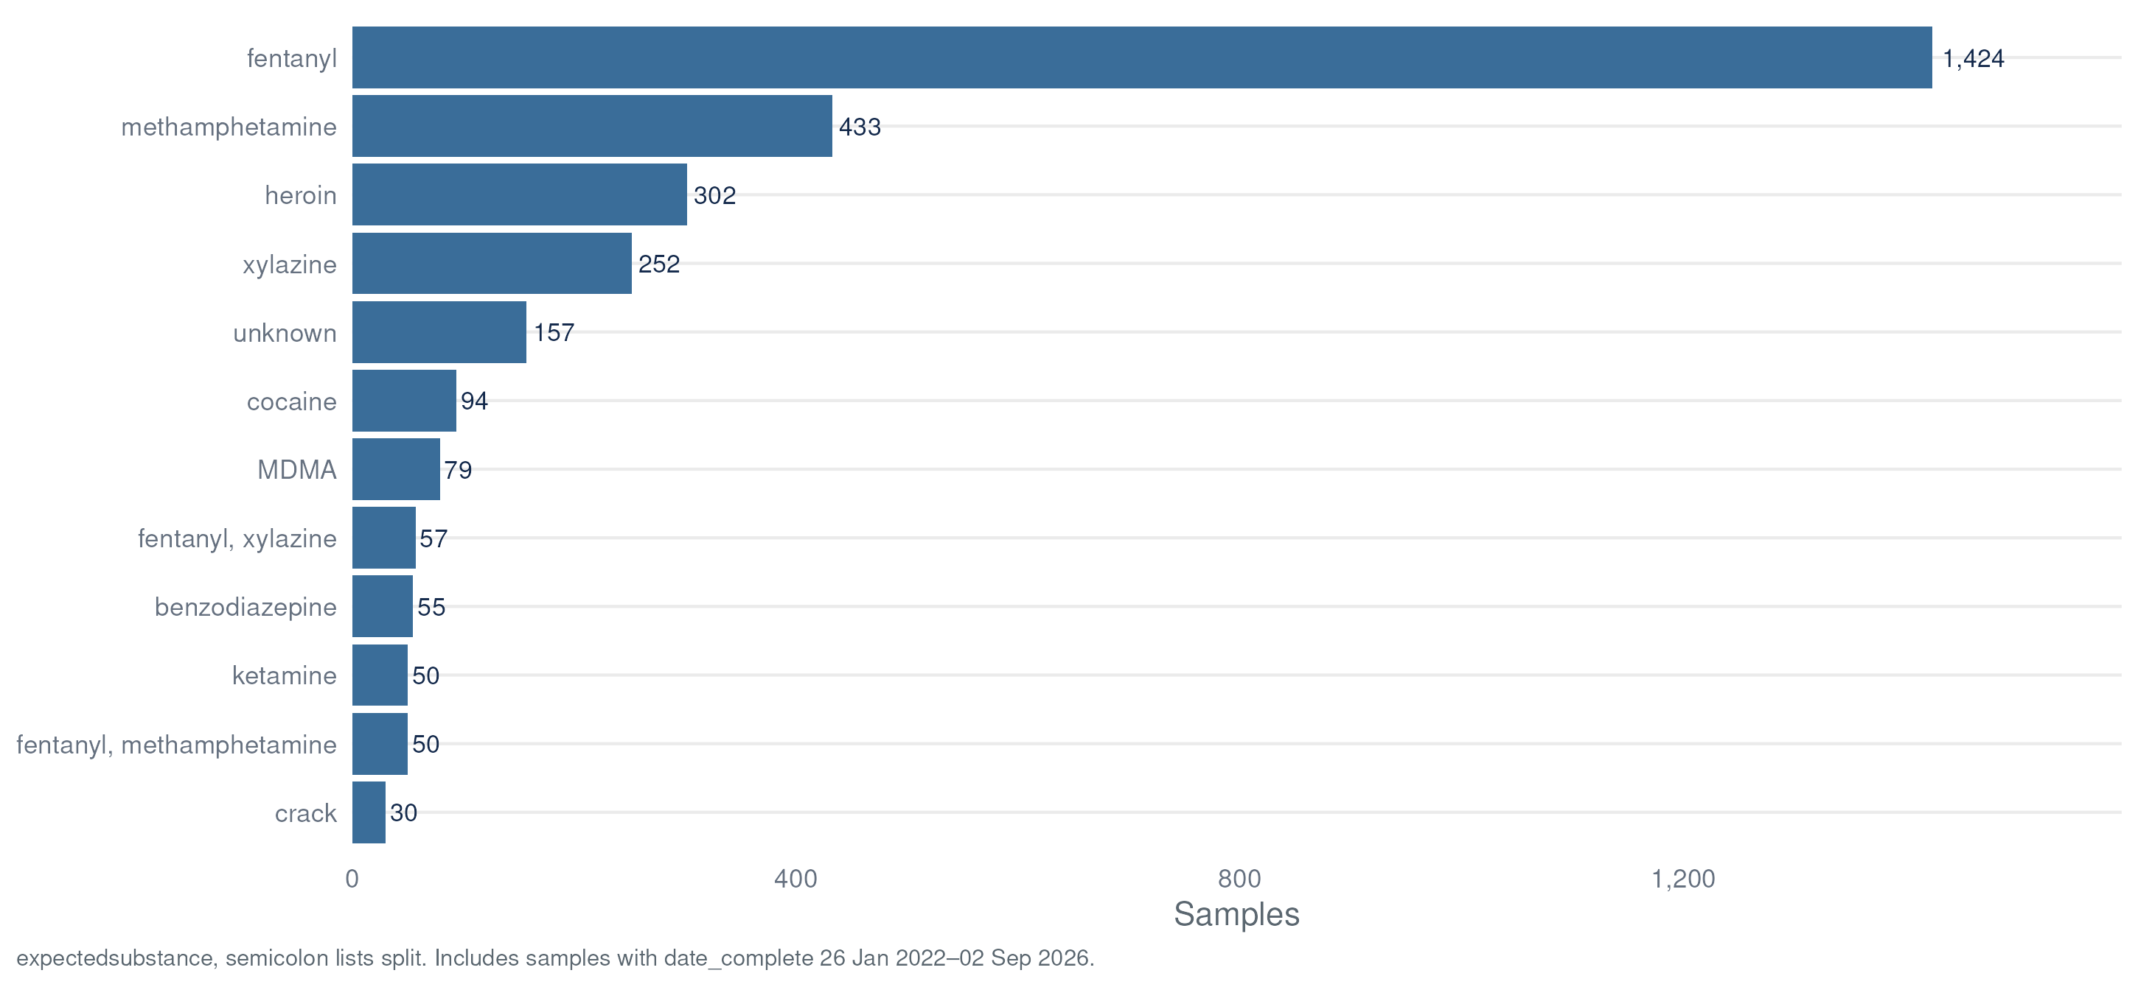
What the Card Tells Us
Expected Substances
expectedsubstance (verbatim card write-in, semicolon lists split) · derived flags: expect_opioid, expect_fentanyl, expect_meth, expect_cocaine, expect_stimulant… · includes samples with date_complete 26 Jan 2022 – 02 Sep 2026 · data table: Appendix A2

Slide 16
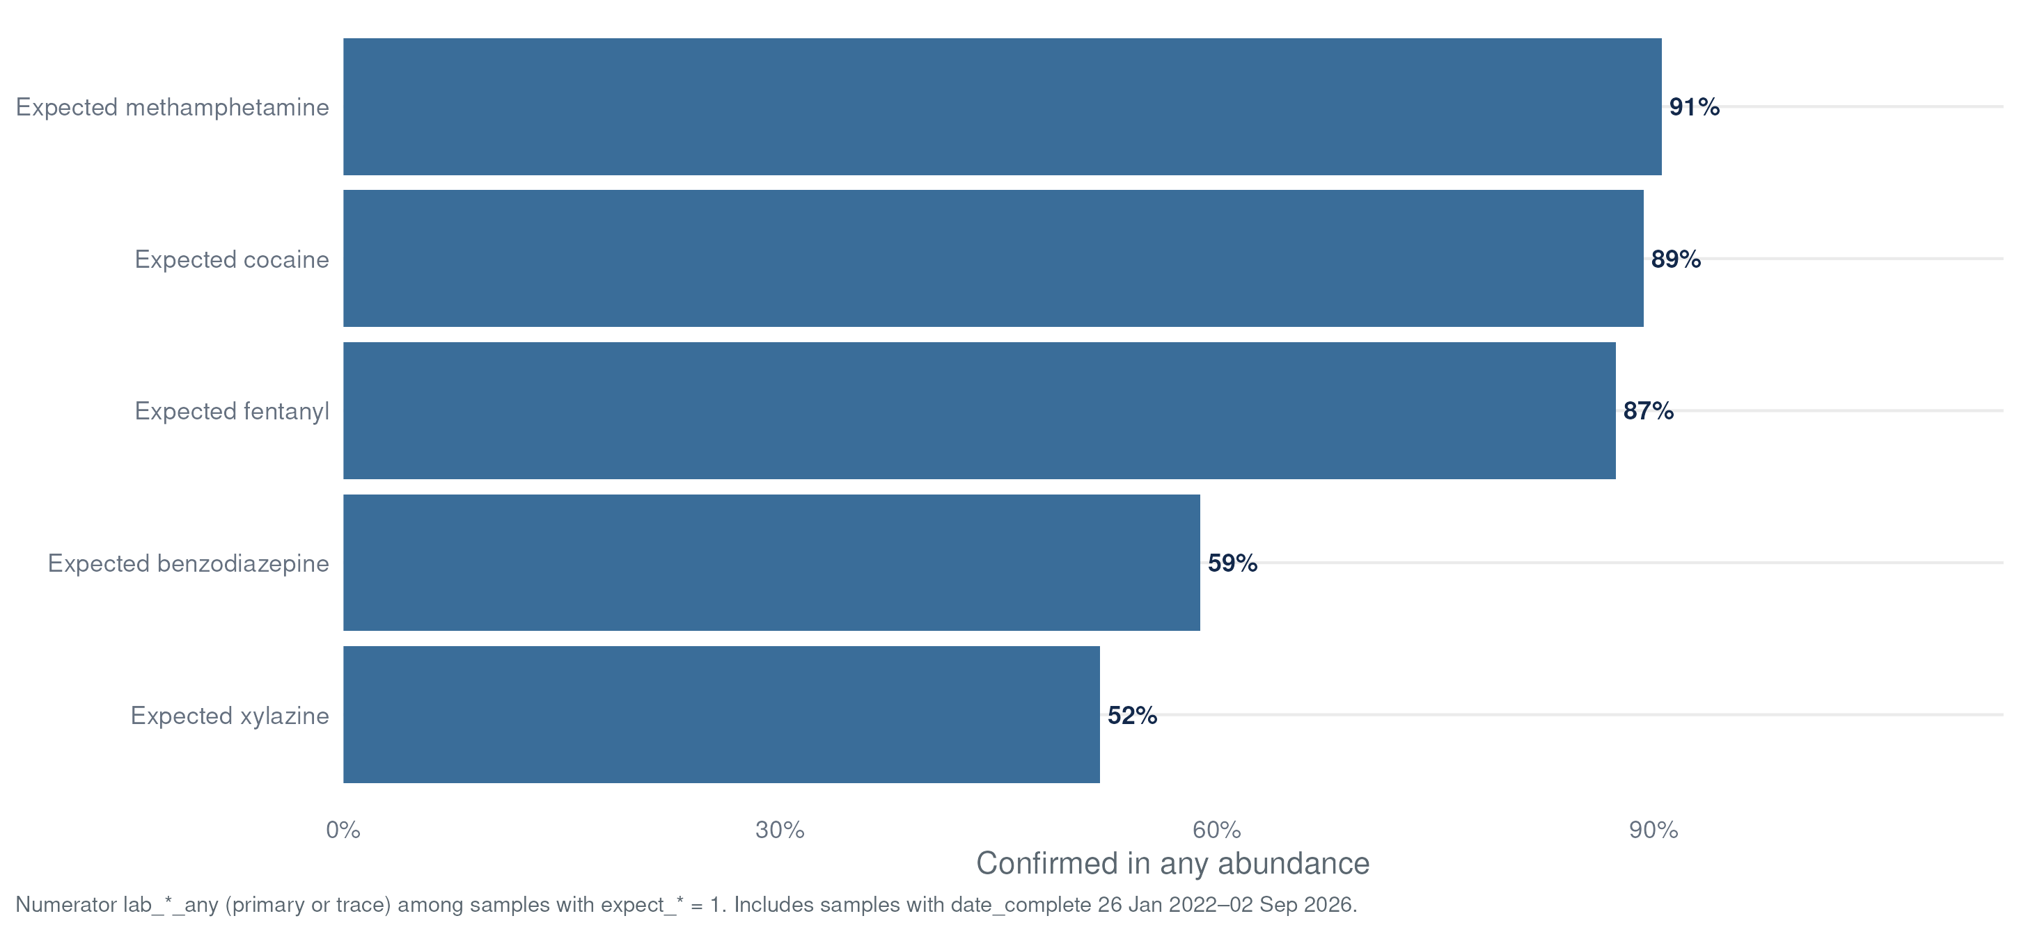
What the Card Tells Us
Expectation vs. Lab Result
Numerator uses lab_*_any (primary or trace) among samples with expect_* = 1 · includes samples with date_complete 26 Jan 2022 – 02 Sep 2026 · data table: Appendix A3

Slide 17
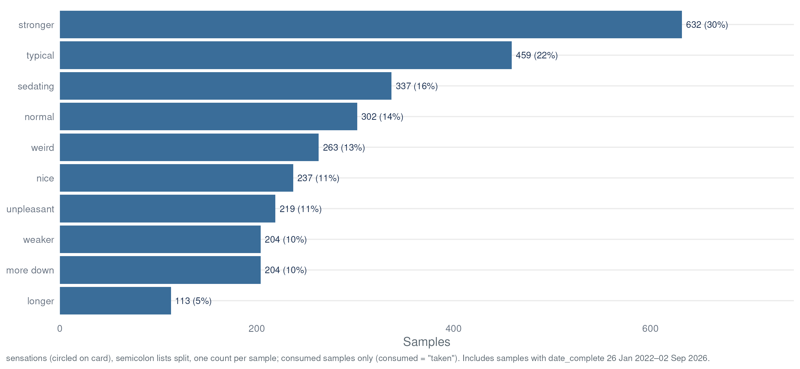
What the Card Tells Us
Reported Sensations
sensations (circled on card, semicolon lists split) · post-consumption samples only (consumed = 1) · includes samples with date_complete 26 Jan 2022 – 02 Sep 2026

Slide 18
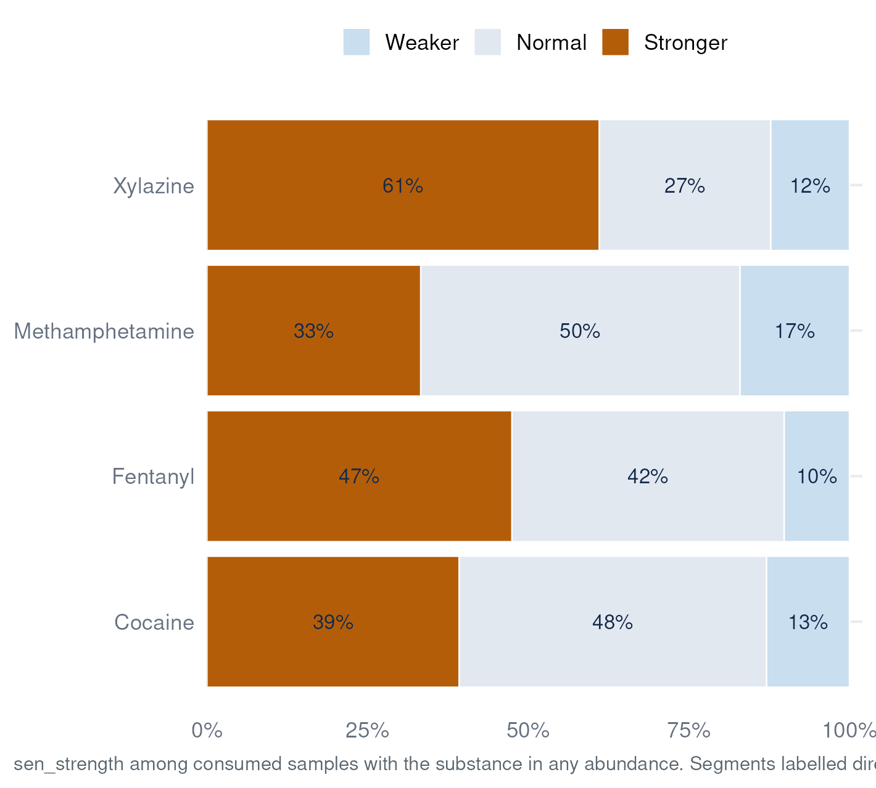
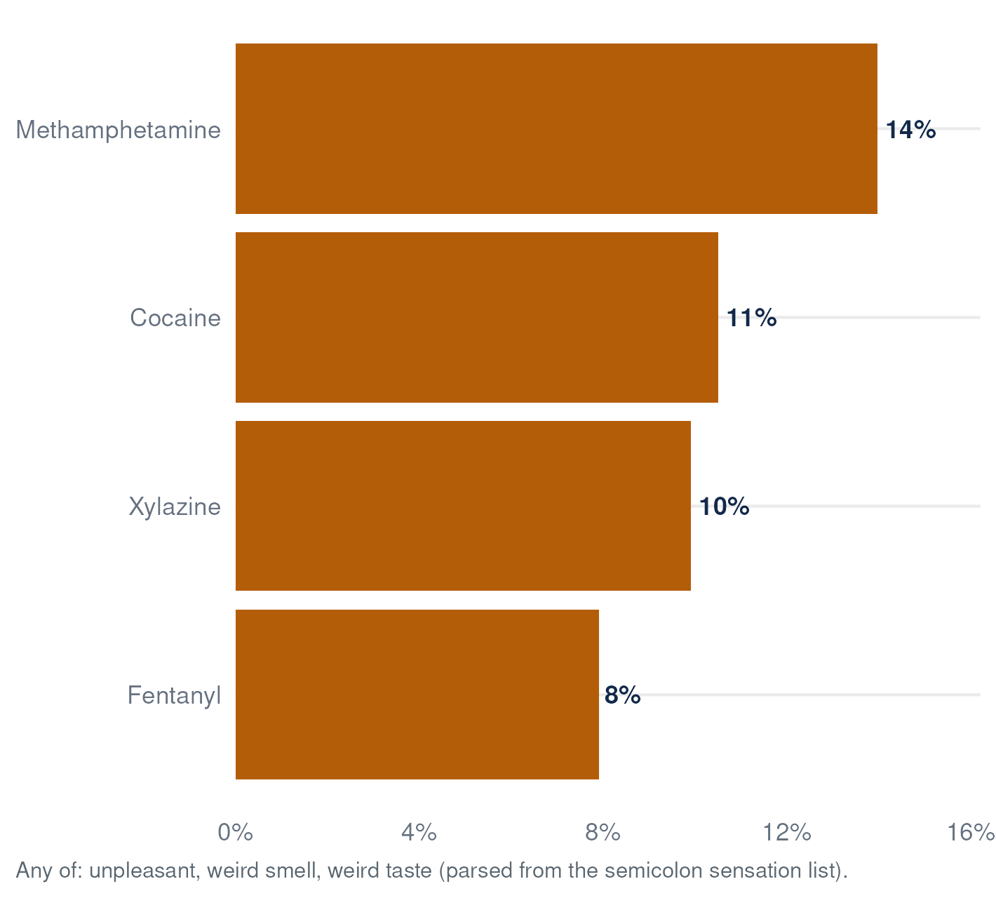
What the Card Tells Us
Sensations by Key Substance
sensations semicolon lists parsed per report · consumed = 1 only · denominator: consumed samples with lab_*_any = 1 · includes samples with date_complete 26 Jan 2022 – 02 Sep 2026

Slide 19
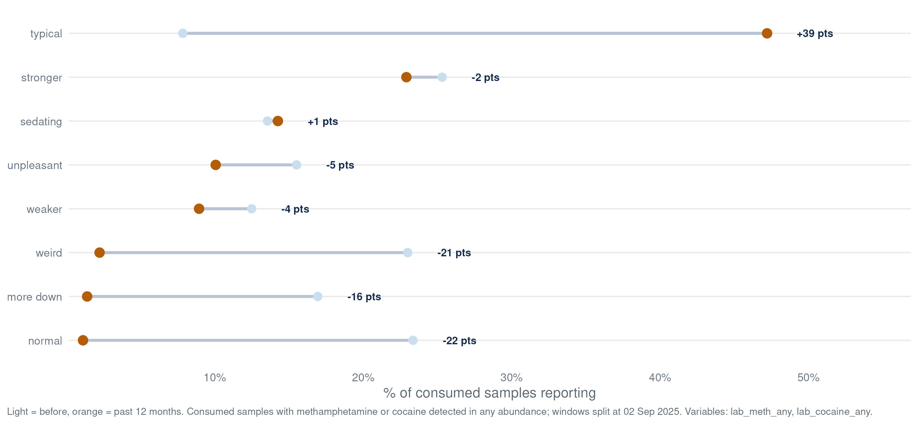
What the Card Tells Us
Sensation Shift — Stimulants
Samples with methamphetamine or cocaine detected (any abundance); samples in both classes appear on both slides · sensations semicolon lists parsed + sen_strength (own denominator) · consumed = 1 only · before: 26 Jan 2022 – 02 Sep 2025 · past 12 months: 05 Sep 2025 – 02 Sep 2026* · Δ in percentage points

Slide 20
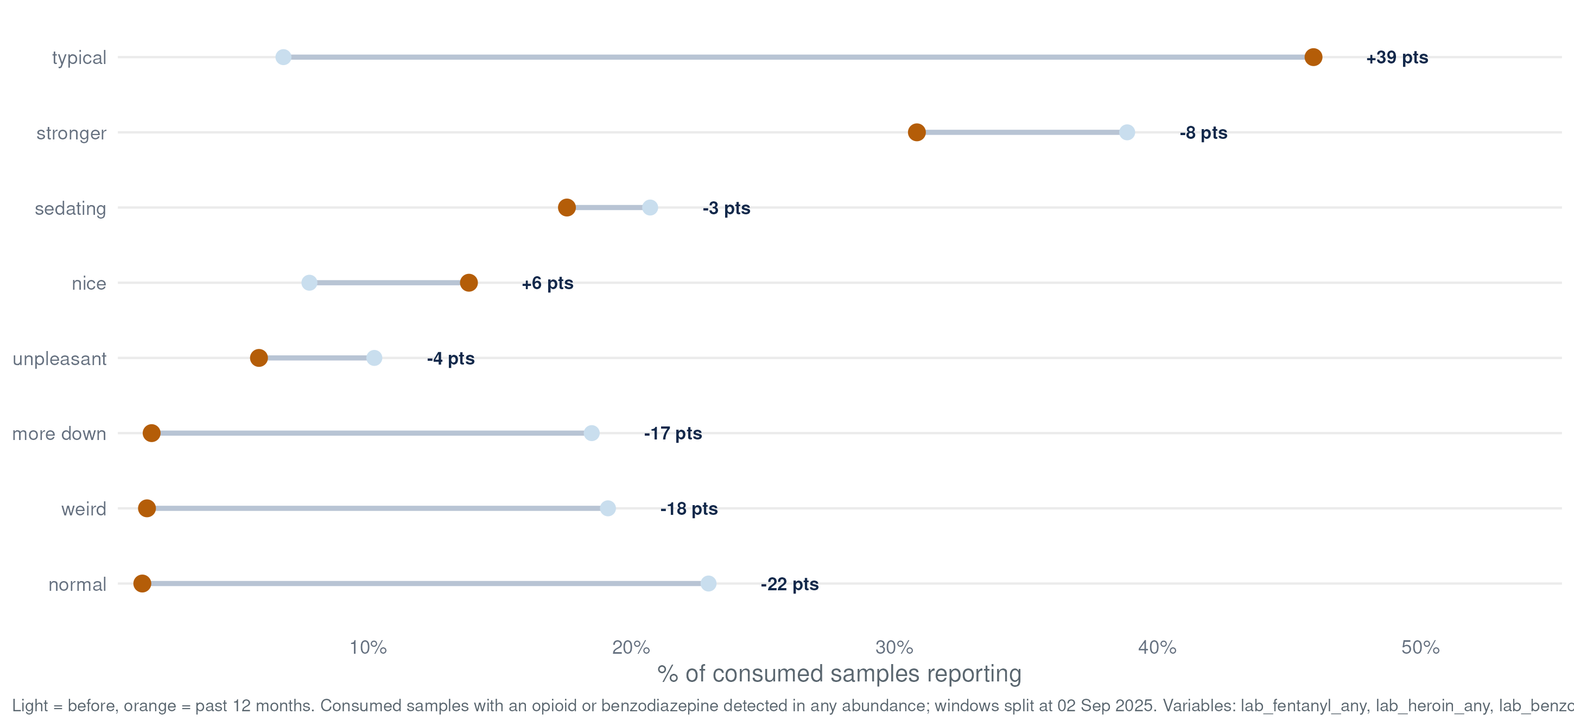
What the Card Tells Us
Sensation Shift — Opioids + Benzos
Samples with an opioid (fentanyl, heroin) or benzodiazepine detected (any abundance); samples in both classes appear on both slides · sensations semicolon lists parsed + sen_strength (own denominator) · consumed = 1 only · before: 26 Jan 2022 – 02 Sep 2025 · past 12 months: 05 Sep 2025 – 02 Sep 2026* · Δ in percentage points

Slide 21
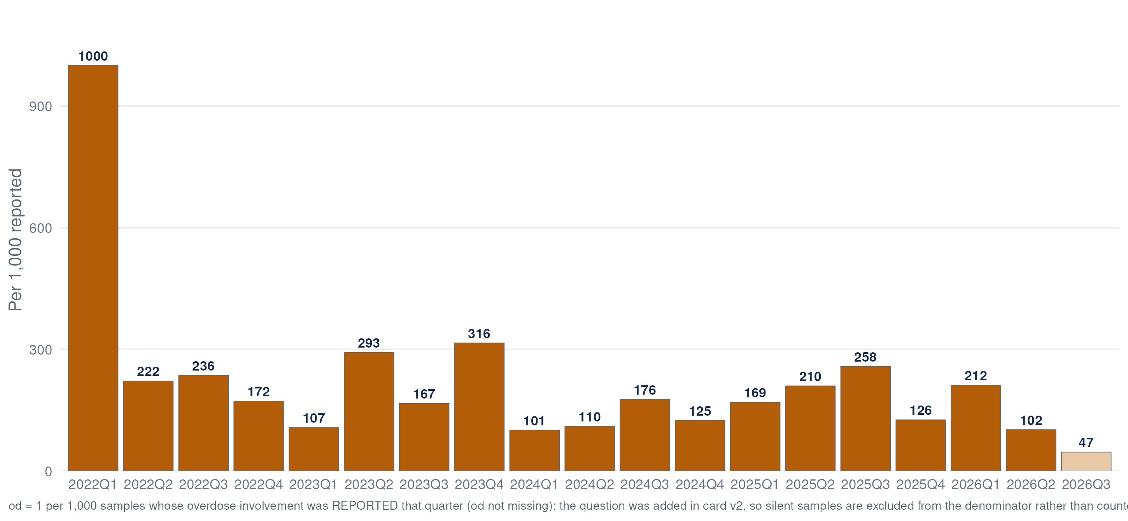
What the Card Tells Us
Overdose Involvement
od = 1 (reported involved) per 1,000 unique samples completed that quarter · verbatim context in overdose_notes

Slide 22
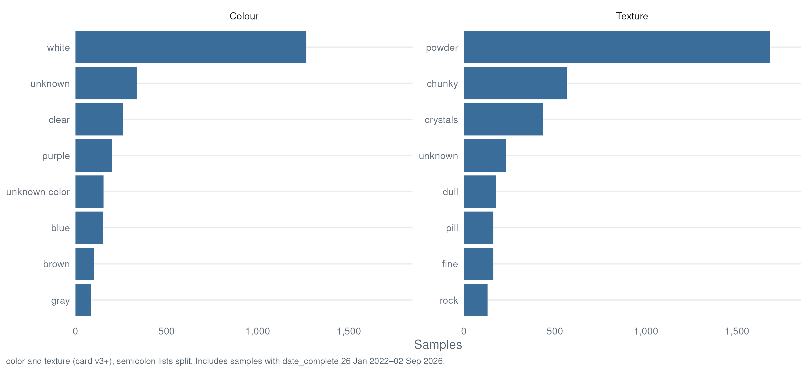
What the Card Tells Us
Color and Texture
color, texture (card v3+, semicolon lists split) · derived: bright_color excludes white/tan/brown family — orange bar above · includes samples with date_complete 26 Jan 2022 – 02 Sep 2026

Slide 23
What the Lab Detects
GCMS results as quarterly rates per 1,000 samples — stacked primary (solid) + trace-only (light) for nine priority substances.

Slide 24
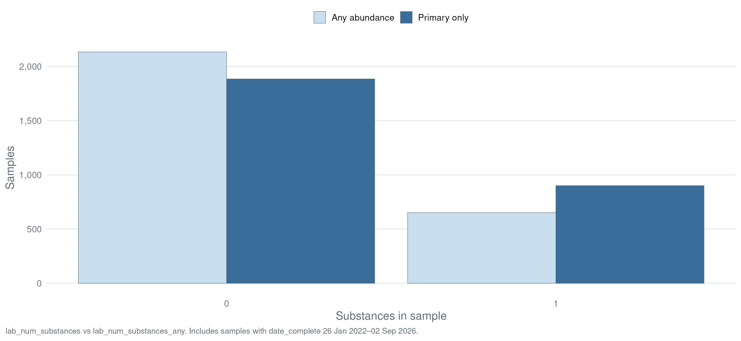
What the Lab Detects
Substances per Sample
Distribution of substances detected per sample, both definitions shown side by side · includes samples with date_complete 26 Jan 2022 – 02 Sep 2026

Slide 25
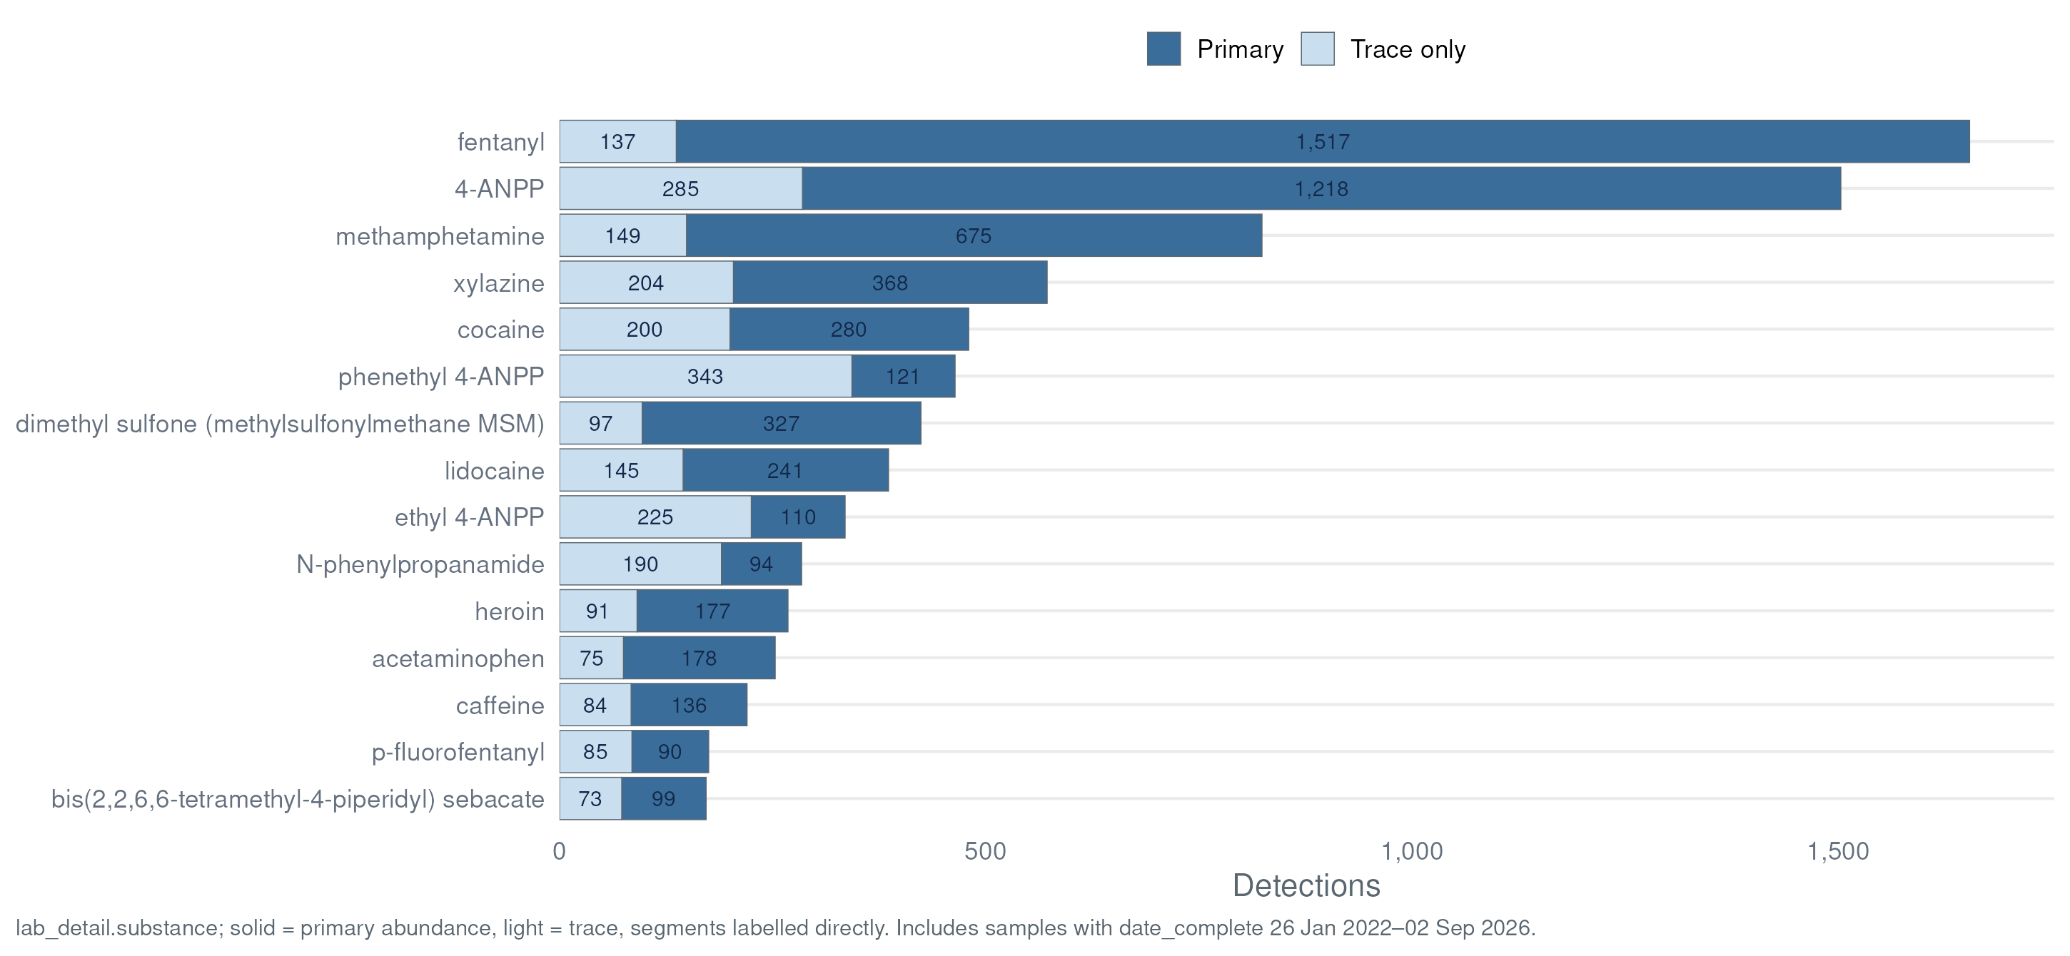
What the Lab Detects
Top Substances Detected
lab_detail.substance counts · solid = primary abundance, light = trace · standardized names (PubChem-linked) · includes samples with date_complete 26 Jan 2022 – 02 Sep 2026

Slide 26
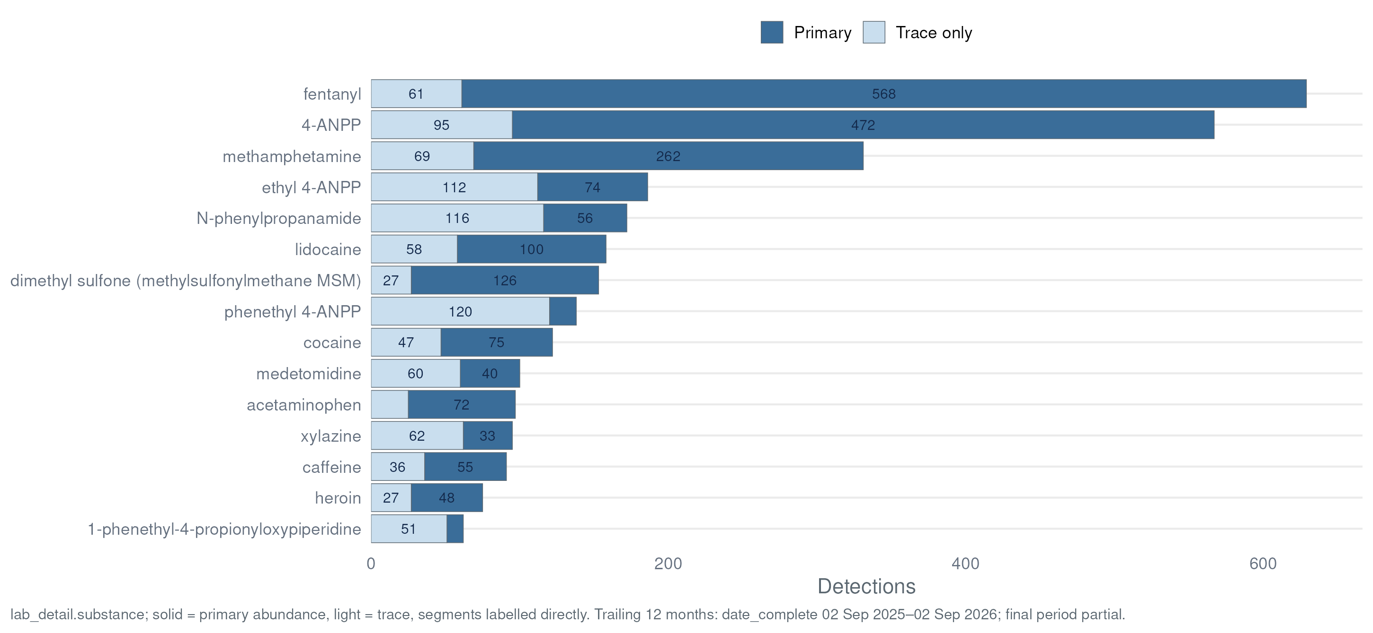
What the Lab Detects
Top Substances — Past 12 Months
lab_detail.substance counts · solid = primary abundance, light = trace · standardized names (PubChem-linked) · window: date_complete 05 Sep 2025 – 02 Sep 2026* (trailing 12 months, current month partial)

Slide 27
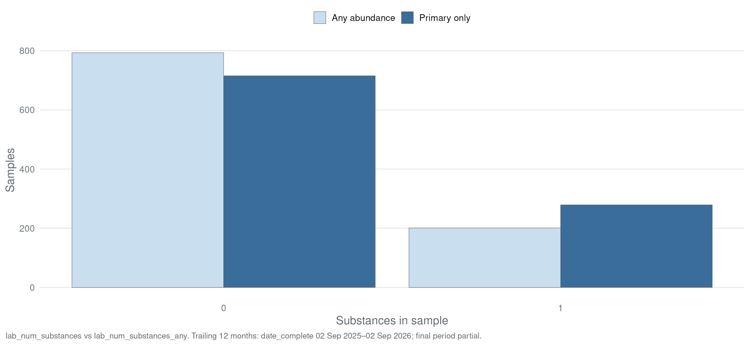
What the Lab Detects
Substances per Sample — Past 12 Months
Distribution of substances detected per sample, both definitions shown side by side · window: date_complete 05 Sep 2025 – 02 Sep 2026* (trailing 12 months, current month partial)

Slide 28
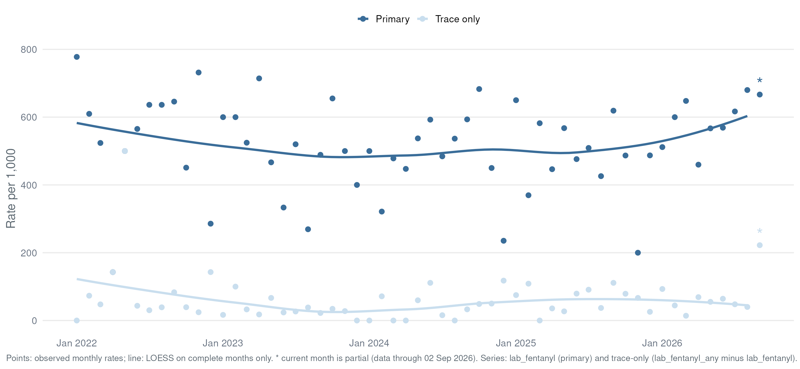
What the Lab Detects
Fentanyl
Series: lab_fentanyl (primary) + trace-only (lab_fentanyl_any − lab_fentanyl) · exact match, analogues excluded · per 1,000/month · LOESS on complete months · * = partial month

Slide 29
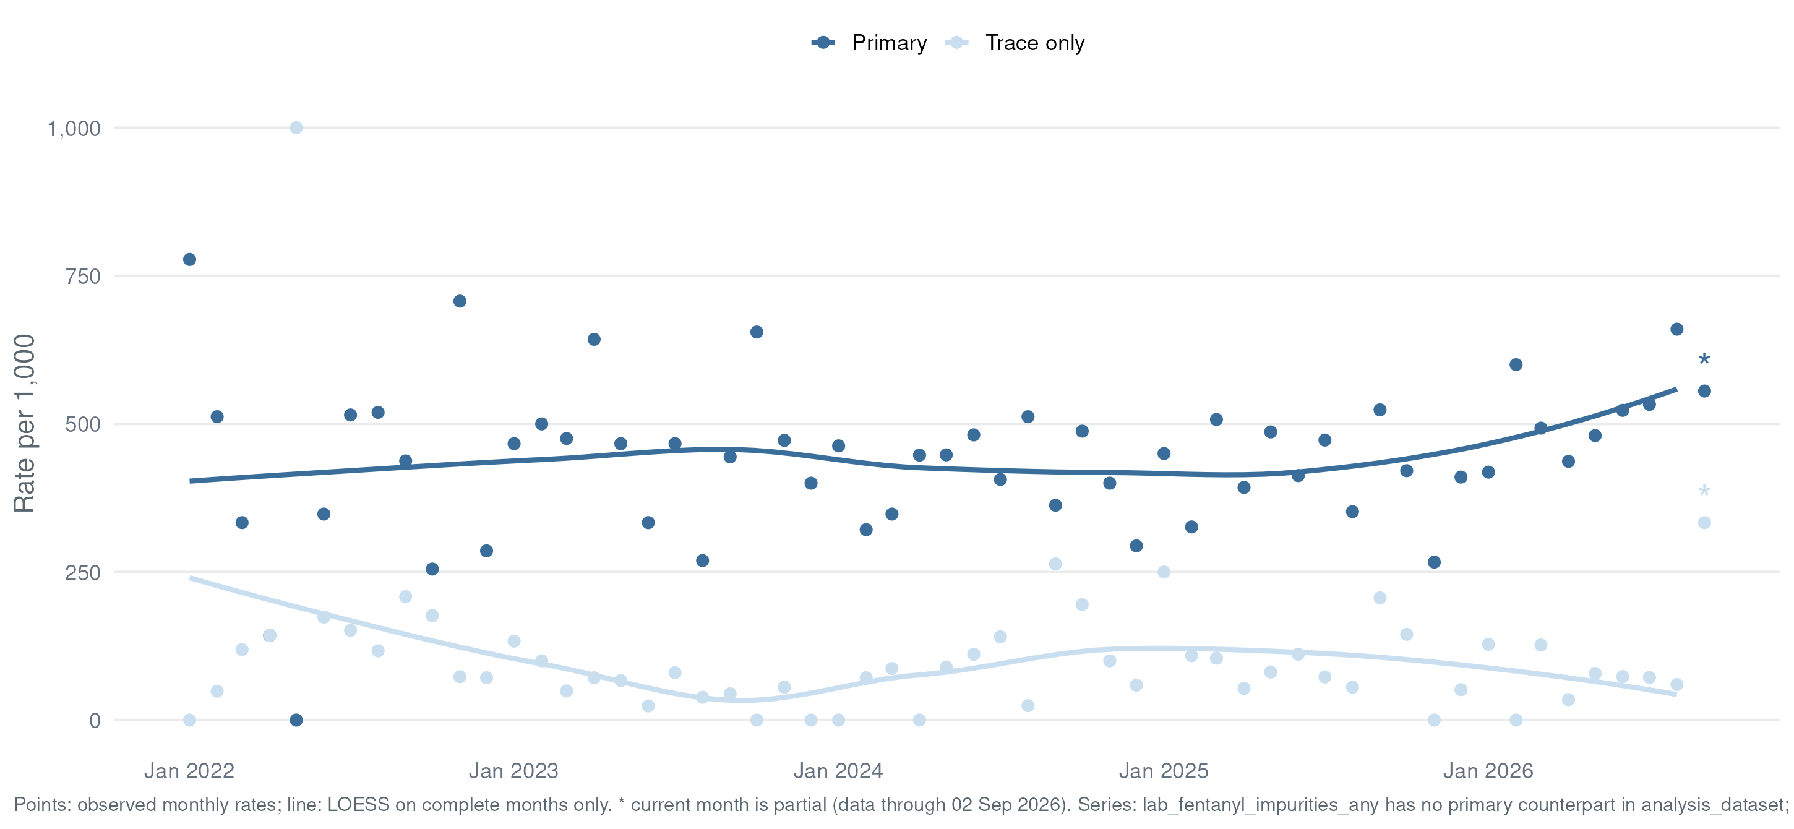
What the Lab Detects
Fentanyl Synthesis Impurities
Flags from lab_detail regex '4-ANPP|phenethyl' (see lab_fentanyl_impurity) · per 1,000/month · LOESS on complete months · * = partial month

Slide 30
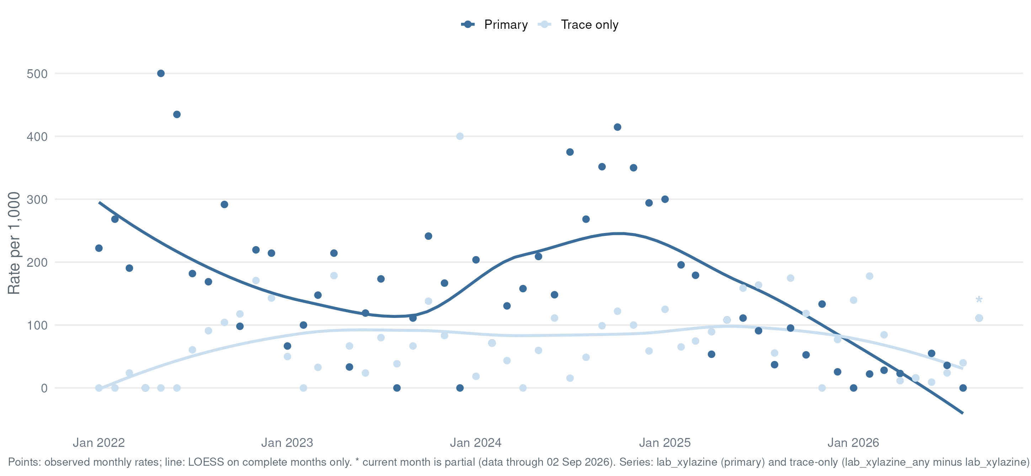
What the Lab Detects
Xylazine
Series: lab_xylazine (primary) + trace-only (lab_xylazine_any − lab_xylazine) · per 1,000/month · LOESS on complete months · * = partial month

Slide 31
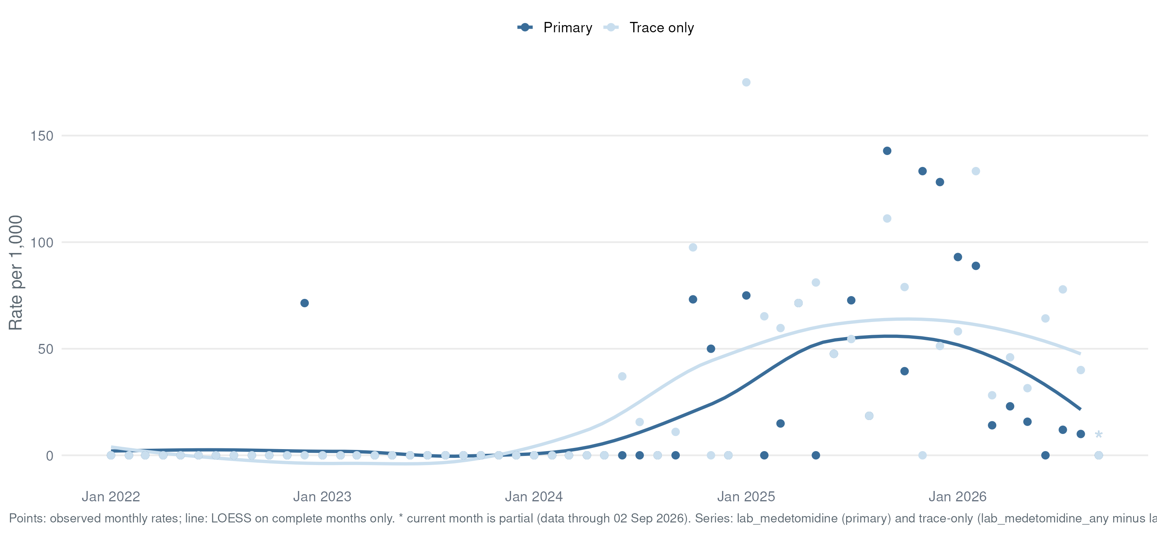
What the Lab Detects
Medetomidine
Flags from lab_detail regex 'medetomidine' with abundance split · per 1,000/month · LOESS on complete months · * = partial month

Slide 32
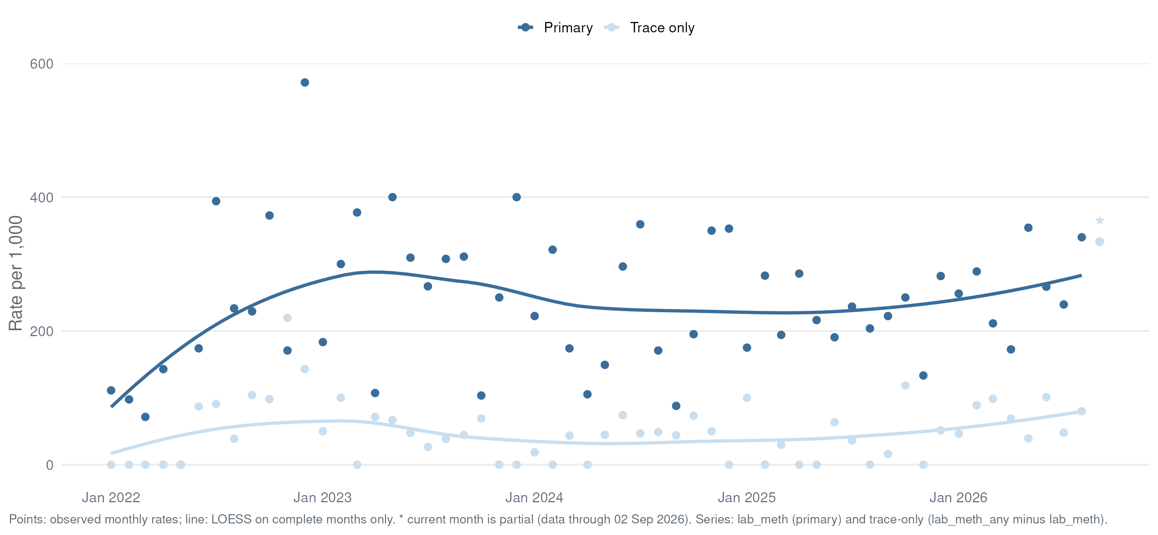
What the Lab Detects
Methamphetamine
Series: lab_meth (primary) + trace-only (lab_meth_any − lab_meth) · per 1,000/month · LOESS on complete months · * = partial month

Slide 33
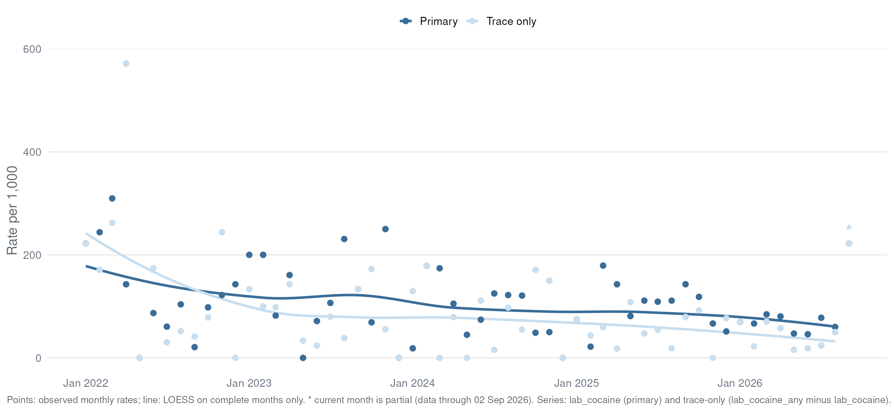
What the Lab Detects
Cocaine
Series: lab_cocaine (primary) + trace-only (lab_cocaine_any − lab_cocaine) · per 1,000/month · LOESS on complete months · * = partial month

Slide 34
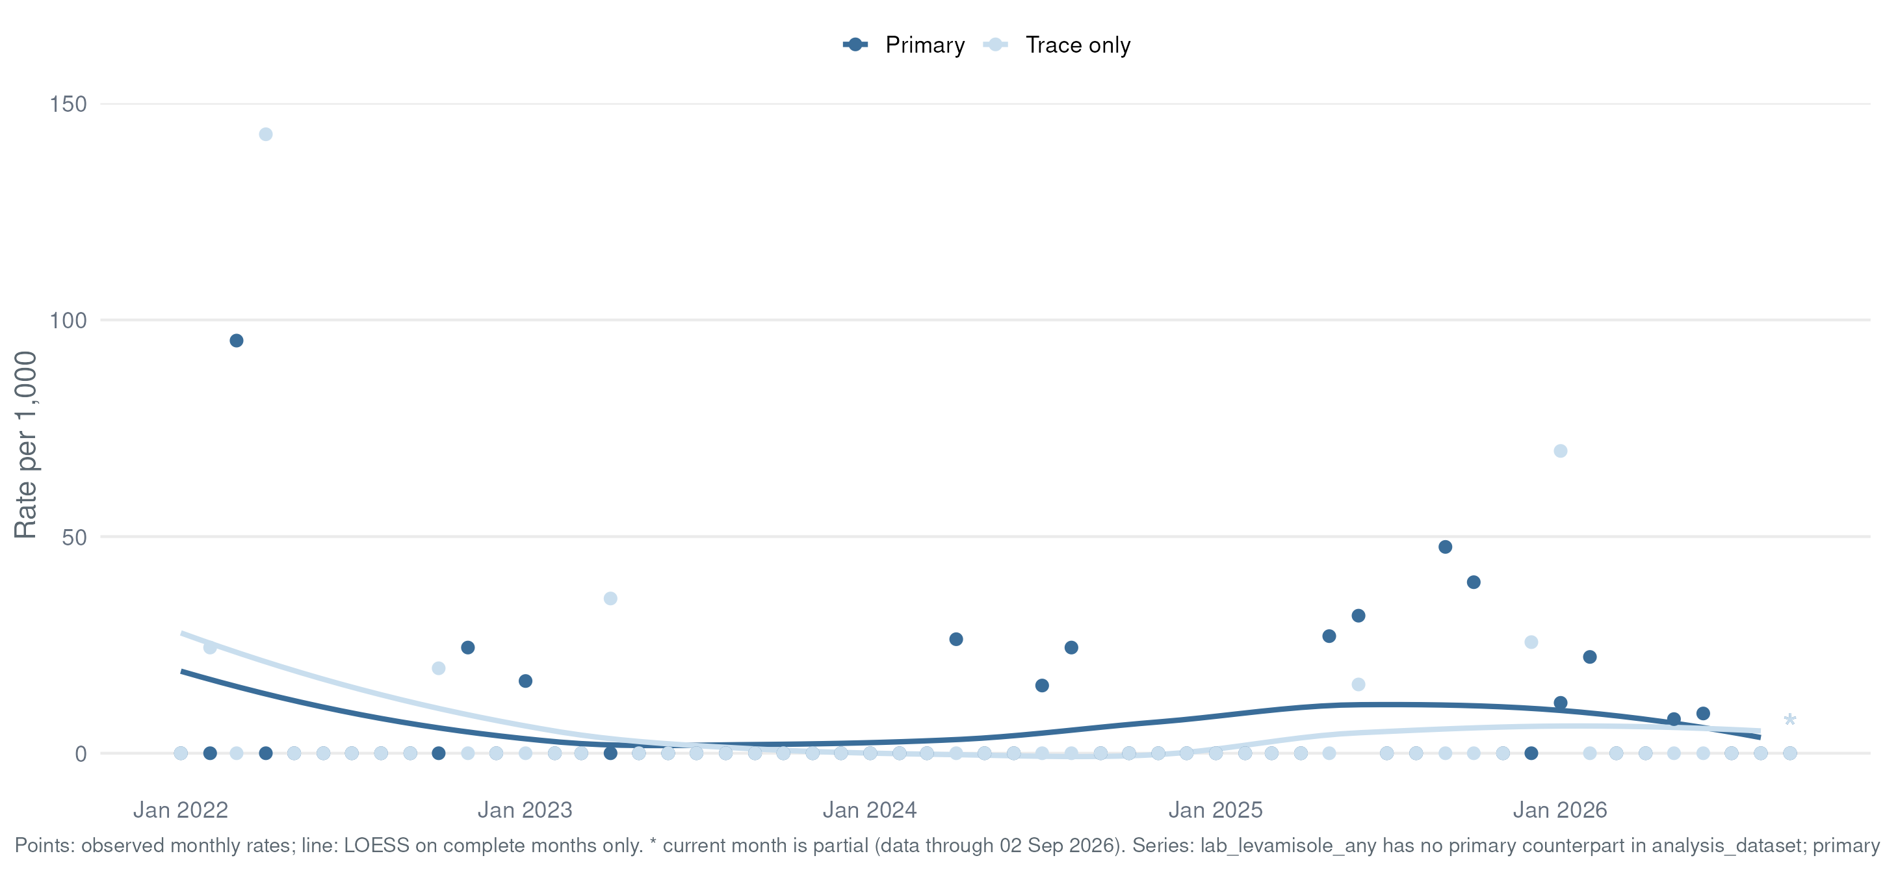
What the Lab Detects
Levamisole
lab_levamisole_any is the only derived flag — primary/trace split rebuilt from lab_detail abundance · per 1,000/month · LOESS on complete months · * = partial month

Slide 35
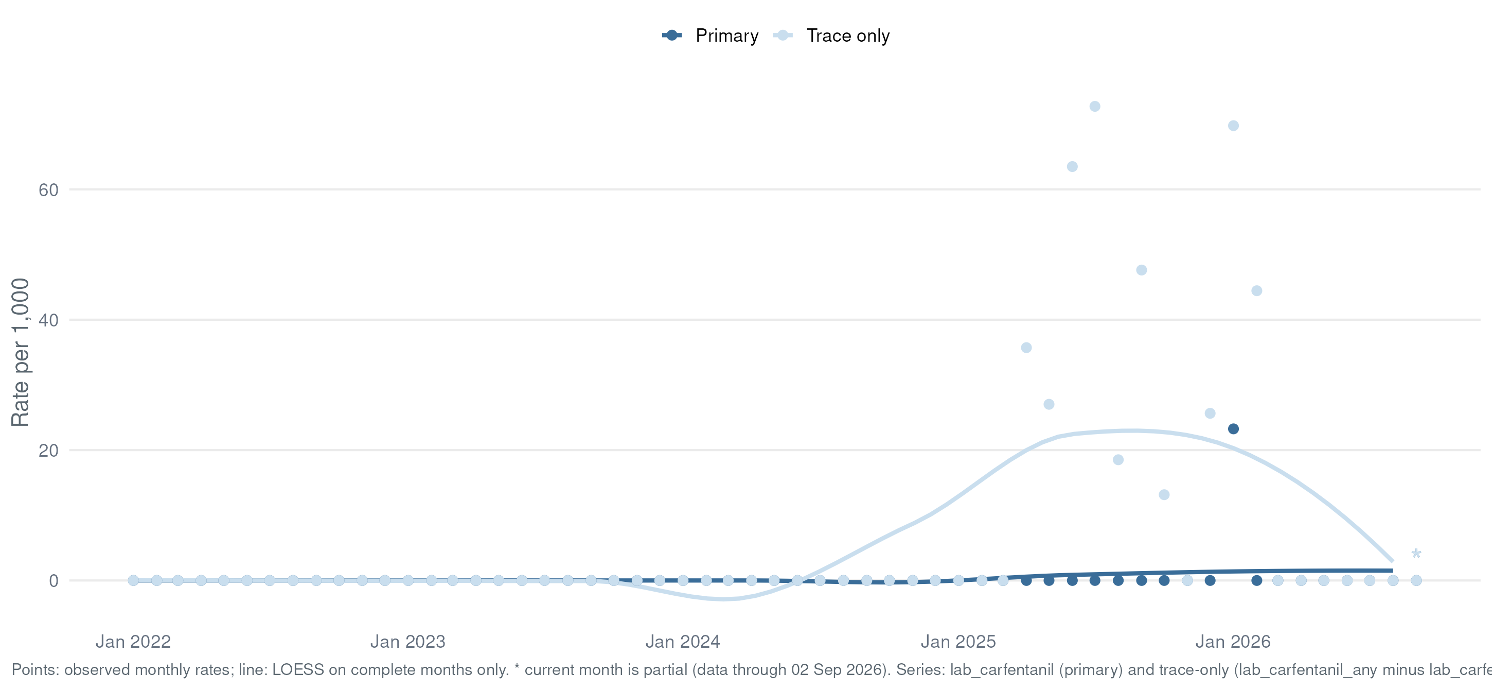
What the Lab Detects
Carfentanil
Series: lab_carfentanil (primary) + trace-only (lab_carfentanil_any − lab_carfentanil) · per 1,000/month · LOESS on complete months · * = partial month

Slide 36
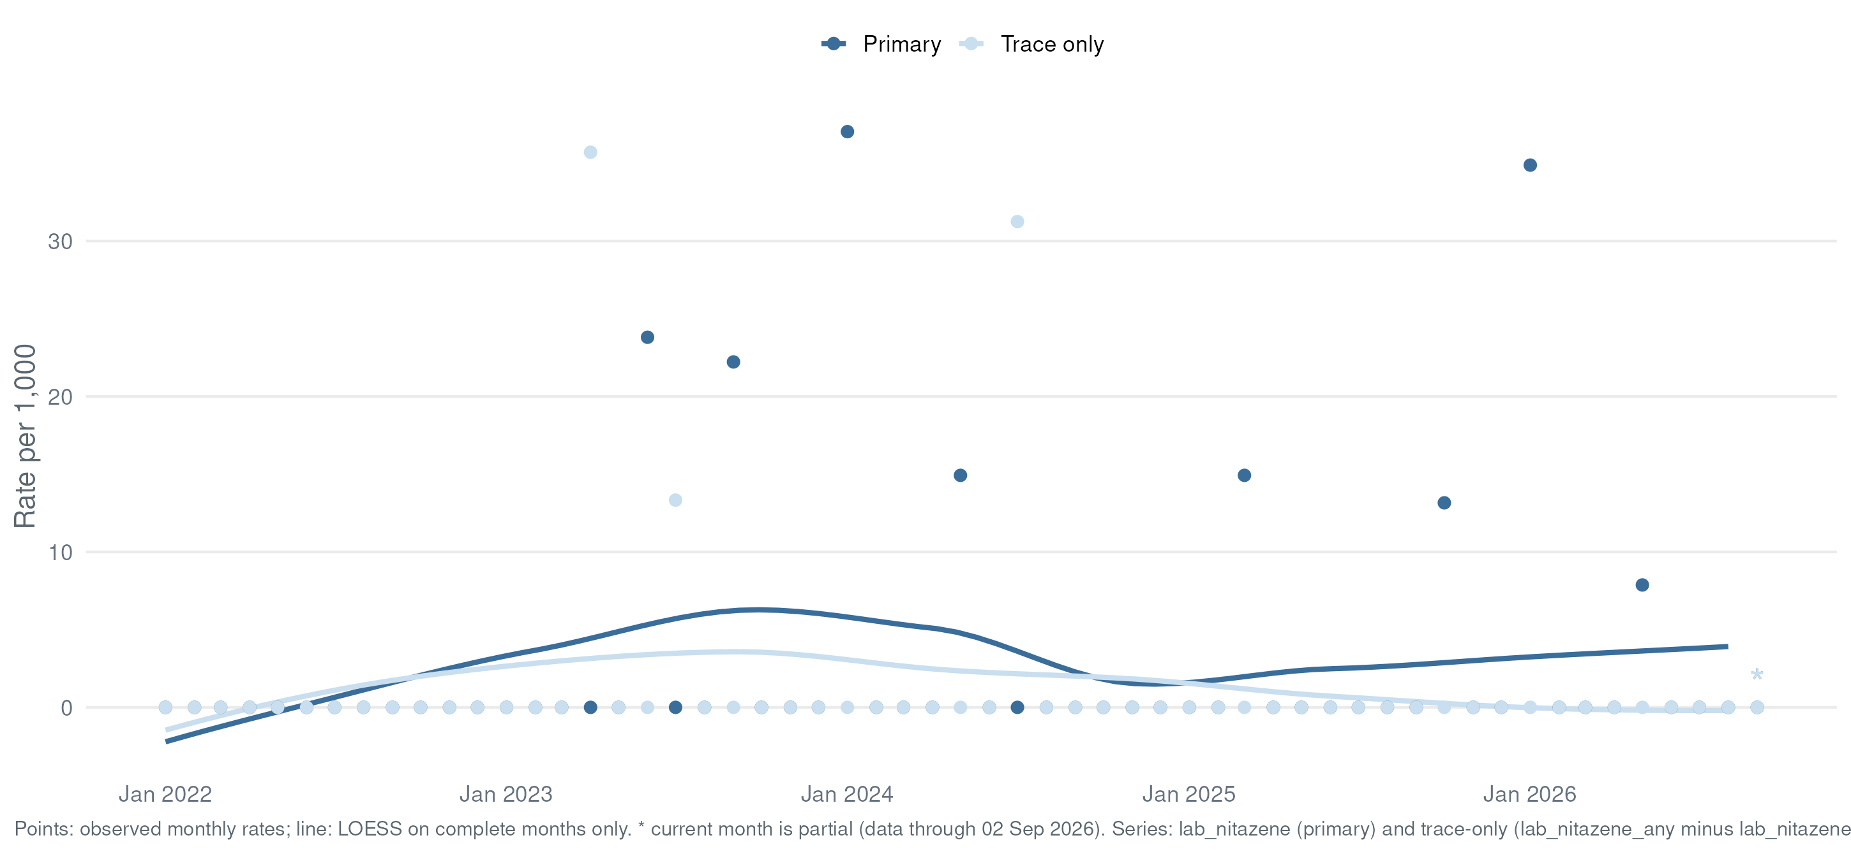
What the Lab Detects
Nitazenes
Flags from lab_detail regex 'nitazene|etonitazene|metonitazene|protonitazene|isotonitazene' · per 1,000/month · LOESS on complete months · * = partial month

Slide 37
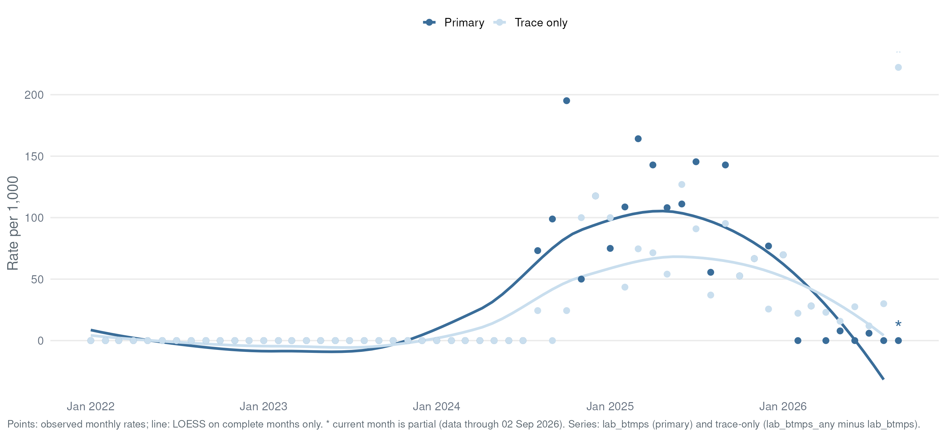
What the Lab Detects
BTMPS
Flags from lab_detail regex 'BTMPS|bis(2,2,6,6…' · per 1,000/month · LOESS on complete months · * = partial month

Slide 38
Two-Year Trends
Key Metrics, Last 24 Months
Monthly values, trailing 24 months from run date · line = LOESS on complete months · Δ = last complete month vs prior · green = favorable direction · orange point* = partial month · data table: Appendix A4

Slide 39
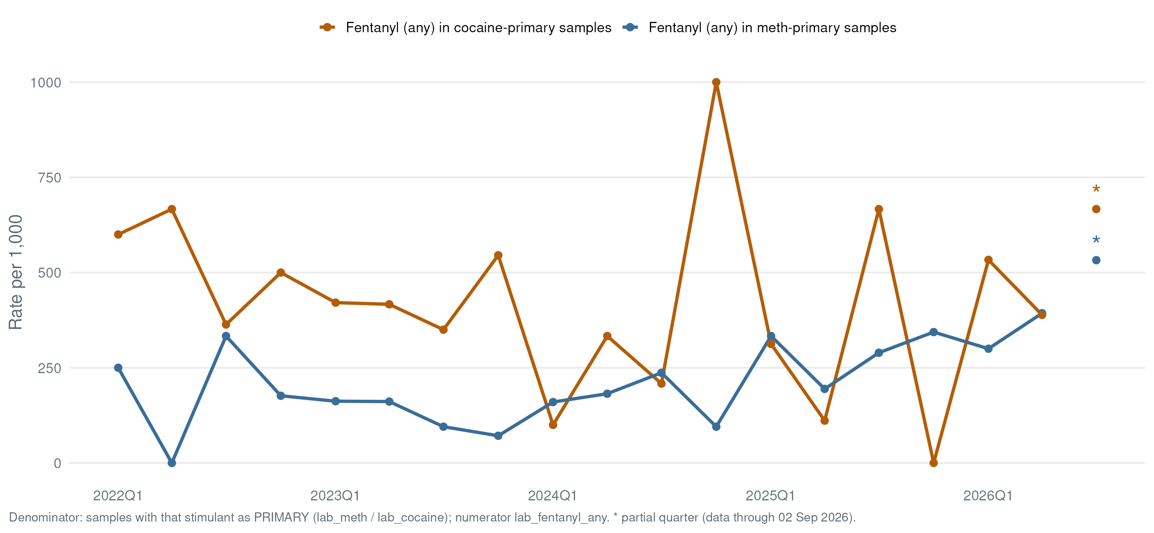
What the Lab Detects
Opioid–Stimulant Overlap
lab_fentanyl_any = 1 per 1,000 samples where lab_meth = 1 (or lab_cocaine = 1) that quarter

Slide 40
The State View
Key substances in the legacy OCME dashboard format the state expects — headline month comparison, month-to-month lines, year-to-year YTD bars, and the co-detection mix — computed from drug checking samples instead of death records.

Slide 41
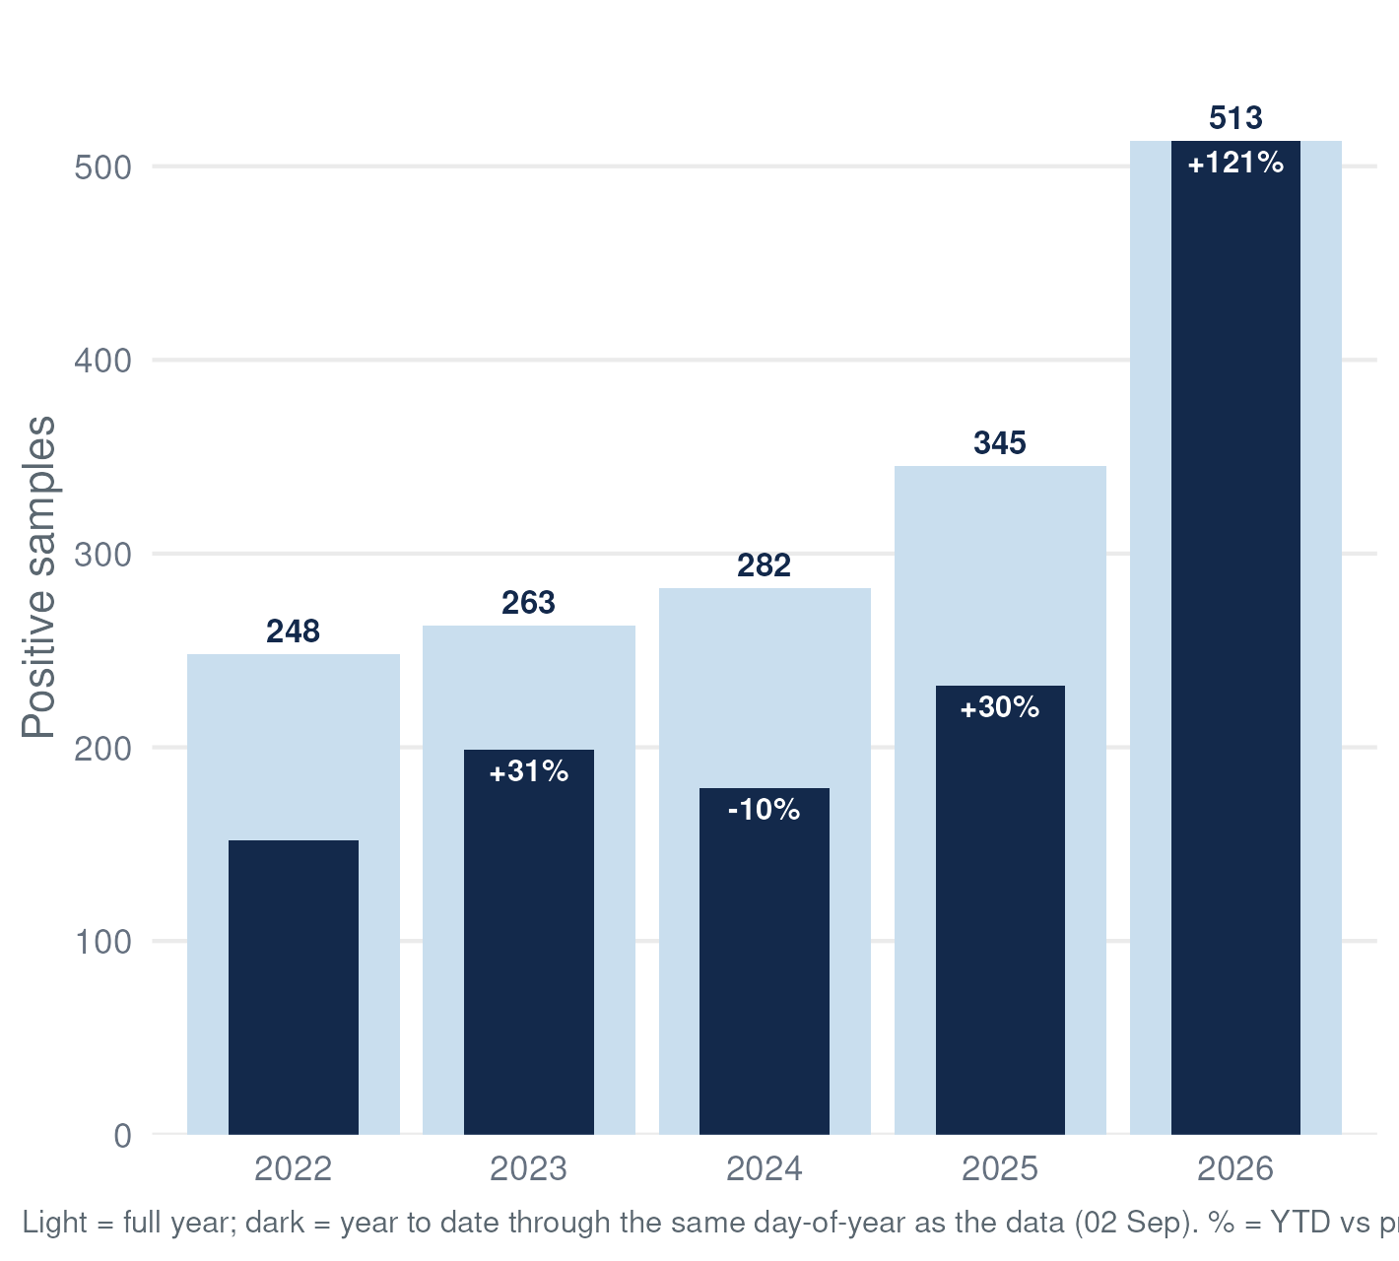
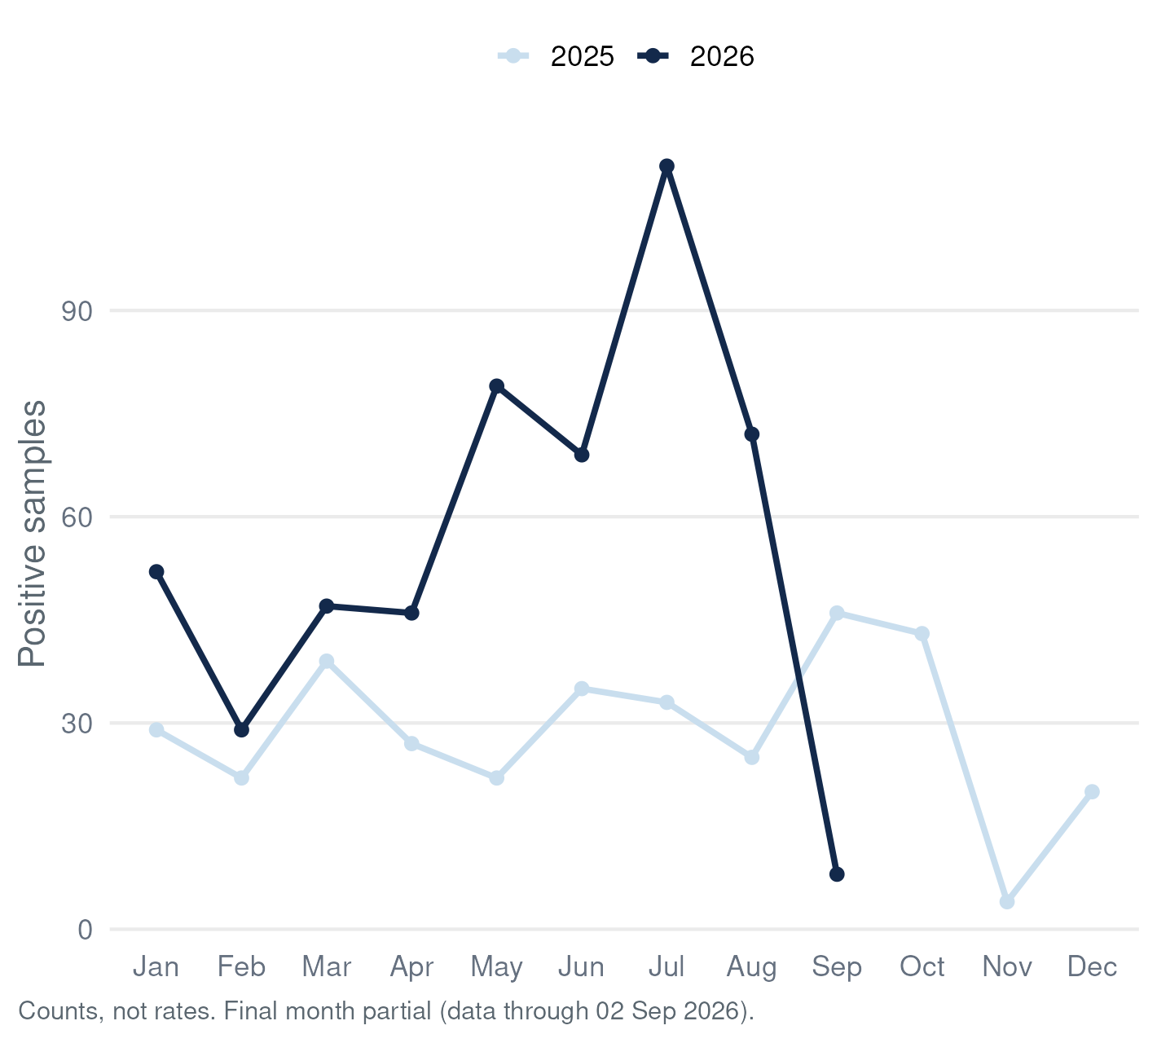
Fentanyl-Positive Samples, UNC Street Drug Analysis Lab (Drug Checking) Data: Sep 2026*

Slide 42
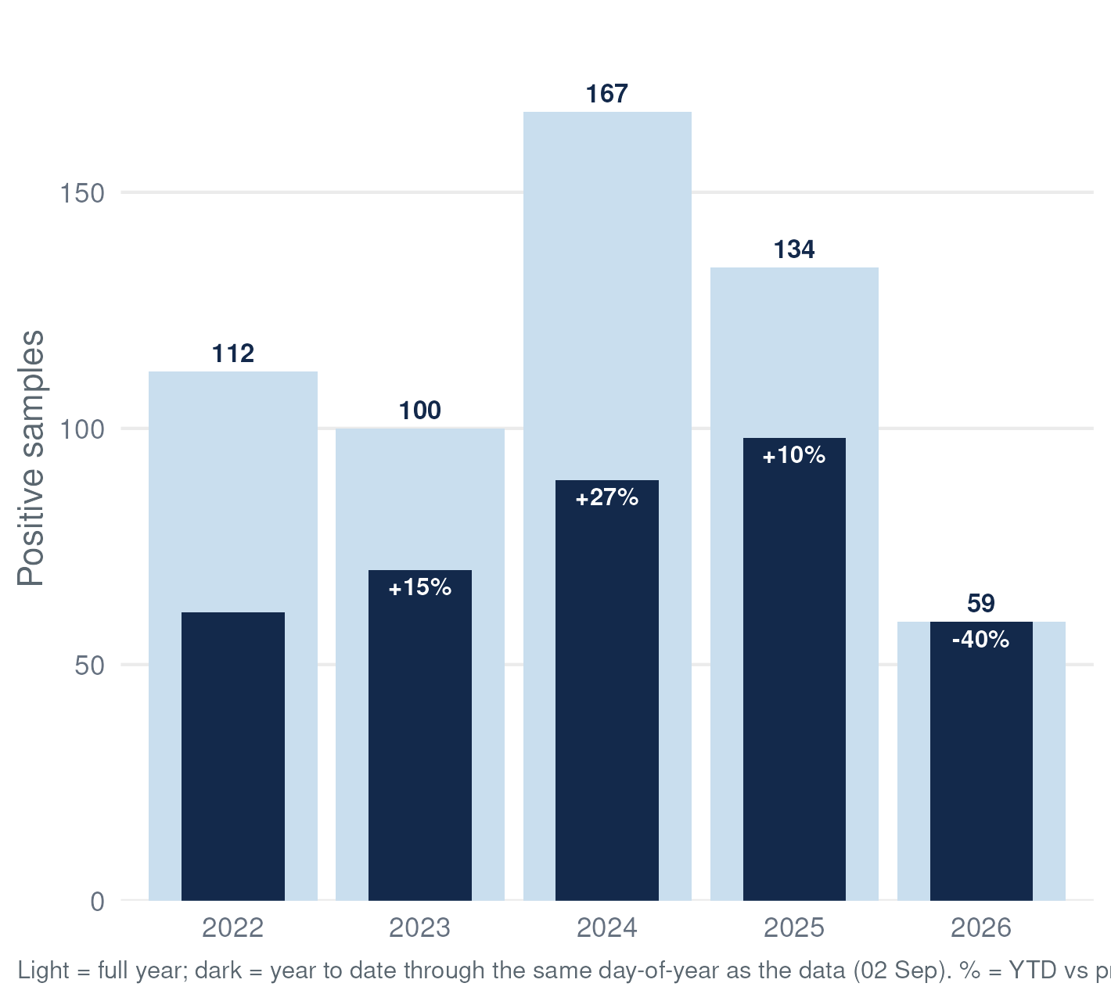
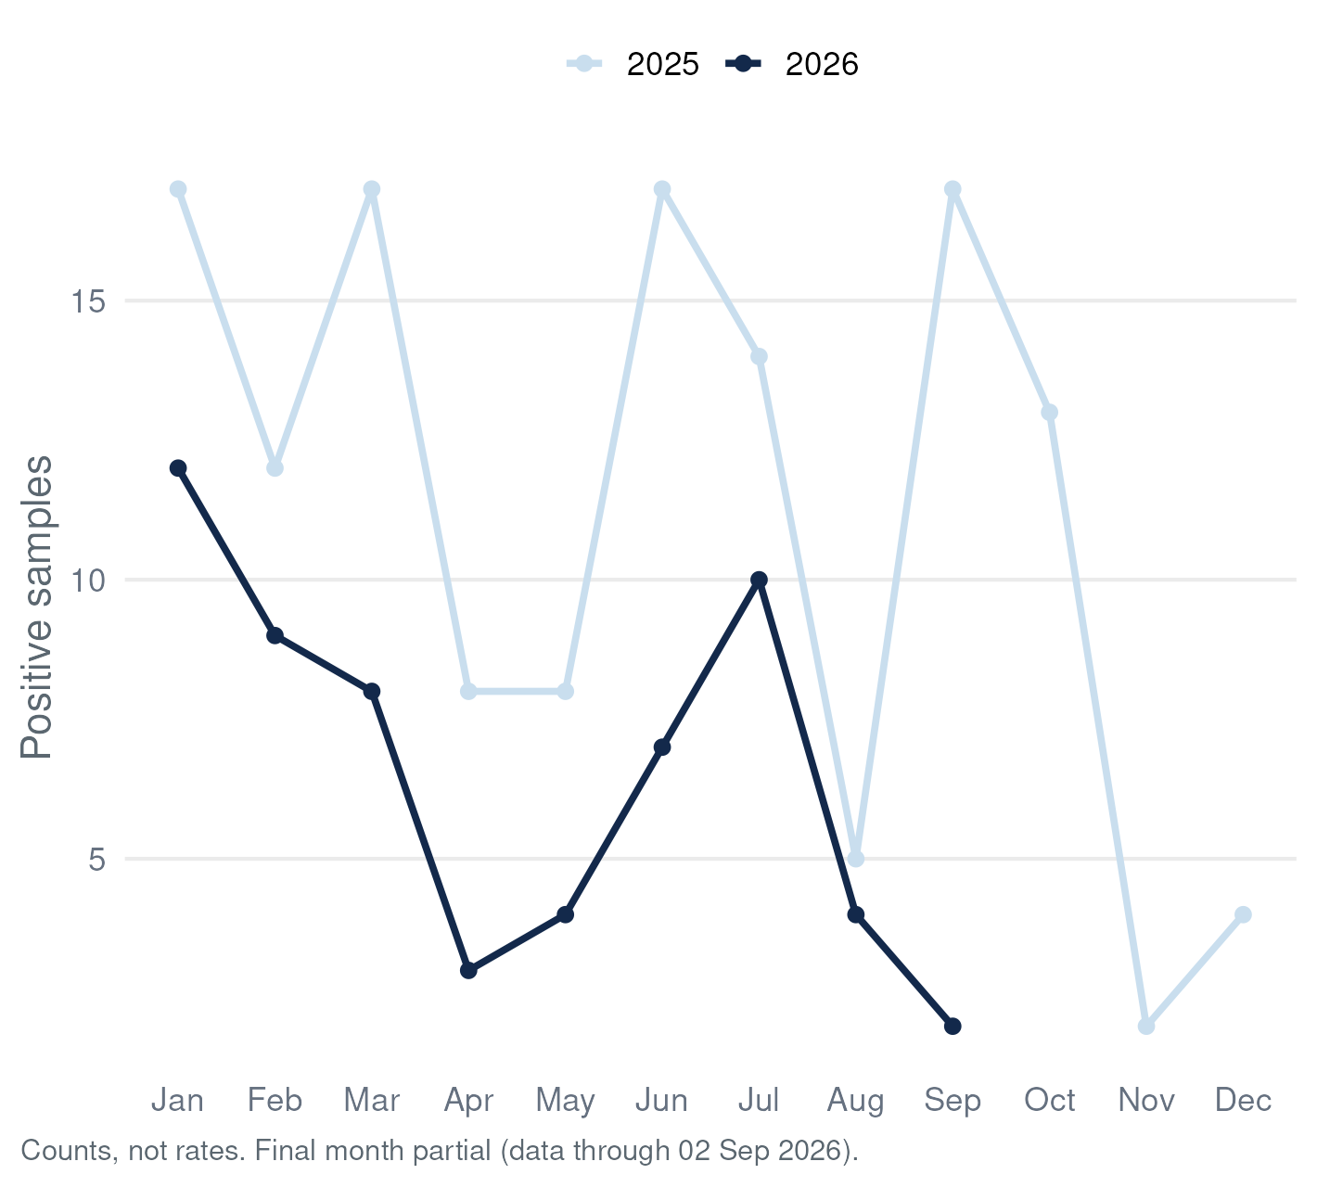
Xylazine-Positive Samples, UNC Street Drug Analysis Lab (Drug Checking) Data: Sep 2026*

Slide 43
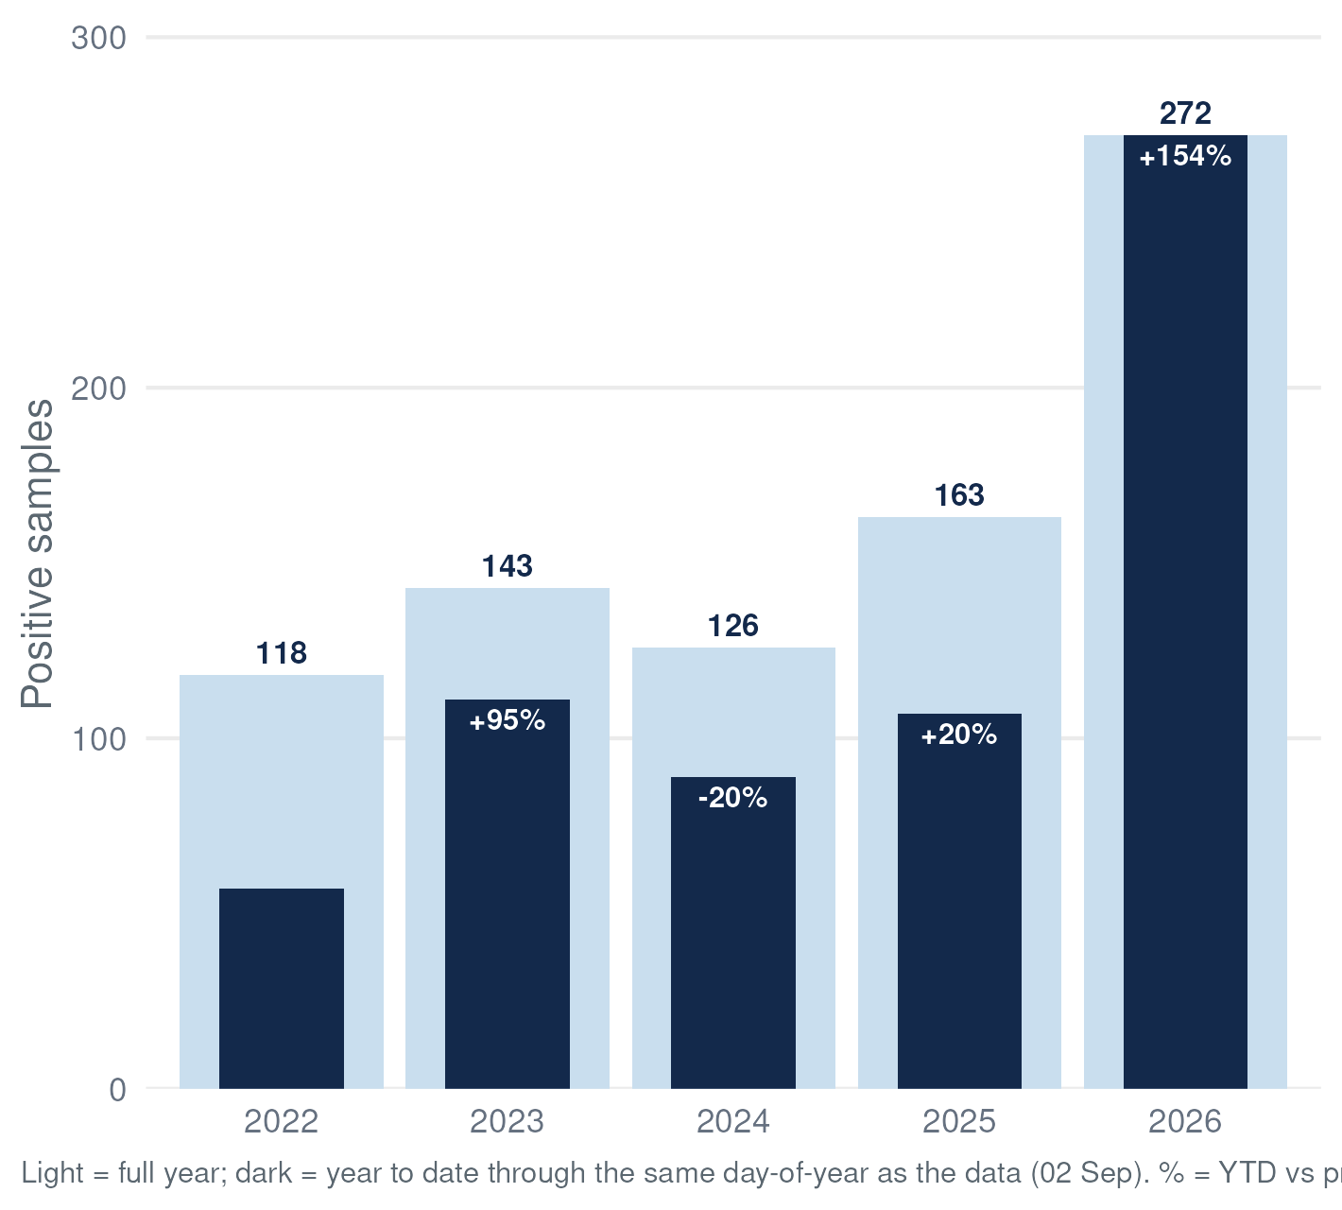
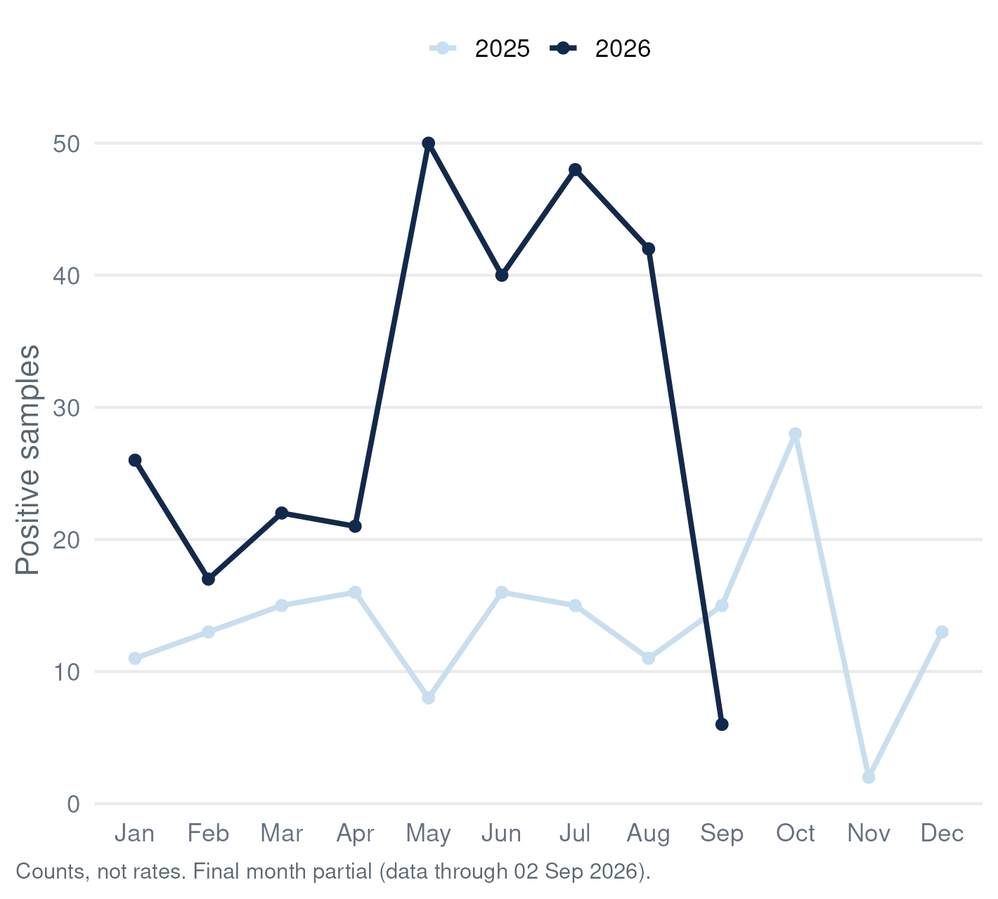
Methamphetamine-Positive Samples, UNC Street Drug Analysis Lab (Drug Checking) Data: Sep 2026*

Slide 44
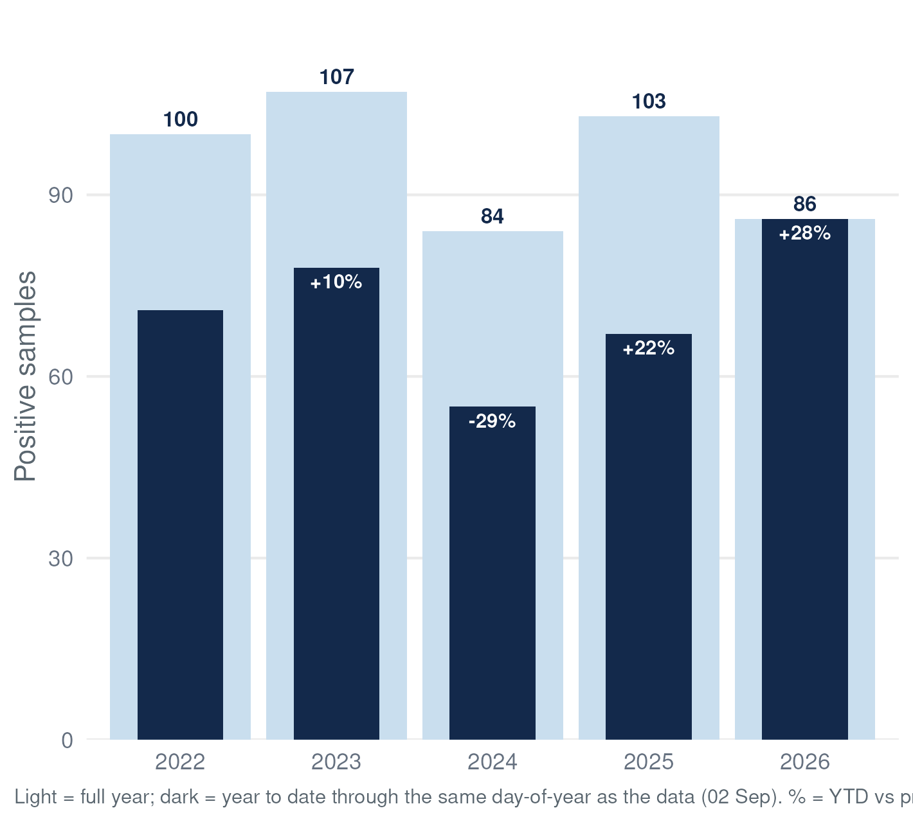
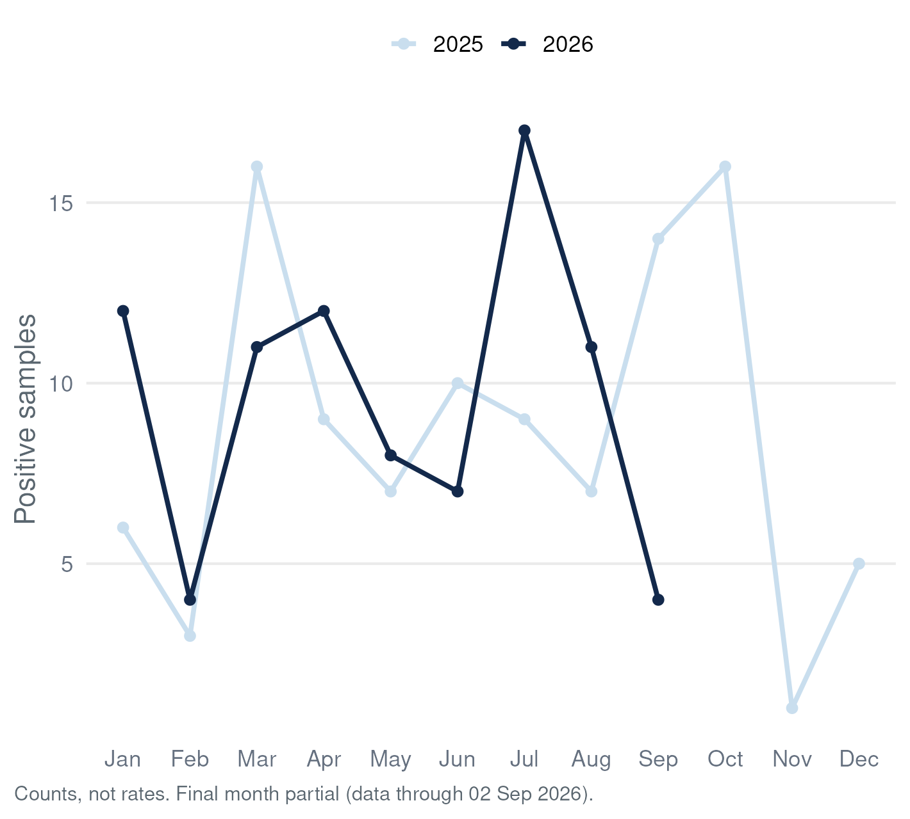
Cocaine-Positive Samples, UNC Street Drug Analysis Lab (Drug Checking) Data: Sep 2026*

Slide 45
Regional Maps
North Carolina in three regions — eastern, central, western — assigned by county of sample collection. For each key substance: prevalence per 1,000 samples last quarter, and the change from the quarter before.

Slide 46
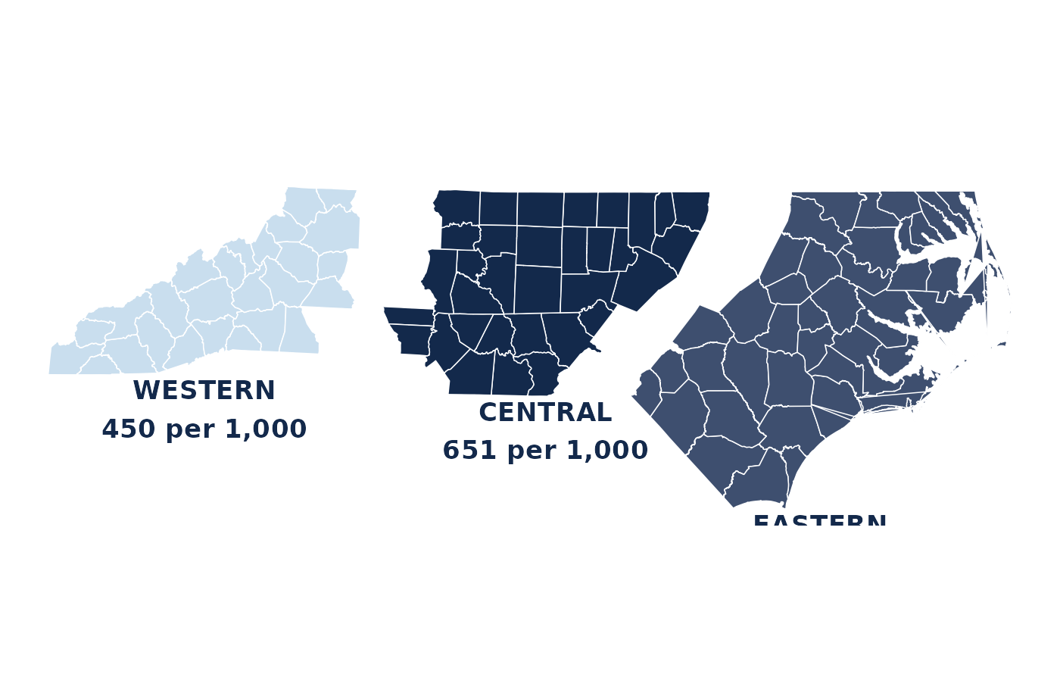
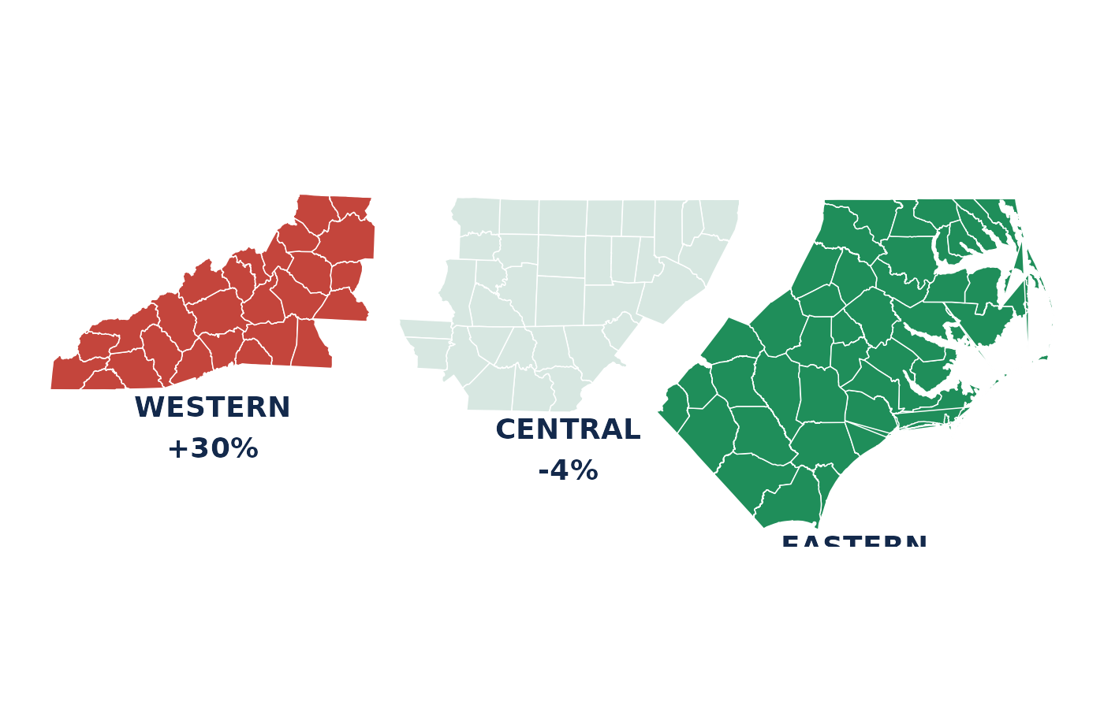
Fentanyl by Region, UNC Street Drug Analysis Lab (Drug Checking) Data: 2026Q2
Fentanyl-positive (any abundance) per 1,000 samples completed in the region, 2026Q2

Slide 47
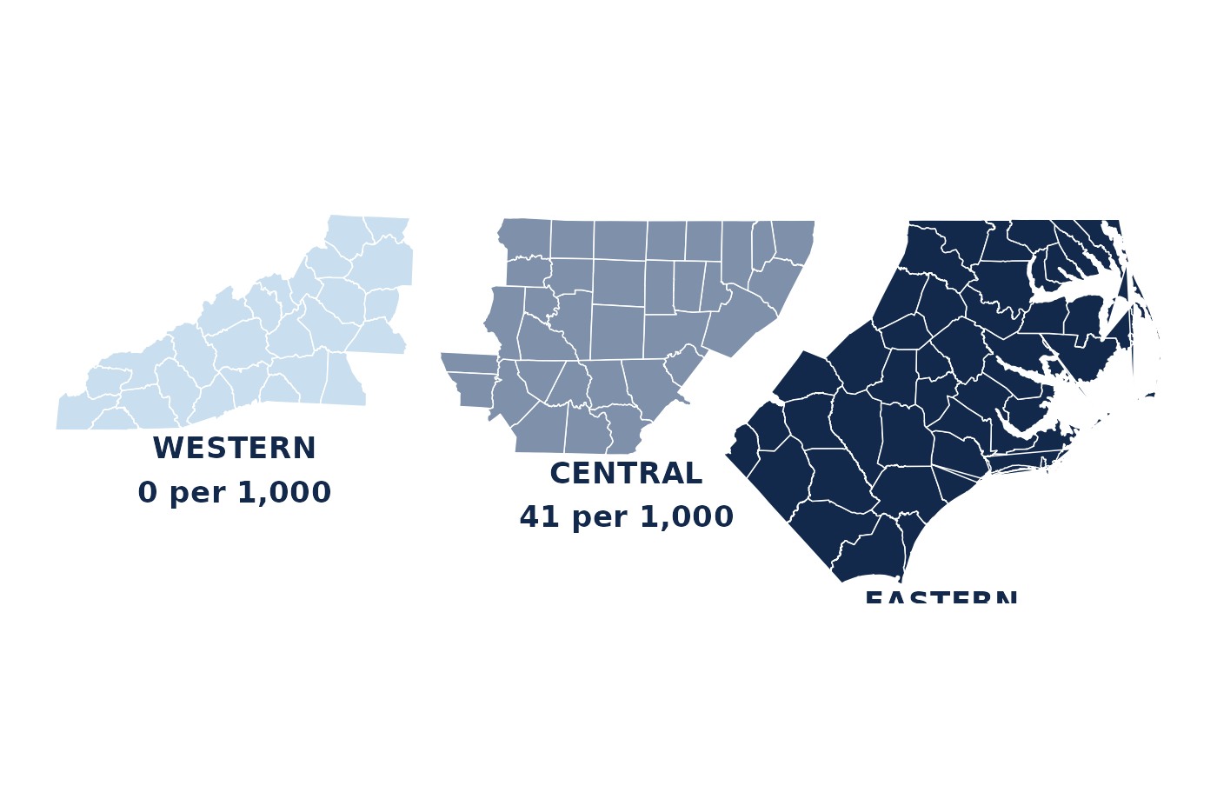
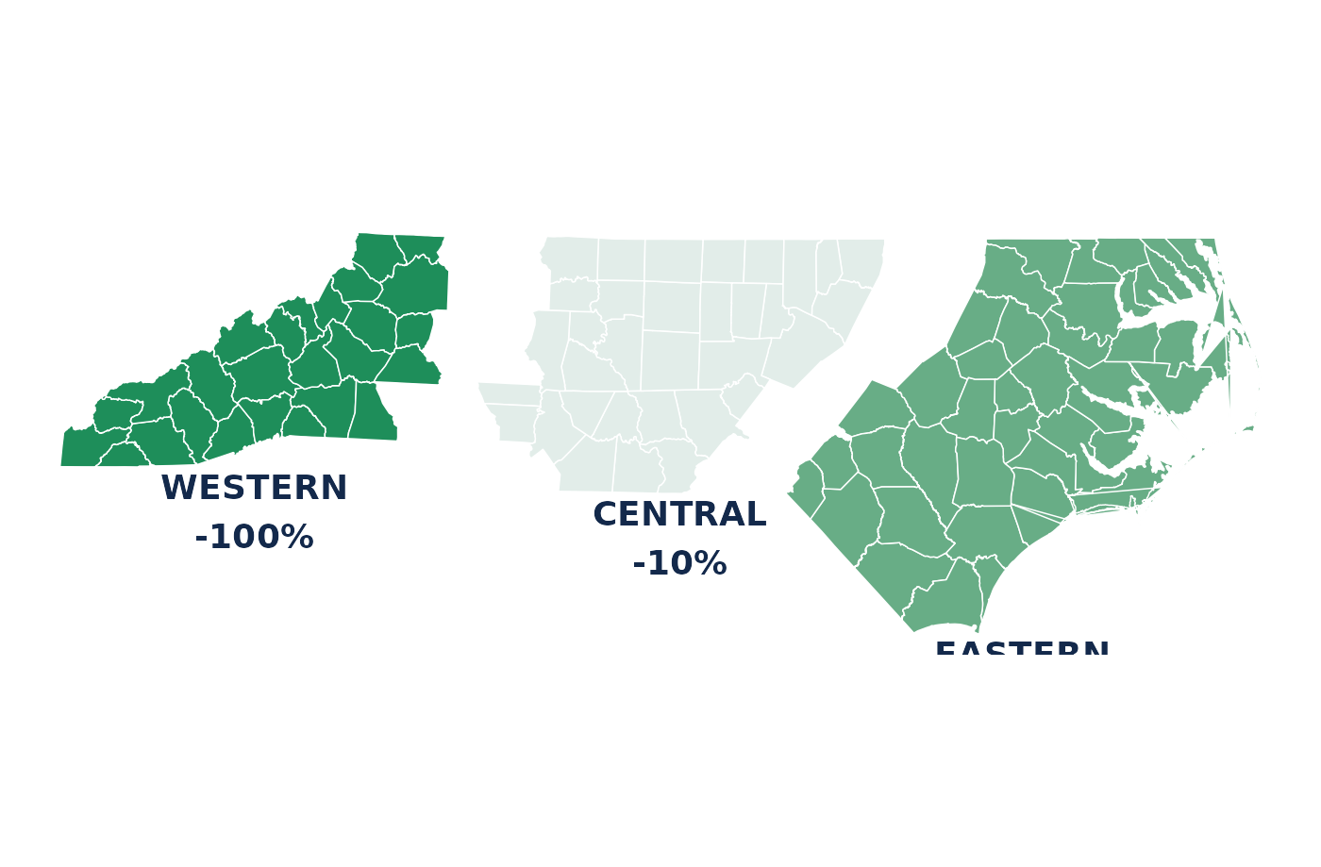
Xylazine by Region, UNC Street Drug Analysis Lab (Drug Checking) Data: 2026Q2
Xylazine-positive (any abundance) per 1,000 samples completed in the region, 2026Q2

Slide 48
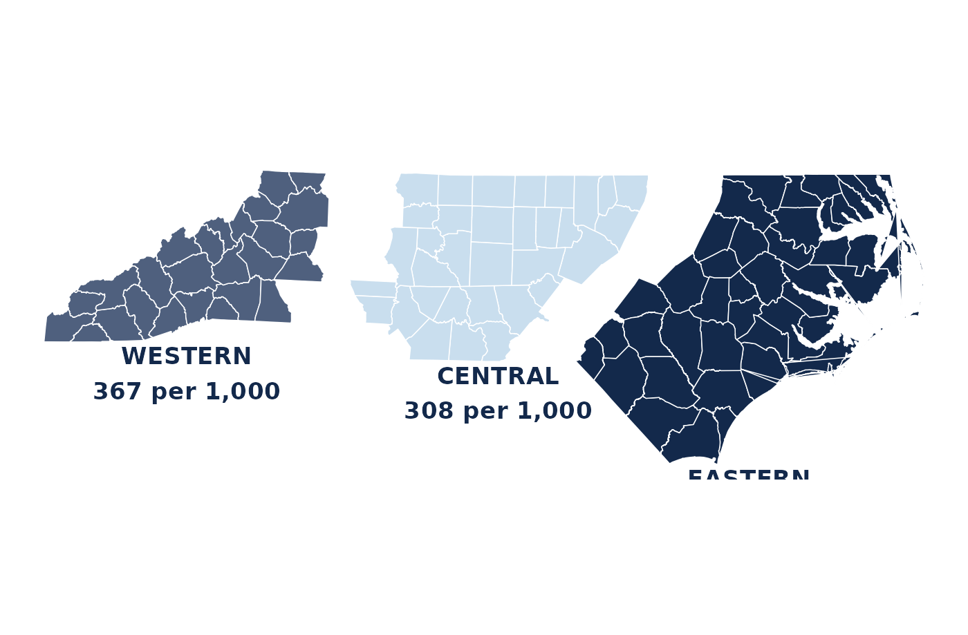
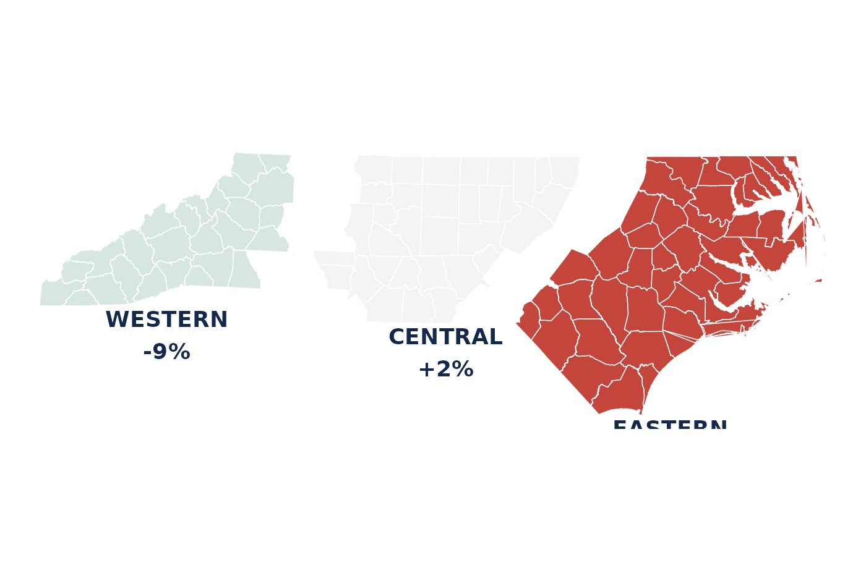
Methamphetamine by Region, UNC Street Drug Analysis Lab (Drug Checking) Data: 2026Q2
Methamphetamine-positive (any abundance) per 1,000 samples completed in the region, 2026Q2

Slide 49
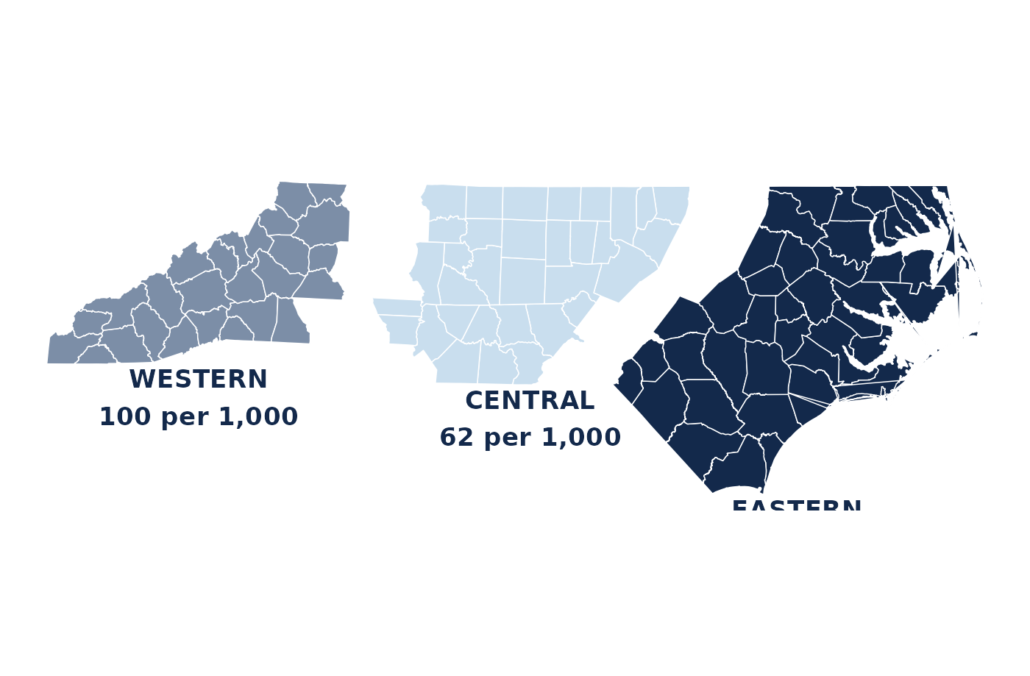
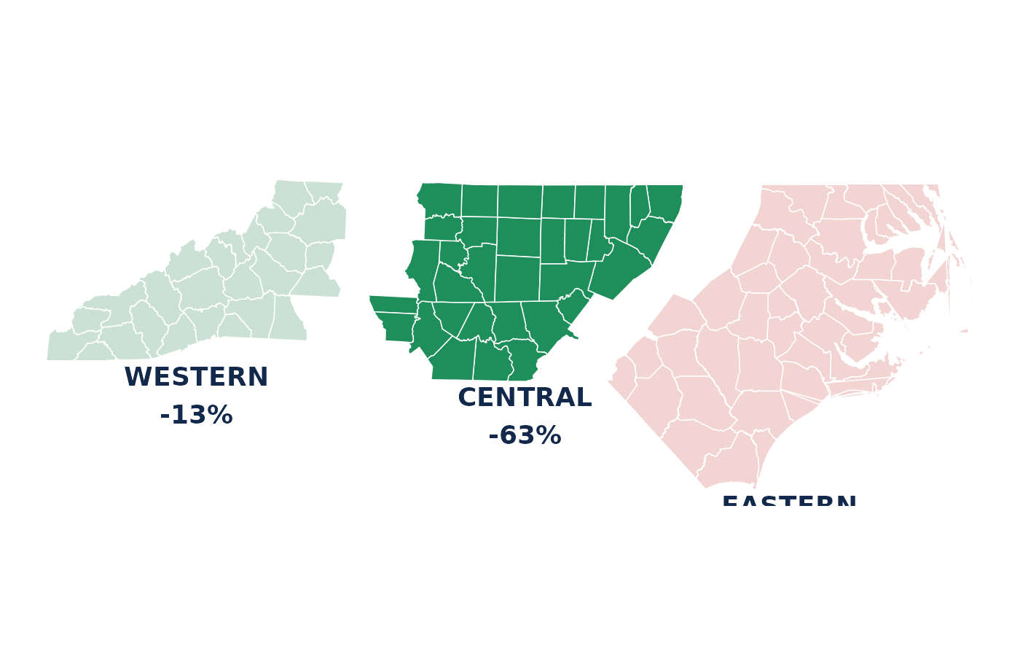
Cocaine by Region, UNC Street Drug Analysis Lab (Drug Checking) Data: 2026Q2
Cocaine-positive (any abundance) per 1,000 samples completed in the region, 2026Q2

Slide 50
New Detections
Substances appearing in North Carolina for the first time ever, surfaced within the last three months of lab completions.

Slide 51
New Detections
New to North Carolina: Last Three Months
Substance | First seen | Abundance | Detections | Sample
chlorphenamine | 02 Sep 2026 | trace | 1 | 605053
delorazepam | 11 Aug 2026 | primary | 1 | 605335
misoprostol | 06 Aug 2026 | primary | 1 | 816799
sucrose octaacetate | 30 Jul 2026 | primary | 1 | 816795
aminopyrine | 28 Jul 2026 | primary | 1 | 605808
antipyrine | 28 Jul 2026 | primary | 1 | 605809
N-(2-phenylethyl)aniline | 17 Jul 2026 | primary | 2 | 900889
fentanyl methylene homolog | 16 Jul 2026 | trace | 1 | 900796
retatrutide | 13 Jul 2026 | primary | 1 | 603217
MDMB-4en-PINACA | 10 Jul 2026 | primary | 1 | 605414
triacetin | 25 Jun 2026 | primary | 20 | 900817
2-fluoro-2-oxo-PCPr | 16 Jun 2026 | primary | 1 | 603838
Definition: min(date_complete) per substance in NC falls within the last 91 days · linked to the public sample record · data table: Appendix A5

Slide 52
New Detections
Emerging Substance Watchlist
MedetomidineFastest-growing adulterant; harder to reverse than xylazine with standard protocols.First NC detection: 2024Q4 · slide 20 BTMPSIndustrial chemical of unknown toxicity, now routine in fentanyl samples nationally.First NC detection: 2024Q4 · slide 26 Nitazene analoguesNew analogues keep appearing; potency varies wildly across the class.Newest analogue: Aug 2026 · slide 25 Curated by lab staff — the one slide reviewed by a human rather than regenerated nightly
Curated by lab staff — the one slide reviewed by a human rather than regenerated nightly

Slide 53
Fine Print
What these data can and cannot say — read before citing any number in this deck.

Slide 54
Fine Print
Data Caveats
· ~70% of samples are post-consumption — drugs often arrive because they caused unexpected reactions, inflating unusual findings · Point-of-care FTIR programs test first and may mail us their most complex samples · This is a convenience sample — rates per 1,000 samples are not population prevalence · GCMS abundance is qualitative: trace ≠ quantified concentration, and no purity is measured · Locations geocode to city/county centroids and default to the program's mailing city when blank · The current quarter is always partial; overdose involvement is only known when reported Full methods and variable notes: technical_details.md + codebook in the opioiddatalab/drugchecking repository
Full methods and variable notes: technical_details.md + codebook in the opioiddatalab/drugchecking repository

Slide 55
Fine Print
Variable Reference
Card variables expectedsubstance · expect_* sensations · sen_* color · bright_color · texture overdose · od · overdose_notes sampletype · collection · consumed location · county · state · countyfips Derived lab flags lab_&lt;drug&gt; = primary lab_&lt;drug&gt;_any = primary or trace lab_&lt;drug&gt;_trace = trace only lab_num_substances(_any) lab_null · primary · trace lab_fentanyl_impurity lab_detail columns sampleid · substance · method abundance (blank = primary) chemical-class flags PubChem CID · CAS · UNII date_complete Full codebook (96 variables): github.com/opioiddatalab/drugchecking → datasets/unc_druchecking_codebook.txt
Full codebook (96 variables): github.com/opioiddatalab/drugchecking → datasets/unc_druchecking_codebook.txt

Slide 56
Fine Print
Data Access
NC extractsdata.streetsafe.supply/datasets/NC/analysis_dataset.csv data.streetsafe.supply/datasets/NC/lab_detail.csv RefreshDaily · four formats (CSV, Stata, Excel, SAS) · link on sampleid DocumentationCodebook + technical_details.md in github.com/opioiddatalab/drugchecking Sample recordsPublic, human-readable result pages at results.streetsafe.supply TermsData Use & Protection Statement at results.streetsafe.supply/data-use Questions about access or additional chemical classifications: contact the lab via opioiddata.org Data and code released under CC0 1.0 (public domain dedication). Attribution is not required, but is requested: UNC Street Drug Analysis Lab · OpioidData.org.
Questions about access or additional chemical classifications: contact the lab via opioiddata.org

Slide 57
Data Tables
The numbers behind the key charts, as accessible tables — regenerated nightly with the figures. Chart slides point here from their footers.

Slide 58
Appendix — Data Tables
A1 · Samples Completed by Quarter
Quarter | Unique samples | Status
2022Q1 | 92 | complete
2022Q2 | 32 | complete
2022Q3 | 158 | complete
2022Q4 | 106 | complete
2023Q1 | 131 | complete
2023Q2 | 128 | complete
2023Q3 | 146 | complete
2023Q4 | 70 | complete
2024Q1 | 105 | complete
2024Q2 | 132 | complete
2024Q3 | 196 | complete
2024Q4 | 78 | complete
Chart: slide 11 · unique sampleid by calendar quarter of date_complete

Slide 59
Appendix — Data Tables
A2 · Expected Substances
Expected substance | Samples
fentanyl | 1,424
methamphetamine | 433
heroin | 302
xylazine | 252
unknown | 157
cocaine | 94
MDMA | 79
fentanyl, xylazine | 57
benzodiazepine | 55
fentanyl, methamphetamine | 50
ketamine | 50
crack | 30
Chart: slide 14 · expectedsubstance, semicolon lists split

Slide 60
Appendix — Data Tables
A3 · Expectation vs. Lab Result
Expectation | Samples | Confirmed (any abundance) | Variable
Expected fentanyl | 1,634 | 87% | lab_fentanyl_any
Expected methamphetamine | 497 | 91% | lab_meth_any
Expected cocaine | 140 | 89% | lab_cocaine_any
Expected benzodiazepine | 68 | 59% | lab_benzodiazepine_any
Expected xylazine | 358 | 52% | lab_xylazine_any
Chart: slide 15 · numerator lab_*_any among samples with expect_* = 1

Slide 61
Appendix — Data Tables
A4 · Key Substance Rates, Latest Complete Month
Metric | Per 1,000 samples | Change
Samples completed | 100 / month | -40%
Fentanyl (any) | 720 | +8%
Fentanyl impurities (any) | 720 | +19%
Xylazine (any) | 40 | -33%
Medetomidine (any) | 50 | -44%
Methamphetamine (any) | 420 | +46%
Metric | Per 1,000 samples | Change
Cocaine (any) | 110 | +8%
Levamisole (any) | 0 | n/a
Carfentanil (any) | 0 | n/a
Nitazenes (any) | 0 | n/a
BTMPS (any) | 30 | +67%
Overdose-involved | 47 | -8%
Chart: slide 37 · rate = per 1,000 unique samples completed in the latest complete month (453 samples)

Slide 62
Appendix — Data Tables
A5 · New to North Carolina, Last Three Months
Substance | First seen | Abundance | Detections | Sample
chlorphenamine | 02 Sep 2026 | trace | 1 | 605053
delorazepam | 11 Aug 2026 | primary | 1 | 605335
misoprostol | 06 Aug 2026 | primary | 1 | 816799
sucrose octaacetate | 30 Jul 2026 | primary | 1 | 816795
aminopyrine | 28 Jul 2026 | primary | 1 | 605808
antipyrine | 28 Jul 2026 | primary | 1 | 605809
N-(2-phenylethyl)aniline | 17 Jul 2026 | primary | 2 | 900889
fentanyl methylene homolog | 16 Jul 2026 | trace | 1 | 900796
retatrutide | 13 Jul 2026 | primary | 1 | 603217
MDMB-4en-PINACA | 10 Jul 2026 | primary | 1 | 605414
triacetin | 25 Jun 2026 | primary | 20 | 900817
2-fluoro-2-oxo-PCPr | 16 Jun 2026 | primary | 1 | 603838
Chart: slide 50 · min(date_complete) per substance within the last 91 days

Slide 63
UNC Street Drug Analysis Lab OpioidData.org · results.streetsafe.supply Samples gathered by North Carolina harm reduction programs and analyzed by the UNC Opioid Data Lab. This brief regenerates nightly; cite the generation date on the title slide. Data and code released under CC0 1.0 (public domain dedication). Attribution is not required, but is requested: UNC Street Drug Analysis Lab · OpioidData.org.

