Slide 1
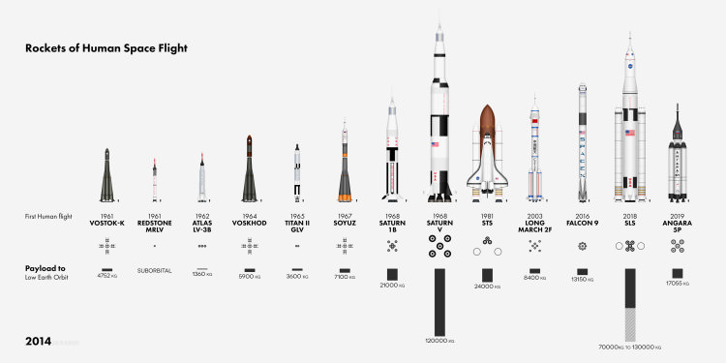
HISTORY OF SPACE EXPLORATION

Slide 2
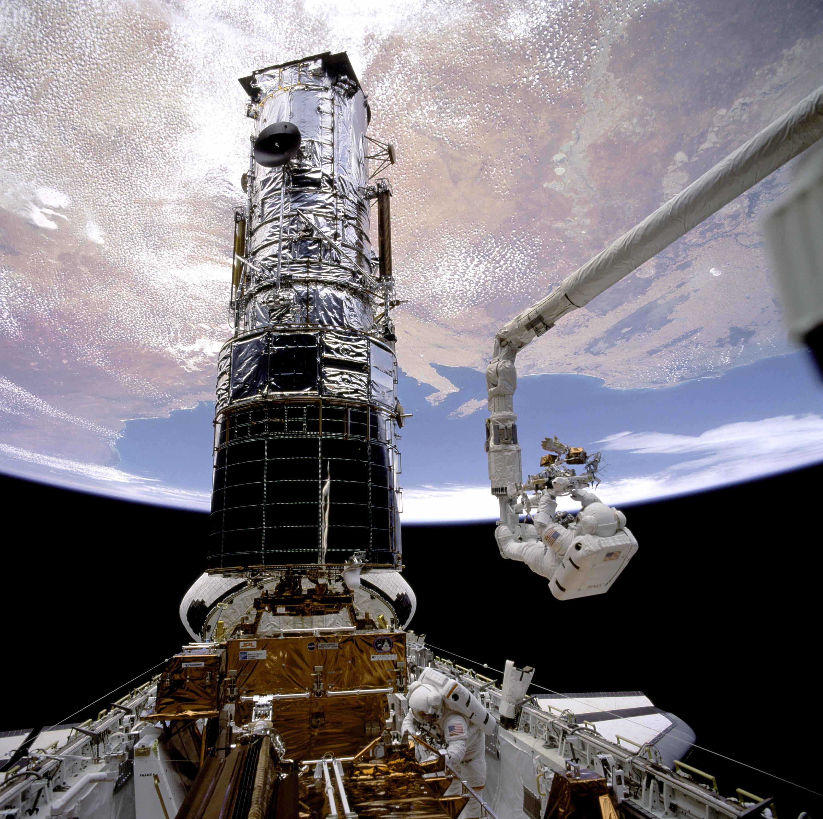
WHAT IS SPACE EXPLOATION
Space exploration is the ongoing discovery and exploration of celestial structures in outer space by means of continuously evolving and growing space technology. The study of space is carried out by the following means:
Astronomers with telescopes
Human space flight
Robotic probes

Slide 3
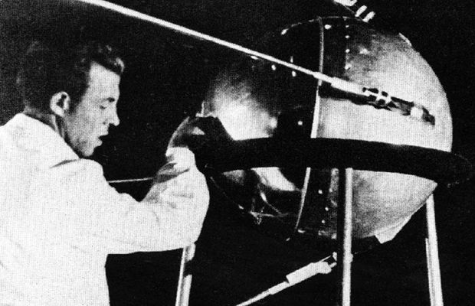
SPUTNIK I SKIMS THE SKY
The Soviet Union launched Sputnik I (“Satellite 1”) on October 4, 1957. Sputnik I orbited Earth at a height of around 160 miles. Two radio transmitters sent “beeps” at 20 and 40 MHz.
Analysis of the radio signals provided information about the ionosphere
The duration of the “beeps” reported temperature and pressure.

Slide 4
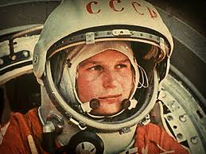
MAN REACHES SPACE
On April 12, 1961 the first successful human spaceflight was Vostok I (“East 1”), carrying 27 year old cosmonaut Yuri Gagarin. The flight made one orbit around Earth lasting about 1 hour and 48 minutes.

Slide 5
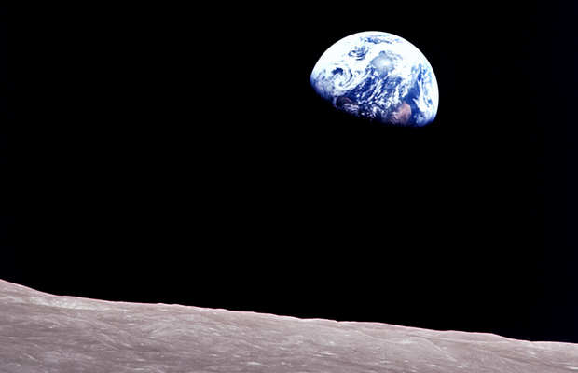
THE DARK SIDE OF THE MOON
On December 21, 1968 Apollo 8, NASA’s second manned space mission launched. It orbited the moon 10 times in 20 hours and was the first spacecraft to leave Earth’s orbit, orbit the moon, and return safely home. The three astronauts Frank Bowman, James Lovell, and William Anders were the first to:
See the far side of the moon not visible from Earth’s surface
See Earth as a whole planet

Slide 6
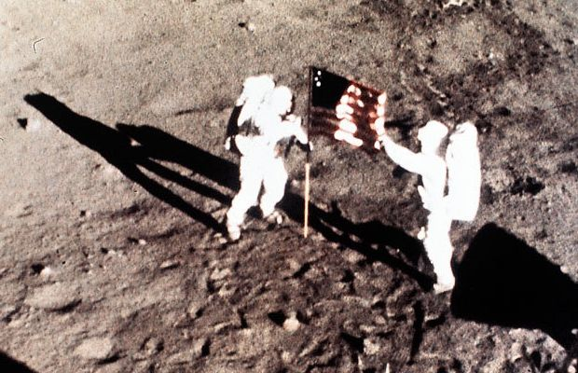
MAN WALKS ON THE MOON
On July 21, 1969 Neil Armstrong and Buzz Aldrin became the first humans to step foot on another celestial body, the moon
They spent about 2 hours and 30 minutes on the moon.

Slide 7
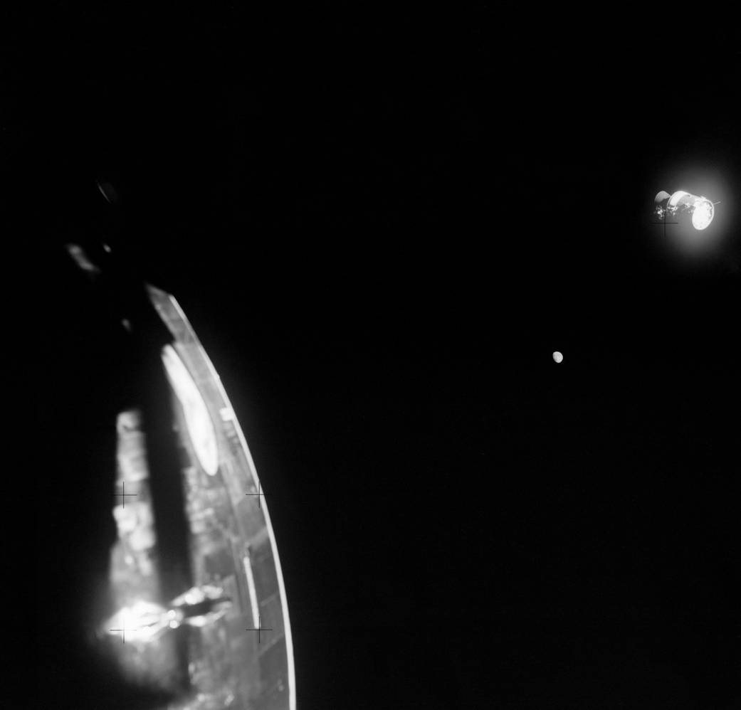
HOUSTON WE HAVE A PROBLEM
The famous saying “Houston we have a problem.” were uttered on the 1970 Apollo 13 mission. The mission was aborted due to an oxygen tank that exploded 2 days into the mission. Apollo 13 was intended to be the third manned mission to the moon. Astronauts James Lovell, John Swigert, and Fred Haise overcame:
Loss of power
Loss of cabin heat
Shortage of water
Returned home safely

Slide 8
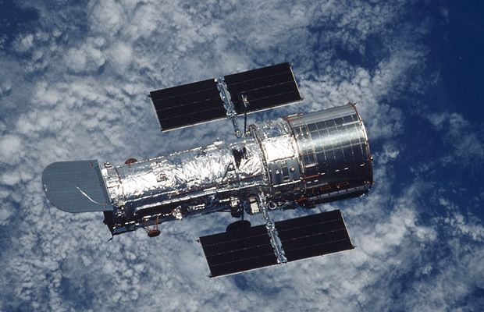
HUBBLE GOES OPERATIONAL
The Hubble Space Telescope became the first observatory placed in space in 1990. The advantages of a telescope in space are a lack of dust and clouds, therefore many powerful images have been produced by the Hubble.

Slide 9
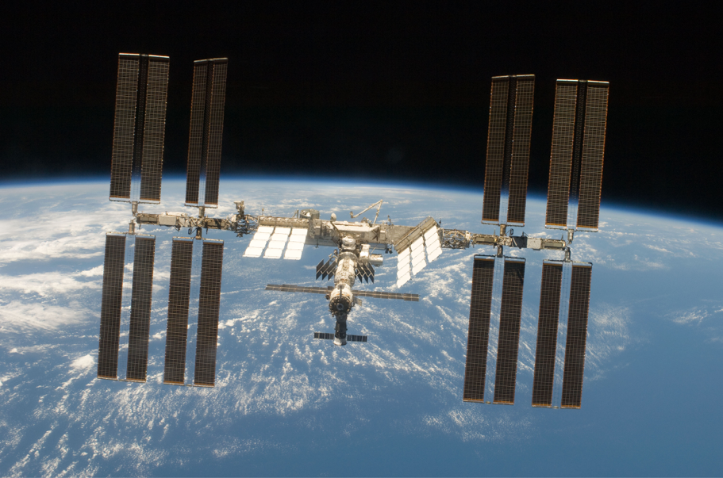
INTERNATIONAL SPACE STATION COMPLETED
The first pieces of the International Space Station (ISS) were launched in 1998
Since 2001, a crew of 2 or 6 have been aboard the ISS at all times
The ISS is the largest artificial body in orbit and can be viewed by the naked eye under the right conditions

Slide 10
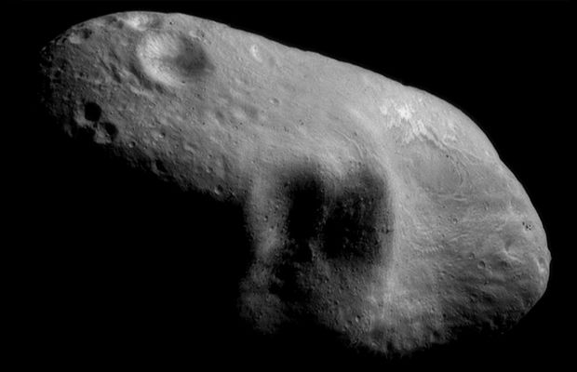
FIRST ORBITING OF AN ASTEROID
NEAR-Shoemaker was a NASA mission designed to orbit an asteroid. The asteroid NEAR was to orbit was Eros, a large near Earth asteroid, and return data on composition, mineralogy, morphology, and magnetic field to answer questions about these asteroids. Important dates of the mission are:
Launched on February 4,1996
Went into orbit around Eros February 14, 2000
Landed on Eros and sent last signal February 28, 2001

Slide 11
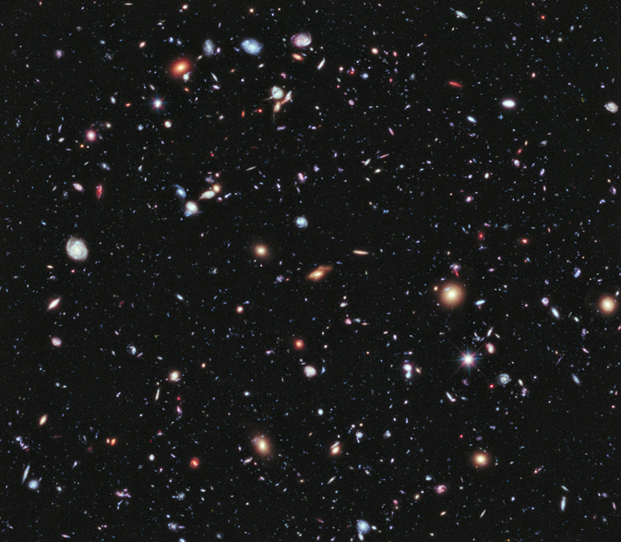
FARTHEST EVER PICTURE OF THE UNIVERSE
This image, dubbed eXtreme Deep Field, is comprised of 10 years worth of photos taken by the Hubble space telescope. The photo depicts thousands of galaxies that are light years away.

Slide 12
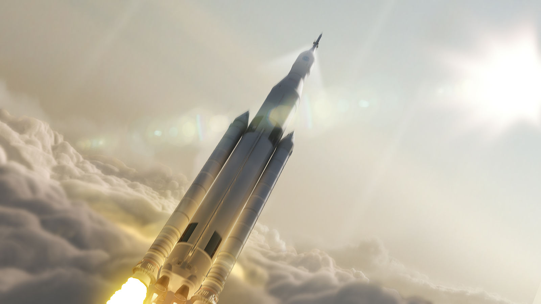
THE FUTURE OF SPACE EXPLORATION
The future of space exploration will be funded by both private investors and traditional governments. Some of the goals stated are:
China: launch a 60 ton multi-module space station into orbit by 2020
NASA: develop the space launch system (SLS) for space exploration beyond Earth’s orbit

