Slide 1
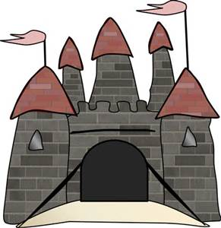
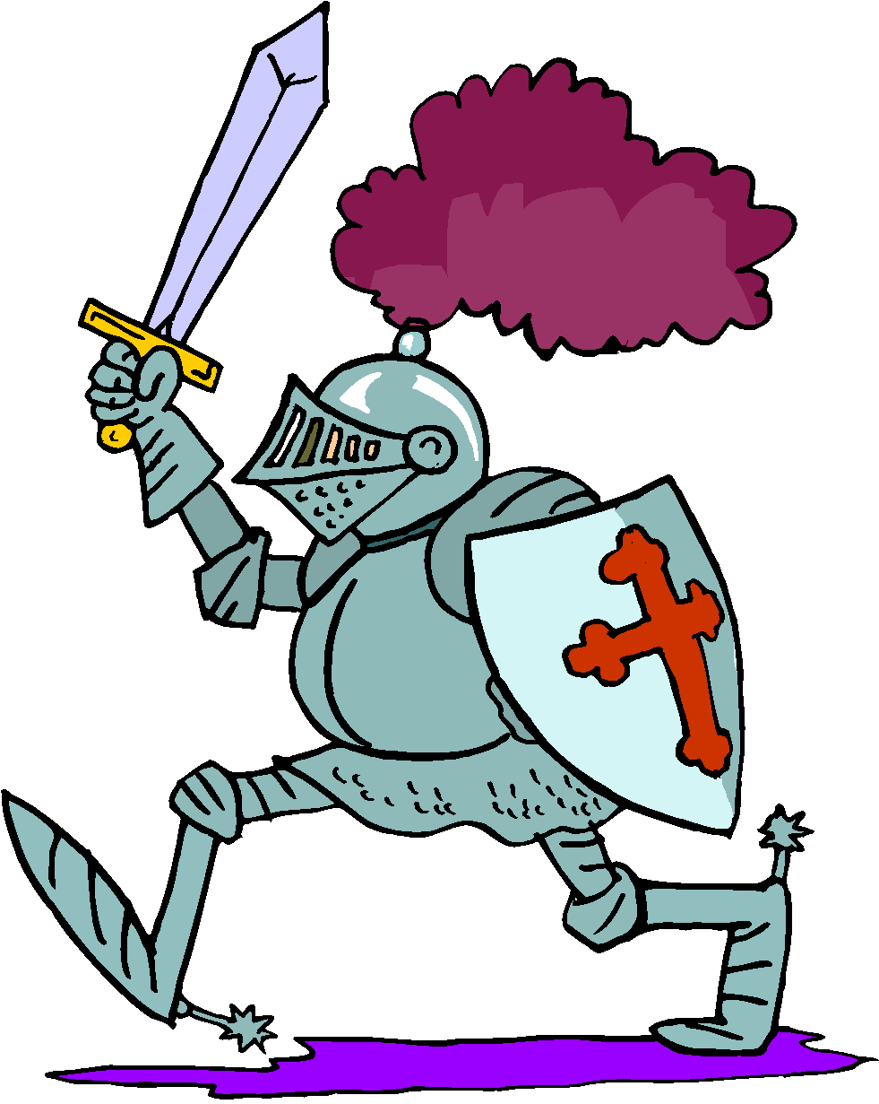
Castle Siege
Martin Rudzki Yusuf Mulyo
Git: MartinRudzki Git: YusufSM

Slide 2
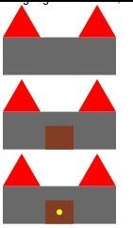
Castle
Sample Image
In Racket
Unit 1
Cost:1
Income per turn: 0
Territories owned: 0
Concept
Unit 2
Cost: 3
Goal of the game:
To spread your units across the land and capture 9 territories.
How to play:
- Each turn you get income from the amount of territories you control.
- To capture a territory your unit must be on the square by your next turn.
- At the beginning of your turn you will receive income for the total amount of territories you control.
- You can only have one unit on a territory at a time.
Bridge | Bridge | Bridge
Bridge | Bridge | Bridge
Water
Water
Water
Water
Racket Libraries
(require 2htdp/universe)
(require 2htdp/batch-io)
(require 2htdp/image)
Castle
Income per turn: 0
Unit 1
Cost:1
Income per turn: 0
Territories owned: 0
Unit 1
Unit 2
Cost: 3
Unit 2

Slide 3
Game Flow
Start Game
Add Territories
Reset Unit Movement
If it equals 9, game over.
Buy Unit
- Move Units
- Attack
- Spend Income
Unit moves on to territory
Enemy unit on territory
Select a bridge to place unit.
End turn
Next player
Can it move there?
Yes: Set territory color to player
Take both units and battle.

Slide 4
Game Objects
Player
---------------------
Income increase
Income decrease/ buy unit
Set territory count
Set active player
Set inactive player
--------Variables----------
Income count
Territory count
Boolean: Current player active
Static: Player 1,2
Territory
-------------------------
Add space occupied/color
Remove space occupied/color
(Fight object1 object2)
--------------Variables-----------
Ownership/color
Boundaries of rectangle (Top, bottom, left, right)
Is Current space occupied/ Object Unit
Units
------------------------
Reset movement
Consume movement
------------Variables-----------
Static: Ownership of unit
Static: Max movement
Static: Unit class
Movement remaining
Unit Picture

Slide 5
Group Responsibilities
Martin Rudzki @MartinRudzki
Making the PowerPoint slides art
Implementing the territory class
Implementing the board Drawing the background/UI
Drawing the castle and units
Implementing the rules
Yusuf Mulyo @YusufSM
Looking into the library for the game engine
Implementing the unit class
Implementing the board
Implementing the rules
Implementing human interaction

Slide 7
The Goal/Concept:
The goal of the game is to spread out your troops to capture 9 territories of the board and hold onto those territories by your next turn.
In this game you will be able to create two types of units, a weak warrior and a strong warrior. Each type of unit has a different cost amount, total moves it can travel across the board, and attack power.

Slide 8
How to play: This is a two player game. One person will be the Blue Team and the other Red Team. Once it is your turn you will be able to spend money to build units and then move your units to take over territories. To attack, move a unit on top of another unit and whoever has the highest dice roll wins, defender had advantage on a tie. Once you can no longer take an action hit end turn.
 | Cost | Moves | Attack
Weak Warrior | 1 | 1 | 1-6
Strong Warrior | 3 | 2 | 1-6

