Slide 1
2048-Game
Henry Walker Tim Barber

Slide 2
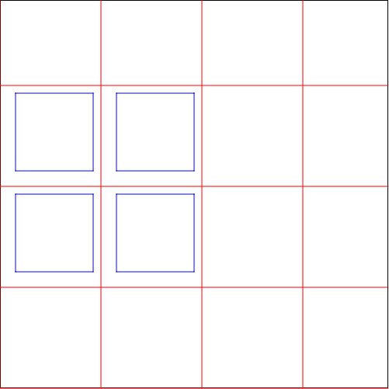
We will be making the game 2048 using turtle-graphics. A player will need to combine tiles of the same color to form a new tile with a different color.
The player is given a limited amount of space and each movement of a tile produces a new tile.
The player must try and combine as many squares as possible before the playing area is full and no moves are left.

Slide 3
