Slide 2
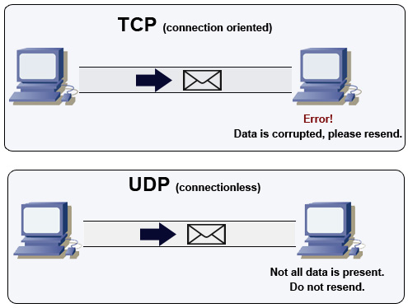
What are TCP and UDP?
TCP
Stands for Transmission Control Protocol
Provides connectivity between a program and the Internet
Focuses on reliability
If data is lost or corrupted, TCP will request that the data be retransmitted
UDP
Stands for User Datagram Protocol
Sometimes known as Unreliable Datagram Protocol
Does not require prior connection to transmit
Focuses on speed
If data is lost or corrupted, UDP doesn’t care

Slide 3
What is Racket?
Racket is a general purpose coding language that is related to Scheme and Lisp
Lisp was developed in 1958 and is one of the oldest high-level programing languages still in use
In Lisp, all code is written as s-expressions. Racket expands upon this through the use of macros
Racket makes it easy to translate your ideas into code
Everything in Racket is either a single value (atom) or a list. This code as lists idea is what helps make Racket so expressive
Racket is a functional language, which helps to prevent inadvertent data mutation
Racket can be used to create new programming languages
Hello World! Program
Racket
“Hello World!”
C
public class HelloWorld { public static void main(String[] args) { System.out.println(
"Hello world"); } }

Slide 4
Hackerman
Machine Object
(define (machine ip ports protocols)
(define open-tcp '())
(define open-udp '())
(define udp-socket (udp-open-socket) )
(define msg (make-bytes 100) )
(define (add-udp port)
(set! open-udp (cons port open-udp)))
(define (add-tcp port)
(set! open-tcp (cons port open-tcp)))
(define (check-uport port)
(if (memq port open-udp) #t #f))
(define (check-tport port)
(if (memq (string->number port) open- tcp) #t #f))
Dispatch
(define (dispatch message)
(cond((eq? (car message) 'tports) (match-ports open-tcp))
((eq? (car message) 'dtports) open-tcp)
((eq? (car message) 'uports) open-udp)
((eq? (car message) 'ip) ip)
((eq? (car message) 'tport) (check-tport (cadr message)) )
((eq? (car message) 'uport) (check-uport (cadr message)) )
(else error "Bad moves, dude")))
(begin (udp-bind! udp-socket "127.0.0.1" 0)
(map (lambda (x) (probe-tcp x)) (enum-ports ports))
(map (lambda (x) (probe-udp x)) (enum-ports ports)) dispatch))

