Slide 1
RCAP
A Network Scanner Utilising TCP and UDP
Josh Everett @josh-everett
Jennifer Green @goldenapplepie

Slide 2
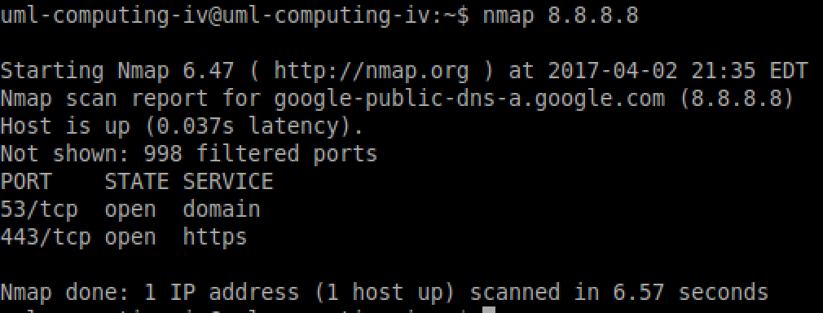
Our goal is:
to create a machine object capable of holding a list of open ports
use racket/TCP and racket/UDP to scan over the ports of a target machine
determine whether each port is open or not, and if open, add it to our list of open ports
check the list of open ports against the list of common ports to determine what the port is used for
report the list of open ports and their purposes back to the user
extend this functionality to include entire subnets of machines

Slide 3
