Slide 1
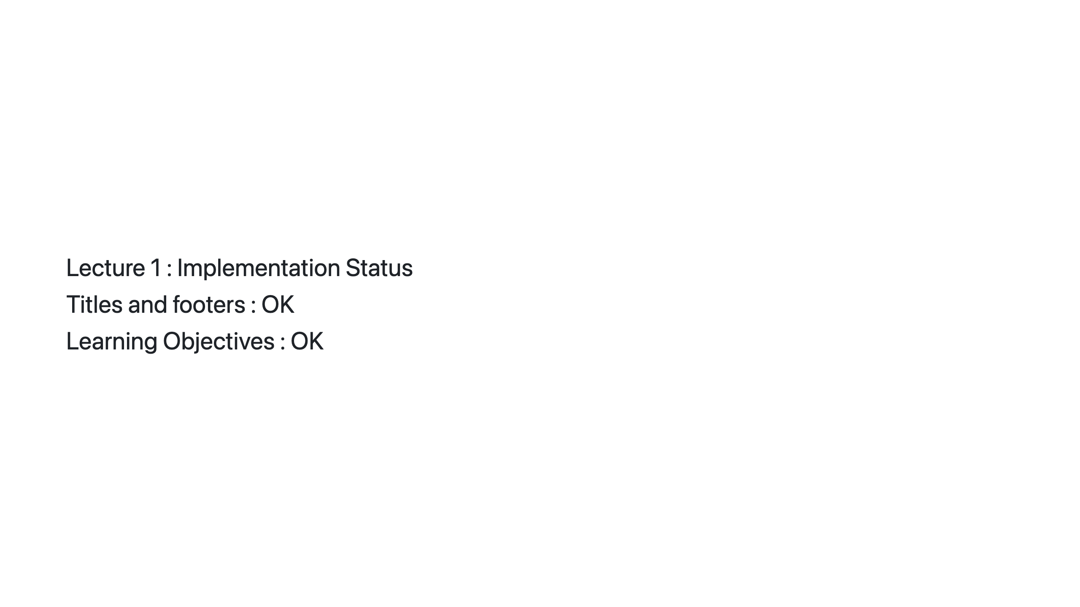
Notes:
© Copyright 2026 Olivier Planson. All rights reserved. Reproduction prohibited. Made with IBM Bob.

