Slide 1

Data Warehousing and
Data Mining
Presentation for Project Evaluation
Ondrej Platek
Peteris Nikiforovs
January 19, 2012

Slide 2


Domain
Daily newspaper
The Wall Street Journal
printed
on-line
Notes:
The domain of this data warehouse project is a fictional daily newspaper, modeled
after The Wall Street Journal (WSJ or the Journal). The Journal was founded in
the 19th century, was active throughout the 20th century as printed newspaper
and in 1996 launched an online version.
It produces a daily printed edition which is delivered to subscribed customers
worldwide and sold at newspaper stands. The same content is also available on
the website. The online edition is available to authenticated paid subscribers
only.
<number>

Slide 3


Data Warehouse Objectives
Multiple data sources
Notes:
Multiple sources
100 years
Launched online edition
<number>

Slide 4
Data Warehouse Objectives
Largest newspaper in the US by circulation
400k online subscribers
Notes:
WSJ is the largest newspaper in the United States by circulation and has more
than 400,000 online paid subscriptions. As such, the amount of data accumulated
over the years is huge and was not designed to be stored for efficient analysis. As
a result, it’s very inefficient to extract useful information as the business queries
would take a long time when run on production databases.
<number>

Slide 5
Business Processes
Selling subscriptions
Advertising
Online content analysis
Notes:
The Journal mainly generates revenue from subscription sales. Since it is an
international newspaper, it’s important to break down the sales by countries and
regions. It’s also necessary for the company shareholders to visualize the growth
over the years, taking into account the data from both editions.
In addition to subscriptions, the Journal places ads in the paper and generates
revenue from it. The company would like to know how much revenue it generates
and compare it to the subscription sales.
Lastly, the paper cares about the quality of its content. The Journal mainly
covers economics and business topics and financial news. Since it’s possible to
track all user actions on the website, the data warehouse would allow testing of
introduction of new content, identifying most popular articles, determine least
successful authors, etc..
<number>

Slide 6

Subscriptions

Slide 7
Subscriptions

Slide 8
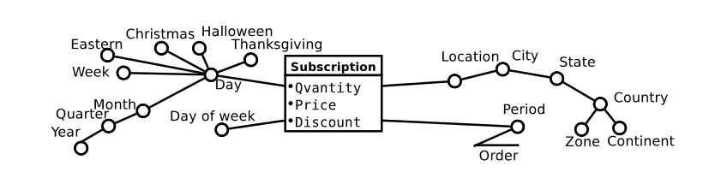
Subscriptions: Fact

Slide 9
Subscriptions: Business Queries
Revenue from subscriptions by year and country
Top 10 least profitable cities taking into account subscription sales & population
How much would we earn without applying discounts on subscriptions, by period type and by year?
Compare sales on various holidays in different countries

Slide 10



Advertising

Slide 11
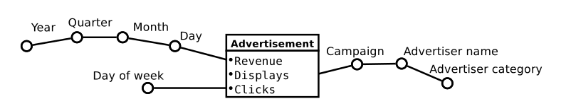
Advertising: Fact

Slide 12


Advertising: Business Queries
Revenue by advertisers from the ”Middle Fish” category who have greater revenue than the average of the ”Big Fish” bias=0.5 together with average of ”Big Fish” advertisers?
CPM (clicks divided by displays) for the top 10 advertisers by revenue together with the average CPM for advertisers category for the advertisers that have at least 15 campaigns?
The campaigns that lasted more than 5 months with revenue bigger than 140k at least in once over the past 5 month, all in year 2011?

Slide 13
Content Analysis

Slide 14
Content Analysis: Fact

Slide 15
Content Analysis: Business Queries
Top 10 read articles and their authors for every month in year 2011?
Compare the number of reads/shares/comments of articles tagged with tags `positive` and `negative` for each year?
Hours of the day when most articles are read grouped by category in year 2010 together with the average number of articles read during this hour in the same year?

Slide 16


Logical & Physical Design
Star schema
Oracle

Slide 17
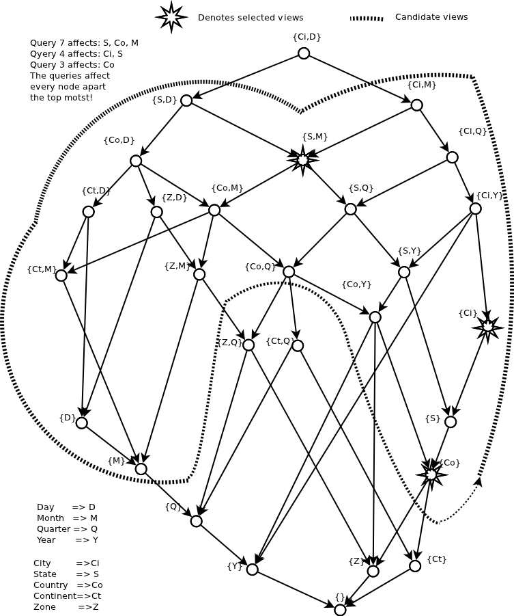

Slide 18
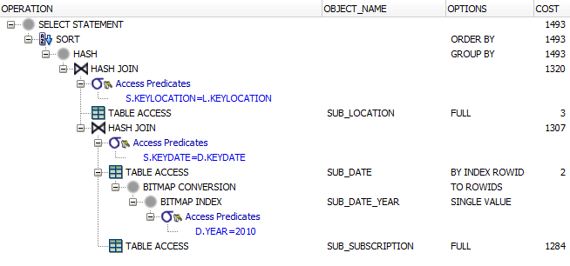
Execution Plan

Slide 19

Android Data Mining
Git logs
Bugs
Bugs Comments

Slide 20


Open Source Tools

Slide 21
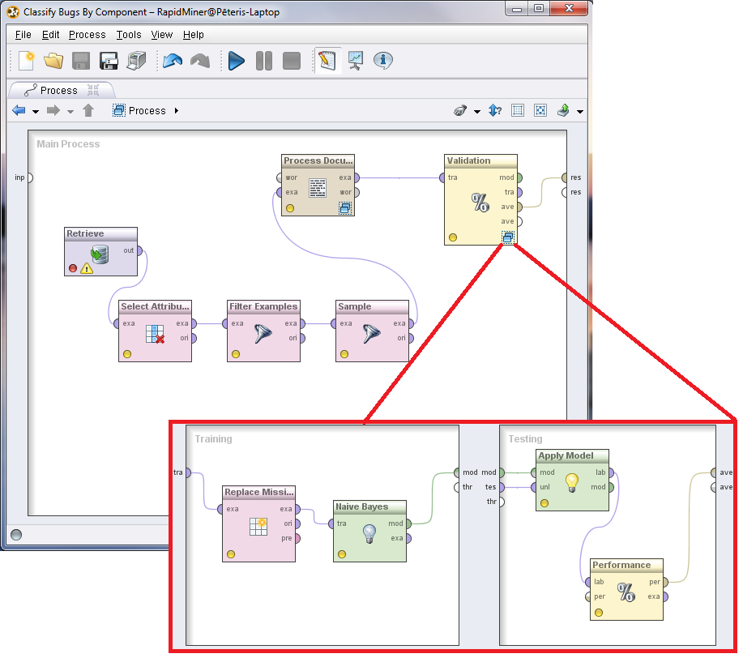
Data mining work flow

Slide 22

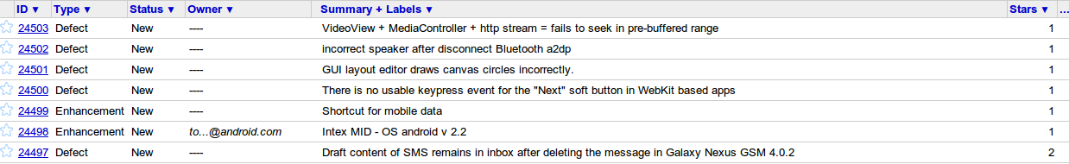
Interesting Bugs
Interesting Bugs
Interesting Bugs
Classification
Description
Title
Component

Slide 23
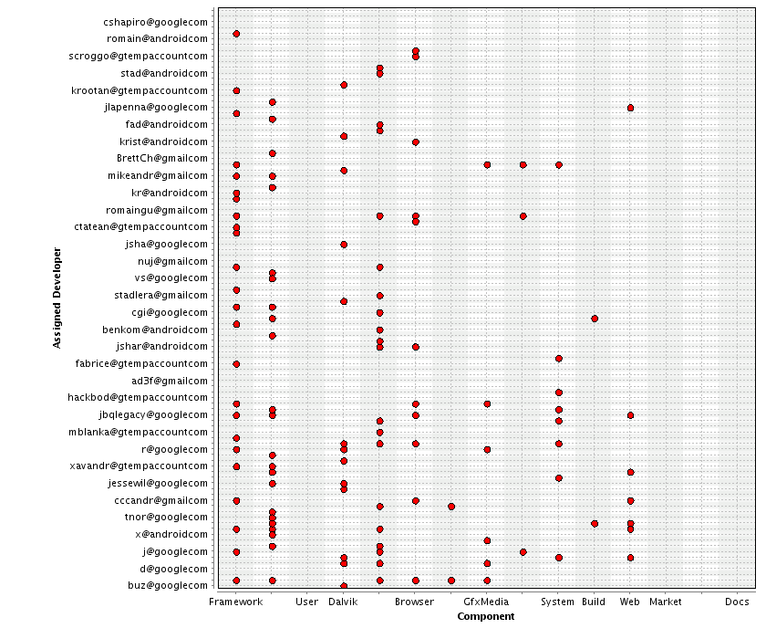
Open Source Tools

Slide 24
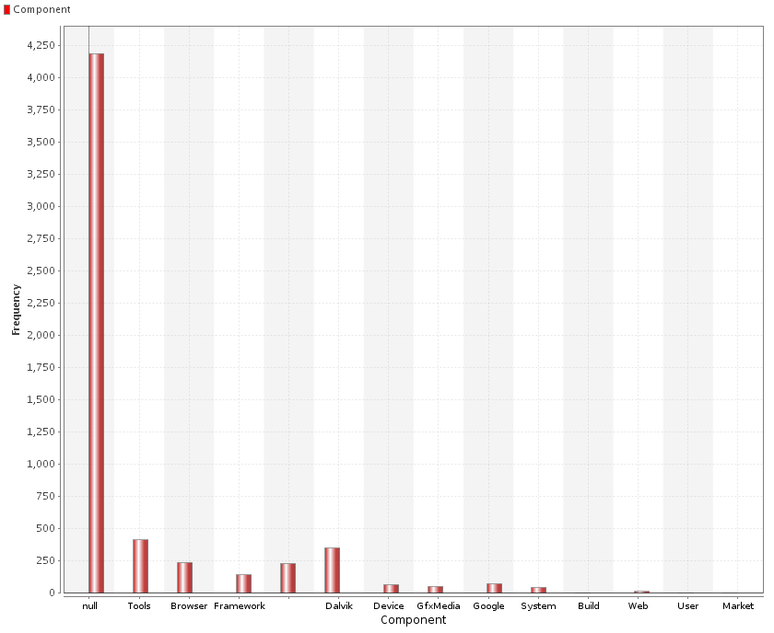

Slide 25
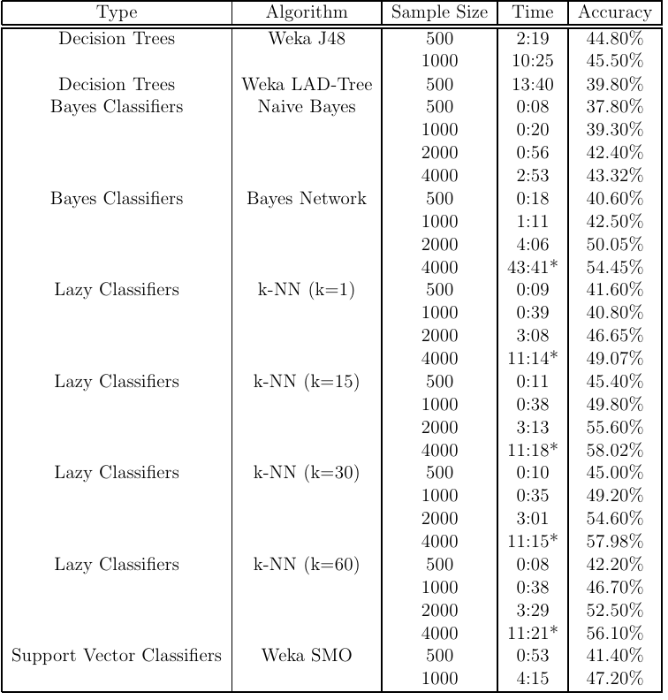

Slide 26
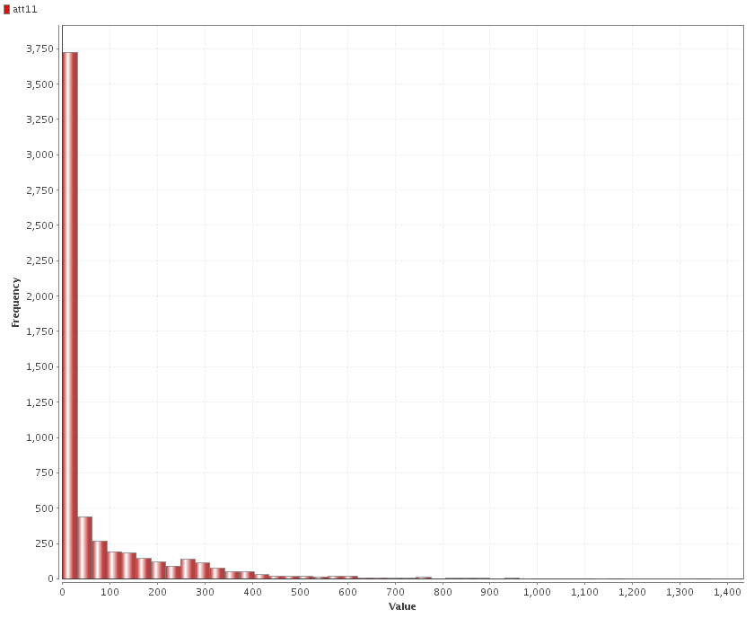
Prediction
Bug duration
Nulls
172 +/- 100
Slow learning

Slide 27
Component classification with Weka
Nulls are easy
No Nulls
79,4 to 64,8

Slide 28
Developer classification in Weka
77,9 to 55%
With
vs
Without
Null
77,9 to 55

Slide 29
Summary - Brainstorming
Time consuming
Command Line vs GUI
Open Source
Learning Time
Text mining
Data statistics & Data understanding
Data presentation

Slide 30

Questions?

