Slide 1
System Programming Lab 3 Buffer Size
Lecturer：Professor Pao-Ann Hsiung
Teaching Assistant:湯凱鈞 & Adarsh
Embedded Systems Laboratory
National Chung Cheng University
Chiayi, Taiwan-62102
Notes:
1

Slide 2
Outline
Buffer Size
Demo & Requirements
Grading Policies
Turn In
Download
Notes:
2

Slide 3
Buffer Size

Slide 4
read
#include<unistd.h>
read(int fd, void * buf, size_t count);
Read count number of data from fd to buf
Return the number of bytes read
Ex: read(STDIN_FILENO, buf,10);
https://man7.org/linux/man-pages/man2/read.2.html
Notes:
read() 系統呼叫會從 fd 所參照檔案的當前位置讀取 count 個位元組到 buf，執行成功時會回傳寫進 buf 的位元組數，同時檔案位置也會前進所讀取的位元組數，執行失敗時會回傳 -1 並設定 error。
回傳值等於 len: 這是預期的正確結果
回傳值等於 0: 表示到了檔案末端 (EOF)，沒有資料可以讀取
回傳值小於 0: 一般代表發生錯誤，有以下幾種可能:
errno = EINTR。表示在讀取過程中收到的信號，可以嘗試再讀取一次
errno = EAGAIN。在 O_NONBLOCK 模式下才會有的情況，表示還沒有資料可以讀取，可以等候一段時間後再嘗試一次
其他的 errno。可能是嚴重的錯誤，重試不一定有用
回傳值大於 0 但小於 len: 可能是以下三種情況之一，再嘗試讀取一次通常就可以找到真正原因:
讀取過程中收到信號中斷
讀取過程中發生錯誤
可讀取的大小不足 len 或以到達 EOF
4

Slide 5
write
#include<unistd.h>
write (int fd, const void * buf,size_t count);
Write count number of data from buf to fd
Return the number of bytes wrote
Ex: write(STDOUT_FILENO, buf,10);
https://man7.org/linux/man-pages/man2/write.2.html
Notes:
write() 系統呼叫會從 buf 中把 count 位元組的資料寫入 fd 所參照檔案的當前位置，執行成功時會回傳寫進入檔案的位元組數，檔案位置也會前進寫入的位元組數，執行失敗時會回傳 -1 並設定 errno。
5

Slide 6
open
#include<fcntl.h>
int open(const char * pathname, int flags, …);
Open or create a file with the flags, return the file descriptor
Flags:
O_RDONLY: read only
O_WRONLY: write only
O_RDWR: read and write
O_DSYNC: have I/O
Ex: each write wait for physical int fd; fd=open(“./myfile",O_RDWR);
Notes:
存取檔案的操作都會需要 fd，而 fd 的取得是透過 open() 系統呼叫。open() 系統呼叫有以下兩種形式，其回傳的 int 變數就是 fd：
open() 的 flags 可以是一個或多個值 OR 的結果，用以表示開啟要求的行為，
且必須包含 O_RDONLY、O_WRONLY 或 O_RDWR 三者其中之一，但如果開檔的行程不具備對應的操作權限，當然也就不能以該模式開啟檔案
6

Slide 7
fsync
#include<unistd.h>
int fsync(int fildes);
Wait for file writes to disk to complete
Notes:
Fildes ->file descriptor
https://en.wikipedia.org/wiki/File
fsync負責寫入所有與特定檔案描述符相關的緩衝區資料[1]_descriptor
只對由檔案描述符fd指定的一個檔案起作用，並且等待寫磁碟操作結束才返回。
7

Slide 8
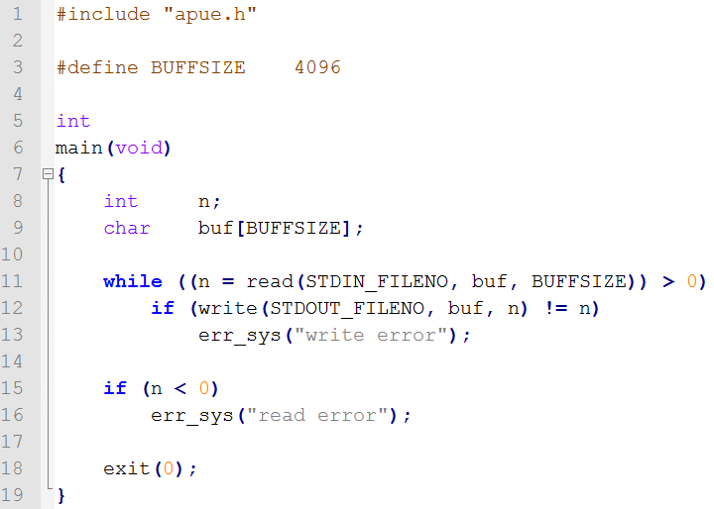
Figure 3.5 buffersize

Slide 9
Demo & Requirements
Notes:
9

Slide 10
Demo Part1
Create the following files with different sizes
Hint: you can use dd to create these files (man dd or dd –help)
Ex: $dd if=/dev/zero of=500mb_file bs=1024 count=512000
[ count = 500*1024*1024 bytes / 1024 = 512000 ]
1 * 1024 *1024/1024=1024
Filename | Size
1mb_file_for_buffSize100 | 1 mb
50mb_file_for_buffSize100 | 50 mb
500mb_file_for_buffSize100 | 500 mb
Notes:
- [ count = 500 (2為底)*1024(10為底)*1024(10為底) bytes / 1024(10為底) = 512000 ]
- mb跟MiB意思一樣，都是2為底
- MB(10為底) = mb(2為底) * 1.024 * 1.024
10

Slide 11
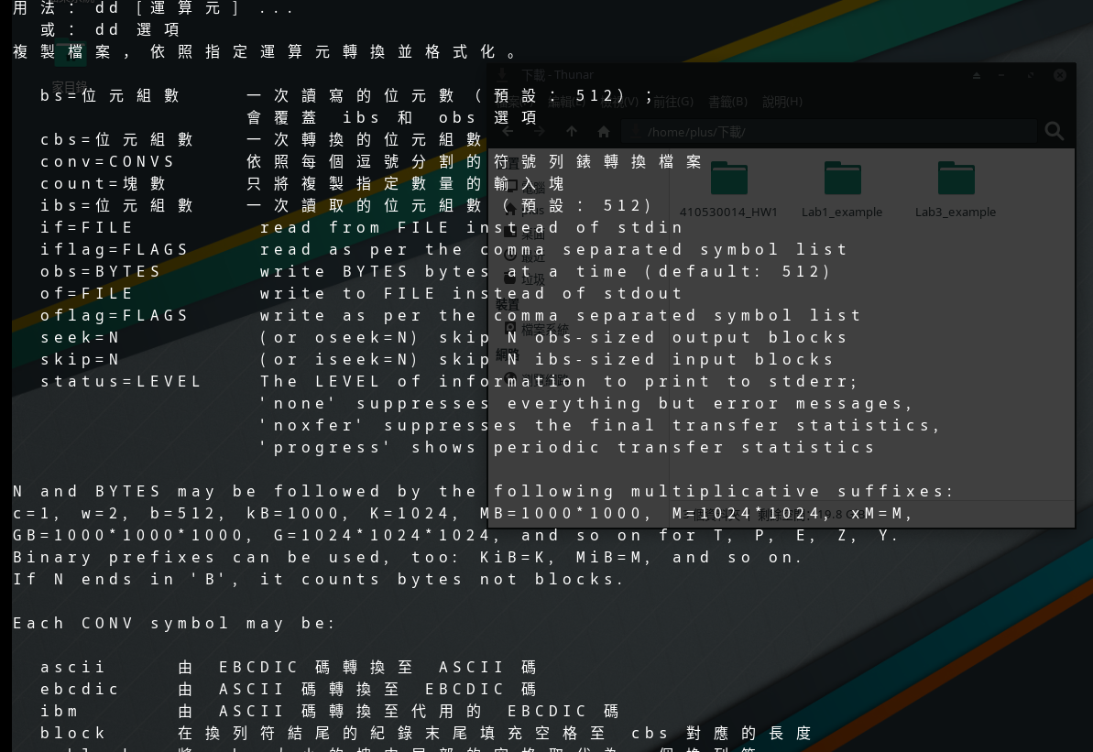

Slide 12
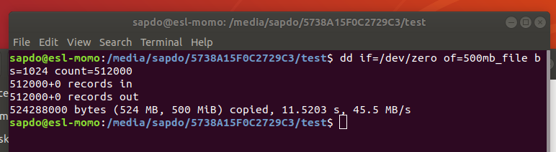
Demo Part1 (con’t)
Ex: $dd if=/dev/zero of=500mb_file bs=1024 count=512000
[ count = 500*1024*1024 bytes / 1024 = 512000 ]
This formula to get 500 MiB (binary system)
MB using decimal system and MiB using binary system.
Reference MB vs MiB: https://www.techtarget.com/searchstorage/definition/mebibyte-MiB

Slide 13
Demo Part1 (con’t)
Create the following files with different sizes
Filename | Size
1mb_file_for_buffSize4096 | 1 mb
50mb_file_for_buffSize4096 | 50 mb
500mb_file_for_buffSize4096 | 500 mb
Notes:
13

Slide 14
Demo Part1 (con’t)
Create the following files with different sizes
Filename | Size
1mb_file_for_buffSize8192 | 1 mb
50mb_file_for_buffSize8192 | 50 mb
500mb_file_for_buffSize8192 | 500 mb
Notes:
14

Slide 15
Demo Part1 (con’t)
Create the following files with different sizes
Filename | Size
1mb_file_for_buffSize16384 | 1 mb
50mb_file_for_buffSize16384 | 50 mb
500mb_file_for_buffSize16384 | 500 mb
Notes:
15

Slide 16
Demo Part1 (con’t)
Create the following 4 files with the same size
Filename | File Size | Used where?
512mb_file1 | 512 MB | Part4
512mb_file2 | 512 MB | Part4
512mb_file3 | 512 MB | Part5
512mb_file4 | 512 MB | Part6
Notes:
16

Slide 17
Demo Part2
Modify Figure 3.5, write data to /dev/null instead of stdout.
Hint: open /dev/null
Compile Figure 3.5 with different BUFFSIZE
Executable Filename | BUFFSIZE
buffsize100 | 100
buffsize4096 | 4096
buffsize8192 | 8192
buffsize16384 | 16384
Notes:
17

Slide 18
Demo Part3
Measure the execution time, and fill in the table as in the next slide
You MUST use corresponding file
Ex: $./buffersize100 < 1mb_file_for_buffSize100 $./buffersize16384 < 500mb_file_for_buffSize16384
Hint: you can use time to measure the execution time
Ex: $time ./buffsize16384 < 500mb_file_for_buffSize16384

Slide 19
Demo Part3 (con’t)
file name BUFFSIZE |  | 1mb_file | 50mb_file | 500mb_file
100 | real
 | user
 | sys
4096 | real
 | user
 | sys
8192 | real
 | user
 | sys
16384 | real
 | user
 | sys

Slide 20
Demo Part4
Measure the execution times, and fill in the table as in the next slide
You MUST follow the following order:
$./buffsize4096 < 512mb_file1
$./buffsize4096 < 512mb_file2
$./buffsize4096 < 512mb_file2

Slide 21
Demo Part4 (con’t)
file name BUFFSIZE |  | 512mb_file1 | 512mb_file2 | 512mb_file2
4096 | real
 | user
 | sys

Slide 22
Demo Part5
Insert fsync into while loop, and redo Demo Part 4, with 512mb_file3 and 512mb_file4 then fill in the table
file name BUFFSIZE |  | 512mb_file3 | 512mb_file4 | 512mb_file4
4096 | real
 | user
 | sys

Slide 23
Result of Demo (1/2)
Answer the following questions:
How did you direct the output file to /dev/null?
In the table of Part3, do bigger buffer sizes make IO faster?
In the table of Part4, what did you observe? Why?
In the table of Part5, what did you observe? Why?
Notes:
23

Slide 24
Result of Demo
Source file for all Demo
Makefile

Slide 25
Turn In
Notes:
25

Slide 26
Turn In
The E-course2
https://ecourse2.ccu.edu.tw//
Upload 學號.zip into “Lab_3”
Source files
Makefile
Due date
2022/03/30 23:59:59
遲交1週內*0.8 超過1週*0.6
Notes:
26

Slide 27
Turn In (cont’d)
TA’s email:
湯凱鈞：4685231GF@gmail.com
Adarsh: vtu10666@veltechuniv.edu.in

