Slide 1
Checklist for cMEG panels
12/10/23

Slide 2
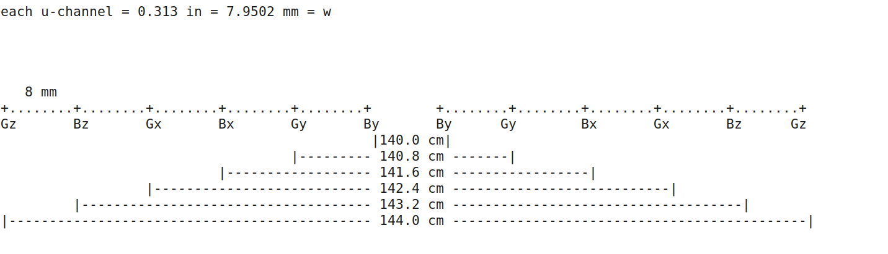
Layout/Arrangement

Slide 3
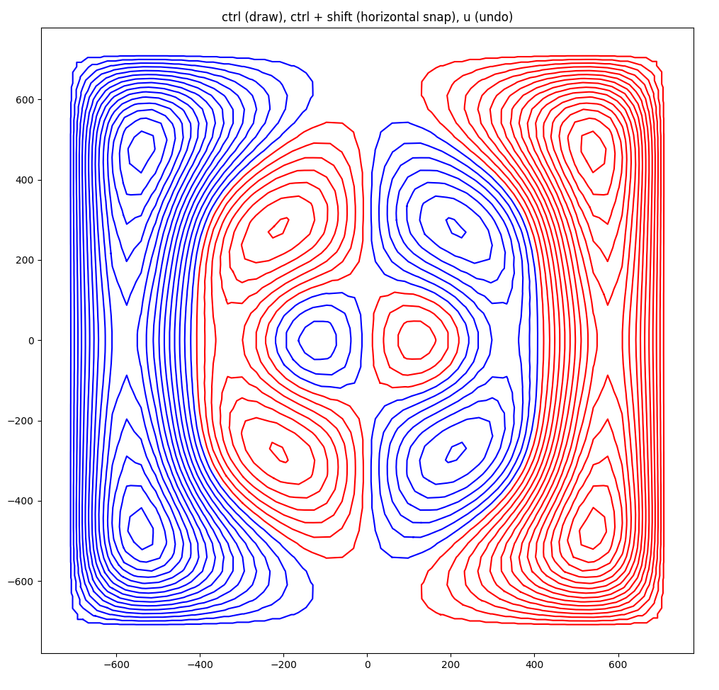
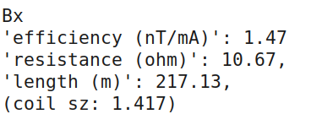
Bx coil

Slide 4
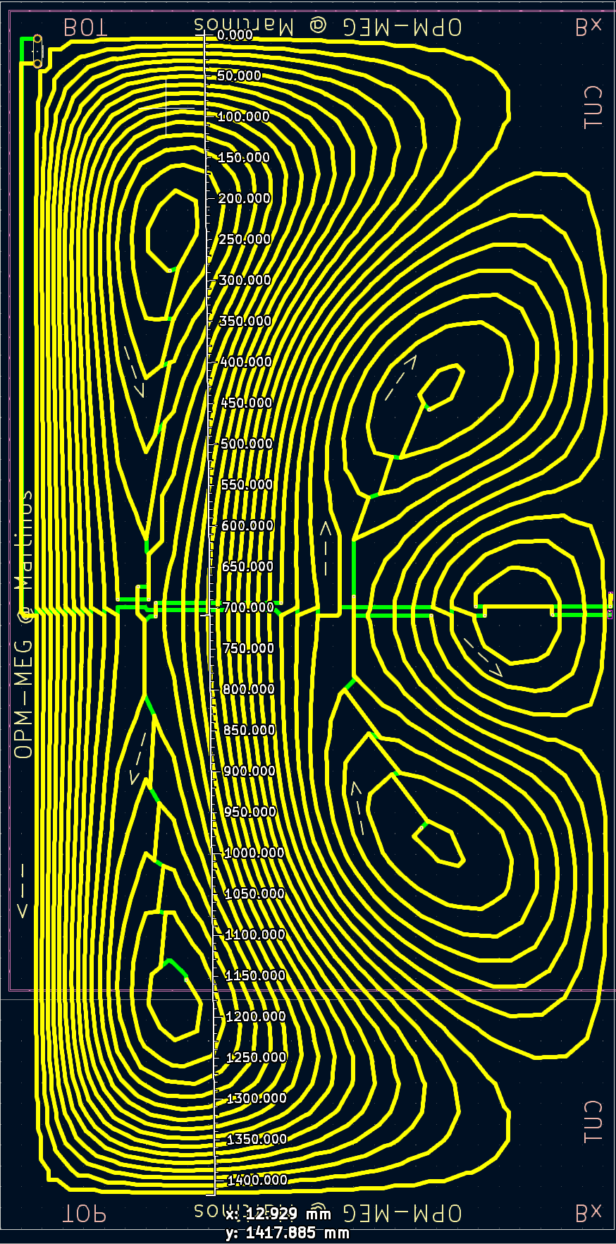
Bx coil - checklist
Power terminal @ (30,60) mm
DRC on both boards
Solder pads match at the cut line between boards
Arrows ok
Dimensions: (approx) 141.7

Slide 5
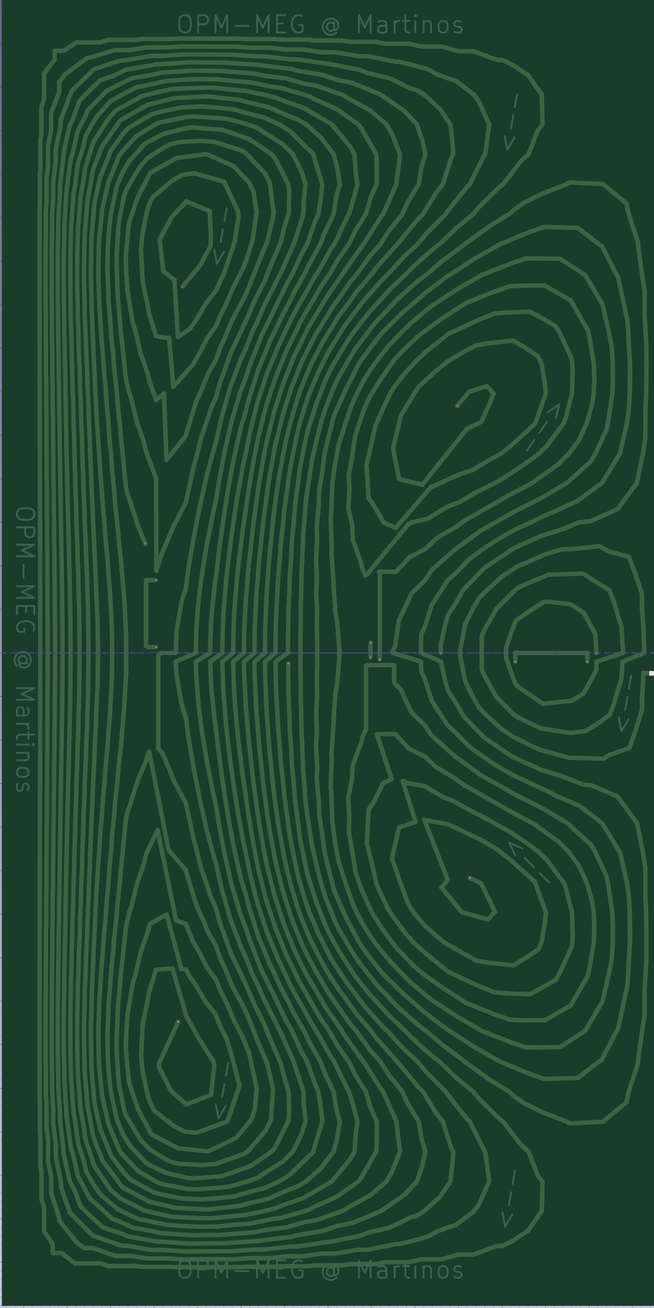
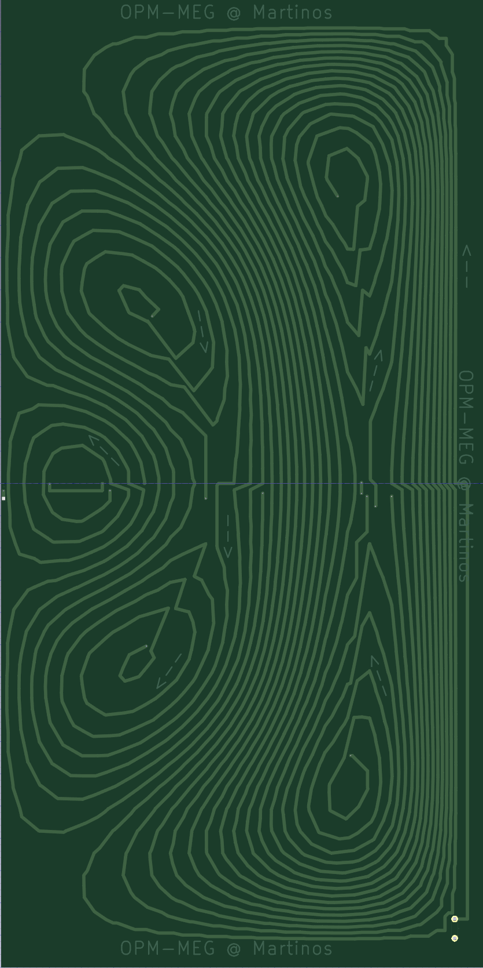
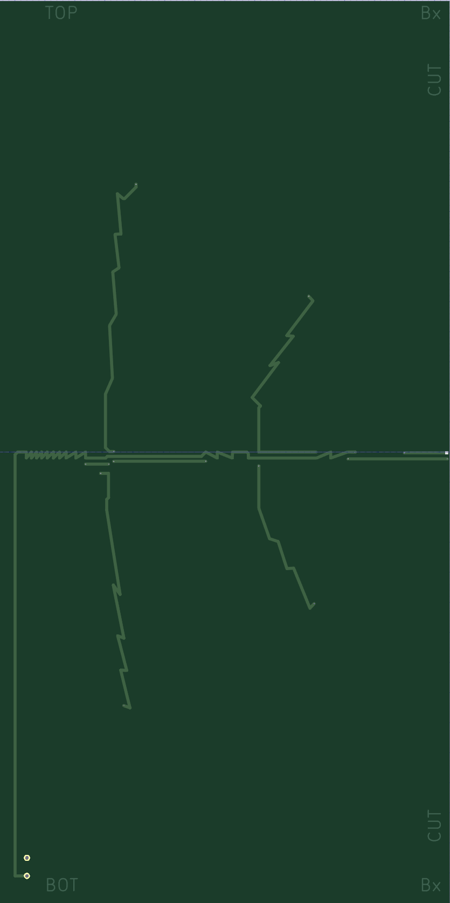
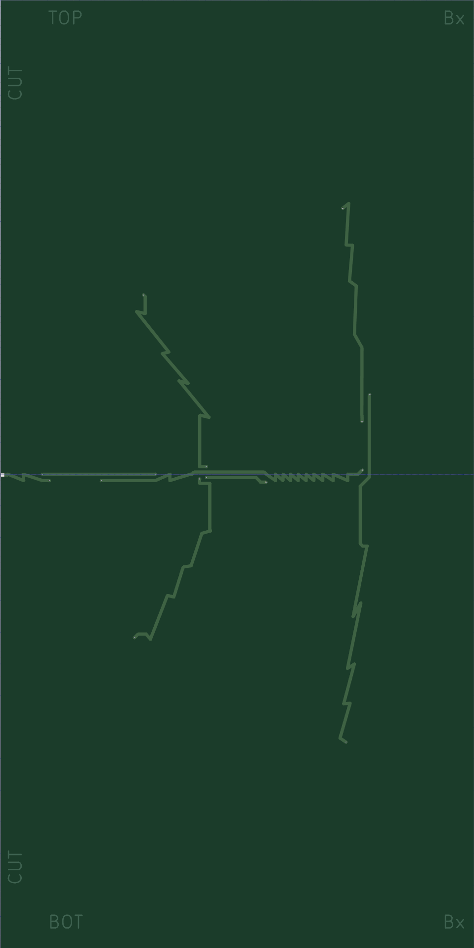
Bx coil – front and back

Slide 6
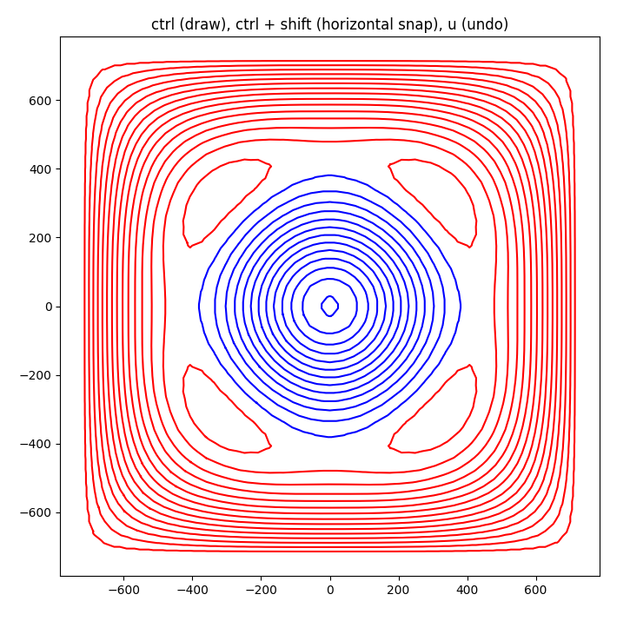
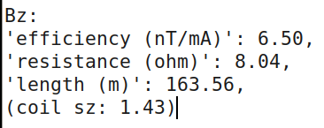
Bz coil

Slide 7
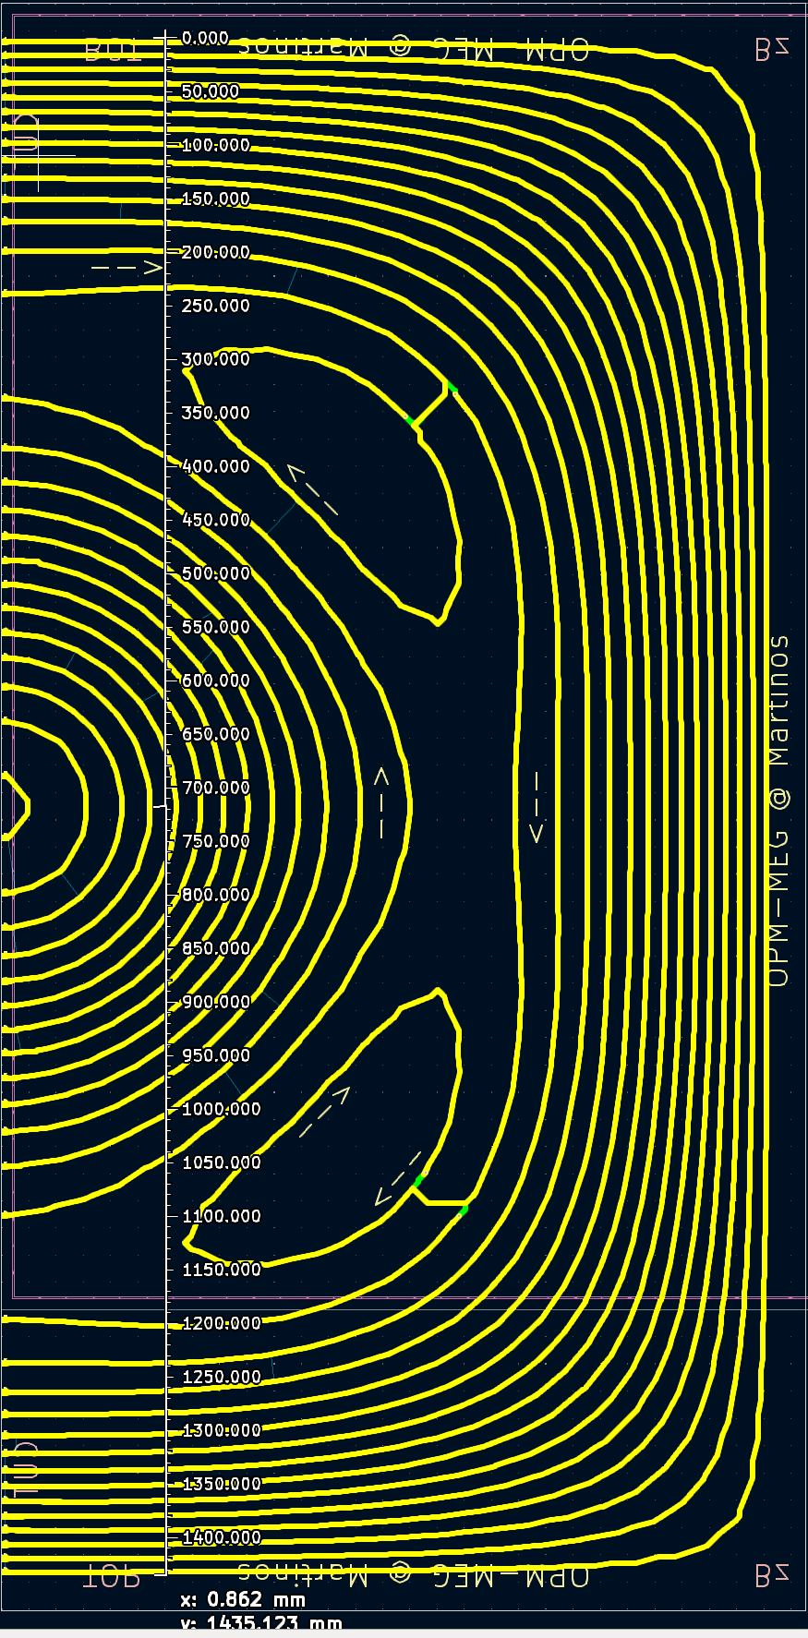
Bz coil - checklist
Power terminal @ (30,60) mm
DRC on both boards
Solder pads match at the cut line between boards
Arrows ok
Dimensions: (approx) 143.5

Slide 8
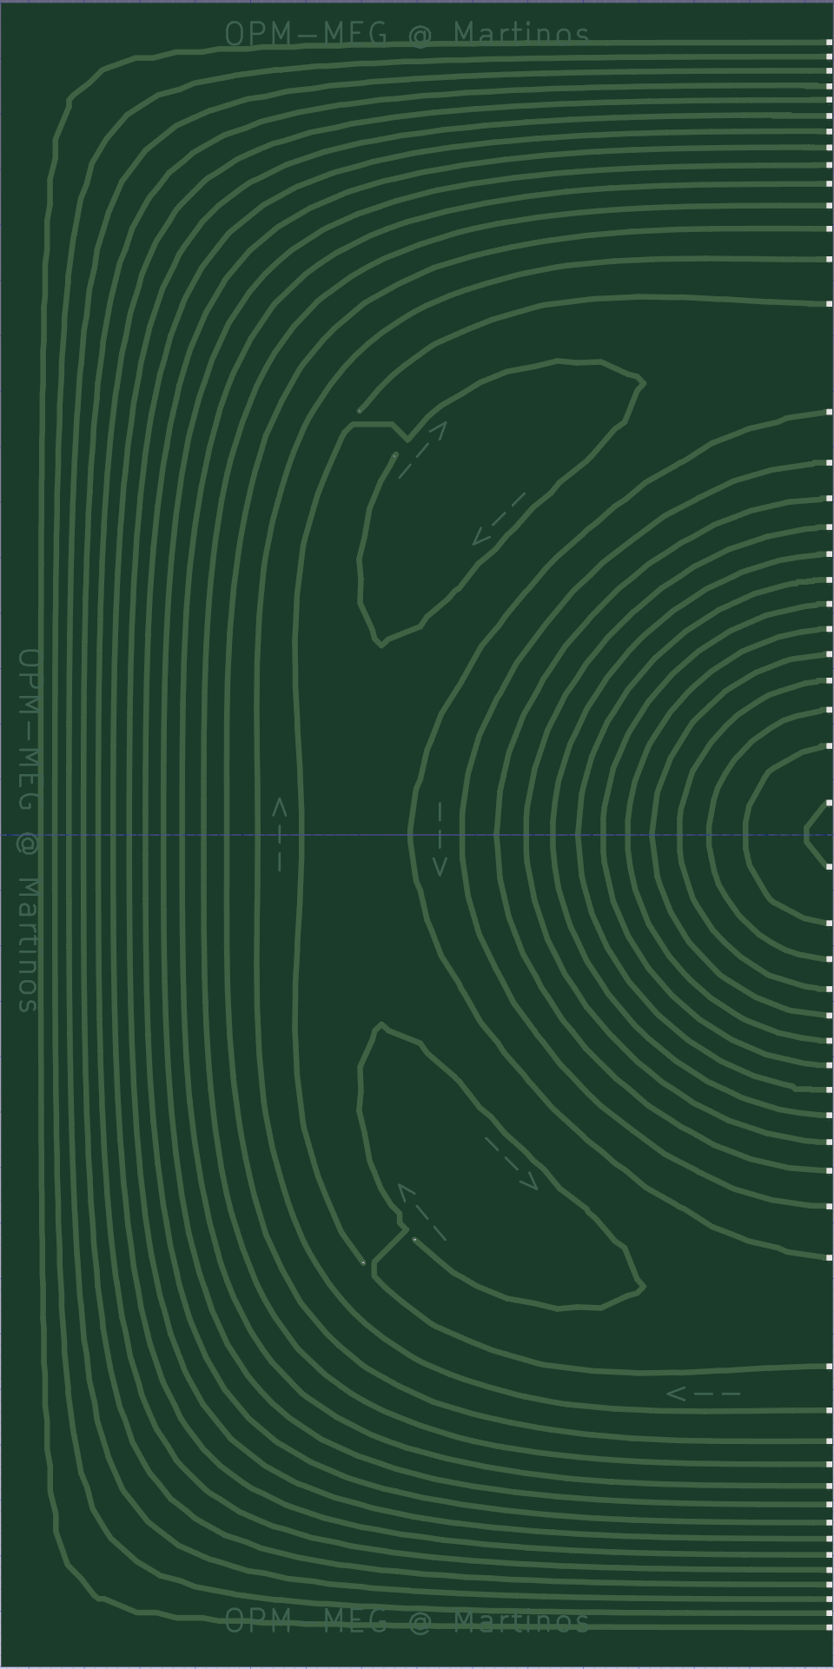
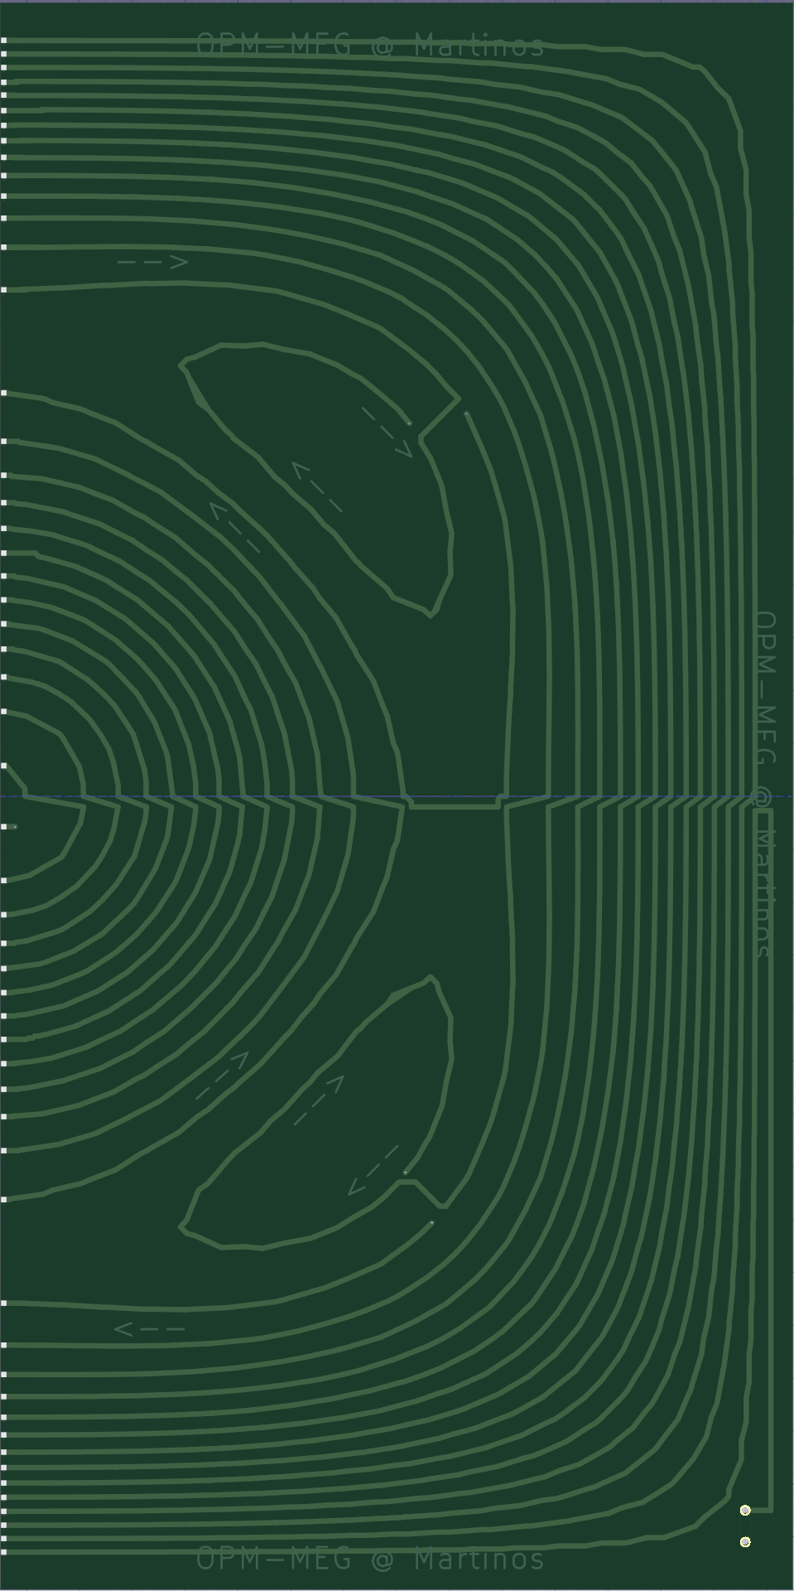
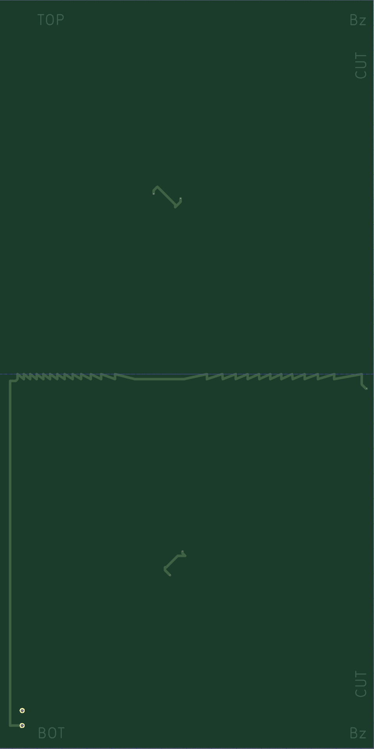
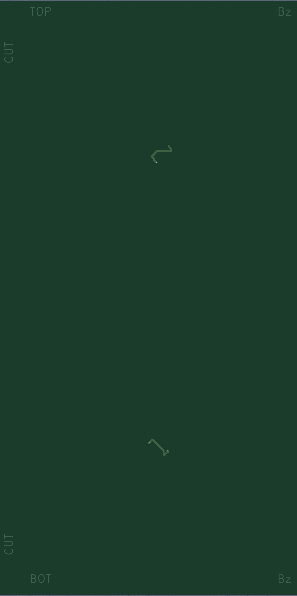
Bz coil – front and back

Slide 9
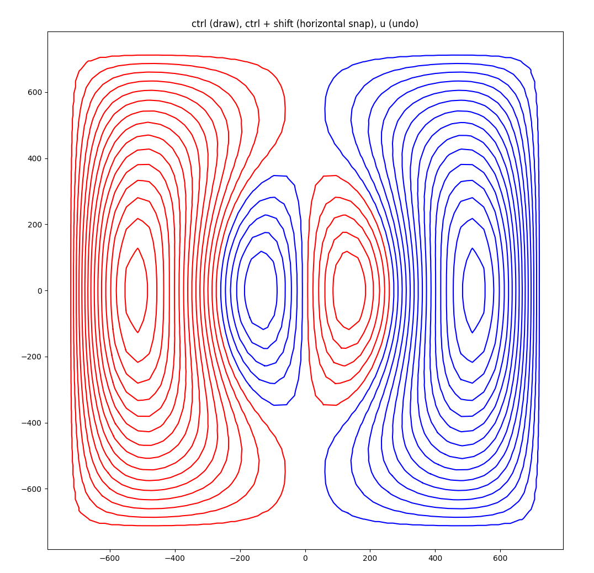
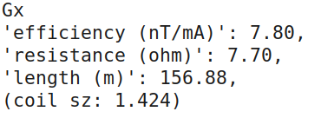
Gx coil

Slide 10
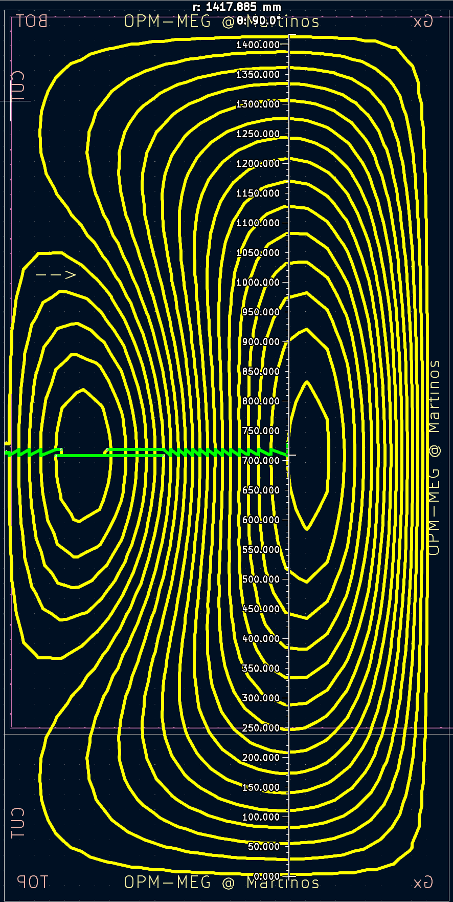
Gx coil - checklist
Power terminal @ (30,60) mm
DRC on both boards
Solder pads match at the cut line between boards
Arrows ok
Dimensions: (approx) 142.4

Slide 11
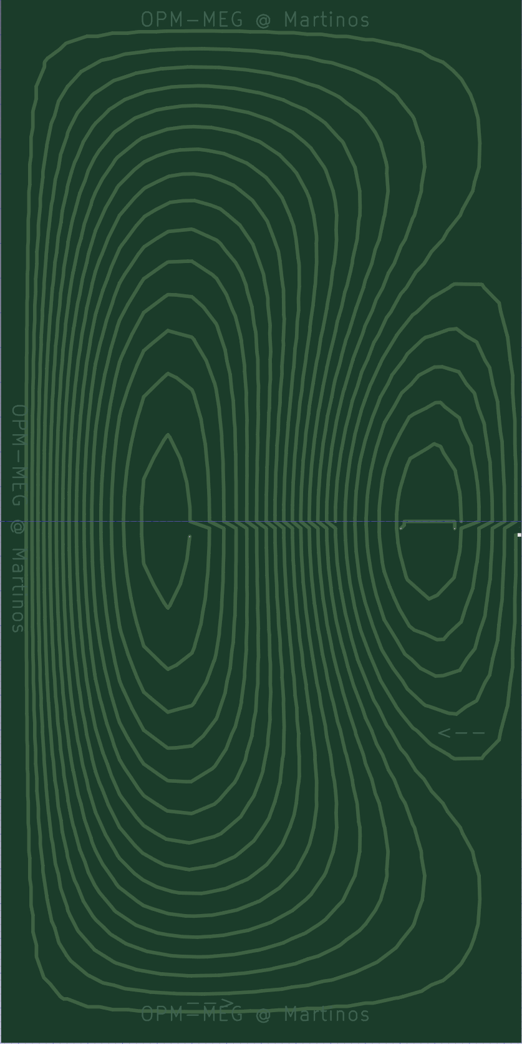
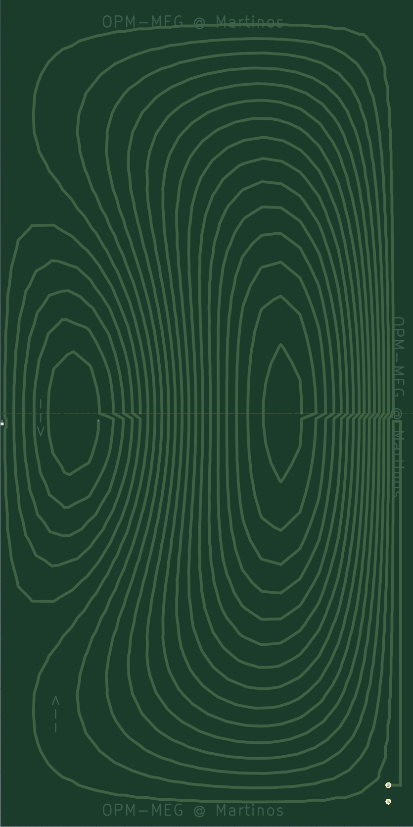


Gx coil – front and back

Slide 12
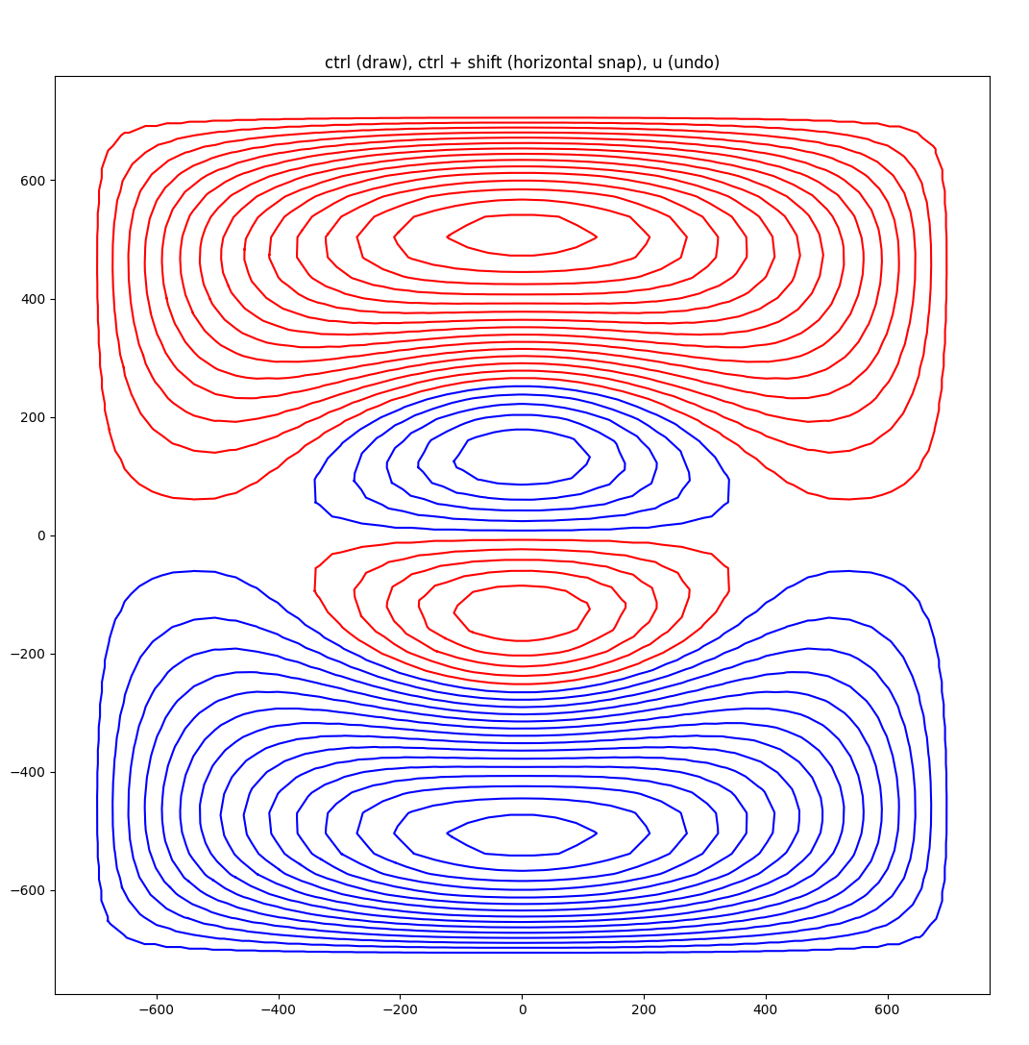
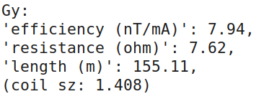
Gy coil

Slide 13
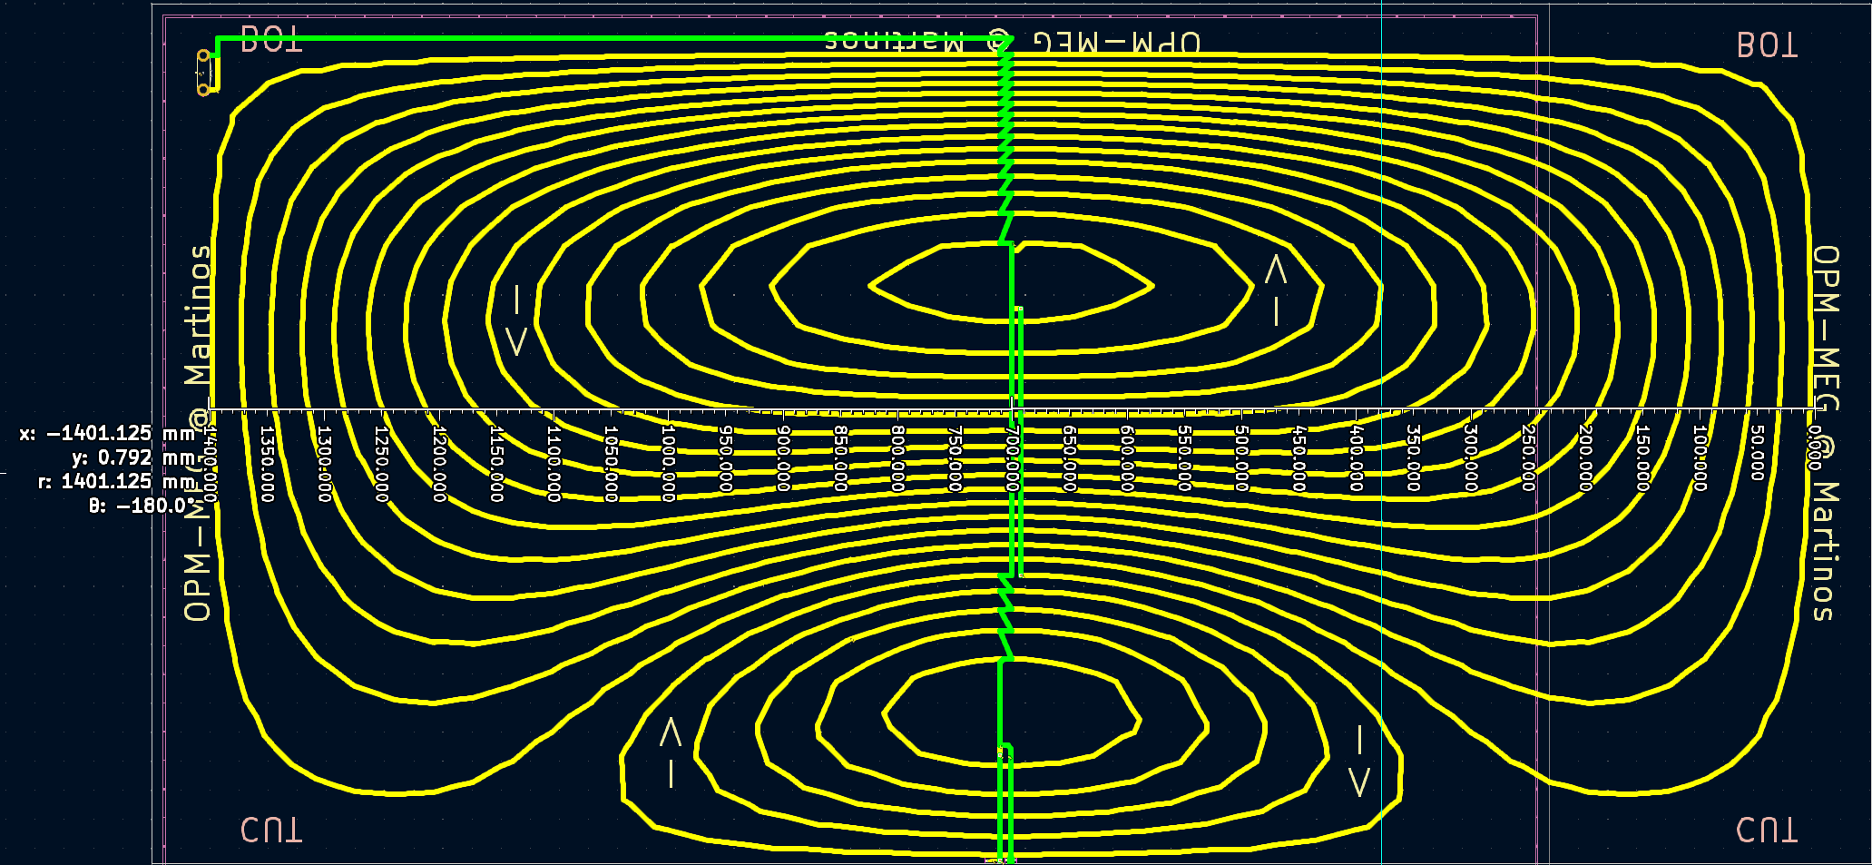
Gy coil - checklist
Power terminal @ (30,60) mm - ok
DRC on both boards - ok
Solder pads match at the cut line between boards - ok
Arrows ok - ok
Dimensions: (approx) 140.1

Slide 14
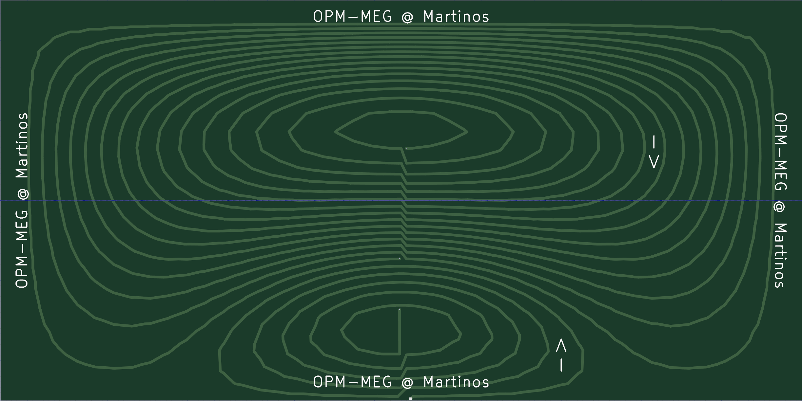
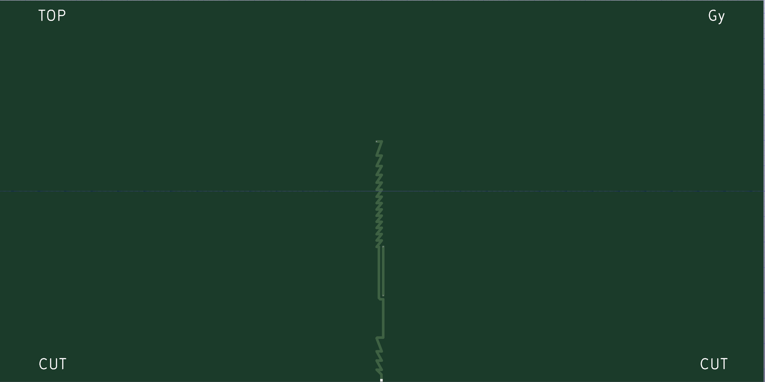
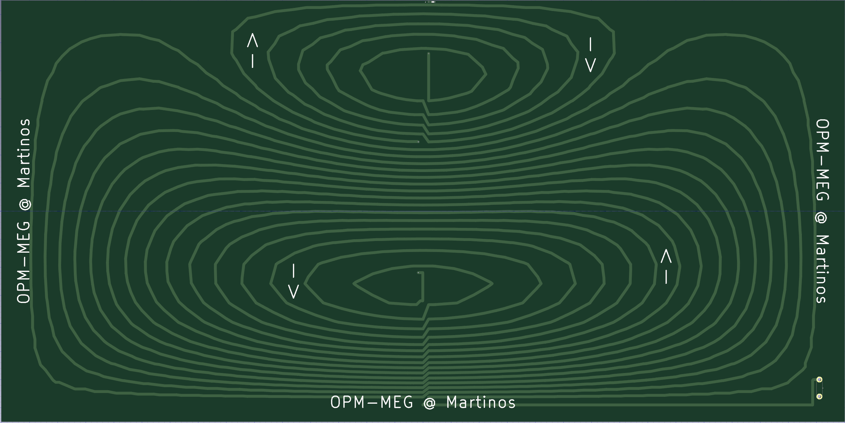
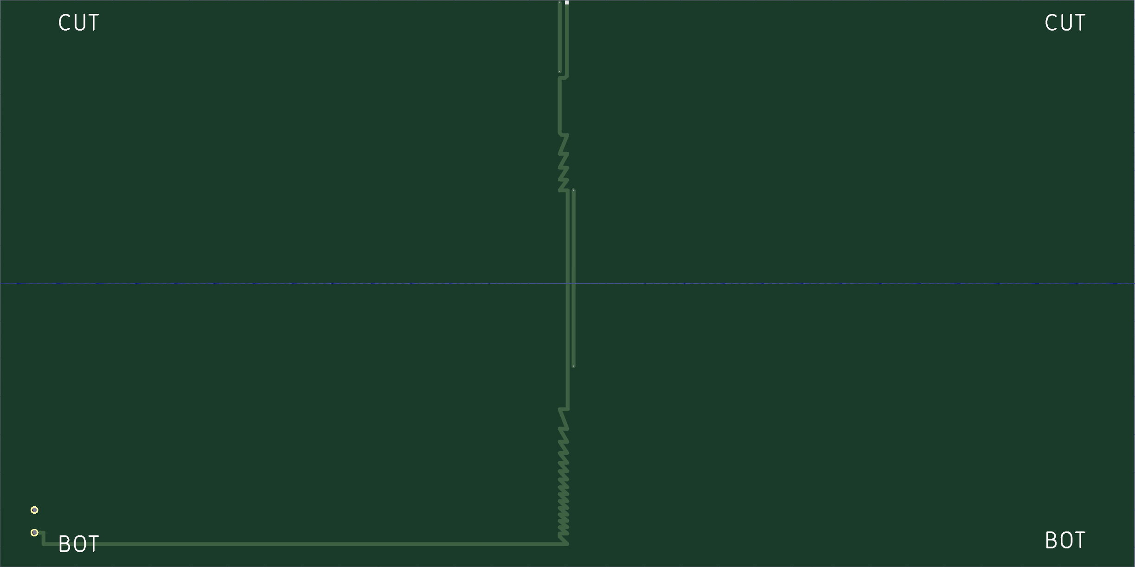
Gy coil – front and back

Slide 15
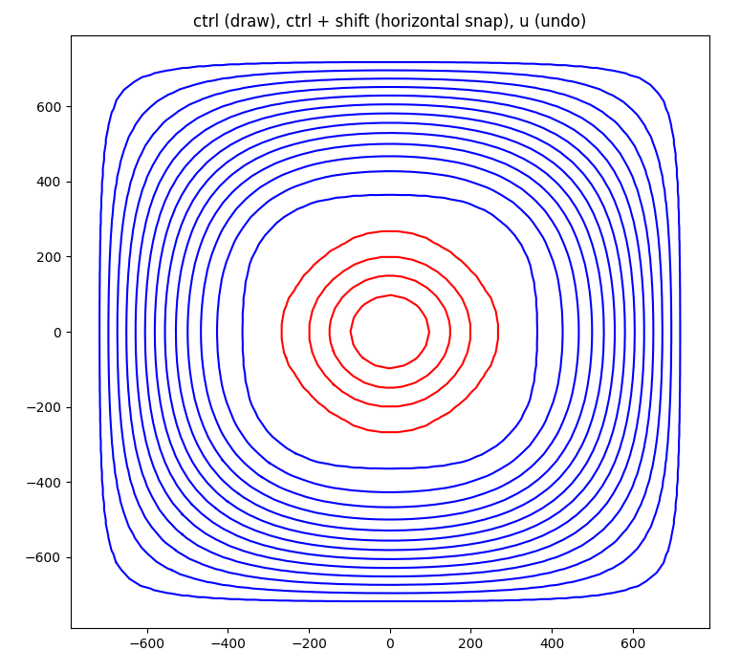
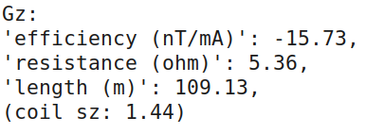
Gz coil

Slide 16
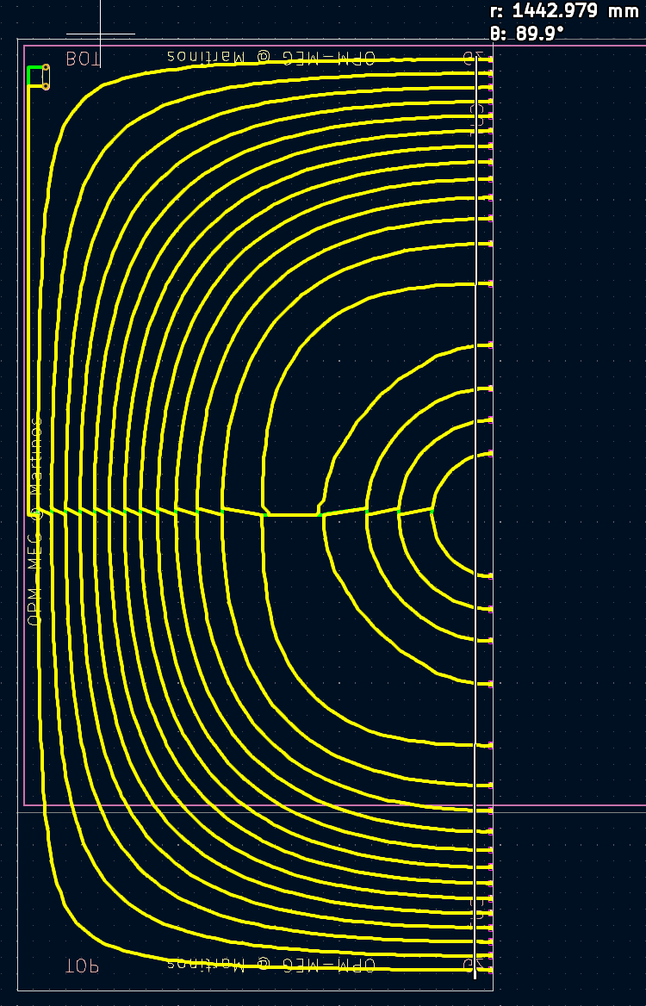
Gz coil - checklist
Power terminal @ (30,60) mm - ok
DRC on both boards
Solder pads match at the cut line between boards
Arrows ok
Dimensions: (approx) 144.2 - ok

Slide 17
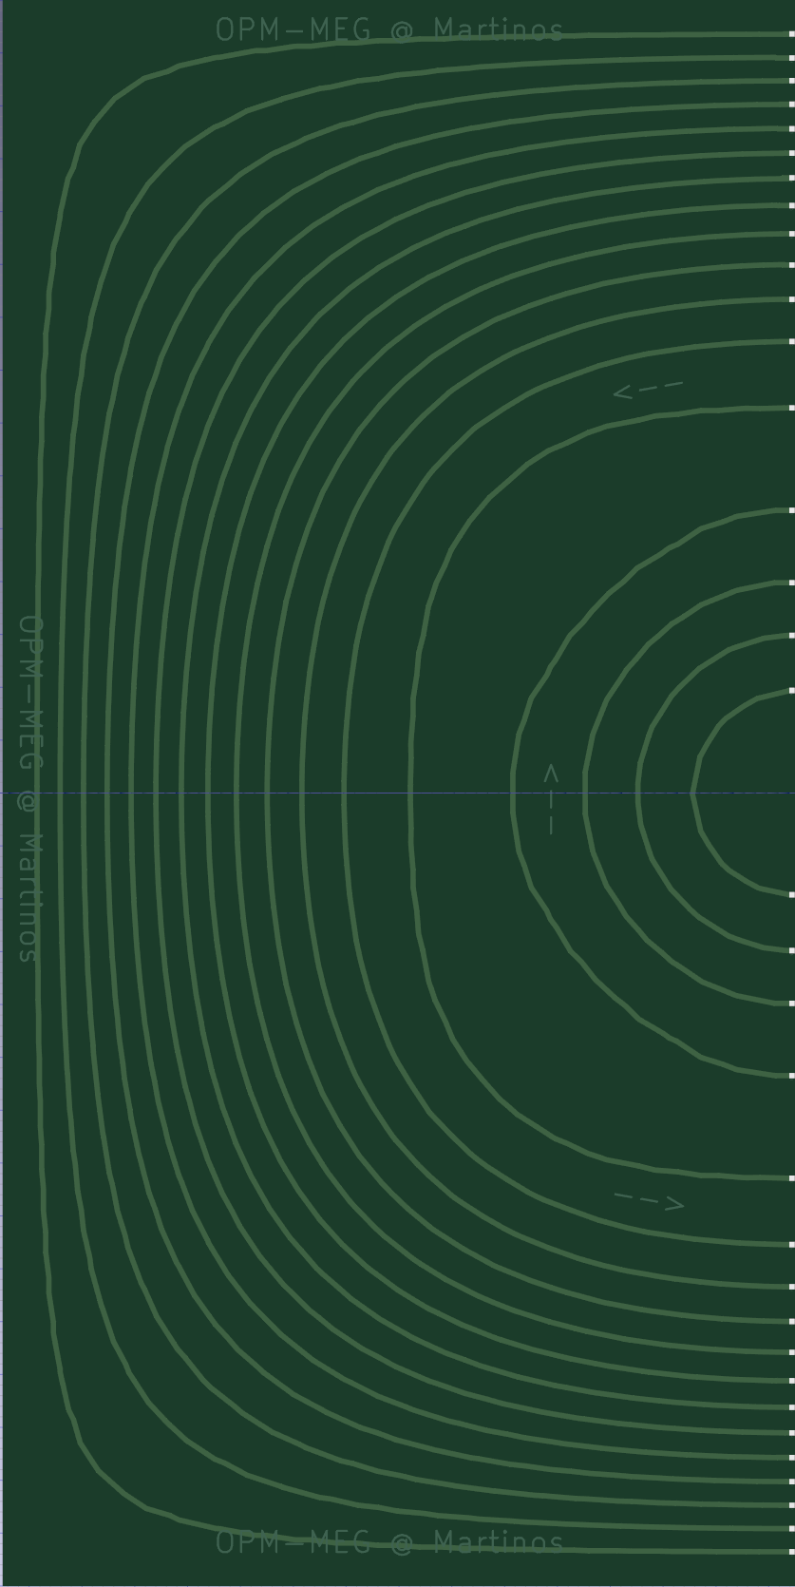
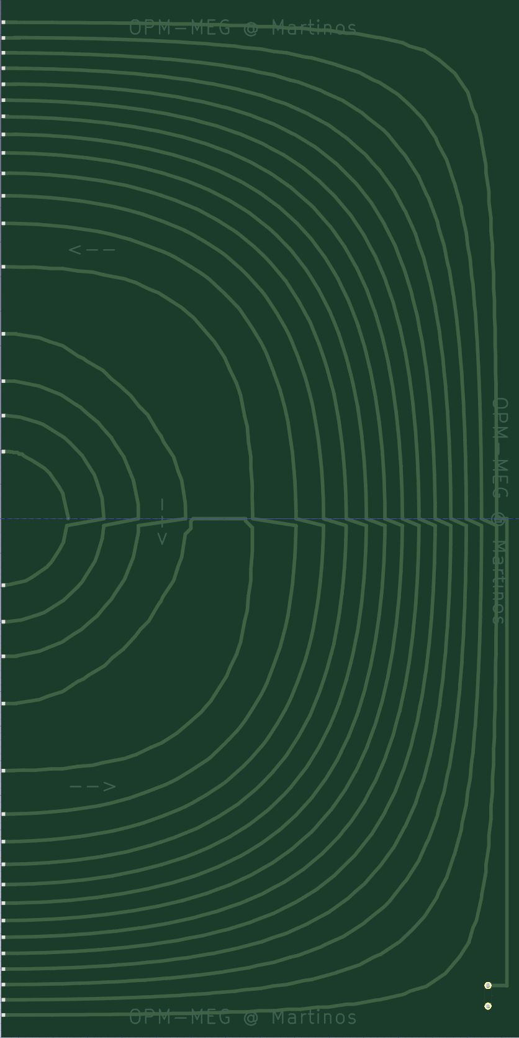


Gz coil – front and back

