Slide 1
Elevator Simulation Study
August 27, 2026

Slide 2
Assumptions
Passengers submit both origin and destination floors at the time of request
Every passenger must make a request (no “freeloaders”)
Onboarding and offloading passengers takes 0 time
i.e., stopping to pick up or let passengers off incurs no additional time for passengers on board or those waiting
Passenger ID’s are assigned sequentially in order of request (used for tiebreaks)
All requests are well-formed (simulation will raise an error otherwise)
Passengers are immediately assigned an elevator, and assignments cannot be changed
Passengers cannot modify their destination after assignment

Slide 3
Simulation Architecture
Scheduler (e.g., ETA, Nearest Car, Round Robin)
Decides where new passengers are assigned
Elevator_1
Elevator_2
Elevator_M
…
All elevators follow same independent internal algorithm/logic based on current state

Slide 4
Elevator Algorithm
An individual elevator follows the LOOK algorithm
Core idea: keep moving in the current direction while there are requests “ahead” in current direction, reverse direction once there are no more requests
Can think of elevator having 3 key pieces of information
Current floor
Current direction (UP or DOWN)
Set of pending floors to visit

Slide 5
Example 1
Suppose we have a simple system with just 1 elevator beginning on Floor 1 @ t = 0 with the following requests
Passenger_1: Floor 1 to Floor 10 @ t = 0
Passenger_2: Floor 5 to Floor 15 @ t = 3
Passenger_3: Floor 12 to Floor 1 @ t = 9
Elevator will first pickup Passenger_1
When elevator arrives at Floor 5, it can pick up Passenger_2 since they are going in the same direction and have capacity
However, when elevator first arrives at Floor 12, it still has work above and will not stop for Passenger_3
Passenger_3 must wait until elevator reverses direction at Floor 15

Slide 6
Elevator Algorithm Tradeoffs
The LOOK algorithm ensures several nice properties for passengers:
A passenger onboard an elevator will never be traveling in the wrong direction
An elevator will never reverse direction with passengers onboard
Once boarded, passengers will never face additional delays (under current assumptions)
However, maintaining these properties is not globally optimal
Consider an elevator on floor 10 moving up with one passenger going to floor 30, and a new request comes in with origin 7, destination 15
Would be less total time to reverse and pick up new passenger, but imposes a travel delay to passenger aboard

Slide 7
Elevator Algorithm Tradeoffs
The simulation prioritizes the experience of passengers currently onboard an elevator, at the expense of potentially increasing some wait times
Worthwhile tradeoff to wait slightly longer for a guaranteed travel time once boarded the elevator
Avoids unpleasant behavior, such as an elevator constantly reversing direction and moving between several floors while a passenger is stuck onboard waiting to go on a longer trip
Assumes waiting longer on a floor is preferable to longer time in elevator

Slide 8
Baseline Schedulers
The next key design choice is determining how the scheduler should assign passengers. Two simple methods are provided for baseline comparisons
Round Robin - assigns passengers to each elevator in sequential order, without considering their source/destination
Nearest Car - calculates how far away each elevator is from the source floor of new request, with a penalty added for cars moving in the opposite direction. Assign to car with lowest score
Does not consider other passenger currently onboard/waiting

Slide 9
ETA Scheduler
The default scheduler is the ETA scheduler, which attempts to minimize the total time per passenger by calculating impact of adding new passenger to current elevator state
For each new request, evaluate every elevator with two isolated “shadow simulations” that don’t impact main simulation state
Known workload as-is (onboard + waiting passengers)
Workload with new candidate added
Score is computed as the increase in summed passenger total time, so includes candidate’s completion time and any delayed imposed on existing passengers
Passenger assigned elevator with lowest score

Slide 10
Scheduler Comparison: Data
To compare the performance of the 3 schedulers, created test data to run and perform analysis with realistic building configuration
10 files, each with 10,000 passenger requests
Model request times with a Poisson distribution, average of 1 request per unit of time
40% of requests originate from the lobby
If source is not the lobby, give 70% chance of request going to lobby
If source is lobby, uniform destination among other floors
Simulation run with 10 elevators, capacity of 10 for each elevator, and 50 floors

Slide 11
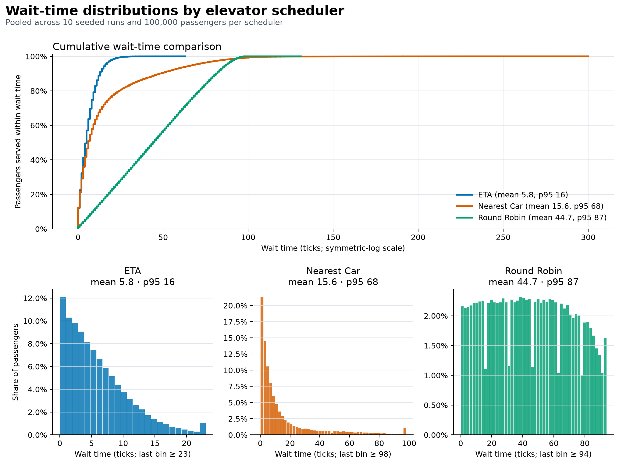

Slide 12
ETA Detailed Statistics
Mean | 5.83
Median | 5.0
p90 | 13.0
p95 | 16.0
Standard Deviation | 5.3
Maximum | 63

Slide 13
Express Elevators
Additional functionality built into simulation to optionally designate some elevators as “express” that only visit certain floors
Simulation allows a max of (num_elevators - 1) express elevators
Reserves at least 1 elevator that can serve entire building
Requests are only considered eligible for an express elevator if both the source and destination are in the designated express floors

Slide 14
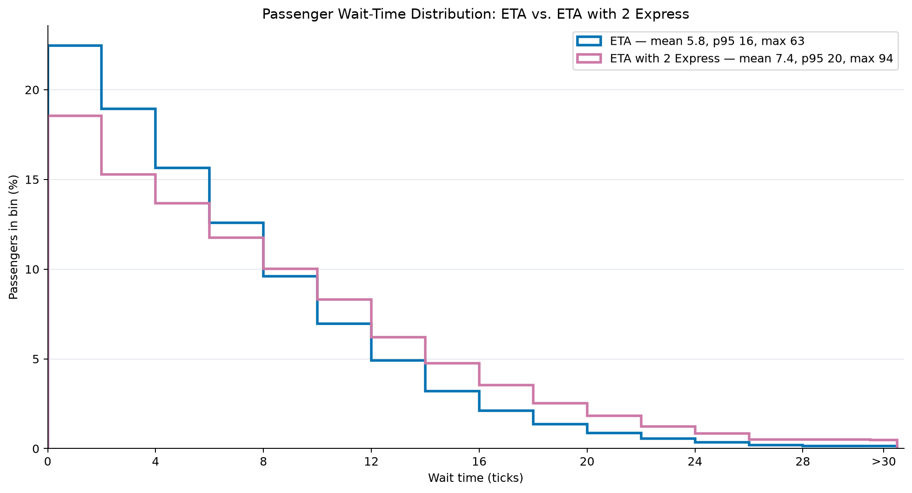
ETA vs. ETA w/2 Express Elevators

Slide 15
Fair-ETA
The ETA algorithm is already quite fair overall, but there is some potential to adversely affect specific passengers
E.g., if adding a passenger to Elev_1 imposes a delay of 10 to a single passenger, but adding them to Elev_2 imposes a delay of 2 to 6 passengers, new passenger would be added to Elev_1 (total cost of 10 vs. 12)
Idea: increasingly penalize additional wait time once waiting time exceeds a specified threshold
If adding a new passenger to an elevator significantly increases wait time for an existing passenger, that elevator will get a much higher score and is less likely to be selected

Slide 16
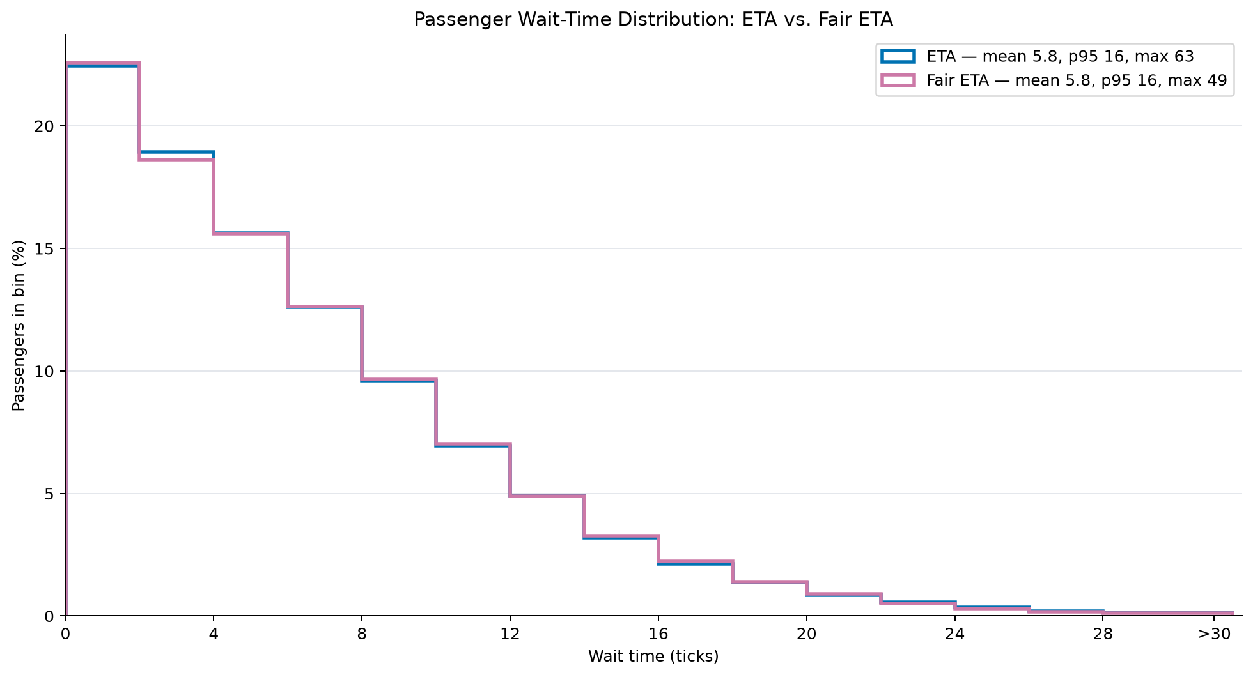
ETA vs. Fair ETA

