Slide 1
FSA-PROJECT
RENTAREA
A modern property rental platform — built end-to-end.
PRESENTED BY OLEH POIASNIK
rent-area.com

Slide 2
01 / CONTEXT
Problems
PROBLEM 01
PROBLEM 02
PROBLEM 03
Outdated listings.
No tooling for owners.
Fragmented communication.
Renters scroll through stale ads with vague addresses, missing photos and no way to verify if the place is still available.
Posting a property is a manual chore — photos, geocoding and updates are spread across spreadsheets and messengers.
Renters and owners juggle phone, WhatsApp and email. There is no shared place to chat, book a viewing and keep history.

Slide 3
02 / APPROACH
Methodology
DDD & TDD
Hexagonal Architecture
DDD MODELS THE BUSINESS DOMAIN IN CODE. TDD DRIVES EACH FEATURE WITH TESTS WRITTEN BEFORE THE IMPLEMENTATION.
A DESIGN PATTERN THAT SEPARATES CONCERNS AND ISOLATES THE APPLICATION CORE FROM EXTERNAL DEPENDENCIES.
REST API
DevOps
AN ARCHITECTURAL STYLE FOR NETWORKED APPLICATIONS — A SCALABLE, FLEXIBLE APPROACH TO BUILDING WEB APPS.
A SET OF PRACTICES THAT IMPROVE COLLABORATION AND COMMUNICATION BETWEEN DEVELOPMENT AND IT OPERATIONS TEAMS.

Slide 4












03 / TOOLING
Technology stack
Front-end
Back-end
DevOps

Slide 5
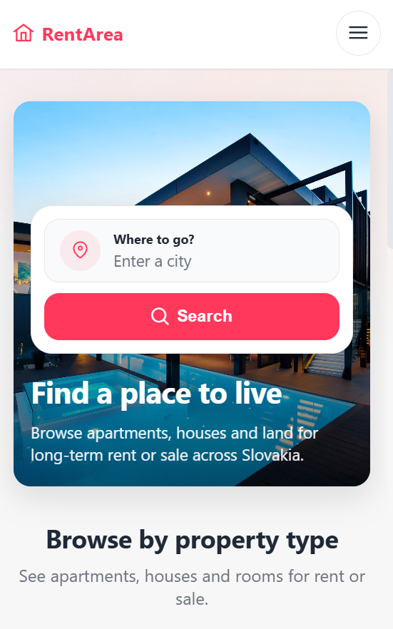
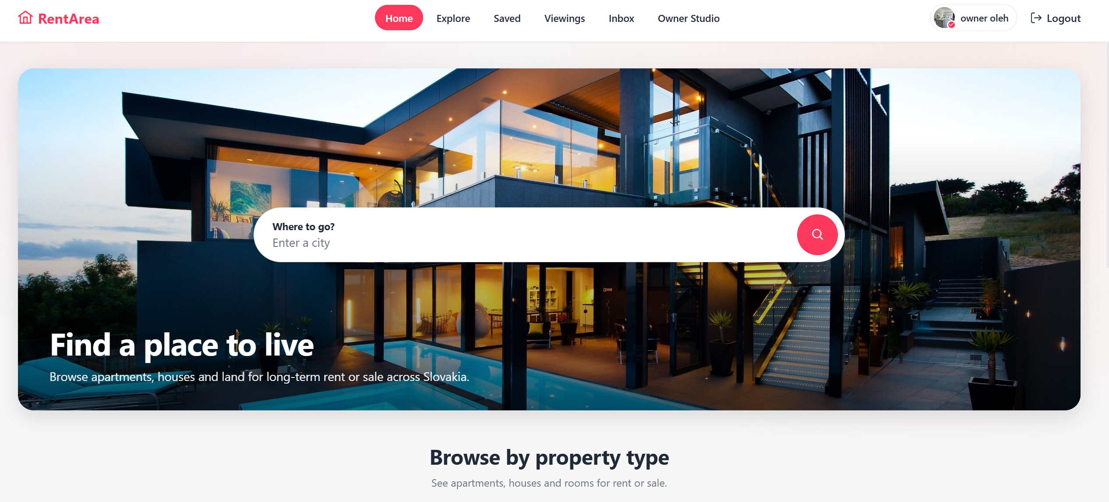
04 / EXPERIENCE
Access on any device
Mobile-first responsive layout — desktop, tablet, phone share the same component tree.
+
+
Desktop screenshot
Mobile screenshot

Slide 6
05 / FEATURES
What it does
01
02
03
Multi-step wizard
Geocoded address
Photo gallery
Listing creation in six guided steps with per-step validation, edit mode support and inline server errors.
Every address is verified and geocoded via Nominatim — coordinates persisted on the listing.
Up to 20 photos per listing. First image becomes the cover; upload, preview and remove before publishing.
04
05
06
In-app messaging
Viewing requests
Owner dashboard
Renters and owners chat per-listing. Read receipts, unread count and listing context always visible.
Booking flow with date and optional notes. Owner can confirm or decline each request from the dashboard.
Stats, listing statuses (active / inactive) and per-listing actions — activate, deactivate or delete.

Slide 7
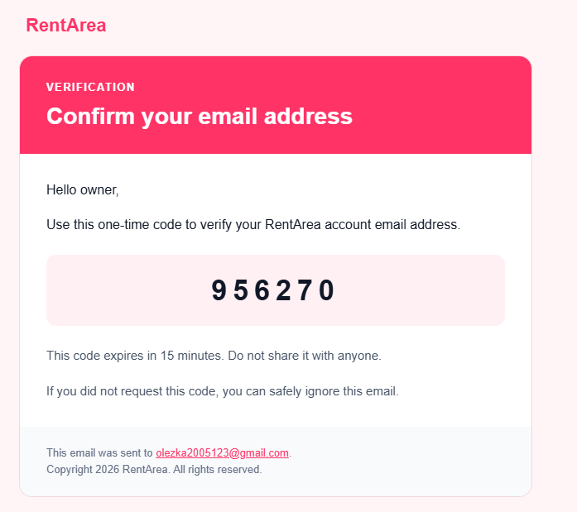
EMAIL VERIFICATION
It actually sends.
6-digit one-time code · expires in 15 minutes · clears after use
Email notifications
Sent when
The platform sends emails to keep
users informed about activity
on their account.
Email verification, new message,
viewing request, viewing approved
or rejected, viewing cancelled.
+
Email screenshot here

Slide 8
DEVELOPMENT PROCESS
Development stages
01
02
03
04
05
Domain
Model
API
Design
Back-end
Front-end
Deploy
Entities, value objects
and business rules
with DDD
OpenAPI spec, REST
endpoints and
MapStruct DTOs
Spring Boot 4, JPA,
PostgreSQL, Liquibase
and Keycloak auth
Angular, TS,
Reactive Forms
and SCSS
Docker, GitLab CI/CD,
Azure ACR and
Kubernetes rollout

Slide 9
07 / ROADMAP
Future steps
01
Payments & deposits
Stripe-powered booking deposits with refundable holds and owner payouts.
02
Reviews & ratings
Let renters leave reviews for listings and owners after a viewing or stay.
03
Saved search alerts
Notify users when a new listing matches their saved search criteria.

Slide 10
08 / TAKEAWAYS
What I've
learned
1
BUILD A FULL-STACK PRODUCT FROM SCRATCH — BACKEND, FRONTEND AND CLOUD
2
WRITE CLEAN, WELL-STRUCTURED CODE THAT IS EASY TO EXTEND AND MAINTAIN
3
DESIGN A RESPONSIVE INTERFACE THAT WORKS BEAUTIFULLY ON ANY DEVICE
4
DEPLOY AND RUN A REAL APPLICATION IN A PRODUCTION ENVIRONMENT
5
SOLVE REAL PROBLEMS AND GROW AS A DEVELOPER WITH EVERY COMMIT

Slide 11
Thank you.
OLEH POIASNIK · FSA RENTAREA

