Slide 1





Agents
Configuration
Preview
+
Save
…
Chat with the agent…
.
What should this agent do?
Agent 1
.
.
Agent 2
Type your answer here…
…
User query.
Agent 3
…
What should this agent avoid?
Input
Etc.
Type your answer here…
"I need to search for the weather." (Internal Monologue).
…
Knowledge base
Thought
Drag’n Drop files here…
call_tool('get_weather', 'Paris')
…
Action
…
Tools
"15°C, Cloudy."
…
Tool 1
Tool 2
Tool 3
Observation
Tool 4
Etc.
"It is currently 15°C in Paris.“
…
Response

Slide 2
1 - What is the purpose of this tool
Here we have, name, description, category and permissions
2 – Select MCP Tools
Here we drop MCP servers. Update to current situation: instead of displaying an MCP server with the list of all its tools, we would:
1 – Allow to drop several MCP servers. So we need « placeholders » so the user understands he can drop other MCP Servers
2 – Each « MCP server box » must display only the name of the MCP server and the selected tools (not all the list of tools), with a way to expand the list in order to select more if needed
3 – Implement Pipeline
Here we display the execution pipeline in a nice graphical way, starting with the input, each step and the output with the ability to display and edit the JSON by clicking on each « node ». We still have the « Generate pipeline » and « Verify pipeline »
4 – Dry-run Pipeline
This is the « Execute » part. It should tell that one can only execute if the pipeline has been successfully verified. And that section activates / deactives accordingly based on the success status of the pipeline verification.

Slide 3
Bugs

Slide 4
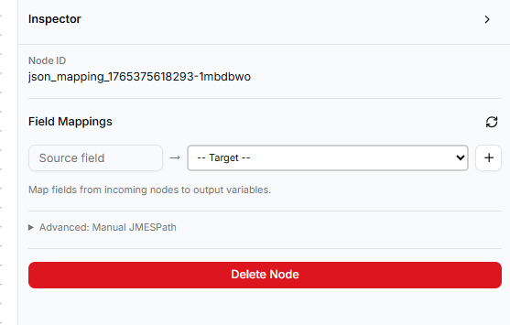
Should display the list of input variables for the target componen( (in the case I am testing it could be country_name, width, height, etc.)
Should display the name of the source field OR the list of possible source fields (if there are many)

Slide 5
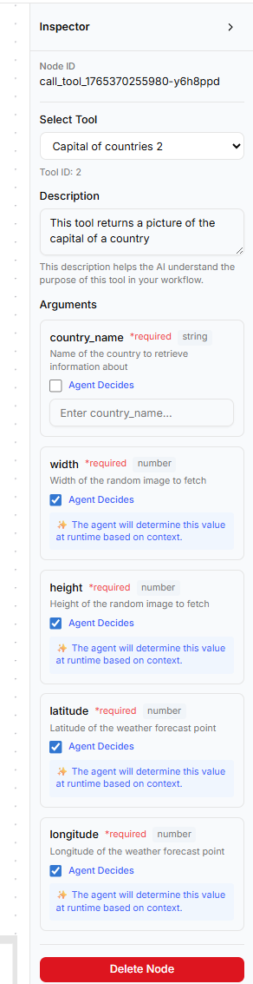
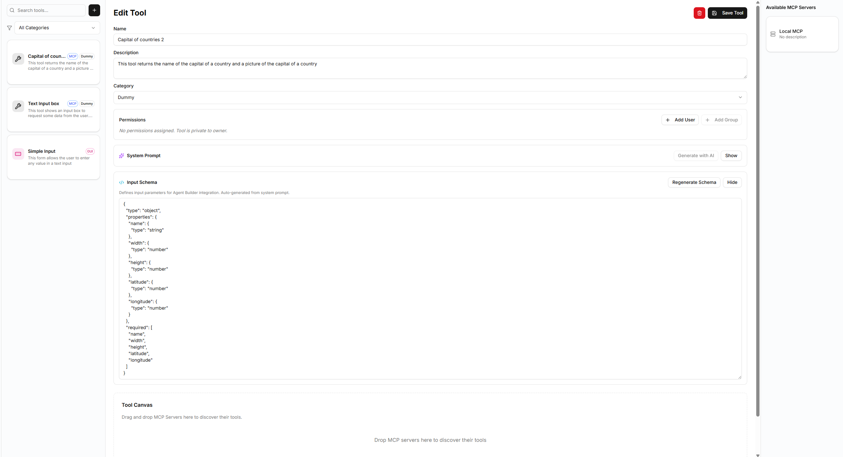
But in the inspector (in the Agent Builder) it displays « country_name »
In the Tool Builder, the schema that has been generated shows « name » as input variable

Slide 6
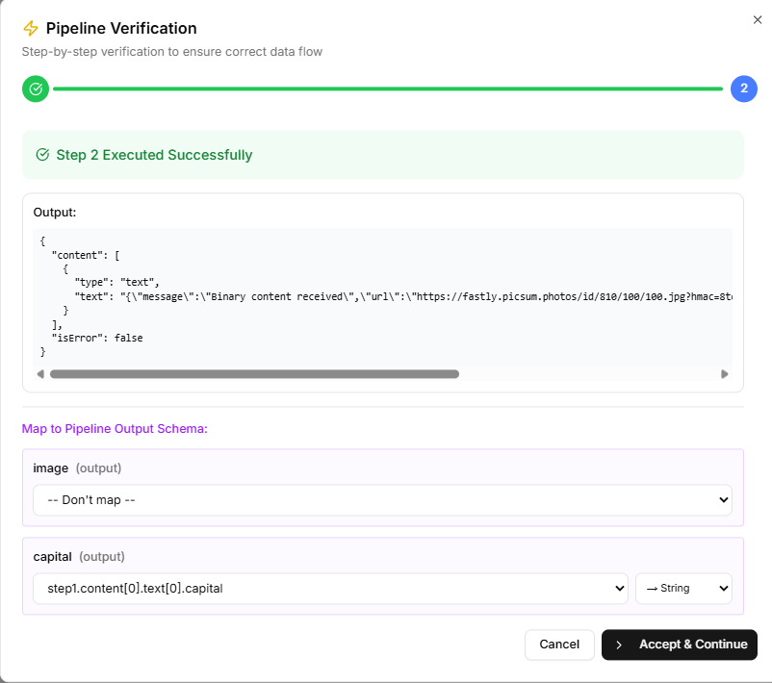
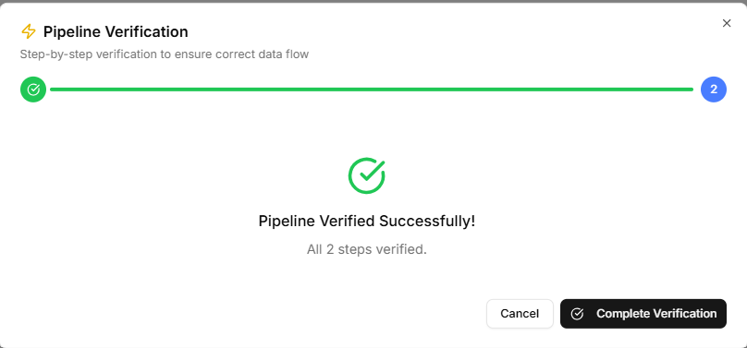
Verify pipeline
Currently, the application displays the output of the each last step (in this example « Step 2 »). OK
The Output of the pipeline MUST BE displayed at this last phase, with all mapping complete
Once the user has mapped the Output variables of Last Step Output Variable to Pipeline Output Schema and clicked « Accept & Continue » , we know what is the final mapping
Be careful, DO NOT CHANGE any process related to these dropdowns

Slide 7
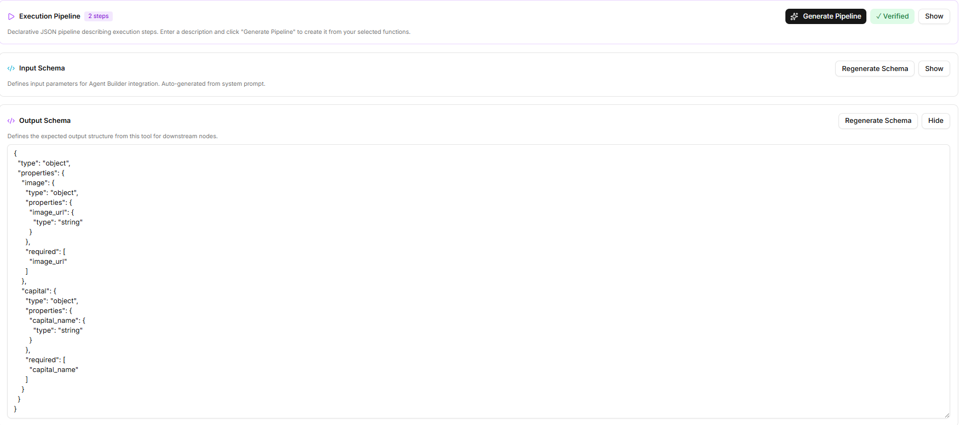
Verify pipeline
During each step of the « Verify Pipeline » process, we map each output variable of each step to one JSON item of the Output Schema of the pipeline. This output schema is defined in the « Output Schema » text box.
My expectation is that at the end of the « Pipeline Verify », we have the complete Output schema o fthe pipeline mapped. Instead we get {}.

Slide 8
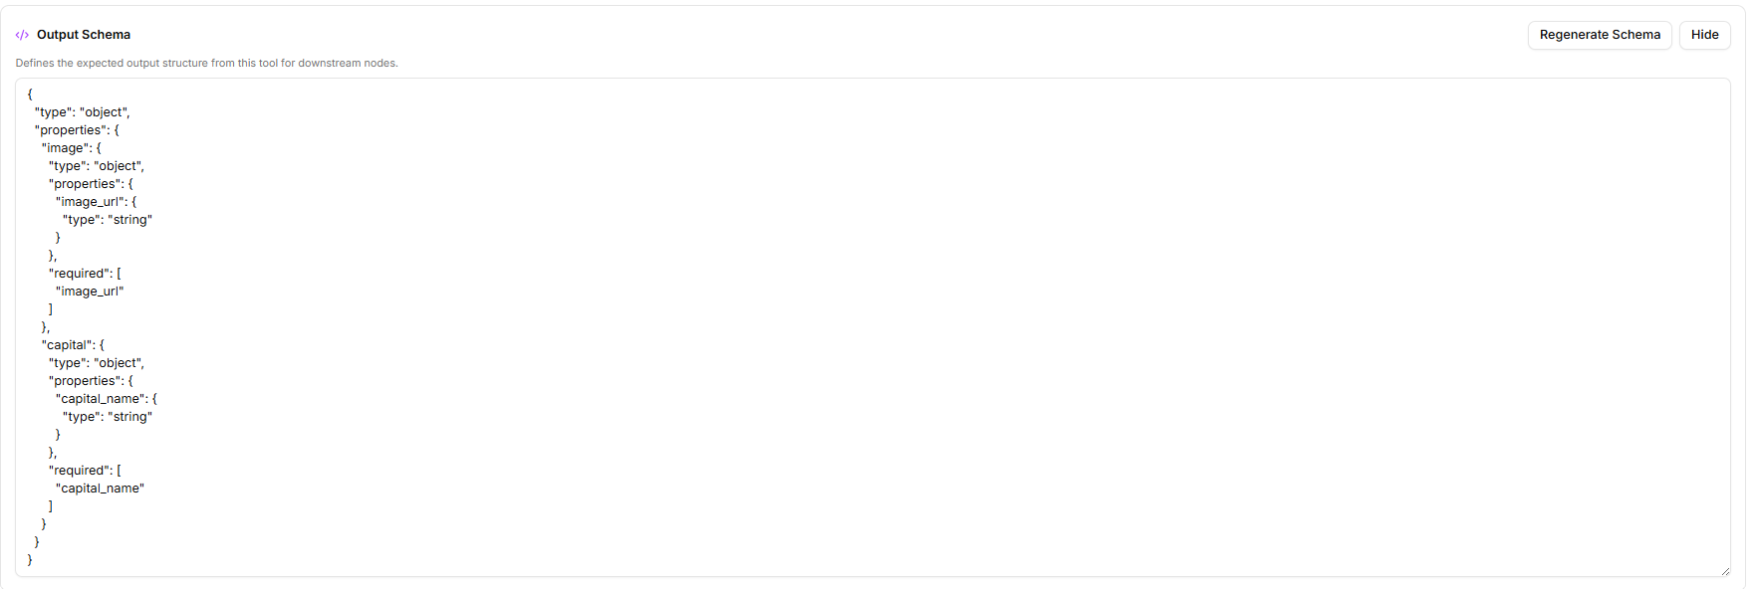
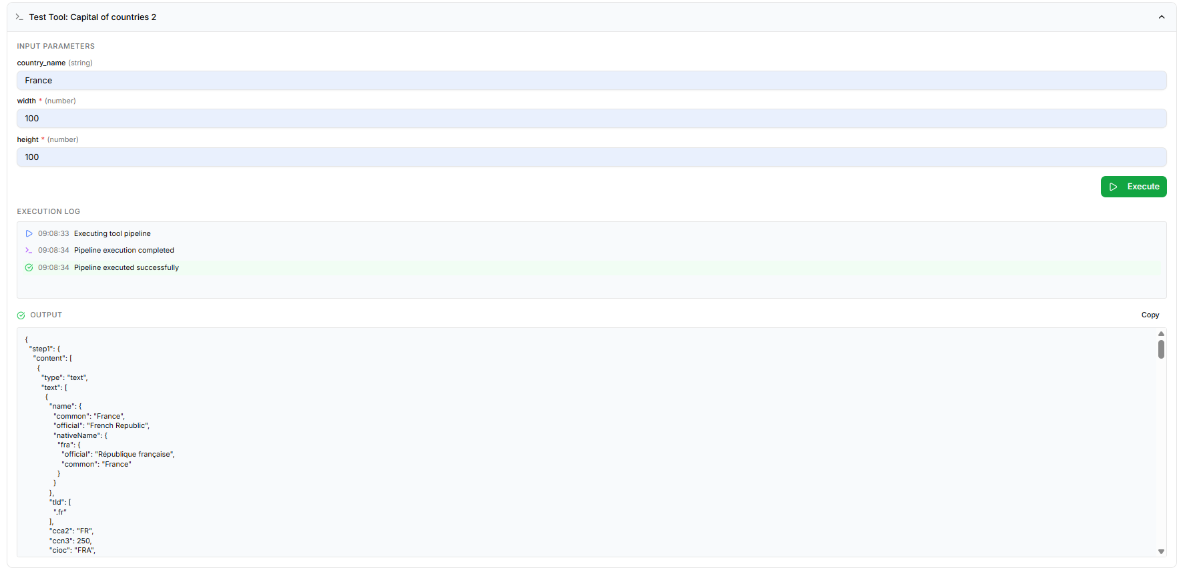
Execute pipeline
Here is the schema defined for the output of the pipeline
Here is the result of the execution. The result DOES NOT Match the schema. WRONG: it should use the mapping done during the « Verify Piepeline process »

Slide 9
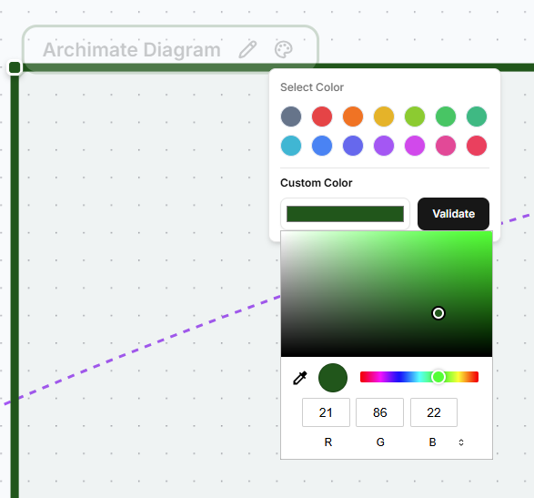
The « Done » Button was fine. Keep it
We need a button to validate the selection on this this popup

