Slide 1

Project Update
THRILL WP 3.4
“Supporting calculations for system design”
Yannik Zobus, Udo Eisenbarth

Slide 2


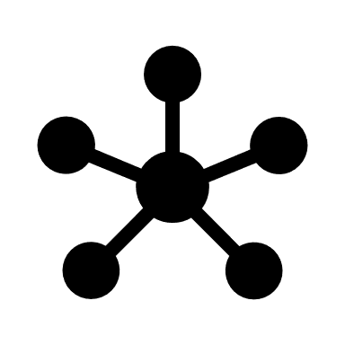



THRILL WP 3.4 - “Supporting calculations for system design”
Introduction
Modern high-intensity laser systems become more sophisticated & complex
Rigorous planning is crucial to make systems sustainable
Our Approach: OPOSSUM OPen-source Optics Simulation System and Unified Modeler
Open Source, accessible for all
Decouple system design from modeling: setup design once, model/analyze in numerous ways
Platform for custom-code integration
Extensible to specific needs
Holistic simulation of large-scale laser facilities
Modern backend, written in Rust for high maintainability, memory safety
Full-scale modeling of these systems, ideally creating a “digital twin” is necessary!
Open Source
However, existing modeling solutions are
Proprietary:
hard / impossible to integrate, expensive
Self-written codes:
Often „single-use“ during a thesis
not well maintained, mostly non-compatible with other code
Targeting specific problems
Custom code integration
Design once,
model often
General
solution
Rust: fast,
memory safe

Slide 3
Outline
Nodes
Analyzer
Report
Code examples
Code-Statistics
Near-future plans

Slide 4
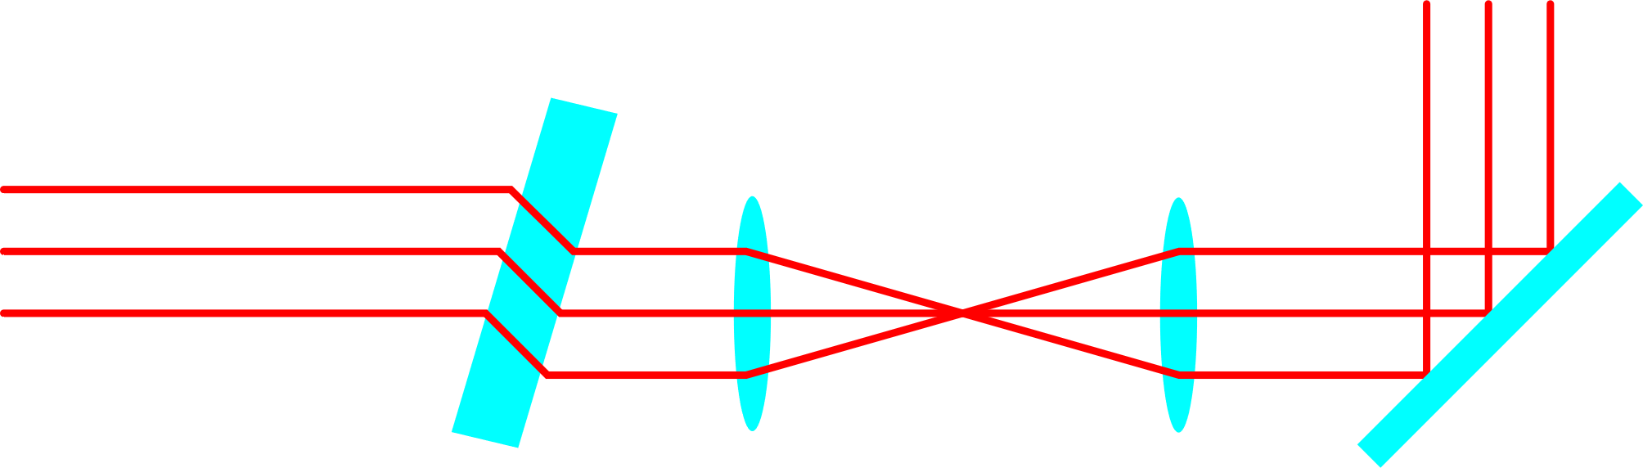



Node Geometry / Positioning
How to define a node position in 3D space?
„Conventional“ Approach (ZEMAX, Code V, OSLO,…)
Using absolute coordinates
Using coordinate breaks
Our Approach
Use relative positioning through calculation of an optical axis
Most optical systems easy to model
Absolute positioning still possible
Needs testing for inconsistencies
non flexible (but sometimes necessary…)
causes headache …!!!

Slide 5
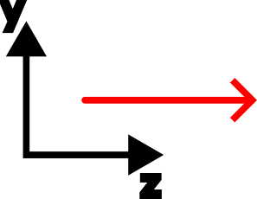
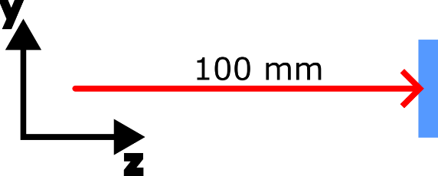

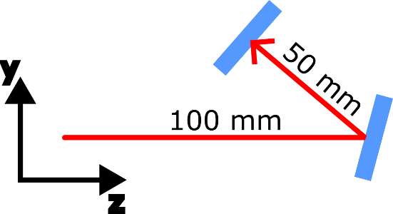
Node Geometry / Positioning II
Position first node (typ. source) absolutely in 3D space.
Define relative distance to next node along the current optical axis.
Define local orientation of node (tilt, decenter of anchor point)
Define relative distance to next node along the current optical axis.

Slide 6
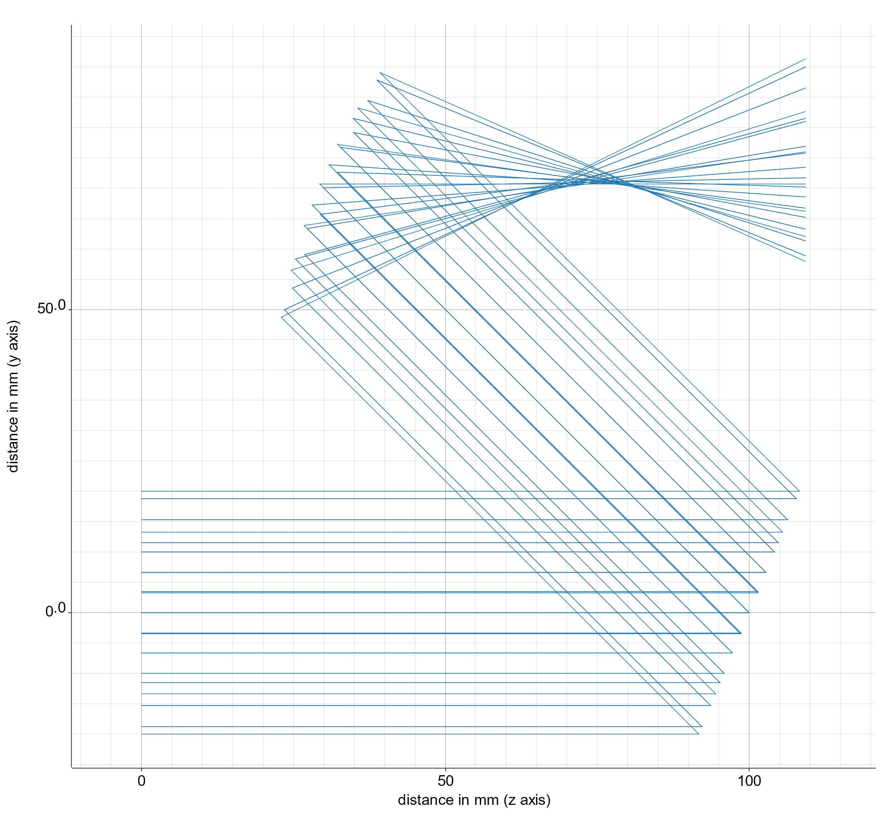
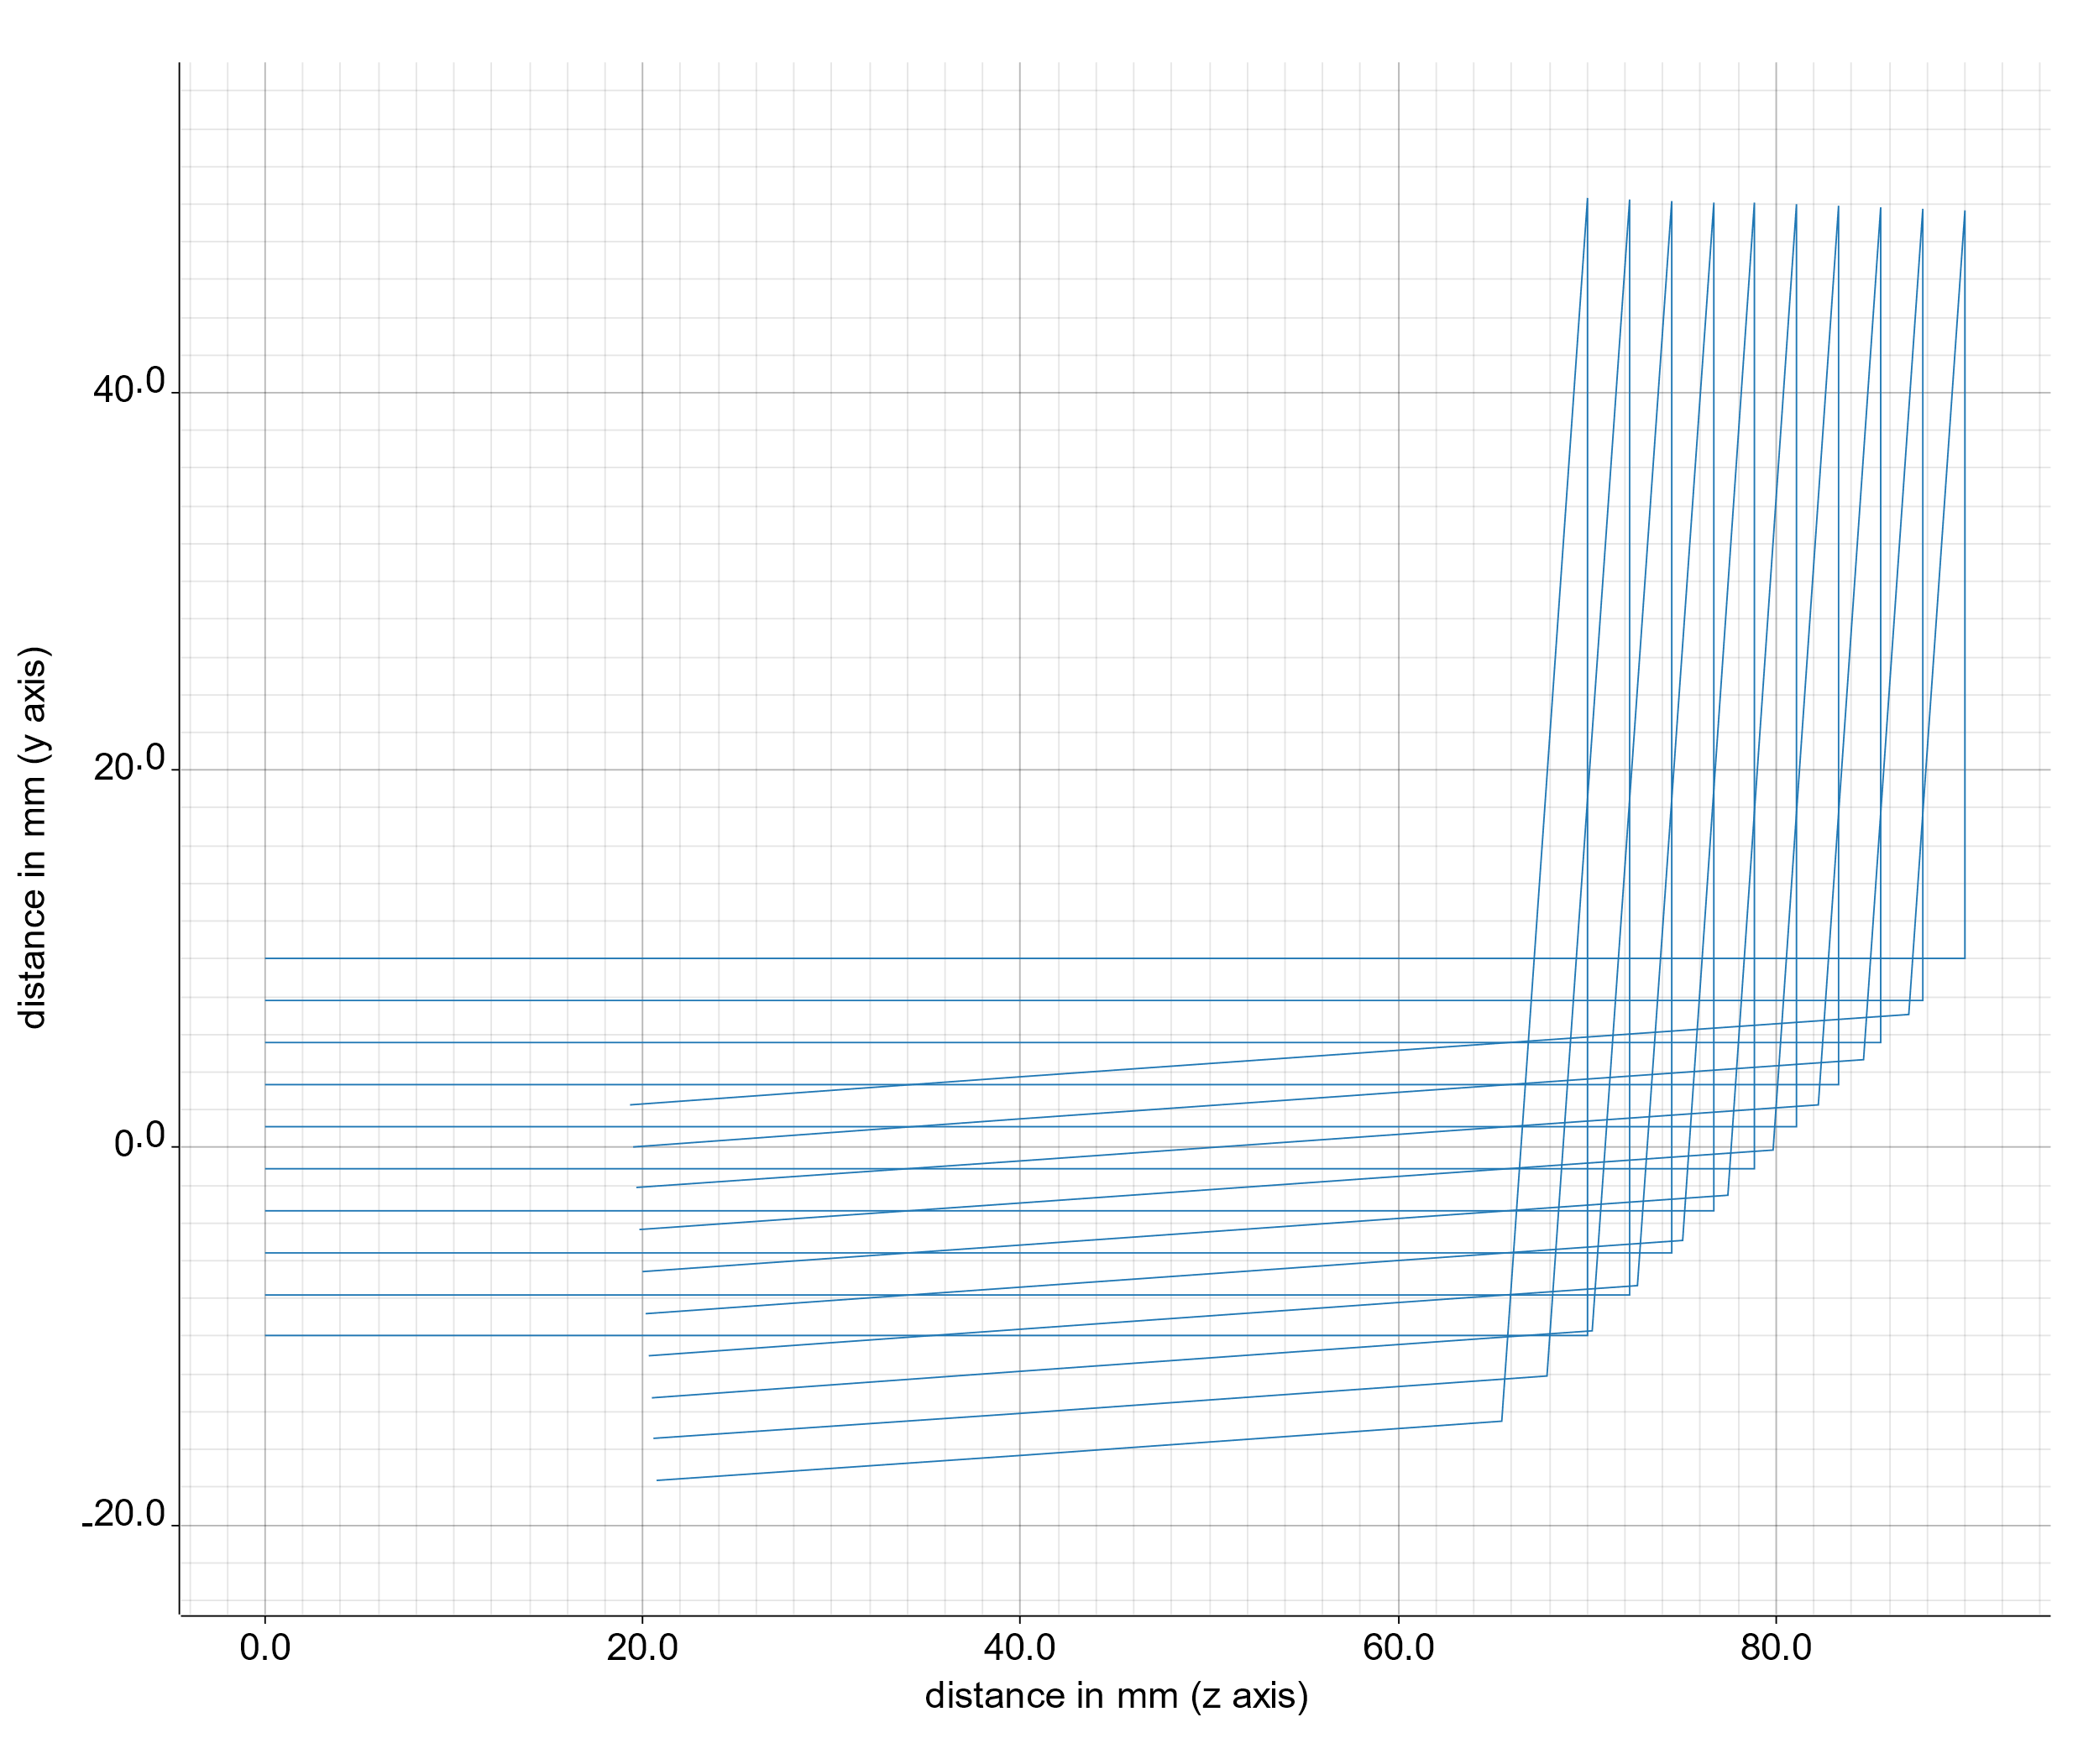
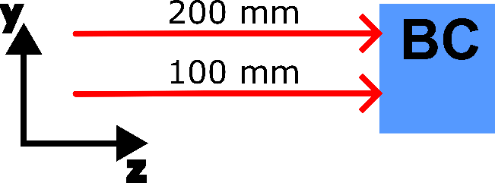
Node Geometry / Positioning II
Examples
Minor drawback: inconsistencies may occur (but can be checked for):
flat -> curved mirror
mirrors in double-pass

Slide 7
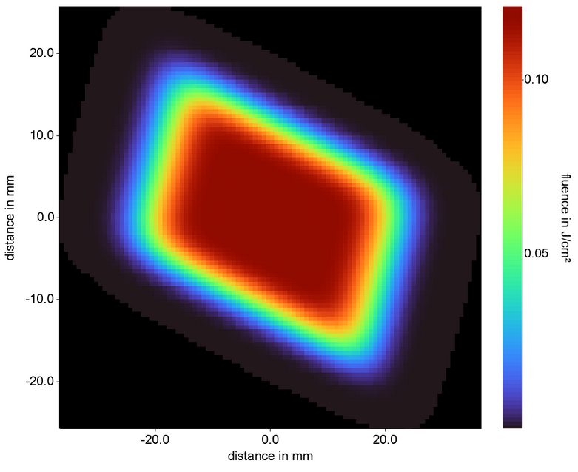
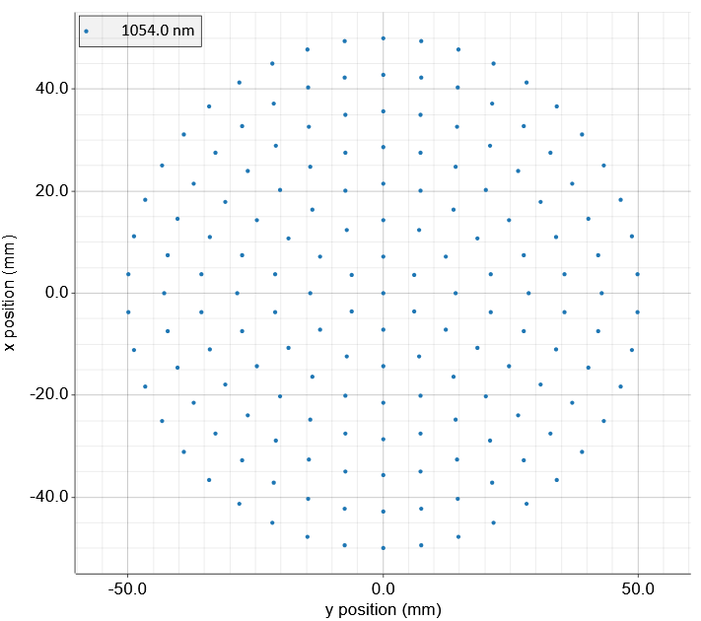
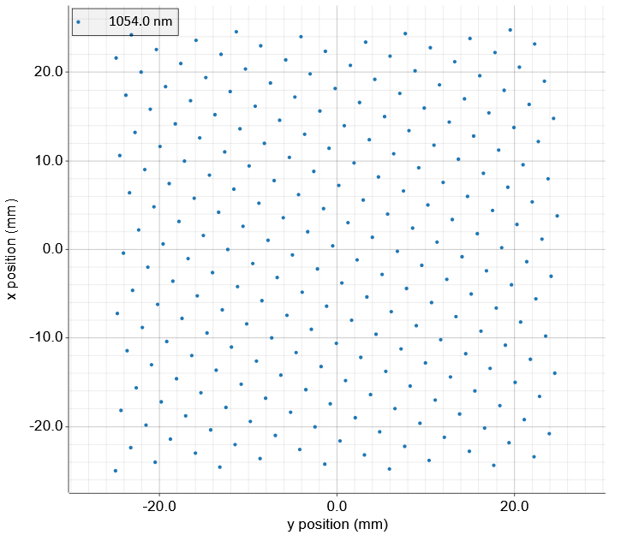
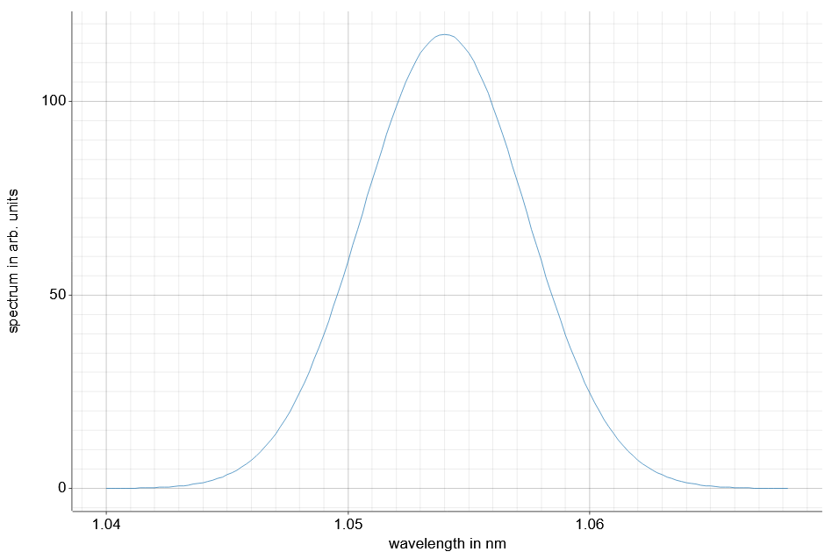
Nodes – Node types
General 2D Gaussian
Hexapolar
Special nodes:
Source:
Holds the initially defined light
Energy distribution: Uniform, General 2D Gaussian
Position distribution: Hexapolar, Hexagonal, Fibonacci, Random, Sobol, Grid
Shape: Ellipse, Rectangle
Spectrum: Gaussian
Rectangle
Spectrum

Slide 8
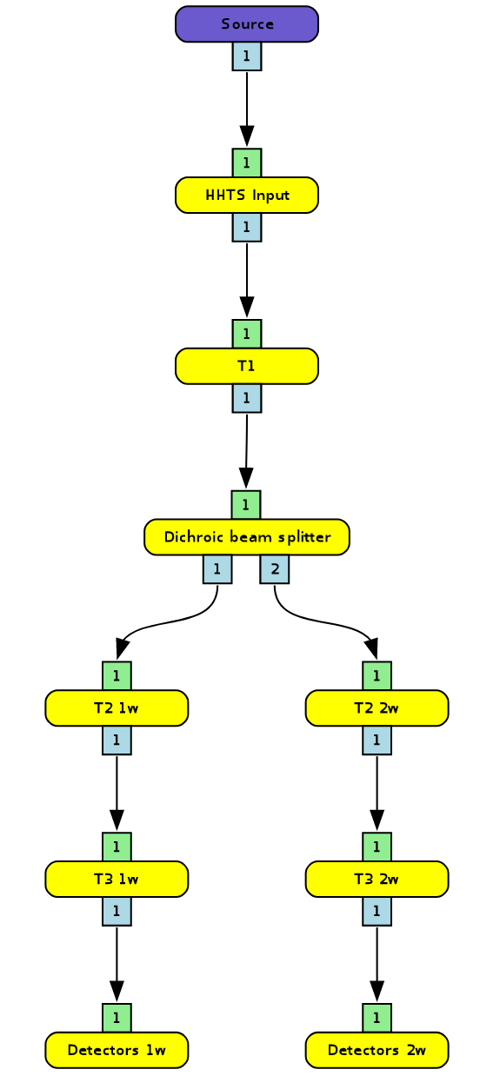
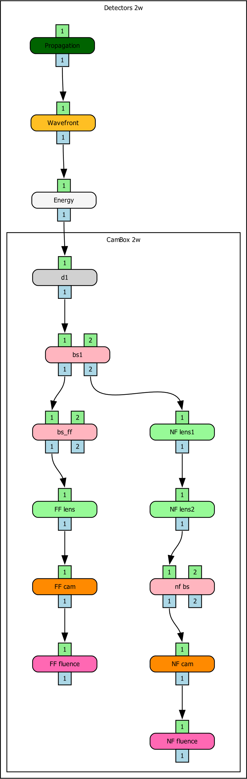
Nodes – Node types
Example: HHTS
Special nodes:
Source:
Holds the initially defined light
Energy distribution: Uniform, General 2D Gaussian
Position distribution: Hexapolar, Hexagonal, Fibonacci, Random, Sobol, Grid
Shape: Ellipse, Rectangle
Spectrum: Gaussian
Nodegroup
Allows grouping of nodes, e.g., multiple lenses as a telescope
Infinite nesting (groups in groups) possible

Slide 9
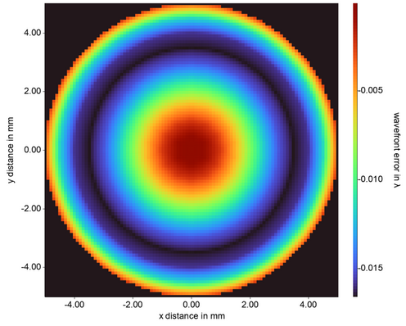
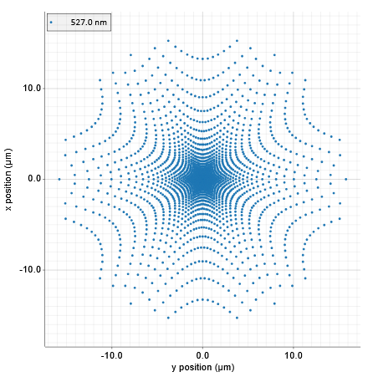
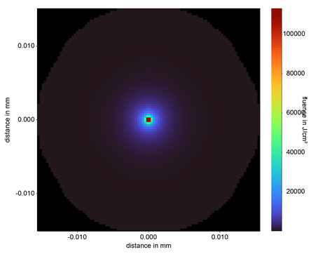
Nodes – Node types
Wavefront
Special nodes:
Source:
Holds the initially defined light
Energy distribution: Uniform, General 2D Gaussian
Position distribution: Hexapolar, Hexagonal, Fibonacci, Random, Sobol, Grid
Shape: Ellipse, Rectangle
Spectrum: Gaussian
Nodegroup
Allows grouping of nodes, e.g., multiple lenses as a telescope
Infinite nesting (groups in groups) possible
Detector nodes:
Energy
Fluence
Spectrum
Spot diagram
Wavefront
FF Spot diagram
FF Fluence

Slide 10
Nodes – Node types
Special nodes:
Source:
Holds the initially defined light
Energy distribution: Uniform, General 2D Gaussian
Position distribution: Hexapolar, Hexagonal, Fibonacci, Random, Sobol, Grid
Shape: Ellipse, Rectangle
Spectrum: Gaussian
Nodegroup
Allows grouping of nodes, e.g., multiple lenses as a telescope
Infinite nesting (groups in groups) possible
Detector nodes:
Energy
Fluence
Spectrum
Spot diagram
Wavefront
Generic nodes:
Spherical lens
Cylindrical lens
Paraxial Lens
Wedge
Thin mirror (single surface)
Ideal filter
Reflective grating
Ideal beam splitter

Slide 11
Nodes – surfaces & Refraction
Every node holds one or multiple optical surfaces
An optical surface consists of:
A geometrical surface: E.g., a plane, a sphere, cylinder…
An aperture
A coating: Ideal-Ar, constant reflectivity or Fresnel
LIDT information (as input parameter, not yet calculated)
The refractive index of a node can be described by:
A constant value
Sellmeier equations
Schott formula
Conrady formula

Slide 12
Analyzer
E₁
E₂
E₃
Simple energy analyzer
Energy flow and splitting between nodes
rudimentary but very fast
Sequential Ray-tracing analyzer:
Rays propagate from node to node guided along a topologically sorted flow-graph
Implementation of detectors allow to evaluate parameters such as fluence, energy, wavefront etc
Semi-sequential ghost-focus / lidt analyzer
Rays propagate similar to ray-tracing analyzer but can bounce off of surfaces
Propagation is handled iteratively in forward and backward direction
Fluence on optical surfaces is evaluated and a report is generated if the fluence exceeds the LIDT
Node 1
Node 2
Node 3
Rays₁
Rays₂
Rays₃
Node 1
Node 2
Node 3
Iteration 1: forward
Node 1
Node 2
Node 3
Iteration 2: backward
Node 1
Node 2
Node 3
Iteration 3: forward…

Slide 13
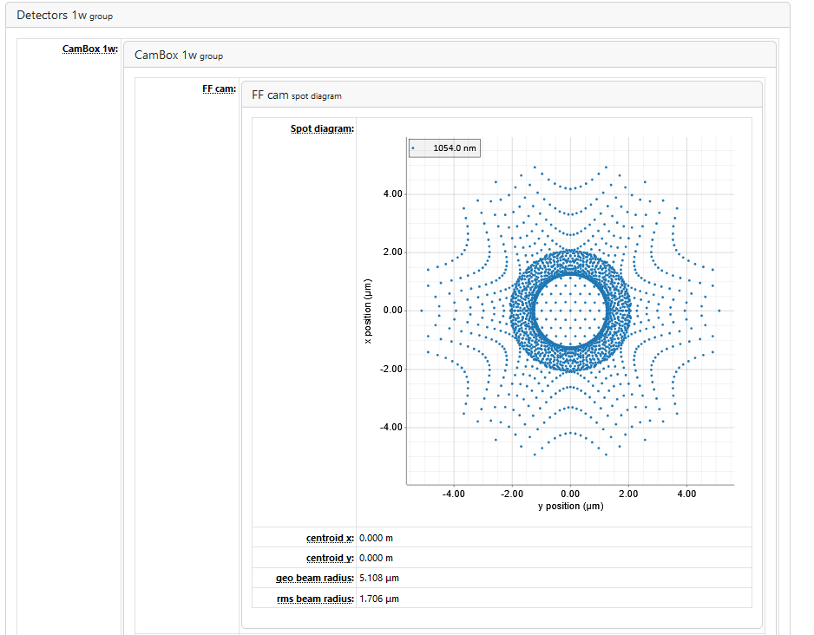
Reports
Example: FF spot diagram in the 1w arm of the HHTS
Reports are generated as HTML to be viewed in a web browser
Reported data is sorted by its position in groups and nodes
Specialized analyzers, such as the ghost focus analyzer, create the reports depending only on their analysis purpose, but not on the detectors in the system

Slide 14
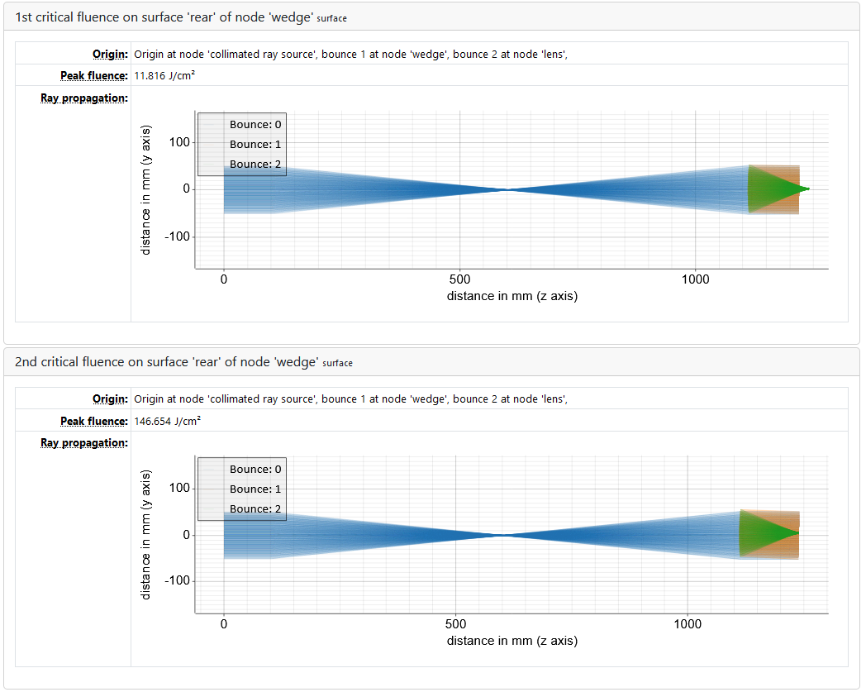
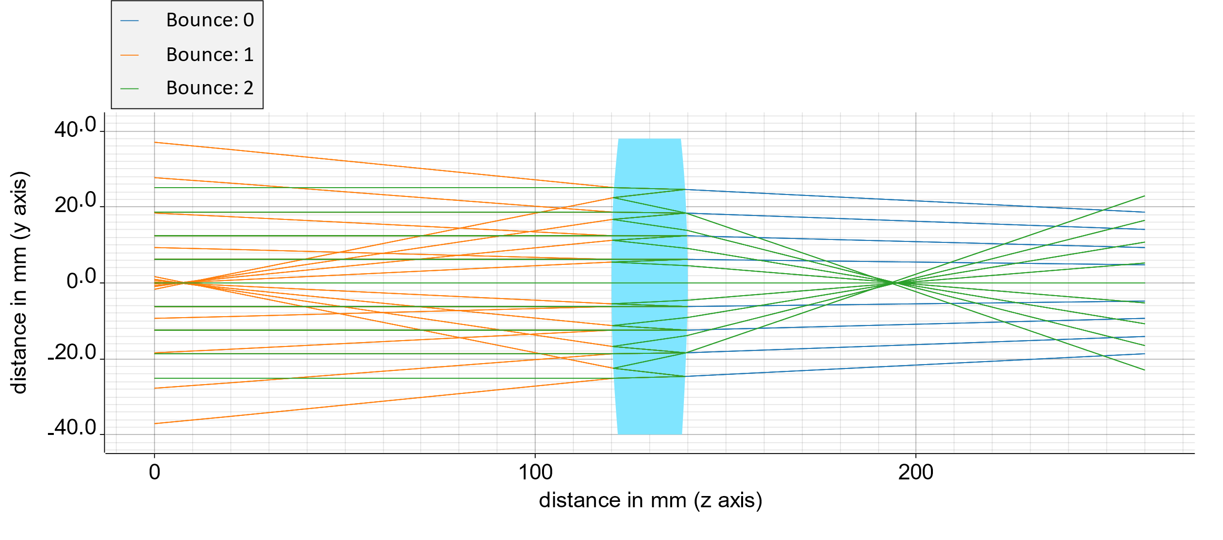
Reports
Example Ghost Focus analyzer
Telescope with two bi-convex lenses
Wedge after telescope
Every damaging ray bundle can be traced back to its origin, including the bounces

Slide 15
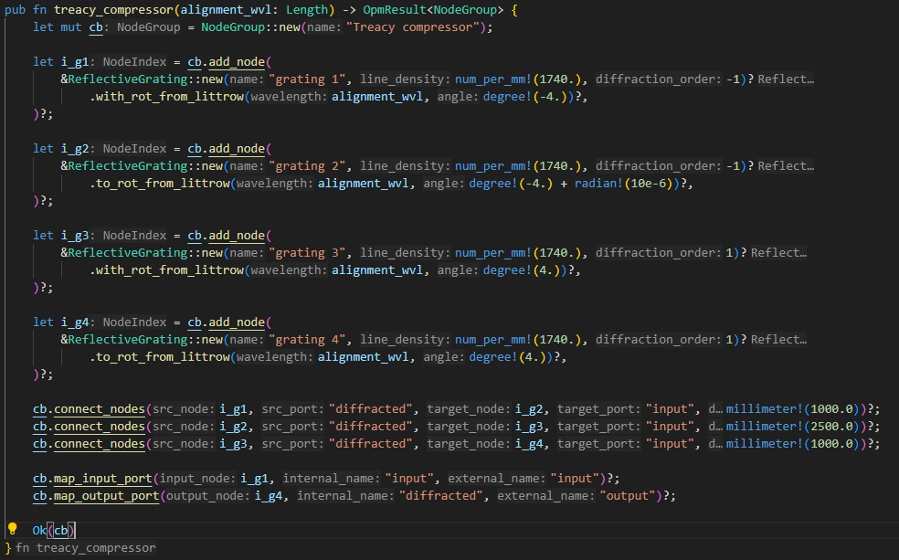
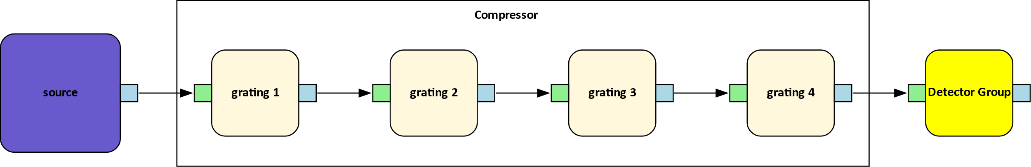
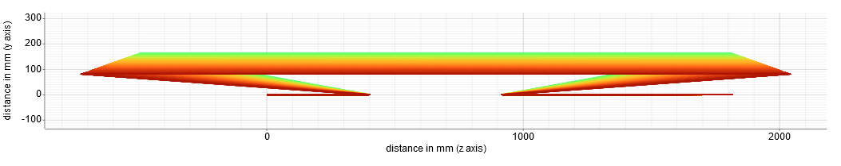
Code examples
Only few lines of code to define a treacy compressor
Flowgraph representation of treacy compressor
Ray tracing output of Beam with Gaussian spectrum (8nm fwhm at 1054 nm)

Slide 16
Code Statistics
31600 lines of code
4500 lines of comments
1098 commits, average of 2 commits per day
255 tickets closed
> 630 unit tests

Slide 17
Near-Future plans
GUI implementation for drag & drop optical-system design
Polarization handling
Real beam splitters
Amplifier via Frantz-Nodvik implementation
Additional nodes: parabolas, polarizers, etc.
Full code coverage with unit tests

