Slide 1


2D Best Practices in Unity
Arturo Nereu – Unity Technologies
@ArturoNereu

Slide 2
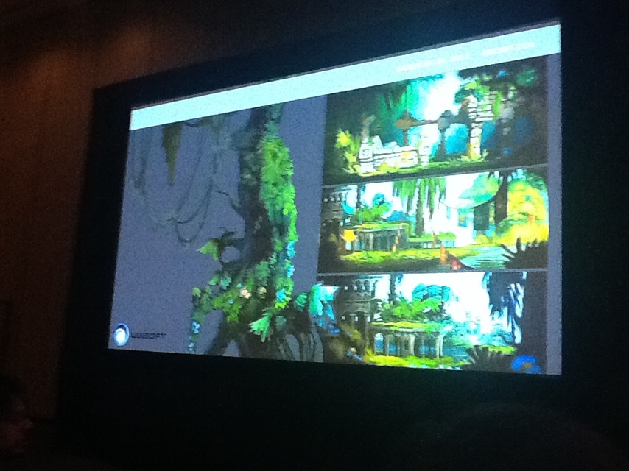
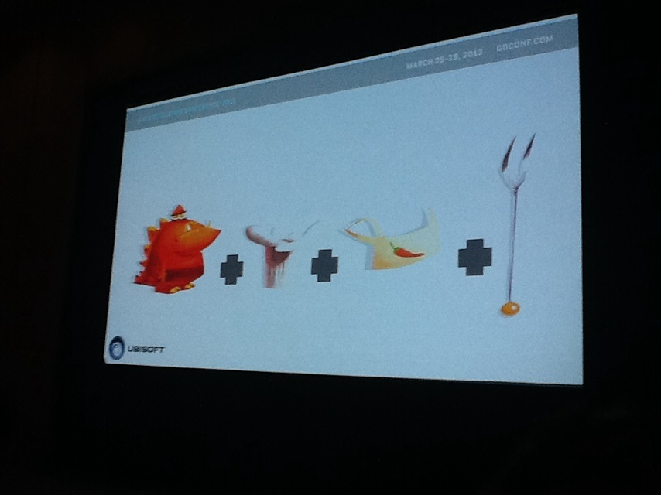
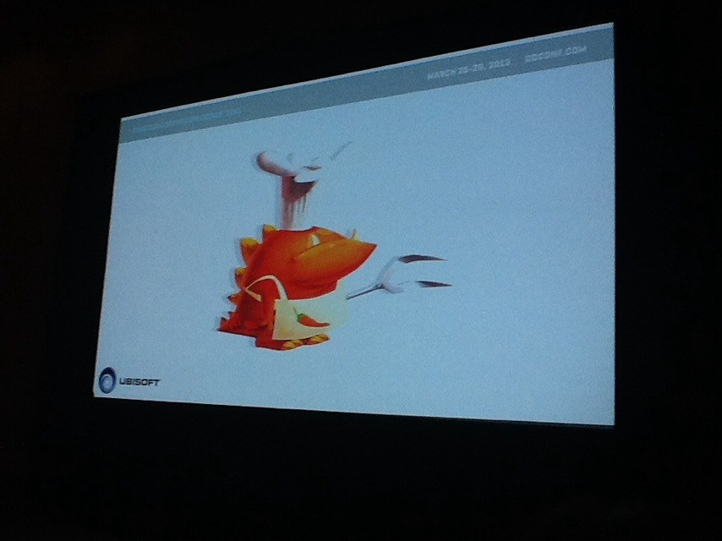
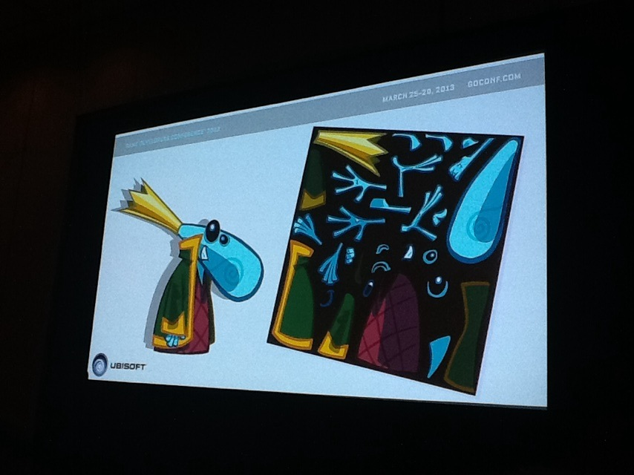
A quick story

Slide 3

Agenda
2D Skeletal animation workflow.
Sprite Animation Re-skinning.
Isometric Sorting.
Camera Scaling.
#HechoConUnity

Slide 4
2D Skeletal Animation
Creating hierarchy and sorting.
Simple CCD for IK solving.
Animation Events to synchronize sound effects.

Slide 5
Sprite Animation Re-skinning
Useful for sharing animations and controllers on different looking characters.
Use Resources folder to load sprites at runtime.
Use LateUpdate to override animated properties.

Slide 6
Camera Scaling
Useful when working with multiple aspect ratios or resolutions.
Scaling by pixel density
Ortographic size = screen height / pixel to units / 2
Scaling by width
Height = target width / screen width * screen height
Ortographic size = height / pixel to units / 2

Slide 7
Tips
Always use POT textures.
Use the best size for what you want to achieve.
Atlas, atlas, atlas.
Play with 2D and 3D objects.

Slide 8
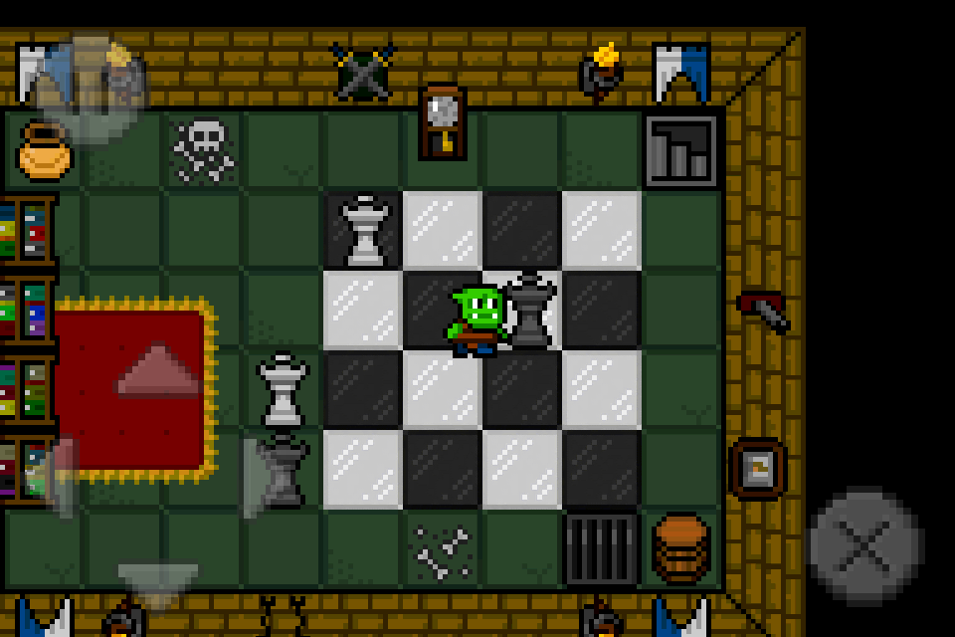
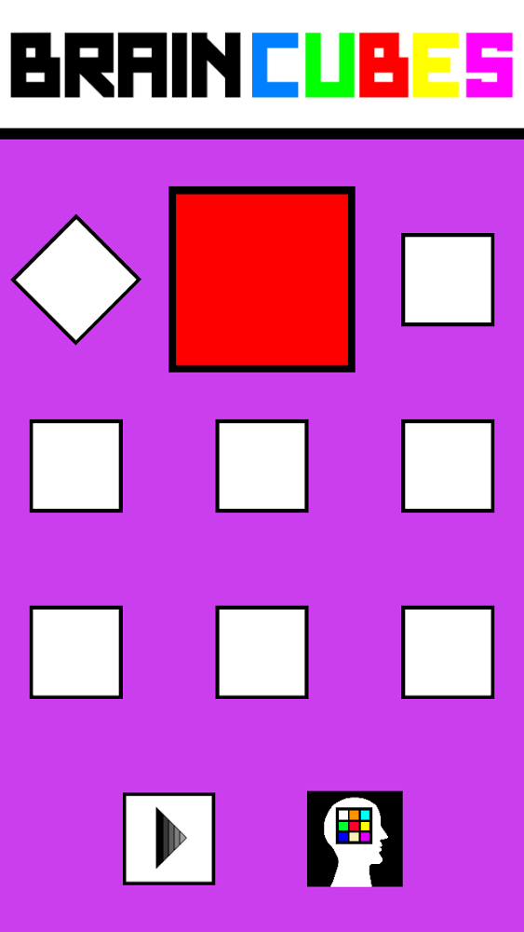
#HechoConUnity

Slide 9
Q&A
Twitter: @ArturoNereu
Assets & PPT: http://bit.ly/1BArfRM
Mail: arturo@unity3d.com
Thanks to: Veli-Pekka Kokkonen and EsotericSoftware

