Slide 1
Microservice and OSS
Microservices
Omprakash Pandey
For CG

Slide 2
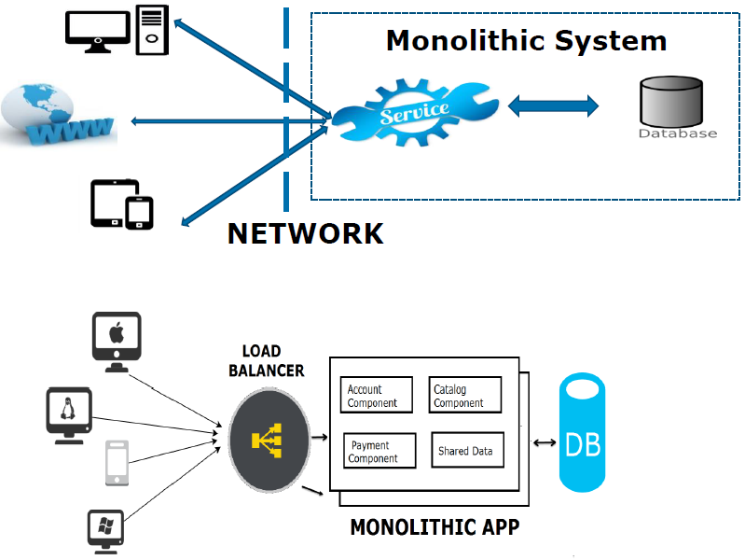
Application Development
Monolithic applications
Layered approach
Service Oriented Architecture (SOA)
Microservices

Slide 3
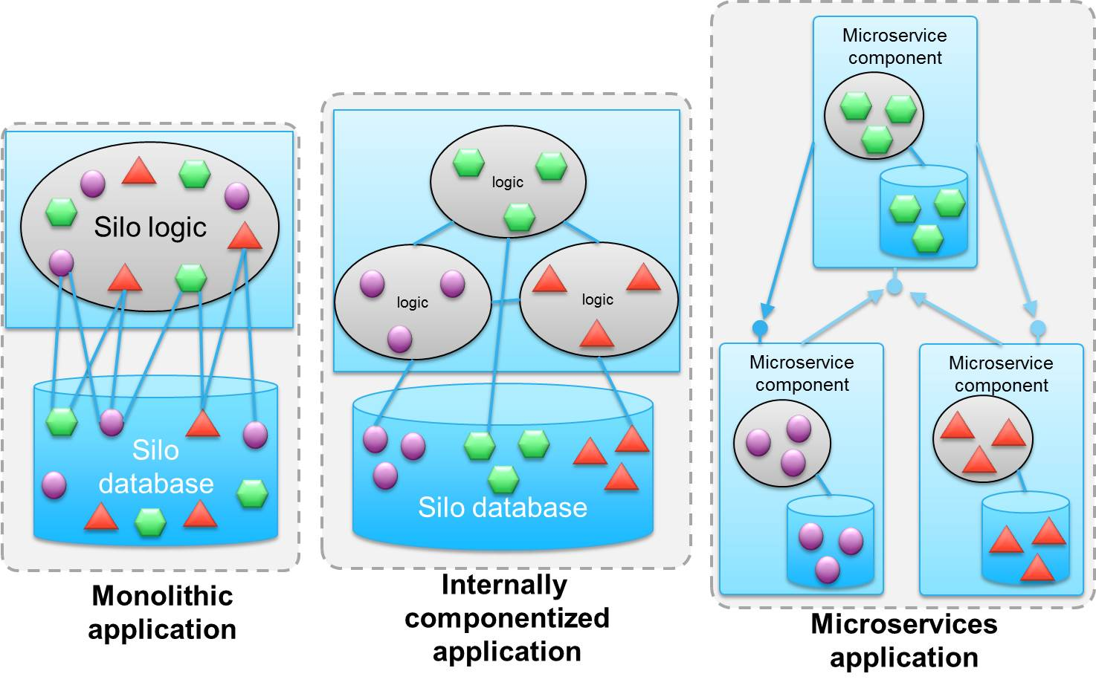
Monolithic vs SOA vs Microservices

Slide 4
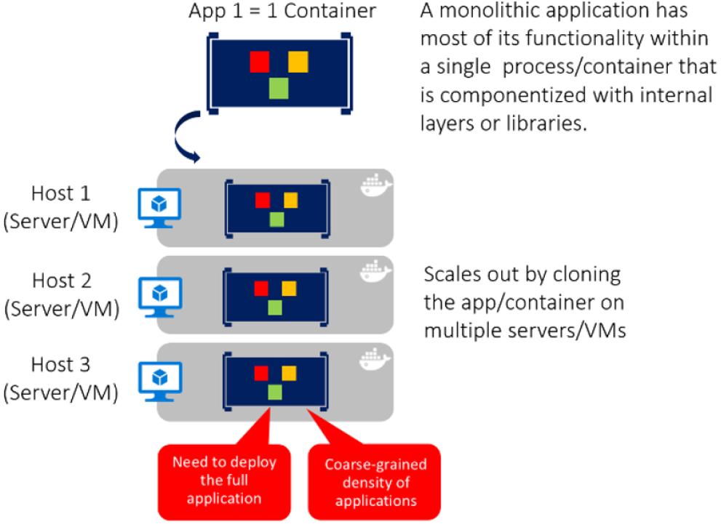
Monolithic Applications
Any single change to any part of the application would mean deploying a completely new version of the application.
Lesser release planning.
Scaling up of a component would need the entire application to be scaled up.

Slide 5
Monolithic System
Monolithic system is a typical enterprise application.
There's always one package which basically contains everything which tends to end up with large code base.
When application expands, It keeps grows with no physical division and no restriction in size.
Developers takes longer time to develop new functionality with in application and it's difficult to make a change without affecting other parts of the system.
Deployment of a large system can also be challenging, because even for a small bug fix, a new version of the entire system need to be redeployed.
New technologies cannot be adopted for a specific functionality, since it is available in a overall package.

Slide 6
Benefits of Monolithic approach
Easy to develop
Less complexity in communication
End-to-end testing
Easy to deploy
Simple to Scale (Horizontally under a load balancer)

Slide 7
Drawbacks of Monolithic approach
Not flexible - Lack in adoption of new technologies.
Not reliable – if one component fails entire system fails.
Cannot scale services independently
Large application size
Redeploy entire application for every code change
Development is slow

Slide 8
Microservices
Runs in its own separate process
Can be deployed on its own, independently of the other microservices
Has its own dedicated data store
Collaborates with other microservices to complete its own action
microservices don’t need to be written in the same programming language or for the same platform (IIS, Node, NGINX, and so on)

Slide 9
Why microservices?
Single Responsibility Pattern- easy to develop and maintain
Adoption of new technologies
Deployed independently – enables continuous deployment
Scaled independently.
Http endpoint - consumed by various clients (Mobile app, Browser based App)

Slide 10
What is Microservices?
Microservices is a method of developing software applications as a suite of independently deployable, small, modular services in which each service runs a unique process and communicates through a well-defined, lightweight mechanism.
Most popular way of communication between services is using HTTP/Rest with JSON because of its comparatively lower complexity over other protocols.
Some microservices would expose a REST, RPC or message-based API
Each service has its own database schema (can use polyglot persistence model)

Slide 11
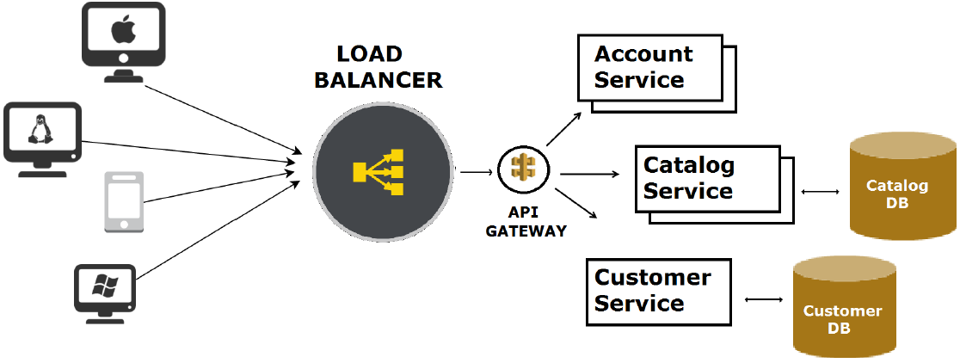
Microservice Architecture

Slide 12
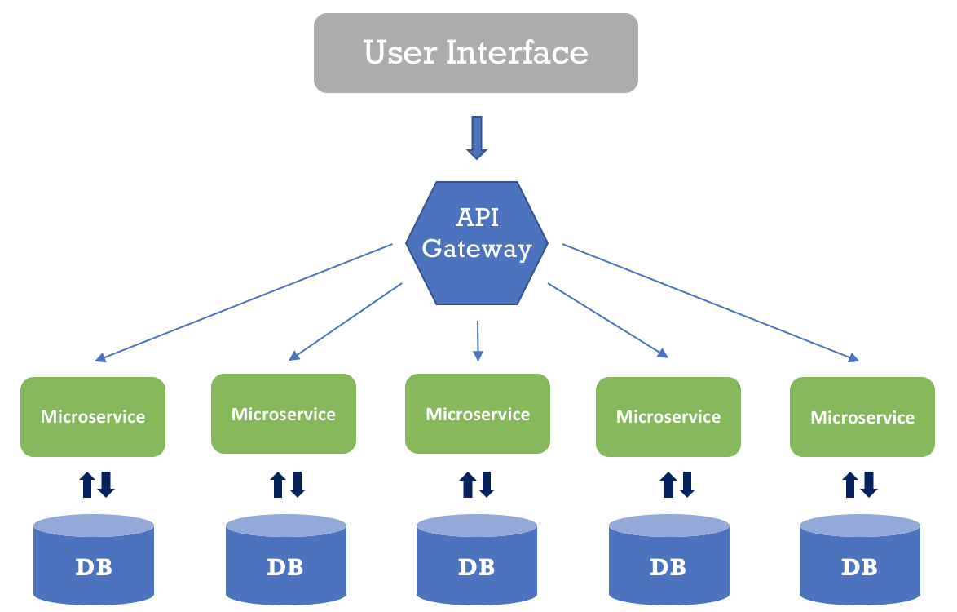

Slide 13
Microservice characteristics
Microservice is responsible for a single capability.
Microservice is individually deployable.
Microservice consists of one or more processes.
Microservice owns its own data store.
Small team can maintain a handful of microservices.
Microservice is replaceable.
Microservices are easier to develop, deploy and debug.
Monitoring and health checks of the services and infrastructure.
Microservices can be scaled easily and can be re-used across different applications / services.
Microservices approach will follow the container principle
Microservices work well with Containers like dockers.
Biggest benefit is –Microservices are independent to each other. i.e., if one micro service goes down, there is a little risk of full application shutdown
DevOps and CI/CD practices and infrastructure

Slide 14
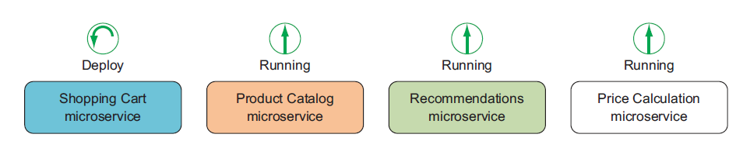
Independently deployable

Slide 15
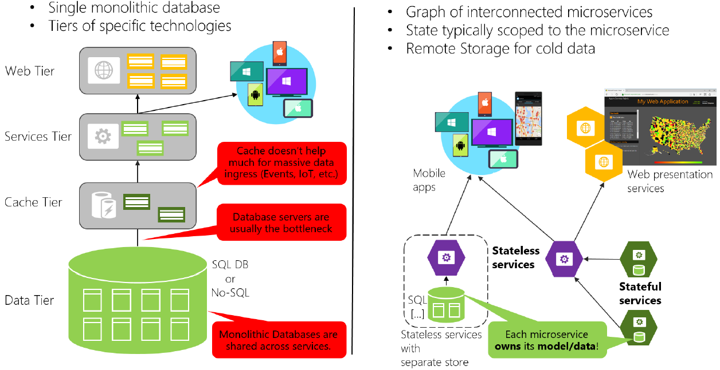
Data sovereignty per microservice

Slide 16
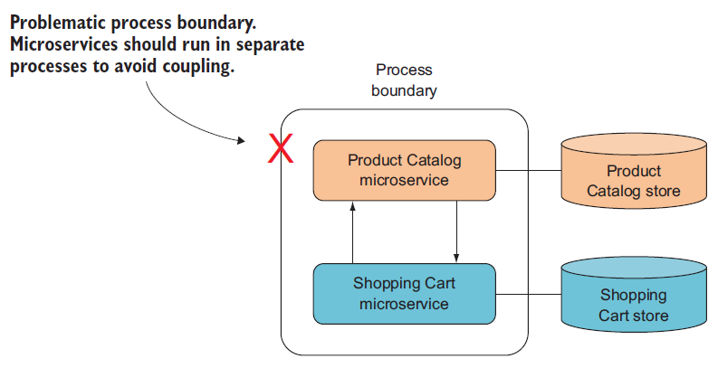
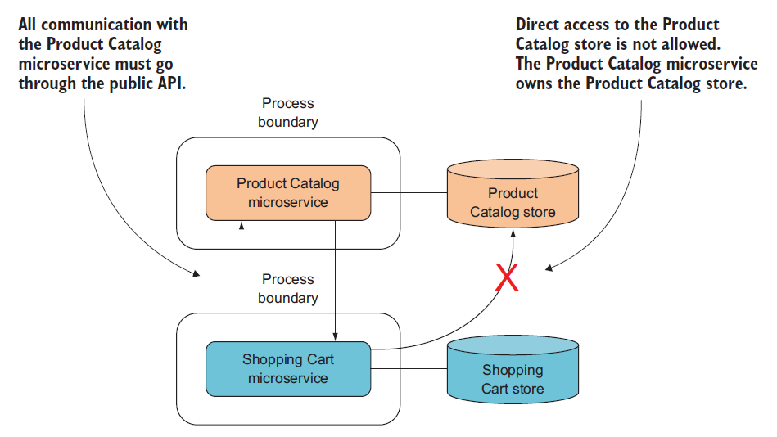
OWNS ITS OWN DATA STORE

Slide 17
Microservices Key Design Principles
High Cohesion
Autonomous
Business Domain Centric
Resilience
Observable
Automation

Slide 18
High cohesion
High cohesion principle controls the size of the microserviceand the scope of the contents of the microservice
Microservices content and functionality in terms of input and output must be comprehensible.
Must have a single focus.
It makes overall system highly scalable, flexible, and reliable

Slide 19
Autonomous
Microservices should also be autonomous
A microservice should not be subject to change because of an external system it interacts with or an external system that interacts with it. i.e. It should be loosely coupled.
Microservice should also be stateless
Microservice should support backwards compatibility
Microservice can be independently changeable and independently deployable
Contracts between the services must be clearly defined
Concurrently developed by several teams

Slide 20
Business Domain Centric
A microservice should be a business domain centric
The overall idea is to have a microservice represent a business function or a business domain
This helps to scope the service and control the size of the service
When business changes or the organization changes or the functions within the business change, microservices should change in the same way because the system is broken up into individual parts which are business domain centric

Slide 21
Resilience
Microservice need to embrace failure when it happens.
Microservice needs to embrace the failure by degrading the functionality within it or by using default functionality.
If one component of a system fails, the failure should not cascade, the problem should be isolated and the rest of the system should work.
Microservices can be more resilient by having multiple instances which registers themselves on start up, and deregister themselves on failure to have an awareness of fully functioning microservices.
Microservices should validate incoming data, and it shouldn't fall over because they've received something in an incorrect format.

Slide 22
Observable
System built with Microservice architecture must be observable.
System's health must be observed in terms of logs, system status and errors.
Logging must be centralized and monitored from a centralized place. Which help us to achieve
•Solving the problem quickly
•Monitor business data
•Data used for scaling and capacity planning.
•Distributed transaction details

Slide 23
Automation
Microservice architecture should support the feature of automation with the help of automation tools.
Automated testing will reduce the amount of time required for manual regression testing, and the time taken to test integration between services and clients, and also the time taken to set up test environments.
Continuous Integration tools

Slide 24
Microservice and Docker
Docker is an excellent tool for managing and deploying microservices.
Each microservice can be further broken down into processes running in separate Docker containers, which can be specified with Docker filesand Docker Compose configuration files.
Combined with a provisioning tool such as Kubernetes, each microservice can then be easily deployed, scaled, and collaborated on by a developer team.
Specifying an environment in this way also makes it easy to link microservices together to form a larger application.

Slide 25
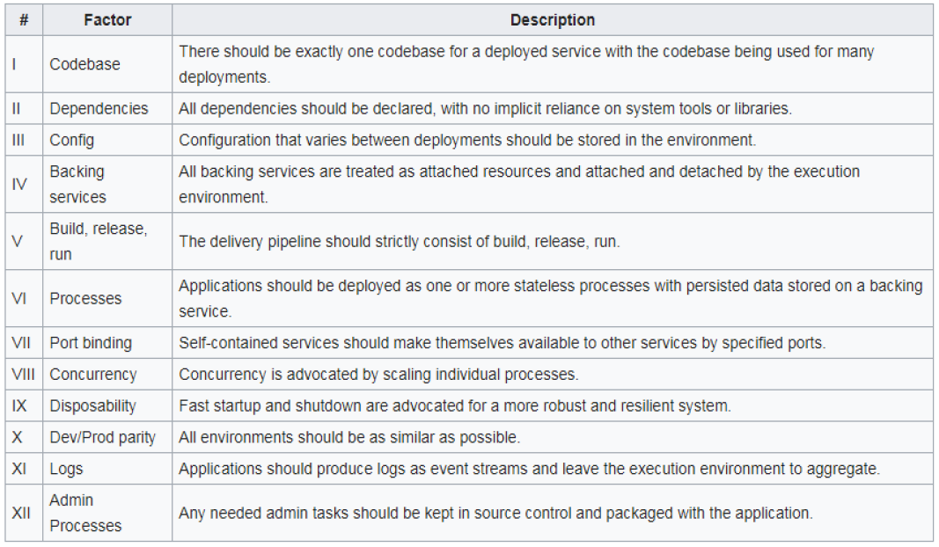
Twelve-Factor App methodology

Slide 26
Microservices Advantages
Individual parts can be enhanced based on market needs.
Microservices can be tested using automated testing tools
Deployment is super easy with the release and deployment tools.
Virtual machines can host microservices on-demand
Embraces new technology
Supports Asynchronous Communication technology
Simpler server side and client side technology
Shorter development times
Highly scalable and better performance
Enables frequent updates and fast issue resolution

Slide 27
Drawbacks of Microservices
Distributed nature adds complexity, needs to implement communication mechanism
Need to handle the eventual consistency when performing transaction across multiple service databases.
Complexity in testing complete application- all services to be up and running.

Slide 28
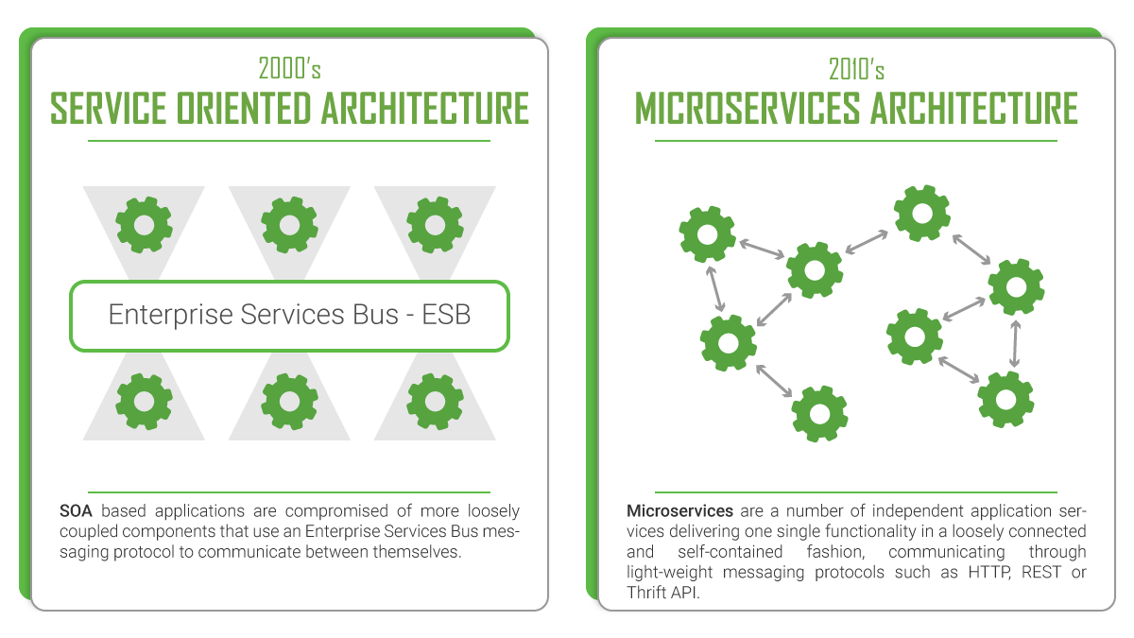

Slide 29
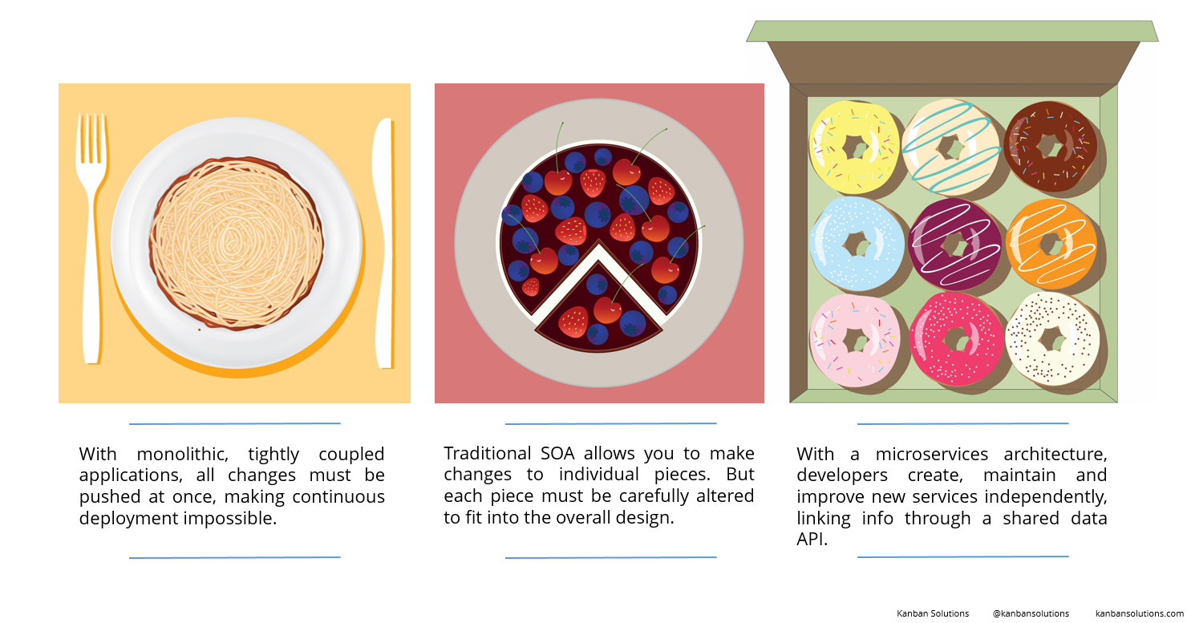

Slide 30
Service Oriented Architecture | Microservices
Importance on business functionality reusability | Importance is on the concept of “bounded context”
Enterprise Service Bus for communication | Simple messaging via HTTP or Queue
Uses traditional RDBMS | Modern NoSQL + RDBMS storage
DevOps supported, but not a mainstream | Strong focus on DevOps/Continues Delivery
Supports multiple message protocols | Uses lightweight protocols such as HTTP, REST or Thrift APIs
SOA services share the data storage | Each microservice can have an independent data storage
Common governance and standards | Relaxed governance, with greater focus on teams collaboration and freedom of choice
Use of containers (such as Docker) is less popular | Containers work very well with microservices
Multi-threaded with more overheads to handle I/O | Single-threaded usually with use of Event Loop features for non-locking I/O handling

Slide 31
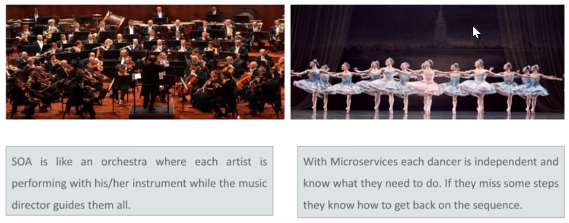
SOA vs Microservices
Notes:
Governance and guidance in SOA. Hence microservices are no or less governance required.

Slide 32
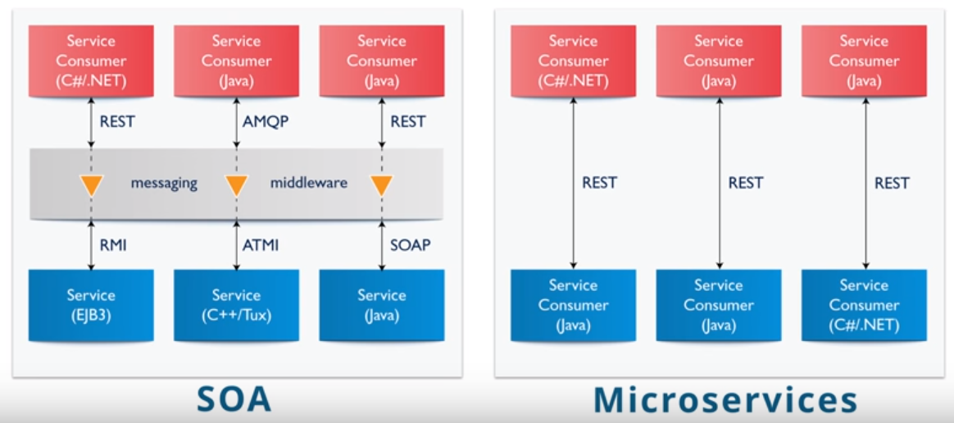
Heterogeneous Interoperability

Slide 33
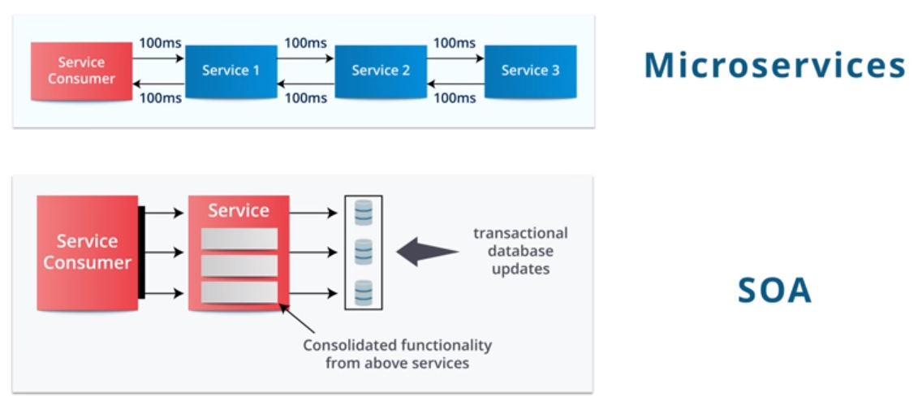
Service Granularity

Slide 34
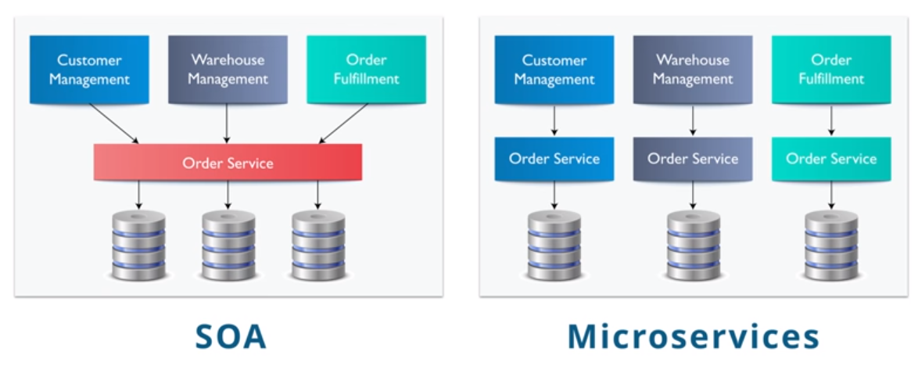
Component Sharing

Slide 35
Polyglot programming
Polyglot programming is the practice of writing code in multiple languages to capture additional functionality and efficiency not available in a single language.
The use of domain specific languages (DSLs) has become a standard practice for enterprise application development.
For example, a mobile development team might employ Java, JavaScript and HTML5 to create a fully functional application.
Other DSLs such as SQL (for data queries), XML (embedded configuration) and CSS (document formatting) are often built into enterprise applications as well.

Slide 36
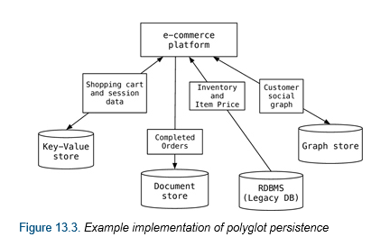
Polyglot persistence
Polyglot Persistence is a fancy term to mean that when storing data, it is best to use multiple data storage technologies, chosen based upon the way data is being used by individual applications or components of a single application.
Different kinds of data are best dealt with different data stores.
In short, it means picking the right tool for the right use case.

Slide 37
Functionality | Considerations | Database Type
User Sessions | Rapid Access for reads and writes. No need to be durable. | Key-Value
Financial Data | Needs transactional updates. Tabular structure fits data. | RDBMS
POS Data | Depending on size and rate of ingest. Lots of writes, infrequent reads mostly for analytics. | RDBMS (if modest), Key Value or Document (if ingest very high) or Column if analytics is key.
Shopping Cart | High availability across multiple locations. Can merge inconsistent writes. | Document, (Key Value maybe)
Recommendations | Rapidly traverse links between friends, product purchases, and ratings. | Graph, (Column if simple)
Product Catalog | Lots of reads, infrequent writes. Products make natural aggregates. | Document
Reporting | SQL interfaces well with reporting tools | RDBMS, Column
Analytics | Large scale analytics on large cluster | Column
User activity logs,CSR logs, Social Media analysis | High volume of writes on multiple nodes | Key Value or Document

Slide 38
Tools and Technologies
Backend API | UI | Communication | Deployment models | Deployment platforms | Tools
.NET Core | Angular/Angular JS | HTTP REST | Docker | AKS | Visual Studio
Java SpringBoot | React | RPC | Service Fabric | Service Fabric | Eclipse/STS
Node + Express/Restify | Ember | Queue | Code | Web App | VS Code
And more … | Vue |  |  | And more… | NPM
 | ASP.NET MVC |  |  |  | Docker
 | JSP/Servlets |  |  |  | Azure Emulators
 | Xamarin
 | Cordova
 | And More …

