Slide 1
Module 01 : Plan and Configure SharePoint Sites

Slide 2
Module agenda
Overview of SharePoint in Microsoft 365
Configure SharePoint sites
Manage SharePoint sites

Slide 3
Lesson 1: Overview of SharePoint in Microsoft 365

Slide 4
Lesson Introduction
Overview of SharePoint in Microsoft 365
SharePoint integration with Microsoft 365
SharePoint integration with Power Platform
SharePoint service description
SharePoint Administrator in Microsoft 365
New SharePoint Admin Center
Classic SharePoint Admin Center
SharePoint Online Management Shell

Slide 5
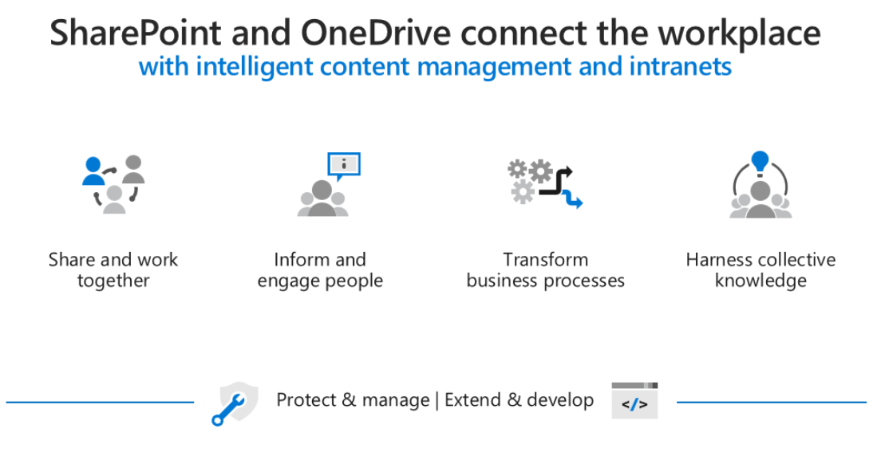
Overview of SharePoint in Microsoft 365
SharePoint is a Microsoft 365 service that enables sharing and collaboration across your organization. Organizations can share and manage content, knowledge, and applications to empower teamwork, quickly find information, and seamlessly collaborate across the organization.
Organizations use Microsoft SharePoint to create websites. Users can use it as a secure place to store, organize, share, and access information from any device. All they need is a web browser, such as Microsoft Edge, Internet Explorer, Chrome, or Firefox.

Slide 6
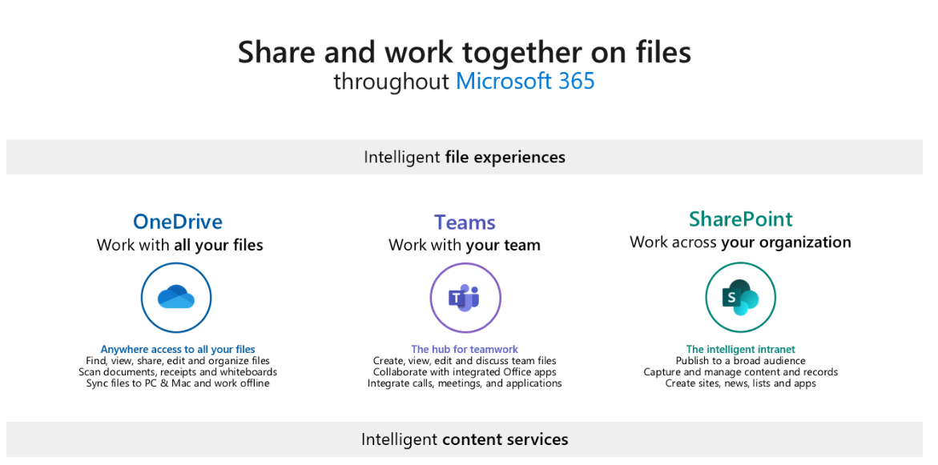
SharePoint integration with Microsoft 365
SharePoint is a Microsoft 365 service that enables sharing and collaboration across your organization. SharePoint can be integrated with Microsoft Teams, OneDrive, and a variety of governance and security options all play a role in creating a rich environment where users can collaborate easily, and your organization's sensitive content remains secure.
SharePoint and Microsoft 365 Groups
SharePoint and Microsoft Teams

Slide 7
SharePoint integration with Power Platform (1/2)
SharePoint is integrated with a variety of other services to provide a much richer experience. With Power Platform, Organizations can streamline business processes.
Organizations can build custom applications that can automate routine processes and supply a structure with tools like Power Apps and Power Automate.

Slide 8
SharePoint integration with Power Platform (2/2)
Power Apps
Power Apps provides a rapid low code development environment for building custom apps for business needs. Power Apps can be used to create custom forms for use in modern SharePoint sites.
Power Automate
Power Automate lets users create automated workflows between applications and services. SharePoint site admins can use Power Automate to require new or updated site pages to be approved before being published.
Power BI
Power BI (Business Intelligence) is a business analytics service that delivers insights for analyzing data. With Power BI's report web part for SharePoint in Microsoft 365, users can easily embed interactive Power BI reports in SharePoint Online pages.

Slide 9
SharePoint service description
SharePoint in Microsoft 365 is a cloud-based service, hosted by Microsoft, for organizations of all sizes. Instead of installing and deploying SharePoint Server on-premises, any organization can subscribe to a Microsoft 365 plan or to the standalone SharePoint service in Microsoft 365.
Feature | Microsoft 365 Business Basic, Business Standard, or Business Premium | Microsoft 365 E3 or E5, Office 365 Enterprise E1, E3, or E5, or SharePoint Plan 1 or 2 | Microsoft 365 F1 or F3, Office 365 Enterprise F3
Total storage per organization | 1 TB plus 10 GB per license purchased | 1 TB plus 10 GB per license purchased | 1 TB
Max storage per site (site collection) | 25 TB | 25 TB | 25 TB
Sites (site collections) per organization | 2 million | 2 million | 2 million
Number of users | Up to 300 | 1- 500,000 | 1- 500,000

Slide 10
SharePoint Administrator in Microsoft 365
Global administrators in Microsoft 365 have all the permissions of a SharePoint administrator and can assign others to the SharePoint administrator role. Global administrators and SharePoint administrators don't have automatic access to all sites, but they can give themselves access to any sites if needed.
Key tasks of SharePoint administrators:
Create, delete, and restore SharePoint sites.
Register hub sites.
Manage site storage limits.
Manage site administrators.
Manage sharing settings at the organization level.
Manage advanced SharePoint features.
View reports to monitor file and user activity.

Slide 11
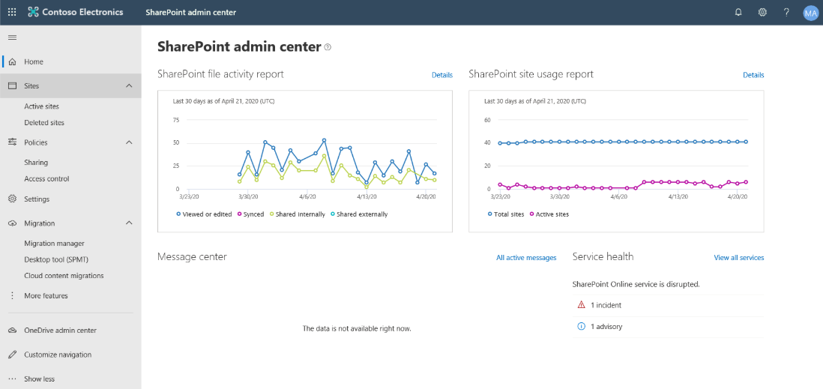
New SharePoint Admin Center (1/2)
The new SharePoint admin center provides a consistent admin experience across services in Microsoft 365 with modern principles.

Slide 12

New SharePoint Admin Center (2/2)
You can use the new SharePoint admin center to:
Monitor the environment at Home page and left pane, including
Create, delete, restore, and manage sites that belong to Microsoft 365 Groups and communication sites.
Link to the OneDrive admin center, SharePoint Migration Tool, and classic SharePoint admin center
A geo location selector for organizations that have set up Multi-Geo in OneDrive and SharePoint
Control Access by creating policies that restrict access from unmanaged devices, sign out users from inactive browser sessions, allow access from only specific IP addresses, and block access from apps that don't use modern authentication.
Manage settings for list and library experience, sync, notifications, site storage limits, default admin experience, and site creation.
Review pending and approved web API permissions and approve or reject access requests.

Slide 13
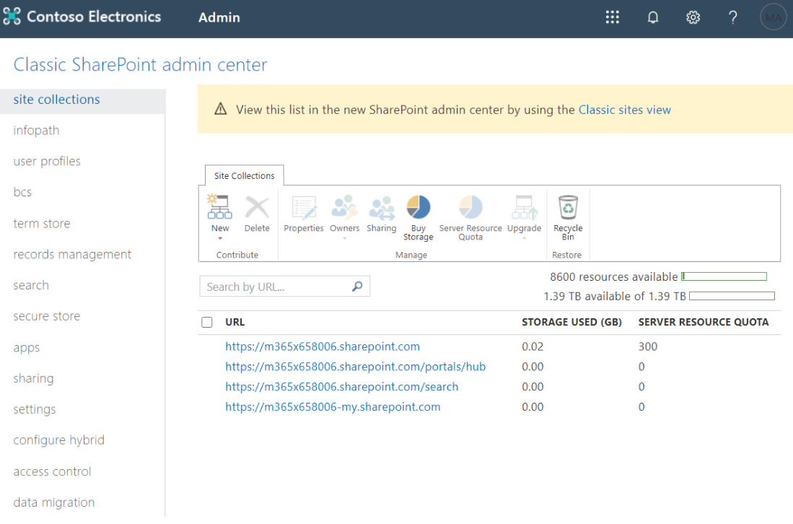
Classic SharePoint Admin Center (1/2)
While you can perform most SharePoint admin tasks from the new SharePoint admin center, you can still access the classic SharePoint admin center.

Slide 14

Classic SharePoint Admin Center (2/2)
You can use the classic SharePoint admin center to:
Create and manage classic site collections including allocating and monitoring site collection storage
Manage permissions and users and help secure content on sites
Manage user profiles and configure OneDrive settings (called “My Sites” settings in the admin center)
Enable and configure specific SharePoint Online features or global settings

Slide 15
SharePoint Online Management Shell
The SharePoint Management Shell is a Windows PowerShell module that lets you run command-line operations. SharePoint Admin can use it to manage SharePoint Online users, sites, and site collections.
SharePoint Admin role
Install SharePoint Online Management Shell
Connect SharePoint Online service
Install-Module –Name Microsoft.Online.SharePoint.PowerShell
Connect-SPOService -Url https://OrgName-admin.sharepoint.com

Slide 16
Lesson 2: Configure SharePoint sites

Slide 17
Lesson Introduction
Overview of SharePoint sites
Overview of navigation in SharePoint
Overview of SharePoint hub sites
Create SharePoint sites
Delete SharePoint sites
Restore SharePoint sites
Configure SharePoint hub sites

Slide 18
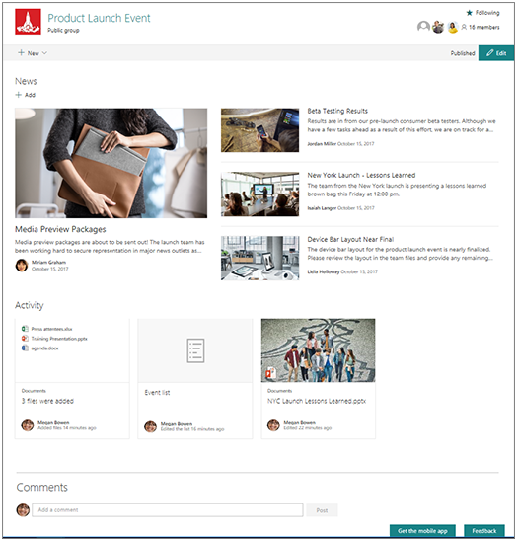
Overview of SharePoint sites (1/4)
Microsoft SharePoint offers a wide variety of options and tools to create intranet sites for your organization. The modern experience in Microsoft SharePoint is designed to be compelling, flexible, and more performant.
Team sites
Team sites are collaboration sites for each project team, department, and division in your organization. Team sites provide document storage and sharing, and support for custom lists, workflow integration with Power Automate, file libraries, and direct integration with Microsoft Teams.

Slide 19
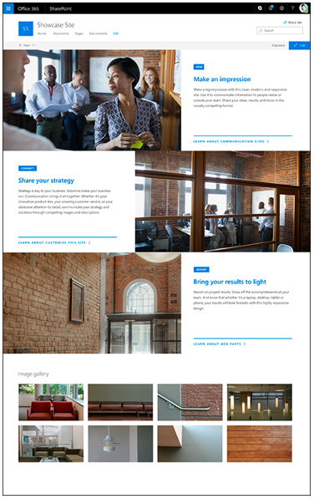
Overview of SharePoint sites (2/4)
Communication sites
Communication sites are designed to broadcast information to a large audience. Much like a team site, a communication site is a SharePoint site that anyone in the organization can create from the SharePoint start page.
Any of the templates can be customized by adding SharePoint web parts—dynamic page elements that display text, images, files, video, and a variety of other content types.

Slide 20

Overview of SharePoint sites (3/4)
Hub sites
SharePoint hub sites are used to organize families of team sites and communication sites together. Every SharePoint site can be associated to a hub site, which is a flat structure of sites that share navigation, branding, and other elements.
SharePoint hub sites help you organize your intranet by connecting and organizing sites based on project, department, division, region, etc. making it easier to:
Discover related content such as news and other site activities.
Apply common navigation, branding, and site structure across associated sites.
Search across all associated sites.

Slide 21
Overview of SharePoint sites (4/4)
Other SharePoint sites
Root site
SharePoint start page (formerly SharePoint home page)
Organization news site
Classic SharePoint sites

Slide 22
Overview of navigation in SharePoint (1/4)
Most visitors start their web experiences by navigating, including internal web sites. Good navigation experiences present visitors with a complete picture of what is available on the site and, combined with the home page, provide a comprehensive “story” for the site.
Planning an effective navigation experience is a critical element of designing SharePoint sites.

Slide 23

Overview of navigation in SharePoint (2/4)
There are several types of navigation in SharePoint:
Local navigation on an individual site
Local navigation is the persistent navigation that visitors see on every page of your site. For team sites, local navigation shows up on the left side of the page in the area referred to as the “quick launch.” For communication sites, local navigation shows up at the top of the page.

Slide 24
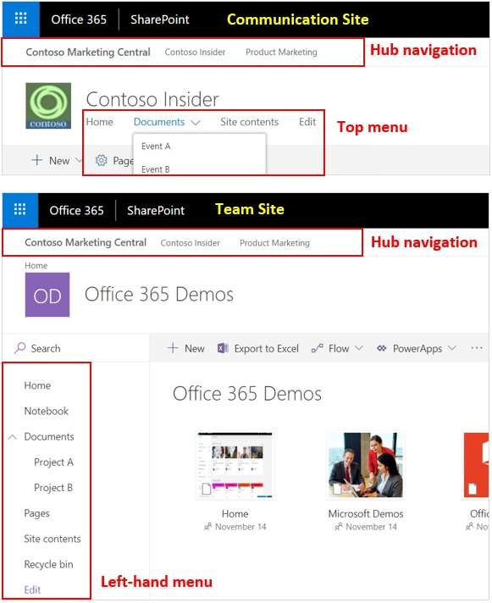
Overview of navigation in SharePoint (3/4)
Hub navigation for groups of related sites
Hub site navigation is displayed above the local navigation on each site, just below the suite bar. Hub sites provide a great way to achieve the cross-site navigation features previously available in managed navigation and site hierarchies in classic SharePoint.

Slide 25
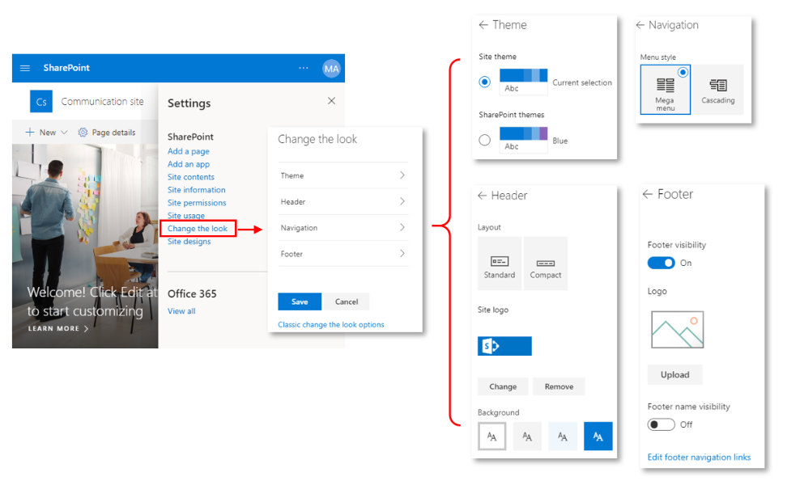
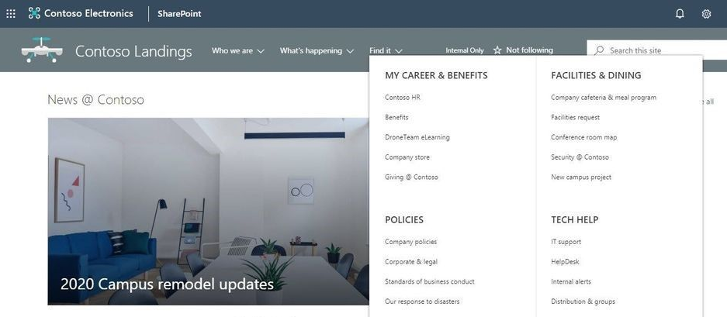
Overview of navigation in SharePoint (4/4)
Megamenu navigation
Megamenu navigation is a feature in “Change the look” options. It allows showing multiple levels of hierarchy at once. This will enable you to better organize and showcase the content and sites. The megamenu navigation layout is only available for horizontally oriented navigations and allows for a panel display of links up to three levels.

Slide 26
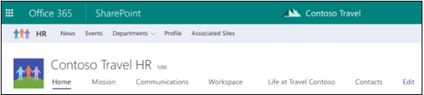
Overview of SharePoint hub sites
SharePoint hub sites provide the flexibility and help organizations by connecting and organizing sites based on project, department, division, region, etc.
Benefits of SharePoint hub sites
Shared navigation
Search across the hub
A home destination for the hub
News roll-up
Associated sites
Highlighted content

Slide 27
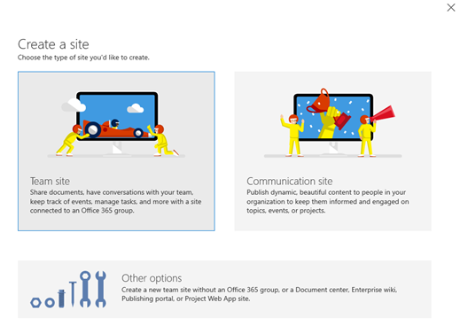
Create SharePoint sites
Microsoft 365 global admins and SharePoint admins can create SharePoint sites with different site templates. It is recommended to use modern SharePoint sites for new sites.
Create from the SharePoint admin center
Create from PowerShell
New-SPOSite
-Url https://contoso.sharepoint.com/sites/accounting
-Owner admin@contoso.com
-Template STS#0
-StorageQuota 100
-ResourceQuota 50

Slide 28
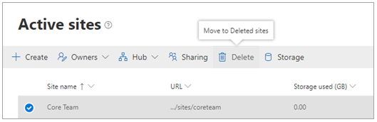
Delete SharePoint sites
Both global and SharePoint admins can delete both classic and modern sites, including sites that belong to Microsoft 365 groups. Deleting these sites will delete the group and all its resources, including the Outlook mailbox and calendar, and any Teams channels.
Delete a site
From the SharePoint admin center
From PowerShell
Permanently delete a site
From the SharePoint admin center
From PowerShell
Remove-SPOSite -Identity https://contoso.sharepoint.com/sites/site1
Remove-SPODeletedSite -Identity https://contoso.sharepoint.com/sites/sitetoremove

Slide 29

Restore SharePoint sites
Deleted site collections are automatically emptied from the site collection Recycle Bin after 93 days. You can restore a deleted site collection before this time.
Restoring a site that belongs to an Microsoft 365 Group restores the Microsoft 365 Group and all its resources. Note that the other group resources are retained for only 30 days, whereas the site is retained for 93.
Restore a site
From the SharePoint admin center
From PowerShell
Restore deleted items from the Recycle Bin
Restore a document library
Restore-SPODeletedSite -Identity https://contoso.sharepoint.com/sites/arecycledsite

Slide 30
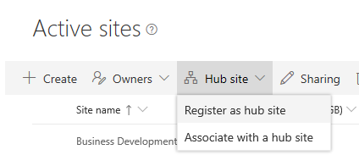
Configure SharePoint hub sites (1/2)
Phase 1: Create a new hub site
To create a hub site, a global admin or SharePoint admin essentially converts an existing SharePoint site to a hub site. It's recommended to select a communication site or a team site that uses the modern template.
Phase 2: Design the hub site
Once the hub site has been created, the hub site owner can start designing the hub site for applying common navigation and branding across all associated sites.
Phase 3: Associates/Disassociate a site with a hub site
Once the hub site been created and configured, we can associates/disassociate sites with the hub site. There are three ways to associates/disassociate a site with a hub site

Slide 31
Configure SharePoint hub sites (2/2)
Phase 4: Remove a site's hub site status
If you are a global admin or SharePoint admin in Microsoft 365, you can demote a hub site (remove its hub site status) by using PowerShell. Make sure you do this before you delete the hub site. When you demote a hub site, any sites still associated with the hub site will be automatically disassociated.
cmdlet | Description
Add-SPOHubSiteAssociation | Adds a new association between a site and a hub site.
Remove-SPOHubSiteAssociation | Removes an association between a site and a hub site.
Get-SPOHubSite | Lists hub sites or hub site information.
Grant-SPOHubSiteRights | Grants rights to users or security groups to access the hub site.
Register-SPOHubSite | Enables the hub site feature on a site to make it a hub site.
Revoke-SPOHubSiteRights | Revokes rights for specified principals to a hub site.
Set-SPOHubSite | Sets the hub site information such as name, logo, and description.
Unregister-SPOHubSite | Disables the hub site feature on a site.
The following PowerShell cmdlets are available for managing hub sites

Slide 32
Lesson 3: Manage SharePoint sites

Slide 33
Lesson Introduction
Manage site administrators
Manage site creation
Manage site storage limits
Change site addresses
Modernize the root site
Connect classic team sites to new Microsoft 365 groups

Slide 34

Manage site administrators
Site admins have the highest level of SharePoint permissions. They have the same Full Control permissions of a site owner, plus they can do additional things, such as managing search, the recycle bin, and site collection features.
Sites that are connected to Microsoft 365 Groups
Use Group owners or Group members of the Microsoft 365 Group to manage the site.
Sites that are not connected to Microsoft 365 Groups
Use Primary Site Administrator or Site Administrators to manage the site collection. A site can have several site admins but must have one and only one primary administrator. Any site admin can add or remove other admins.

Slide 35
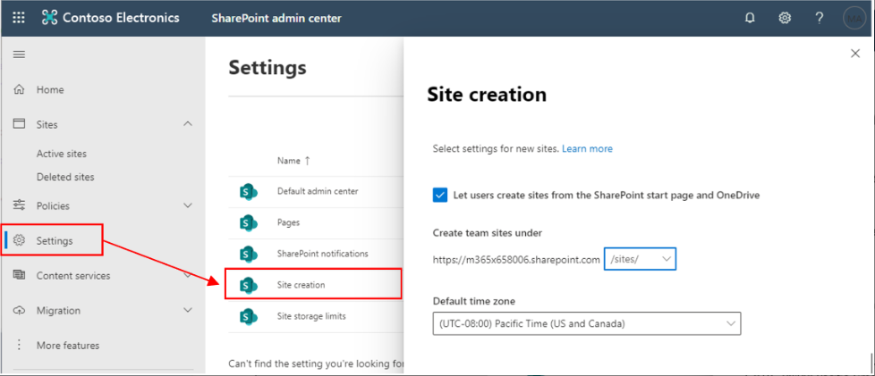
Manage site creation
As a global or SharePoint admin in Microsoft 365, you can let your users create and administer their own SharePoint sites, determine what kind of sites they can create, and specify the location of the sites. By default, users can create communication sites and Microsoft 365 group-connected team sites.

Slide 36
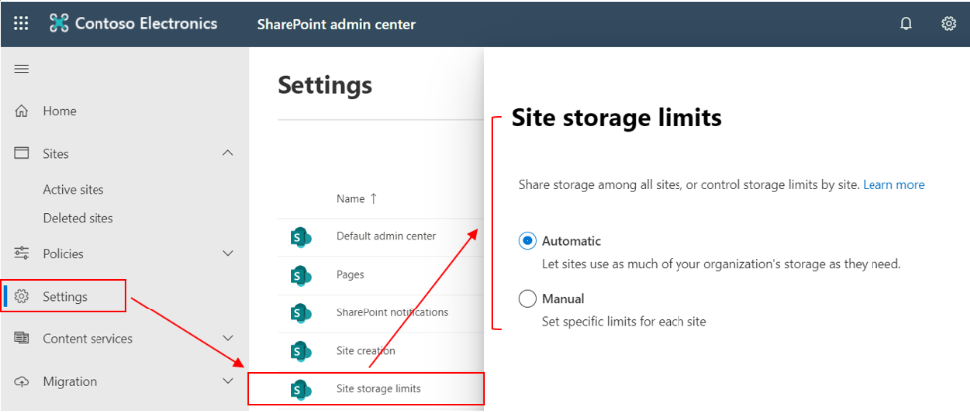
Manage site storage limits
Manage storage limits automatically or manually
Manage individual site collection storage limits
Monitor site storage limits with email alerts

Slide 37
Change site addresses
As a global or SharePoint admin in your organization, you can change the URL for the following types of SharePoint sites.
Communicate the address change to users
Change a site address
From the new SharePoint admin center
From PowerShell
Remove a redirect
Effects of changing a site address

Slide 38
Modernize the root site
When Microsoft SharePoint is set up for an organization, a root (or top-level) site is created. The URL of this site is typically contoso.sharepoint.com, the default name is “Communication site,” and the owner is Company Administrator.
Before April 2019, the site was created as a classic team site. You can modernize your root site with the following approaches:
Replace with the other site
Modernize existing classic team site
Add a new modern home page
Enable the modern site pages library experience

Slide 39
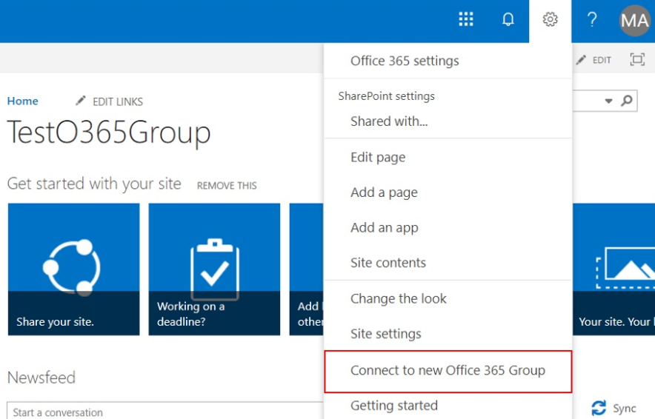
Connect classic team sites to new Microsoft 365 groups
Allow or prevent site from connecting classic team sites to new Microsoft 365 Groups
Connect classic team sites to new Microsoft 365 Groups
From User Interface
From PowerShell
Set-SPOSiteOffice365Group
-Site https://contoso.sharepoint.com/sites/site1
-DisplayName "site1group"
-Alias "site1group"
-Classification "Highly Confidential"

Slide 40
Lab: Configure SharePoint sites

Slide 41
Lab Exercises
Exercise 1: Create SharePoint sites
Exercise 2: Configure a hub site

